Slide 1
Handout # 10: Transport Protocols
CSC 458/2209 – Computer Networks
Instructed by:
Joe Lim – L5101
joe.lim@utoronto.ca
Sajad Shirali-Shahreza – L0201
shirali@cs.toronto.edu
AbdulAziz AlHelali – L0101
a.alhelali@mail.utoronto.ca
Slides adapted from
Professor Yashar Ganjali

Slide 2
Announcements
Programming assignment 1
Due: Sunday Oct. 22 at 11:59pm
This week
Chapter 5 of the textbook

Slide 3
Role of Transport Layer
Link layer
Transfer bit frames between neighboring nodes
E.g., Ethernet
Network layer
Logical communication between nodes
Hides details of the link technology
E.g., IP
Transport layer
Communication between processes (e.g., socket)
Relies on network layer and serves the application layer
E.g., TCP and UDP
Application layer
Communication for specific applications
E.g., HyperText Transfer Protocol (HTTP), File Transfer Protocol (FTP), Network News Transfer Protocol (NNTP)

Slide 4
Today’s Lecture
Principles underlying transport-layer services
(De)multiplexing
Detecting corruption
Reliable delivery
Flow control
Transport-layer protocols in the Internet
User Datagram Protocol (UDP)
Transmission Control Protocol (TCP)

Slide 5
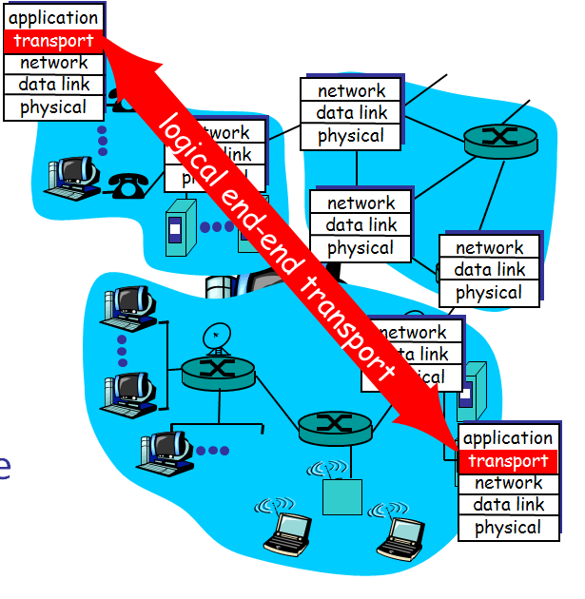
Transport Protocols
Provide logical communication between application processes running on different hosts
Run on end hosts
Sender: breaks application messages into segments, and passes to network layer
Receiver: reassembles segments into messages, passes to application layer
Multiple transport protocol available to applications
Internet: TCP and UDP
TCP and UDP should be part of the OS

Slide 6
Internet Transport Protocols
Datagram messaging service (UDP)
No-frills extension of “best-effort” IP
Reliable, in-order delivery (TCP)
Connection set-up
Discarding of corrupted packets
Retransmission of lost packets
Flow control
Congestion control (next lecture)
Other services not available
Delay guarantees
Bandwidth guarantees

Slide 7
Multiplexing and Demultiplexing
Host receives IP datagrams
Each datagram has source and destination IP address,
Each datagram carries one transport-layer segment
Each segment has source and destination port number
Host uses IP addresses and port numbers to direct the segment to appropriate socket
32 bits
source port #
dest port #
other header fields
application
data
(message)
TCP/UDP segment format

Slide 8
Unreliable Message Delivery Service
Lightweight communication between processes
Avoid overhead and delays of ordered, reliable delivery
Send messages to and receive them from a socket
User Datagram Protocol (UDP)
IP plus port numbers to support (de)multiplexing
Optional error checking on the packet contents
SRC port
DST port
checksum
length
DATA

Slide 9
Why Would Anyone Use UDP?
Finer control over what data is sent and when
As soon as an application process writes into the socket
… UDP will package the data and send the packet
No delay for connection establishment
UDP just blasts away without any formal preliminaries
… which avoids introducing any unnecessary delays
No connection state
No allocation of buffers, parameters, sequence #s, etc.
… making it easier to handle many active clients at once
Small packet header overhead
UDP header is only eight-bytes long

Slide 10

Popular Applications That Use UDP
Multimedia streaming
Retransmitting lost/corrupted packets is not worthwhile
By the time the packet is retransmitted, it’s too late
E.g., telephone calls, video conferencing, gaming
Simple query protocols like Domain Name System
Overhead of connection establishment is overkill
Easier to have application retransmit if needed
“Address for www.cnn.com?”
“12.3.4.15”

Slide 11
Transmission Control Protocol (TCP)
Connection oriented
Explicit set-up and tear-down of TCP session
Stream-of-bytes service
Sends and receives a stream of bytes, not messages
Reliable, in-order delivery
Checksums to detect corrupted data
Acknowledgments & retransmissions for reliable delivery
Sequence numbers to detect losses and reorder data
Flow control
Prevent overflow of the receiver’s buffer space
Congestion control
Adapt to network congestion for the greater good

Slide 12
An Analogy: Talking on a Cell Phone
Alice and Bob on their cell phones
Both Alice and Bob are talking
What if Bob couldn’t understand Alice?
Bob asks Alice to repeat what she said
What if Bob hasn’t heard Alice for a while?
Is Alice just being quiet?
Or, have Bob and Alice lost reception?
How long should Bob just keep on talking?
Maybe Alice should periodically say “uh huh”
… or Bob should ask “Can you hear me now?” ☺

Slide 13
Some Take-Aways from the Example
Acknowledgments from receiver
Positive: “okay” or “ACK”
Negative: “please repeat that” or “NACK”
Timeout by the sender (“stop and wait”)
Don’t wait indefinitely without receiving some response
… whether a positive or a negative acknowledgment
Retransmission by the sender
After receiving a “NACK” from the receiver
After receiving no feedback from the receiver

Slide 14
Challenges of Reliable Data Transfer
Over a perfectly reliable channel
All of the data arrives in order, just as it was sent
Simple: sender sends data, and receiver receives data
Over a channel with bit errors
All of the data arrives in order, but some bits corrupted
Receiver detects errors and says “please repeat that”
Sender retransmits the data that were corrupted
Over a lossy channel with bit errors
Some data are missing, and some bits are corrupted
Receiver detects errors but cannot always detect loss
Sender must wait for acknowledgment (“ACK” or “OK”)
… and retransmit data after some time if no ACK arrives

Slide 15
TCP Support for Reliable Delivery
Checksum
Used to detect corrupted data at the receiver
…leading the receiver to drop the packet
Sequence numbers (keep track of which data received)
Used to detect missing data
... and for putting the data back in order
Retransmission
Sender retransmits lost or corrupted data
Timeout based on estimates of round-trip time
Fast retransmit algorithm for rapid retransmission

Slide 16
TCP Segments

Slide 17
TCP “Stream of Bytes” Service
Host A
Byte 0
Byte 1
Byte 2
Byte 3
Byte 80
Host B
Byte 0
Byte 1
Byte 2
Byte 3
Byte 80

Slide 18
…Emulated Using TCP “Segments”
Host A
Byte 0
Byte 1
Byte 2
Byte 3
Byte 80
Segment sent when:
Segment full (Max Segment Size),
Not full, but times out, or
“Pushed” by application.
TCP Data
TCP Data
Host B
Byte 0
Byte 1
Byte 2
Byte 3
Byte 80

Slide 19
TCP Segment
IP Data
TCP Data (segment)
TCP Hdr
IP Hdr
IP packet
No bigger than Maximum Transmission Unit (MTU)
E.g., up to 1500 bytes on an Ethernet
TCP packet
IP packet with a TCP header and data inside
TCP header is typically 20 bytes long
TCP segment
No more than Maximum Segment Size (MSS) bytes
E.g., up to 1460 consecutive bytes from the stream
MSS - TCP

Slide 20
Sequence Numbers
Initially get ISN from ISN clock
Then for each segment, recompute ISN_{i+1} = ISN_{i} + segmentlength
Sequence number inside TCP header,
Host A
ISN (initial sequence number)
Sequence number = 1st byte
TCP
HDR
TCP Data
ACK sequence number = next expected byte
TCP Data
TCP
HDR
Host B
If 8 bytes segment,
Host A sends SYC(100)
Host B send back AWK(108)
After placing segment in a buffer

Slide 21
Initial Sequence Number (ISN)
Sequence number for the very first byte
E.g., Why not a de facto ISN of 0?
Practical issue
IP addresses and port #s uniquely identify a connection
Eventually, though, these port #s do get used again
… and there is a chance an old packet is still in flight
… and might be associated with the new connection
So, TCP requires changing the ISN over time
Set from a 32-bit clock that ticks every 4 microseconds
… which only wraps around once every 4.55 hours!
But, this means the hosts need to exchange ISNs

Slide 22
TCP Three-Way Handshake

Slide 23
Establishing a TCP Connection
A
B
SYN
SYN ACK
Each host tells its ISN to the other host.
ACK
Data
Data
Three-way handshake to establish connection
Host A sends a SYN (open) to the host B
Host B returns a SYN acknowledgment (SYN ACK)
Host A sends an ACK to acknowledge the SYN ACK

Slide 24
TCP Header
Source port
Destination port
Sequence number
Flags:
SYN
FIN
RST
PSH
URG
ACK
Acknowledgment
HdrLen
0
Flags
Advertised window
Checksum
Urgent pointer
Options (variable)
Data

Slide 25
Step 1: A’s Initial SYN Packet
A’s port
B’s port
A’s Initial Sequence Number
Flags:
SYN
FIN
RST
PSH
URG
ACK
Acknowledgment
20
Flags
Advertised window
0
Checksum
Urgent pointer
Options (variable)
A tells B it wants to open a connection…

Slide 26
Step 2: B’s SYN-ACK Packet
B’s port
A’s port
B’s Initial Sequence Number
Flags:
SYN
FIN
RST
PSH
URG
ACK
A’s ISN plus 1
20
Flags
Advertised window
0
Checksum
Urgent pointer
Options (variable)
B tells A it accepts, and is ready to hear the next byte…
… upon receiving this packet, A can start sending data

Slide 27
Step 3: A’s ACK of the SYN-ACK
A’s port
B’s port
Sequence number
Flags:
SYN
FIN
RST
PSH
URG
ACK
B’s ISN plus 1
20
Flags
Advertised window
0
Checksum
Urgent pointer
Options (variable)
A tells B it is okay to start sending
… upon receiving this packet, B can start sending data

Slide 28
What if the SYN Packet Gets Lost?
Suppose the SYN packet gets lost
Packet is lost inside the network, or
Server rejects the packet (e.g., listen queue is full)
Eventually, no SYN-ACK arrives
Sender sets a timer and wait for the SYN-ACK
… and retransmits the SYN if needed
How should the TCP sender set the timer?
Sender has no idea how far away the receiver is
Hard to guess a reasonable length of time to wait
Some TCPs use a default of 3 or 6 seconds

Slide 29
SYN Loss and Web Downloads
User clicks on a hypertext link
Browser creates a socket and does a “connect”
The “connect” triggers the OS to transmit a SYN
If the SYN is lost…
The 3-6 seconds of delay may be very long
The user may get impatient
… and click the hyperlink again, or click “reload”
User triggers an “abort” of the “connect”
Browser creates a new socket and does a “connect”
Essentially, forces a faster send of a new SYN packet!
Sometimes very effective, and the page comes fast

Slide 30
TCP Retransmissions

Slide 31
Automatic Repeat reQuest (ARQ)
Automatic Repeat reQuest
Receiver sends acknowledgment (ACK) when it receives packet
Sender waits for ACK and timeouts if it does not arrive within some time period
Simplest ARQ protocol
Stop and wait
Send a packet, stop and wait until ACK arrives
Sender
Receiver
Packet
Timeout
ACK
Time

Slide 32
Reasons for Retransmission
Packet
Packet
Packet
Timeout
Timeout
ACK
Timeout
ACK
Packet
Packet
Packet
ACK
Timeout
Timeout
Timeout
ACK
ACK
Packet lost
ACK lost
DUPLICATE PACKET
Early timeout
DUPLICATE PACKETS
Notes:
Application may get duplicates in the case of early timeouts

Slide 33
How Long Should Sender Wait?
Sender sets a timeout to wait for an ACK
Too short: wasted retransmissions
Too long: excessive delays when packet lost
TCP sets timeout as a function of the RTT
Expect ACK to arrive after an RTT
… plus a fudge factor to account for queuing
But, how does the sender know the RTT?
Can estimate the RTT by watching the ACKs
Smooth estimate: keep a running average of the RTT
EstimatedRTT = a * EstimatedRTT + (1 –a ) * SampleRTT
Compute timeout: TimeOut = 2 * EstimatedRTT
estimatedRTT -> previousRTT sampleRTT -> currentRTT

Slide 34
Example RTT Estimation

Slide 35
A Flaw in This Approach
An ACK doesn’t really acknowledge a transmission
Rather, it acknowledges receipt of the data
Consider a retransmission of a lost packet
If you assume the ACK goes with the 1st transmission
… the SampleRTT comes out way too large
Consider a duplicate packet
If you assume the ACK goes with the 2nd transmission
… the Sample RTT comes out way too small
Simple solution in the Karn/Partridge algorithm
Only collect samples for segments sent one single time

Slide 36
TCP Sliding Window

Slide 37
Motivation for Sliding Window
Stop-and-wait is inefficient
Only one TCP segment is “in flight” at a time
Especially bad when delay-bandwidth product is high
Numerical example
1.5 Mbps link with a 45 msec round-trip time (RTT)
Delay-bandwidth product is 67.5 Kbits (or 8 KBytes)
But, sender can send at most one packet per RTT
Assuming a segment size of 1 KB (8 Kbits)
… leads to 8 Kbits/segment / 45 msec/segment ➔ 182 Kbps
That’s just one-eighth of the 1.5 Mbps link capacity

Slide 38
Sliding Window
Allow a larger amount of data “in flight”
Allow sender to get ahead of the receiver
… though not too far ahead
Sending process
Receiving process
TCP
TCP
Last byte written
Last byte read
Next byte expected
Last byte ACKed
Last byte received
Last byte sent

Slide 39
Receiver Buffering
Window size
Amount that can be sent without acknowledgment
Receiver needs to be able to store this amount of data
Receiver advertises the window to the sender
Tells the sender the amount of free space left
… and the sender agrees not to exceed this amount
Window Size
Data ACK’d
Outstanding
Un-ack’d data
Data OK
to send
Data not OK
to send yet
Receiver also has a sliding window

Slide 40
TCP Header for Receiver Buffering
Source port
Destination port
Sequence number
Flags:
SYN
FIN
RST
PSH
URG
ACK
Acknowledgment
HdrLen
0
Flags
Advertised window
Checksum
Urgent pointer
Options (variable)
Data

Slide 41
Fast Retransmission

Slide 42
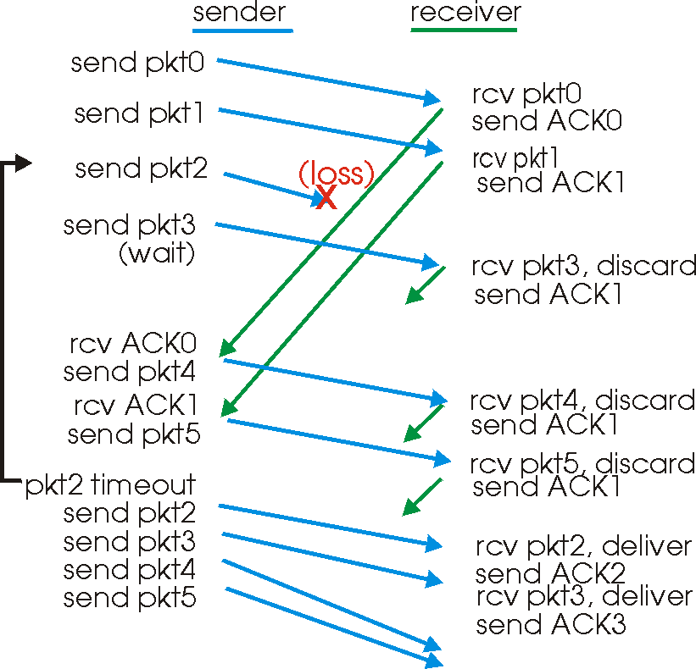
Timeout is Inefficient
Timeout-based retransmission
Sender transmits a packet and waits until timer expires
… and then retransmits from the lost packet onward

Slide 43
Fast Retransmission
Better solution possible under sliding window
Although packet n might have been lost
… packets n+1, n+2, and so on might get through
Idea: have the receiver send ACK packets
ACK says that receiver is still awaiting nth packet
And repeated ACKs suggest later packets have arrived
Sender can view the “duplicate ACKs” as an early hint
… that the nth packet must have been lost
… and perform the retransmission early
Fast retransmission
Sender retransmits data after the triple duplicate ACK
With ISN for segment lost

Slide 44
Effectiveness of Fast Retransmit
When does Fast Retransmit work best?
Long data transfers
High likelihood of many packets in flight
High window size
High likelihood of many packets in flight
Low burstiness in packet losses
Higher likelihood that later packets arrive successfully
Implications for Web traffic
Most Web transfers are short (e.g., 10 packets)
Short HTML files or small images
So, often there aren’t many packets in flight
… making fast retransmit less likely to “kick in”
Forcing users to like “reload” more often… ☺

Slide 45
Tearing Down the Connection

Slide 46
Tearing Down the Connection
B
ACK
SYN
SYN ACK
Data
ACK
FIN
FIN ACK
FIN
ACK
A
time
Closing the connection
Finish (FIN) to close and receive remaining bytes
And other host sends a FIN ACK to acknowledge
Reset (RST) to close and not receive remaining bytes

Slide 47
Sending/Receiving the FIN Packet
Sending a FIN: close()
Process is done sending data via the socket
Process invokes “close()” to close the socket
Once TCP has sent all of the outstanding bytes…
… then TCP sends a FIN
Receiving a FIN: EOF
Process is reading data from the socket
Eventually, the attempt to read returns an EOF

Slide 48
Conclusions
Transport protocols
Multiplexing and demultiplexing
Sequence numbers
Window-based flow control
Timer-based retransmission
Checksum-based error detection
Next lecture (after midterm)
Congestion control

