Slide 1
CSC458 Programming Assignment II: NAT

Slide 2

NAT: Network Address Translation
rest of
Internet
local network
(e.g., home network)
10.0.0/24
10.0.0.1
10.0.0.4
10.0.0.2
138.76.29.7
10.0.0.3
all datagrams leaving local
network have same single source NAT IP address: 138.76.29.7,different source port numbers
datagrams with source or
destination in this network
have 10.0.0/24 address for
source, destination (as usual)

Slide 3
NAT
motivation: local network uses just one IP address as far as outside world is concerned:
range of addresses not needed from ISP: just one IP address for all devices
can change addresses of devices in local network without notifying outside world
can change ISP without changing addresses of devices in local network
devices inside local net not explicitly addressable, visible by outside world (a security plus)

Slide 4
NAT
implementation: NAT router must:
outgoing datagrams: replace (source IP address, port #) of every outgoing datagram to (NAT IP address, new port #)
. . . remote clients/servers will respond using (NAT IP address, new port #) as destination addr
remember (in NAT translation table) every (source IP address, port #) to (NAT IP address, new port #) translation pair
incoming datagrams: replace (NAT IP address, new port #) in dest fields of every incoming datagram with corresponding (source IP address, port #) stored in NAT table

Slide 5
NAT
NAT translation table
WAN side addr LAN side addr
2: NAT router
changes datagram
source addr from
10.0.0.1, 3345 to
138.76.29.7, 5001,
updates table
1: host 10.0.0.1
sends datagram to
128.119.40.186, 80
138.76.29.7, 5001 10.0.0.1, 3345
…… ……
S: 10.0.0.1, 3345
D: 128.119.40.186, 80
10.0.0.1
1
2
S: 138.76.29.7, 5001
D: 128.119.40.186, 80
10.0.0.4
10.0.0.2
138.76.29.7
S: 128.119.40.186, 80
D: 10.0.0.1, 3345
4
S: 128.119.40.186, 80
D: 138.76.29.7, 5001
3
10.0.0.3
3: reply arrives
dest. address:
138.76.29.7, 5001

Slide 6
NAT
16-bit port-number field:
60,000 simultaneous connections with a single LAN-side address!
NAT is controversial:
routers should only process up to layer 3
address shortage should be solved by IPv6
violates end-to-end argument
NAT possibility must be taken into account by app designers, e.g., P2P applications
NAT traversal: what if client wants to connect to server behind NAT?

Slide 7
Recall PA I
Static topology + static routing table
IP Routing + ICMP messages
ARP requests and replies

Slide 8
PA II Overview
You’re going to write a “simplified” NAT (+Router)
Take your PA I code add NAT handling ICMP and TCP
READ your PA2 handout.

Slide 9
Backup File
Backup your PA1 router directory
Download skeleton code for NAT
Copy back your PA1 files
Read PA2 handout!

Slide 10
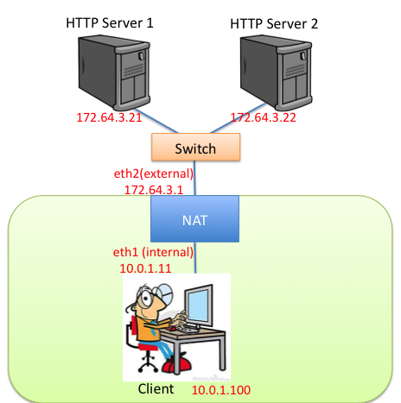
Outline
Use mininet to create a NAT
HTTP servers and switch are outside of NAT
Client is inside NAT

Slide 11
Required Functionality
Pinging the NAT's internal interface from client host machines
Pinging any of the HTTP servers
Downloading files using HTTP from the app servers

Slide 12
Required Functionality
Keep your PA 1 functionality
Enable NAT with ./sr_nat –n
ICMP messages
Ping echo request + reply
External host independence
TCP packets
Endpoint-Independent mapping behavior
Endpoint-Independent filtering
Simultaneous open
Mapping timeouts MUST be configurable

Slide 13
Example: ICMP Echo Request
Ping (ICMP ECHO)
Src: 172.64.3.1
Dst: 172.64.3.21
Id: 100
Ping (ICMP ECHO)
Src: client
Dst: 172.64.3.21
Id: 10

Slide 14
Example: ICMP Echo Reply
Ping (ICMP ECHO Reply)
Src: 172.64.3.21
Dst: 172.64.3.1
Id: 100
Ping (ICMP ECHO Reply)
Src: 172.64.3.21
Dst: client
Id: 10

Slide 15
ICMP: External Host Independence
Rewriting is the same,
Independent of packet destination
Timeout after 60 seconds
Ping (ICMP ECHO)
Src: client
Dst: 172.64.3.21
Id: 10
Ping (ICMP ECHO)
Src: client
Dst: 172.64.3.22
Id: 10
Ping (ICMP ECHO)
Src: 172.64.3.1
Dst: 172.64.3.21
Id: 100
Ping (ICMP ECHO)
Src: 172.64.3.1
Dst: 172.64.3.22
Id: 100

Slide 16
TCP: Requirements
Endpoint-Independent Mapping behavior
If a mapping (x,px)→(x’,px’) is created for a packet destined to (y1,py1)
Then the same mapping is used for for packets from (x,px) to (y2,py2) (i.e. doesn’t depend on endpoints, depends on source)
Endpoint-Independent Filtering
If a mapping (x,px)→(x’,px’) is created for (y1,py1), then allow (y2,py2) to communicate to (x,px) via (x’,px’) (Idea is just use entries in the NAT table, don’t check where request coming from)
Simultaneous open
Dealing with Inbound SYNs
Timeouts and a few others (webpage lists all)
Use ports > 1023 for mapping.

Slide 17
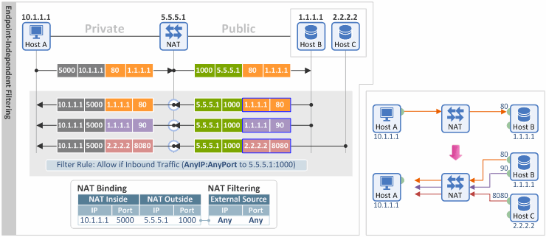
Endpoint-Independent Mapping

Slide 18
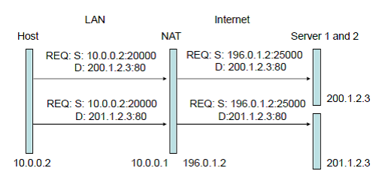
Endpoint-Independent Mapping

Slide 19
Threads!
Spawn a thread to timeout NAT entries
Similar to ARP cache timeouts
Search code for pthread_create, pthread_mutex_lock
Synchronize access to shared data using locks
NAT mapping lookup, insertion, deletion, etc.
Be conservative with locks☺
Race conditions harder to debug than deadlocks

Slide 20
Data Structures
Mapping table
Linked list is fine, O(n) lookup
ICMP or TCP
Keep a time field to remember when a mapping was used
Remember: locks!
Protect all accesses: lookup, insertion, deletion

Slide 21
Rough pseudocode
Receive packet on an interface
Check if ICMP or TCP
If packet is outbound (internal -> external)
insert or lookup unique mapping
else:
if no mapping and not a SYN (for simultaneous open)
drop packet
Rewrite IP src (dst) for outgoing (incoming) packets
Rewrite ICMP ID / TCP port
Update relevant checksums
Route packet

Slide 22
Rough pseudocode
This is just to give you a rough idea
Details missing (rules for filtering, reusing mapping, etc.)
ICMP port unreachable, etc. Locks ☺
Read instructions for detailed information
Start early!
Due Friday Nov. 26th

Slide 23
Summary
Build on top of PA 1
NAT must work for ICMP, TCP
UDP: not required, but up to you...
Clear defunct mappings using timeouts
Timeouts must be configurable
ICMP query id timeout
TCP established timeout
TCP transitory timeout (e.g. SYN sent but no response)
Which means you have to track TCP state transitions ☺

Slide 24
Things Might Be Helpful
Modularize your code!
To handle NAT state insertions, lookups, etc.
Dealing with ICMP, TCP
Start with ICMP first, then move to TCP
Debugging workflow
Mininet console, tcpdump, ping, wireshark
GDB/Valgrind
Debug Functions
print_hdrs, print_addr_ip_int

