Slide 1

Capstone Project: Point of sale Web Application
Abdelrahman Abu Zahra

Slide 2
What is the purpose of point of sale ?
Inventory Managements.
Tracking The Transactions.
Simplifying The Accounting Process.
Reduce time and effort.

Slide 3
Project Requirements: Meeting the challenges of POS
A login page with “Remember Me” functionality.
A dashboard Page exclusively for admin.
Inventory management for procurement role.
Selling page with AJAX requests for seller role.
Transactions Page for accountant role.
Users' management for admin.
Security.
Style and responsiveness.

Slide 4
Technical Components
DigitalOcean provides hosting service.
DESIGN PATTERN
Model-View-Controller (MVC).
The permissions are based on roles
API
AJAX is used to handle the API requests.
jQuery library.
STYLING
Bootstrap 5 library is used for better user experience.
No SQL injections
XSS protection
Password hashing
Form validation
Hosting
SECUTIRY

Slide 5
Login Components
The login page serve as home page for POS.
Username, password and “remember me” fields.
Cookies is set when “remember me” is checked.
Backend form validation to prevent unauthorized actions.
Dashboard is only for admin role.
Total transactions, total users and total items [ count() function ].
Total Sales [ SUM() Syntax ].
Top five expensive items to buy. [ ORDER BY selling_price DESC LIMIT 5 ].
Dashboard Components

Slide 6
Inventory management
The inventory main page view all the products in the inventory and provide all CRUD functionality through pages. Every product contain information about: ID, name, cost price, selling price, quantity, date of created and date of last update.
get_all() function retrieve all the data from database table. It uses MYSQLi statement and execute “SELECT” query on the the specified table.
To create a page for a product, create() function is used to store the data that has been filled in the creation form. It uses MYSQLi statement and execute “INSERT INTO” and “VALUE” queries.
Store() function update a single product information. It use MYSQLi statement and execute “UPDATE”, “SET” and ”WHERE” queries on the specified table and item.
Delete() function used to delete the product information's. It uses MYSQLi statement and execute “DELETE FROM” and “WHERE” quires on the specified table and item.

Slide 7
SELLING DASHBOARD
The Selling dashboard provide all CRUD functionality in single page and without reloading the page. And view all the transactions that has been made today for the current logged user.
Selling form contain product name, product id, price, quantity and total value.
Four AJAX requests is developed using JavaScript jQuery library, GET, POST, PUT and DELETE.
When create, update or delete transaction, the quantity of the product also is updated.
There is a relation between the seller id and transaction id.
Inner join is used to combined between two tables based on transaction id.

Slide 8

Transactions Managements
The Transactions page provide the accountant with read, update and delete functionalities through pages. Every transaction contain: transaction id, item id, item name, price, quantity, made by, creation date and last update date.
the accountant can determine who created the transaction even if the user who made it has been deleted.
For read, update and delete functionalities, they all use get_all(), store() and delete() functions, respectively.
Only the admin and the seller can create transaction.

Slide 9
USERS and Profile
The users pages is only accessed by the admin and provide all CRUD functionalities. Every single user page contain: Name, username, id, role, date of creation and last updated. The admin can not view the password.
For create, read, update and delete, the functions create(), get_all(), store() and delete() are used, respectively.
Every user can view his profile page and edit only name, username and email.

Slide 10
Security
All MYSQLi statements are protected against SQL injections. It use prepare () and bind_param() methods.
All the inputs are encoded to prevent XSS (Cross-Site Scripting) injections using htmlspecialchars() function.
password_hash() function used to secure passwords in database and make it extremely difficult to extract the original password.
From validation is implemented in the front-end by HTML required attribute or JavaScript statements, and in the back-end by using isset(), empty() and isnumeric() functions.

Slide 11
Styles and responsiveness
All the pages on the web application are built using BOOTSTRAP library, except for the login page.
media queries has been used, so at certain breakpoint the structure behave differently.
breakpoints: 600px, 768px, 992px and 1200px

Slide 12
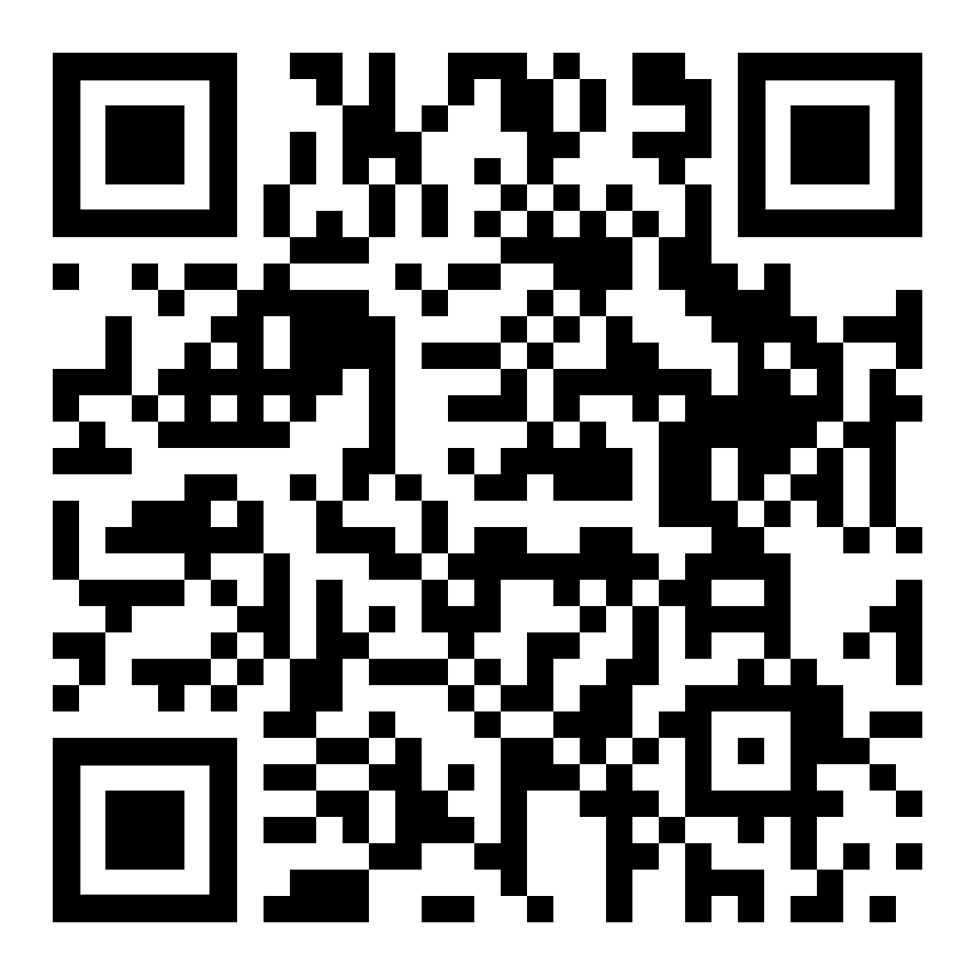
Hosting

Slide 13

THANK YOU

