Slide 1
Future Stock Price Prediction Using historical data
SAN JOSE STATE UNIVERSITY | Department of Computer science
data mining | cmpe-255 |professor DAVID C. ANASTASIU
Team members :
ajith Balaji nagaranjan
pooja RAMAswamy
divjot singh dhody

Slide 2
Outline
Introduction and Motivation
Datasets
Data Preprocessing
Algorithm Used
Evaluation
Application
Future Work

Slide 3
INTRODUCTION
PREDICTION OF STOCKS:
Pretty complex problem consisting of multiple trends from past and based on that predictions about future price
Problem addressed:
Find best model based on the data to predict stock prices

Slide 4
Flow Diagram
FD
Data Collection from Yahoo
Data Preprocessing
Data Training
Forecasting Results
Visualize data
Interpretation

Slide 5
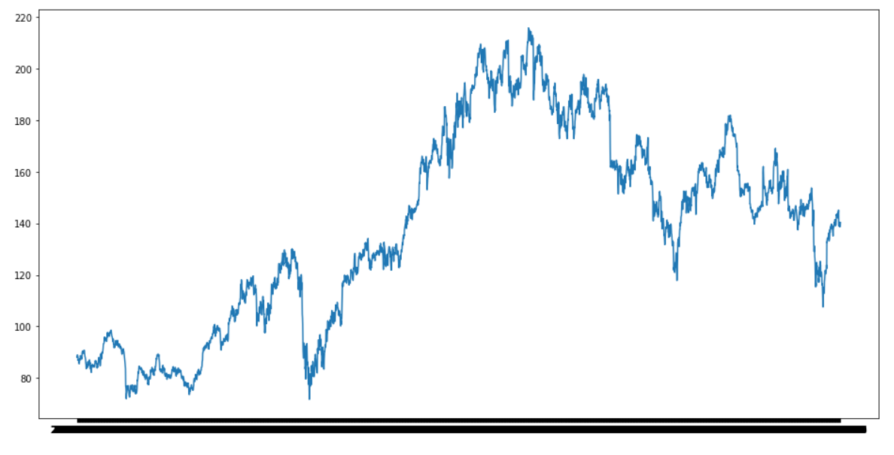
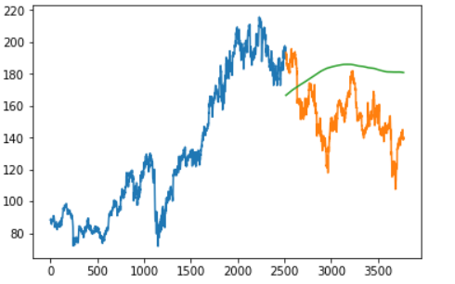

Visuals of data and output of various models
15 year stock value of IBM
Moving Average

Slide 6
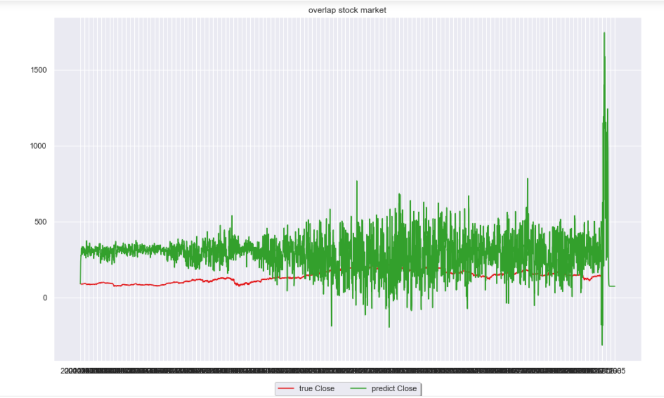
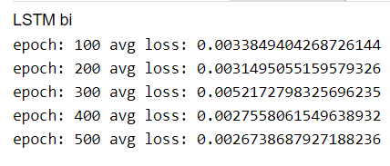
Visuals of data and output of various models
LSTM RNN
LSTM bi

Slide 7
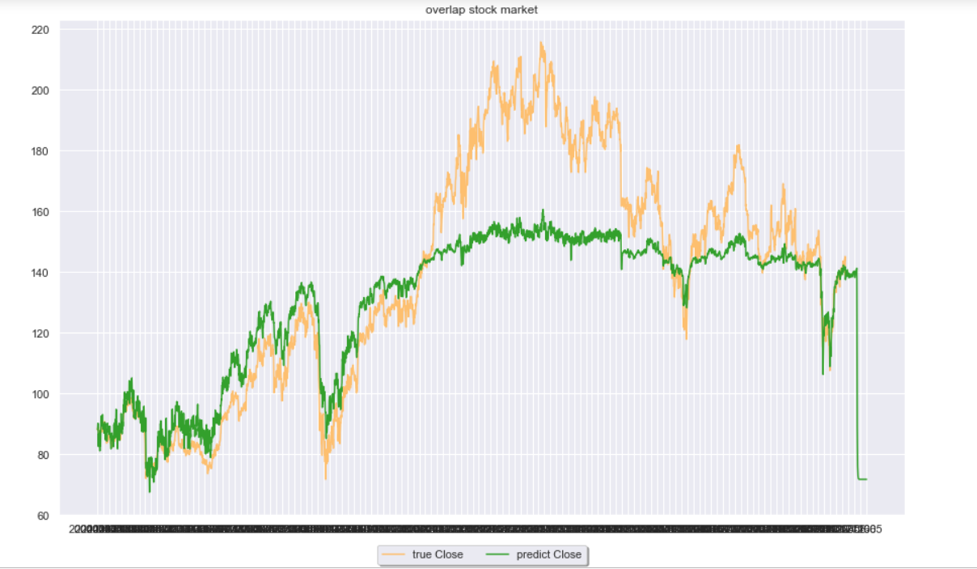
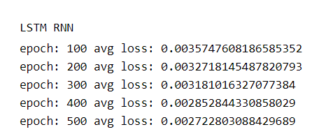
Visuals of data and output of various models
LSTM RNN

Slide 8
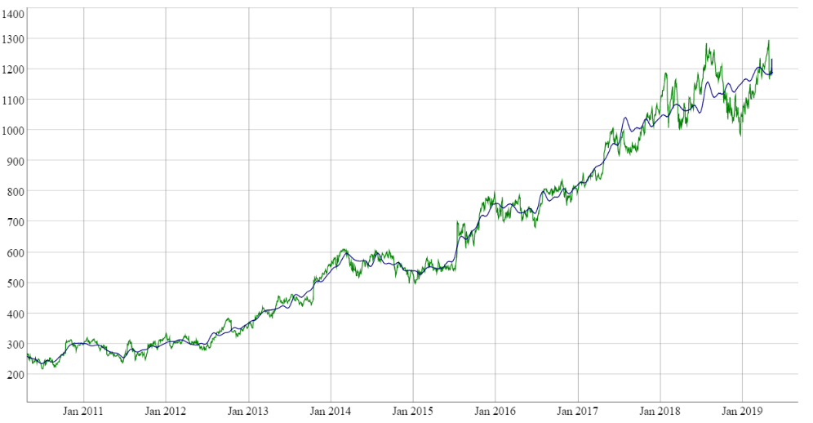
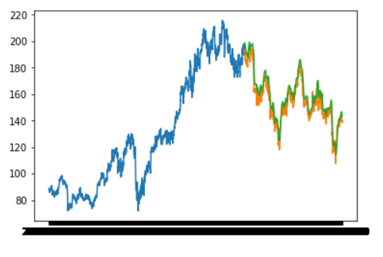


Visuals of data and output of various models
FB Prophet
LSTM

Slide 9
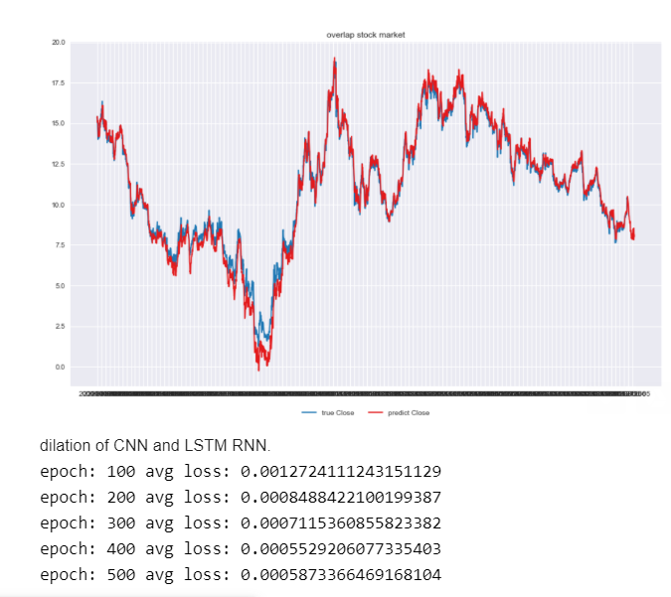
Visuals of data and output of various models

Slide 10
Data Prep
Imported data into frame
Feature Scaling : Scaling the data through standardization
Feature Selection: Remove Highly correlated Columns
Training Validation Split

Slide 11
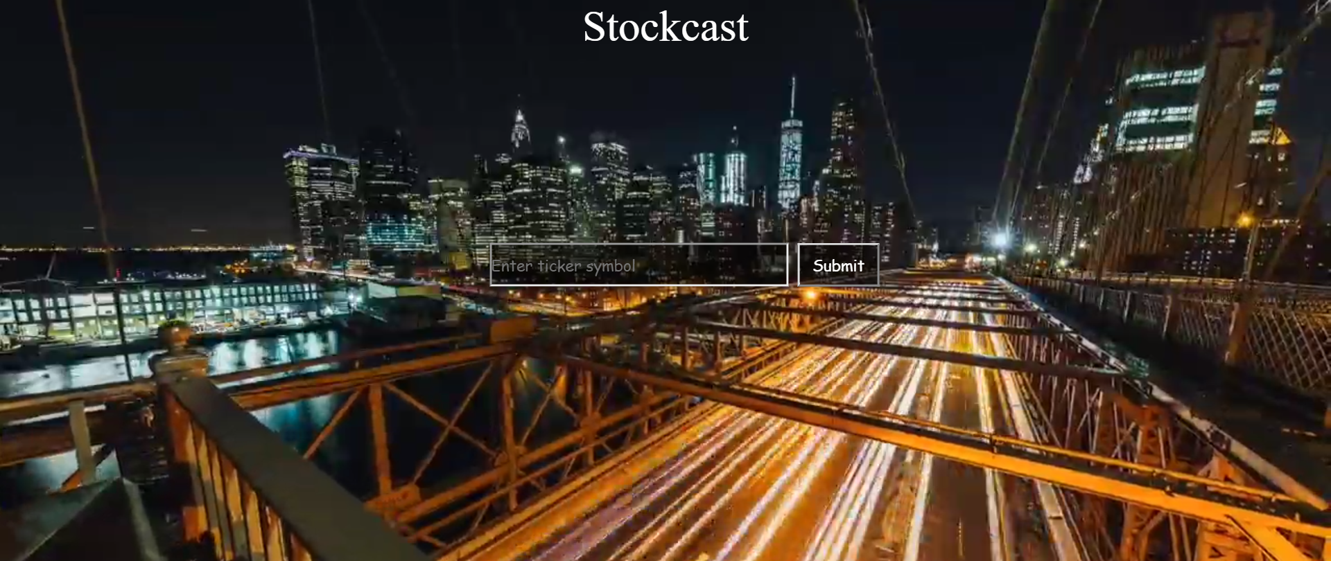
Front End of Application

Slide 12
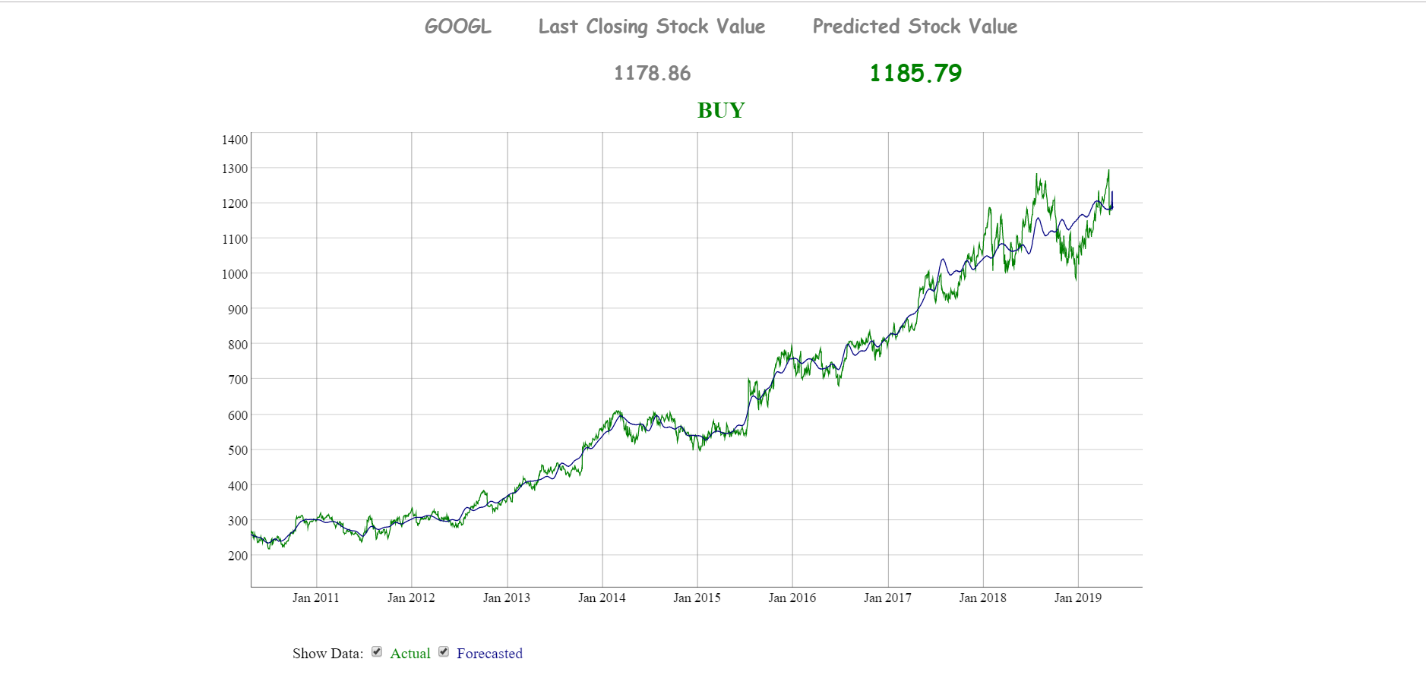
Result of inputs

Slide 13
Future Work
To implement models on various other features like capital base , holding change with time , balance statements etc .
Planning on optimizing LSTM further to give better performance at faster rate
To replace yahoo stock api with api’s such as quandl that cover broad range of stock values across various countries to make application available across the globe

