Slide 1
The draft genome of tropical fruit durian
(Durio zibethinus)
Genome Analysis 2023
Paper IV
Andreas Bergfeldt

Slide 2
What is a Durian and why do this assembly?
What?
Fruit popular in southeast asia
Pungent odor, not allowed in some public spaces
Why?
2016 China imported 600 mUSD
Almost non existent genetic research
My assembly
__________________________
One scaffold
Scaffold 10
Too much to do whole genome
Computing power
Time

Slide 3
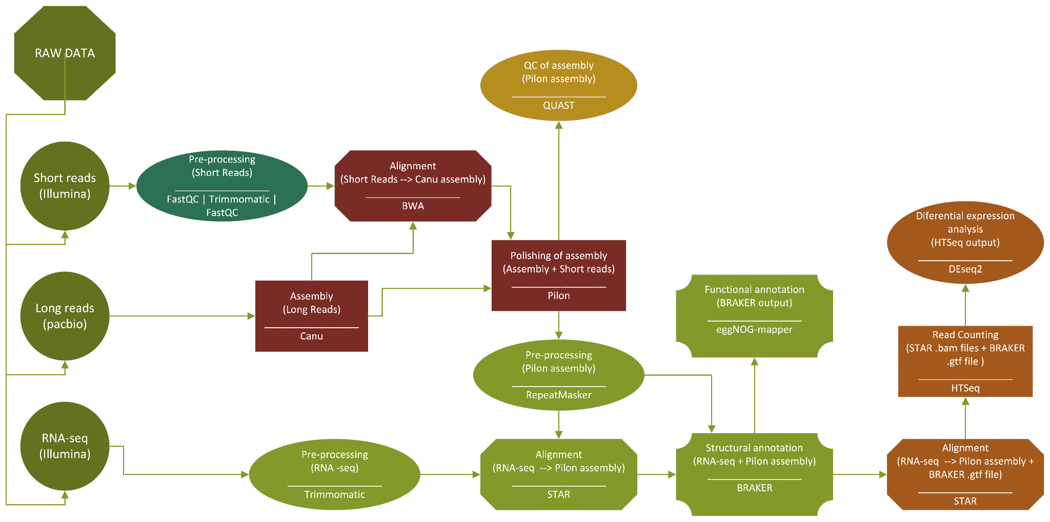
Workflow

Slide 4
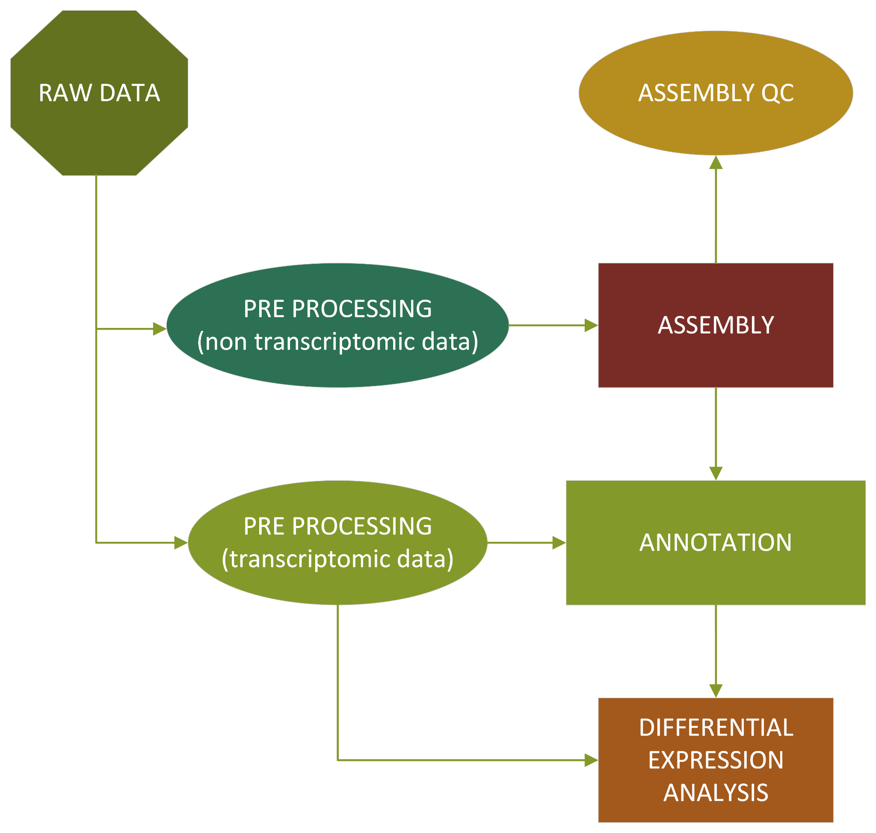
Workflow - simplified

Slide 5
Pre-processing - Trimmomatic
Pre-trimmed data
Trimmed again to make sure it is good
Trimming to remove adapters and low quality bases
Quality control was done before and after
Parameters - Trimmomatic
__________________________
ILLIUMINACLIP = TruSeq3-SE:2:30:10
LEADING = 3
TRAILING = 3
SLIDINGWINDOW= 4:15
MINLEN = 36

Slide 6
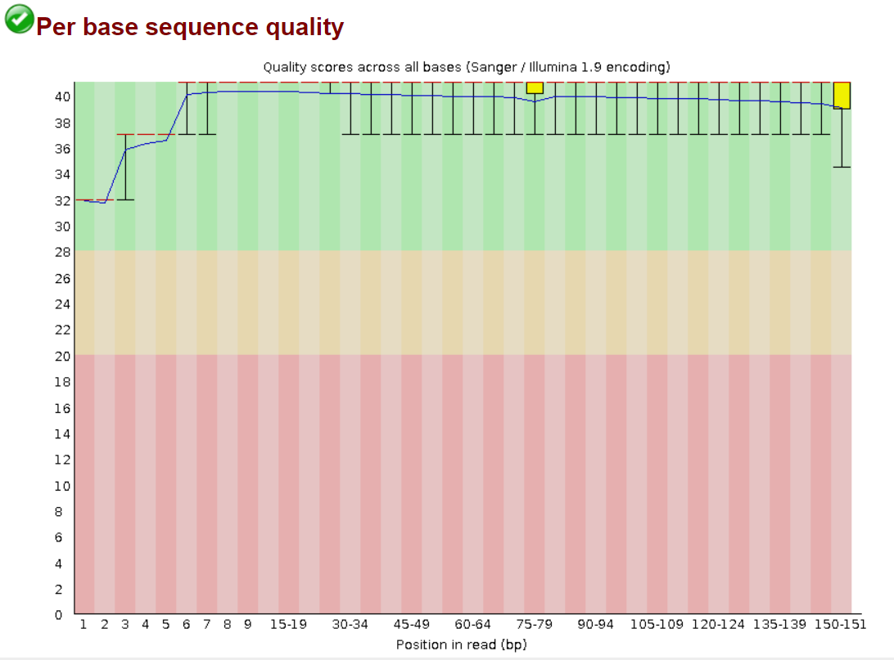
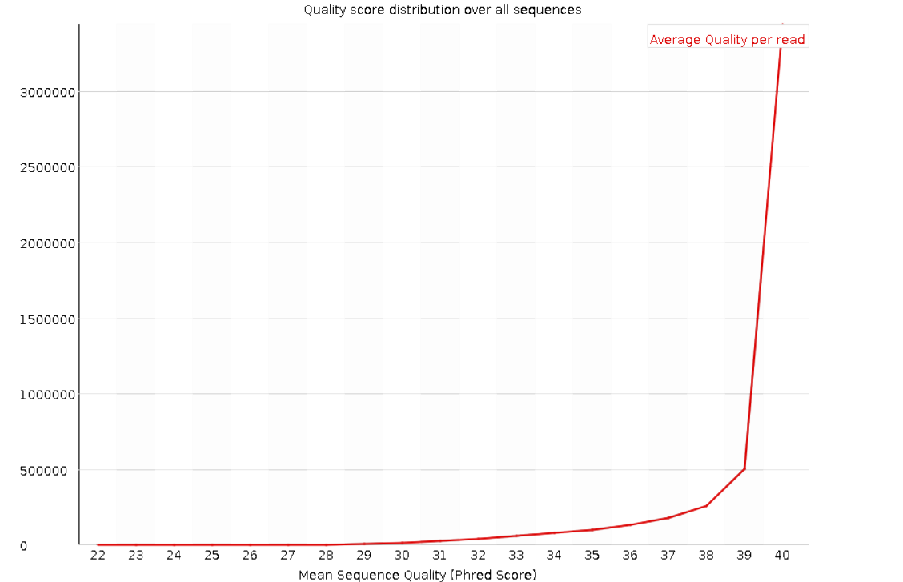
Pre-processing - FastQC
Important to check data before proceeding!
Quality deemed good enough
Pictures are from after trimming

Slide 7
Assembly - Canu
Assembly of the long reads
Plant genome with many repeats:
corrMaxEvidanceErate parameter
useGrid for running in UPPMAX
Parameters - Canu
__________________________
useGrid = false
genomeSize = 30m
corMaxEvidenceErate = 0.15

Slide 8
Assembly - BWA ( + samtools)
BWA
Mapping short reads to long reads
Necessary for polishing later
Manipulating BWA output with samtools to get .bam file
.fasta → .sai → .sam → .bam

Slide 9
Assembly - Pilon
Pilon
Polishing assembly with short read data
Higher accuracy to long scaffolds
Results: (No good summary logfile so taken random reads)
Total Reads: 18201
Confirmed 177014 of 192342 bases (92.03%)
Corrected 11 snps; 0 ambiguous bases corrected 96 small insertions totaling 102 bases 41 small deletions totaling 42 bases

Slide 10
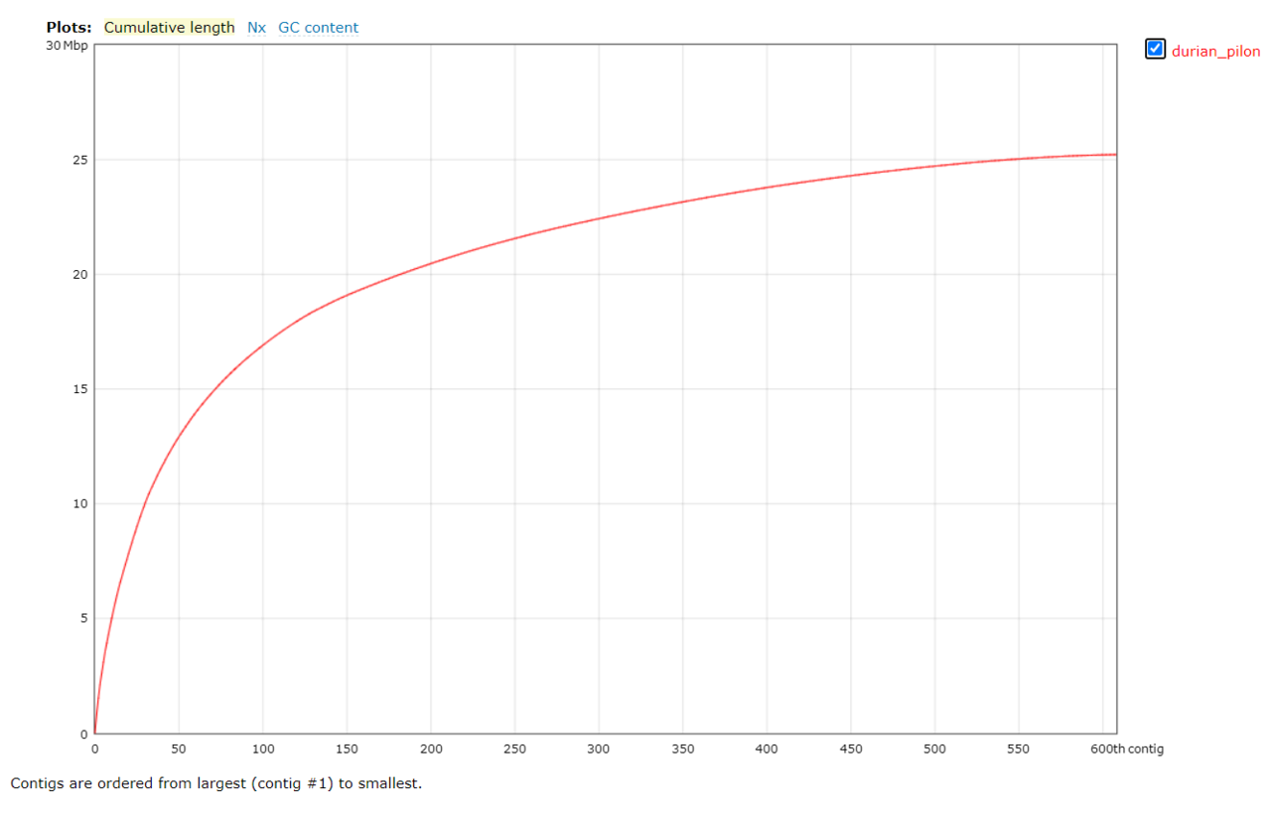
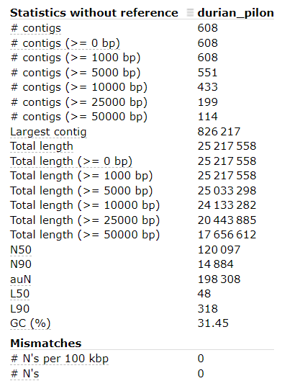
Assembly QC - QUAST
Was the assembly any good?

Slide 11
Annotation - Trimmomatic + repeatMasker
Pre-processing before annotation
Trimmomatic → same as before
RepeatMasker
softmasking repeats for better annotation
Important to specify softmasking
Softmasking
__________________________
Identifies and “masks” repeats
Changes bases in the fasta file from uppercase to lowercase
Hardmasking removes info, softmasking does not

Slide 12
Structural annotation - BRAKER
Pipeline consisting of Augustus and GeneMark
Annotates based on reference genome (masked assembly), and transcriptomic data
Gives way to many outputs, still don’t know exactly what is what
BRAKER results
__________________________
Hardmasked scaffold → 96 genes identified
Softmasked scaffold → 110 genes identified
What are the genes?
who knows…
will come later

Slide 13
Functional annotation - eggNOG-mapper
Web based UI
Loads of information about found hits
Does not say a lot at this stage
Vital for differential expression analysis
Yes more patience is needed..

Slide 14
Counting reads - STAR and HTSeq
For transcriptomic reads to be counted they first need to be aligned
Done with STAR
HTSeq counts the reads that are aligned to each predicted gene (from BRAKER), using a .gtf file
HTSeq results
__________________________
8 files with reads of varying length
Total 29 269 185 record pairs
835 record pairs with missing mate record
0.003% of total record pairs

Slide 15
Differential expression analysis
DESeq2
R-module for expression analysis
Finally some tangible results!
The analysis in short
(In depth on future slides)
__________________________
2 different species
Musang King and Mothong
2 different type of analysis
Between species (Musang king, Mothong)
Within species (Musang King)
Different plant organs (aril, stem, leaf, root)
__________________________
Types of visualization
PCA
Heatmap

Slide 16
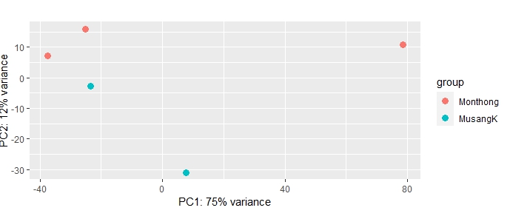
DE - Between species - PCA

Slide 17
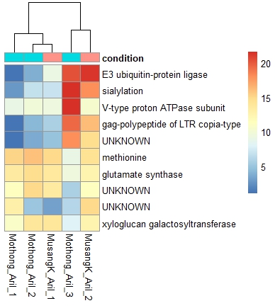
DE - Between species - Heatmap
Overall hard to separate the two species
On PCA the grouping is not good
Groups Musang with Mothong
Does not group all of same species
The heatmap does not show any patterns in which the species can be separated

Slide 18
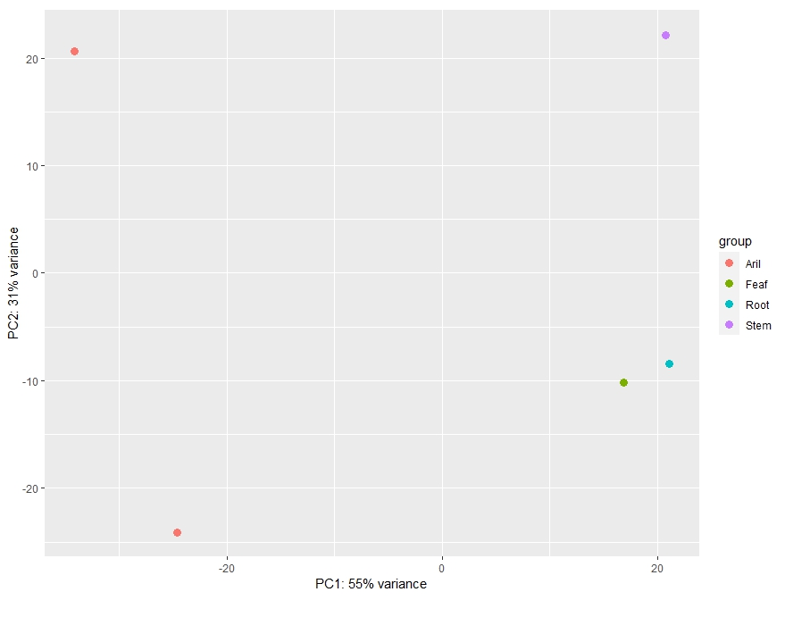
DE - Within species - PCA

Slide 19
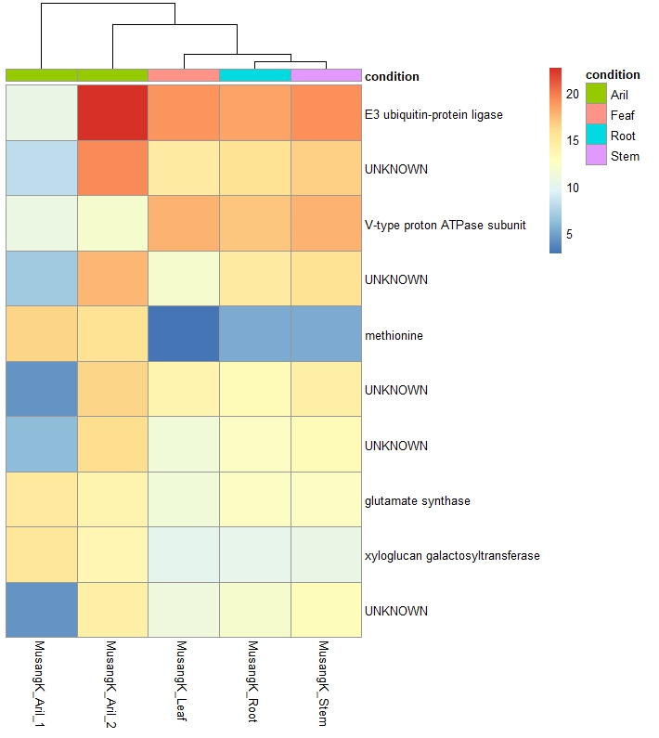
DE - Within species - Heatmap
Better separation between plant organs compared to plant species
PCA did okay
Possible separations at least
Some patterns can be seen that separates arils from the rest of the plant organs
Eg. methionine and xyloglucan

Slide 20
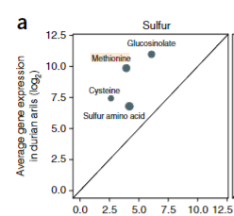
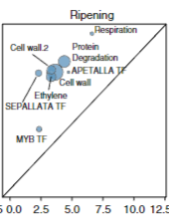
DE - Biological conclusions
Methionine converted to methanethiol with the enzyme methionine γ-lyase
Methanethiol has key role in odor of durian
Xyloglucan building block of cell wall 2
“interlace cellulose microfibrils in most flowering plants.”
Genes with association to cell wall 2 upregulated in arils
Figures from paper IV

Slide 21
Thank you for your attention!
For more in depth information about programs etc. please look at my github wiki for this project: https://github.com/A-Bergfeldt

