Slide 1
Weekly Presentation
Jiayu Chen
2023.11.06
Notes:
Ok, I will begin my weekly Presentation

Slide 2
Work Description
Part_1:
About Getting Template (Weighted Average, Kalman Filter, DTW)
Some Thoughts about Removing Breathing Effect
Part_2:
Paper_1: A global averaging method for DTW
Paper_2: shapeDTW: shape Dynamic Time Warping
Paper_3: k-Shape
Part_3: Learning Progress and Future Learning Plan
Part_4: Some Thoughts about Undergraduate Thesis
Part_5: Questions

Slide 3
Part_1: Research - Getting Template
Model | State | S Prediction | D Prediction
No Template | No RR, Peak-Based Segmentation | 0.79 / 1.64 | 1.79 / 4.31
Mean | No RR, Peak-Based Segmentation | 1.35 / 1.38 | 4.53 / 4.44
Median | No RR, Peak-Based Segmentation | 1.42 / 1.45 | 4.07 / 4.49
PCA | No RR, Peak-Based Segmentation | - / - | - / -
K-shape 1 | No RR, Peak-Based Segmentation | 2.20 / 2.74 | 4.85 / 5.88
Weighted Avg | No RR, Peak-Based Segmentation
K-shape 2 | No RR, Peak-Based Segmentation | 2.18 / 1.79 | 4.76 / 5.24
Kalman Filter | No RR, Peak-Based Segmentation | 1.45 / 1.37 | 4.82 / 4.60
DBA | No RR, Peak-Based Segmentation | 2.05 / 1.96 | 3.43 / 4.15

Slide 4
Part_1: Research - Getting Template
实验结果反映的初步结论：
Conclusion1:
在仍然使用线性回归的情况下，对纯净SCG信号的D指标预测的理论上限，应该是1.8。但是，目前使用DBA算法的效果，已经初步得出：获取标准模板的过程，是一个denoising的过程。
（DBA算法会在之后简单的介绍）
Conclusion2:
我们之前对K-shape的使用和结论是错误的。
K-shape的精髓
Conclusion3:
Kalman Filter从原理上来说，Multi-sensor confusion的思路，是可以很好的抑制噪声的。
目前虽然效果不好，但我仍然认为，Kalman Filter的道路是能走通的。
但可能没有发表的价值。

Slide 5
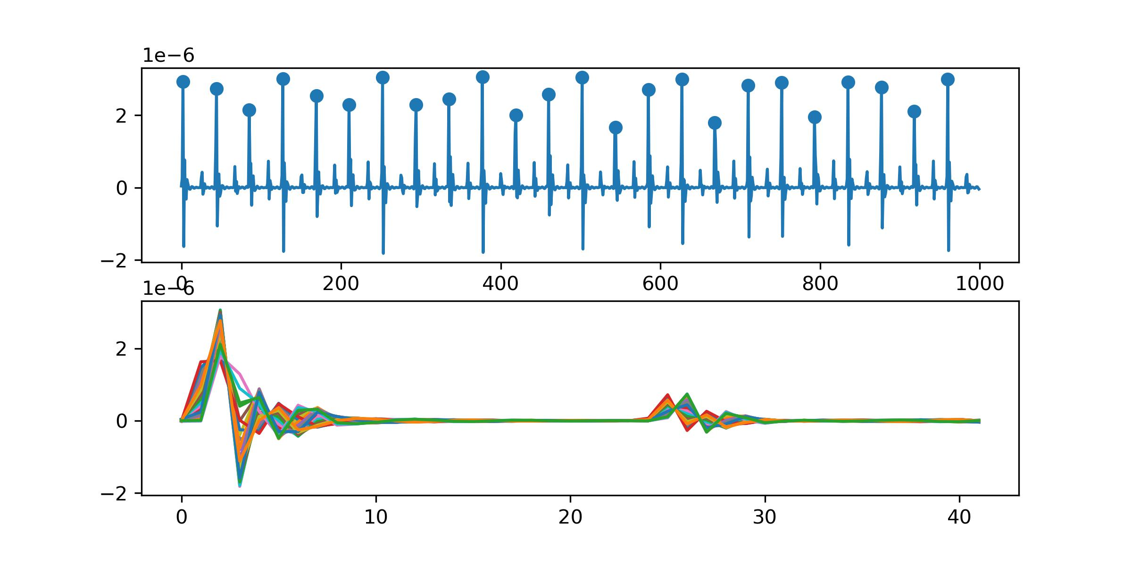
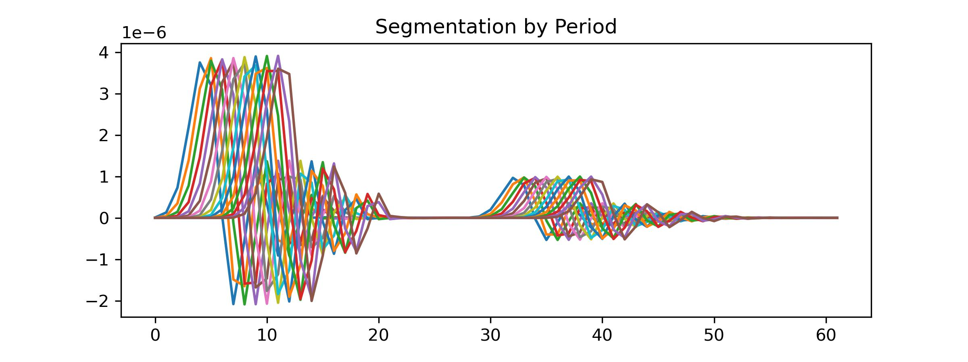
What features should a good algorithm for obtaining a template have?
Feature 1: The highest points of both large and small peaks for each piece should be aligned after applying the algorithm.
Feature 2: The distance between two peaks of the template should be the rounded average of distances between two peaks for all pieces.
Feature 3: The ability to handle time shifts (possibly essential in real data but less critical in simulated signals).
The primary focus of research should indeed be on Time Warping to get perfect template of SCG signals.

Slide 6
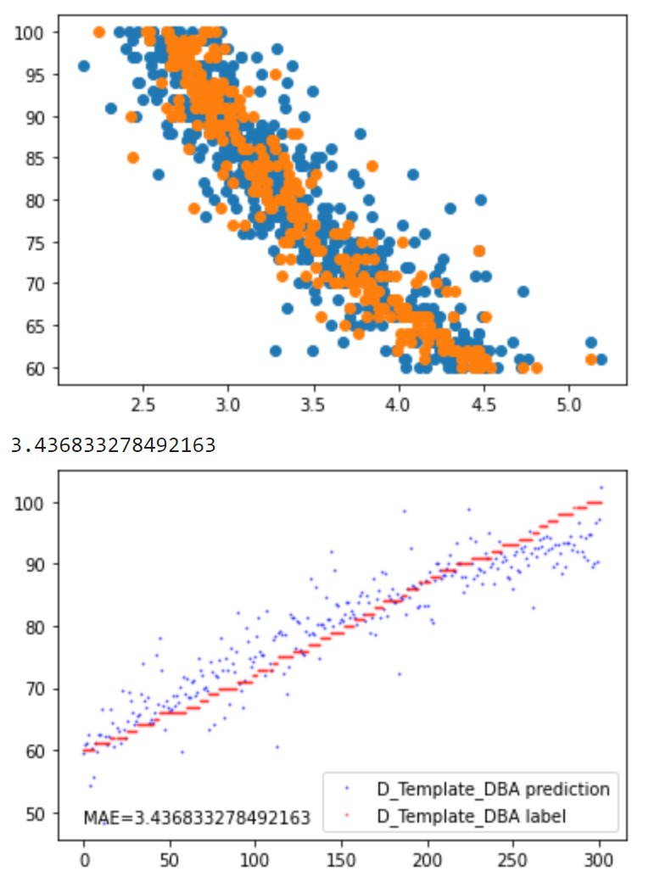
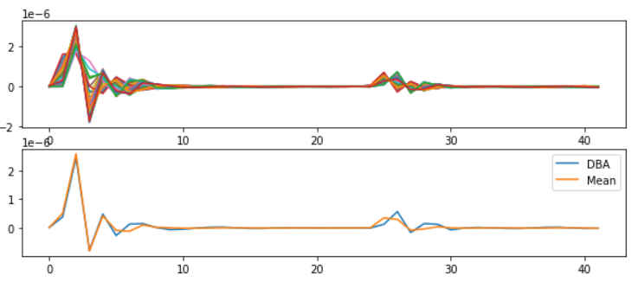
Part_1: Research - Getting Template
At the same time, I have separately run models like DTW, dDTW, wDTW, and shapeDTW on pure SCG signals. Since SCG signals themselves are not very complex, the matching results are all quite similar.
Conclusion:
1. Thanks to methods like DBA for calculating the mean of sequences, the issue of small peaks has been largely resolved.
2. As can be seen in the graph on the right, the points are scattered. In the future, further analysis is needed to
identify the bottlenecks of this algorithm.

Slide 7
Part_1: Research - Getting Template

Slide 8
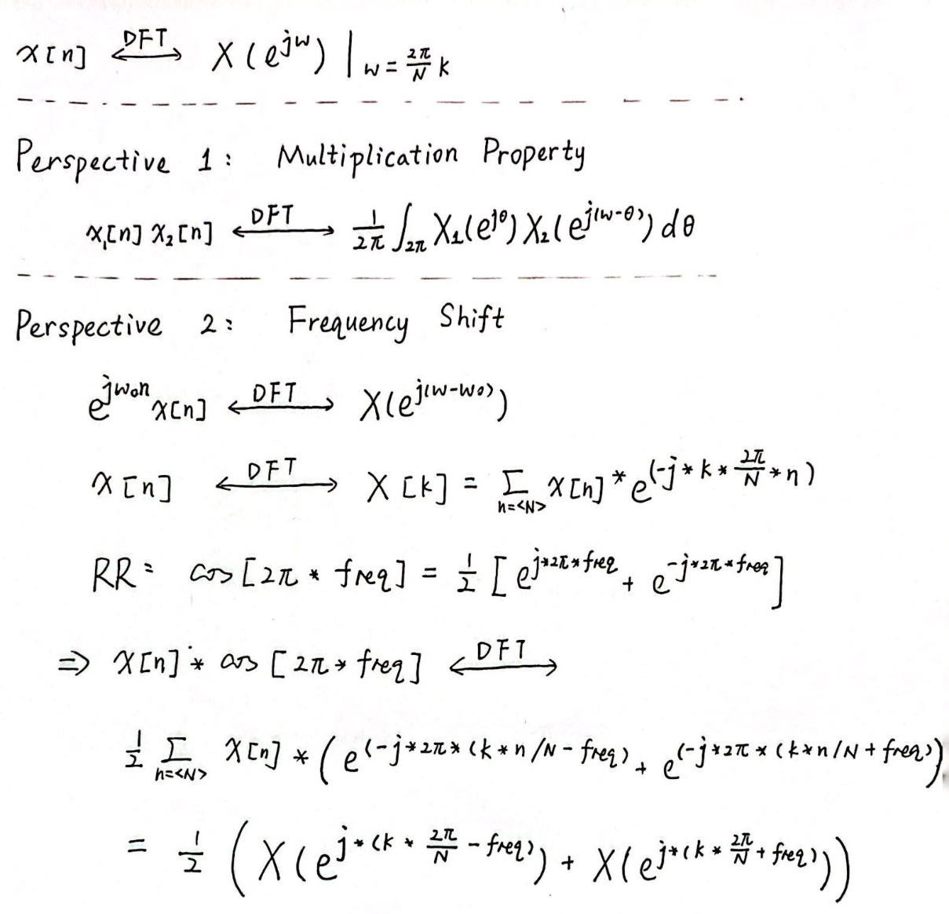
Part_1: Research - Breath Removal
Perspective 1:
The multiplication in the time domain is equivalent to convolution in the frequency domain. It's not easy to approach the problem from this perspective.
Perspective 2:
The original equation is equivalent to the linear addition of the original signal after it undergoes a frequency shift.
Provided us with some insights:
1. Breathing is very likely the lowest-frequency component in meaningful signals.
2. For time-domain decomposition, there is no way to separate the breathing signal.
3. Multiplying the original signal by a periodic signal in the frequency domain works well. Algorithms that can decompose the frequency domain may be able to solve the problem.

Slide 9
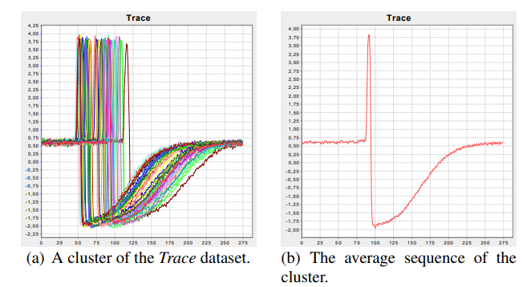
Part_2: Paper Reading
Paper_1: A global averaging method for DTW - DBA
The Propose of the Paper: the computation of an average of a set of sequences
Solved Problems:
They develop a global technique for averaging a set of sequences, which avoids using iterative pairwise averaging.
2. They describe a new strategy to reduce the length of the resulting average sequence.

Slide 10
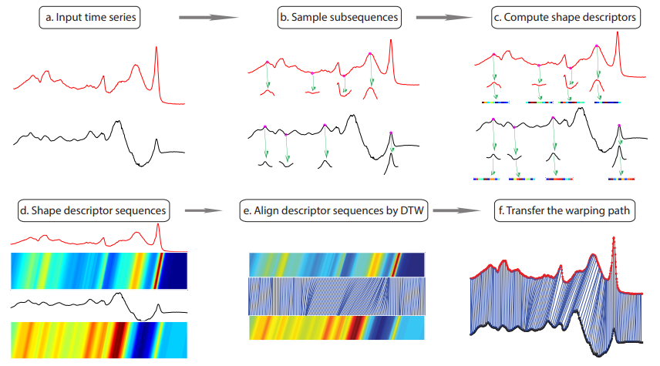
Part_2: Paper Reading
Paper_2: shapeDTW: shape Dynamic Time Warping
Shape Descriptors:
Raw-Subseq,
PAA, DWT,
Slope, HOG1d
Derivative

Slide 11
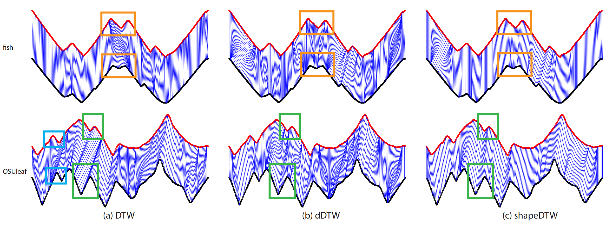
Part_2: Paper Reading
Paper_2: shapeDTW: shape Dynamic Time Warping

Slide 12
Part_2: Paper Reading
Paper_3: k-Shape
NLAAF: Nonlinear alignment and averaging filters
PSA: Prioritized shape averaging
RSTMF: Ranking Shape-based Template Matching Framework
DBA: Dynamic Time Warping Barycenter Averaging
KSC: K-Spectral Centroid Clustering

Slide 13
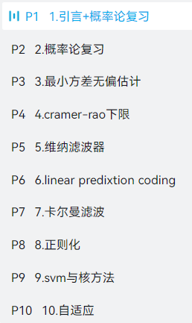
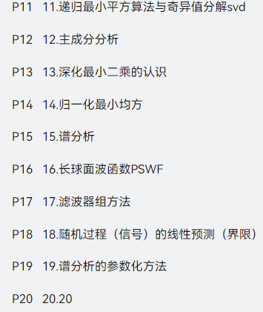
Work_3: Learning Progress and Future Learning Plan
Completed theoretical studies:
EE120 (all videos and lectures)
Complex Functions and Integral Transforms (completed half of the exercise book)
Theoretical studies I plan to undertake next.：
现代数字信号处理I 张颢
现在数字信号处理II 张颢
(Array signal processing, time-frequency analysis,
compressive sensing, Bayesian methods)
Next research directions:
1. Further exploration of methods mentioned in K-shape.
2. Seek out latest methods in data mining journals.
3. Search for algorithms that can effectively decompose the frequency domain.
4. Gradually explore real datasets based on the laboratory's research papers.

Slide 14
Some Thoughts about My Undergraduate Thesis
I hope it is a framework for any periodic physical signal.
Segmentation
Get Template
The actual achieved results should be as follows:
Even when segmentation is only possible based on the periodic length, it's possible to synthesize a reasonably good signal.
If more information can be generated during the segmentation process, the template synthesis will be even better.
Sliced signals without any knowledge of their nature
Sliced signals with some knowledge of their nature
Sliced signals with deep knowledge of their nature

Slide 15
Questions
Do you think what I just said has any research value, or if it's implemented, does it make sense?
2. In our laboratory paper, does the deep learning model also have data shift in its dataset? I have built an identical model, but it doesn't work.
3. Regarding the proposal presentation, Professor Xie's advice is to approach it from a more general perspective. For instance, what I should write about is how to perform the extraction of a standard template from a periodic physical signal, then elucidate my methodology, and in the experimental section, validate it using our SCG signal or BCG signal.
4. In the current thesis, when mentioning 'Time Alignment' or 'DTW,' they are often used for clustering, classification, and data argumentation. Can we refer to the current work as 'DTW for Regression'? Compared to 'DTW for Classification,' 'DTW for Regression' has a distinct focus.

Slide 16
Questions
Regarding excellent graduation theses in Jiangsu Province, the bottom line is that there must be a thesis publication.

Slide 17
Thanks!

