Slide 1
Presentation
Jiayu Chen
2024.07.22

Slide 2
Outline
Part_1: Our New Model Works Well In Real AFib Data
Part_2: Effects of Improved Method

Slide 3
Our New Model Works Well In Real Data (3AE4)
HR Estimation on Real AFib Data
Dataset | IoT2023 | Jiayu | Comparison
3AE4_1 | Number:13981 Ratio:81% MAE:6.57 | Number:9765 Ratio: 58% MAE: 3.27 | Ratio -28.3% MAE -50.2%
3AE4_2 | Number: 10971 Ratio: 64% MAE:13.82 | Number:6899 Ratio: 41% MAE:3.58 | Ratio -35.9% MAE -74.1%
3AE4_3 | Number:11285 Ratio:66% MAE:21.75 | Number: 5312 Ratio: 31% MAE: 4.54 | Ratio -53% MAE -79.1%
3AE4_All | Number: 36237 Ratio:70% MAE: 13.58 | Number: 21976 Ratio:43% MAE: 3.69 | Ratio -38% MAE -72.8%
*Number in the table means useful 10s signal piece after Quality Control. Ratio=Number/All.
I got 3 datasets of the Afib patient from Zixuan.
Yingjian’s method doesn’t work on this patient, which utilized 70% of all data and achieved 13.58 on MAE. (Figures are on the next page.)
My new model works well, utilizing 43% of all data and achieving 3.69 on MAE.
Attention: I treated this Afib patient as a healthy person and didn’t use the model specially designed for Afib patients(very computationally expensive). The MAE should be smaller than 3 finally.
Notes:
I do the HR estimation on Real Afib data. The results are listed in this table sheet. The table has 4 colums

Slide 4
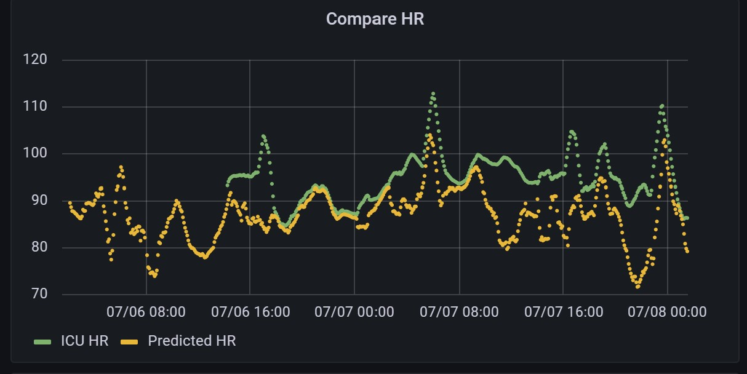

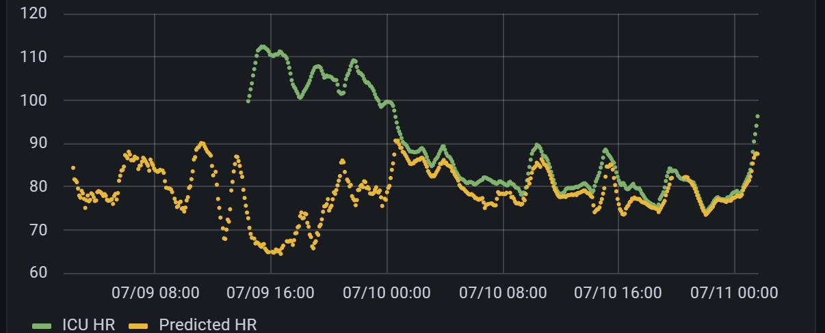


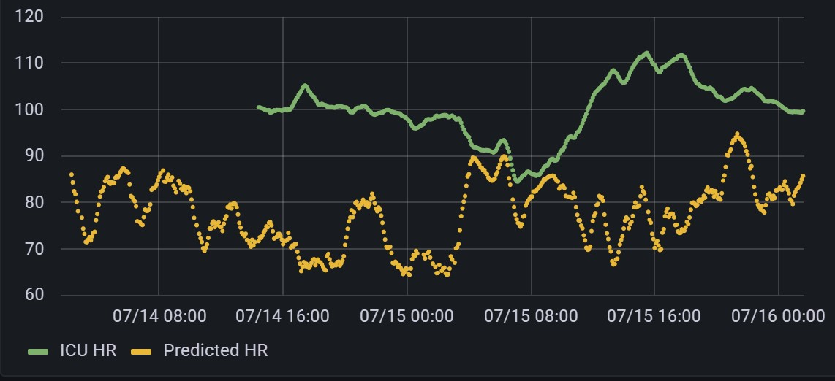
Blue points and yellow points are ground truth and predicted values by Yingjian’s model respectively.
3AE4_1
3AE4_2
3AE4_3
The code Yingjian sent to me should be a little different from the algo implemented in Beddot. Anyway, it doesn’t work well.

Slide 5
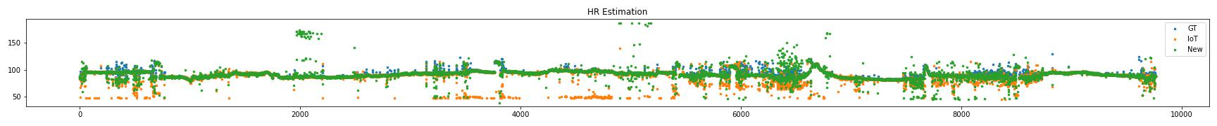
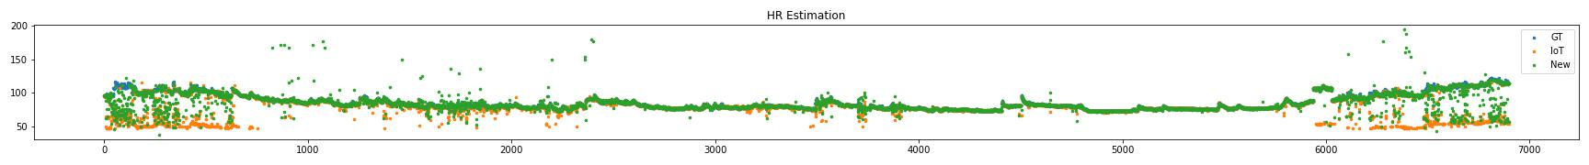
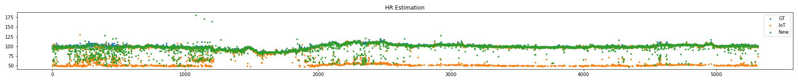
3AE4_1, MAE of IoT: 6.57, MAE of New: 3.27
3AE4_2, MAE of IoT: 13.82, MAE of New: 3.58
3AE4_3, MAE of IoT: 21.75, MAE of New: 4.54
No matter from these figures or the MAE, we can see the performance of the new method is better than the old method. Here are two reasons:
New ICU data is high quality, and waveforms are more clear and stable, which helps a lot for segmentation and template generation.
The feature of real Afib data is consistent with our before assumption which we based on to generate simulated Afib data. We don’t need to change the algo too much to make it work on real data.

Slide 6
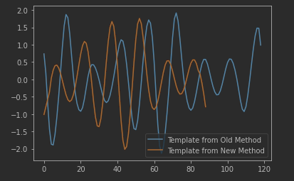
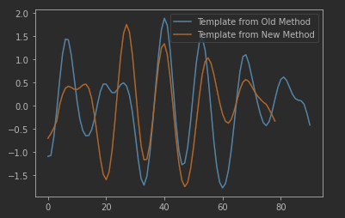
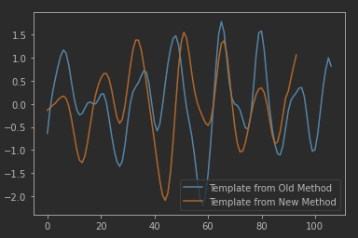
Effects of Improved Method
Segmentation and template generation are crucial parts of the algorithm, directly impacting the accuracy. I made some improvements to the segmentation.
After this improvement, the long template containing more than one period, like the above bule lines, won’t appear again. The blue lines above will be replaced by the yellow lines.
Compared to research, this improvement is more about engineering implementation, but it works so well. HR estimation(MAE) of the Afib patient(3AE4) improved from 5.7 to 3.69.

