Slide 1
Presentation
Jiayu Chen
2024.03.25

Slide 2
Work Description
Part_1: IBI Prediction
Part_2: Heart Rate Prediction
Part_3: Arrhythmia
Part_4: Alignment of BSG and PPG
Part_5: Thoughts about Paper Writing

Slide 3
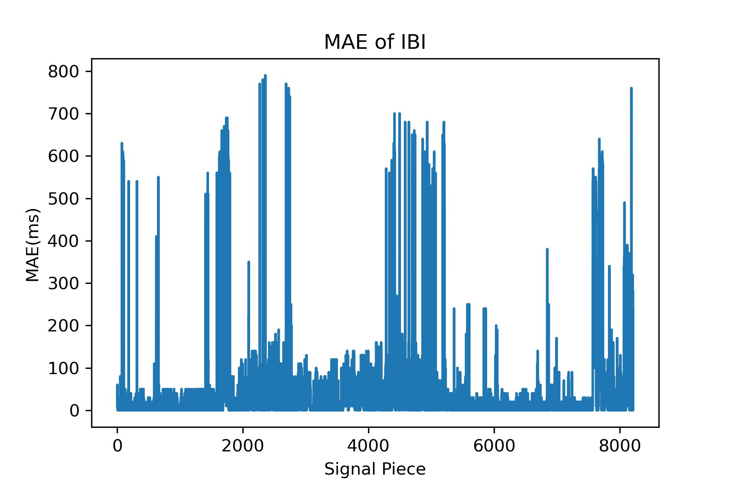
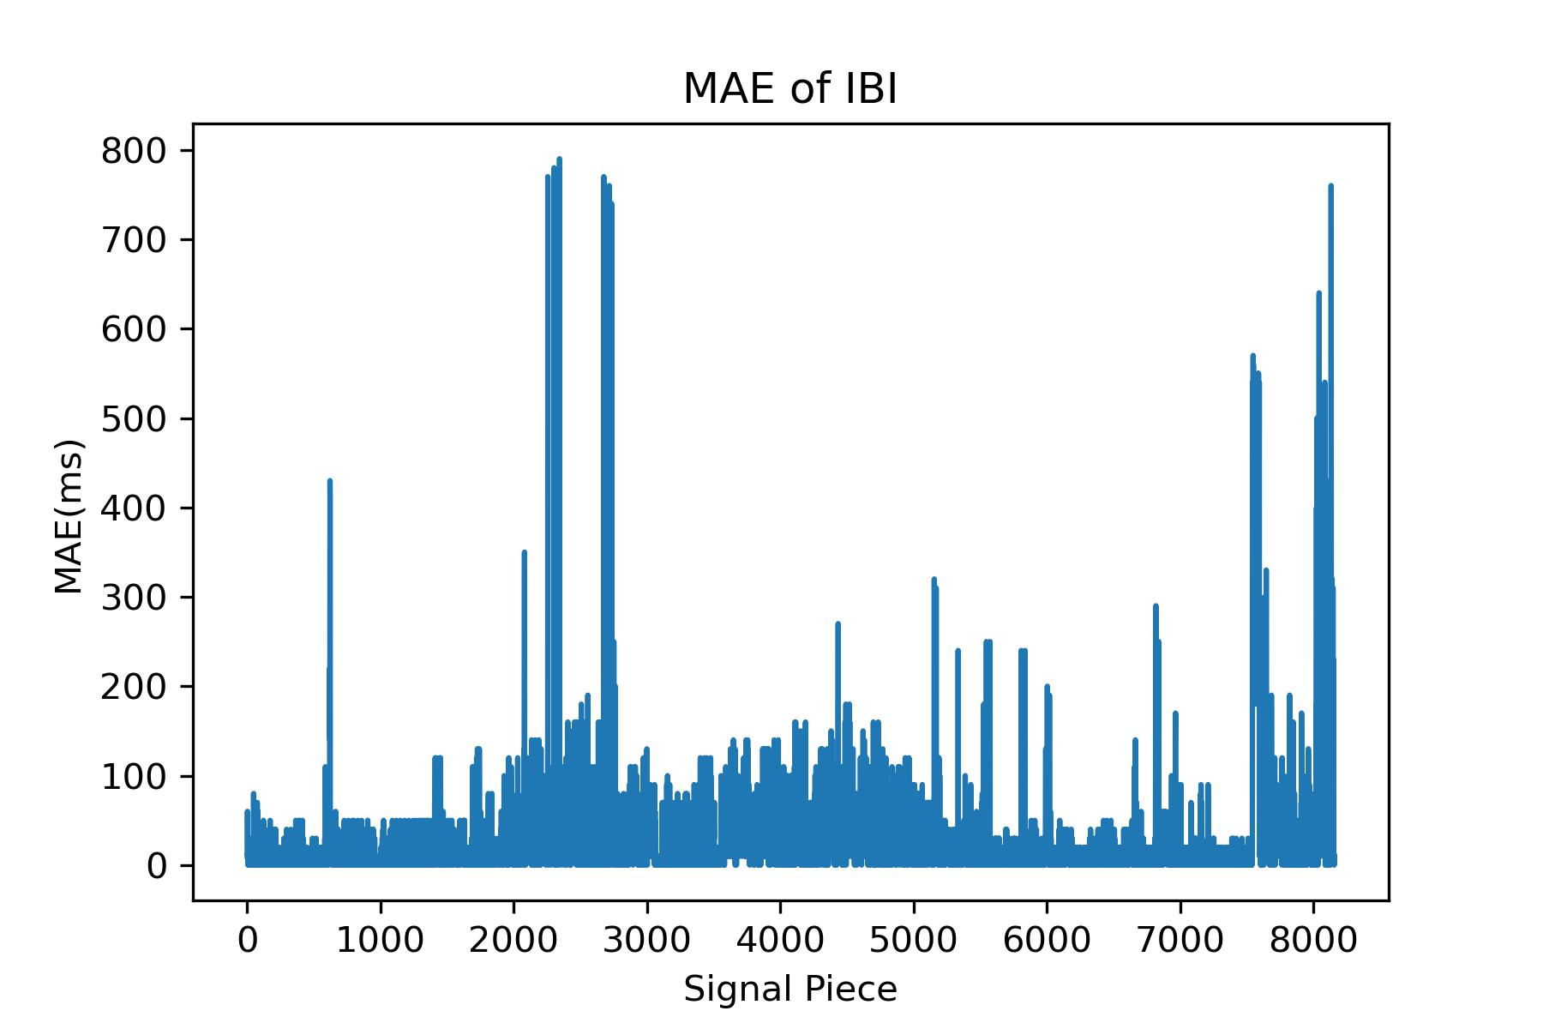
IBI Prediction
VITAL | Conditions | Yingjian(77) | Template-based Algo v2 (99) | Template-based Algo v3 (99)
IBI(ms) | Back | 26.36 | 18.74 (-28.9%) | 17.37 (-34.1%)
 | Left | 25.37 | 19.42 (-23.4%) | 18.58 (-26.8%)
 | Right | 24.71 | 17.75 (-28.1%) | 17.68 (-28.5%)
 | STOMACH | 21.40 | 16.60 (-22.4%) | 16.51 (-22.9%)
 | ALL | 24.84 | 18.34 (-26.1%) | 17.47 (-29.7%)
Last meeting's outcome: Under the conditions of Back, IBI's MAE error is 22ms, representing only an 15% improvement compared to the 26.36ms result in the Yingjian’s paper.
Two major versions of improvements were made to the algorithm and quality control conditions. The data utilized signals of 20 seconds, with aligned PPG signals after calibration used as labels.
The top 10 individuals with the highest MAE were selected. This allows for a visual comparison of the improvements between algorithm versions v2 and v3.

Slide 4
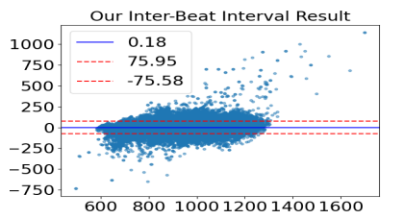
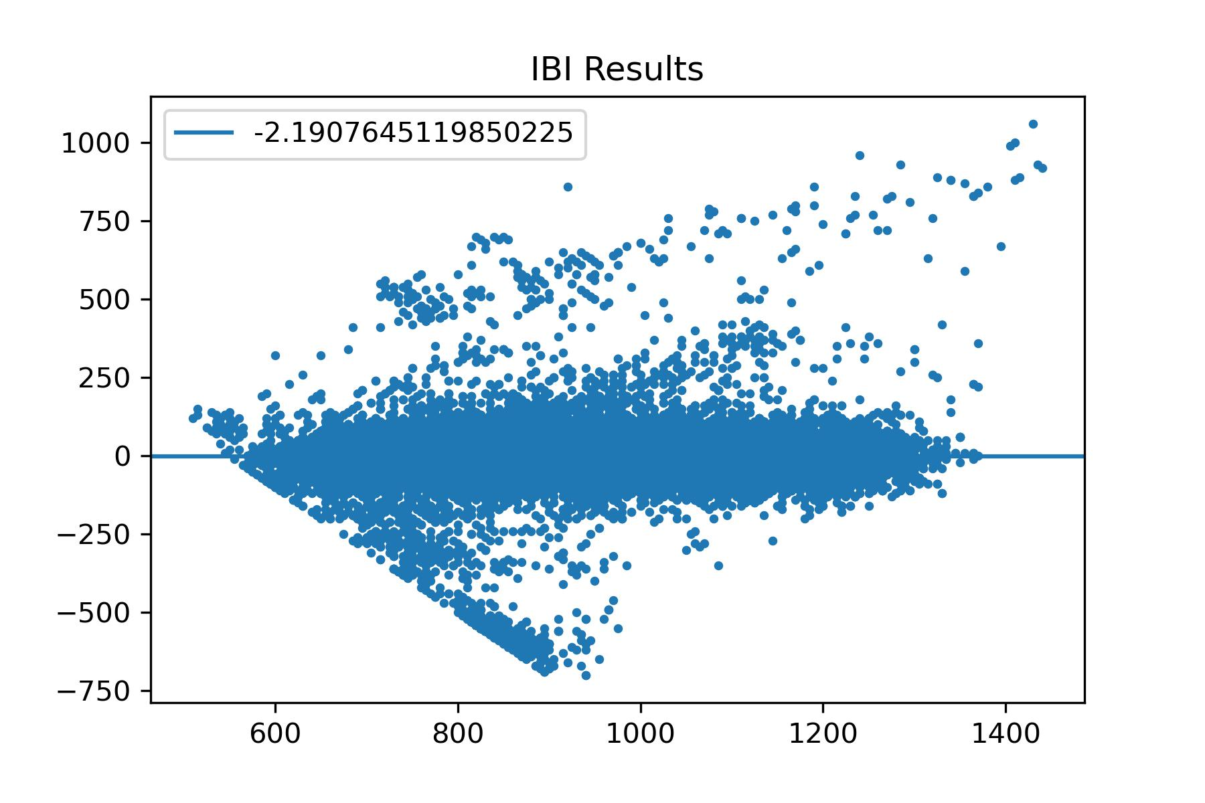
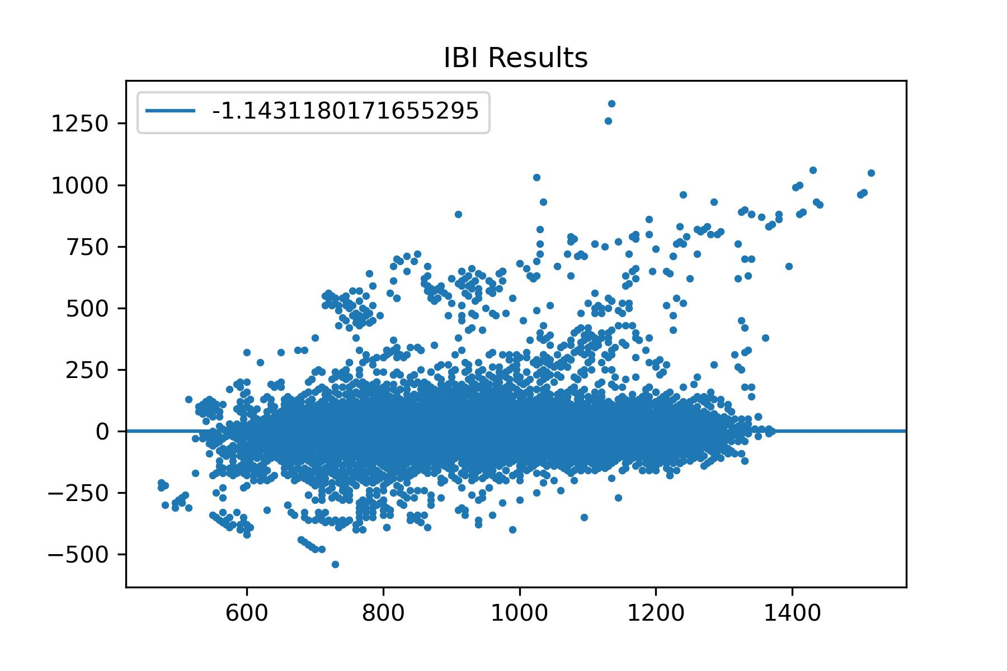
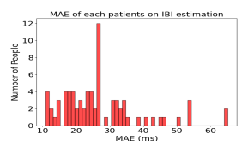
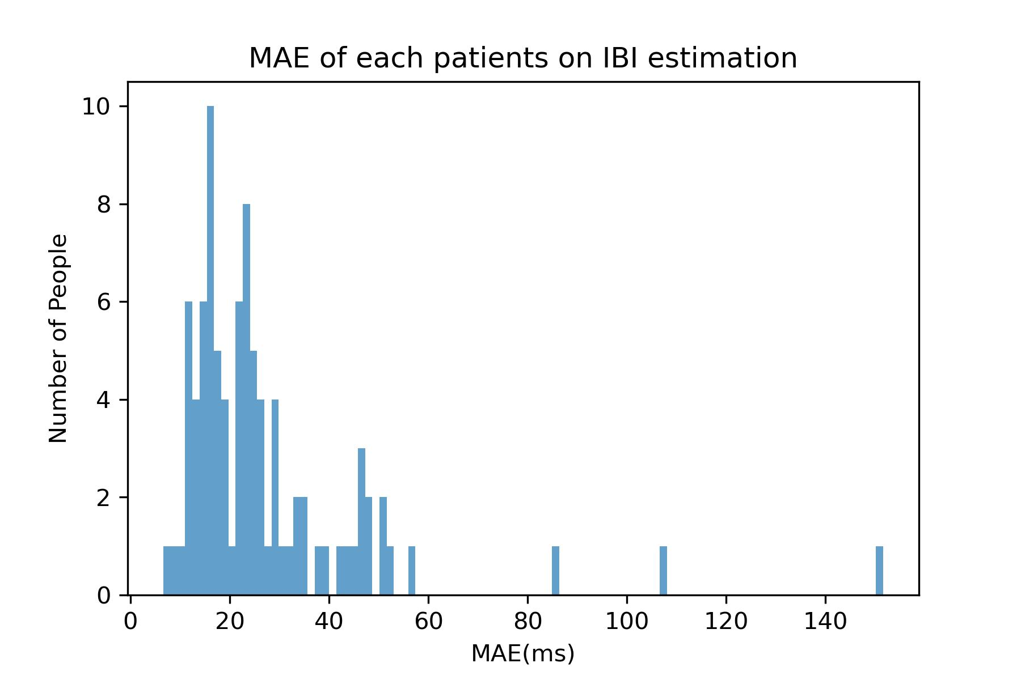
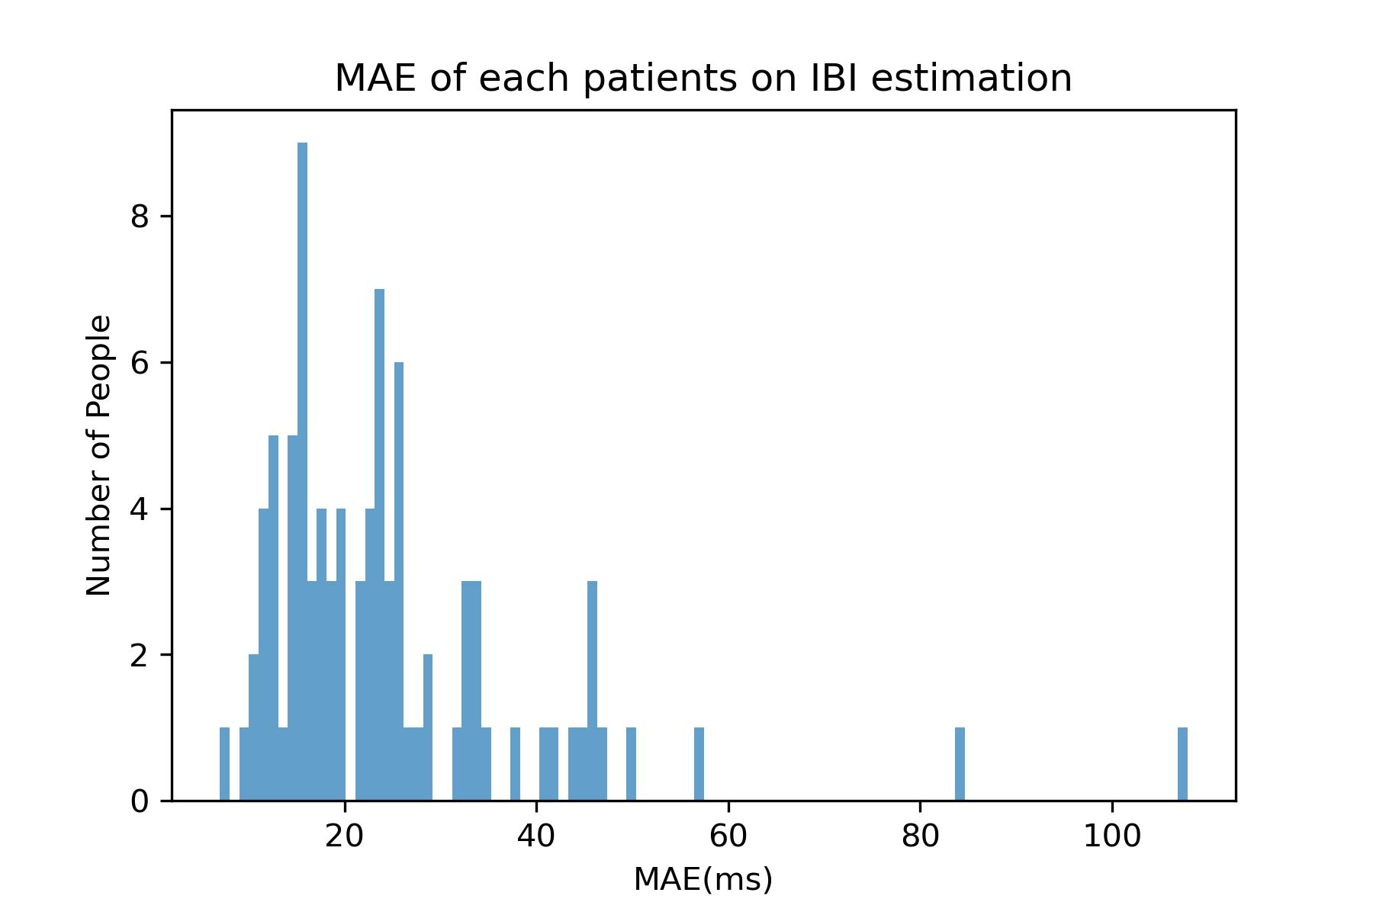
IBI Prediction
Yingjian(77)
Template-based Algo v2 (99)
Template-based Algo v3 (99)

Slide 5
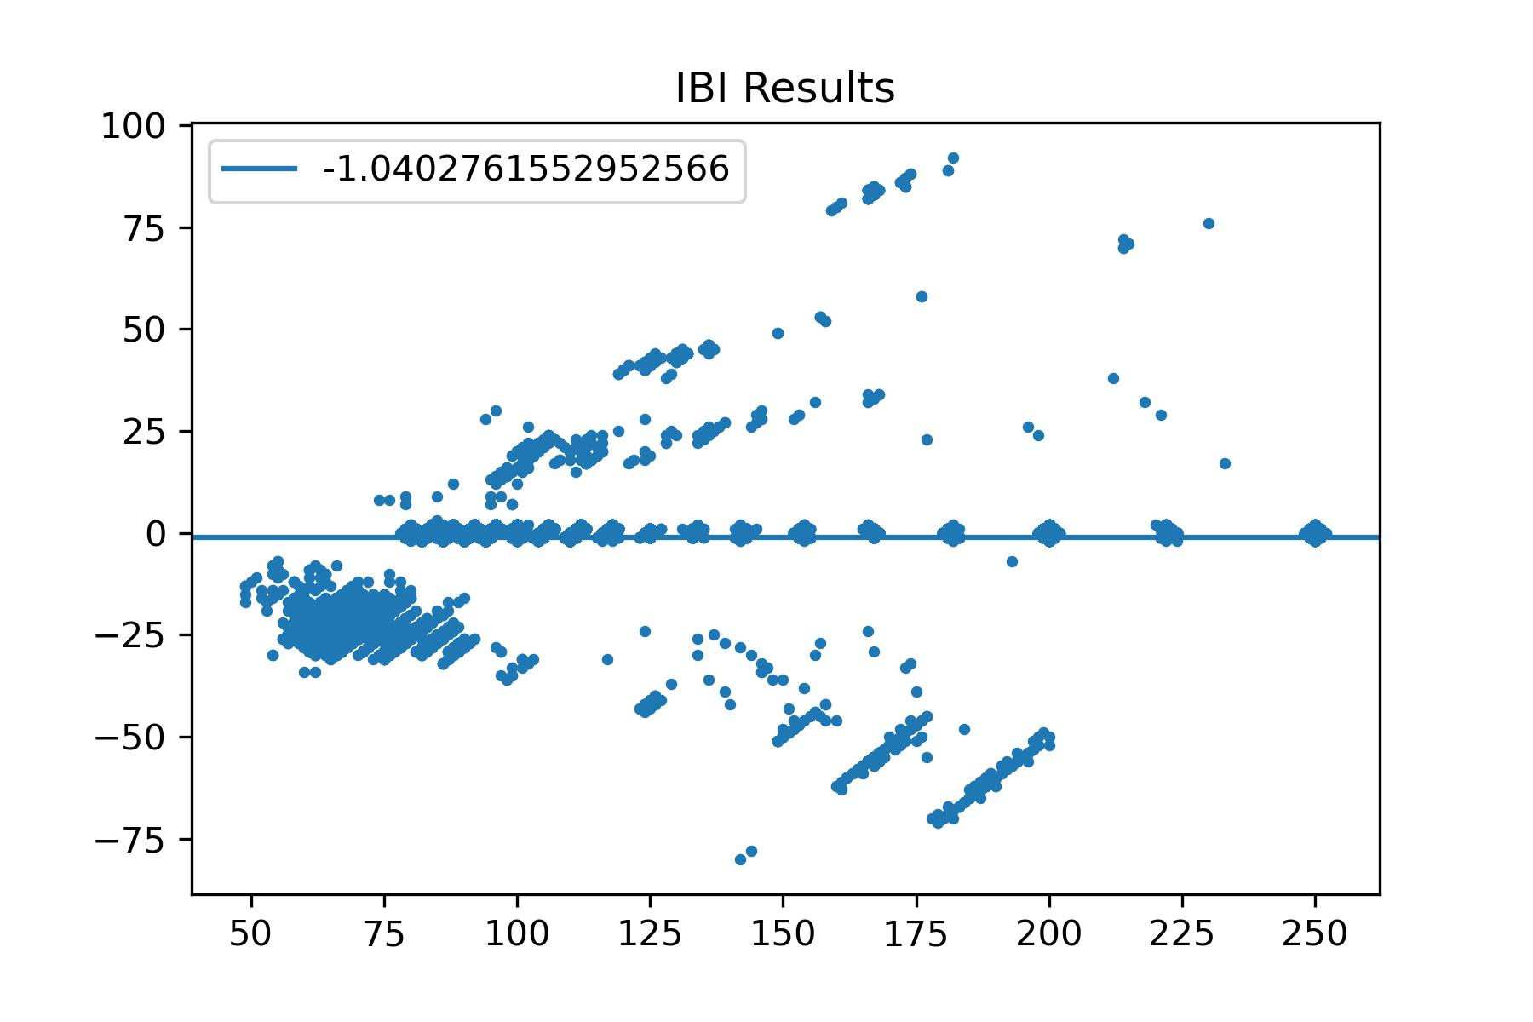
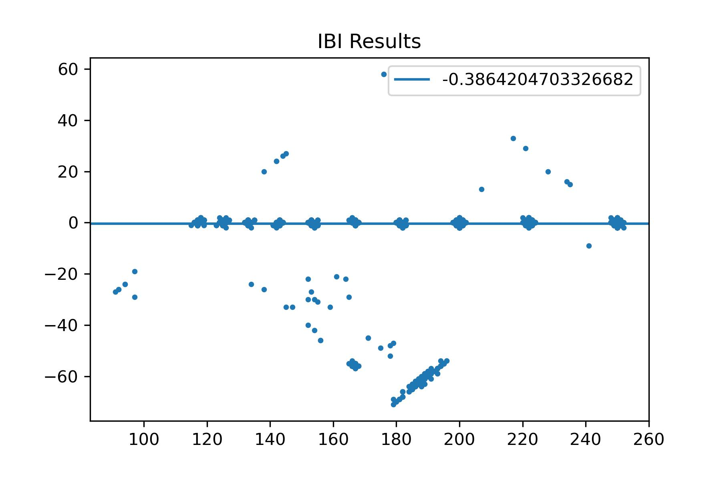
IBI Prediction
VITAL | Signal | Conditions | Template-based Algo v3 (99)
IBI(ms) | BSG | ALL | 17.47(ms)
 | Simulated SCG | HR(50-150) | 15.38(ms)
 | Simulated SCG | HR(50-105) | 7.78(ms)

Slide 6
HR Estimation
VITAL | Conditions | Yingjian IOT2023 | Yingjian | Template- based | Yingjian | Template- based | Yingjian | Template-based
 |  | - | All Data | All Data | Good Data (33890, 28891) |  | Bad Data (2657, 2236)
HR(BPM) | Back | 1.17 | 1.730 | 1.198 | 1.674 | 1.141 | 2.445 | 1.948
 | Left | 1.11 | 1.469 | 1.080 | 1.428 | 1.041 | 1.997 | 1.578
 | Right | 1.10 | 1.639 | 1.243 | 1.612 | 1.214 | 1.987 | 1.612
 | STOMACH | 1.40 | 2.089 | 1.075 | 2.092 | 1.020 | 2.056 | 1.790
 | ALL | 1.38 | 1.697 | 1.174 | 1.656 | 1.125 | 2.223 | 1.801
The results of Yingjian originate from the `hr_estimation` function in Algo_DSPYS.py. This implementation appears to be a simplified version in the paper, lacking the Bayesian fusion of time and frequency domains.
Template-based HR estimation generally discards approximately 15% more data compared to Yingjian's algorithm.
While accurate data becomes more precise and inaccurate data becomes less so, due to the majority of data being accurate and extreme values being rare, the effectiveness of this algorithm is not expected to be significantly worse than Yingjian's. However, it is also not expected to be considerably better.

Slide 7
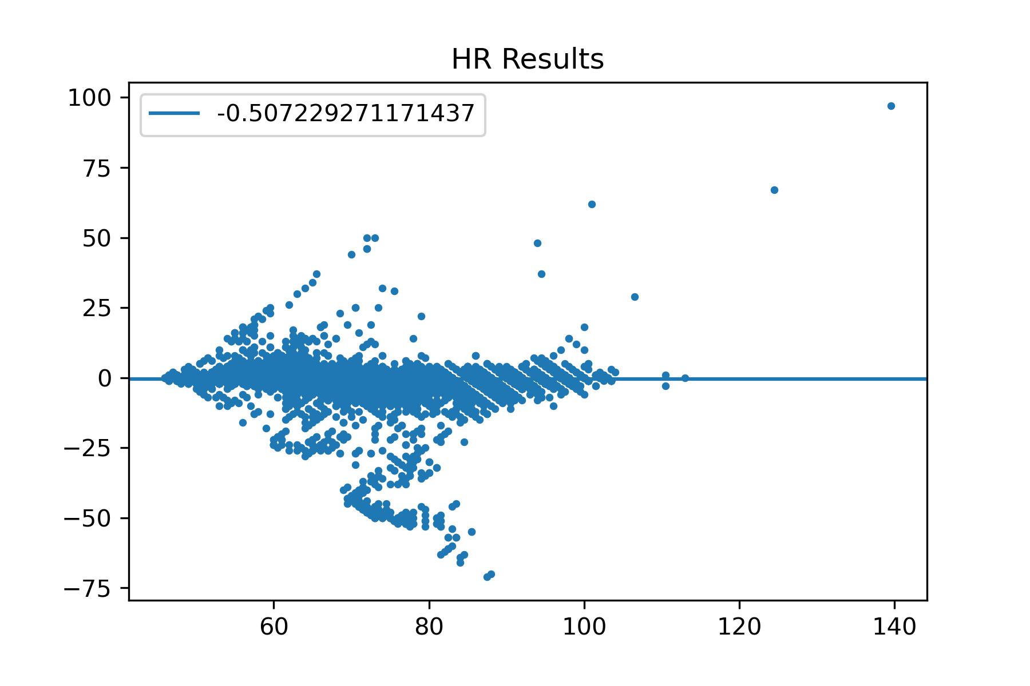
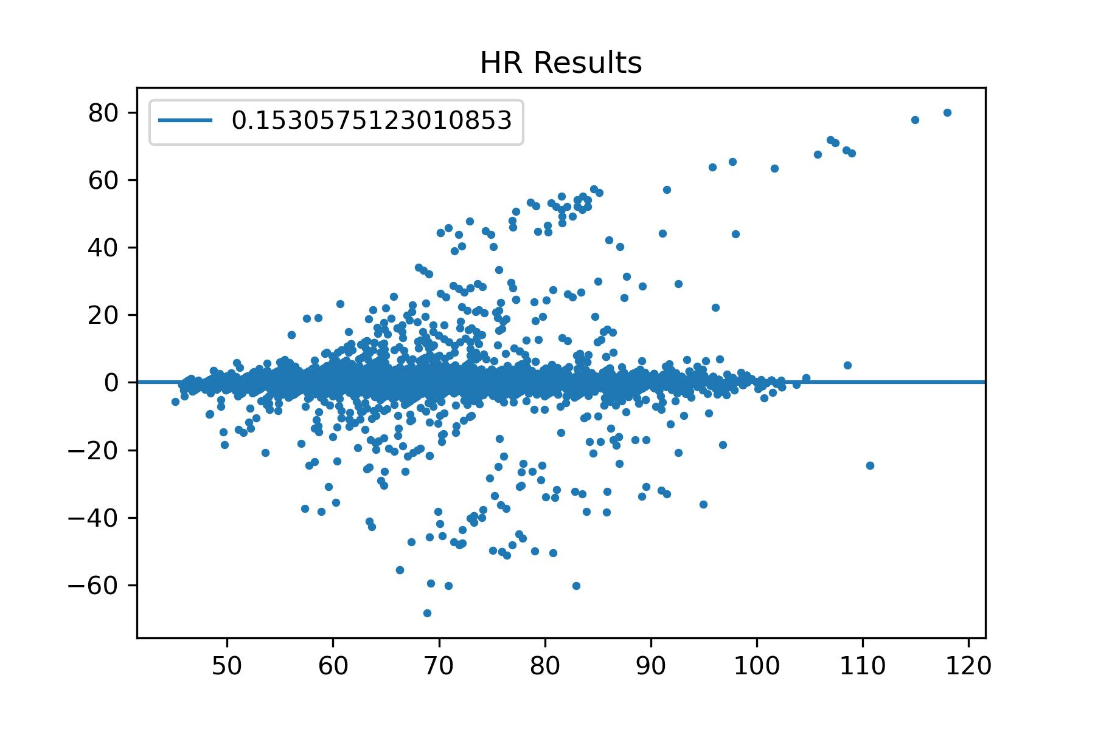
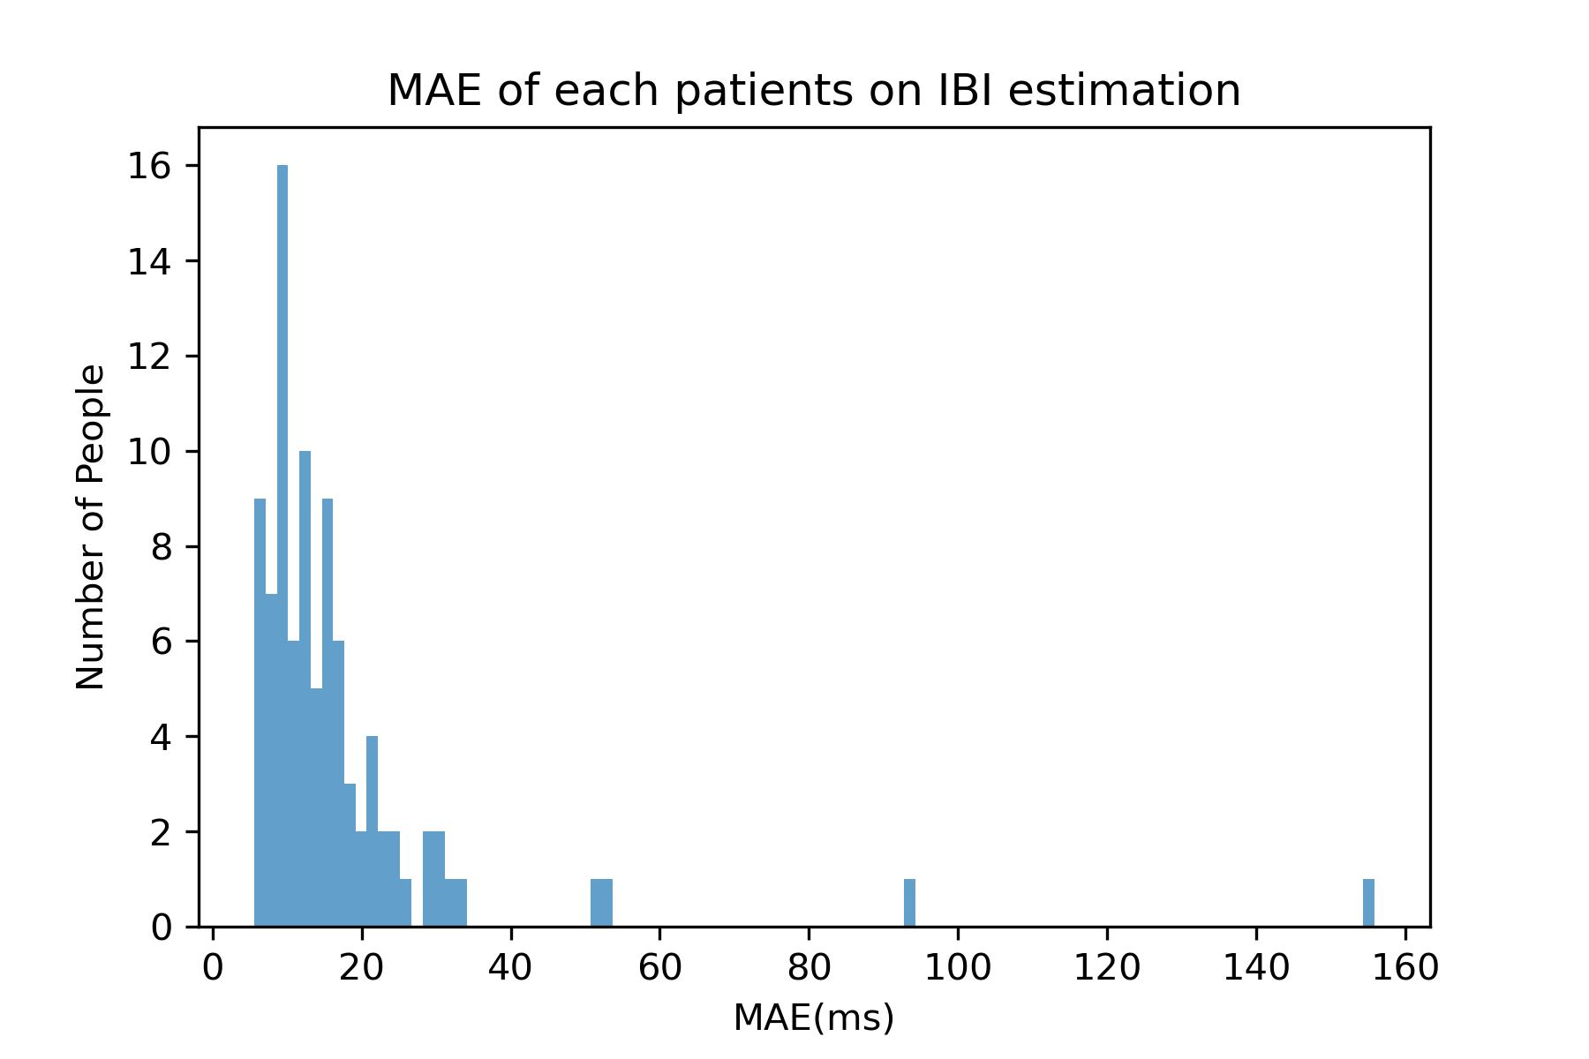
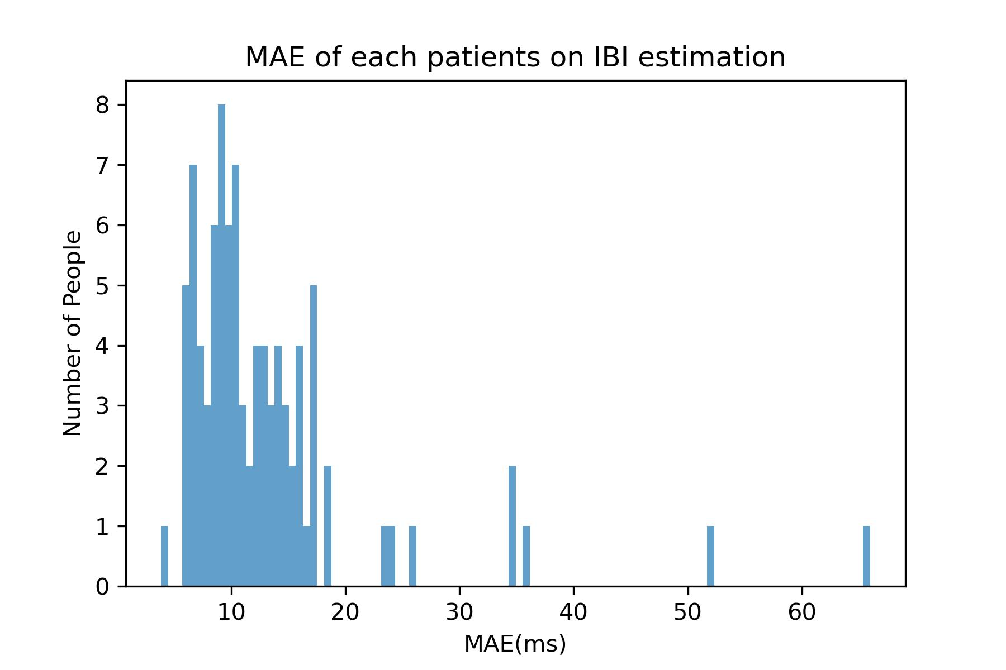
IBI Prediction

Slide 8
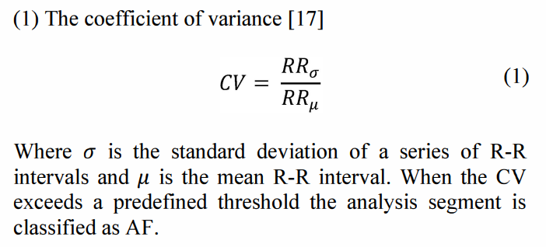
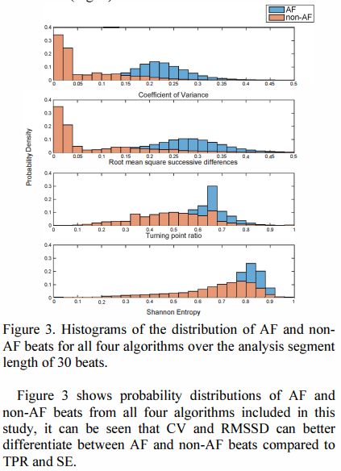

Arrhythmia
When the coefficient of variation (CV) is 0.16, the algorithm achieves the best performance on both major public datasets for arrhythmia(MIT-BIH arrhythmia database, MIT-BIH SVT database), with an accuracy of 91%.
Therefore, I will use CV=0.16 as the criterion for distinguishing arrhythmia. Testing will be conducted on 10-second BSG-IBI signals.
Conclusion: It seems that our dataset does not contain patients with arrhythmia, and there are no labels. We cannot include arrhythmia classification in paper.
Reference: Kennedy A, Finlay D D, Guldenring D, et al. The accuracy of beat-interval based algorithms for detecting atrial fibrillation[C]//2015 Computing in Cardiology Conference (CinC). IEEE, 2015: 893-896.

Slide 9
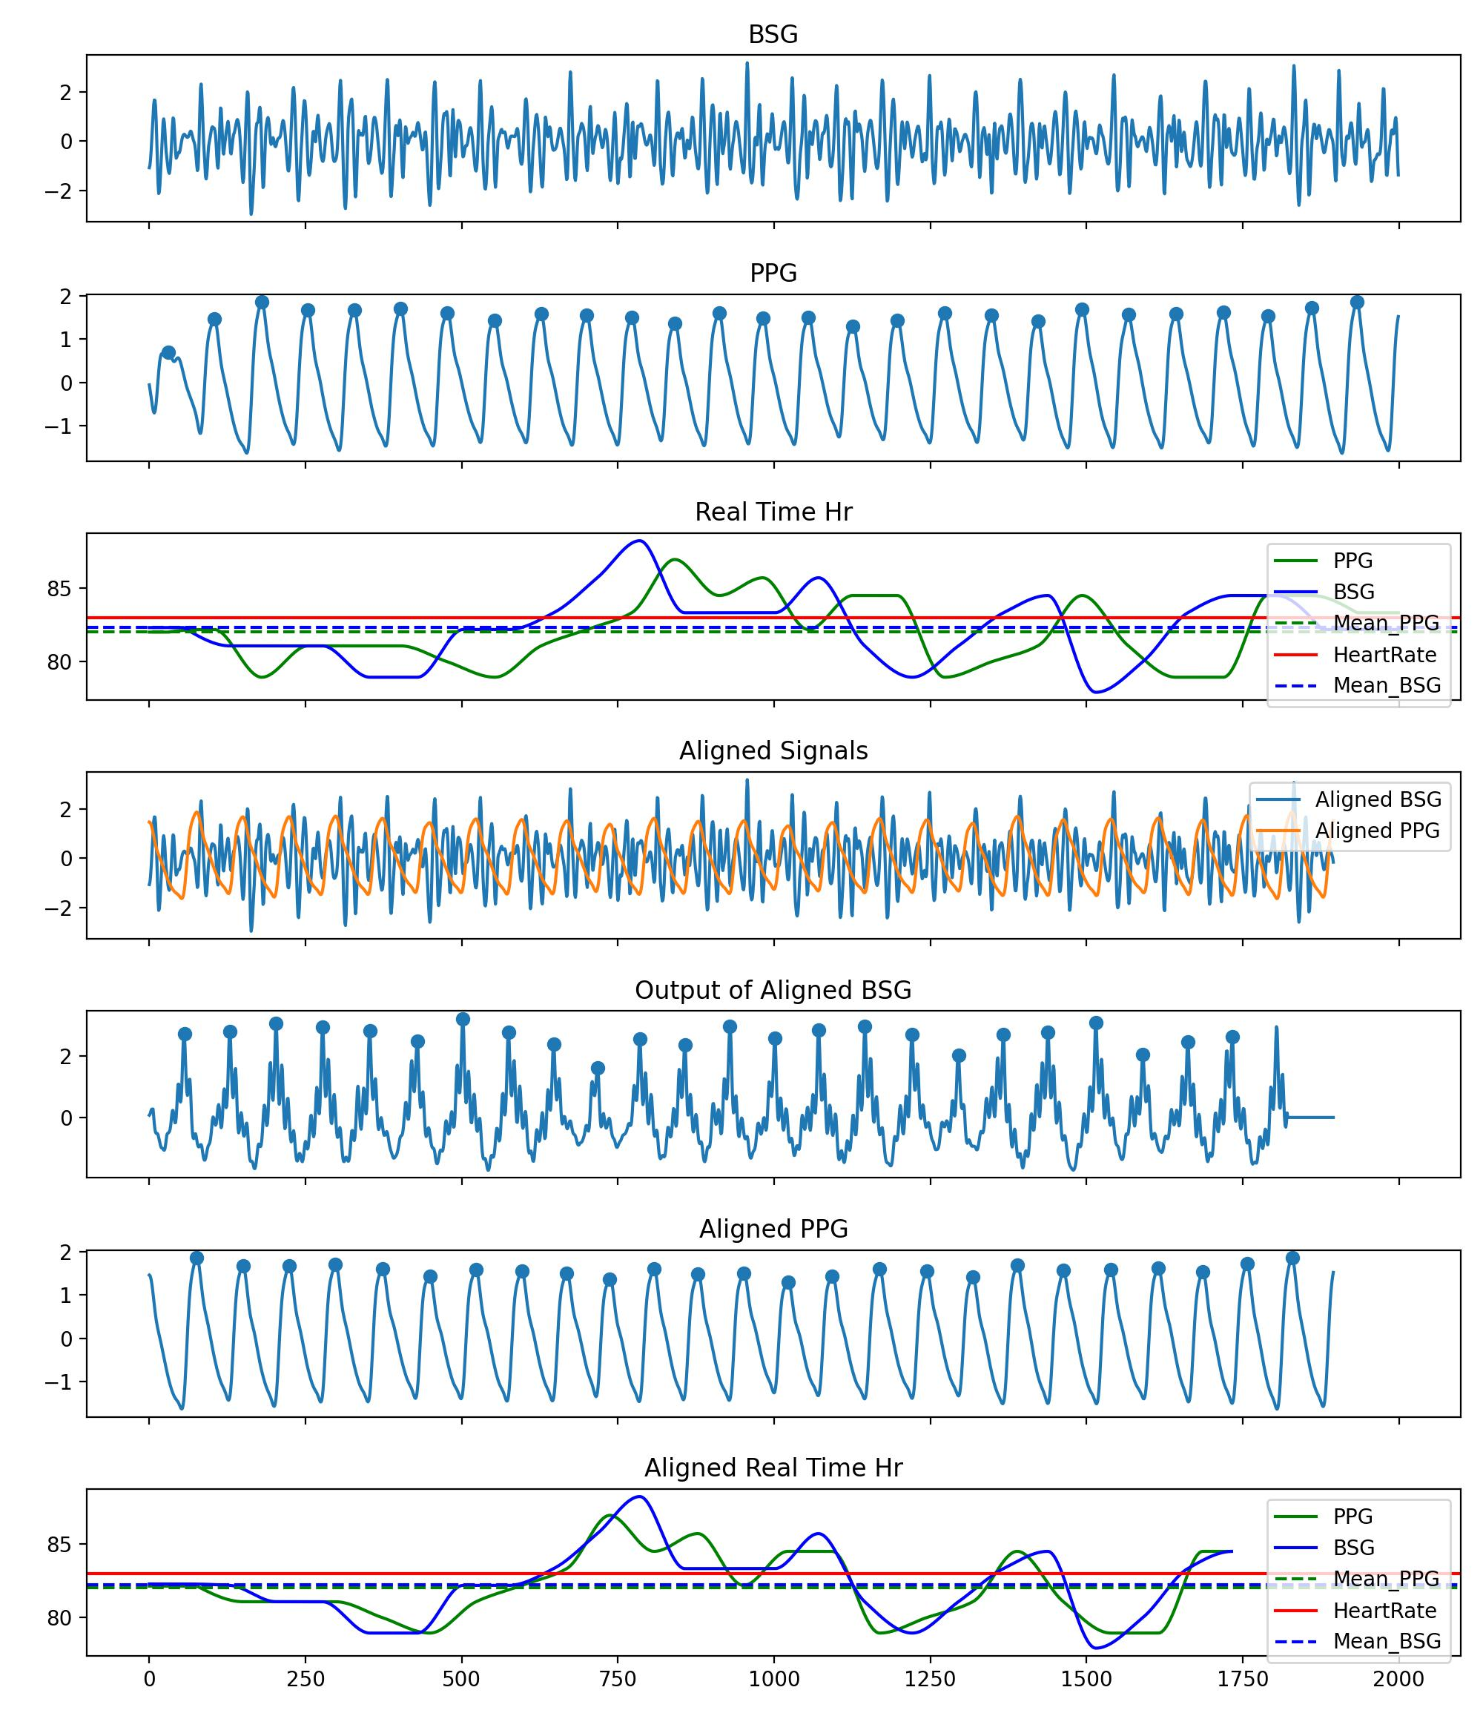
Alignment of BSG and PPG
Using Real-Time Heart Rate for signal alignment ensures that each cycle of the PPG signal corresponds to each cycle of the BSG signal. However, it cannot be used to extract features along the time axis, such as Pulse Transit Time (PTT), Pulse Arrival Time (PAT), etc.
Radar Wave -> PPG Signal
Reference: Khan U M, Rigazio L, Shahzad M. Contactless Monitoring of PPG Using Radar[J]. Proceedings of the ACM on Interactive, Mobile, Wearable and Ubiquitous Technologies, 2022, 6(3): 1-30.

Slide 10
Thoughts about Paper Writing
Question1：Specific details
Should we discuss the relationship between signal dropout rate and accuracy metrics? For example, consider establishing a metric to evaluate this trade-off.
Question2：
The core of the paper lies in computing high-precision IBI and utilizing it to calculate HR and several indicators of Heart Rate Variability (HRV) (approximately 6-8 metrics). Would this focus make the paper appear thin?
Question3：Paper Writing Direction
Possible Direction 1:
Describe a non-contact, non-invasive detection system(BedDot) capable of accurately measuring IBI, while proposing a stable and highly transferable IBI detection algorithm.
Pros: 1. Suitable for journals or conferences focused on IoT.
2. The BedDot device itself is innovative, enhancing the quality of the paper.
Cons: The algorithm involves numerous details; In Ubicomp, the algorithmic details are not as extensive.
Possible Direction 2:
Propose a template-based solution for models like "noisy, non-stationary, multi-peak signals" and use BedDot's BSG signal as an example.
Pros: The paper focuses on a specific point; The innovation in the algorithm should outweigh that of the BedDot device, requiring high-quality writing.
Cons: The algorithm may not be particularly innovative given the current circumstances.

Slide 11
Thoughts about Paper Writing
Questions 4
Submit to a top conference(Ubicomp) to get reviewers’ feedback and accumulate experience in submitting and writing for top-tier conferences.
Next steps
Conduct tests on various signals: BSG, BCG, SCG, and simulated SCG signals.
Establish 6 baseline algos for rigorous comparison. It may be necessary to replicate around 15 papers.
Finalize the experimental dataset, ensuring it is comprehensive enough. This might require recalibration.
Spend time studying papers from top conferences and learn the style and structure of these papers.

Slide 12
Thanks!

