Slide 1
Presentation
Jiayu Chen
2024.04.22

Slide 2
Outline
Part_1: Question about Paper Submission
Part_2: BedDot Testing

Slide 3
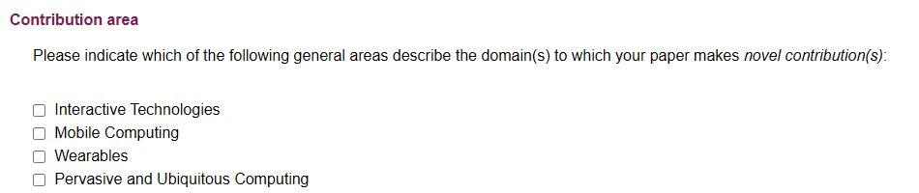
Question about Paper Submission
1. Acknowledgments: Should I mention others or is just mentioning CTRU sufficient?
2. Author Information:
Professor Xie wants a joint corresponding author, but it seems the submission system does not allow marking this. Should we follow the details in the accepted paper after acceptance?
3. Affiliation:
Should the affiliation for Yida and me be listed as Hohai University or UGA?
It seems that there is no place on the system to submit complete affiliation details.
4. Contributing Area: Which one is it?
5. Paper Length: After revisions based on feedback, the paper is about 29.5 pages long. Is it too long and needs some trimming?

Slide 4
BedDot Testing
Two Beddots don’t have MAC addresses.
The remaining one with an address cannot detect the Wi-Fi of mine and Yida's phones. We'll try again after submitting the paper.
There is only one charger, and this version of Beddot seems to have no battery.

Slide 5
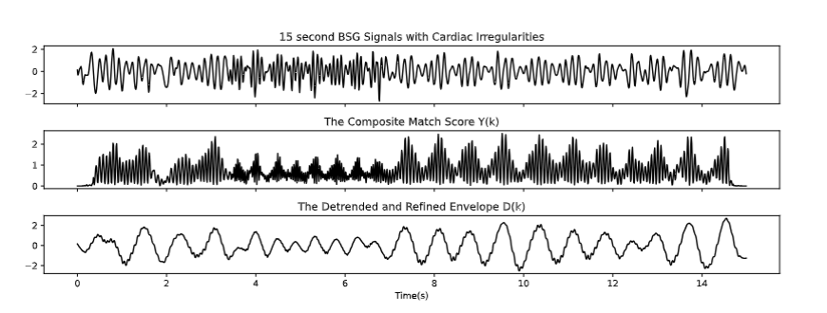
Heartbeat Simulator
The vendor said the motor drivers are out of stock and will be restocked after May Day.

