Slide 1
Presentation
Jiayu Chen

Slide 2
Outline
Part_1: Analysis of Zaid’s Design
Part_2: My Design
Part_3: Current Results
Part_4: Next Step

Slide 3

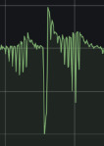
Analysis of Zaid’s Design
Initial Analysis
Amplitude is proportional to the duty circle(average voltage) of motor
Received Signal = real * kernel (* is convolution)
According to Zaid’s experiment, the kernel of our system should be easy

Slide 4
Analysis of Zaid’s Design
Further Analysis: Frequency
Outputs of Zaid’s Simulator are high frequency.
The number of small peaks is equal to the time resolution.
But peaks number of BSG signals is around 4-9, which means the motor should move in low frequency. (4-9 times each heartbeat circles, rather than 30 times as shown in figures.)

Slide 5
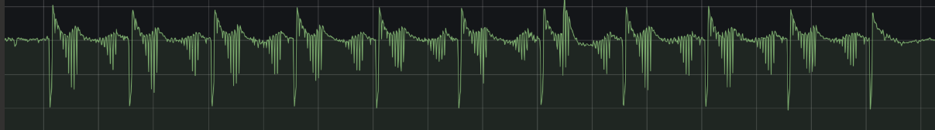
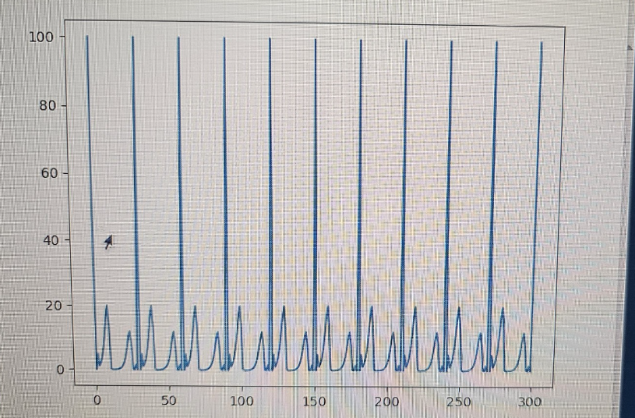
Analysis of Zaid’s Design
Further Analysis: Amplitude
只能控制一半，电压不可能是负值，只能是0-100。因而反映在Beddot接受到的信号上，只能控制黄色的线以下的那一部分，黄色线以上的几乎无法控制。
黄色线以上的部分，出现在电压由大变小并且快接近0的地方。原本由支撑motor的磁力突然消失，导致motor的帽子自由落体。是gravity带来的。
黄色线以上的那一部分是如何产生的呢？

Slide 6
Analysis of Zaid’s Design
不能满足Low Frequency
Amplitude只有一个方向

Slide 7
My Design
Low Frequency
Amplitude只有一个方向

