Slide 1
Presentation
Jiayu Chen
2023.12.12

Slide 2
Work Description
Part_1: 直接先看一下tutorial
Part_2: Why doesn’t FMM work?
Part_3: An easy experiment about sampling rate.
Part_4:对真实信号近些切分，重对齐和模板提取
Part_5: 接下来的一些研究方向
Part_6: Questions

Slide 3
Part_1

Slide 4
Part_2

Slide 5
Why doesn’t FMM work
Advantages of FMM (from emails):
“particularly when dealing with pronounced spike waves”
“The FMM model is specifically effective at identifying high peaks against the background noise”
“to detect other less prominent peaks more components could be added.”
Disadvantages of FMM (from the demo code):
必须将单周期信号分解成足够多的分解量后，才能关注到较小的峰
经过分解后，各个分量之间比较混乱，分解过后已经没有可解释性了。

Slide 6
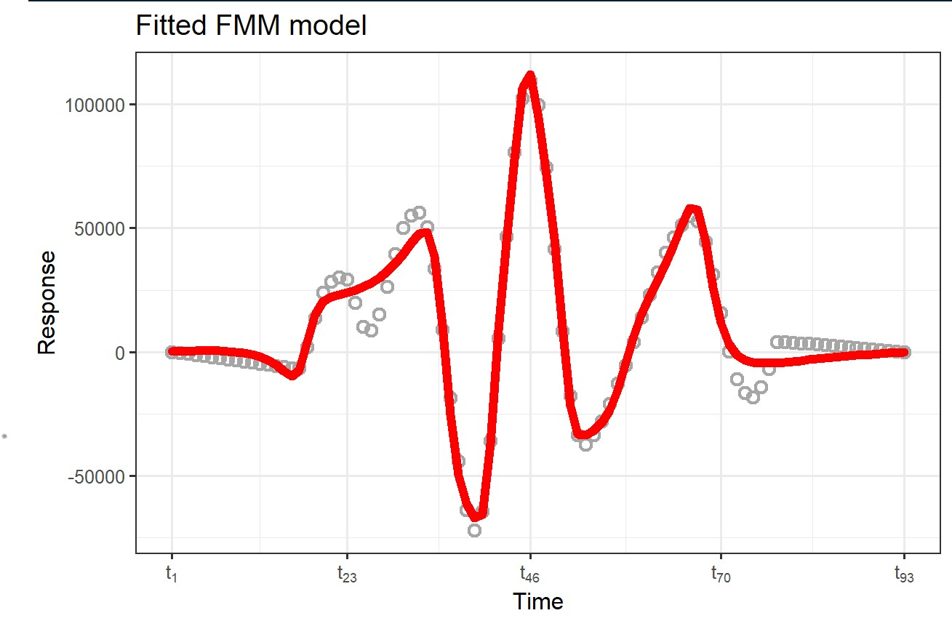
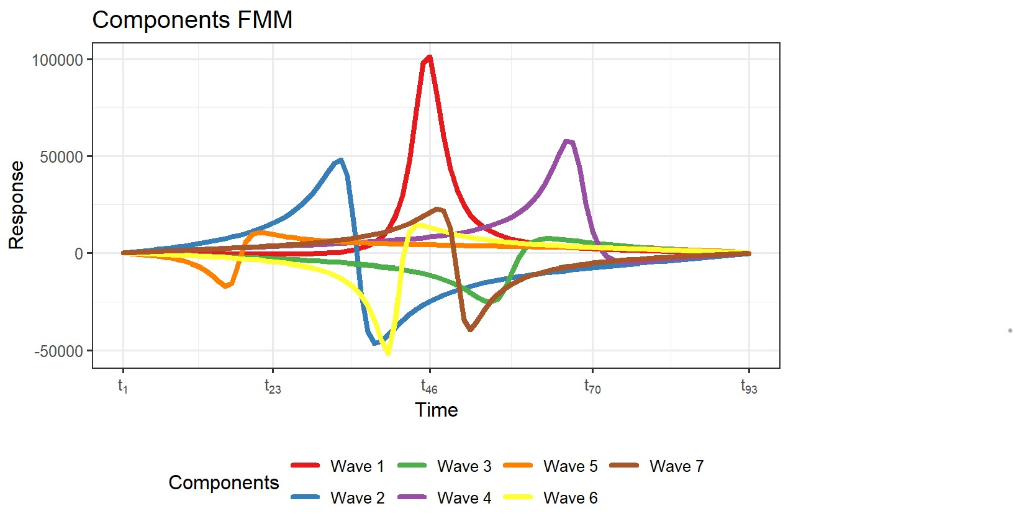
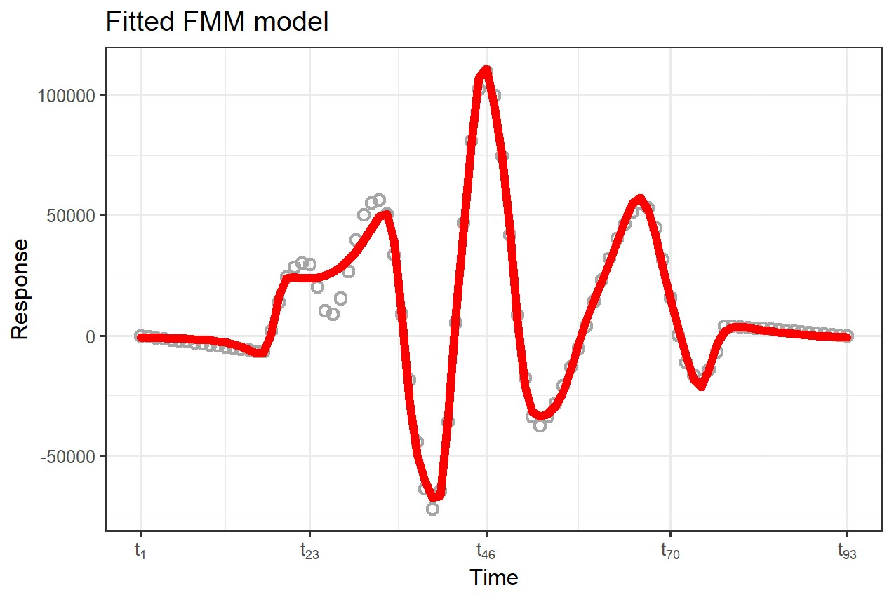
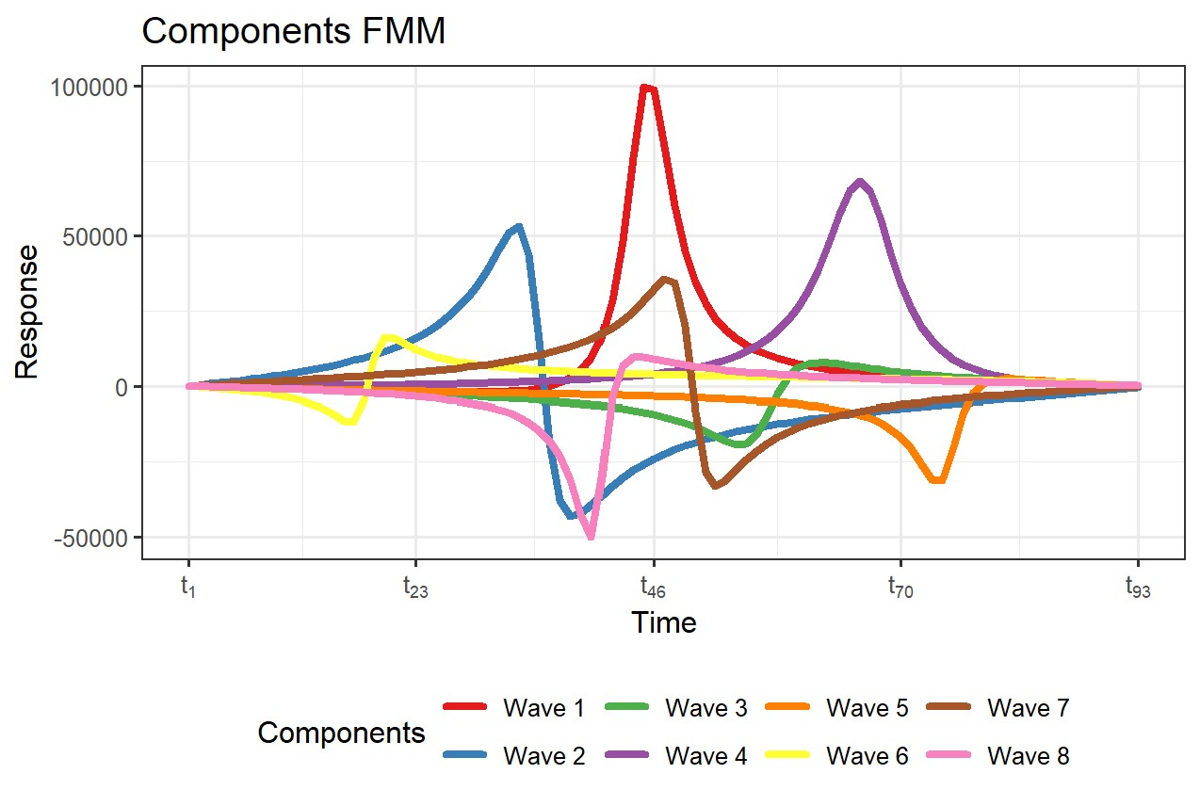
Why doesn’t FMM work

Slide 7
Part_3

Slide 8
An easy experiment about sampling rate.
The impact of different sampling rates on time series alignment.
Model | Data | Sampling Rate | Resample Method | S | D
Template: Mean | Simulation | 100 | - | 1.35 | 4.53
Template: Mean | Simulation | 100->150 | FFT | 0.95 | 3.24
Template: Mean | Simulation | 100->150 | POLY | 0.95 | 2.98
Template: Mean | Simulation | 150 | - | 0.92 | 2.36
Model | Data | Sampling Rate | Resample Method | S | D
Template: Mean | Simulation | 100 | - | 1.35 | 4.53
Template: Mean | Simulation | 100->200 | FFT | 0.70 | 2.47
Template: Mean | Simulation | 100->200 | POLY | 0.64 | 2.07
Template: Mean | Simulation | 200 | - | 0.65 | 1.75
Conclusion:
对低采样率的信号重采样，能够大幅度的提升模型效果。一定范围内，采样率越高越好。
重采样模式对结果有重大的影响，FFT和POLY

Slide 9
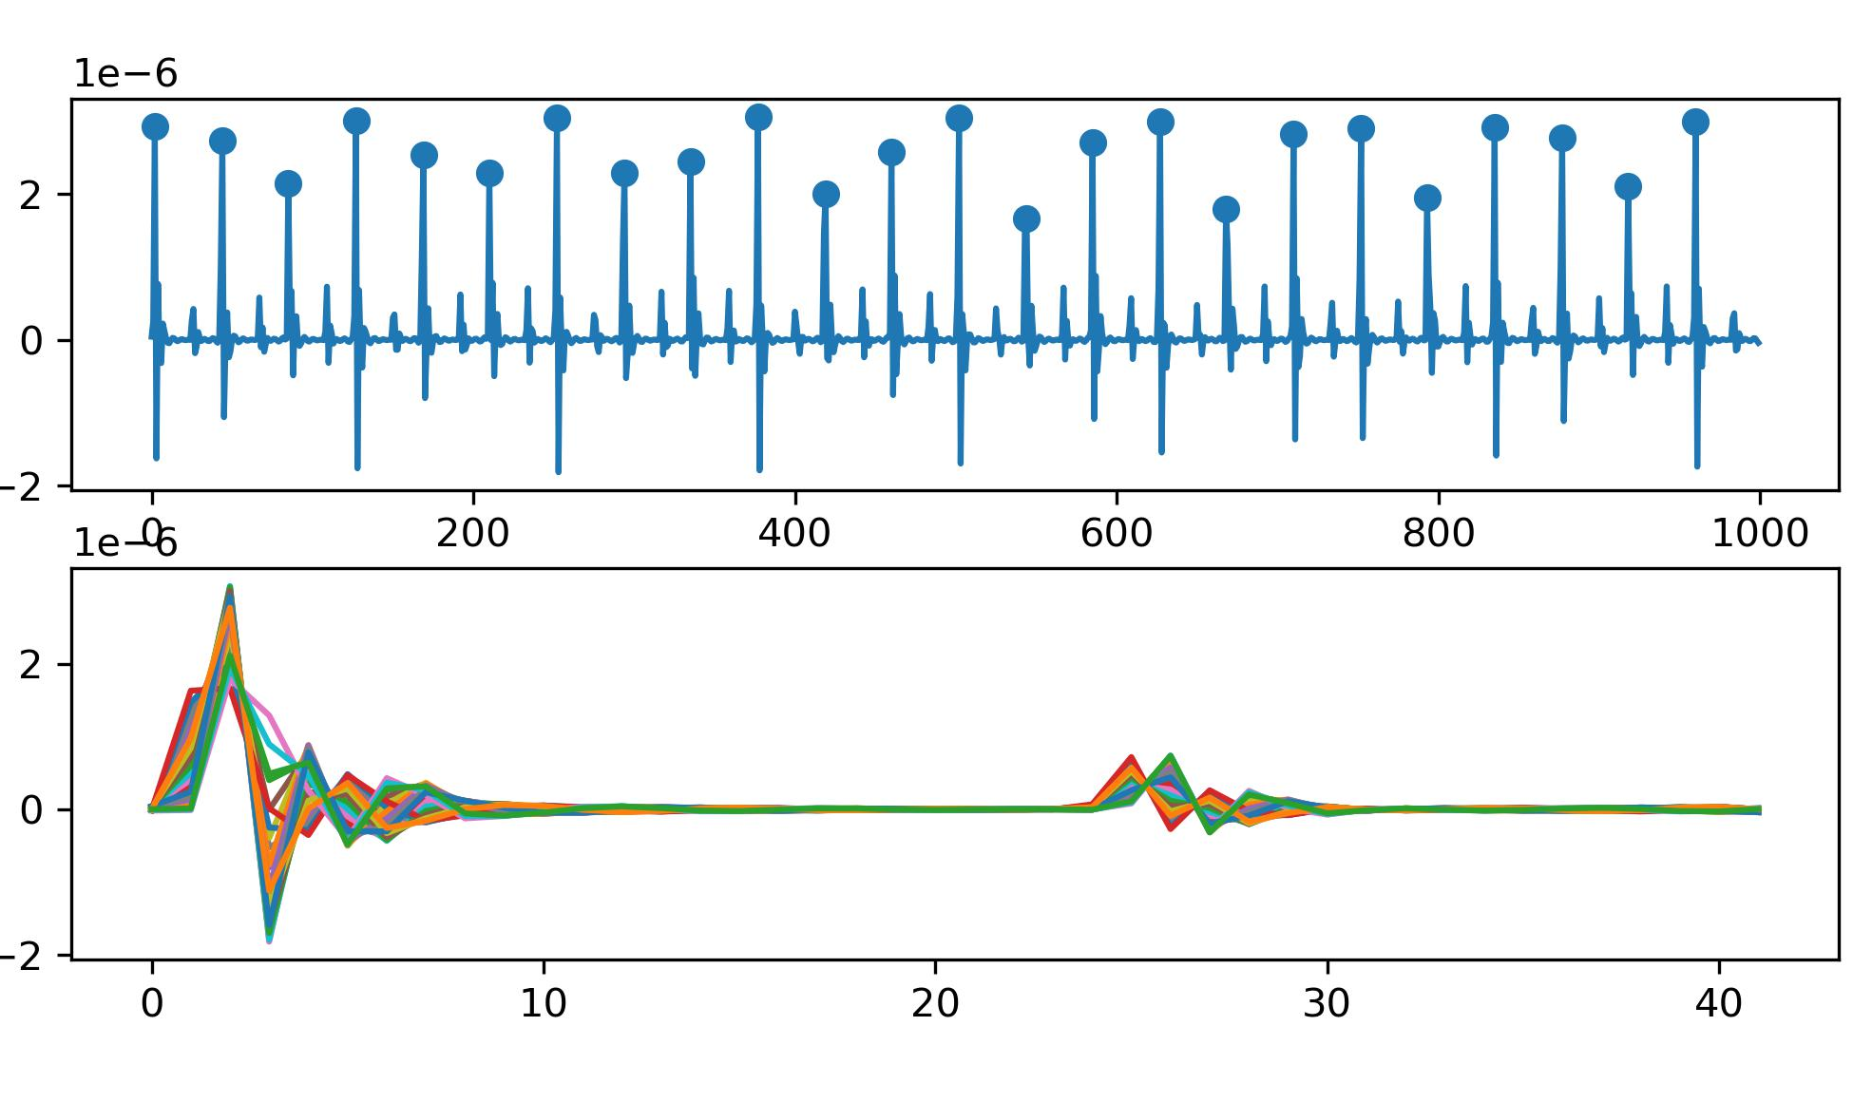
Previous Slides
No Noise
Method | S Prediction | D Prediction
No Template | 0.79 | 1.79
Median | 1.42 | 4.07
Mean | 1.35 | 4.53
2 Why does methods of getting the template result in poor performances for both S and D prediction, even in noise-free signals?
I think I find the reason.
For D Prediction:
Small peaks are not aligned properly. Both mean and median methods significantly affect height of small peaks, leading to a decrease in accuracy.
For S Prediction:
Due to the limitation of the sampling rate, even with a perfect "Get Template" algorithm, the S prediction result is still not as good as that of the "No Template" algorithm.
e.g.
No Template: d12 = 12.5 (can be a decimal)
Get Template: d12 = 12/13 (can only be int)
Example of Segmentation

Slide 10
Part_4

Slide 11
Part_5

Slide 12
Questions
To what extent should my research reach? What will the results be compared against? Will testing be done on publicly available datasets of real signals? Currently, even if we extract templates from our mixed signals, we can't find corresponding indicators for S and D.
Regarding the TS-LLM project, is it already decided to proceed, or are we still in the observation stage? What level of knowledge should be acquired for the foundation?
Do we have the latest real data? I noticed many signals in IOT2023 are 30 seconds long.

Slide 13
Thanks!

Slide 14
Analysis of Experimental Results
1. All Experiment Results
Model | S Prediction | D Prediction | Model | S Prediction | D Prediction
No Template | 0.79 / 1.64 | 1.79 / 4.31 | New
Mean | 1.35 / 1.38 | 4.53 / 4.44 | NLAAF1 | 8.43 / 23.19 | 3.14 / 5.21
Median | 1.42 / 1.45 | 4.07 / 4.49 | NLAAF2 | 20.67 / 33.39 | 3.64 / 7.04
PCA | - / - | - / - | GTW | - / - | - / -
K-shape 1 | 2.20 / 2.74 | 4.85 / 5.88 | TTW | 1.52 / - | 4.28 / -
Weighted Avg | 1.95 / 1.98 | 4.63 / 4.74 | K-SC | - / - | - / -
K-shape 2 | 2.18 / 1.79 | 4.76 / 5.24 | PSA | 2.27 / 19.05 | 5.40 / 8.89
Kalman Filter | 1.45 / 1.37 | 4.82 / 4.60 | Soft-DTW | 1.35 / 1.38 | 4.53 / 4.44
DBA | 2.05 / 1.96 | 3.43 / 4.15 | ICDTW | 2.66 / - | 5.08 / -
DWRT | 2.78 / | 4.50 /

Slide 15
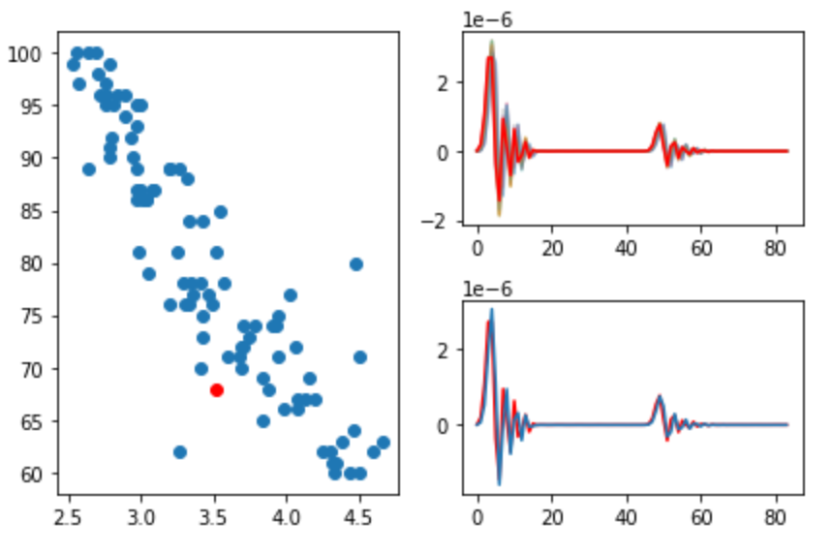
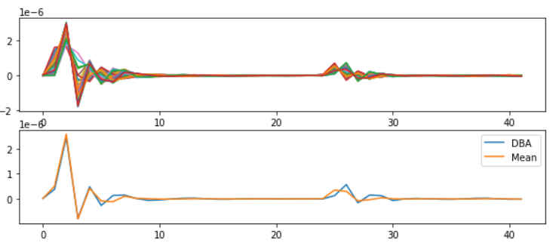
Analysis of Experimental Results
2. Source of Error of DBA
Why, despite the template looking very similar, is the error in D unsatisfactory (3.43)?
DBA Template
Model | S Prediction | D Prediction
No Template | 0.79 / 1.64 | 1.79 / 4.31
Mean | 1.35 / 1.38 | 4.53 / 4.44
DBA | 2.05 / 1.96 | 3.43 / 4.15
D
Mean
DBA
Feature
Feature = Amp(Large Peak) / Amp(Small Peak)
Source of Errors:
Amplitudes of large peak are underestimated.
Large peaks have more time points than small peaks, leading to inevitable errors in matching due to DTW misalignment.
Error from small peaks’ misalignment has been solved successfully.
Notes:
散点图，表示D这个特征和他对应特征之间的相关性。 特征就是 大峰的幅度 / 小峰的幅度。
如果这些散点都落在了两条黄色的虚线之间，那说明特征提取的非常好
但是呢，我们可以看到，就是说，蓝色的散点，普遍落在了左侧的区域中。
特征的分母是小峰的高度，这个我们已经测得非常非常准了，但是测出来的特征偏小，说明我门大峰的高度，有问题。
这个红色的点，它理想中应该出现在绿色的这个地方。我们结合右边的图来看，DBA获取得到的template它是偏小的。
误差的来源，在于Large peaks have more time points than small peaks, leading to inevitable errors in matching due to DTW misalignment.

Slide 16
Analysis of Experimental Results
4. Trainable Method
Model | S Prediction | D Prediction
DBA | 2.05 / 1.96 | 3.43 / 4.15
GTW | - / - | - / -
TTW | 1.52 / - | 4.28 / -
Soft-DTW | 1.35 / 1.38 | 4.53 / 4.44
These models all have available libraries. Currently, the trainable methods don't seem effective.
However, these papers involve a lot of mathematical theory, and I'll need some time to understand it.
As of now (up to papers from 2018), there‘s a trend in Time Series Average method shifting from intuitive to counterintuitive(Gradient related), which we need to pay attention to.

Slide 17
Part_2

Slide 18
Part_3

Slide 19
Work_3: Learning Progress and Future Learning Plan
Theoretical Studies:
1. 现代数字信号处理I/II 张颢
Too difficult, omitted too many relevant foundations of traditional filter design.
2. EE123 Digital Signal Processing, UCB
More inclined towards traditional methods, more suitable for laying a solid foundation.
Next Research Directions:
Read more papers in the relevant field between 2018-2023.
Read and contemplate papers you sent me that are related to blood pressure.
3. When evaluating algorithm performance, make extensive use of real datasets, or explore the effects on different types of signals.
4. Prioritize knowledge in DSP and if there's additional capacity, delve into Li Mu's hands-on deep learning series.

