Slide 1
Presentation
Jiayu Chen
2024.01.29

Slide 2
Work Description
Part_1: Template-based IBI Prediction
Part_2: Attempts to S and D Prediction
* Original Signal
* Differentiated Signal
* Filtered Signal
Part_3: Questions

Slide 3
Part_1

Slide 4
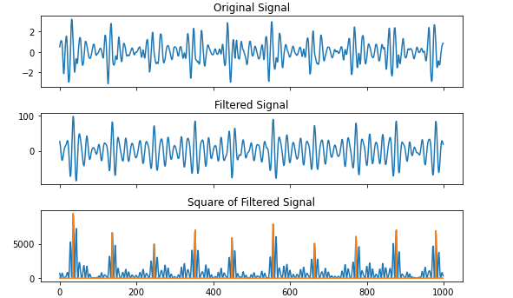
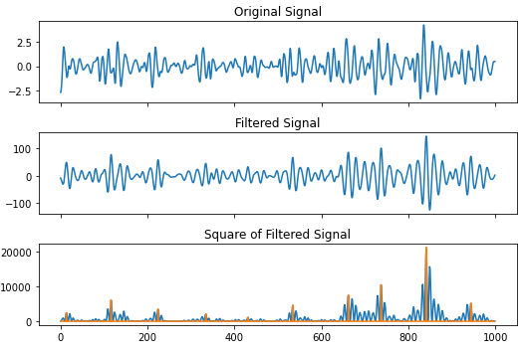
Template-based IBI Prediction
After Attempts on More Real data:
I’m sure the IBI could be accurately calculated, by applying Matched Filter to the 10 second signal and its template.
If we can first roughly calculate the Heart Rate

Slide 5
Template-based IBI Prediction
Original Signal
Rough Heart Rate
Find Peaks
(Local Max）
IBI Prediction
Matched Filter
Filtered Signal
Get Template
A easy and useful way for rough heart rate will be introduced in next pages

Slide 6
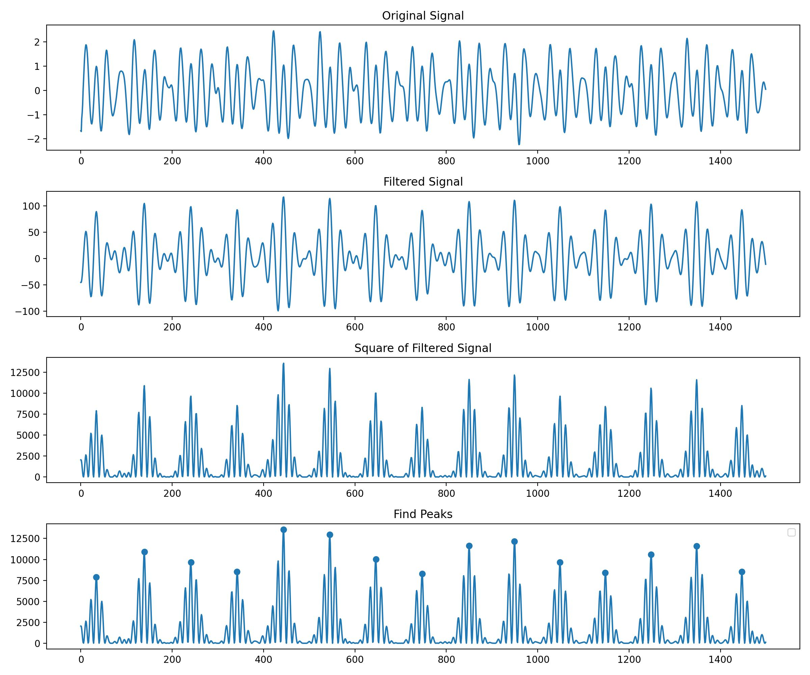
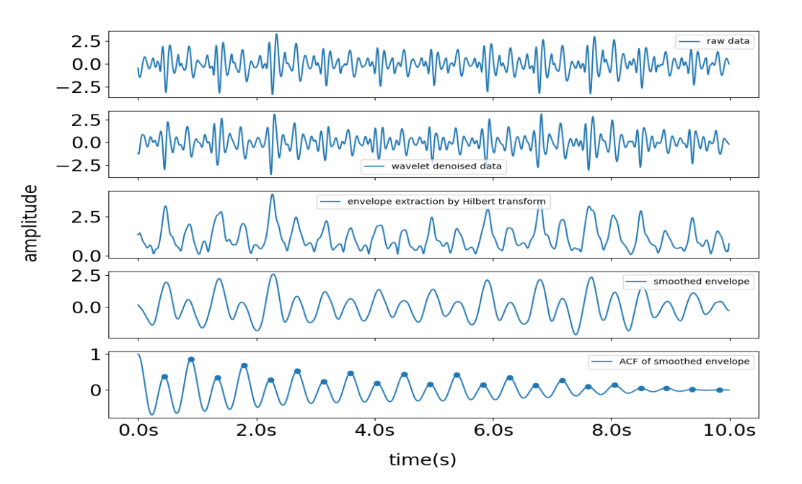
Template-based IBI Prediction
Material From Yingjian’s Paper
原因：
目前来看，信号特别明显（有特别显著的大峰，和模式），IBI的计算效果越好，反而是对于模糊不清的信号，会出现不小的问题。
However, errors can arise when the incoming signal displays two distinct peaks within a single heartbeat cycle, as illustrated on the right side of fig.9. The first of these peaks is termed the systolic peak, while the second is the diastolic peak.

Slide 7
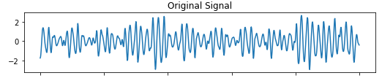
Template-based IBI Prediction
Question: At which frequencies of signals can we observe the heartbeat cycle?
一定在低频吗？
根据我们的观察：黏连的心跳是一个很大的问题。
但是心跳周期的连接部分，原则上来说应该是接近于0，
心跳时的信号，原则上信号在非常多的频率，频域的范围会更大。
实际上：观察到大部分造成的黏连情况是低频。去掉低频信号，只看心跳的高频部分。

Slide 8
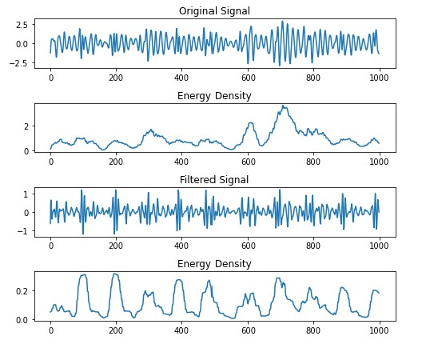
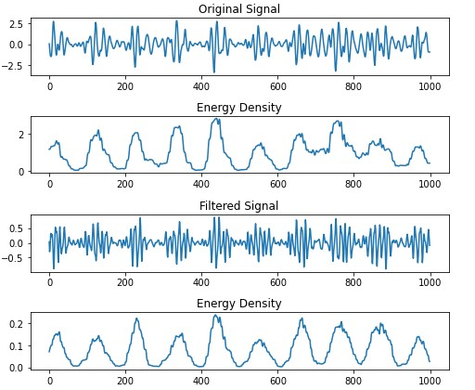
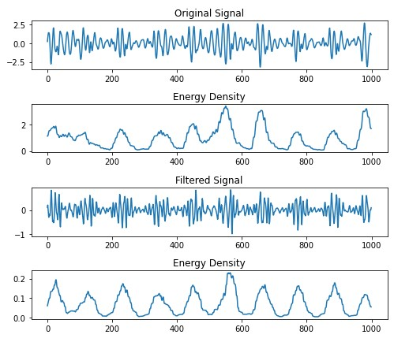
Template-based IBI Prediction
Advantage:
原本的心跳黏连，能被有效区分
去掉信号的低频后（低频能量高），反而在能量域上，更加的均匀

Slide 9
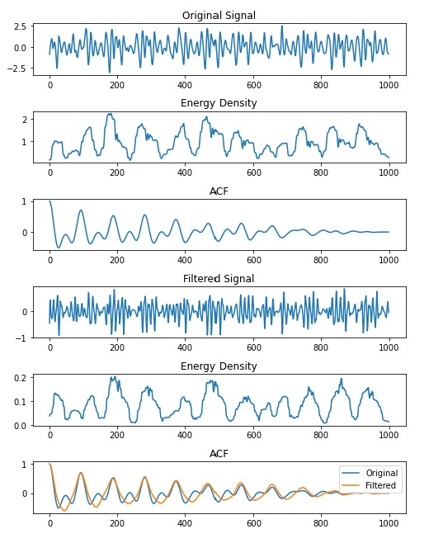
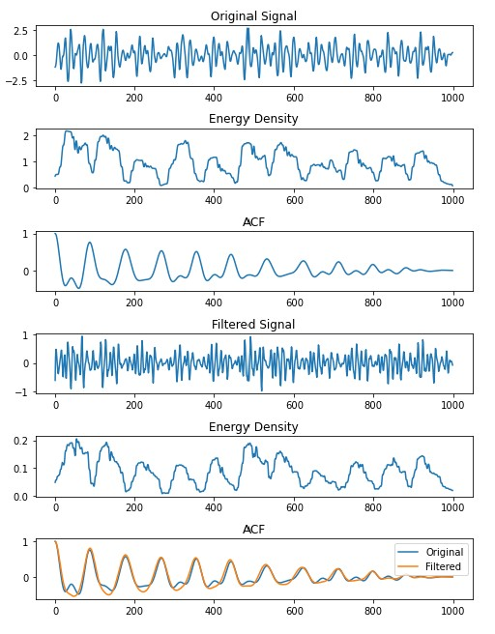
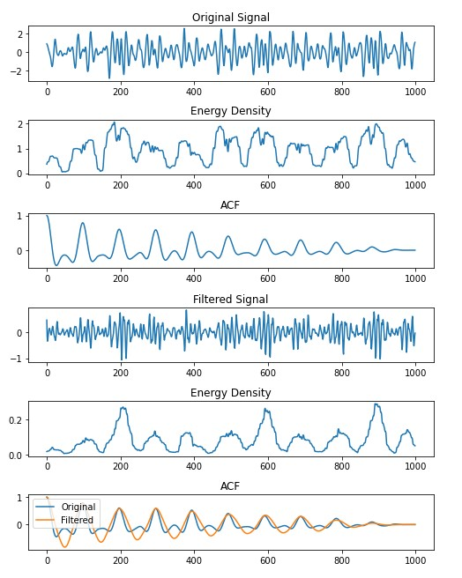
Template-based IBI Prediction
把低频信号抽掉了，对包络线进行自回归，就不会出现双峰了。
In one word, 高频信号用于HR Estimation有奇效。

Slide 10
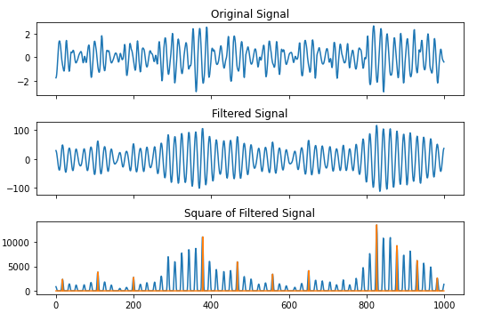
Template-based IBI Prediction
Template-Based IBI Estimation并不是完全完美，
唯一害怕的就是这种信号连接处信号和心跳信号很接近的。
我觉得，你上次给我的思路，大概就是Fuzzy Matched Filter如果真的能够实现，可能能够解决这个问题

Slide 11
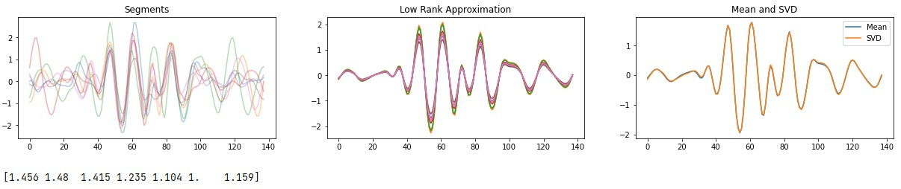
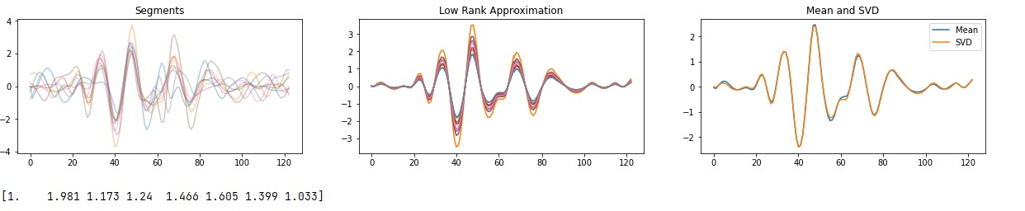
Template-based IBI Prediction
Low Rank Approximation
The mean template of circles is roughly equally to the low rank approximation of circles.
What’s more, we can get a set of templates with different amplitudes corresponding one-to-one with the original circles’ amplitudes.
This might be helpful to design a fuzzy matched filter.

Slide 12
Part_2

Slide 13
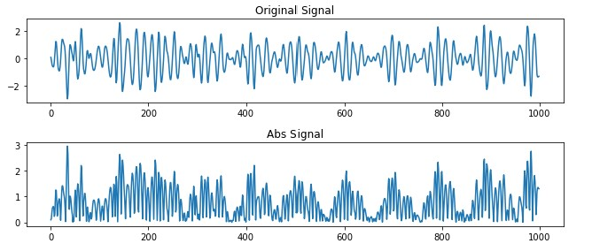
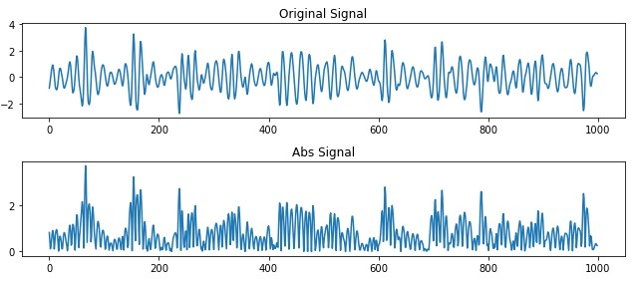
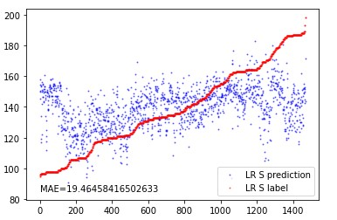
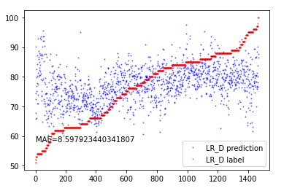
Attempts to S and D Prediction * Original Signal
Point_1
We can hardly get some useful information from signals after taking absolute values
Point_2
We can hardly get hints from features extracted by Tsfresh.
location_of_minimum, first & last
time_reversal_asymmetry_statistic
autocorrelation__lag_*
cwt_coefficients
agg_linear_trend_chunk_len_5__f_agg_“max\min\mean”
fourier_entropy

Slide 14
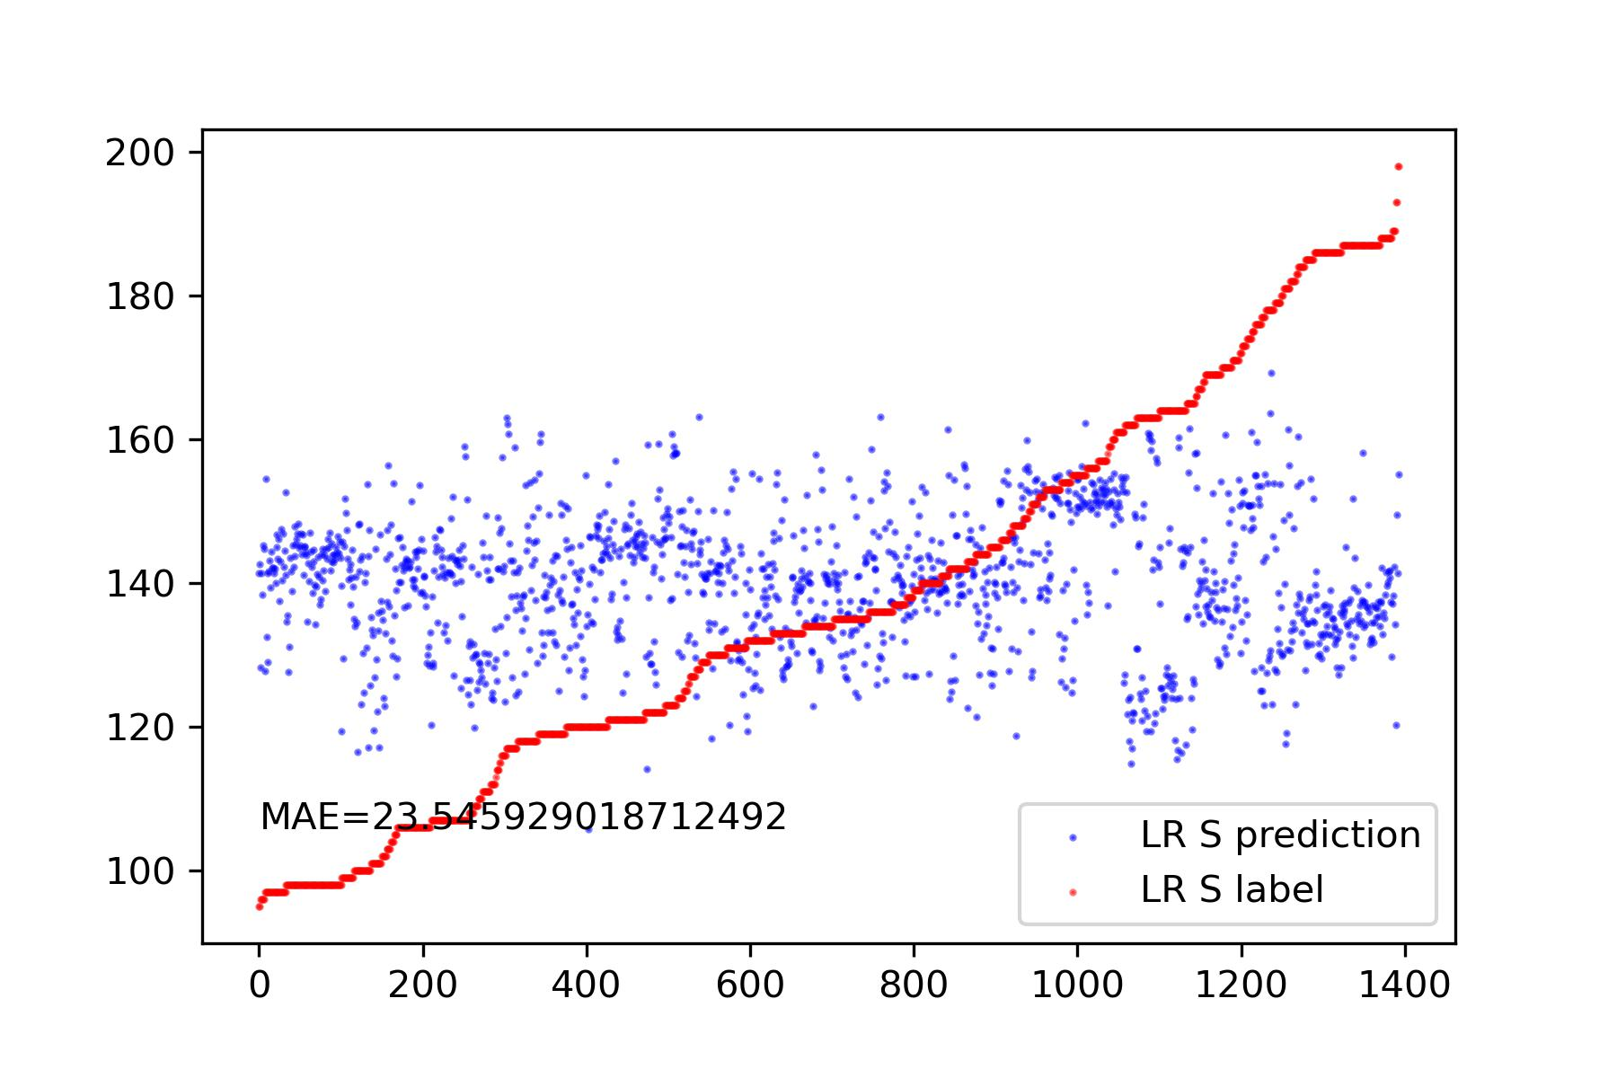
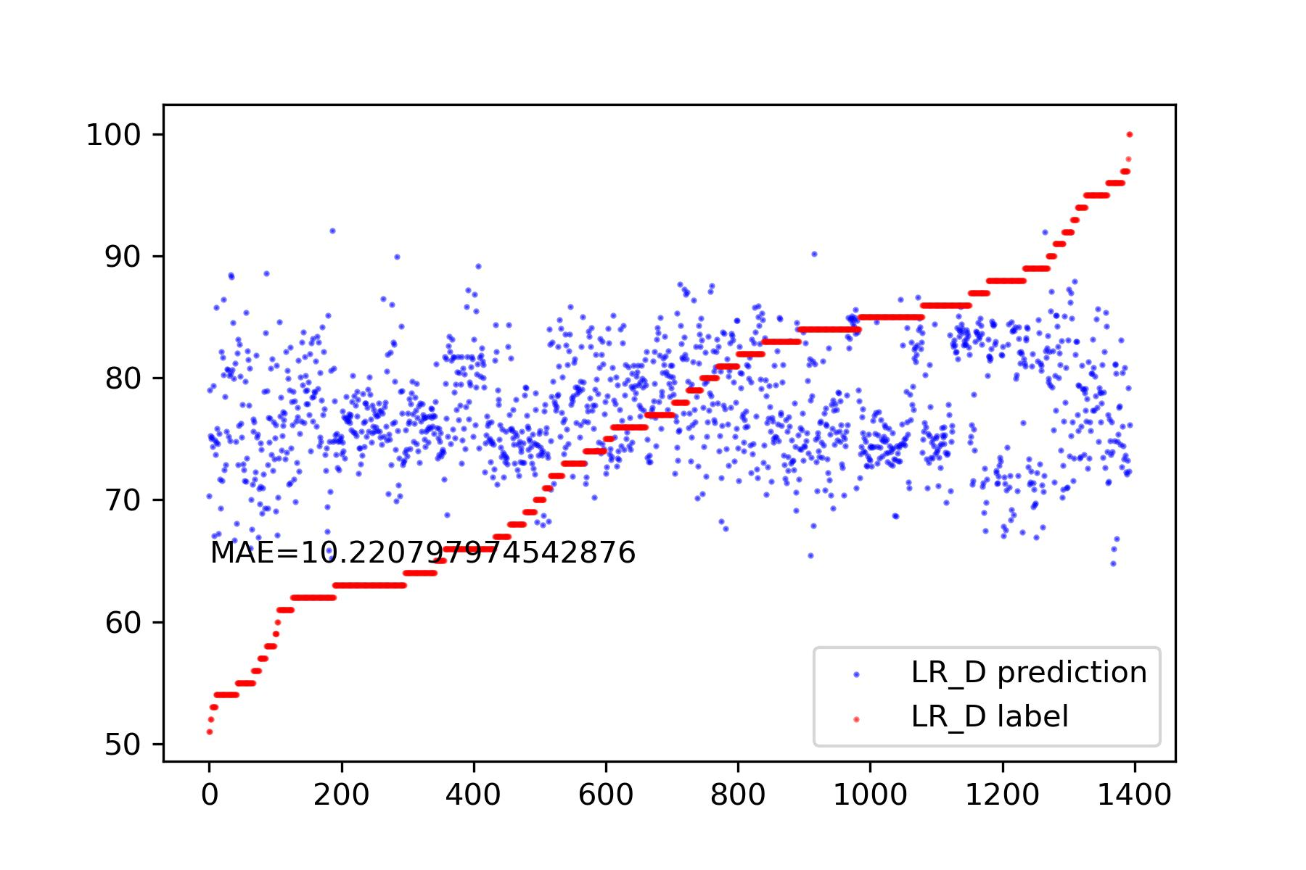
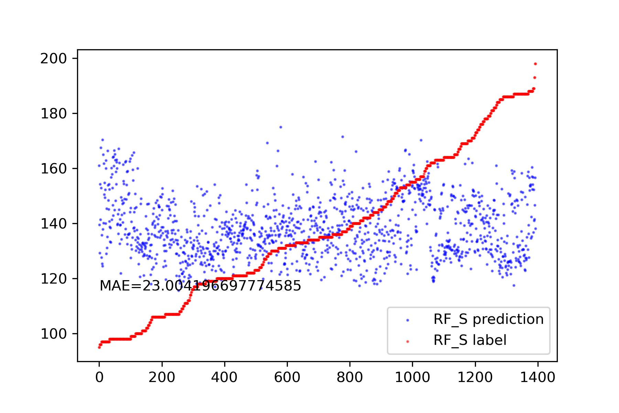
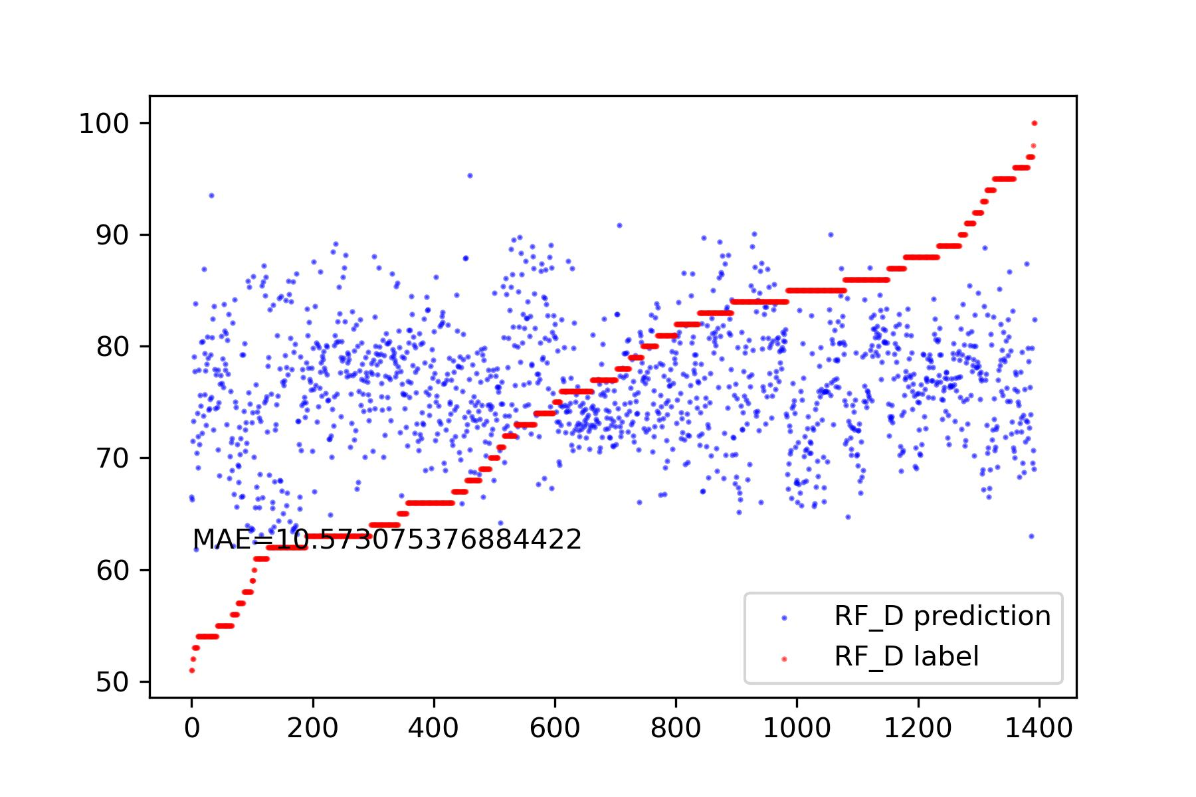
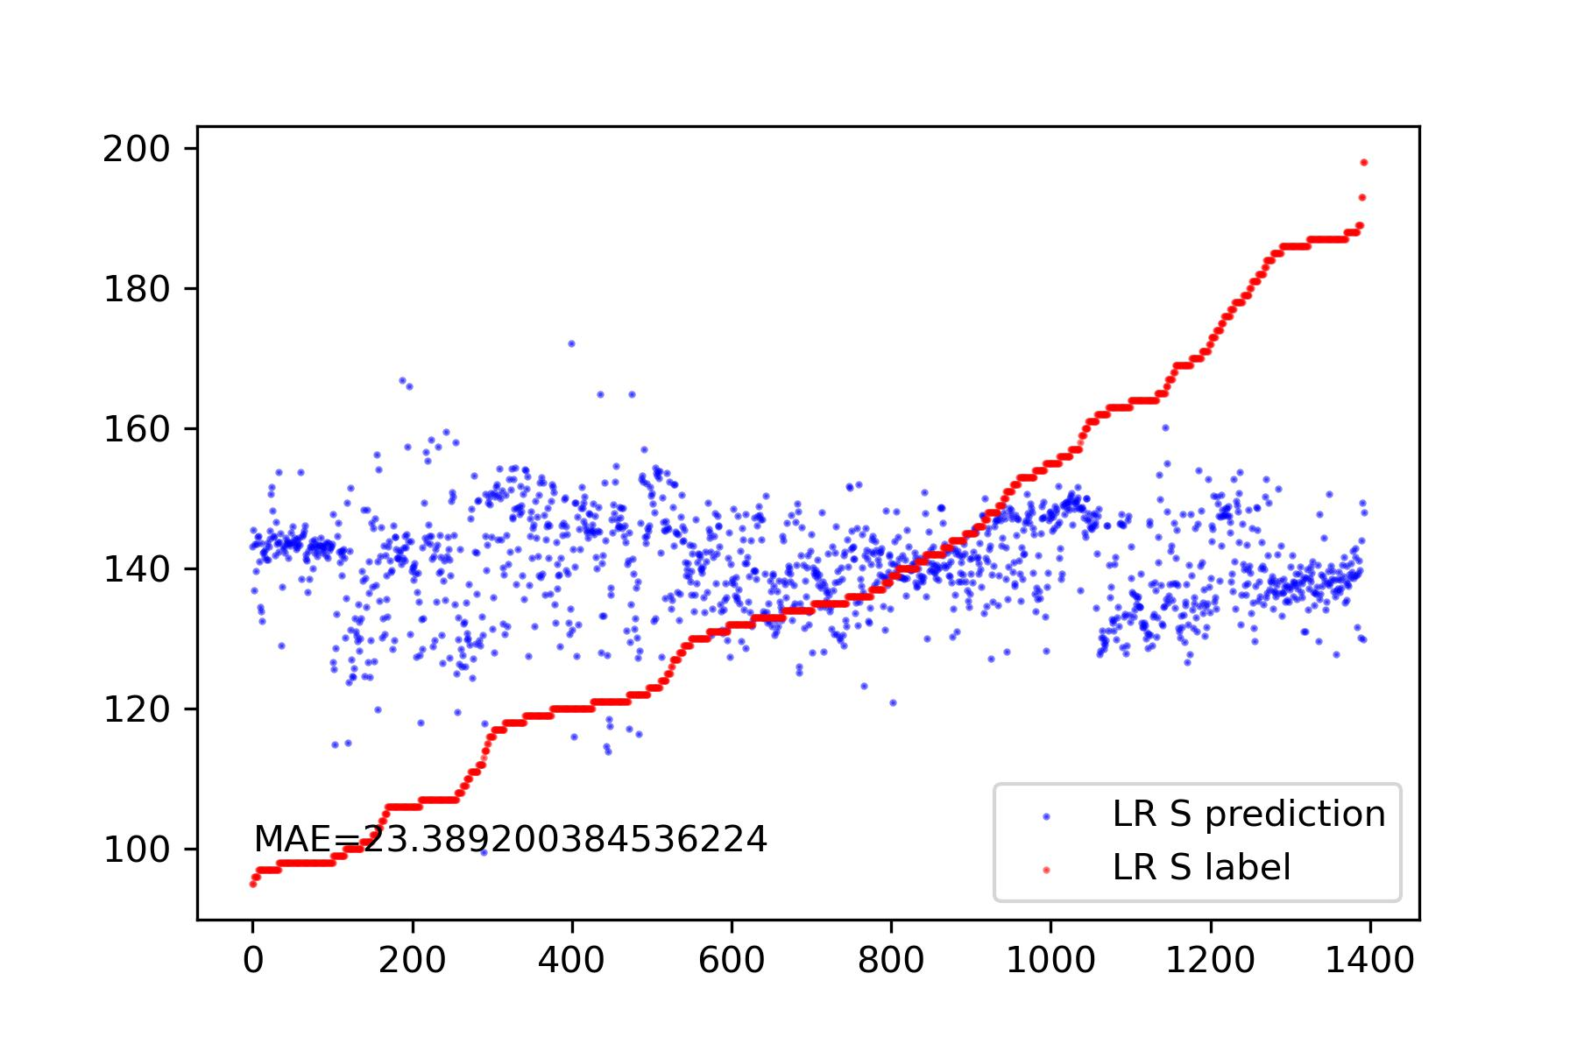
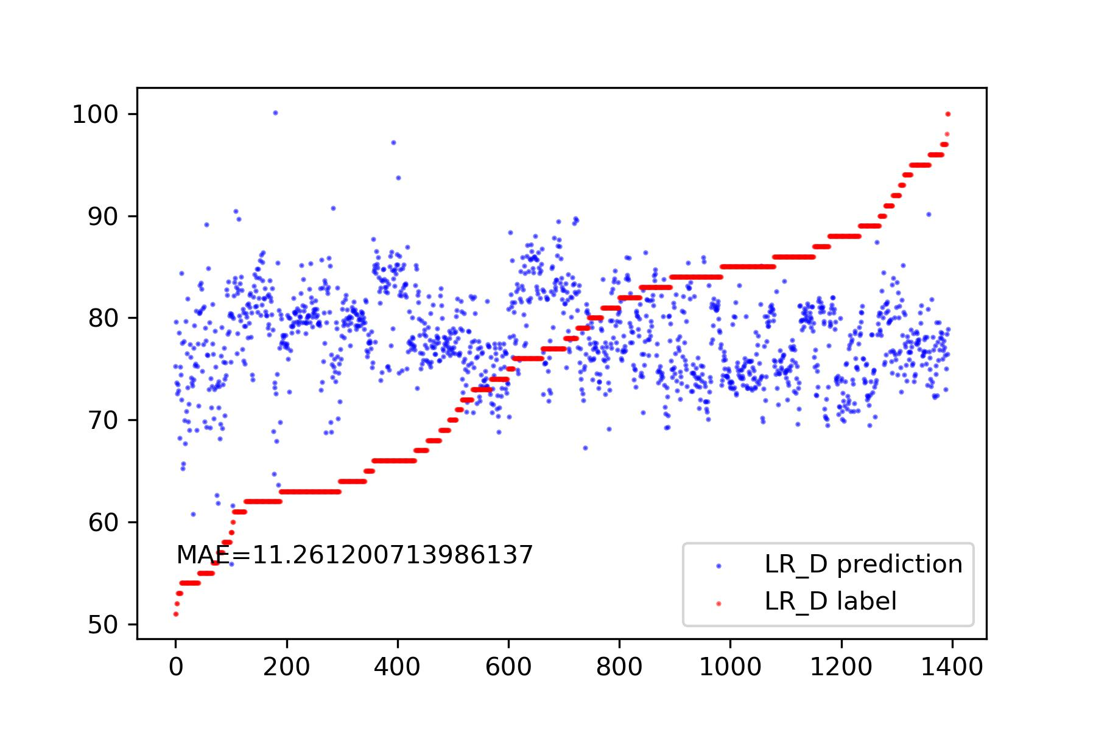
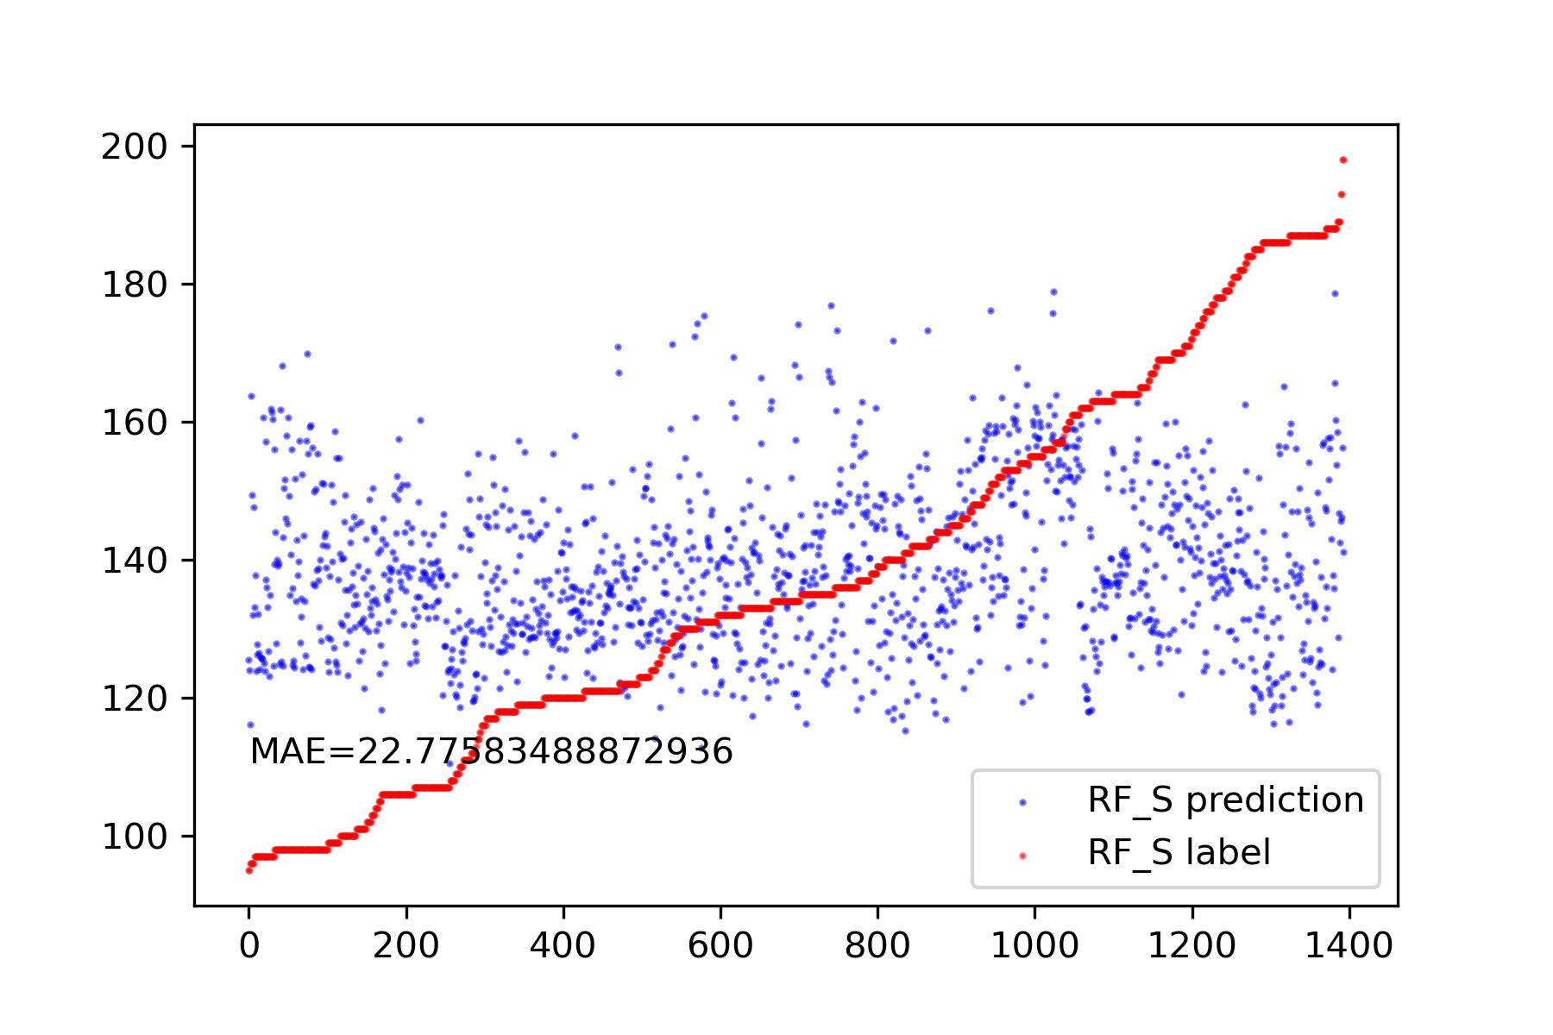
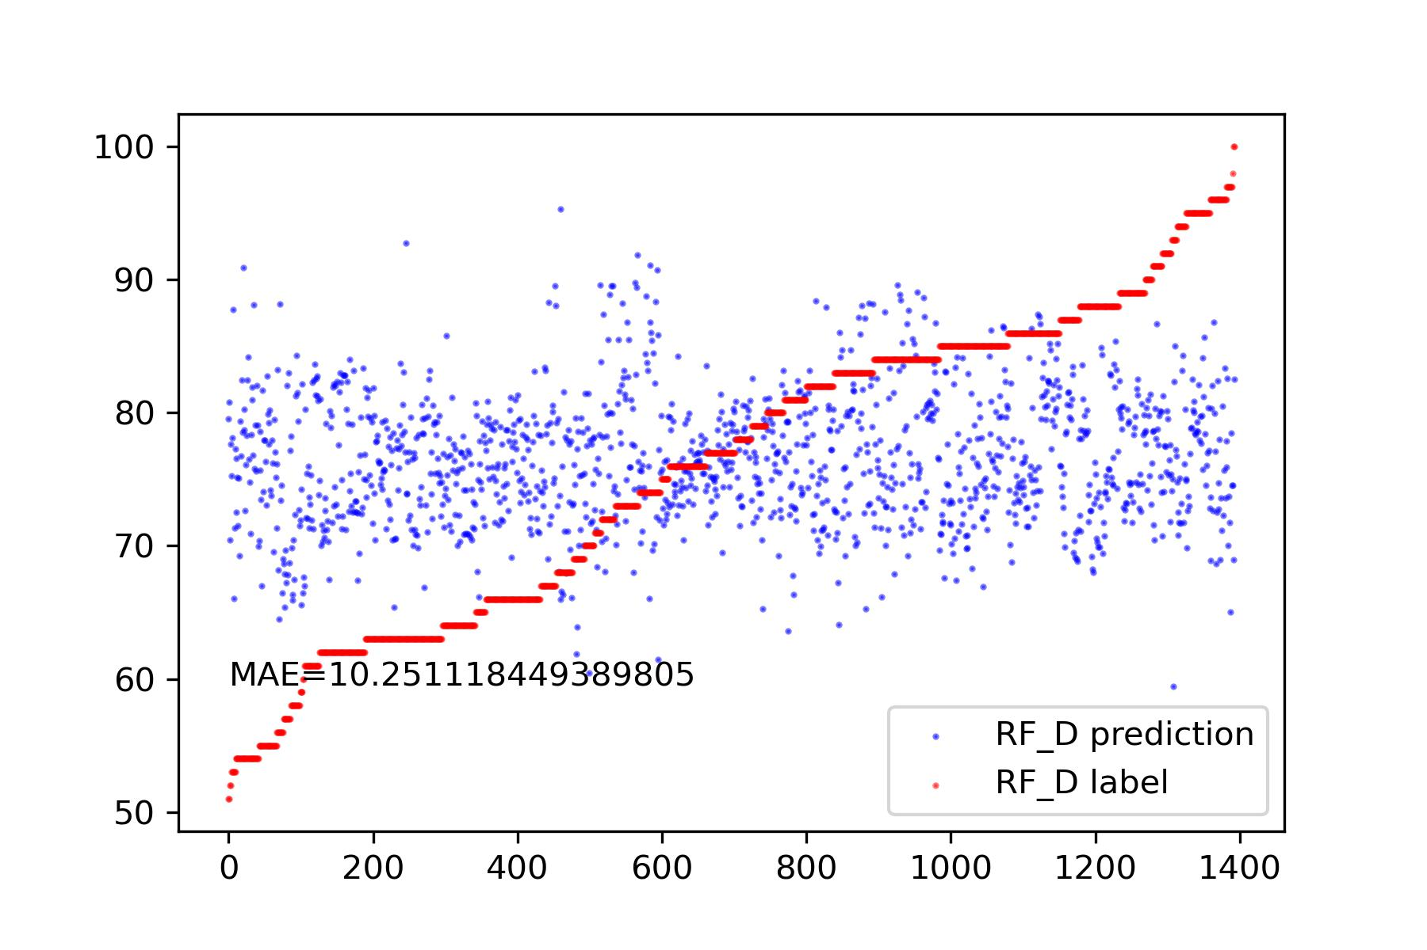
Attempts to S and D Prediction * Original Signal
[Top-k highest peaks, Top-k lowest valleys, Top-k highest peaks’ position, Top-k lowest valleys’ positions ]
[Sorted(Top-k highest peaks, Top-k lowest valleys), Sorted(Top-k highest peaks’ position, Top-k lowest valleys’ positions) ]
Sorted by positions

Slide 15
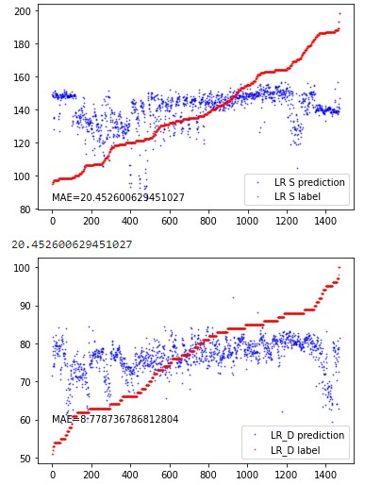
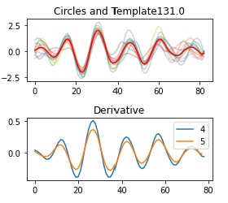
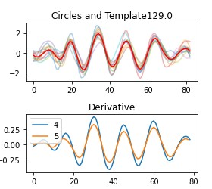
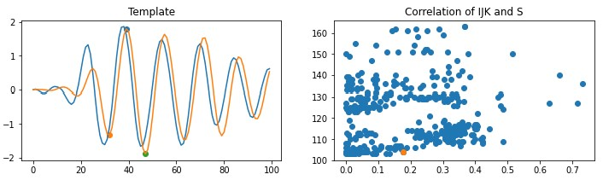
Attempts to S and D Prediction * Differentiated Signal
Autocorrelation
fourier_entropy

Slide 16
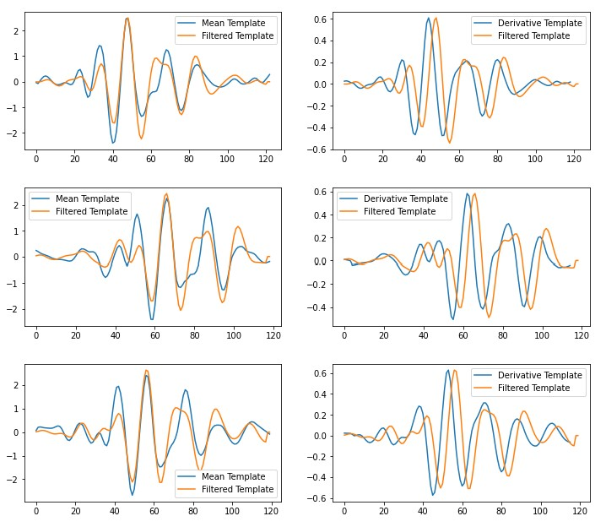
Attempts to S and D Prediction * Filtered Signal

Slide 17
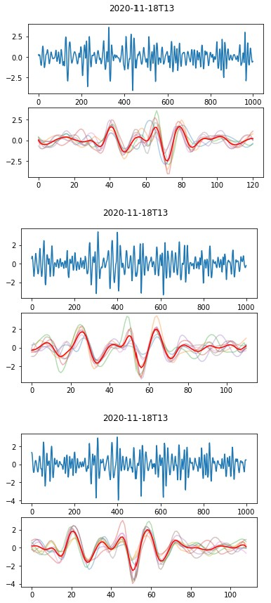
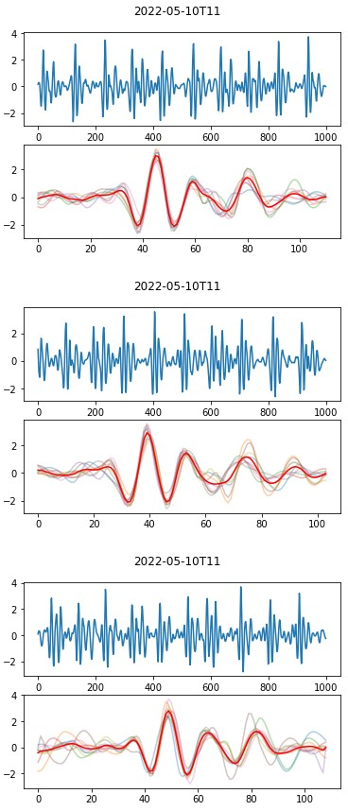
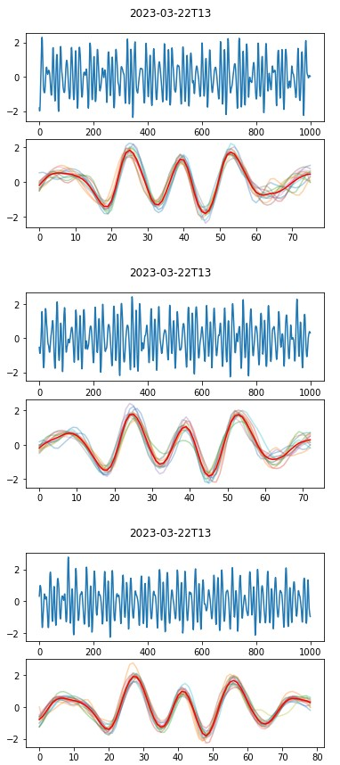
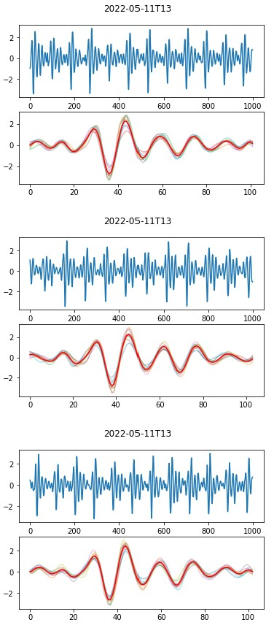
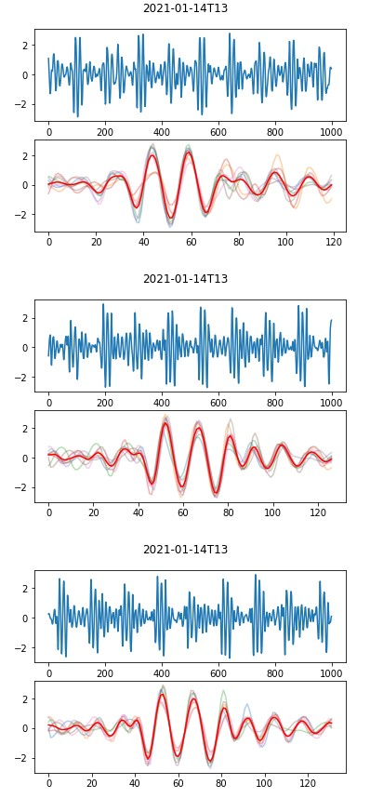
Attempts to S and D Prediction
People 1
People 2
People 3
People 4
People 5

Slide 18
Problems
The research we are doing doesn’t meet the requirement of the graduation project.
* 没有Baseline，几乎没法对比 * 完整的工作
I totally have no idea how to extract features from S and D.
I previously collaborated with Professor Xie on a paper. Now, I might need to spend some time completing the paper.

Slide 19
Thanks!

