Slide 1
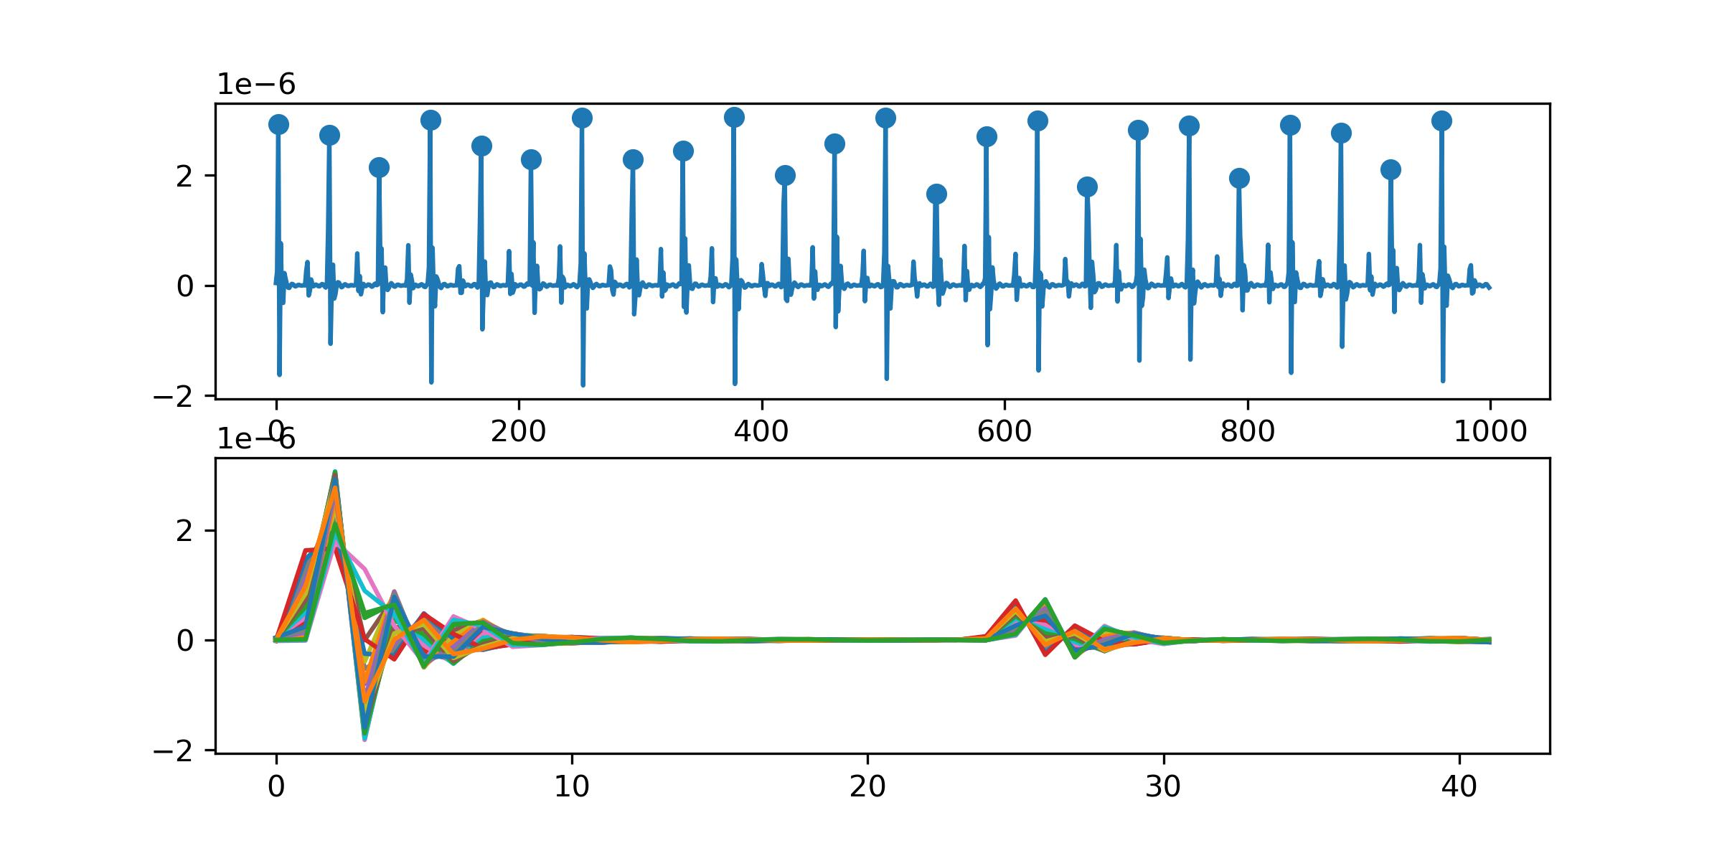
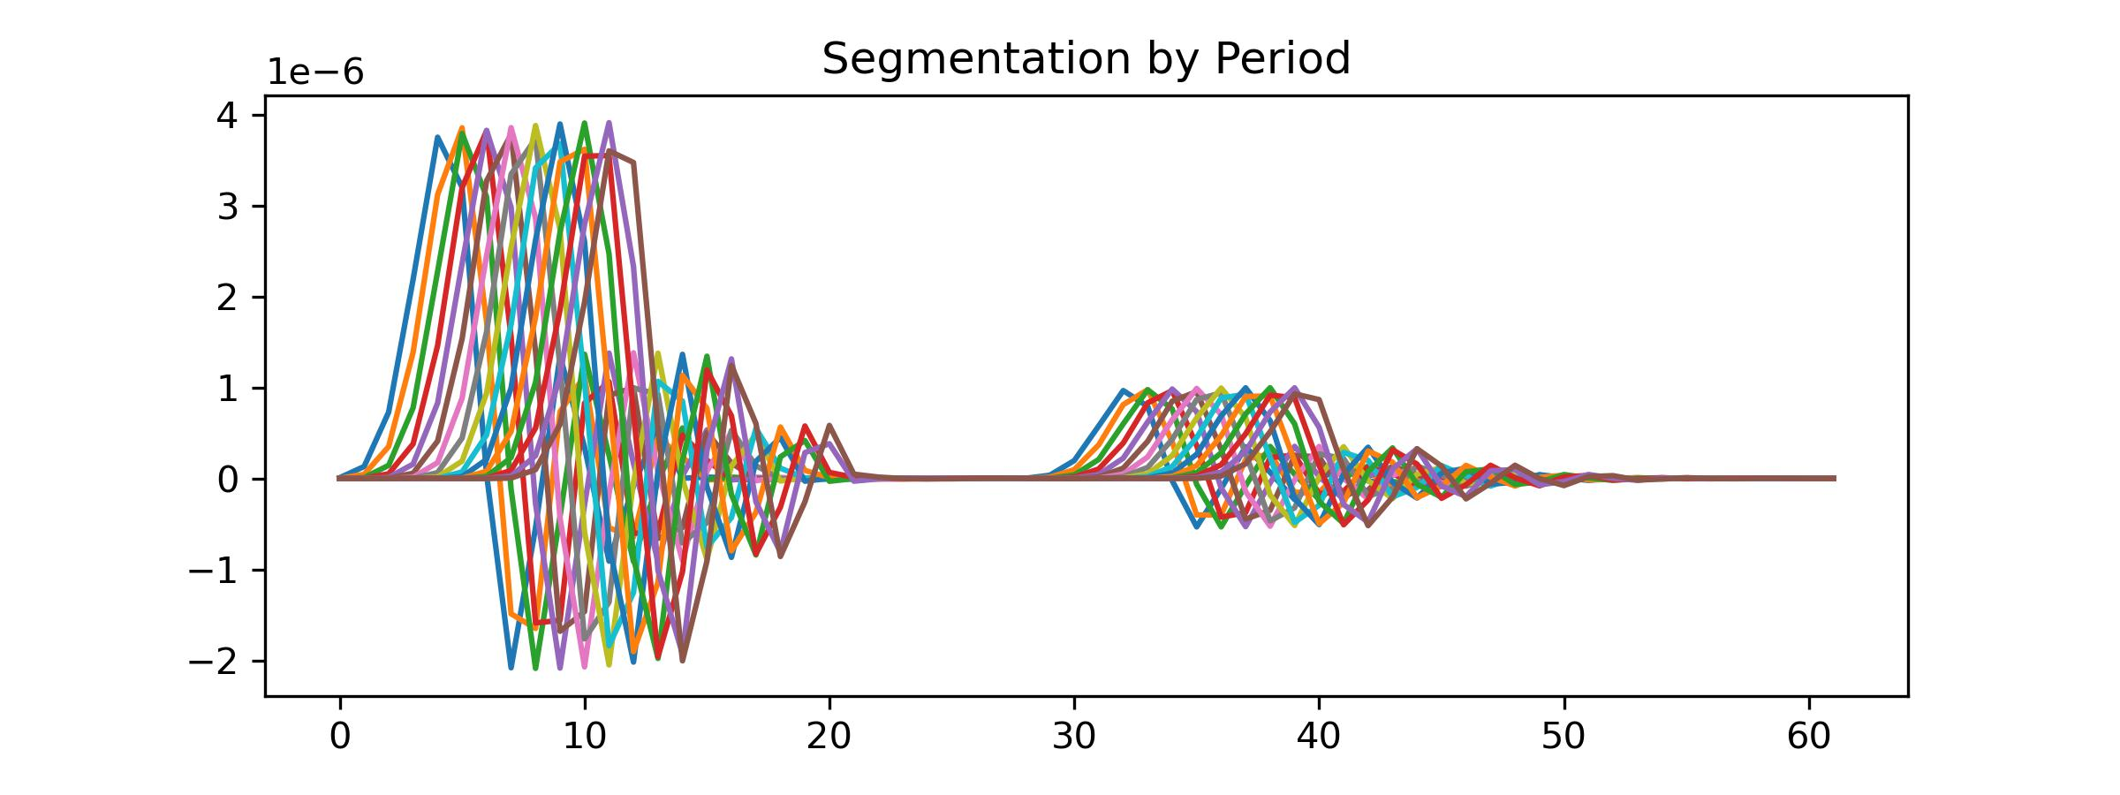
Work_3: Obtaining Template
What features should a good algorithm for obtaining a template have?
Feature 1: The highest points of both large and small peaks for each piece should be aligned after applying the algorithm.
Feature 2: The distance between two peaks of the template should be the rounded average of distances between two peaks for all pieces.
Feature 3: The ability to handle time shifts (possibly essential in real data but less critical in simulated signals).
The primary focus of research should indeed be on Time Warping to get perfect template of SCG signals.

Slide 2
