Slide 1
Weekly Presentation
Jiayu Chen
2023.9.18
Notes:
Ok, I will begin my weekly Presentation

Slide 2
Work Description
Work_1:
Tutorial Writing:
1. Refactor all functions in Generate Wave Module and Filter Module
2. Add new features to the framework of the main function
3. Write some notes in ipynb (Jupyter) file about algorithm details.
4. Learn 2 new filters (Matched Filer and Notch Filter)
Work_2:
In situations with heavy echoes, I find an potential segmentation method.
Work_3:
About Template. Based on observation, an attempt has been made to define what constitutes a good algorithm for obtaining an SCG signal template. It consists of three features, and some exploration has been carried out.

Slide 3
Work_1: Tutorial
For Main Function
I refactor Generate Wave Module(7) and Filter Module(4), including interfaces, visualization, code comments and more.
I added the new feature that people can use the signal created by themselves as the input rather than only SCG signals.
We can save the results.
Use 5 commands to show you the demo.
Next week I will spend time improving the robustness of codes.
And you can reflect BUGs to me. Maybe I can create a google-doc. And you can post issues.

Slide 4
Work_1: Tutorial
For Notes
Start studying and documenting theoretical aspects of the tutorial content (some parts may be included in the docstring of functions in the future).
This week I mainly focus on Wavelet denoising.
Unique properties and shapes of different wavelets.
I turned my attempts with certain algorithms into a playground, such as differences in SCG signals using different wavelets and distinctions between discrete wavelet transform(DWT) and empirical wavelet transform(EWT).
Show notes easily.

Slide 5
Work_1: Tutorial
For Algorithm
Matched Filter and Notch Filter have been tested on SCG signals.
Unlike last week’s 2 filters (Wiener and Savitzky-Golay), they didn't produce unexpectedly good results.
It seems challenging to apply them for noise reduction in SCG signals.

Slide 6
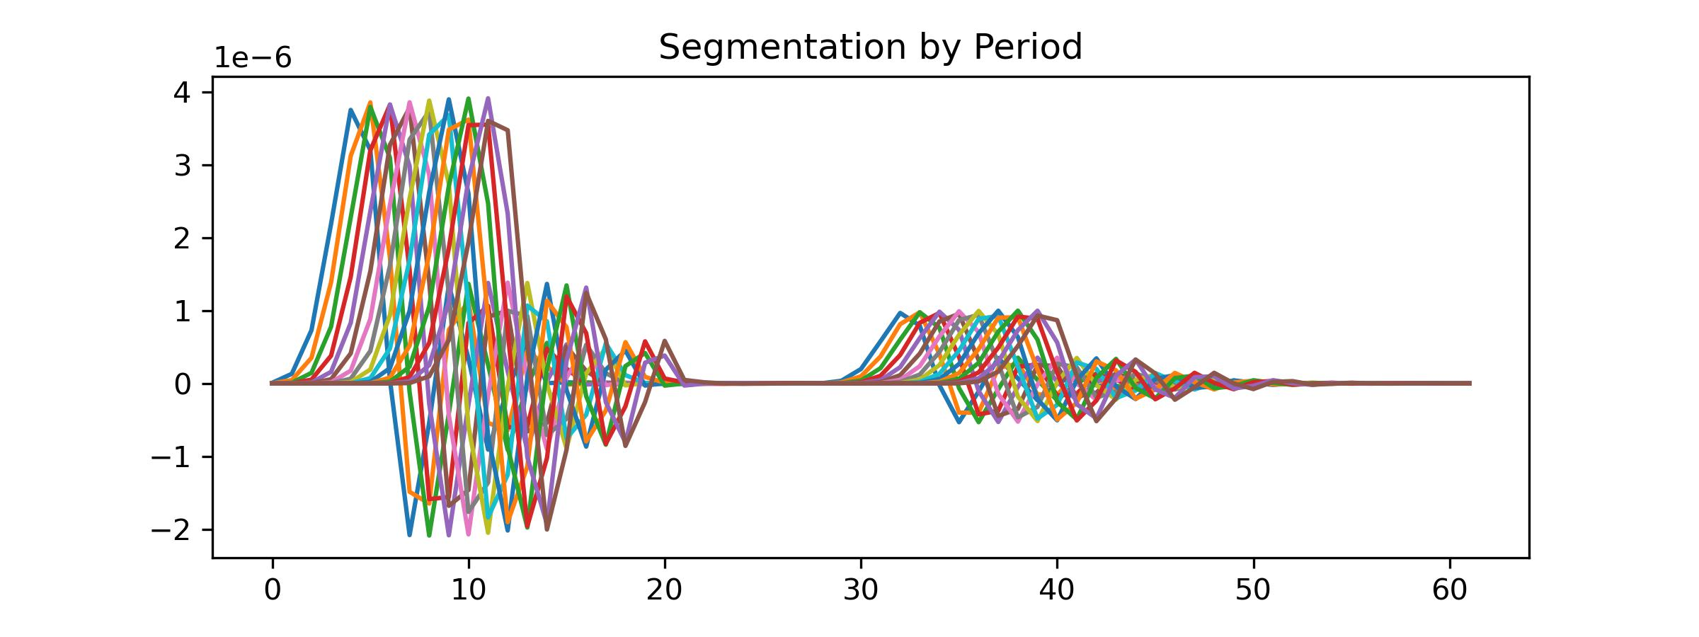
Work_2: segmentation method in situations with heavy echoes
I added 5 echoes to the clean signal, and attenuation coefficients for these echoes are [0.9, 0.7, 0.6, 0.5, 0.4], with delays of [5, 10, 15, 20, 25] time points, respectively.
In data with strong echoes, it’s impossible to perform cycle segmentation by locating large peaks, as it is hard to locate large peaks. X
At the same time, directly using Heart Rate to calculate the cycle length for segmentation will result in a significant time shift (as shown in the figure below). X

Slide 7
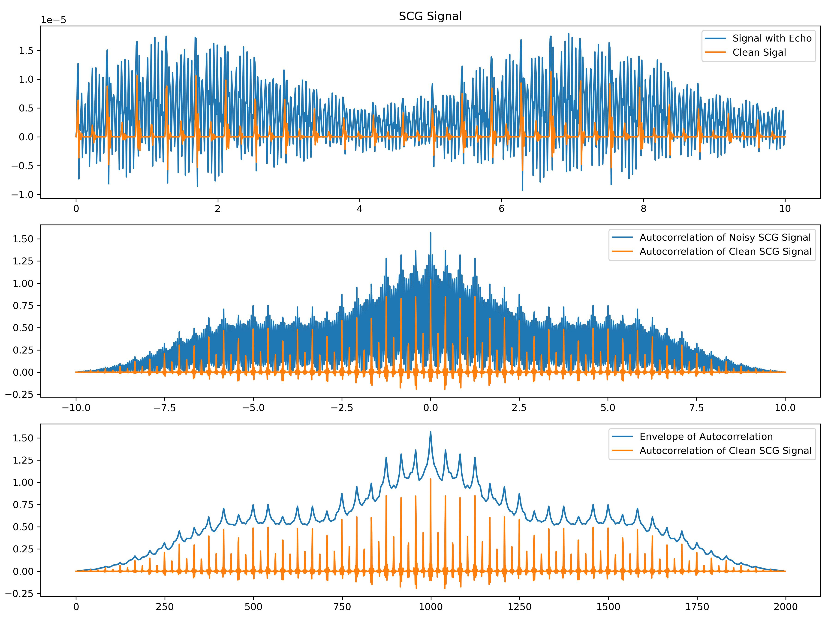
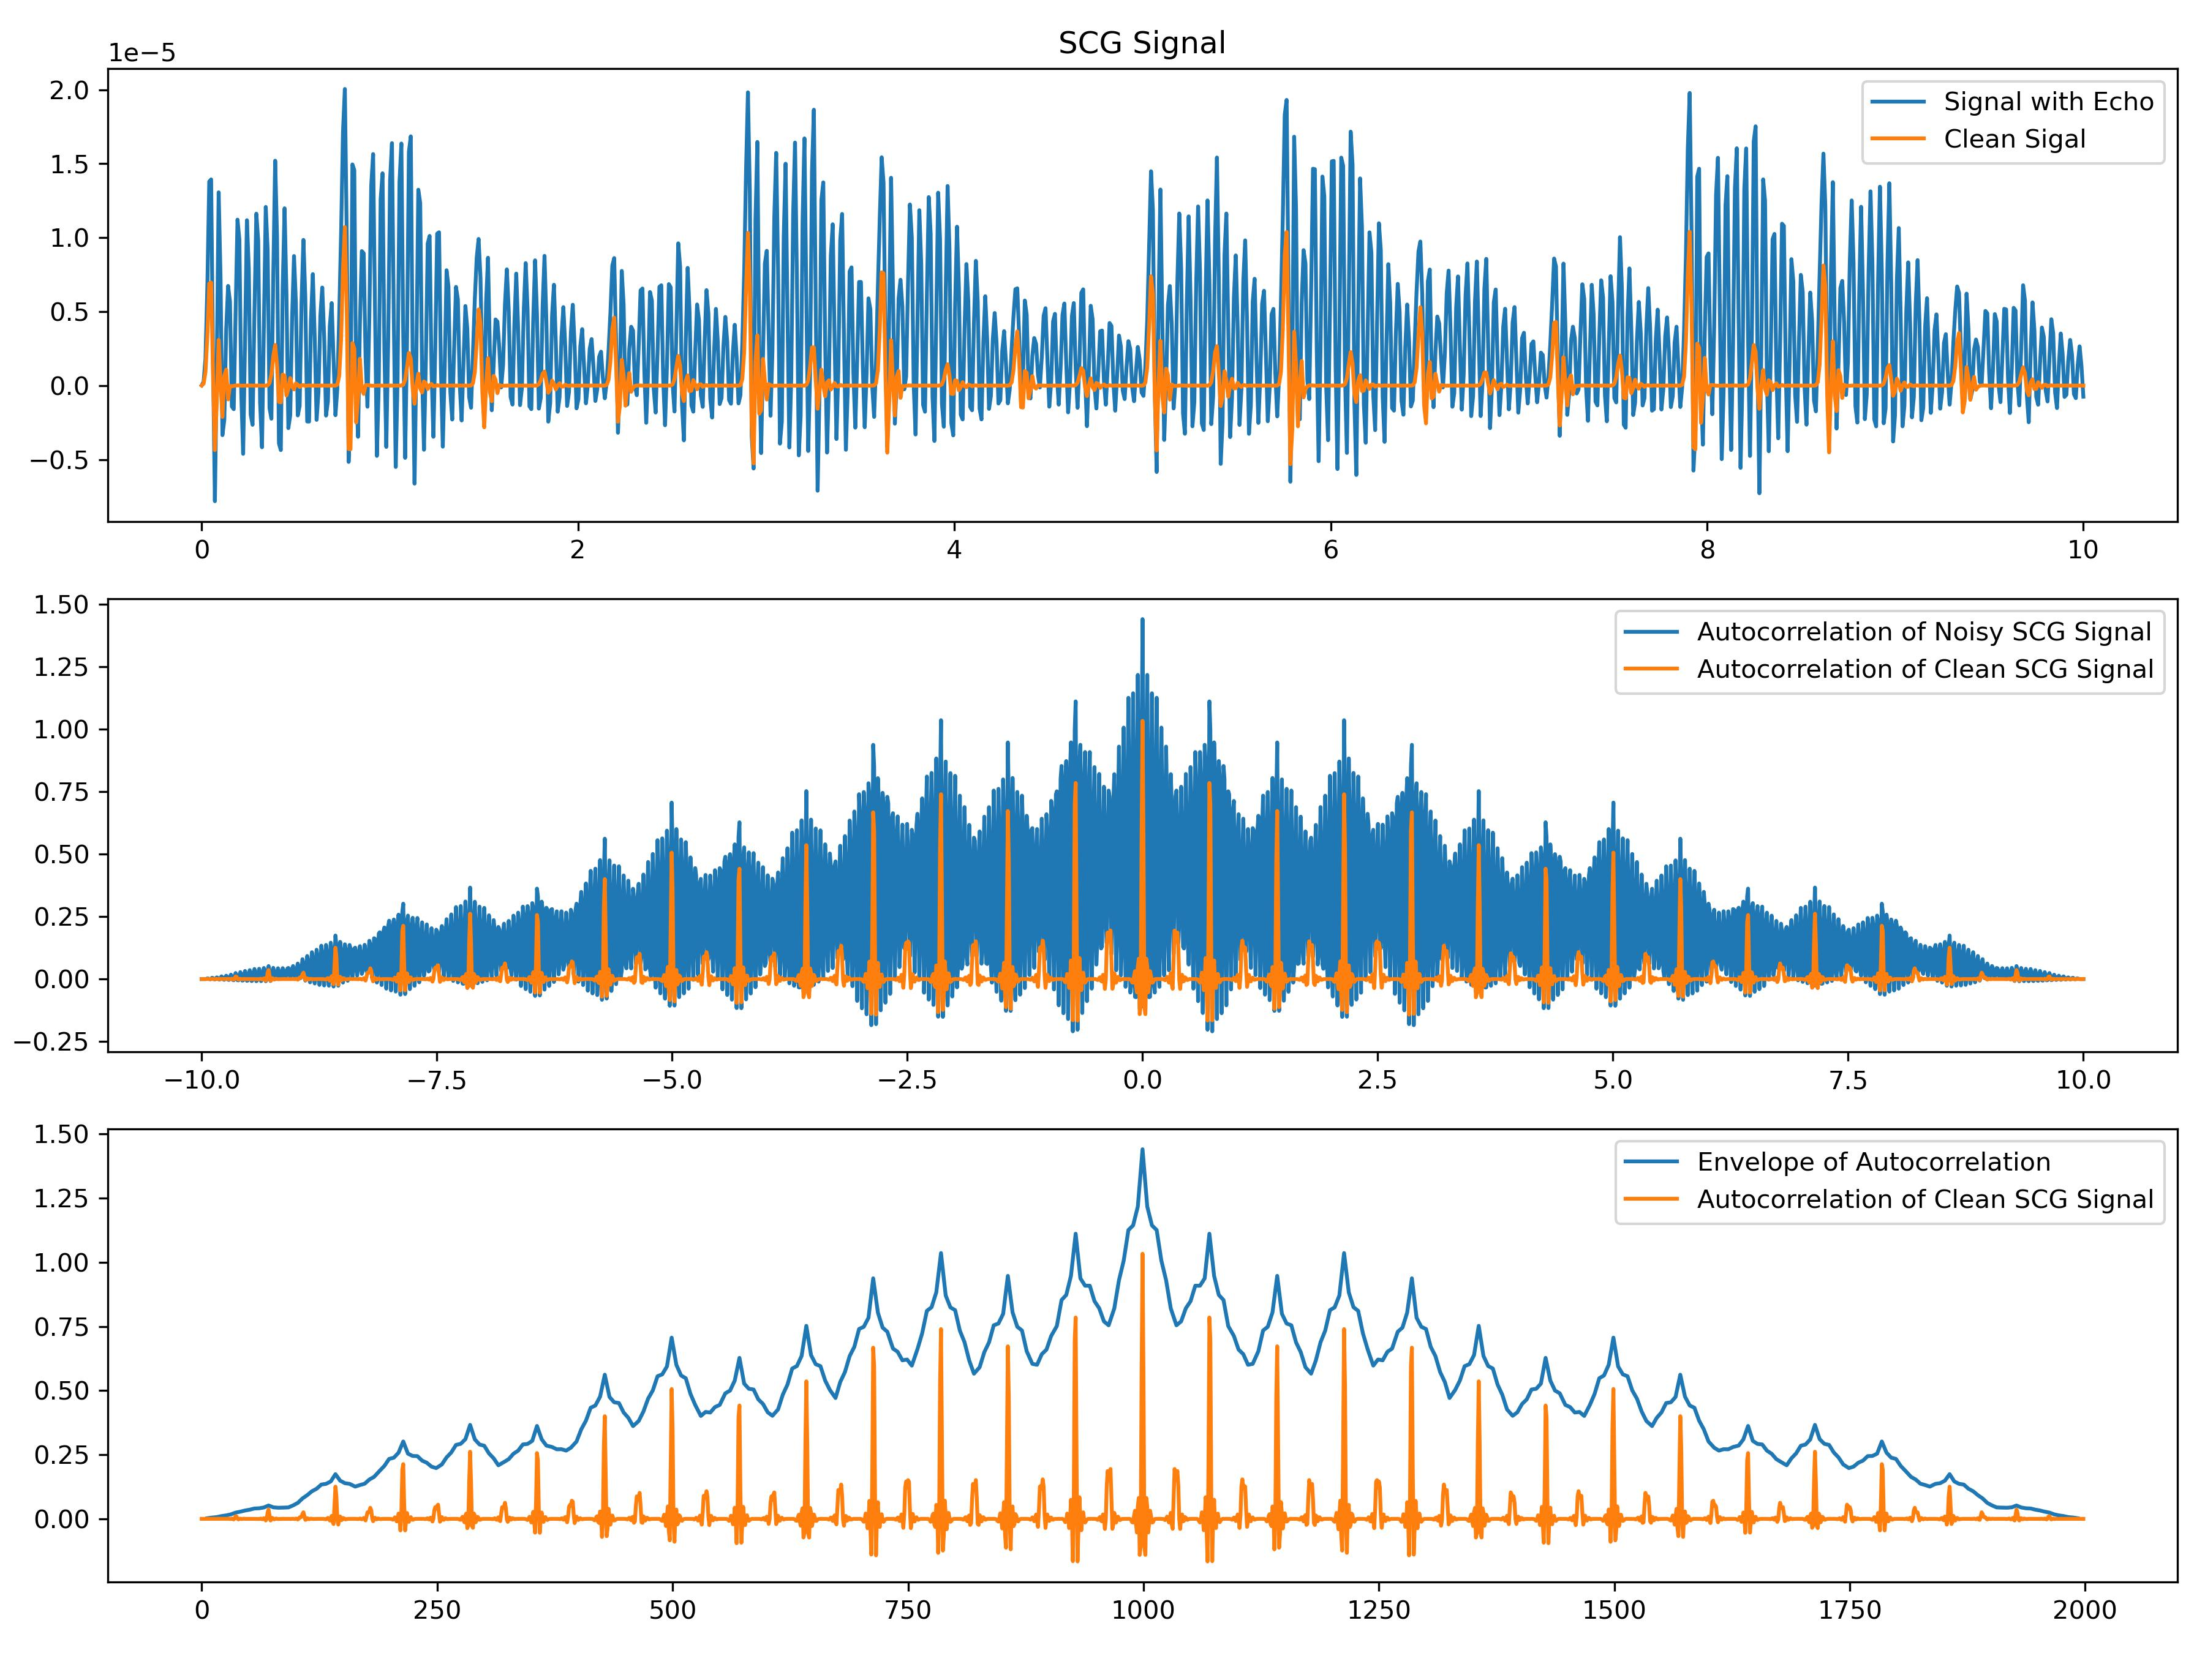
Work_2: segmentation method in situations with heavy echoes
I find, within a relatively short time, like 10 sec, patterns of echoes remain relatively consistent and don't exhibit significant variations.
So, using autocorrelation for separation is a good idea.
Below are two examples: left one with a high number of circles and right one with very few circles.
Notes:
We can see that the echo noise is very high, making it nearly impossible for us to effectively identify the large peaks and perform useful segmentation.
However, once we perform autocorrelation, we find that peaks of autocorrolation of Noisy SCG signal is aligned with these of Clean signals.
Then, we can get the envelope of Autocorrelation. Finally, peaks detection can help us find the location of large peaks and we can perform segmentation.

Slide 8
Work_3: Obtaining Template
In Work 3, an attempt has been made to define what constitutes a good algorithm for obtaining an SCG signal template.
Let’s begin with a comparison of algorithms that can recover a single-cycle signal, evaluating their performances on both noise-free and slightly noisy data.
I will give analyses on this table in detail.
No Noise / Noise Level of 0.1
Method | S Prediction | D Prediction
No Template | 0.79 / 1.64 | 1.79 / 4.31
Median | 1.42 / 1.45 | 4.07 / 4.49
Mean | 1.35 / 1.38 | 4.53 / 4.44
K-shape | 2.20 / 2.74 | 4.85 / 5.88
PCA-based | - / - | - / -

Slide 9
Work_3: Obtaining Template
1 Comparison of ‘No Template’ method and ‘Get Template’ method
The ‘No Template’ method is not robust and is heavily affected by noise.
However, the ‘Get Template’ methods, while not very accurate on clean signals(this part will be explained later), are less affected by noise.
No Noise / Noise Level of 0.1
Method | S Prediction | D Prediction
No Template | 0.79 / 1.64 | 1.79 / 4.31
Median | 1.42 / 1.45 | 4.07 / 4.49
Mean | 1.35 / 1.38 | 4.53 / 4.44
Raise Rapidly
Raise Slightly
Raise Slightly
From results of Mean Method, we could say recovering a single cycle signal can help us to achieve noise reduction.

Slide 10
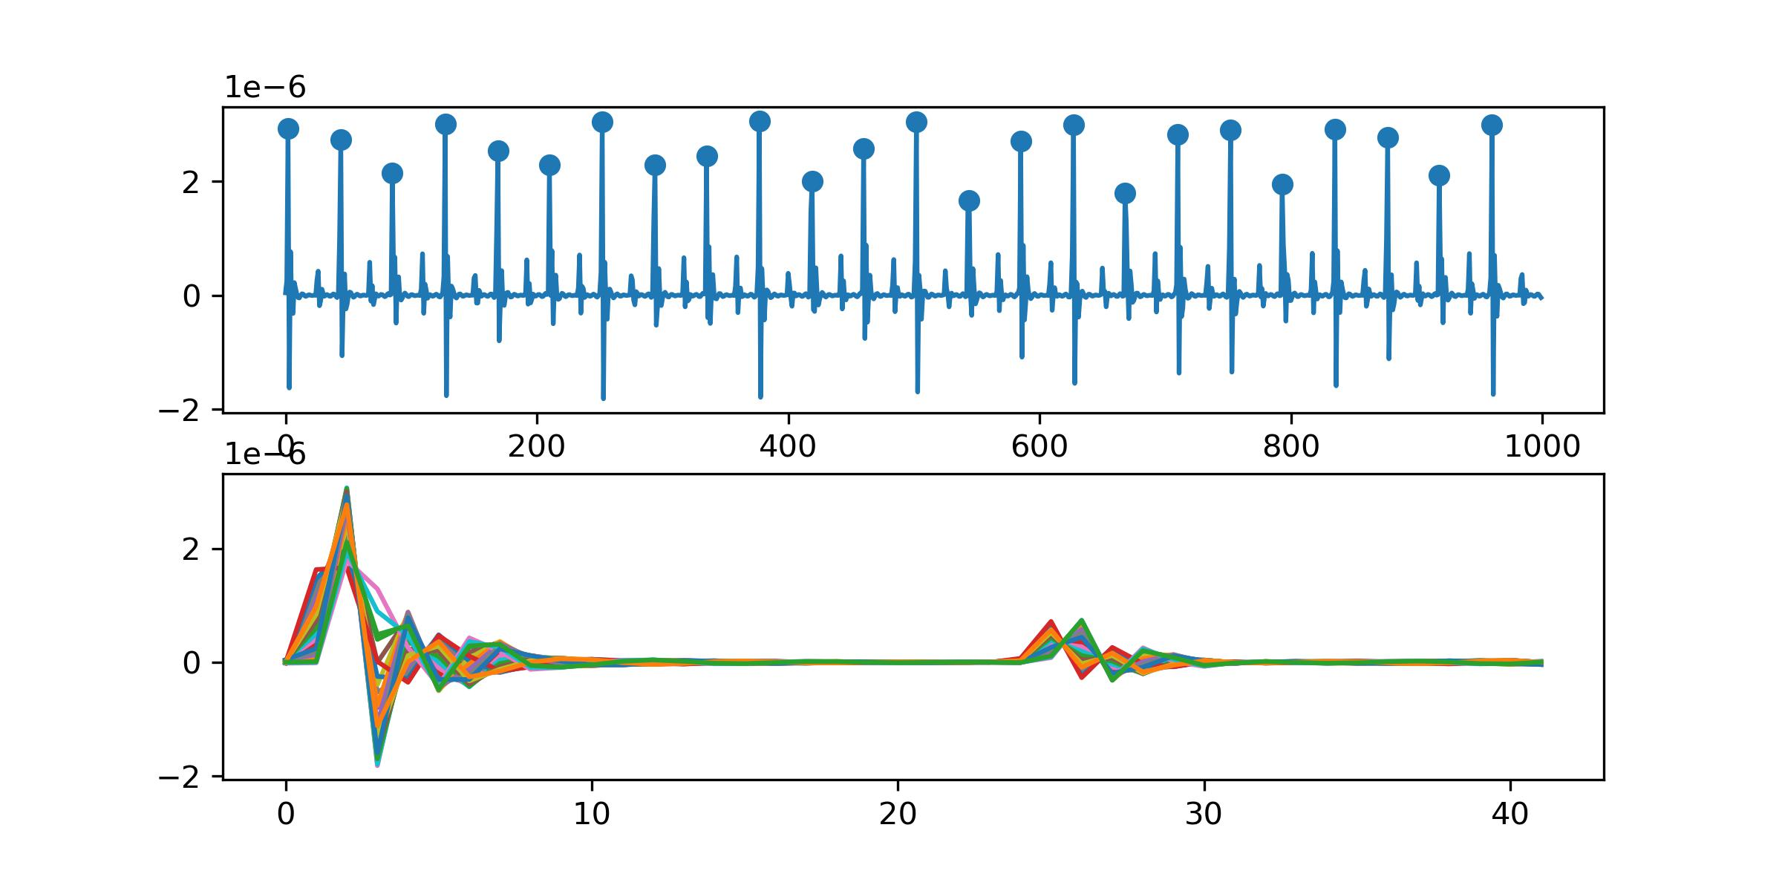
Work_3: Obtaining Template
No Noise
Method | S Prediction | D Prediction
No Template | 0.79 | 1.79
Median | 1.42 | 4.07
Mean | 1.35 | 4.53
2 Why does methods of getting the template result in poor performances for both S and D prediction, even in noise-free signals?
I think I find the reason.
For D Prediction:
Small peaks are not aligned properly. Both mean and median methods significantly affect height of small peaks, leading to a decrease in accuracy.
For S Prediction:
Due to the limitation of the sampling rate, even with a perfect "Get Template" algorithm, the S prediction result is still not as good as that of the "No Template" algorithm.
e.g.
No Template: d12 = 12.5 (can be a decimal)
Get Template: d12 = 12/13 (can only be int)
Example of Segmentation
Notes:
For D Prediction:
The reason is peaks are not aligned properly. Both mean and median methods significantly affect height of small peaks, leading to a decrease in their accuracy.
For S prediction:
Due to the limitation of the sampling rate, even with a perfect "Get Template" algorithm, the S prediction result is still not as good as that of the "No Template" algorithm.

Slide 11
Work_3: Obtaining Template
No Noise / Noise Level of 0.1
Method | S Prediction | D Prediction
No Template | 0.79 / 1.64 | 1.79 / 4.31
Median | 1.42 / 1.45 | 4.07 / 4.49
K-shape | 2.20 / 2.74 | 4.85 / 5.88
3 Why the performance of K-shape is not satisfactory?
The K-shape algorithm generates a new signal during clustering. The issue lies in the clustering rather than the underlying Time-Warping concept.
We should discard clustering and focus on researching how to apply Time-Warping effectively.

Slide 12
Work_3: Obtaining Template
What features should a good algorithm for obtaining a template have?
Feature 1: The highest points of both large and small peaks for each piece should be aligned after applying the algorithm.
Feature 2: The distance between two peaks of the template should be the rounded average of distances between two peaks for all pieces.
Feature 3: The ability to handle time shifts (possibly essential in real data but less critical in simulated signals).
The primary focus of research should indeed be on Time Warping to get perfect template of SCG signals.

Slide 13
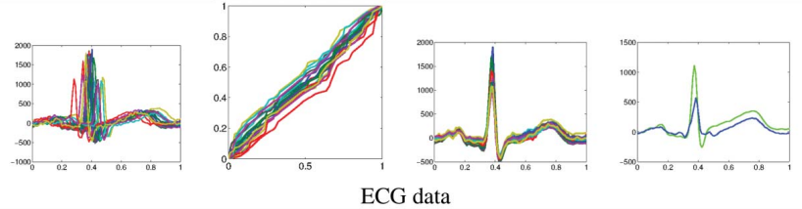
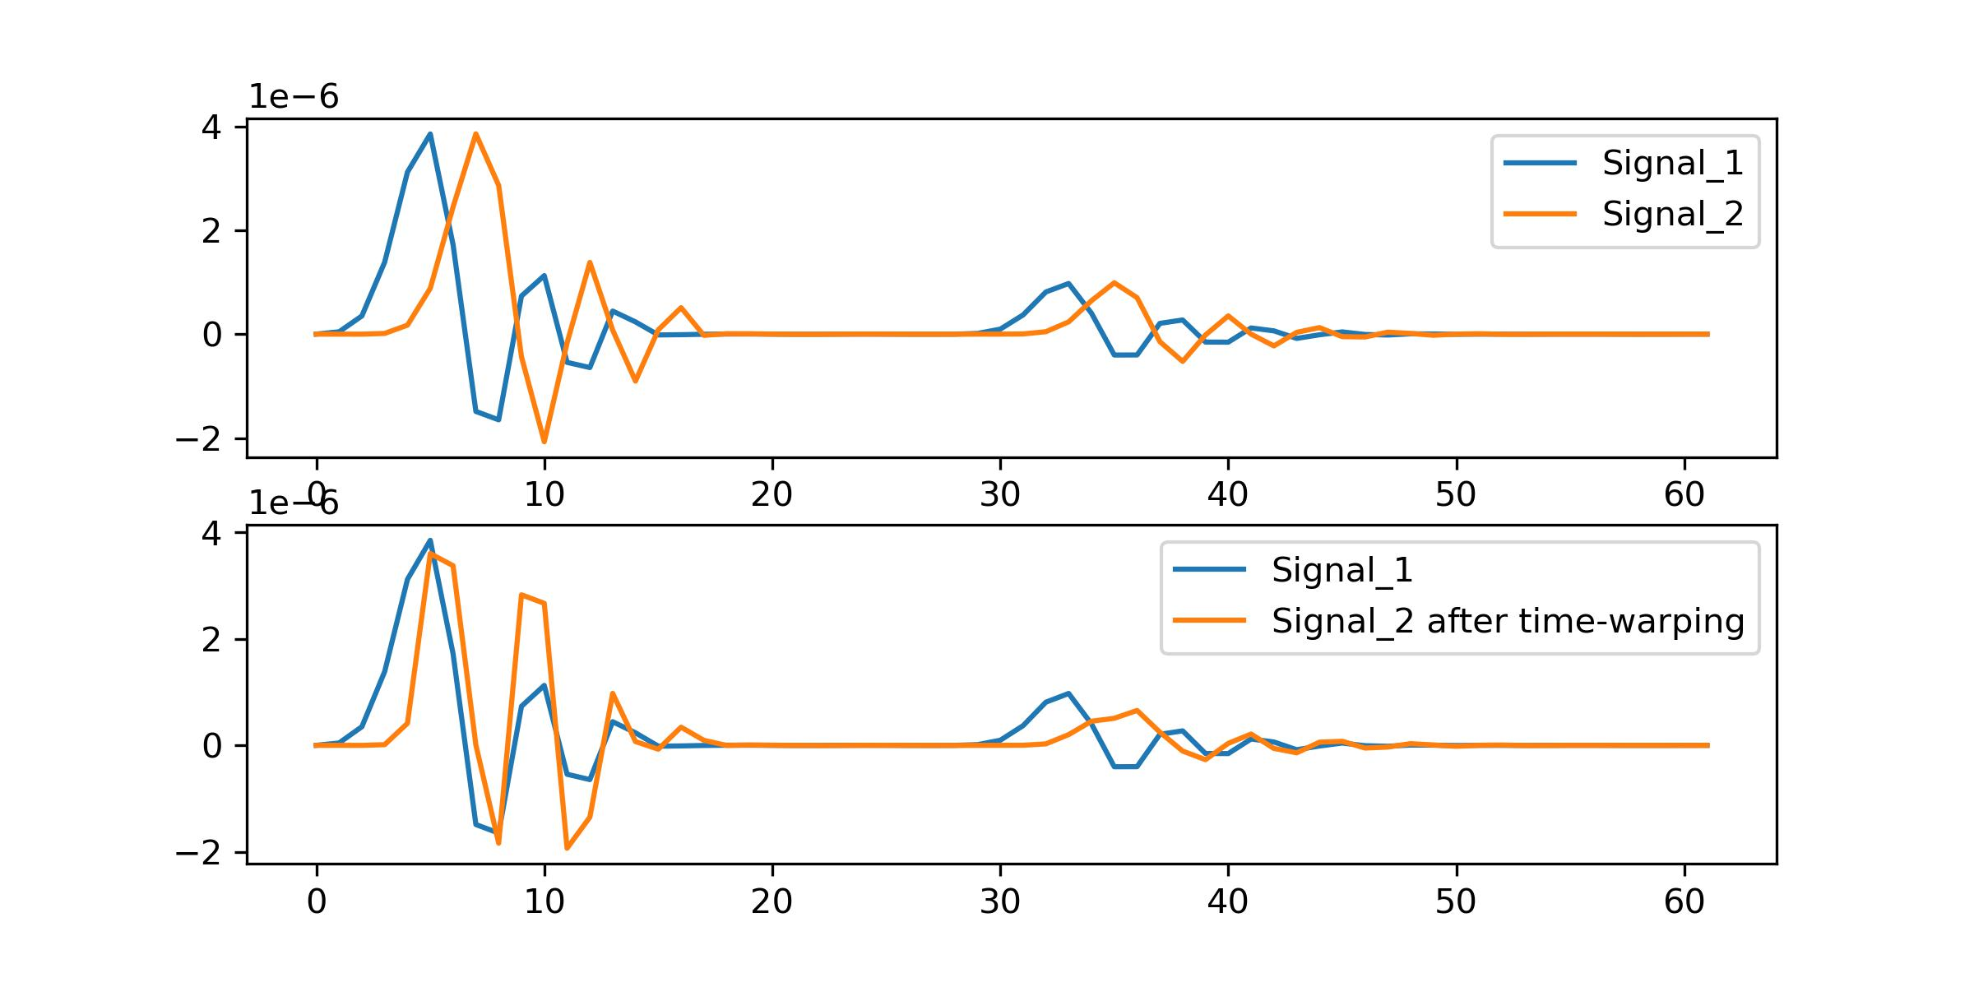
Work_3: Obtaining Template
I have tried one Time-Warping method this week.
I read a statistical paper^{[1]}. Its shown result is amazing.
Even the paper didn’t offer codes, I still spent 2 days implementing this paper.
The result on SCG is not satisfactory. I will offer a brief analysis of possible reasons.
Sliced Signals
The results presented in the paper:
Fisher–Rao distance is invariant to domain warping.
The segmented cycles are represented by square root velocity function(SRVFs).
The results I have obtained regarding SCG signal:
Transform the original problem into an optimization problem. Determine how to stretch the horizontal axis of the signal.
Before
Algorithm
After
Algorithm
[1] Kurtek S, Wu W, Christensen G E, et al. Segmentation, alignment and statistical analysis of biosignals with application to disease classification[J]. Journal of Applied Statistics, 2013, 40(6): 1270-1288.

Slide 14
Work_3: Obtaining Template
The results I have obtained regarding SCG signal are as follows:
Big peaks are aligned.
The alignment effect for small peaks is not noticeable.
The signal distortion is significant.
Reason 1:
The method is based on derivations. However, ECG signals are relatively smooth, but simulated SCG signals are much sharper.
Reason 2:
In the paper, after stretching the time axis, missing parts need to be interpolated.
The ECG signals in the paper have a sampling rate of 1 KHz, while our signals have a sampling rate of only 100 Hz. The length of our templates is often in the range of 40-80. Interpolation will introduce significant errors which result in distortion.

Slide 15
Conclusion
In conclusion, I believe the method for obtaining the perfect template should involve an overlay of all signal cycles after Time-Warping, rather than generating a template like K-shape or PCA.
The method I tried this week based on SRVF is not successful. Next week, I will attempt the Discrete Time Warping (DTW) algorithm behind K-shape.

Slide 16
Questions
1. Regarding the idea of increasing the Signal-to-Noise Ratio (SNR) of periodic (physiological) sensor signals to recover a single cycle signal in high fidelity, what are our baseline experiments? Can you provide me with some papers on this topic? It seems that there are few papers in this category. Or are we comparing my ‘Get Template’ algorithm to methods previously used for predicting S and D?

Slide 17
Thanks!

