Slide 1
Weekly Presentation
Jiayu Chen
2023.9.11
Notes:
Ok, I will begin my weekly Presentation

Slide 2
Work Description
Work_1: Tutorial Writing: finish the framework of the main function and try 2 advanced filter(Wiener filter and Savgol filter)
Work_2: Preliminarily remove the impact of respiratory by fft.
Work_3: Using the combination of Wiener filter and fft denoising to remove the Normal noise (add np.random.normal() directly) and respiratory.
Work_4: Confronted with Laplace Noise and Normal Noise added by Neurokit2, the combination of Savgol filter and fft denoising achieved better results, more accurate in prediction and much more faster, compared with the combination of SSA and Template.

Slide 3
Work_1: Tutorial
Completed the full reconstruction for Generate Waves(7), Add Noise(10), Filters(4), Decompose(8), including interfaces, visualization, and more.
Currently, the fundamental features have been implemented.
Some details are still not quite in place: there will be issues with input strings if they contain spaces.
I haven't conducted thorough testing yet.
I still haven't figured out how to implement the Save function.
Notes:
本周：
完成了对于Generate waves(7), Add Noise(10), Filter(4), decompose(8)完成了全部的重构，包括接口，作图等
目前基本的功能已经实现
直接进行展示3个指令
下周需要改进的：
有一些细节仍然不太到位：对于输入的字符串，如果有空格会出问题
还没有进行充分的测试
Save功能仍然没有想好如何实现

Slide 4
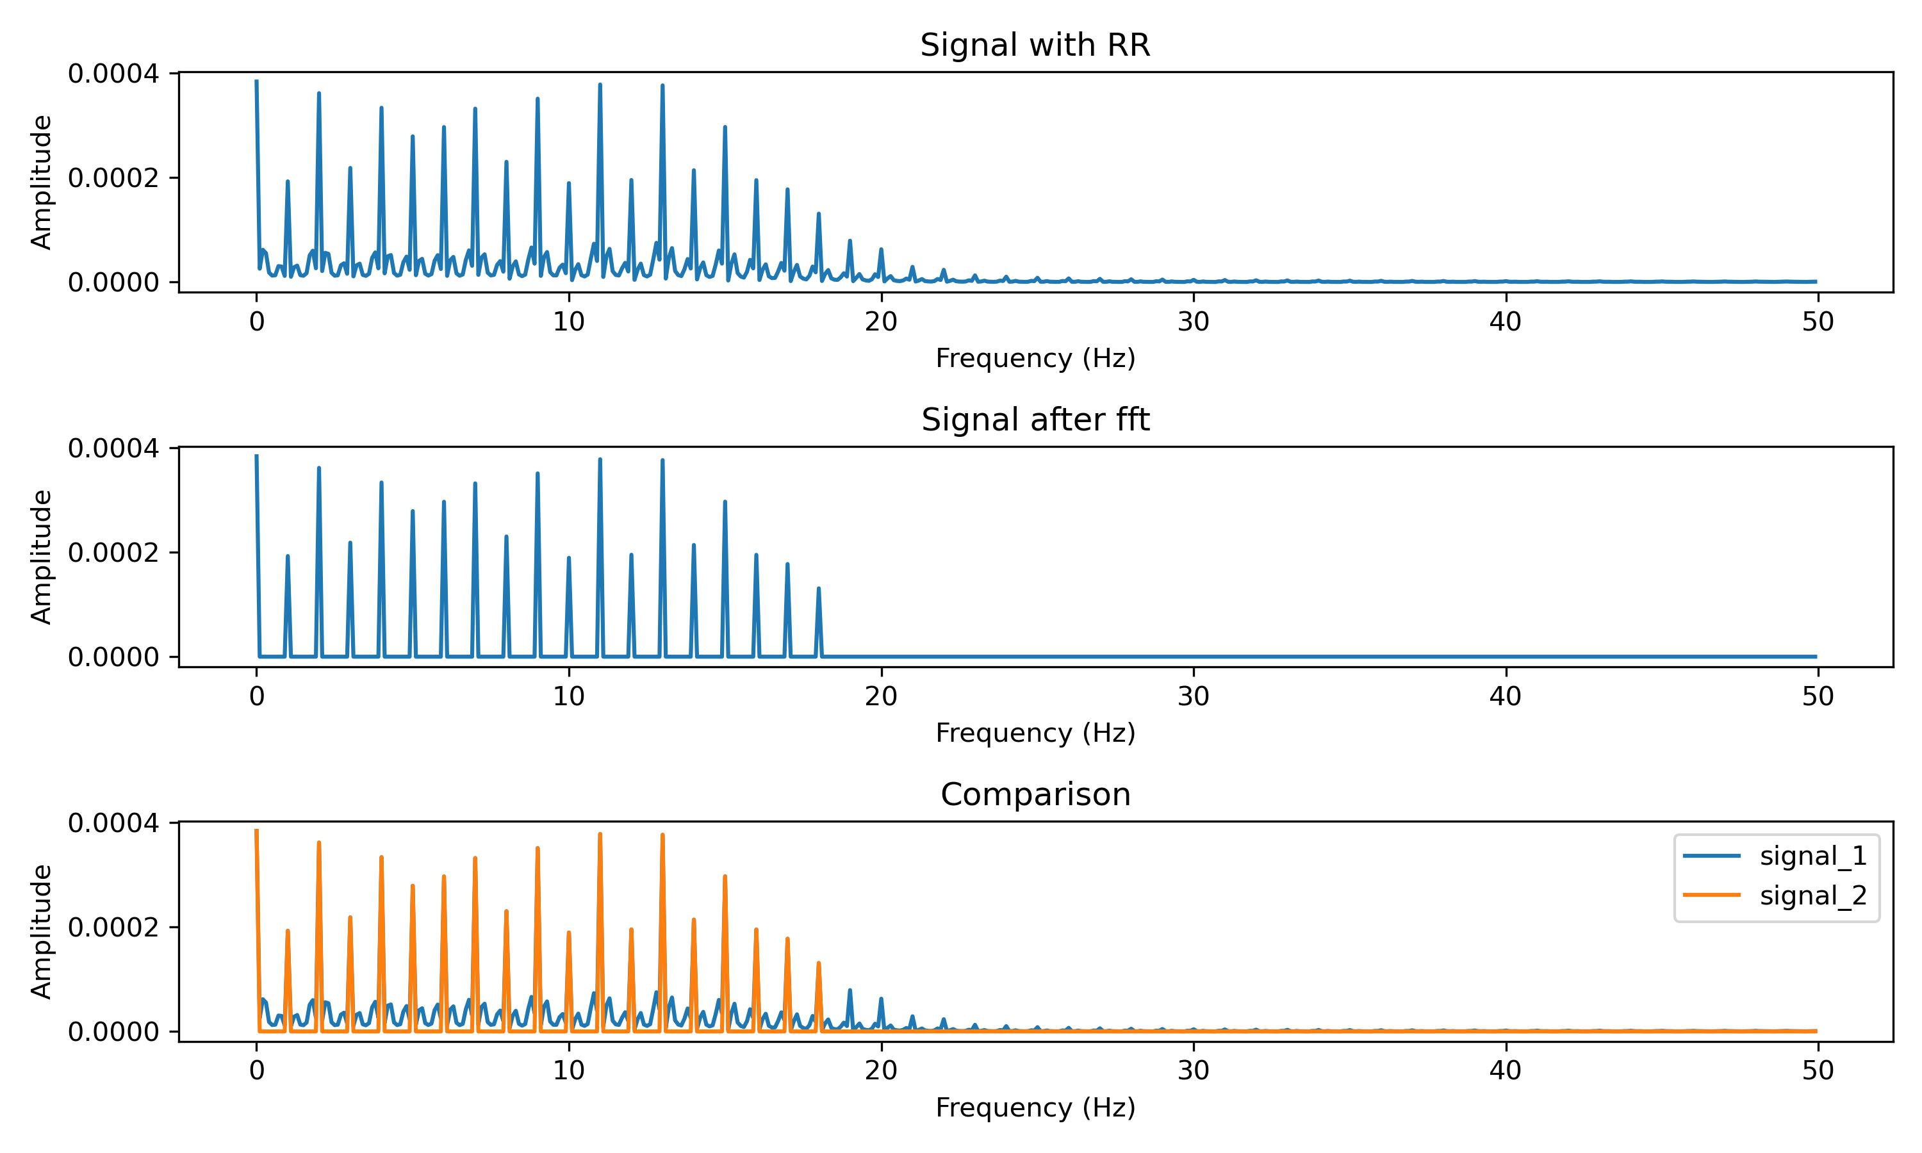
Work_2: Remove the impact of respiratory by fft
Notes:
展示频域的
展示单个信号使用fft以后的效果
展示数据集上测试的结果

Slide 5
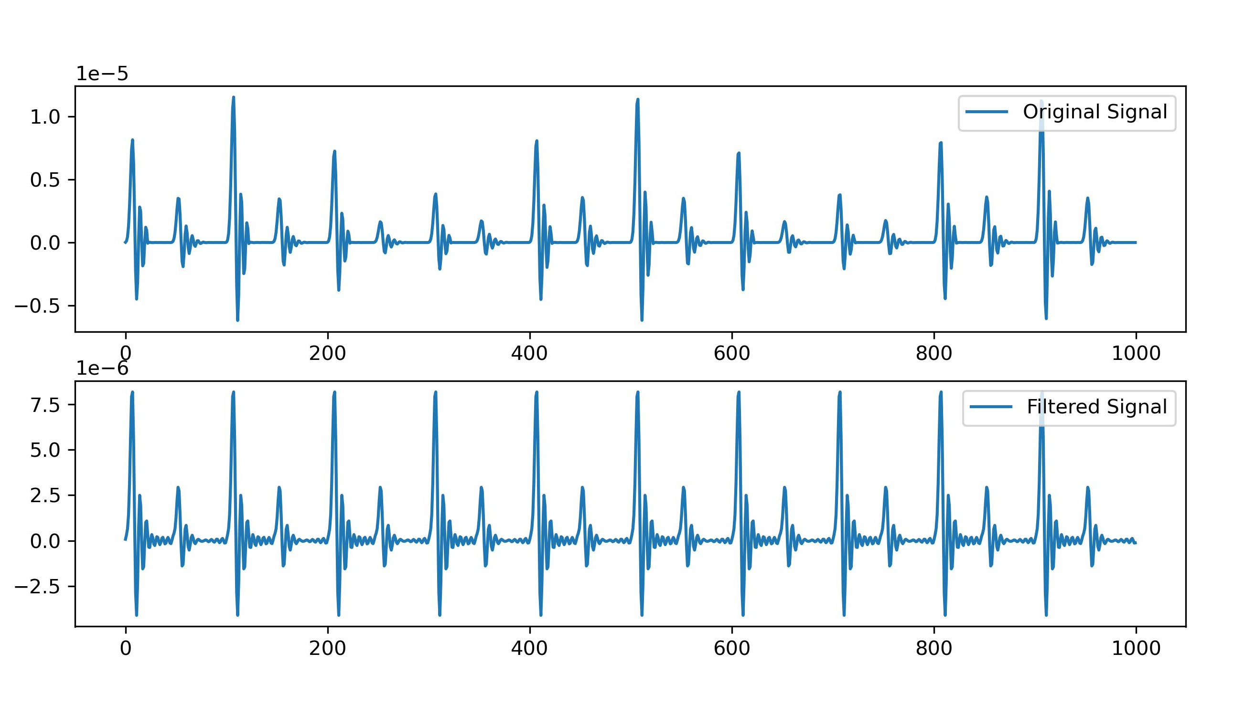
Work_2: Remove the impact of respiratory by fft
Notes:
展示频域的
展示单个信号使用fft以后的效果
展示数据集上测试的结果

Slide 6
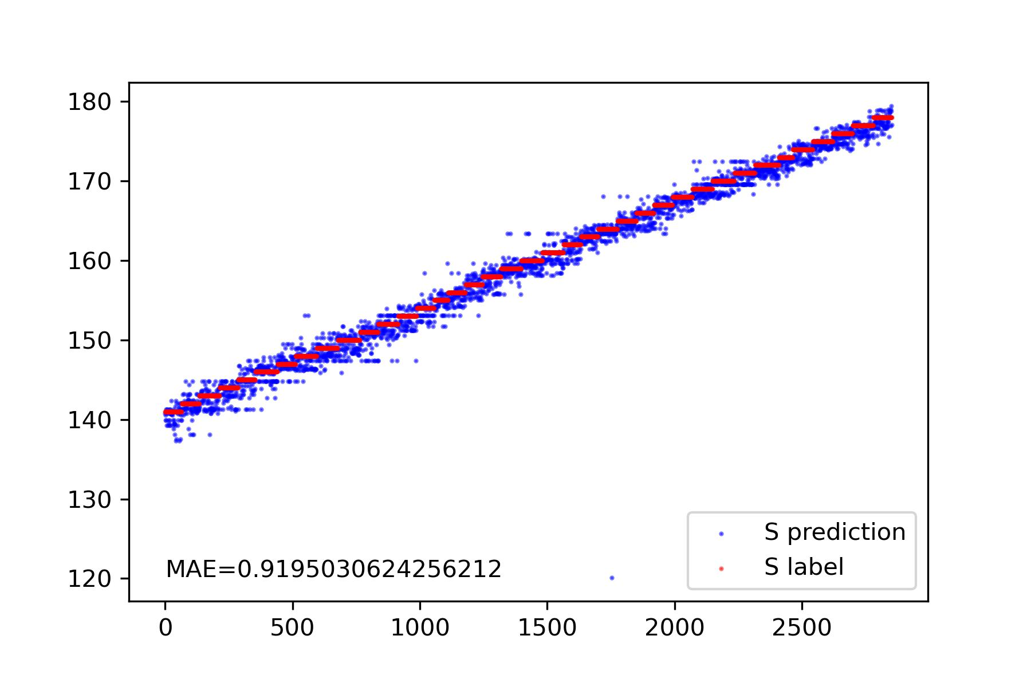
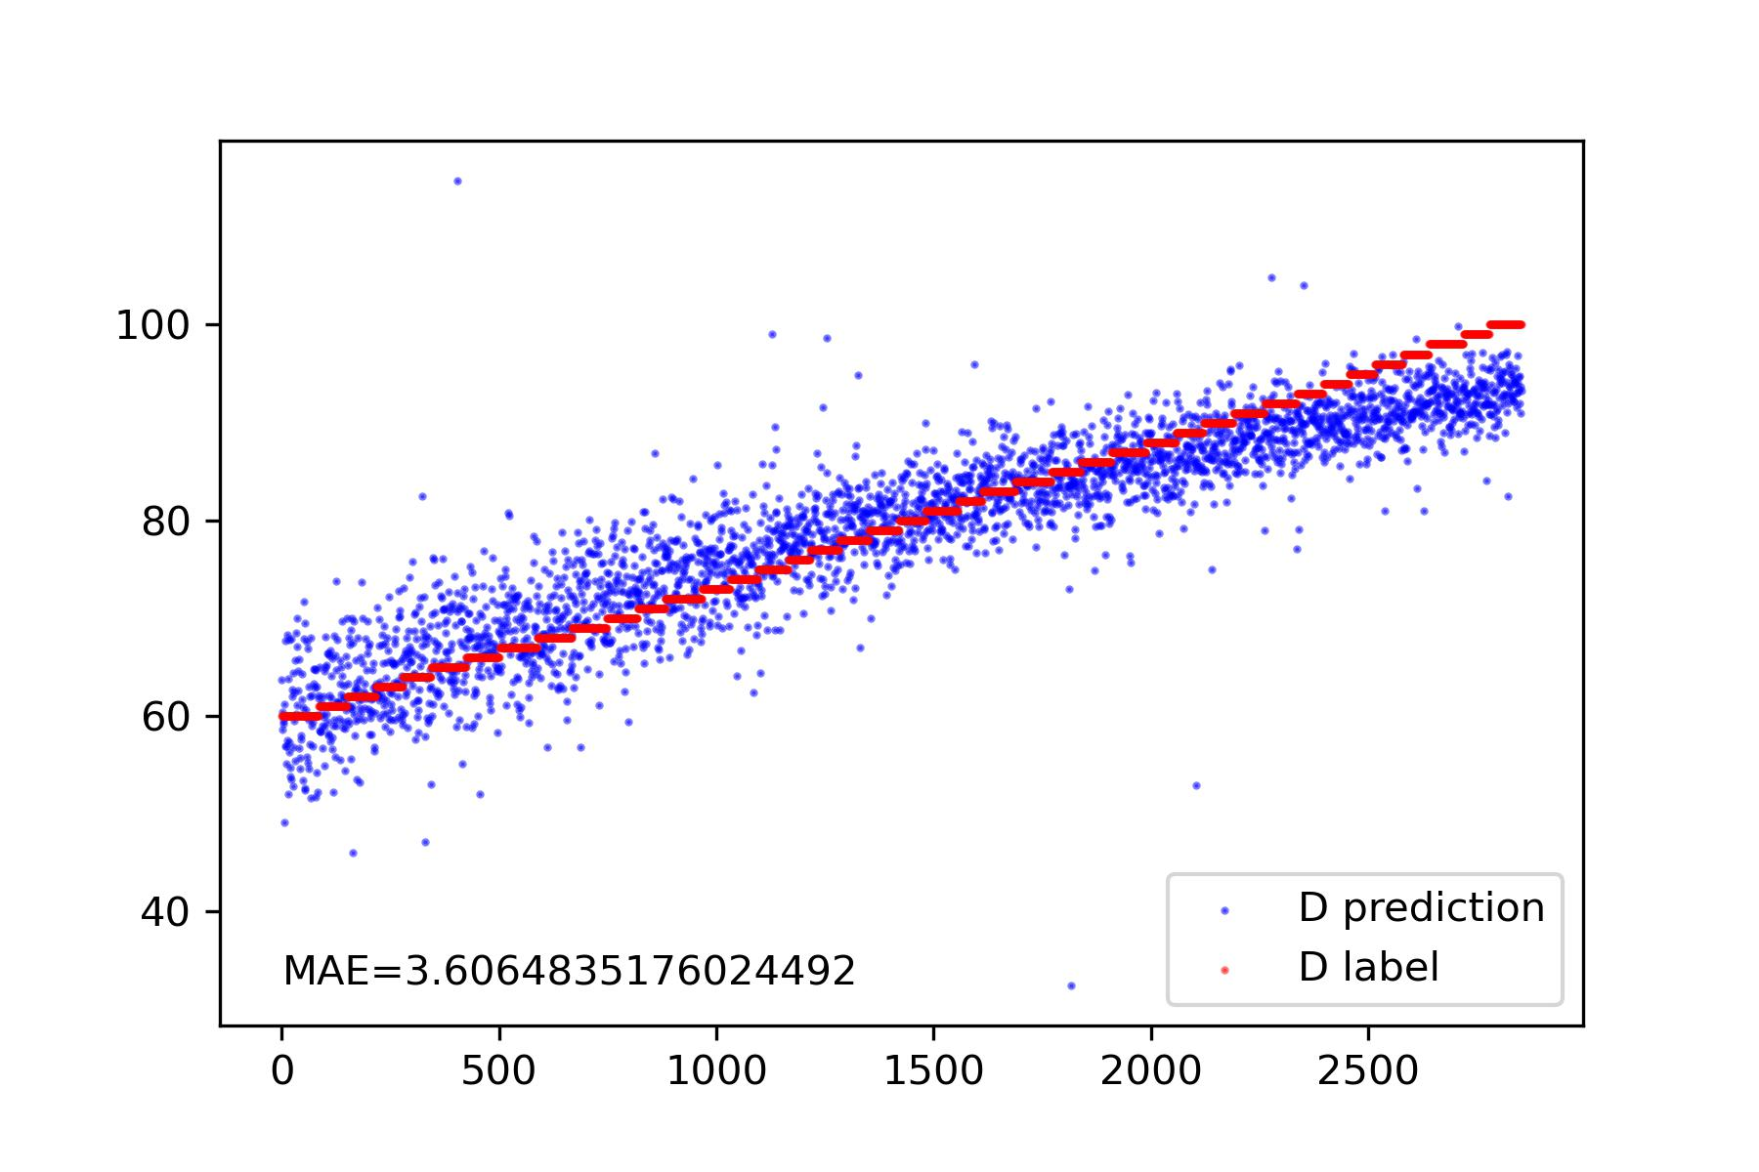
Work_2: Remove the impact of respiratory by fft
Notes:
展示频域的
展示单个信号使用fft以后的效果
展示数据集上测试的结果

Slide 7
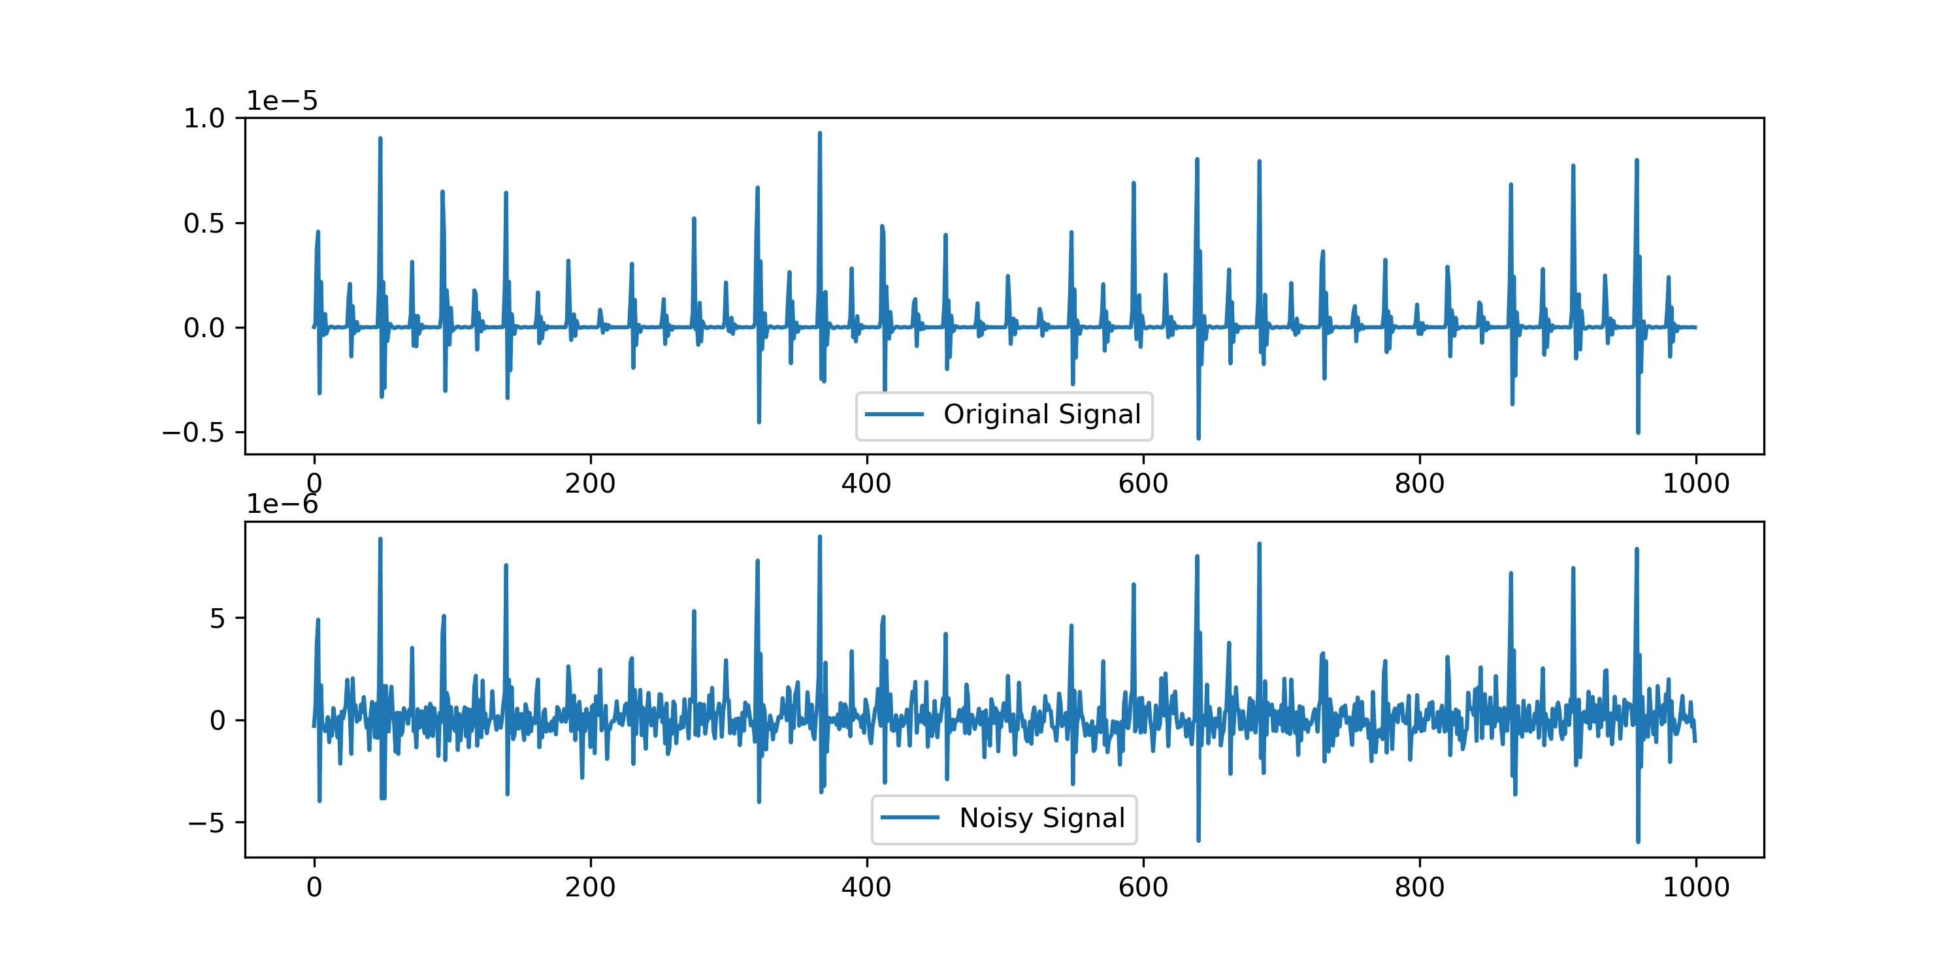
Work_3: Remove Normal Nosie and respiratory
Notes:
展示Normal Noise的效果, 这种情况下SSA并不起作用，因为get不到趋势
展示W filter的效果，wfilter如何应用到了我们算法中去
直接展示结果的表格

Slide 8
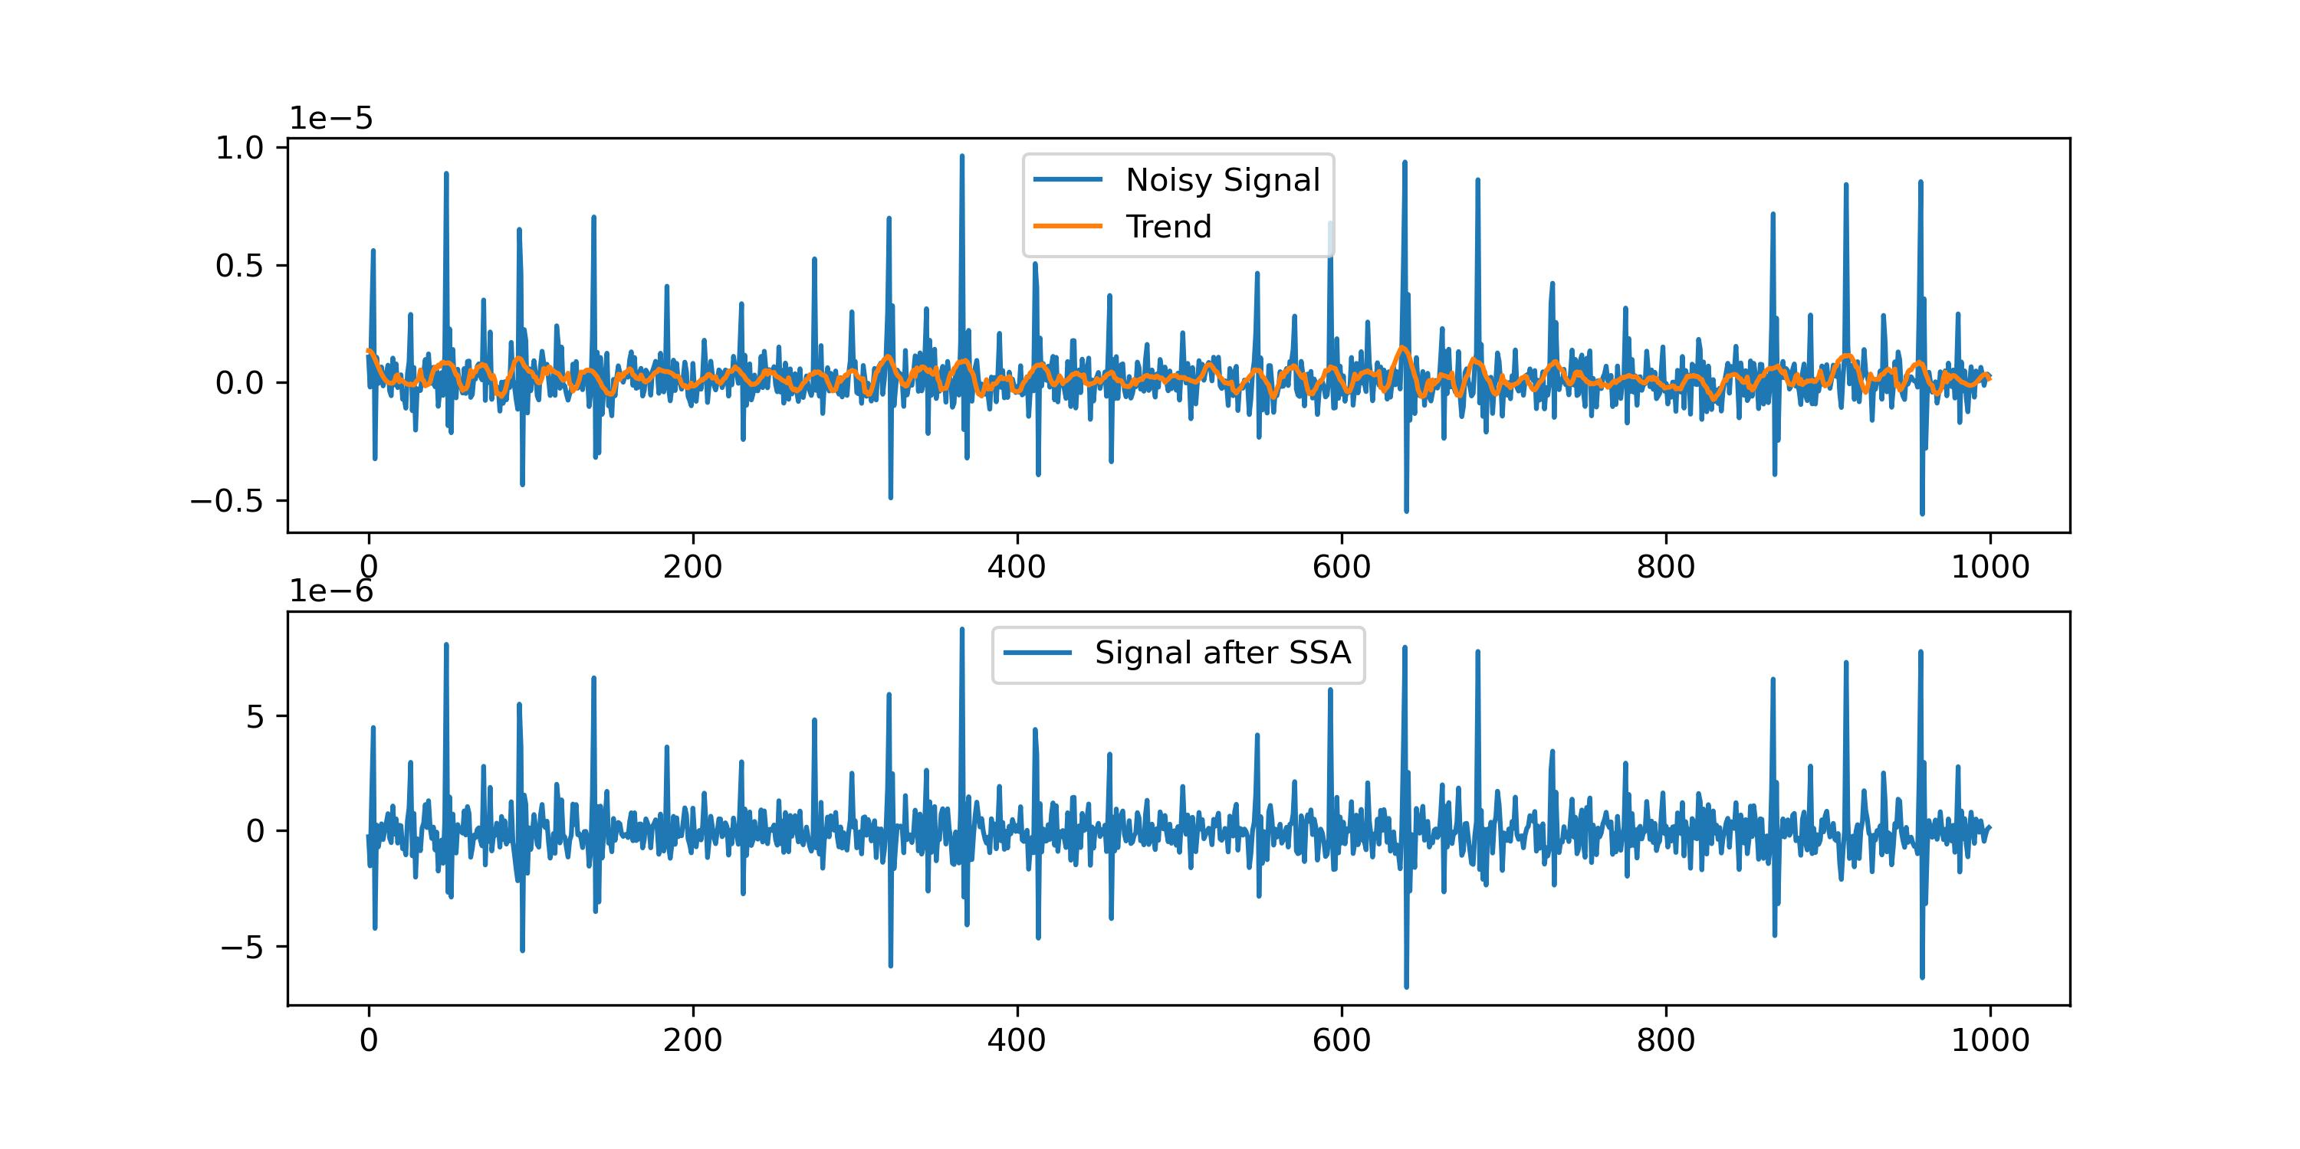
Work_3: Remove Normal Nosie and respiratory
Notes:
展示Normal Noise的效果, 这种情况下SSA并不起作用，因为get不到趋势
展示Wiener filter的效果，wiener filter 如何应用到了我们算法中去
直接展示结果的表格

Slide 9
Work_3: Remove Normal Nosie and respiratory
Notes:
展示Normal Noise的效果, 这种情况下SSA并不起作用，因为get不到趋势
展示W filter的效果，wiener filter如何应用到了我们算法中去
直接展示结果的表格

Slide 10
Work_3: Remove Normal Nosie and respiratory
Noise Level | S | D
0 | 0.9 | 3.1
0.1 | 0.9 | 3.9
Notes:
展示Normal Noise的效果, 这种情况下SSA并不起作用，因为get不到趋势
展示W filter的效果，wfilter如何应用到了我们算法中去
直接展示结果的表格

Slide 11
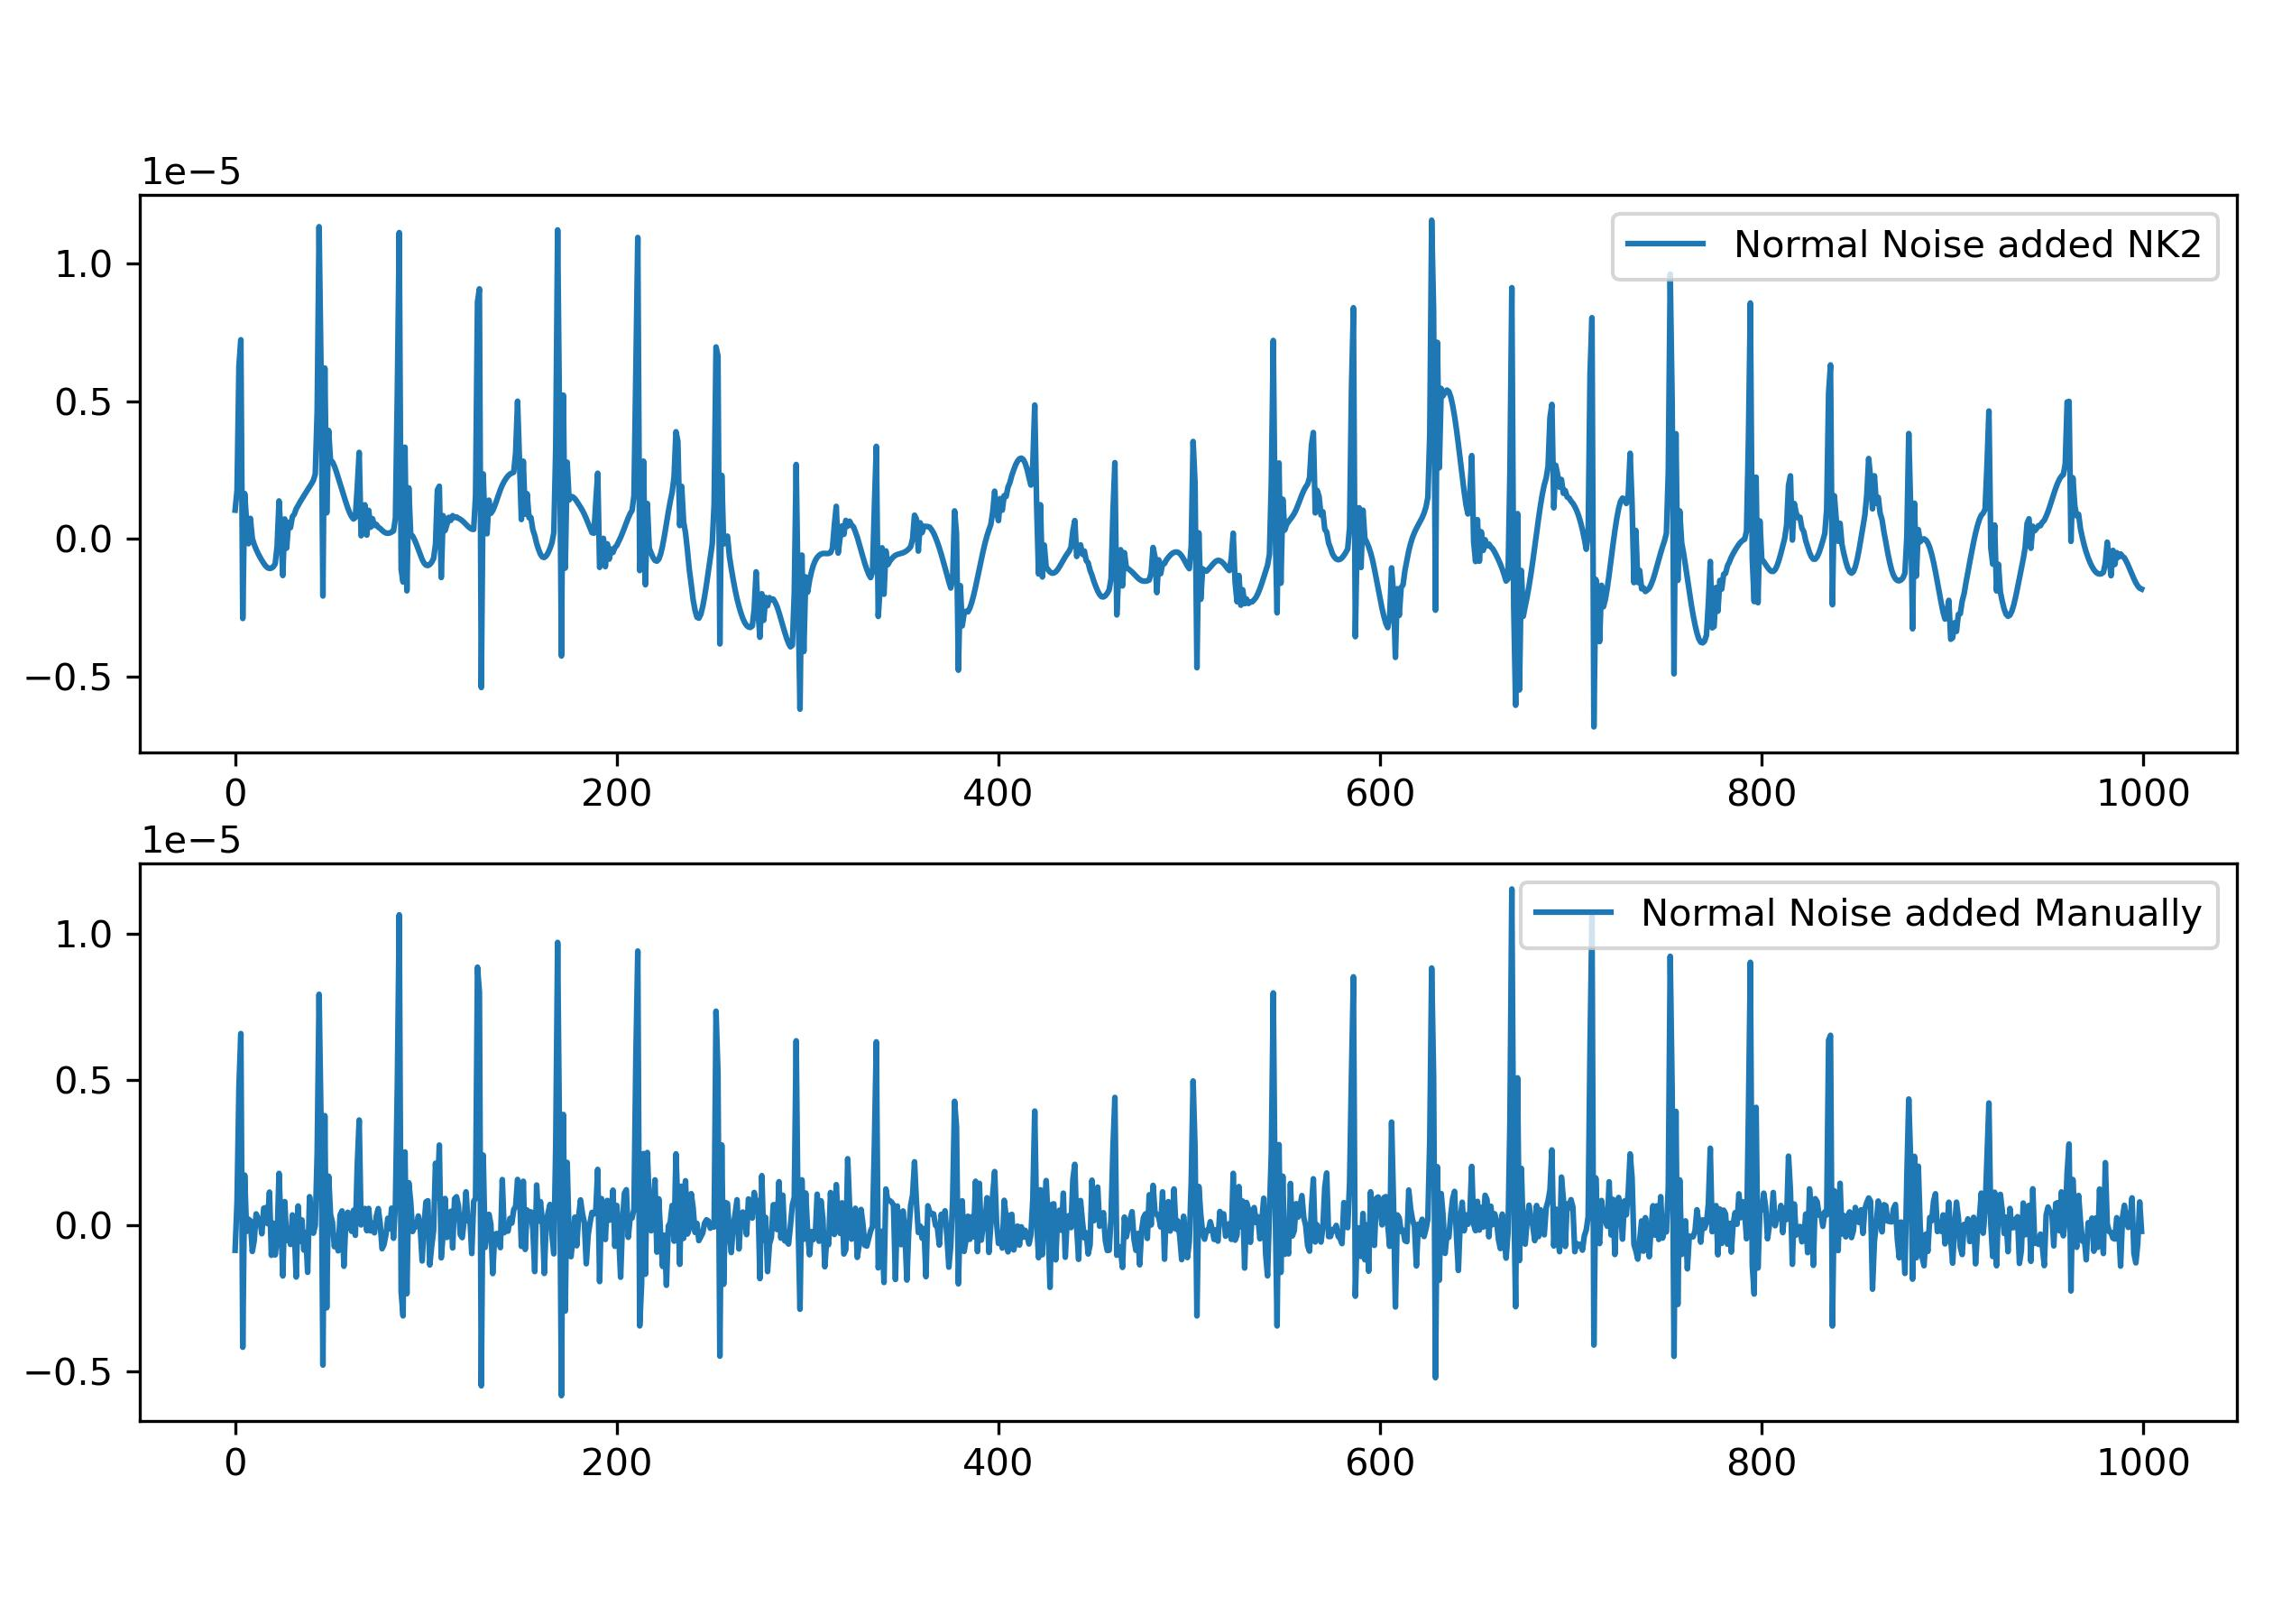
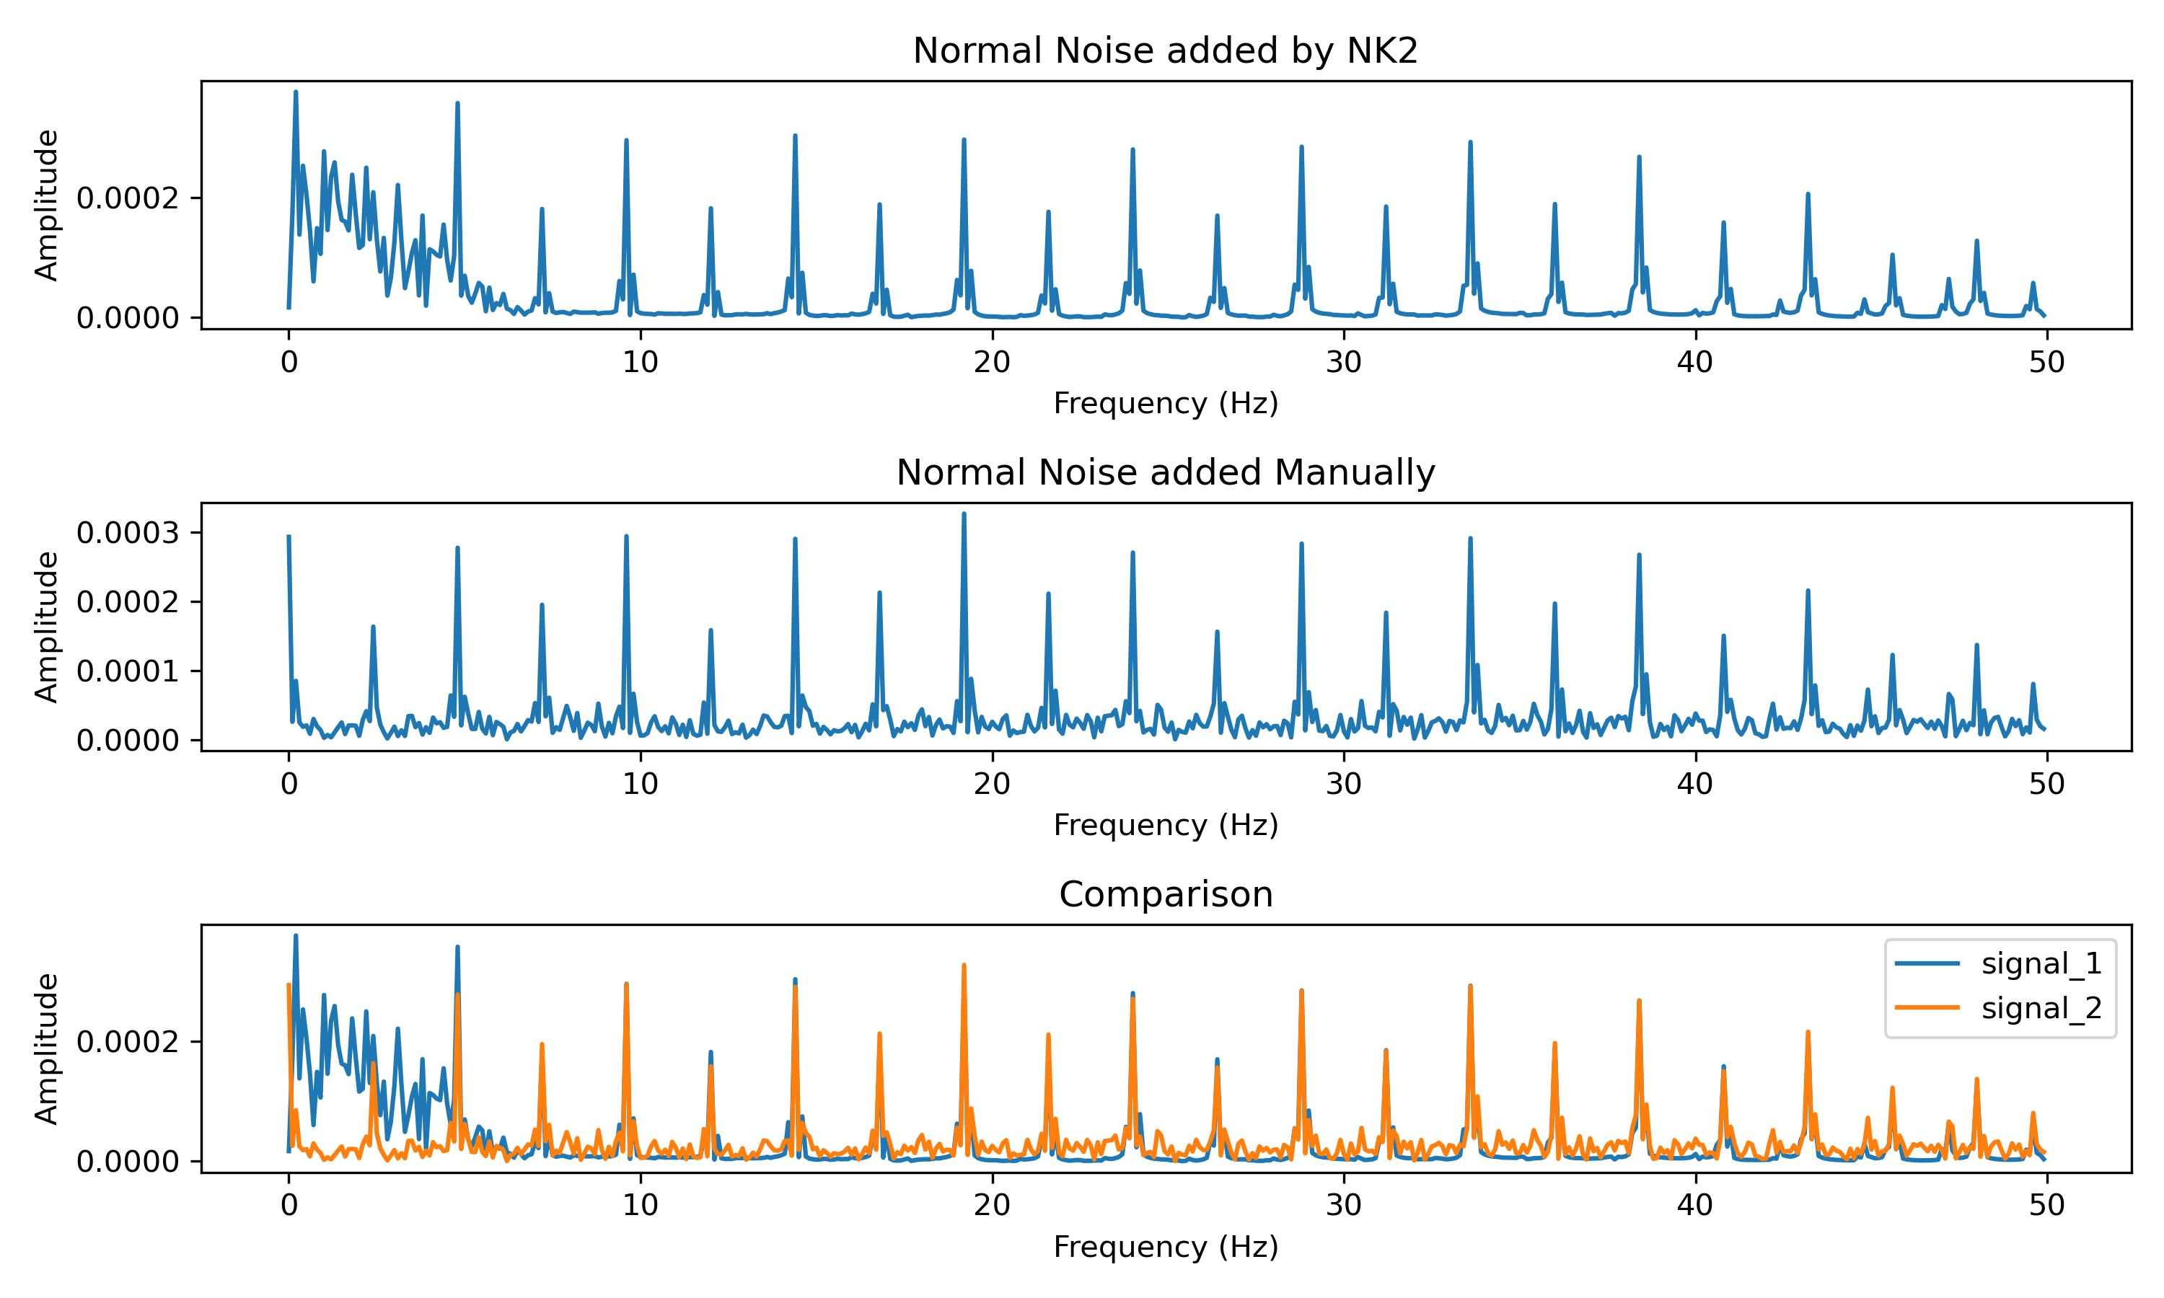
Work_4: Remove Laplace Noise and Normal Noise added by Neurokit2
Notes:
展示Nk2的添加和直接添加之间的区别，时域和频域
展示S filter的效果，以及为什么可以代替SSA
直接展示结果的表格

Slide 12
Work_4: Remove Laplace Noise and Normal Noise added by Neurokit2
Noise | S | D
Normal Noise_level 0.1 | 0.97 | 4.99
Normal Noise_level 0.4 | 0.92 | 5.11
Normal Noise_level 0.8 | 0.97 | 5.47
Laplace Noise_level 0.1 | 0.95 | 4.91
Laplace Noise_level 0.4 | 0.90 | 5.18
Laplace Noise_level 0.8 | 1.15 | 6.11
Notes:
展示Nk2的添加和直接添加之间的区别，时域和频域
展示S filter的效果，以及为什么可以代替SSA
直接展示结果的表格

Slide 13
Work_4: Theoretical knowledge Learning
Signals and Systems
Probability for Computer Scientists
Course: EE120, Berkeley
This week’s Progress:
None
Next week’s plan:
Lecture 10 (the DFT; FIR filters)
Lecture 11 (Fourier transforms in two dimensions)
Finish 1 lab
Course: CS109, Standford
This week's progress:
Part * 12
Next week’s plan:
Part * 12

Slide 14
Questions
真实数据集的标签有点问题
Compare to EEMD,可以给我进一步的解释
真实的波真的是模拟的信号加噪声以后的结果吗？

Slide 15
Thanks!

