Slide 1
Presentation
Jiayu Chen
2024.01.29

Slide 2
Work Description
Part_1: Template-based IBI Prediction
Part_2: Attempts to S and D Prediction
* Original Signal
* Differentiated Signal
* Filtered Signal
* Coefficients of FMM
Part_3: Questions

Slide 3
Part_1

Slide 4
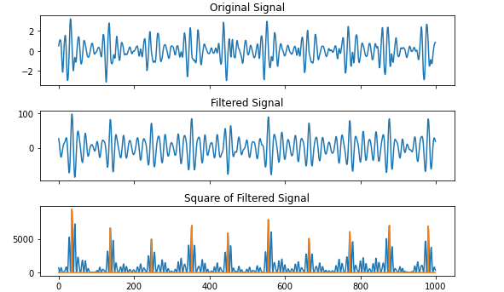
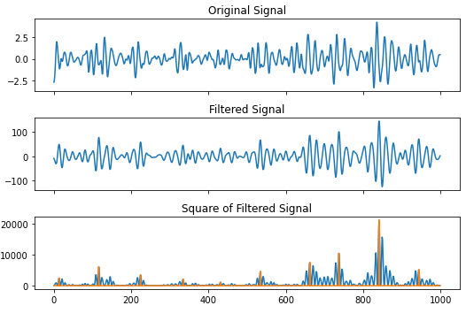
Template-based IBI Prediction
After Attempts on More Real data:
I’m sure the IBI could be accurately calculated, by applying Matched Filter to the 10 second signal and its template. If we can first roughly calculate the Heart Rate.
In an ideal solution
In less than ideal solutions

Slide 5
Template-based IBI Prediction
Workflow of IBI Prediction
Original Signal
Rough HR
Prediction
Find Peaks
(Local Max)
IBI
Prediction
Matched Filter
Filtered Signal
Get Template
* A easy and useful way for rough heart rate will be introduced in next pages

Slide 6
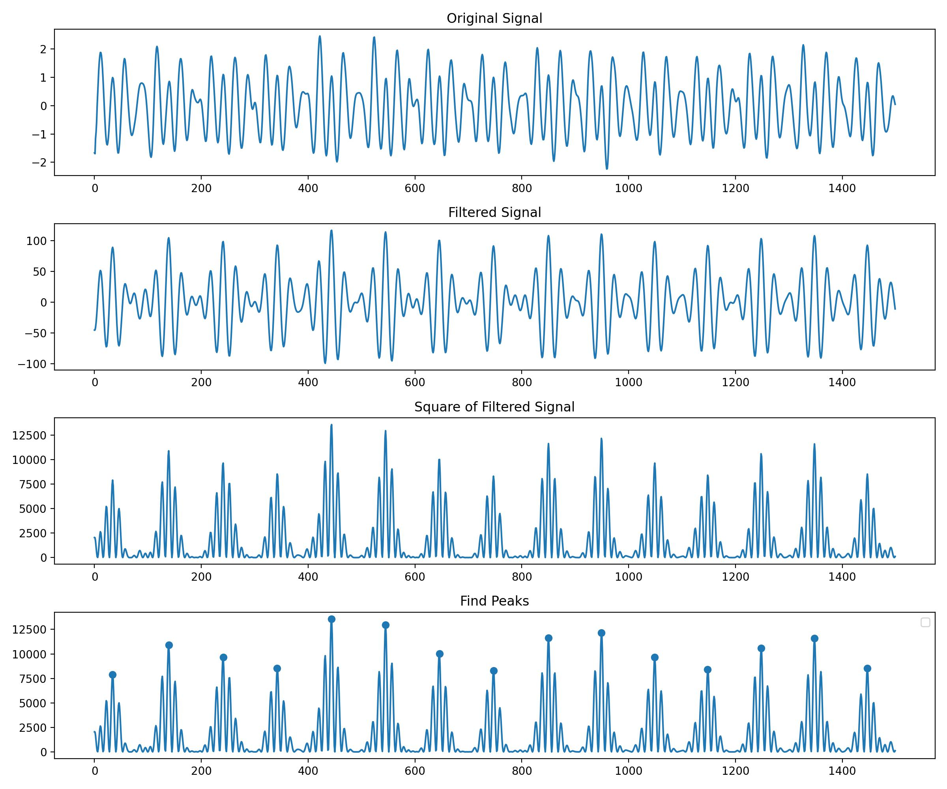
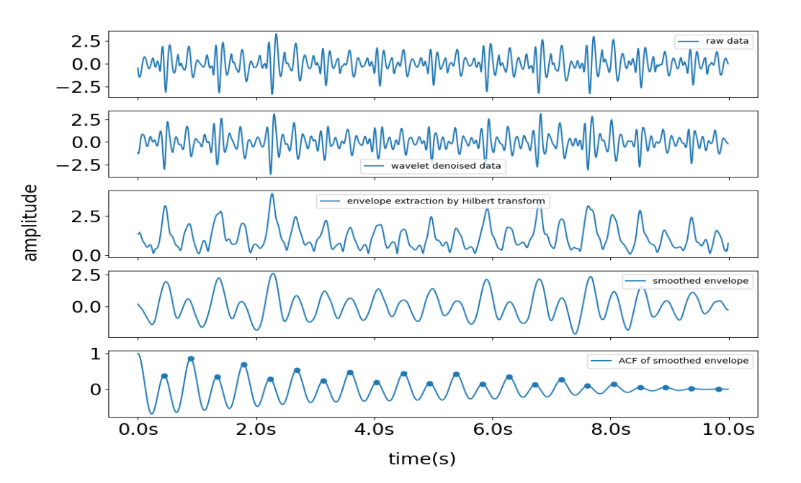
Template-based IBI Prediction
Material From Yingjian’s Paper
Reason:
For signals with particularly prominent patterns or significant peaks, the calculation of IBI works well.
Conversely, for signals unclear or ambiguous, IBI calculation may encounter some issues. These issues and the possible solution will be mentioned later on.
However, errors can arise when the incoming signal displays two distinct peaks within a single heartbeat cycle, as illustrated on the right side of fig.9. The first of these peaks is termed the systolic peak, while the second is the diastolic peak.

Slide 7
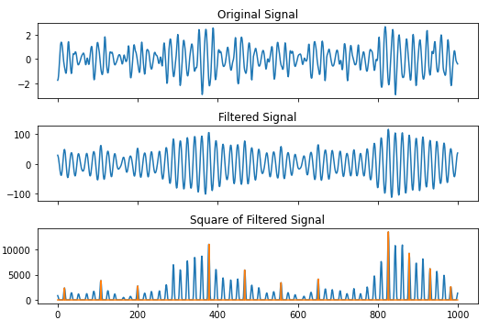
Template-based IBI Prediction
Question: In the paper, Song reconstruct signals with frequency ranges spanning 0.8 Hz to 12 Hz. At which frequencies of signals can we clearly observe the heartbeat cycle? Is it necessary to include all information related to heartbeats in the signals?
Fact：
Sticky heartbeats are a significant issue. They have a considerable impact on IBI calculations.
Assumption:
In the connection between two heartbeats, the signal values should ideally be close to zero.
For signals during heartbeats, there should, in principle, be rich information, exhibiting a wide frequency range.
Observation:
Most instances of sticky connections are caused by low frequencies.
Solution:
Eliminating low-frequency signals, only the high-frequency information related to heartbeats is considered.

Slide 8
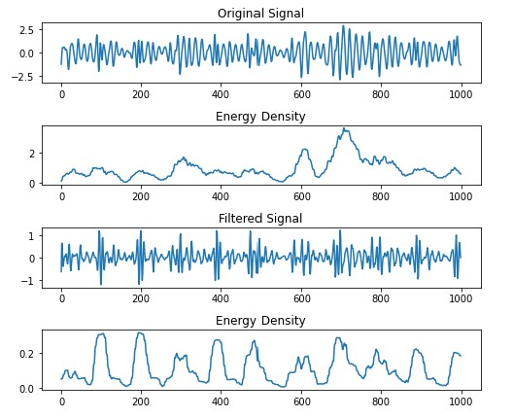
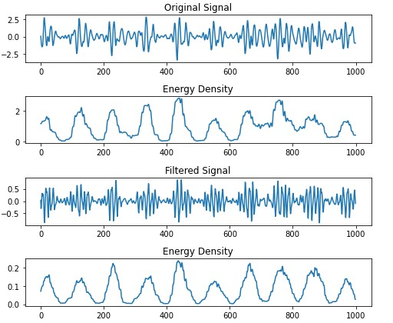
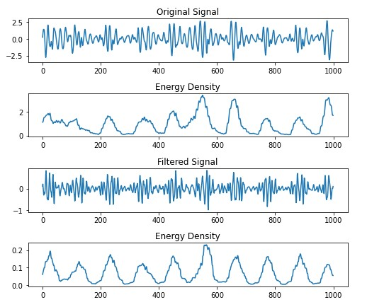
Template-based IBI Prediction
Advantages:
Sticky Heartbeats signals could be identified easily.
Due to the higher energy content of low-frequency signals, filtering out these signals results in a more uniform and periodic distribution of signal energy.

Slide 9
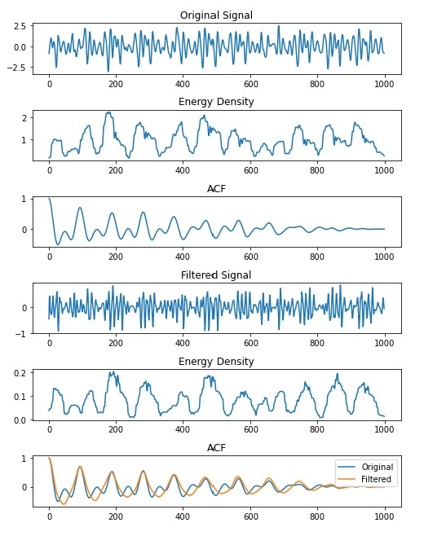
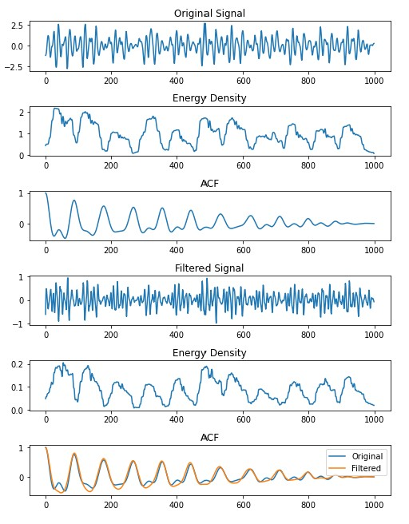
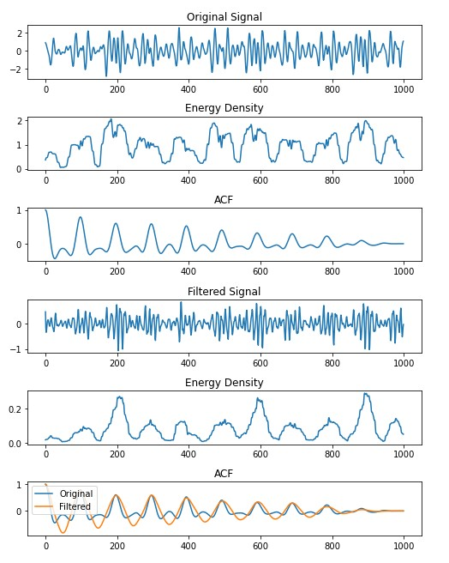
Template-based IBI Prediction
After filtering out the low-frequency signals, applying ACF to the envelope curve prevents the occurrence of bimodal phenomena. Based on observations, 80% of the bimodal phenomena will disappear, while the remaining 20% will significantly diminish.
In summary, high-frequency signals are effective for HR estimation, but they prevent the meaningful extraction of templates.

Slide 10
Template-based IBI Prediction
Template-Based IBI Estimation is not flawless, and the main concern is the similarity between the signals at the connection points and the heartbeat signals.
The idea you provided about the concept of the Fuzzy Matched Filter, might potentially address this issue if successfully implemented. We should spend more time on it.

Slide 11
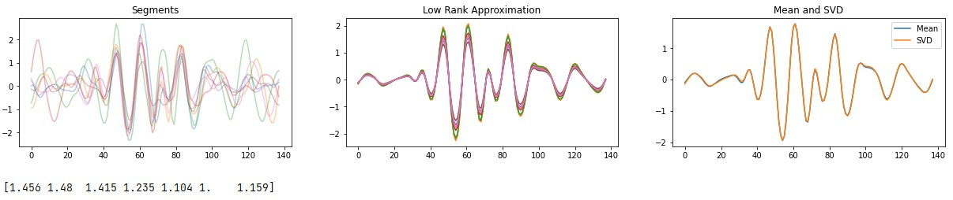
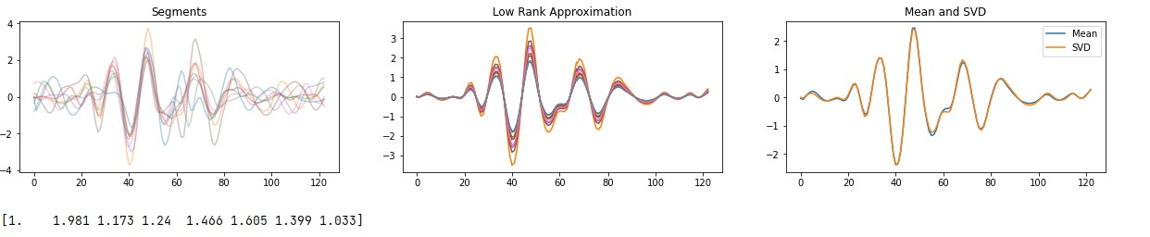
Template-based IBI Prediction
Low Rank Approximation
The mean template of circles is roughly equally to the low rank approximation of circles.
What’s more, we can get a set of templates with different amplitudes corresponding one-to-one with the original circles’ amplitudes.
This might be helpful to design a fuzzy matched filter.

Slide 12
Part_2

Slide 13
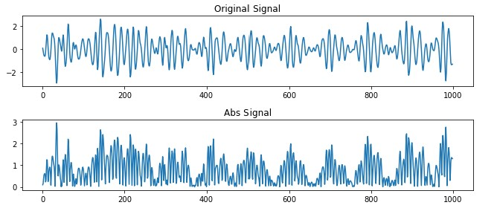
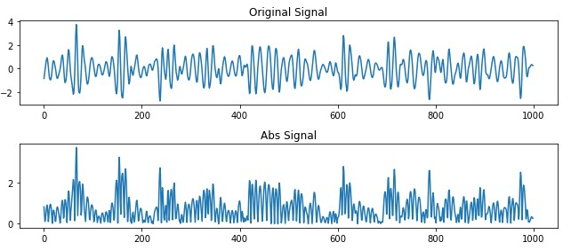
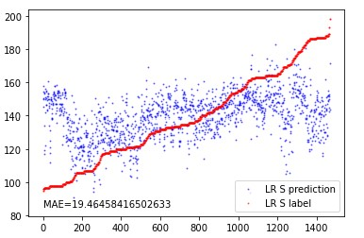
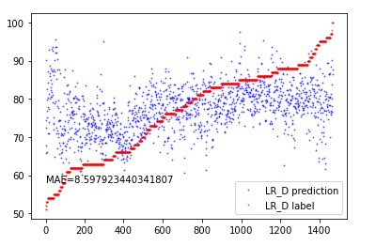
Attempts to S and D Prediction * Original Signal
Point_1
We can hardly get some useful information from signals after taking absolute values.
Point_2
We can hardly get hints from features extracted by Tsfresh.
location_of_minimum, first & last
time_reversal_asymmetry_statistic
autocorrelation__lag_*
cwt_coefficients
agg_linear_trend_chunk_len_5__f_agg_“max\min\mean”
fourier_entropy

Slide 14
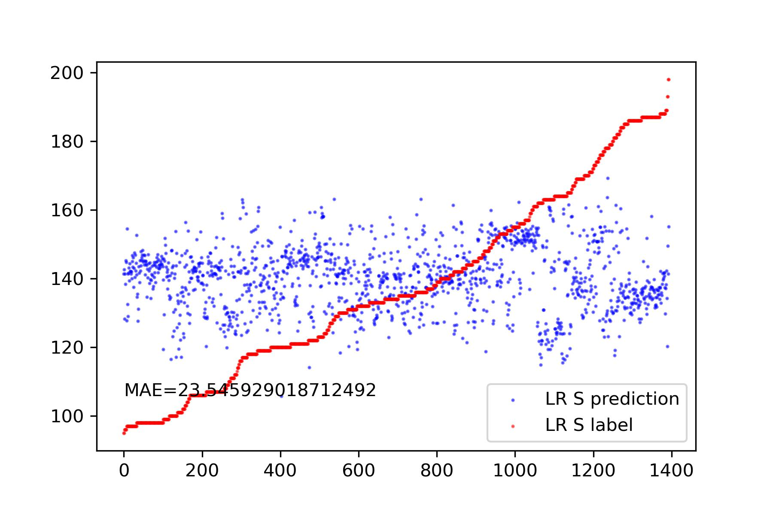
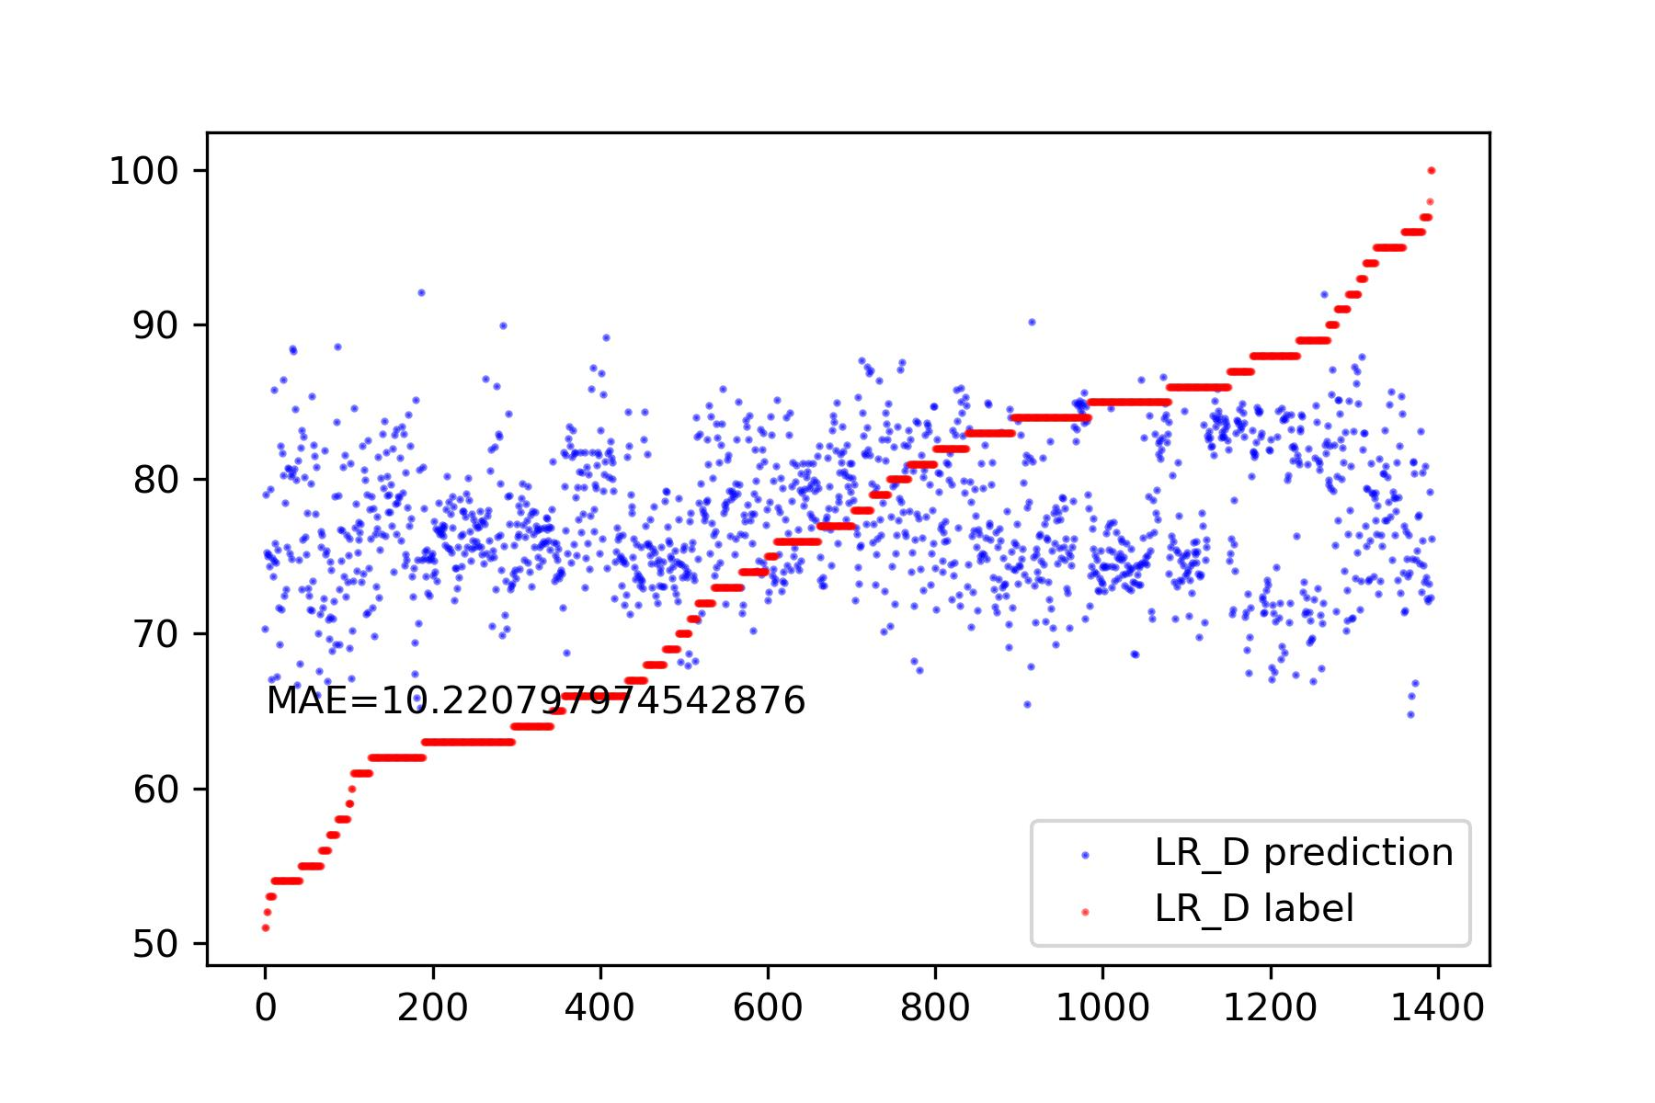
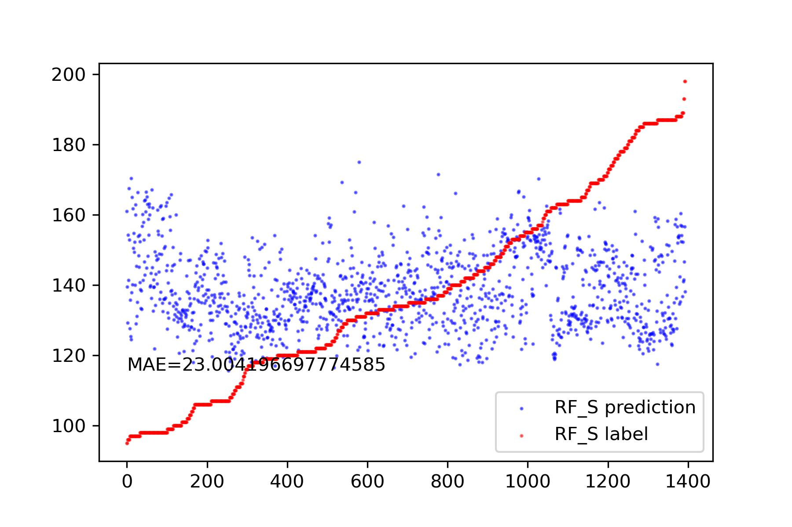
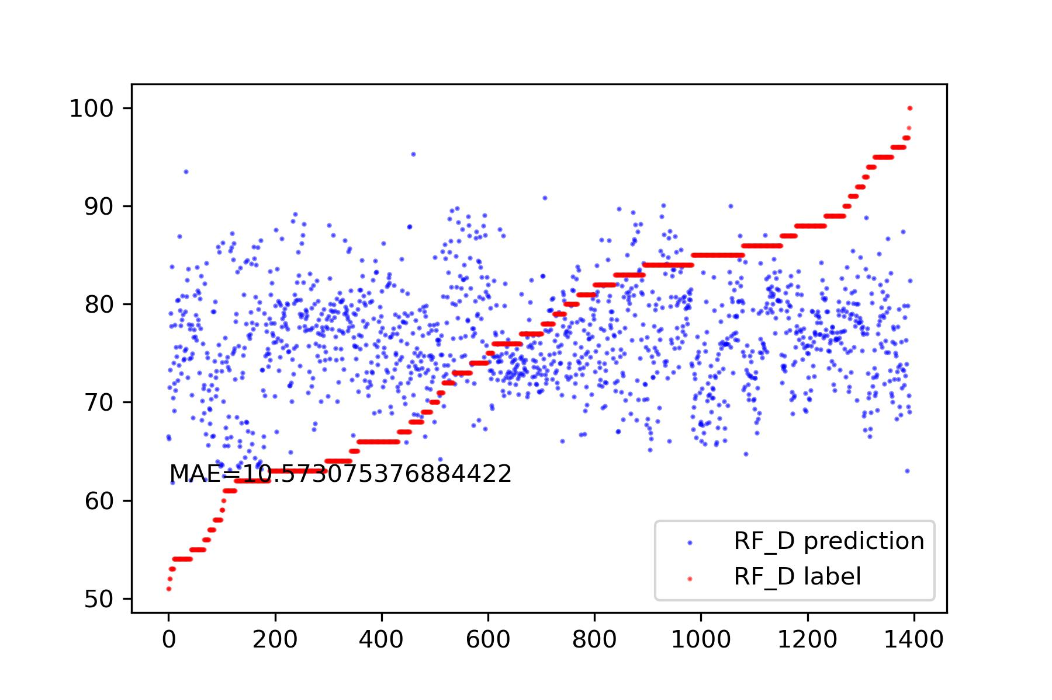
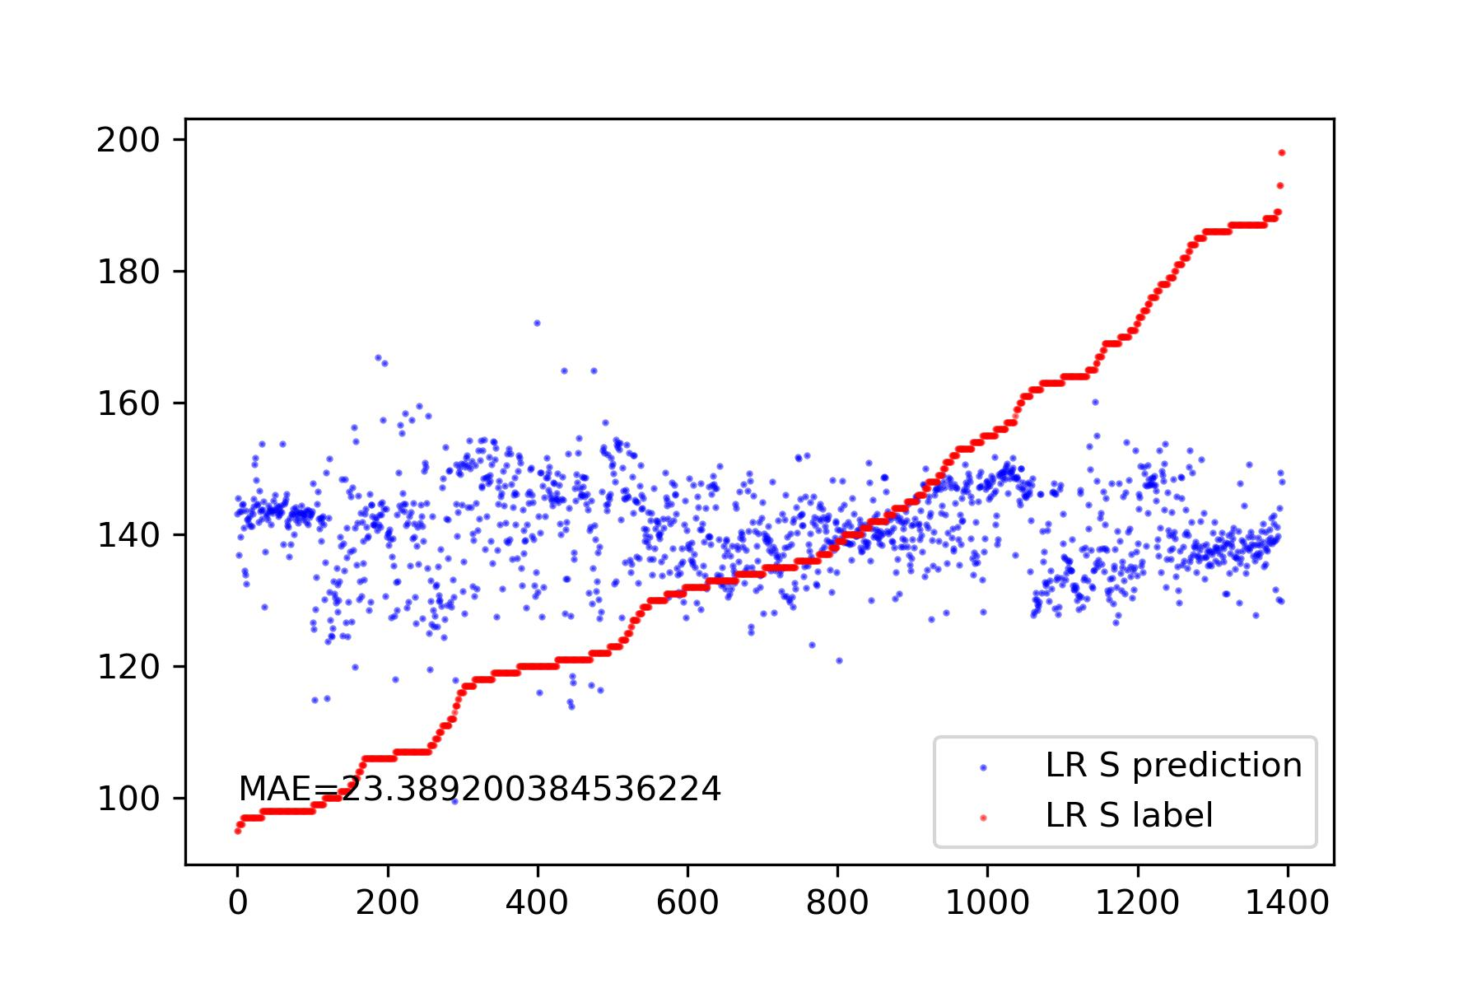
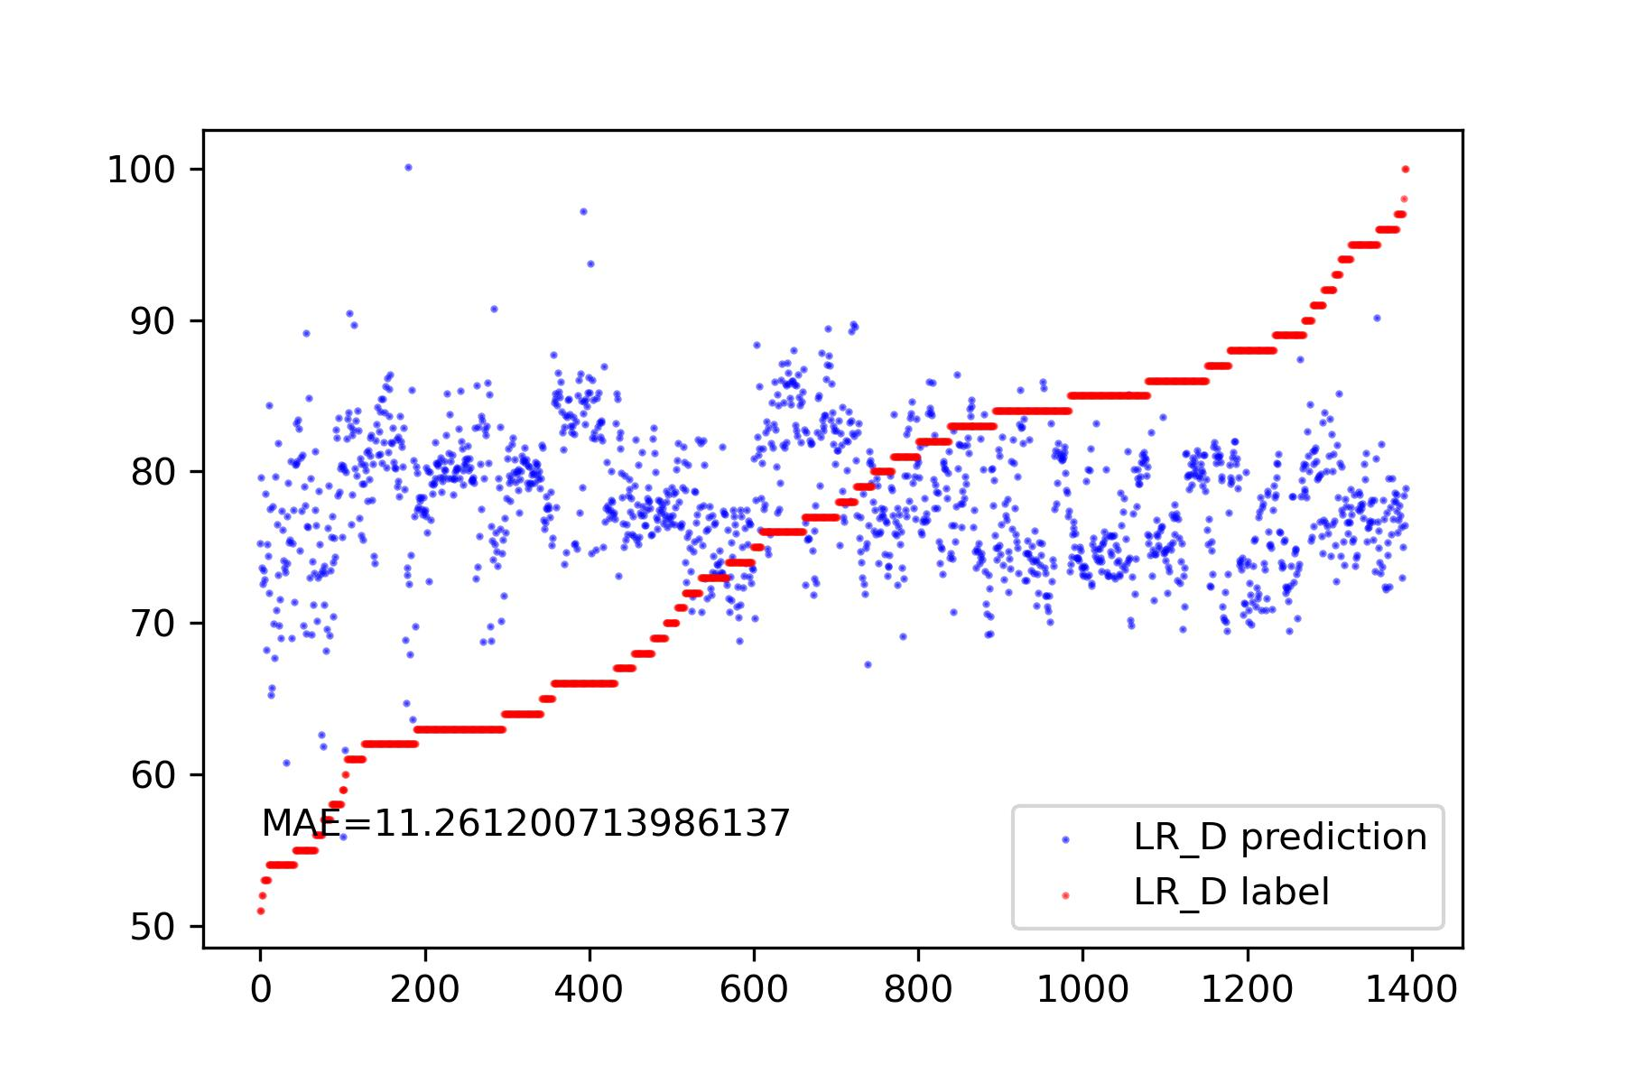
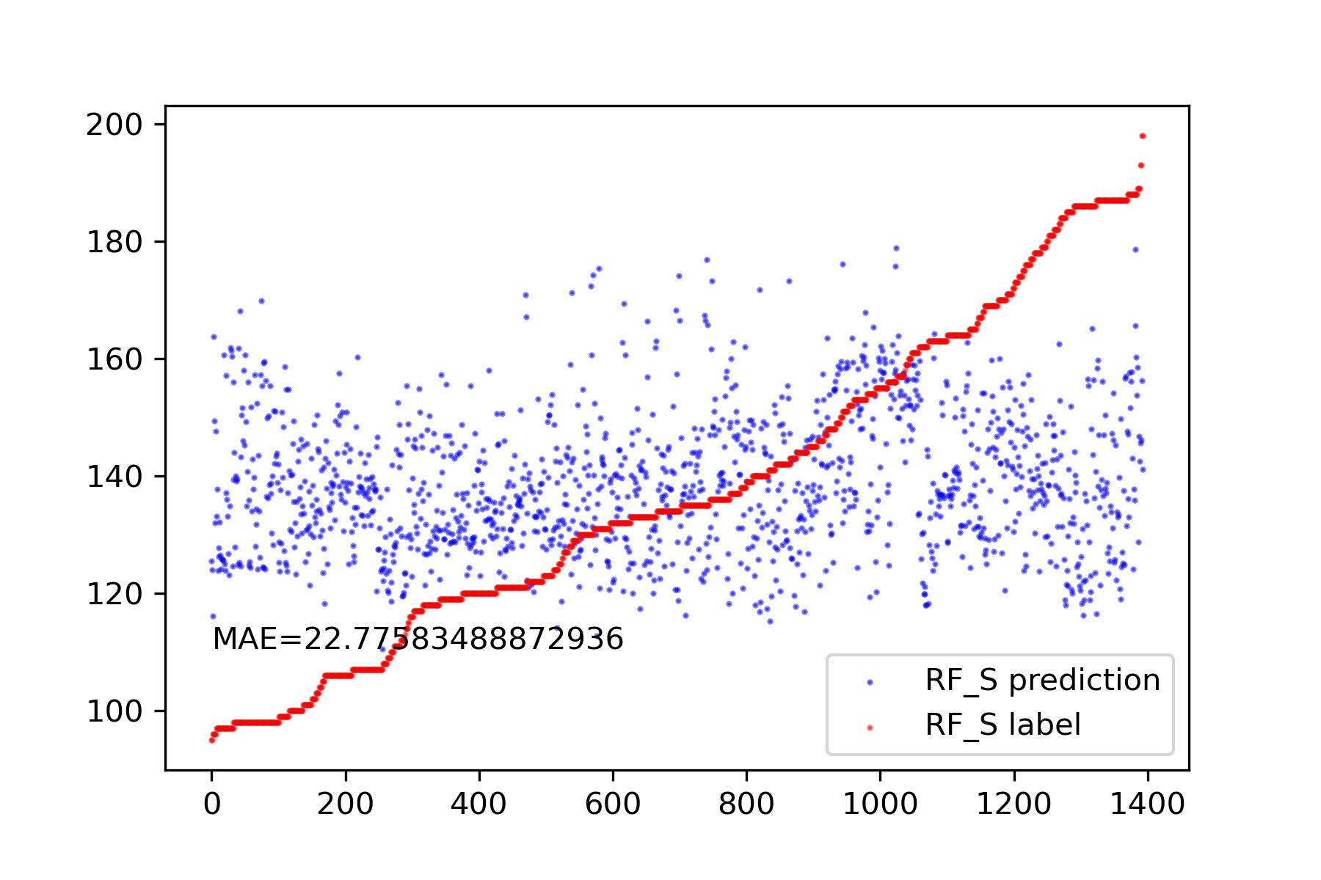
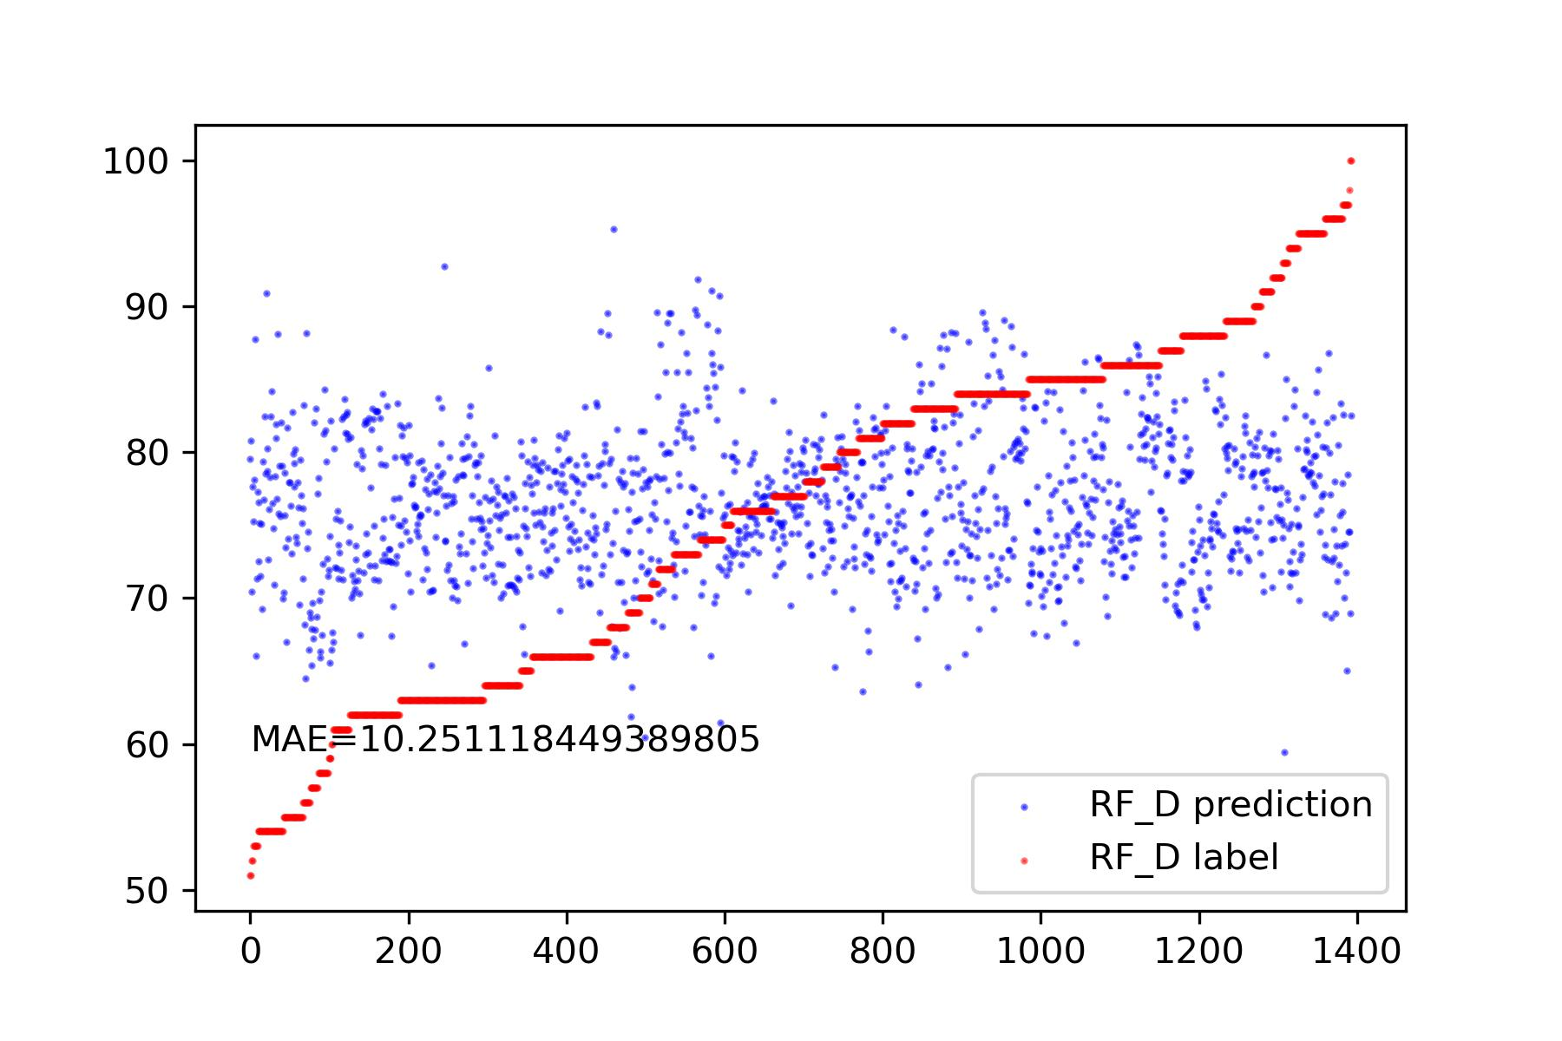
Attempts to S and D Prediction * Original Signal
Point_3
[Top-k highest peaks, Top-k lowest valleys, Top-k highest peaks’ position, Top-k lowest valleys’ positions ]
[Sorted(Top-k highest peaks, Top-k lowest valleys), Sorted(Top-k highest peaks’ position, Top-k lowest valleys’ positions) ]

Slide 15
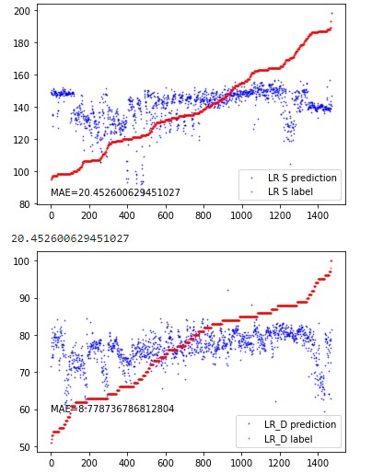
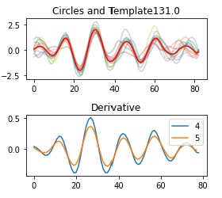
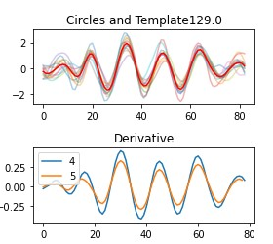
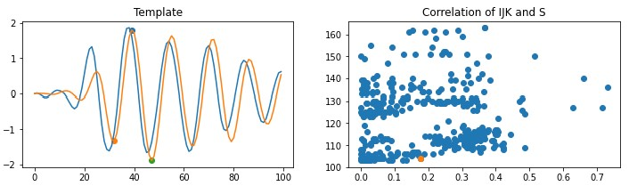
Attempts to S and D Prediction * Differentiated Signal
Point_2
Use features extracted by Tsfresh to make prediction.
Point_1
After differentiation, BSG signals closely resemble BCG signals. Most of the time, we can easily identify the J Peak. However, the IJK features are not always prominent.
Autocorrelation
Fourier_entropy

Slide 16
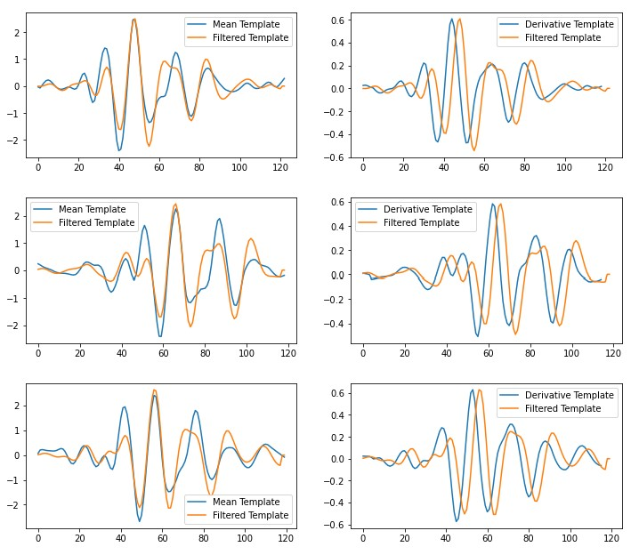
Attempts to S and D Prediction * Filtered Signal
After applying a high-pass filter (2Hz), the J Peak becomes easily identifiable. However, the IJK features are more pronounced compared to differentiated signals.
The reason for the appearance of IJK is not clear, possibly occurring by chance. What can be confirmed is that the signals filtered by the high-pass filter show a clearer presence of IJK compared to differentiated signals.

Slide 17
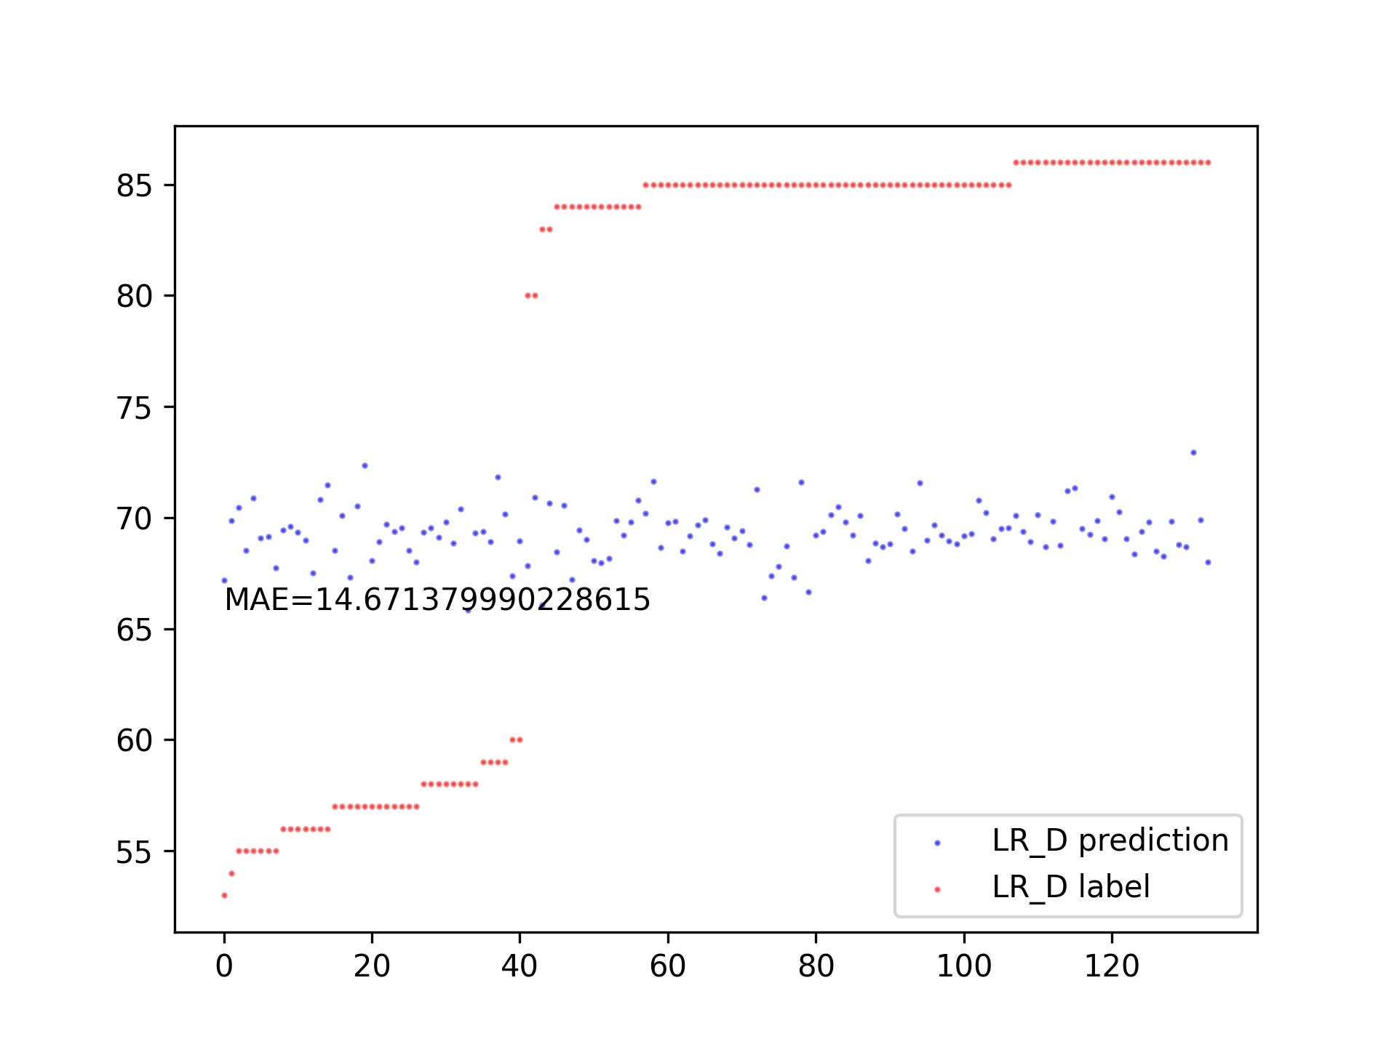
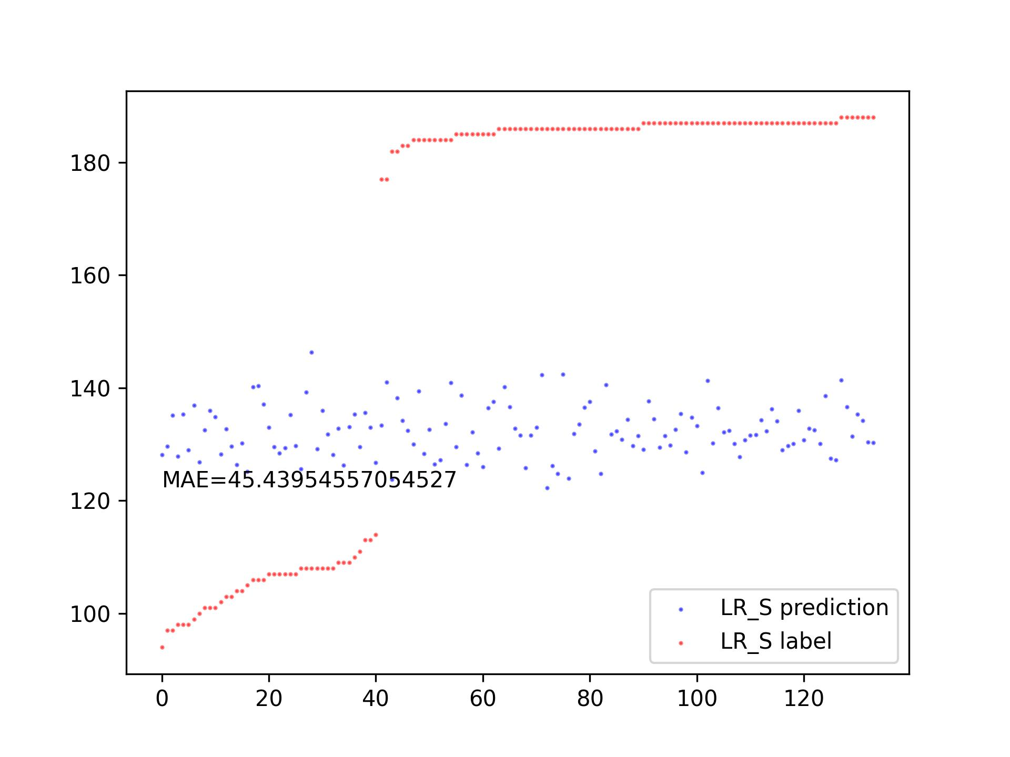
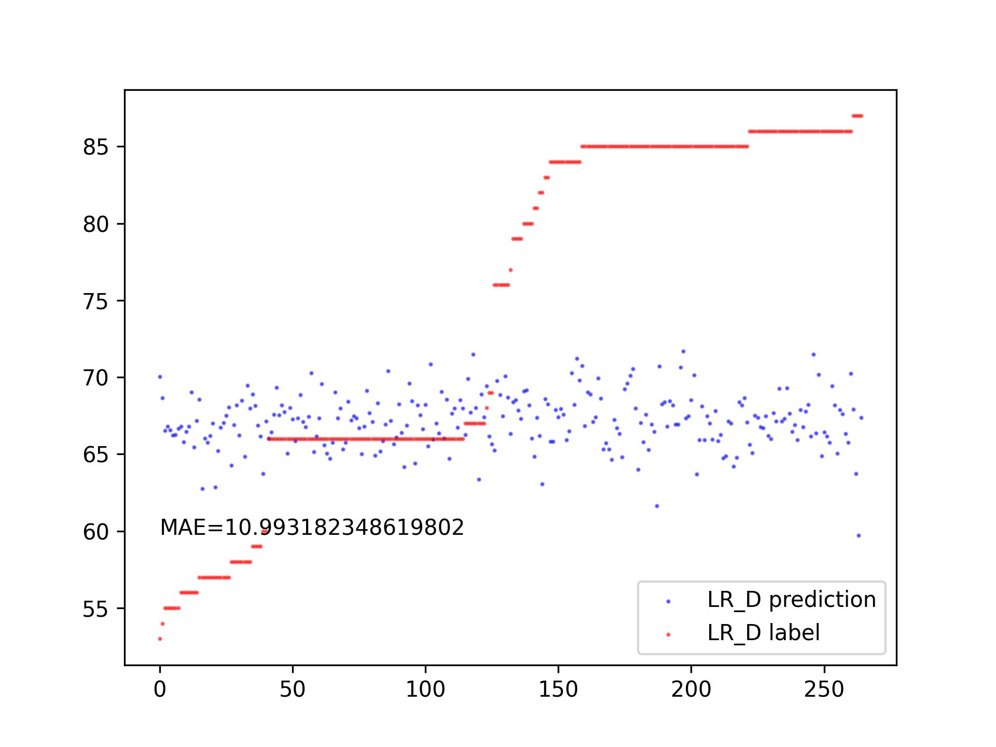
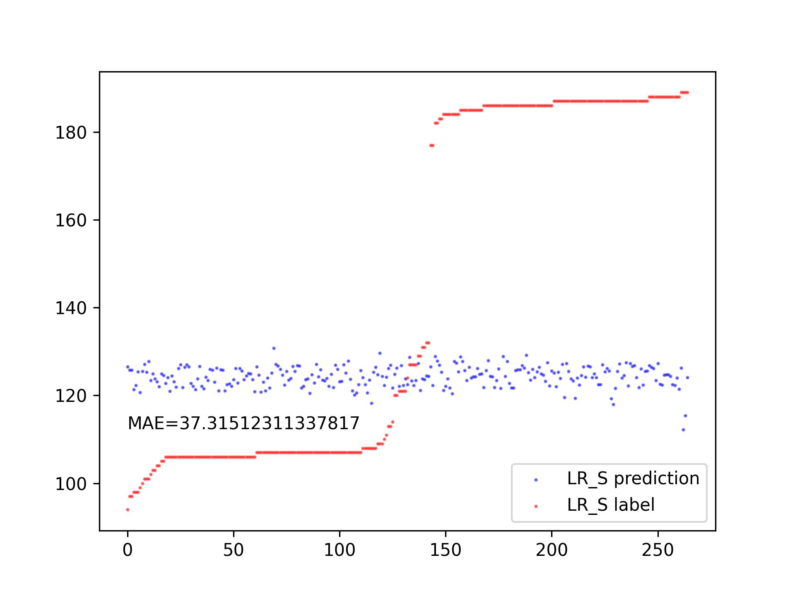
Attempts to S and D Prediction * FMM
Train Set: 300, Test Set: 150
Train Set: 500, Test Set: 300

Slide 18
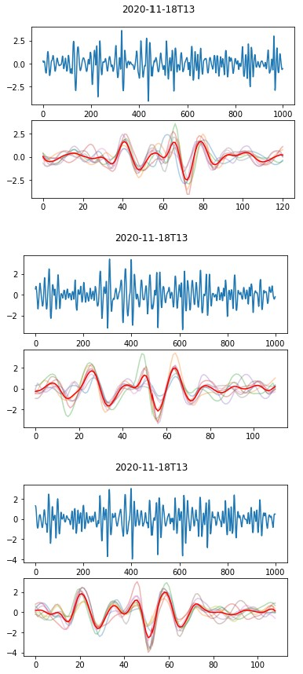
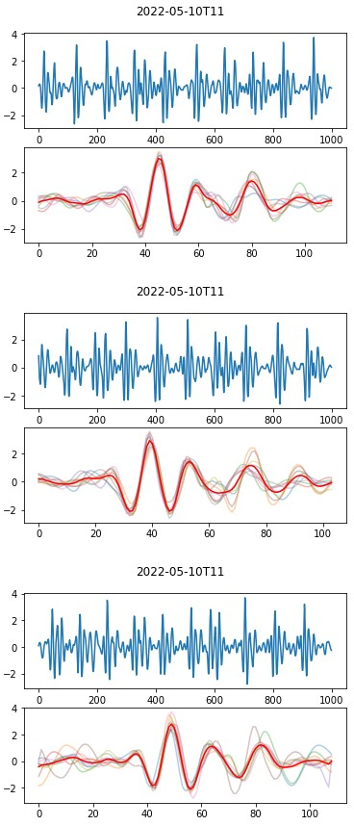
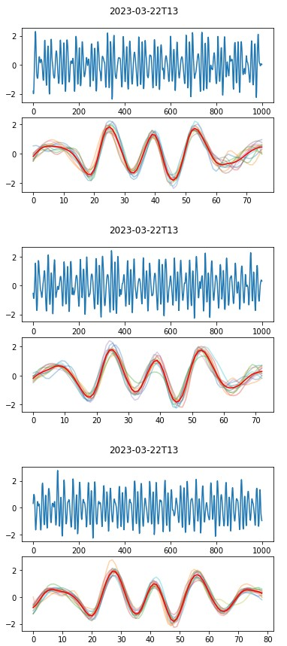
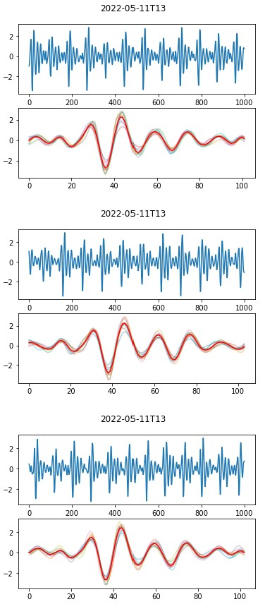
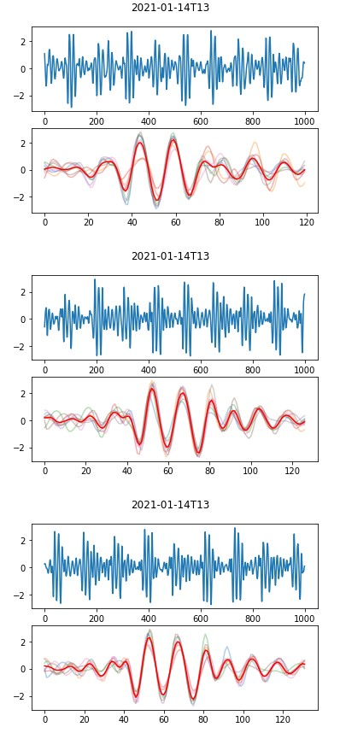
Attempts to S and D Prediction
People 1
People 2
People 3
People 4
People 5

Slide 19
Problems
The research we are doing seems doesn’t meet the requirement of the graduation project.* Without a baseline, there is hardly any way to compare. * It doesn't resemble a complete piece of work.
2. I totally have no idea how to extract features from S and D.

Slide 20
Thanks!

