Slide 1
Presentation
Jiayu Chen
2024.04.15

Slide 2
Outline
Part_1: New Algo for AFib
Part_2: Thoughts about Further Research on BP
Part_3: Paper Writing

Slide 3
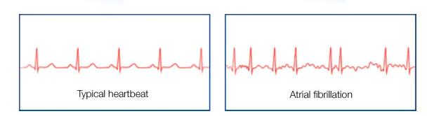
New Algo for AFib
Able to cope with a part of it
Heart can complete a full cardiac cycle. Heart Rate increases Rapidly.
The electrical signals in the atrium are uncontrolled, leading to rapid atrial contractions.
ventricle
Too much to handle
Atrial contracts individually
Expressed in the BSG signal, it should be a portion of the heartbeat completes a heartbeat cycle in a very short time.
The core of the problem is that AFib heartbeats have temporal stretching.
Almost all parts of the previous algorithm need to be done over again.
https://www.mayoclinic.org/diseases-conditions/atrial-fibrillation/symptoms-causes/syc-20350624

Slide 4
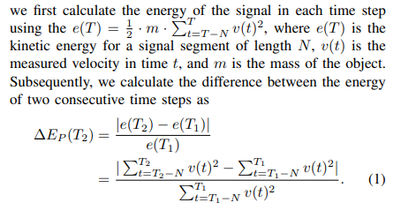
New Algo for AFib
Why does IoT 2023 Quality Control determine the Afib signal as not a heartbeat?
The Denoise range is wrongly estimated. 0.8Hz-12.5Hz is too narrow, it will treat some heartbeats with Afib as noise. 0.8Hz-25Hz would be safer.
Yingjian‘s actual Quality Control code is partly based on ACF, which is different from IoT’s paper.
The heartbeats of Afib patients, 30% will be filtered, then 30% will be distorted due to denoise, leaving 40% that can be recognized as heartbeats and are not distorted.
A previous thought: use the ratio of the kinetic energy of two consecutive time steps to make a distinction between the presence of other vibrational signals in the signal. The empirical parameter of 20% given in the paper would result in almost no signal being retained.
This method, based on the ratio of kinetic energies, with modifications can be used for the separation of the vibration source with little effect on the Afib heartbeats.

Slide 5
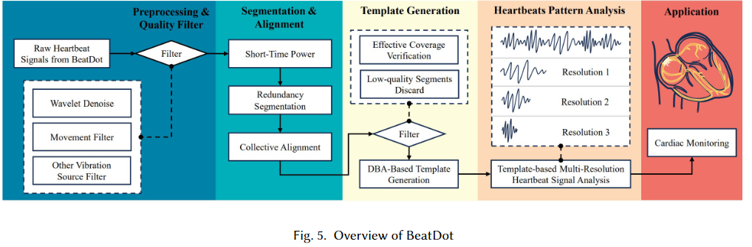
New Algo for AFib
The core of the altered algorithm is to vary the scale of the Template so that the heartbeat signals of Afib patients can be processed at multiple resolutions.

Slide 6
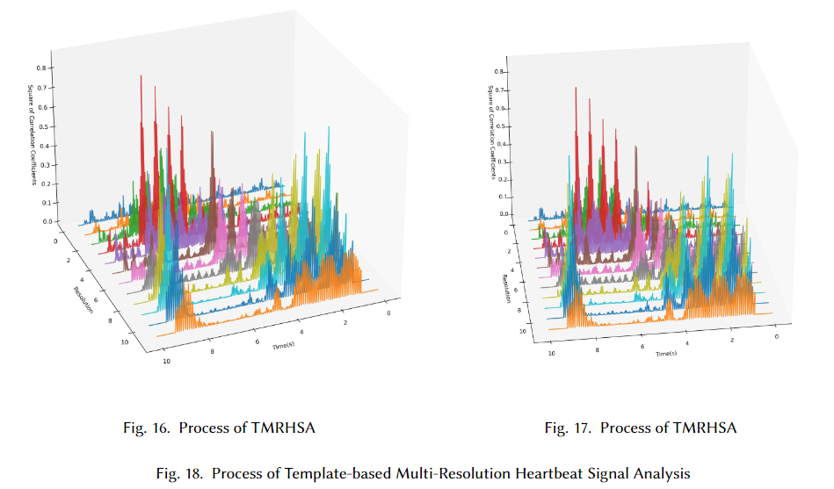
New Algo for AFib

Slide 7
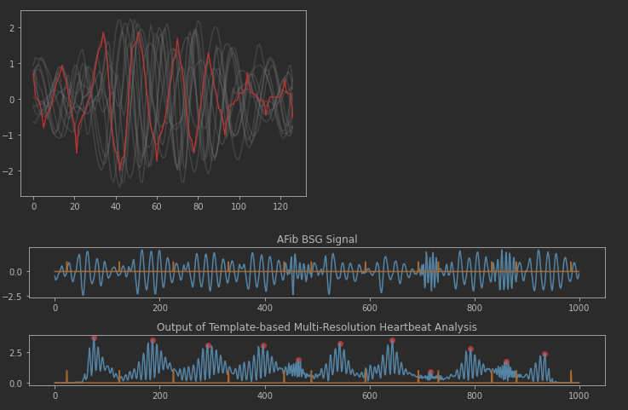
New Algo for AFib
Seventy-five 10s signals were manually examined, with roughly 190 abnormal heartbeats and 5 that were not localized.
IBI Label

Slide 8
Thoughts about Further Research on BP
At the moment, I think the existing time-domain features have basically been tried. If the real features are complex interactions between multiple time-domain features. We may need to use Yida's feature selection method.
I think there are two ways to potentially go deeper into BP
Finding explainable features to classify High Pressure (>135) and Low pressure (<125).
Few-shot. Given a person's initial blood pressure, a prediction is then made for that person.
I'm not capable of writing a paper with such a short deadline and researching blood pressure at the same time. Can we research BP after this article is submitted？

Slide 9
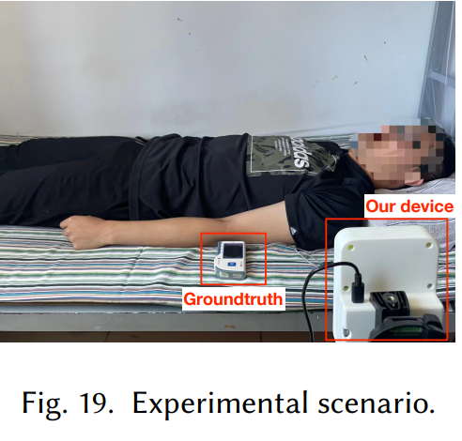
Paper Writing
A photo is needed from side: the patient, HealthCare4 and BedDot in the same photyouro.
Use BedDot to collect data.
When writing the introduction, I found 2-3 papers that had used Template matching to estimate IBI, and they were all in 2023 or 2024 year.
Parlato S, Centracchio J, Esposito D, et al. Heartbeat Detection in Gyrocardiography Signals without Concurrent ECG Tracings[J]. Sensors, 2023, 23(13): 6200.
Centracchio J, Parlato S, Esposito D, et al. Accurate Localization of First and Second Heart Sounds via Template Matching in Forcecardiography Signals[J]. Sensors, 2024, 24(5): 1525.

