Slide 1
Presentation
Jiayu Chen
2024.8.16
Notes:
Noise reduction and signal reconstruction.

Slide 2
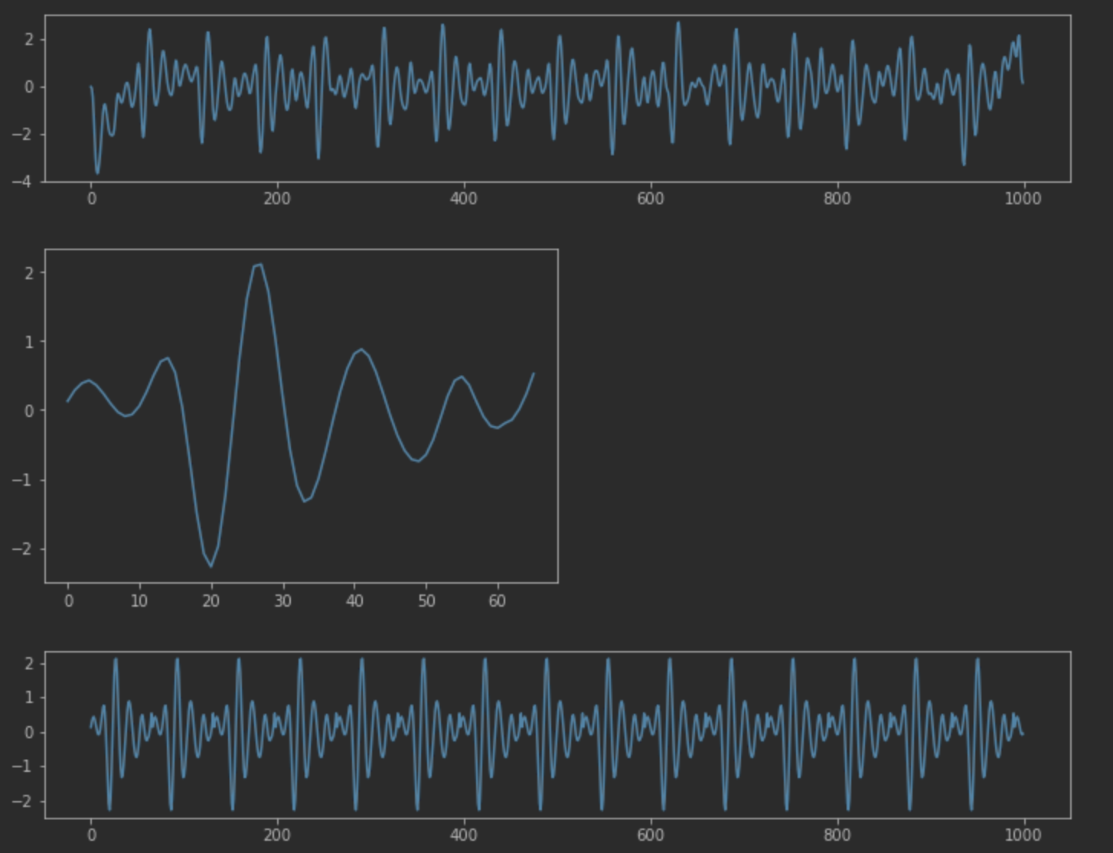
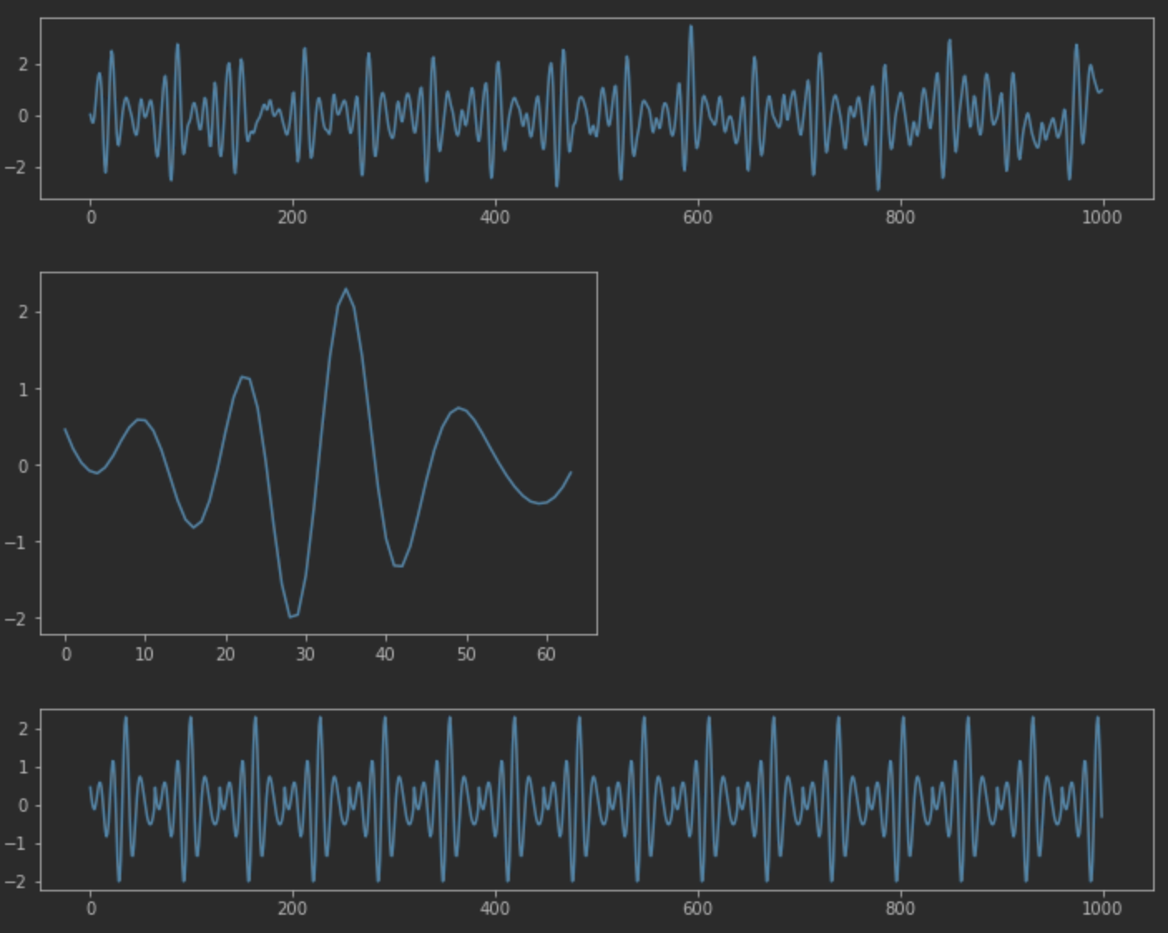
Signal Reconstruction
During our discussion, we think we need to relax the constraints. If heartbeat templates are high quality, the reconstructed 10s signals contain the same information as the original 10s signals. But DL models could learn features more easily.
Notes:
Next are some problems I have encountered in my learning.

Slide 3
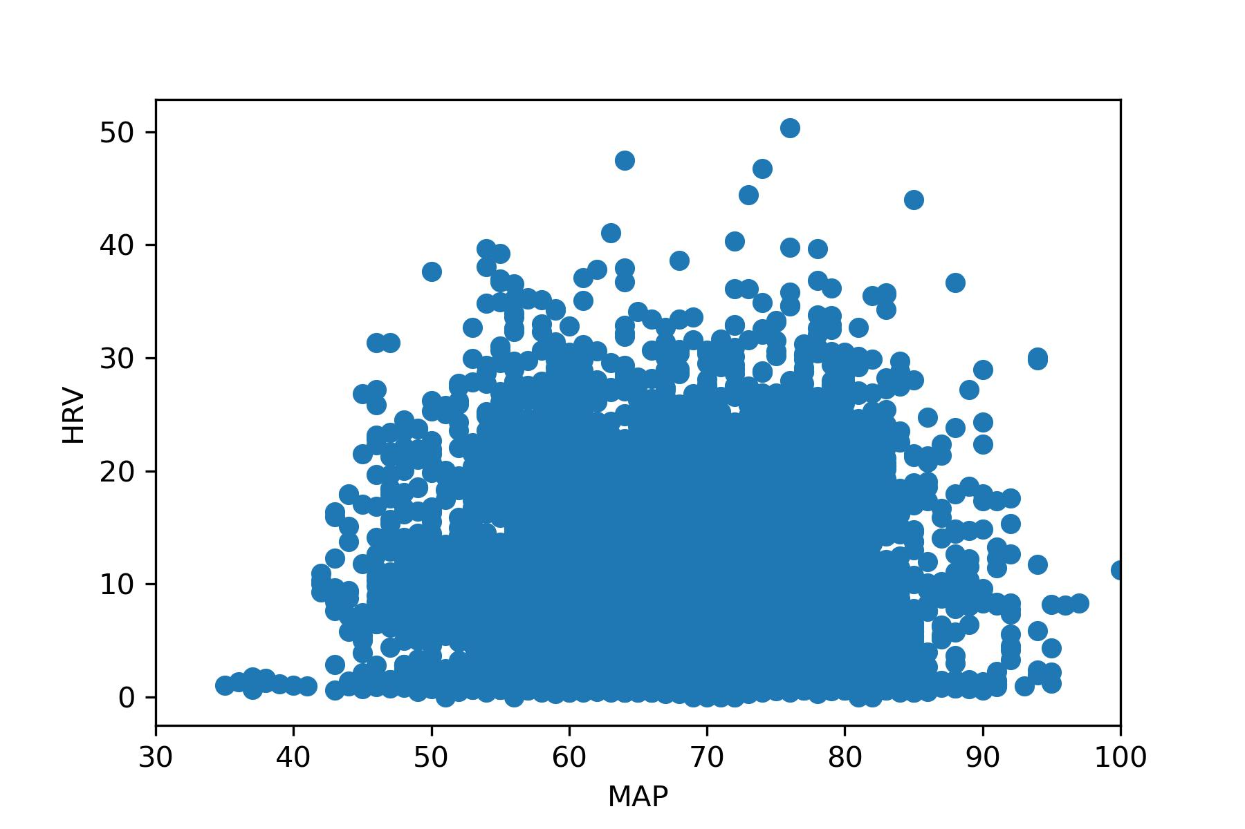
HRV-MAP
We use RMSSD as HRV. The result shows the HRV is unrelated to MAP.
This result is consistent with the expected outcome since the 10-s segment is too short.
Notes:
Next are some problems I have encountered in my learning.

Slide 4
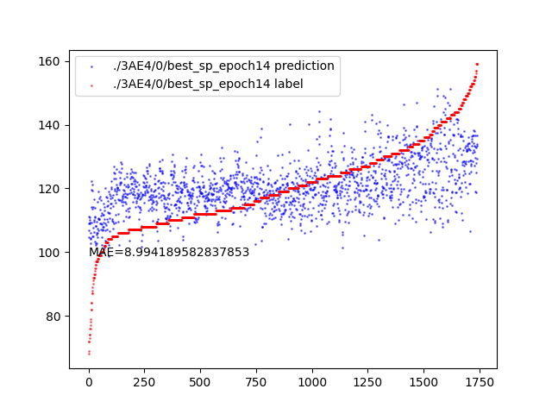
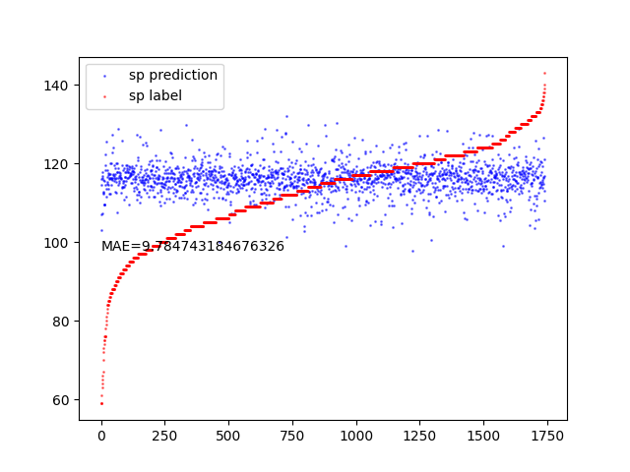
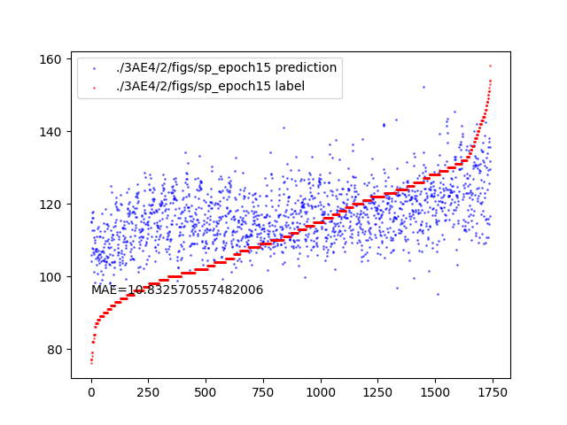
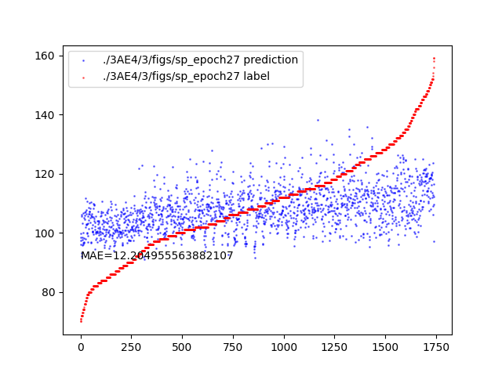
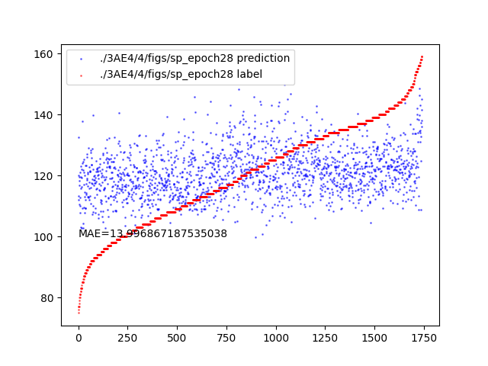
5Fold VTCN on an Improved Dataset
Yingjian
Jiayu
This Dataset
Notes:
Next is my time breakdown for this week.
The yellow parts are the time I used to learn theory.
The blue parts are time for reading books and coding.
The gray is time spent preparing this presentation.

Slide 5
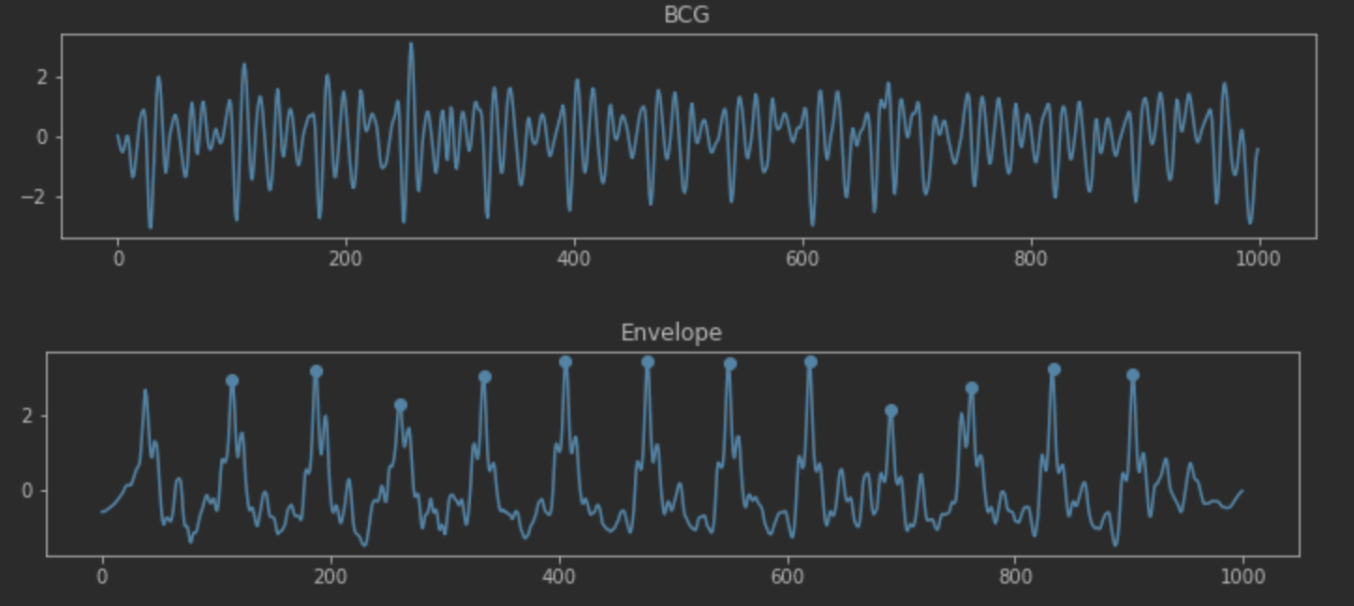
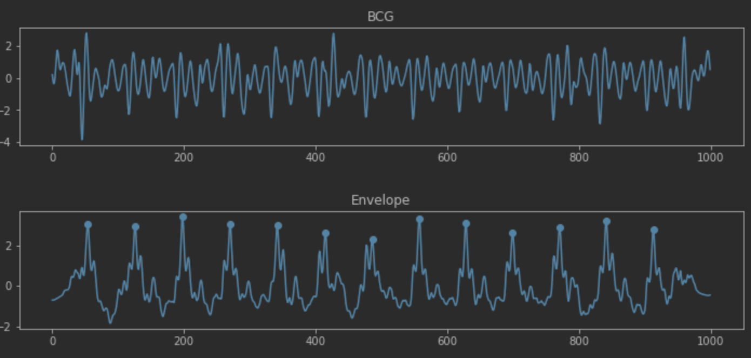
Thought
We assume that BP is based on waveform.
However, for the same person, the model may learn the HR-related features as BP features.
We can use a 10-second BCG signal and its template to generate an envelope. By training a model with this envelope as the input, we can determine if the model learns anything. If the model fails to learn any significant features, it would demonstrate that BP and HR are not related when training on data from the same person.
Notes:
Next are some problems I have encountered in my learning.

Slide 6
Mixup
Mixup is a nice trick for the accuracy improvement, when we can initially predict the BP.
Notes:
Next are some problems I have encountered in my learning.

