Slide 1
Weekly Presentation
Jiayu Chen
2023.9.11
Notes:
Ok, I will begin my weekly Presentation

Slide 2
Work Description
Work_1:
Tutorial Writing:
1. Refactor all functions in Generate Wave Module and Filter Module
2. Add new features to the framework of the main function
3. Write some notes in ipynb file about algorithm details.
4. Learn 2 new filters (Matched Filer and Notch Filter)
Work_2:
In situations with heavy echoes, find an potential segmentation method.
Work_3:
About Get Template. Based on observation, an attempt has been made to define what constitutes a good algorithm for obtaining an SCG signal template. It consists of three features, and some exploration has been carried out.

Slide 3
Work_1: Tutorial
For Main Function
I refactored Generate Wave Module(7) and Filter Module(4), including interfaces, visualization, code comments and more.
I added new feature that people can use the signal created by themselves as the input rather than only SCG signals.
We can save the result.
Use 5 core commands to show you the demo.

Slide 4
Work_1: Tutorial
For Notes
Start studying and documenting theoretical aspects of the tutorial content (some parts may be included in the docstring of functions in the future).
Unique properties and shapes of Different wavelets
The theoretical differences between Notched Filter and Butterworth Bandstop Filter, as well as their practical effects when applied to SCG signals.
I turned my attempts with certain algorithms into a playground, such as differences in SCG signals using different wavelets and distinctions between discrete wavelet transform(DWT) and empirical wavelet transform(EWT).
Show the Notes.

Slide 5
Work_1: Tutorial
For Algorithm
Matched Filter and Notch Filter have been tested on SCG signals.
Unlike last week's Wiener filter and Savitzky-Golay filter, they didn't produce unexpectedly good results.
It seems challenging to apply them for noise reduction in SCG signals.

Slide 6
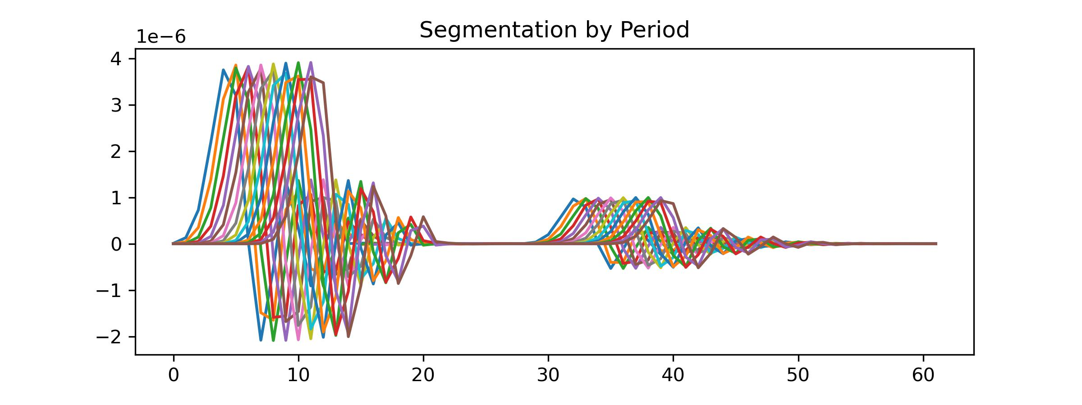
Work_2: Remove
Noisy signal with strong echoes. I added 5 echoes to the clean signal, and the attenuation coefficients for these echoes are [0.9, 0.8, 0.7, 0.6, 0.5], with delays of [5, 10, 15, 20, 25] time points, respectively.
In data with strong echoes, it's nearly impossible to perform cycle segmentation by locating large peaks.
At the same time, directly using Heart Rate as the cycle length for segmentation results in a significant time shift (as shown in the figure below).

Slide 7
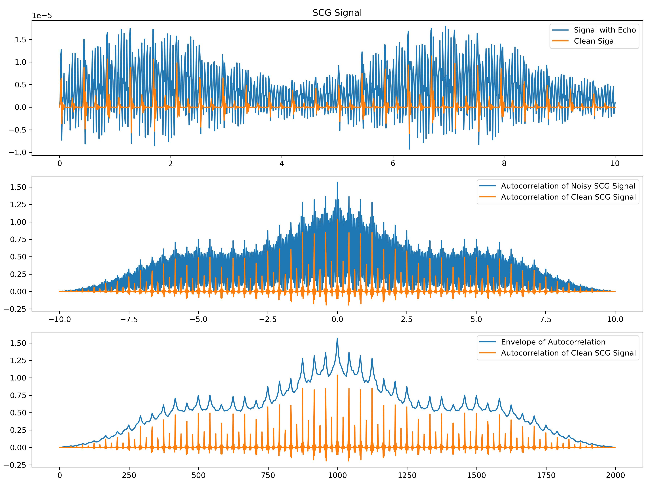
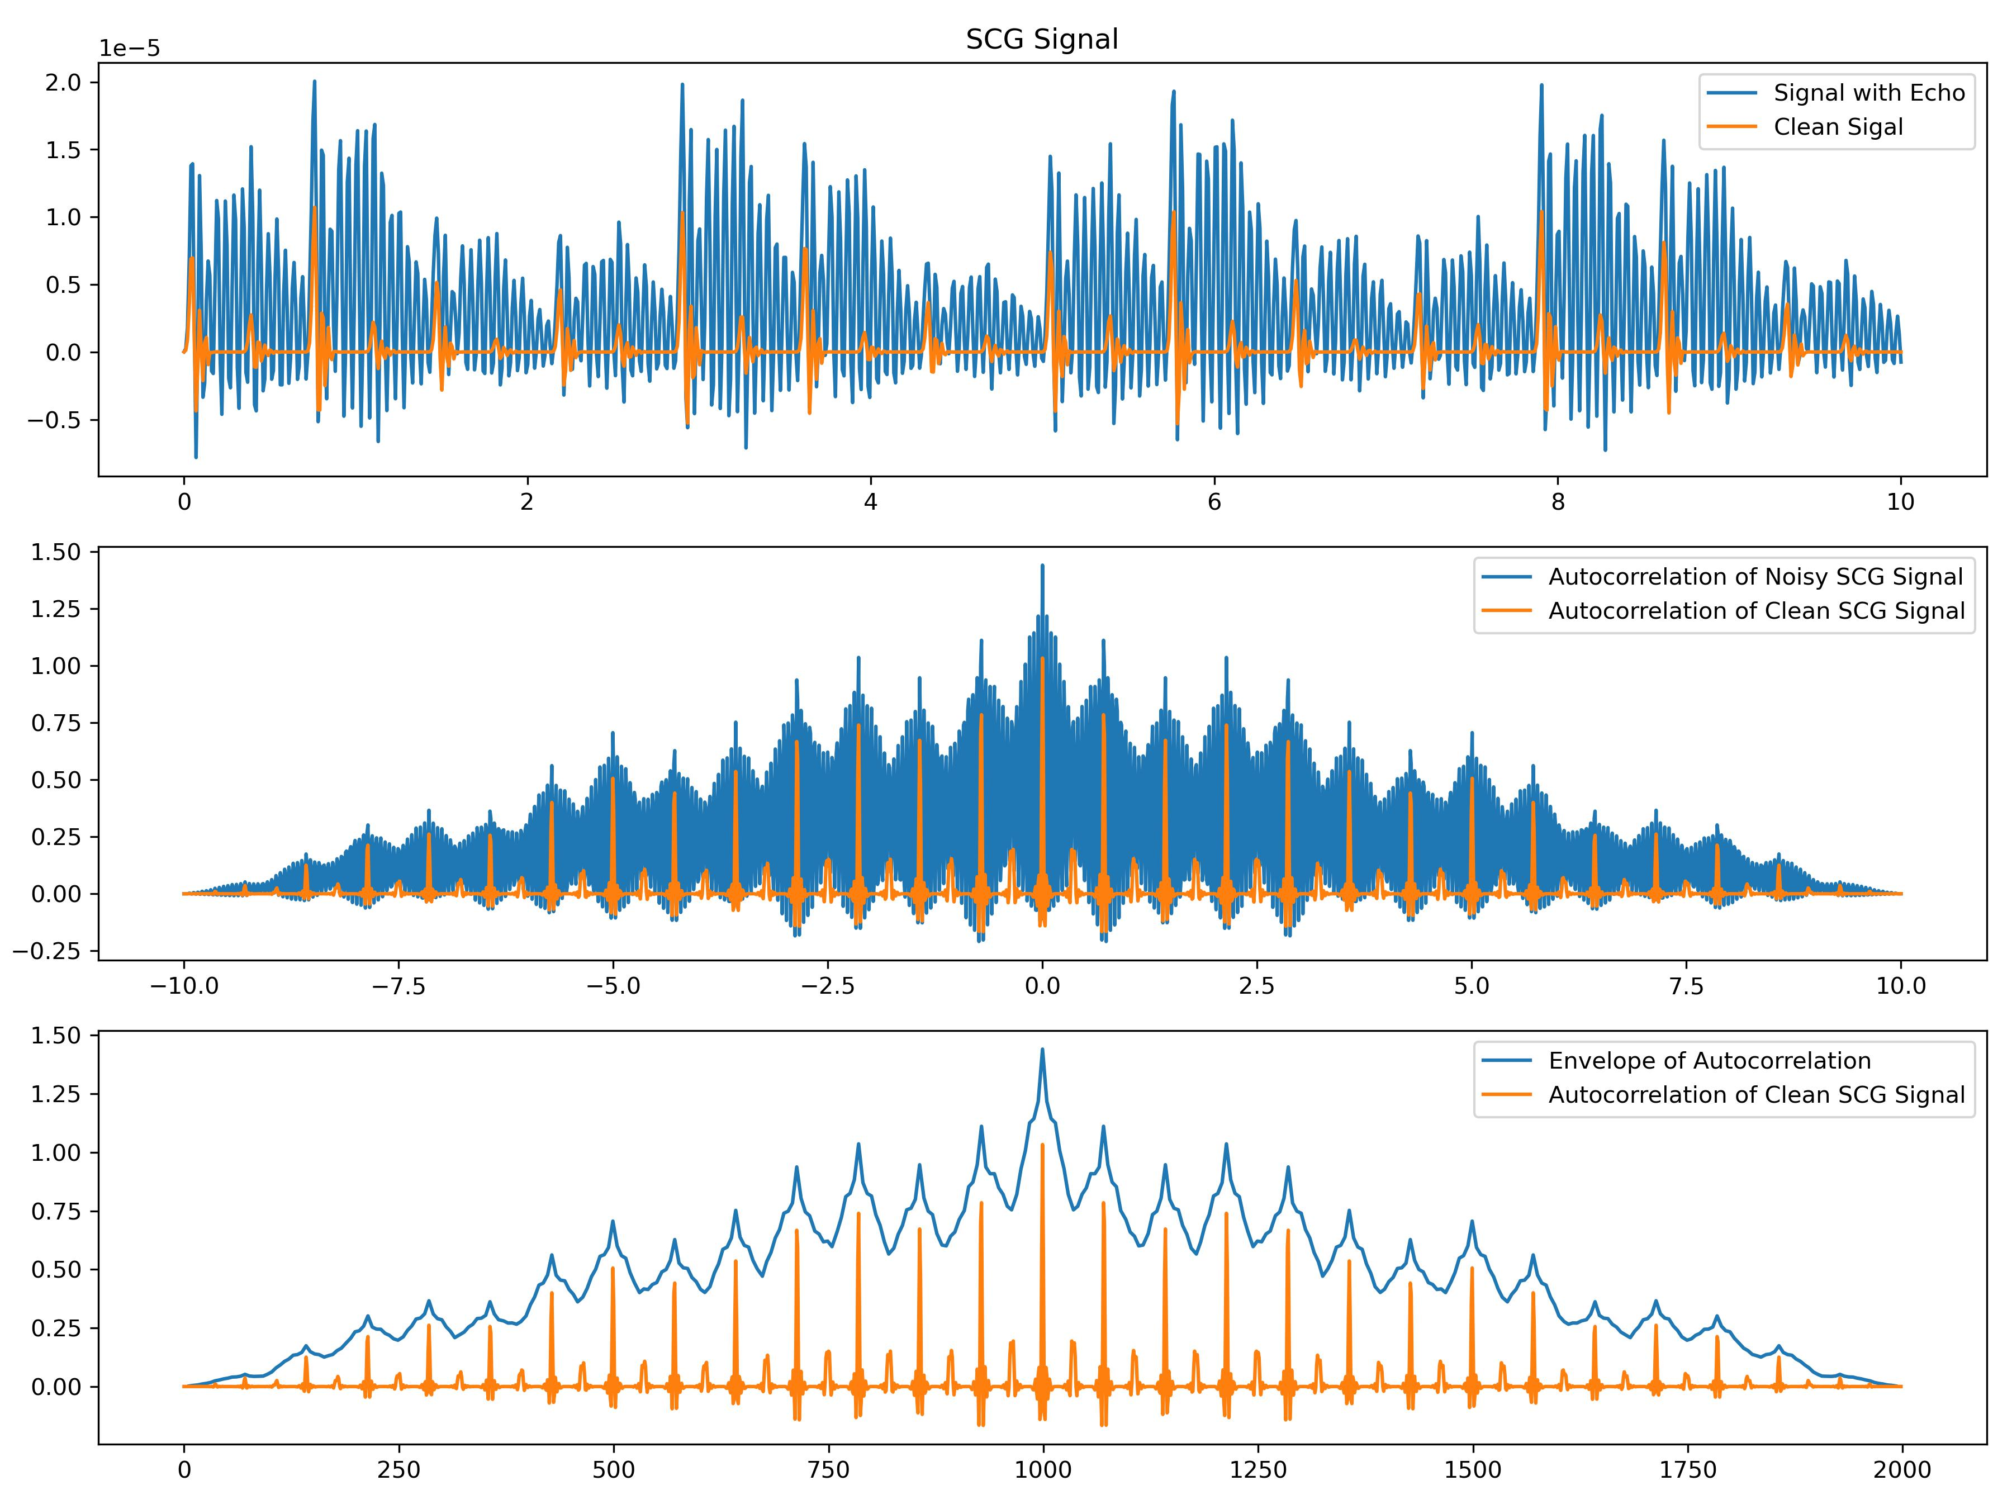
Work_2: Remove
Within a relatively short timeframe, the patterns generated by echoes remain relatively consistent and don't exhibit significant variations.
So, using autocorrelation for separation is a good idea.
Below are two examples: one with very few peaks and another with a high number of peaks.

Slide 8
Work_3: Remove Normal Nosie and respiratory
In Work 3, an attempt has been made to define what constitutes a good algorithm for obtaining an SCG signal template.
I did a simple comparison of algorithms that can recover a single-cycle signal, evaluating their performance on both noise-free and slightly noisy data.
No Noise / Noise Level of 0.1
Method | S Prediction | D Prediction
No Template | 0.79 / 1.64 | 1.79 4.31
Median | 1.42 1.45 | 4.07 4.49
Mean | 1.35 1.38 | 4.53 4.44
K-shape | 2.20 2.74 | 4.85 5.88
PCA-based | -- | --

Slide 9
Work_3: Remove Normal Nosie and respiratory
合适的方法，更加稳健，能够抵消一部分施加在峰上的噪声。（加了噪声后，直接计算的D指标暴涨，而使用了Template的仅仅微微上涨，上涨的那一部分才是噪声的影响）
直接定位而不使用xxx的方法，并不稳健，随着噪声的轻微提升，准确率会大幅度下降
No Noise / Noise Level of 0.1
Method | S Prediction | D Prediction
No Template | 0.79 / 1.64 | 1.79 /4.31
Median | 1.42 / 1.45 | 4.07 /4.49
Mean | 1.35 / 1.38 | 4.53 /4.44
当Noise level > 0.1, 使用Stack

Slide 10
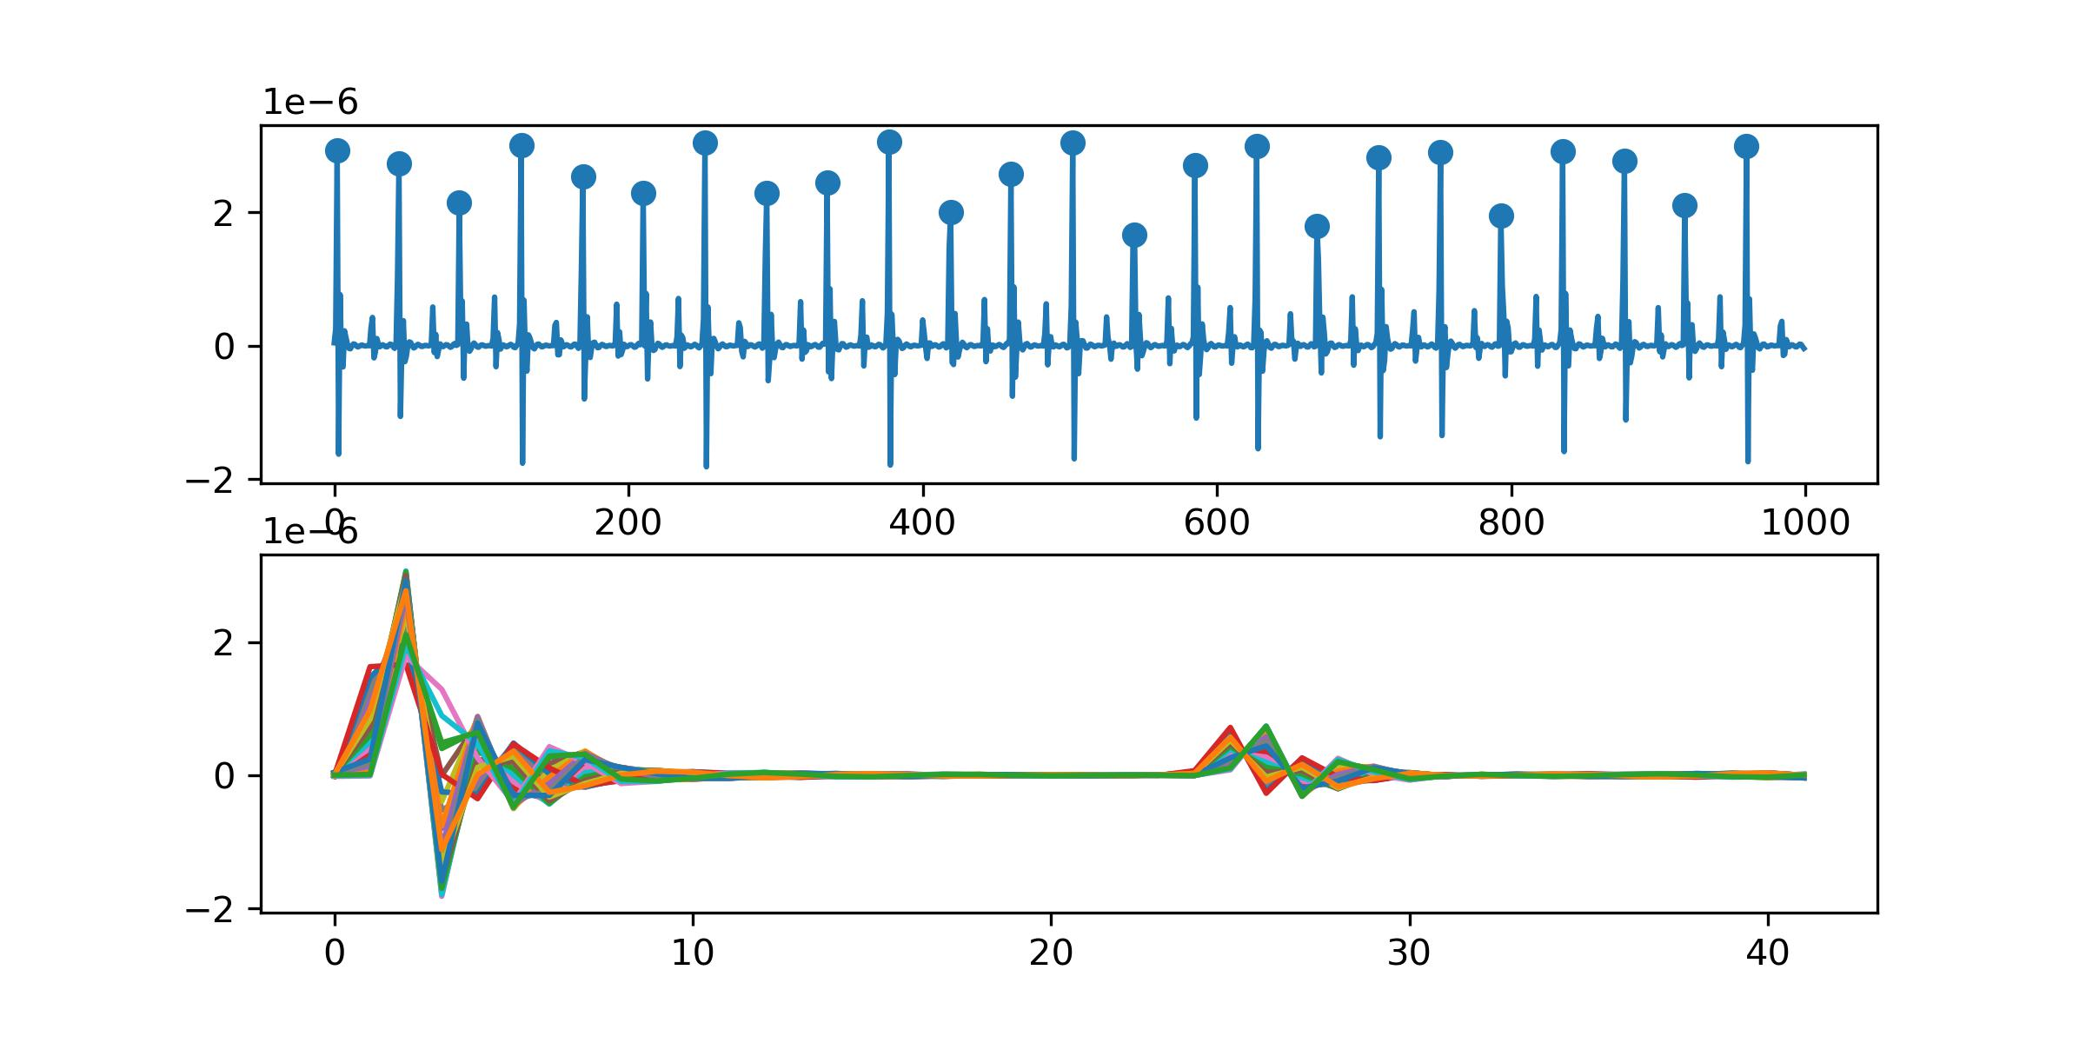
Work_3: Remove Normal Nosie and respiratory
No Noise
Method | S Prediction | D Prediction
No Template | 0.79 | 1.79
Median | 1.42 | 4.07
Mean | 1.35 | 4.53
Why does common methods of obtaining the template result in poor performance for S and D prediction, even in noise-free signals?
For D Prediction:
Small peaks are not aligned properly. Both mean and median methods significantly affect height of small peaks, leading to a decrease in accuracy.
For S prediction:
Due to the limitation of the sampling rate, even with a perfect "Get Template" algorithm, the S prediction result is still not as good as that of the "No Template" algorithm.
e.g.
No Template Method: dis12 = 12.5
Template Method: dis12 = 12 / 13(less accurate)
Notes:
For D Prediction:
The reason is peaks are not aligned properly. Both mean and median methods significantly affect height of small peaks, leading to a decrease in their accuracy.
For S prediction:
Due to the limitation of the sampling rate, even with a perfect "Get Template" algorithm, the S prediction result is still not as good as that of the "No Template" algorithm.

Slide 11
Work_3: Remove Normal Nosie and respiratory
No Noise / Noise Level of 0.1
Method | S Prediction | D Prediction
No Template | 0.79 / 1.64 | 1.79 / 4.31
Median | 1.42 / 1.45 | 4.07 / 4.49
K-shape | 2.20 / 2.74 | 4.85 / 5.88
Why the performance of K-shape is not satisfactory?
The K-shape algorithm generates a new signal during clustering. The issue lies in the clustering process rather than the underlying Time-Warping concept.
We should consider discarding clustering and focus on researching how to apply Time-Warping effectively.

Slide 12
Work_3: Remove Normal Nosie and respiratory
Feature 1: The highest points of both the major and minor peaks for each piece should align after applying the algorithm.
Feature 2: The distance between the two peaks of the standard template should be the rounded average of the distances between the two peaks for all pieces.
Feature 3: The ability to handle time shifts (possibly essential in real data but less critical in simulated signals).
Your idea seems to suggest that the primary focus of research should indeed be on Time Warping to achieve these features successfully.

Slide 13
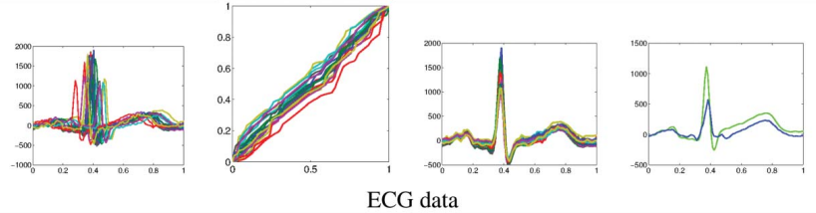
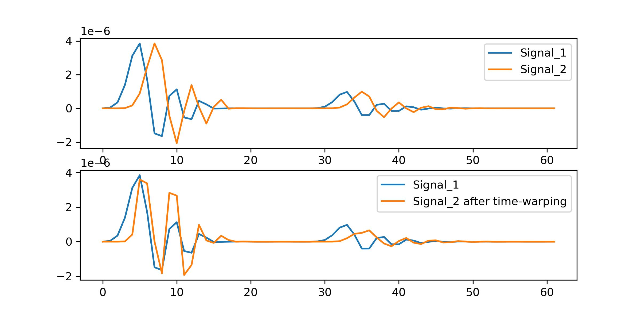
Work_3: Remove Normal Nosie and respiratory
这周，我花了整整两天，去看懂一篇统计学论文[Segmentation, alignment and statistical analysis of biosignals with application to disease classification]，并尝试复现的，效果并不好。我会给出效果，并且进行简单的原因分析。
Noisy Signals
The results presented in the paper are as follows:
给出一种能够衡量xx的距离。
The results I have obtained regarding SCG signal are as follows:
将原始信号转化到和导数的空间里，以便方便的计算xx距离
将问题转化为优化问题。求解如何对信号的横轴进行拉伸与收缩。
Apply FFT Denoising

Slide 14
Work_3: Remove Normal Nosie and respiratory
The results presented in the paper are as follows:
The results I have obtained regarding SCG signal are as follows:
原因1. 该论文提出的方法有大量的导数。而ECG信号相对比较的平滑。而SCG信号比较的尖锐。
原因2. 论文中对时间轴进行拉伸后，缺失的部分需要插值。论文中给出的ECG信号采样率为1KHz,而我们的信号的采样率仅仅为100Hz，我们一个template的长度往往为40-80。插值会造成巨大的误差

Slide 15
Questions

Slide 16
Thanks!

