Slide 1
Differences between simulated signals and real signals:
Simulated SCG Signal Segmentation: Large Peak Extraction
Real Signal Segmentation: Multipeak, noisy, irregular waveform (sometimes similar to BCG, sometimes similar to SCG)
Transforming the multi-peak issue in the time domain into a single-peak problem in the energy domain.
Based on an observation, the highest point of energy density is relatively consistent within each cycle.
Method from IoT2023 is enough for HR estimation, but doesn’t work well on Real Signal Segmentation.
Hilbert transform for envelope extraction
Sliding Window for Energy Calculation
Savitzky-Golay filter smoothing
Peak Detection
ACF
Signal Segmentation
Peak Detection
Linear realignment based on ACF
Signal Segmentation

Slide 2
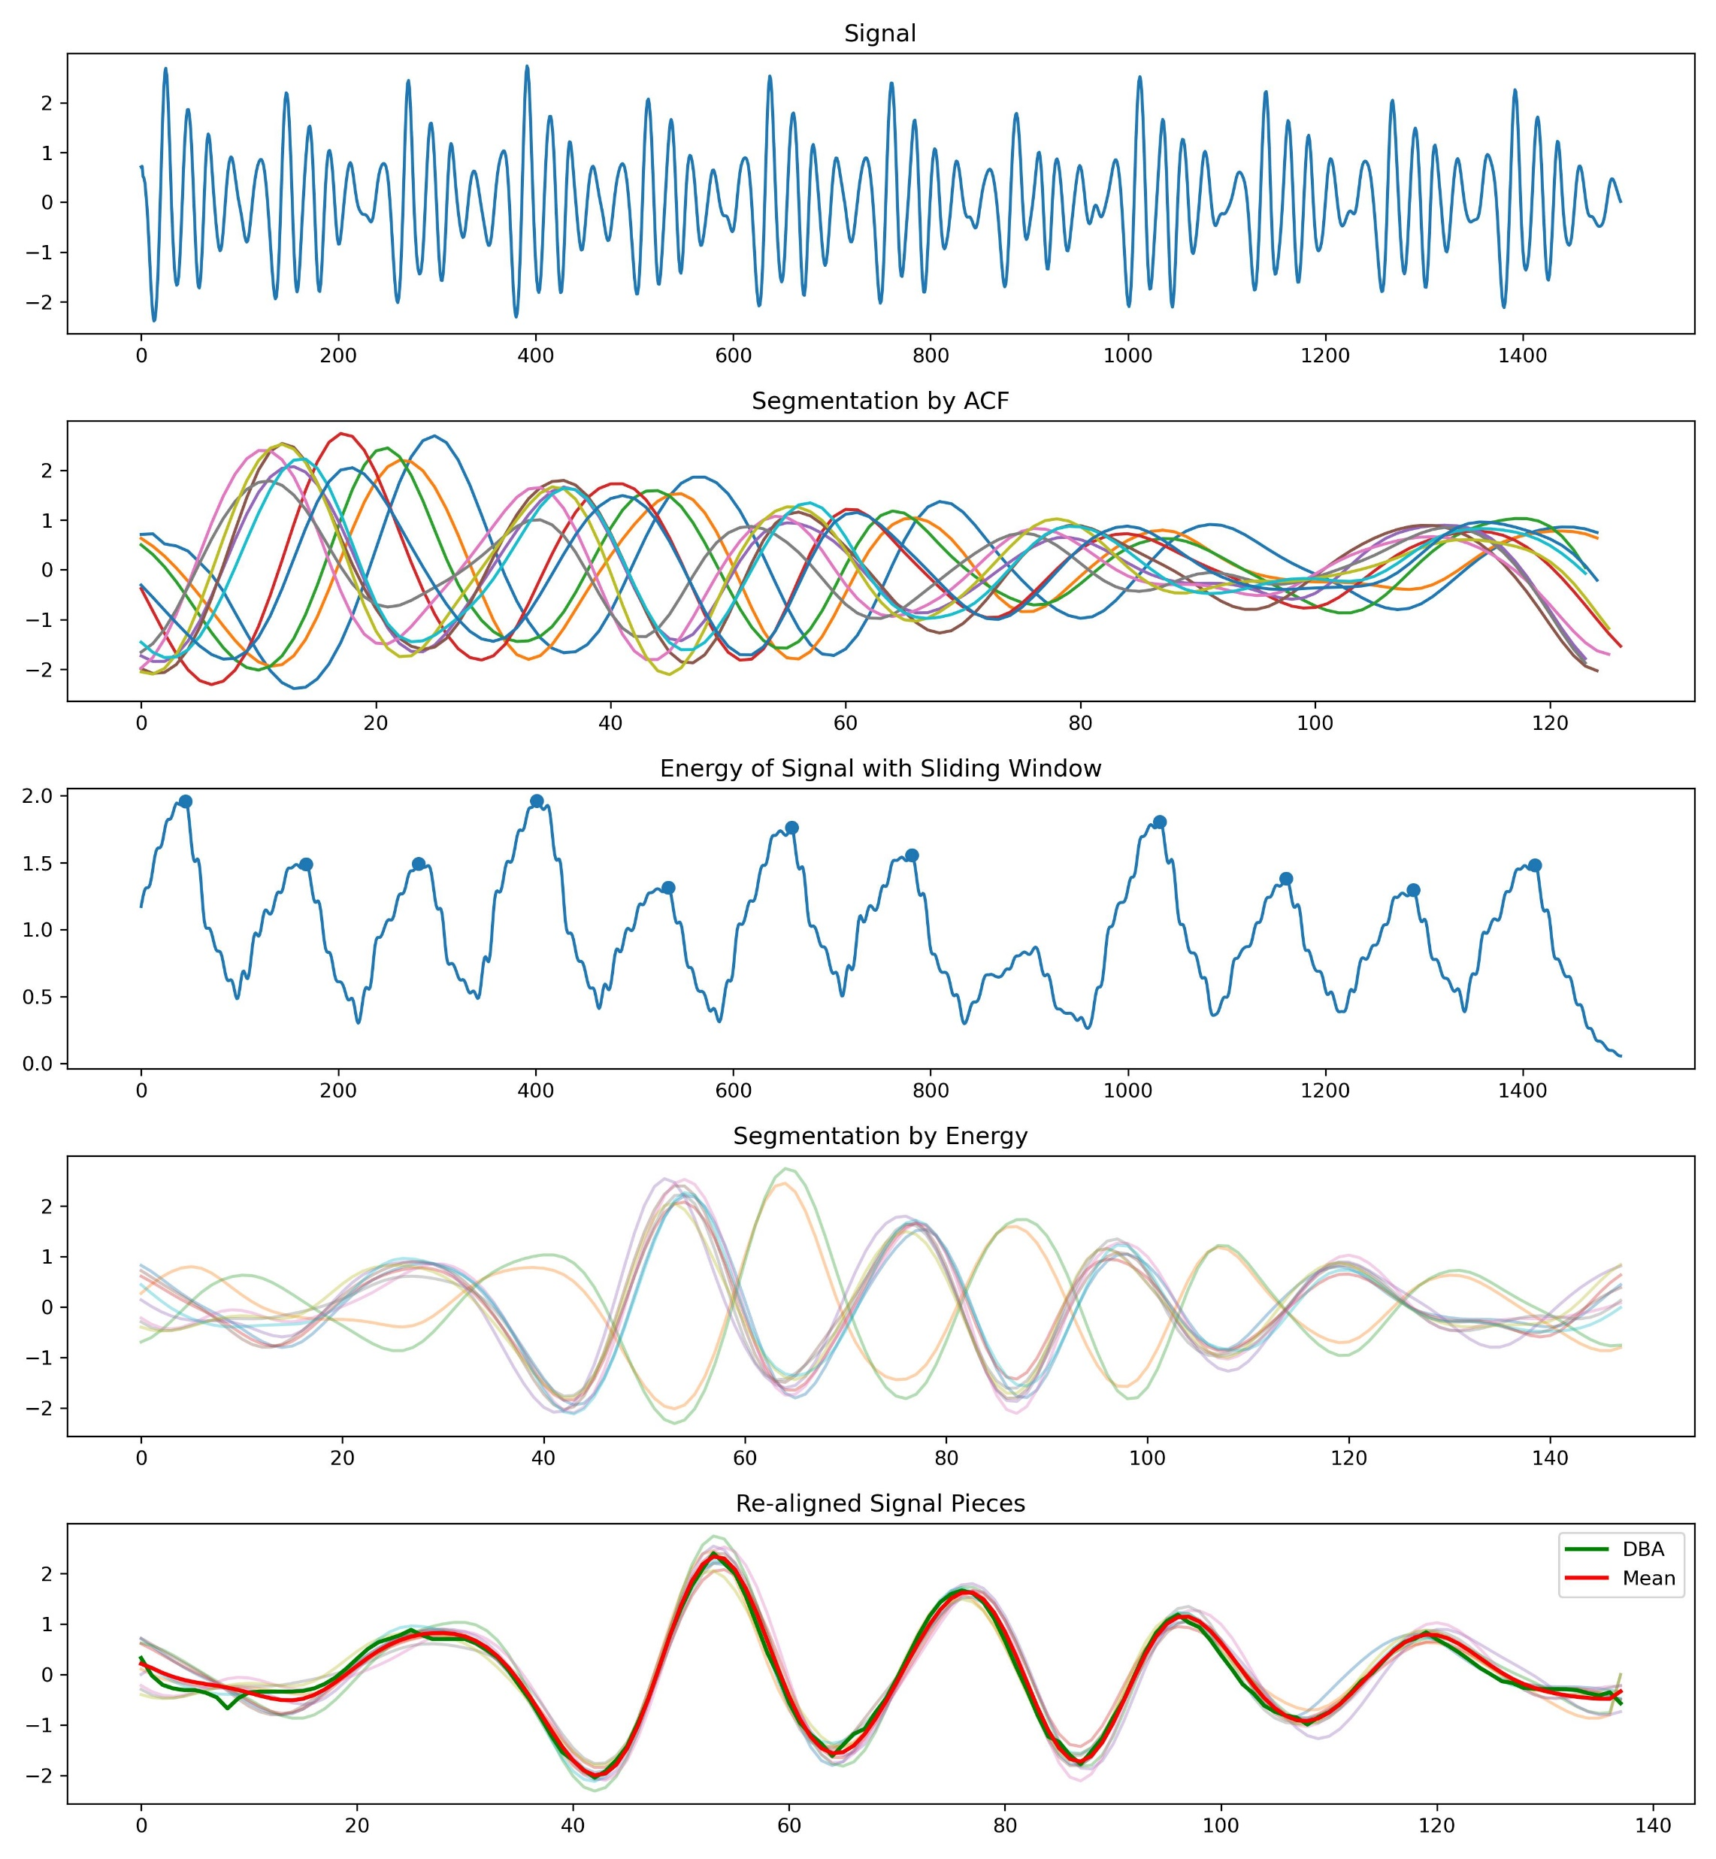
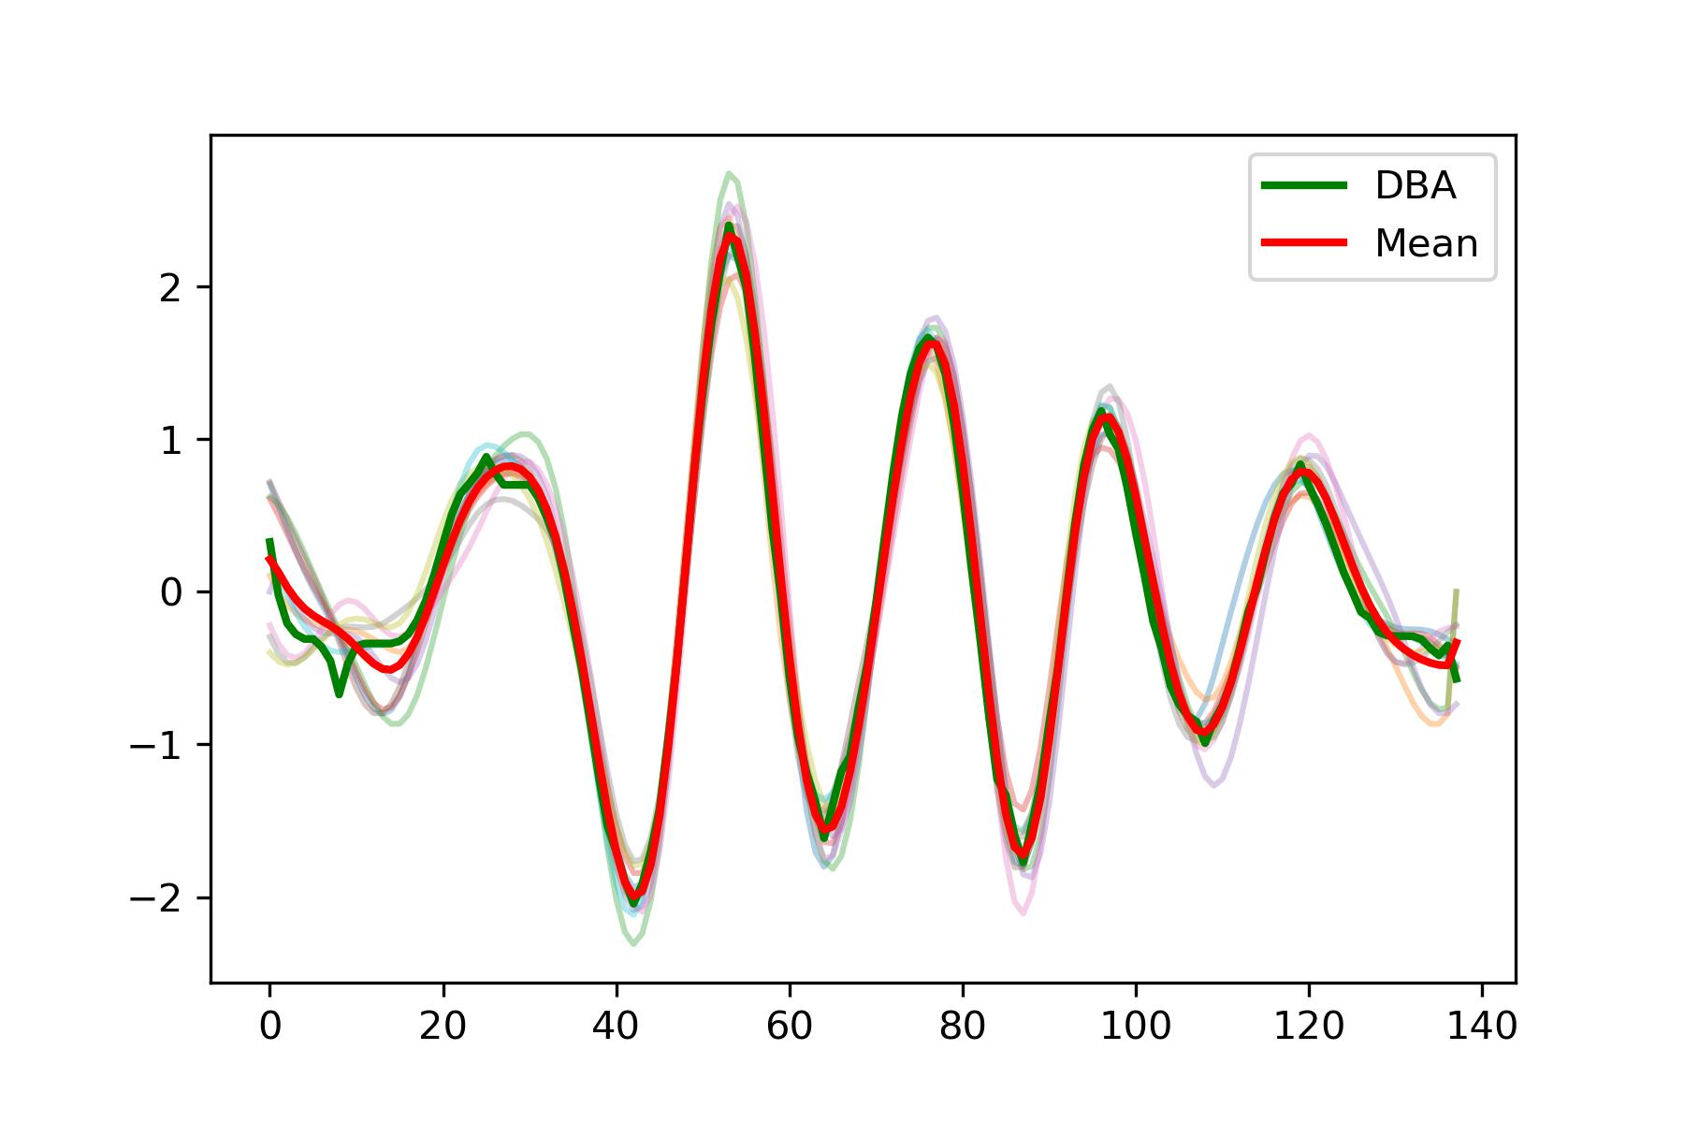
High-quality signal.

Slide 3
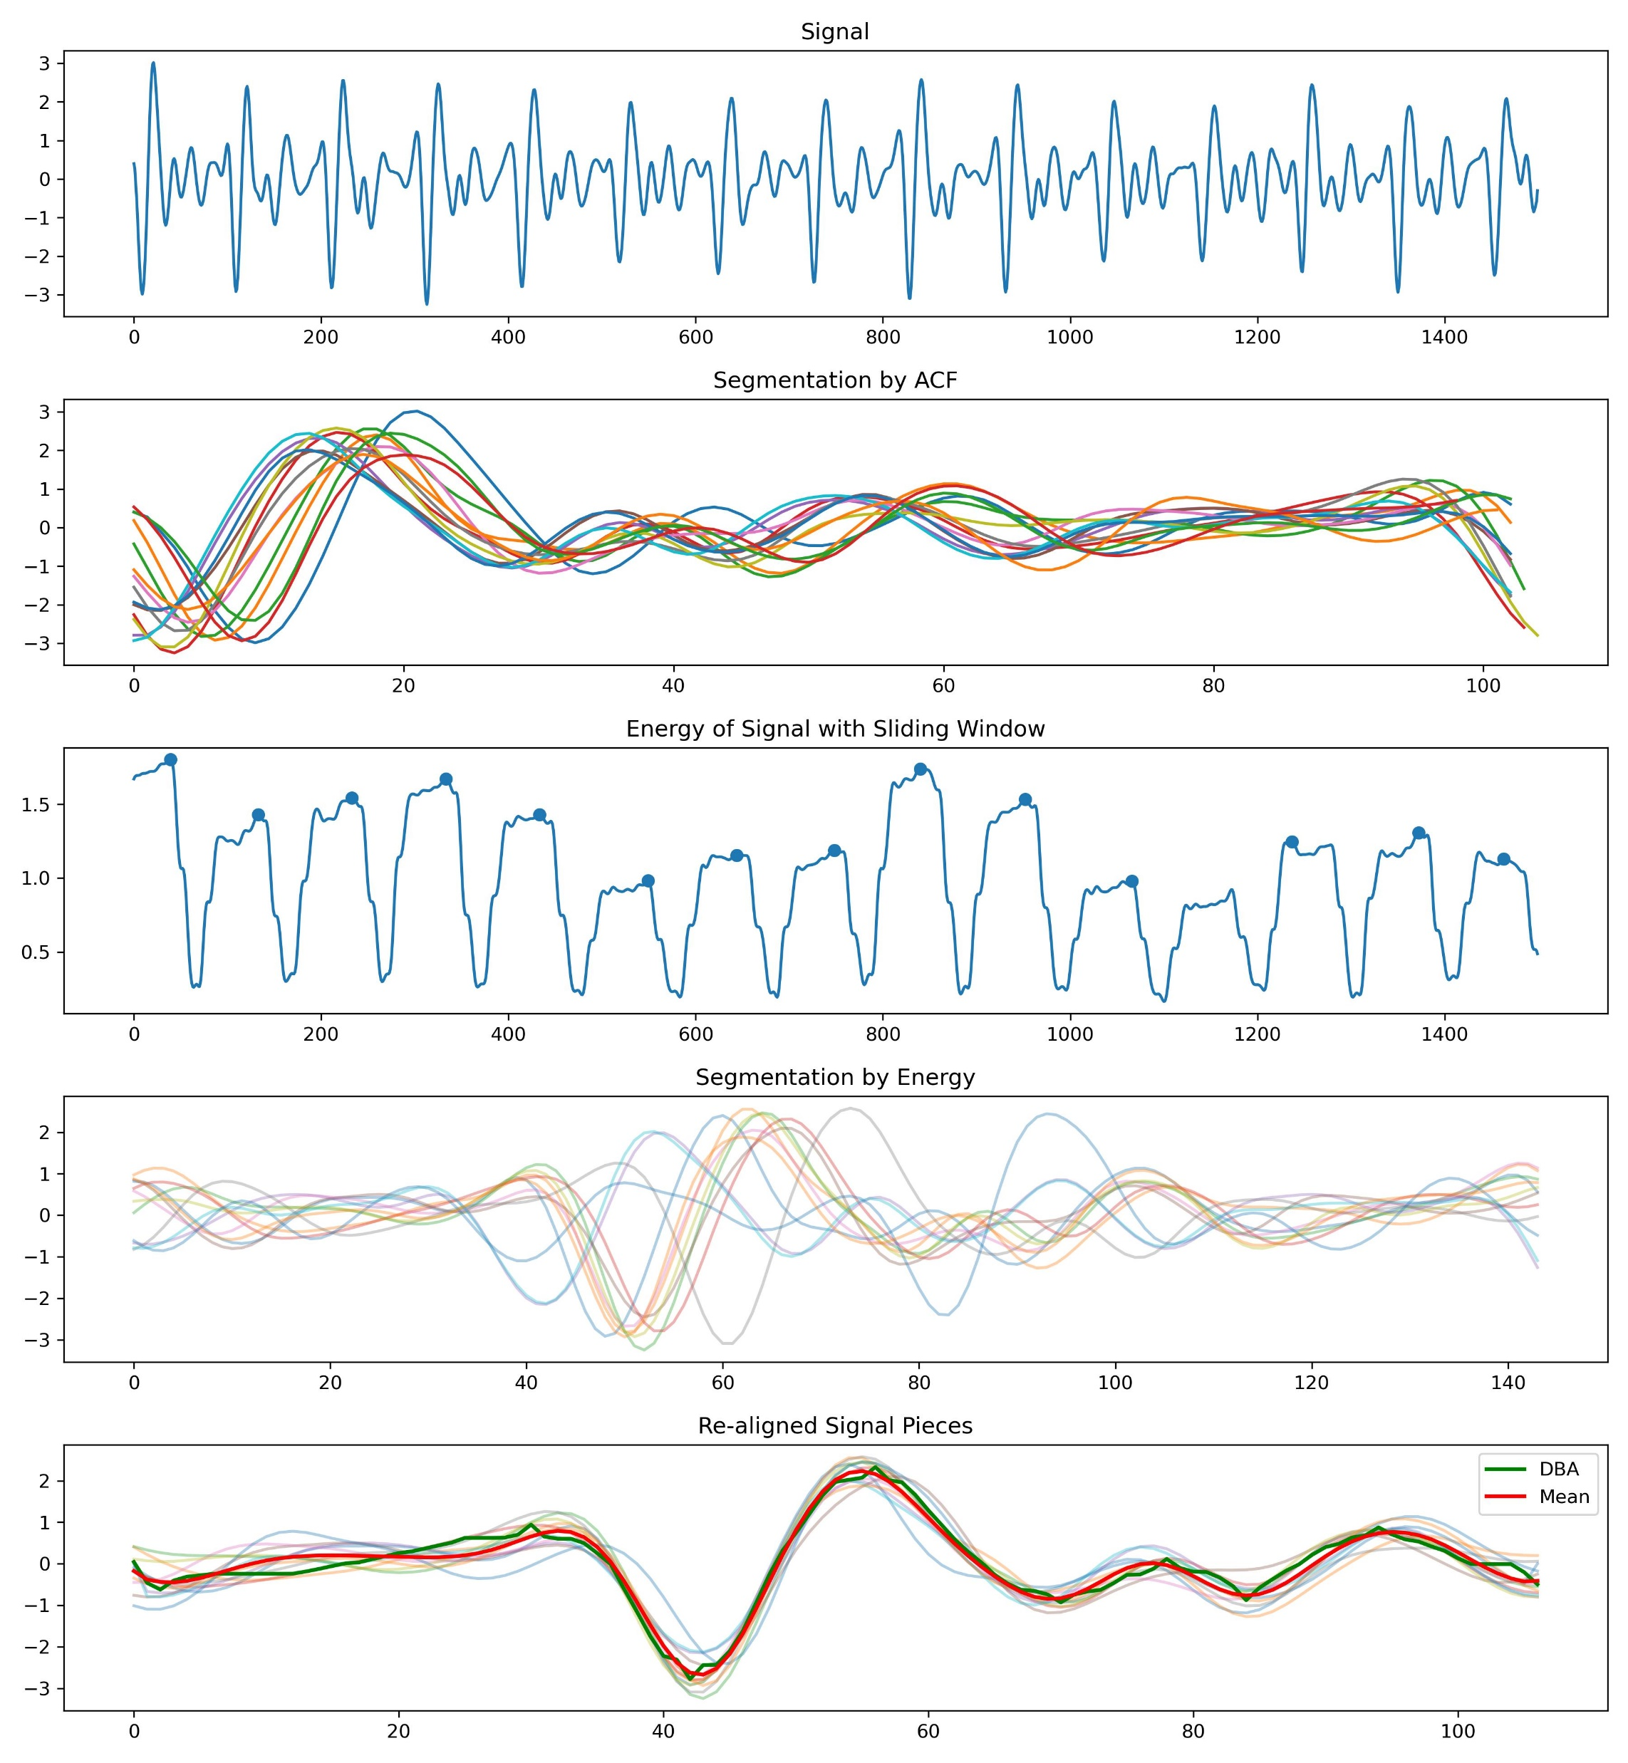
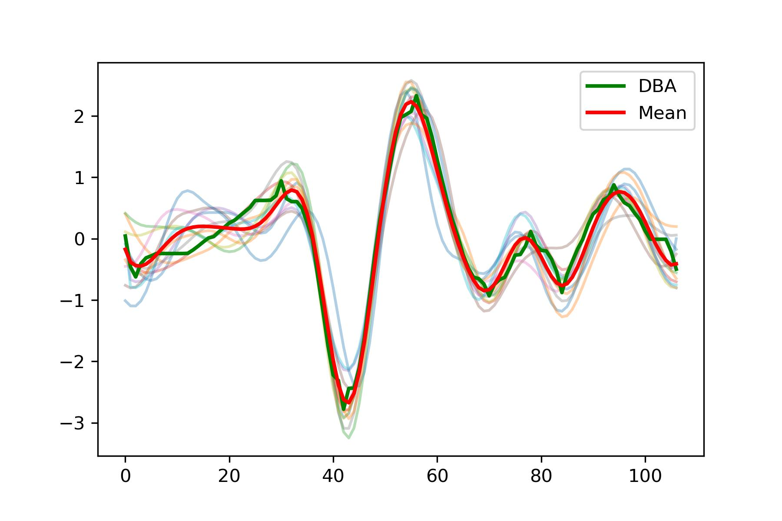
Segmentation of signals similar to SCG.

Slide 4
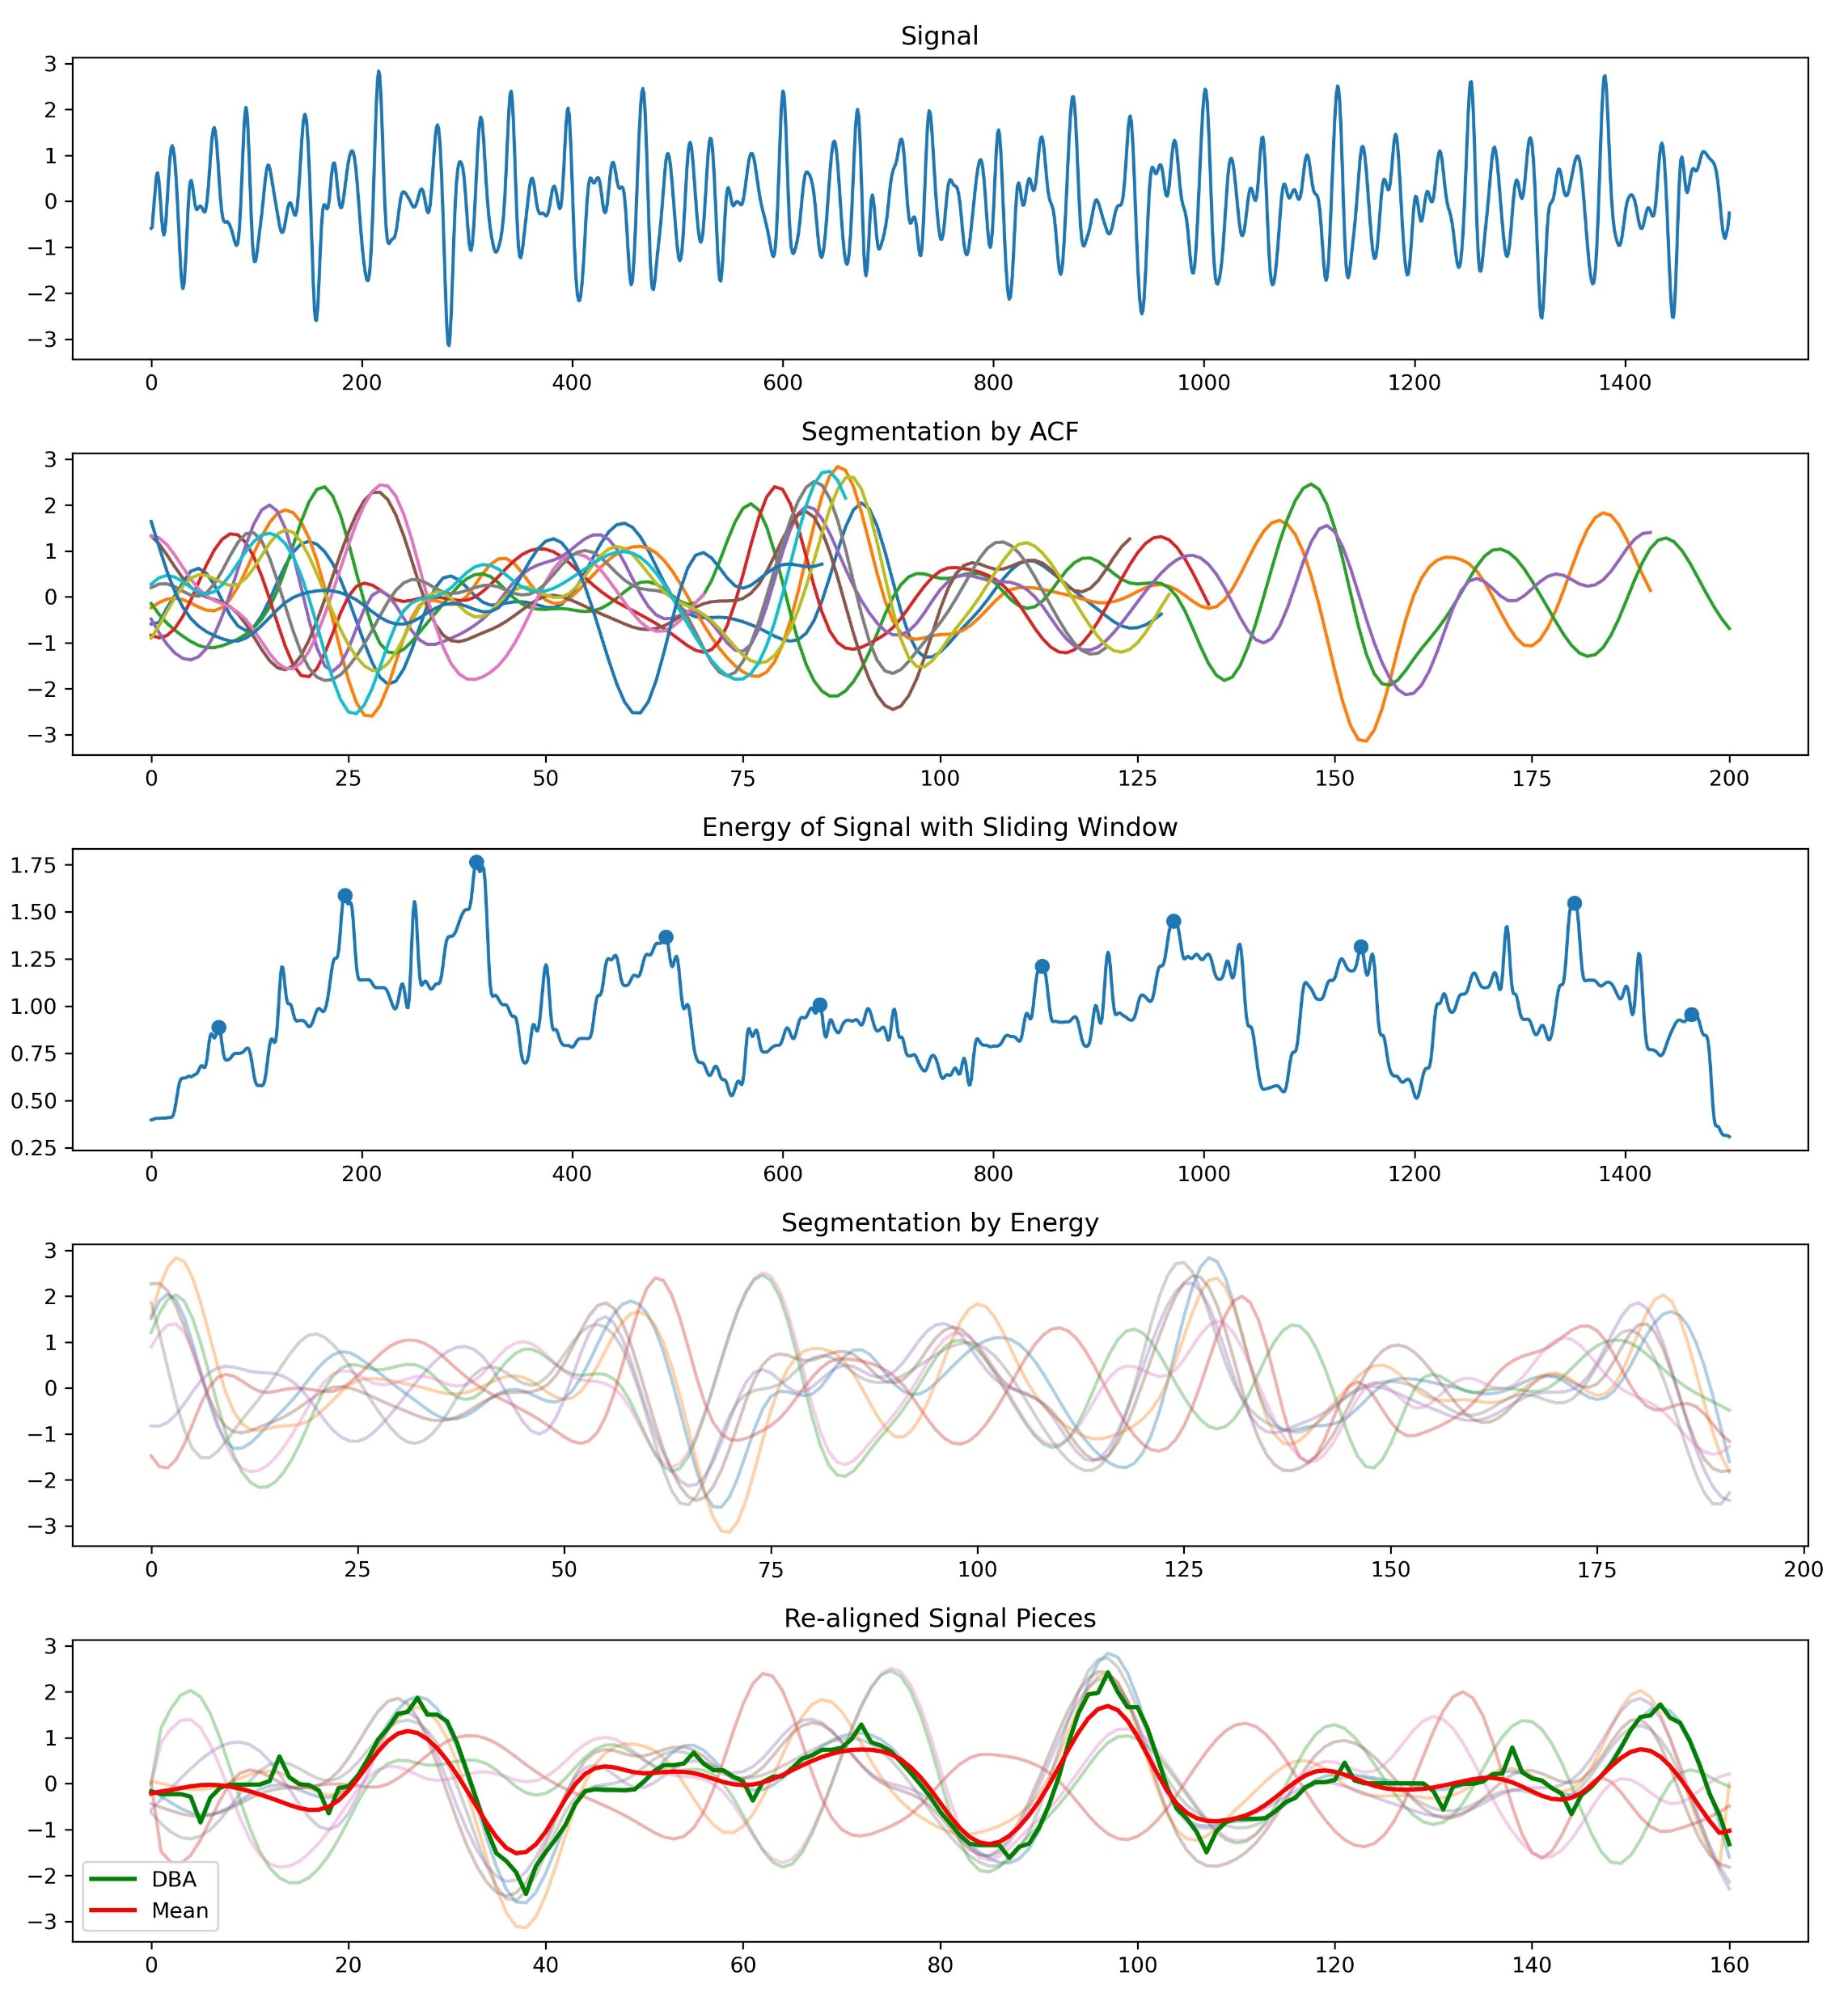
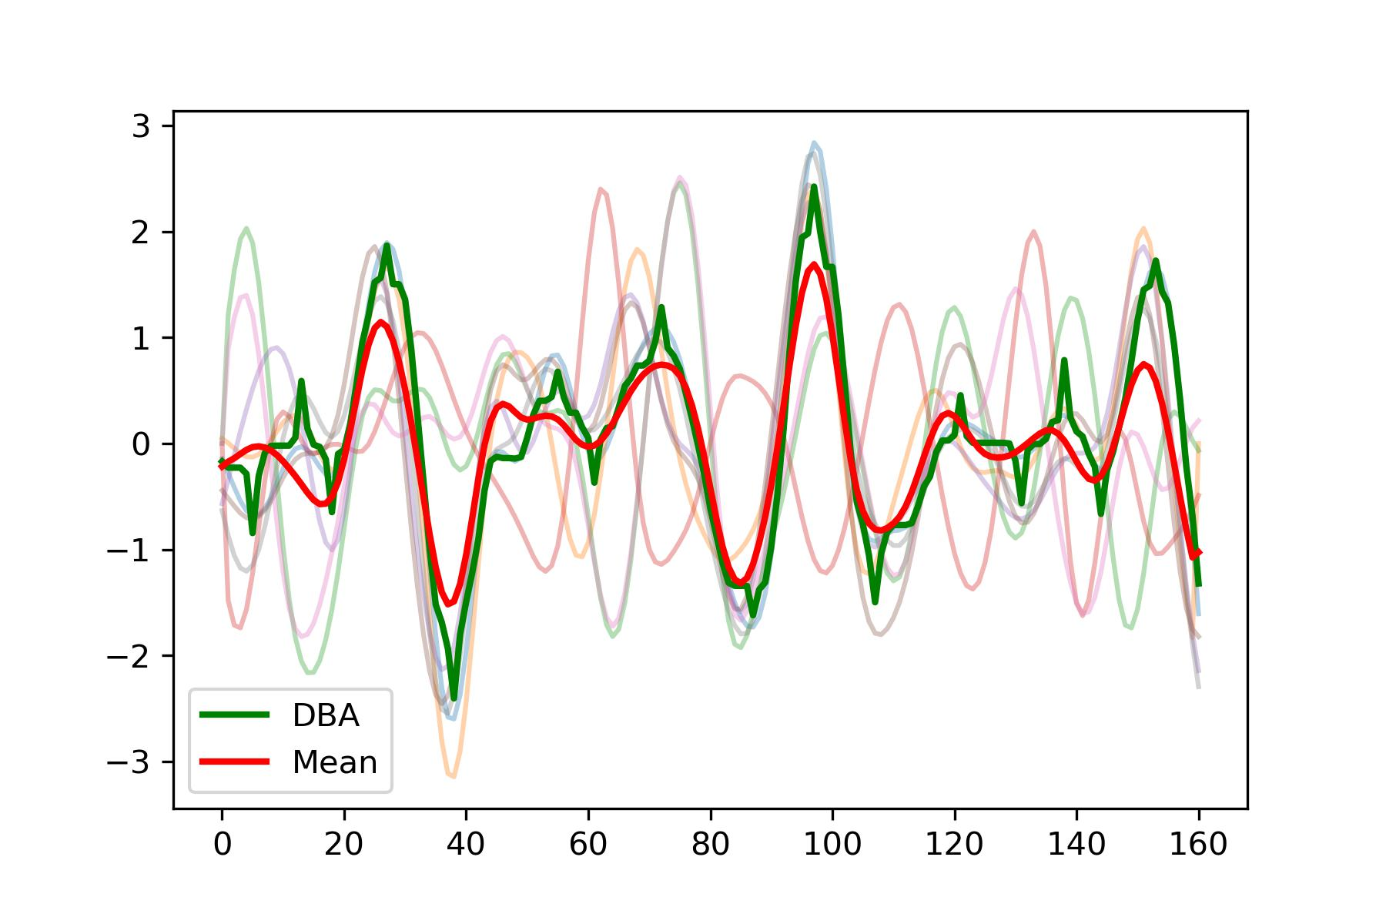
Unable to accurately extract template.

