Slide 1
Weekly Presentation
Jiayu Chen
2023.11.20

Slide 2
Work Description
Part_1:
The overall framework of the research
Easy introduction to important papers
Analysis of experimental results
Part_2: Analysis of experimental results of the paper from IoT2023
Part_3: Some arrangements for future research studies.
Part_4: Questions

Slide 3
Part_1

Slide 4
Overall Framework of the Research
The main direction of current exploration
Before 2018
With DTW
In 2018
Time Series Average
After 2018
Phototype4Regression
Template4Regression
Phototype4Prediction
Template4Prediction
Need careful consideration
Without DTW
Multi-Sensors Fusion
Another relatively large field
Sporadic support from
research papers
Generative Model
The concept definitely did not exist in 2018 and before. As of 2019 onwards, I have not found it so far.

Slide 5
Overall Framework of the Research
Asymmetric
Increment
Incremental Averaging
Warping Path: (X_t, Y_t-1), (X_t, Y_t), (X_t, Y_t+1)
Symmetric
Increment
Asymmetric Method: Take a reference.
Take X as a reference.
Result: X_t = (X_t + Y_t-1 + Y_t, + Y_t+1) / 4
Disadvantage: Not well-defined. There is no natural criterion for choosing a reference.
Asymmetric
Batch
Batch
Averaging
Symmetric Method: Create a new one.
Result: Z_t+1 = (X_t + Y_t-1) / 2
Z_t = (X_t + Y_t) / 2
Z_t+1 = (X_t + Y_t+1) / 2
Disadvantage: Have more time points than X and Y.
Symmetric
Batch

Slide 6
Before 2017: Intuitive
After 2017
Asymmetric
Increment
SSG^{[5]}, 2017
Incremental Averaging
PSA^{[2]}, 2009
Soft-DTW^{[6]} 2017
Symmetric
Increment
NLAAF^{[1]}, 1996
ICDTW^{[3]}, 2012
TTW^{[8]}, 2018
Asymmetric
Batch
DBA^{[4]}, 2011
CDBA^{[7]}, 2017
Batch
Averaging
Symmetric
Batch
O(T^N)
computationally expensive
1. Improve the NLAAF algorithm.
2. Prepare for the emergence of the DBA algorithm.

Slide 7
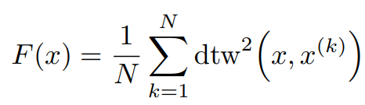
After 2017: Optimization
SSG, 2017
Fr´echet Function
A polynomial-time algorithm for finding a global minimum of the non-differentiable, non-convex Fr´echet function is unknown.
Soft-DTW 2017
TTW, 2018
SSG
F = min{F_C1, F_C2, F_C3, …}, F_C is differentiable and convex function.
Soft-DTW
DTW(min, +) -> DTW(*, +)
TTW
Translate Discrete Signal into Continuous Signal by Sinc function. And Take DTW as constraints of optimization problem.

Slide 8
Analysis of Experimental Results
The impact of different sampling rates on alignment.
Model | Sampling Rate | S Prediction | D Prediction
Template: Mean | 100 | 1.35 | 4.53
Template: Mean | 150 | 0.92 | 2.36
Template: Mean | 200 | 0.65 | 1.75
For simulated signals, the source of error lies in the sampling rate.
Simulated signals, low sampling rate, Non-Linear Alignment
Simulated signals, high sampling rate, Linear Alignment
Linear Alignment -> O(T)
Acceptable
Non-Linear Alignment -> O(T^2)
For real signals, the degree of distortion on time axis depends on the alignment we actually need.
Next week, I will use the periodicity determination method from IoT2023 to segment real signals.
Unacceptable

Slide 9
Analysis of Experimental Results
1. All Experiment Results
Model | S Prediction | D Prediction | Model | S Prediction | D Prediction
No Template | 0.79 / 1.64 | 1.79 / 4.31 | New
Mean | 1.35 / 1.38 | 4.53 / 4.44 | NLAAF1 | 8.43 / 23.19 | 3.14 / 5.21
Median | 1.42 / 1.45 | 4.07 / 4.49 | NLAAF2 | 20.67 / 33.39 | 3.64 / 7.04
PCA | - / - | - / - | GTW | - / - | - / -
K-shape 1 | 2.20 / 2.74 | 4.85 / 5.88 | TTW | 1.52 / - | 4.28 / -
Weighted Avg | 1.95 / 1.98 | 4.63 / 4.74 | K-SC | - / - | - / -
K-shape 2 | 2.18 / 1.79 | 4.76 / 5.24 | PSA | 2.27 / 19.05 | 5.40 / 8.89
Kalman Filter | 1.45 / 1.37 | 4.82 / 4.60 | Soft-DTW | 1.35 / 1.38 | 4.53 / 4.44
DBA | 2.05 / 1.96 | 3.43 / 4.15 | ICDTW | 2.66 / - | 5.08 / -
Segmentation Methods: Base on Large Peaks
The implication of experimental results: Assess the performance limits of various algorithms under the most ideal conditions.

Slide 10
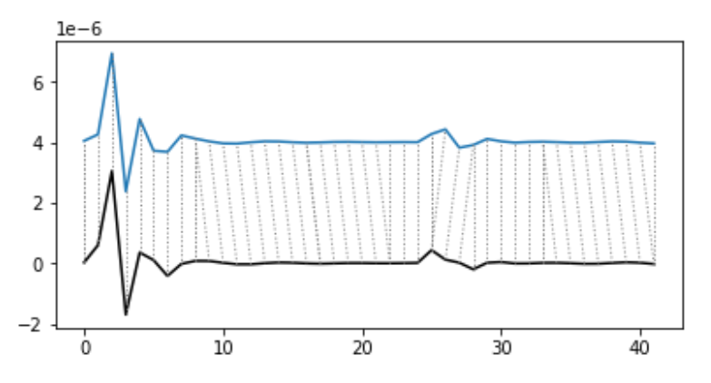
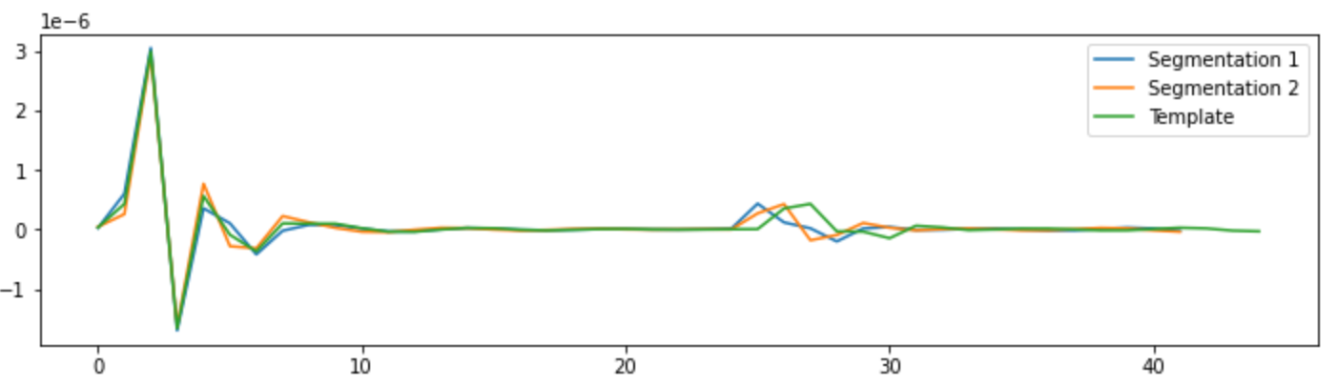
Analysis of Experimental Results
2. Effectiveness of NLAAF
Model | S Prediction | D Prediction
No Template | 0.79 / 1.64 | 1.79 / 4.31
Mean | 1.35 / 1.38 | 4.53 / 4.44
NLAAF1 | 8.43 / 23.19 | 3.14 / 5.21
NLAAF2 | 20.67 / 33.39 | 3.64 / 7.04
DBA | 2.05 / 1.96 | 3.43 / 4.15
NLAAF:
Z_t+1 = (X_t + Y_t-1) / 2
Z_t = (X_t + Y_t) / 2
DBA:
Z_t = (X_t + Y_t-1 + Y_t) / 3
Values of large peak and small peak in template must be the average of all correctly extracted peak values.
Therefore, its theoretical upper limit should be 1.79.

Slide 11
Analysis of Experimental Results
2. Effectiveness of NLAAF
Model | S Prediction | D Prediction
No Template | 0.79 / 1.64 | 1.79 / 4.31
Mean | 1.35 / 1.38 | 4.53 / 4.44
NLAAF1 | 8.43 / 23.19 | 3.14 / 5.21
NLAAF2 | 20.67 / 33.39 | 3.64 / 7.04
DBA | 2.05 / 1.96 | 3.43 / 4.15
The poor performance in the presence of noise.
Is likely because the highest peak corresponds to another highest peak.
There is never a situation where positive and negative contributions cancel each other out.
This scenario tends to amplify the noise rather than mitigating it.

Slide 12
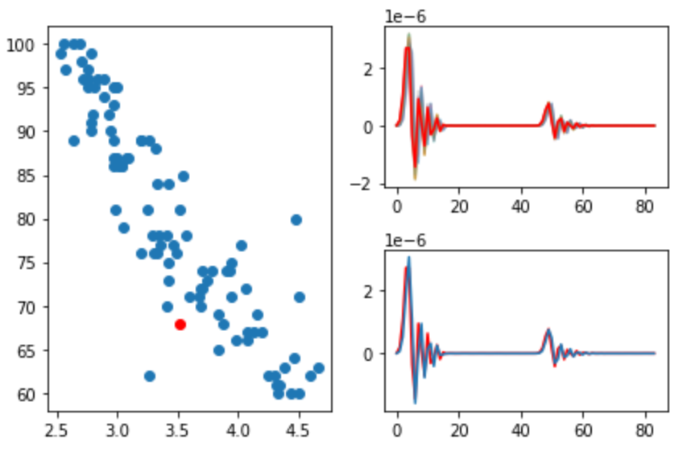
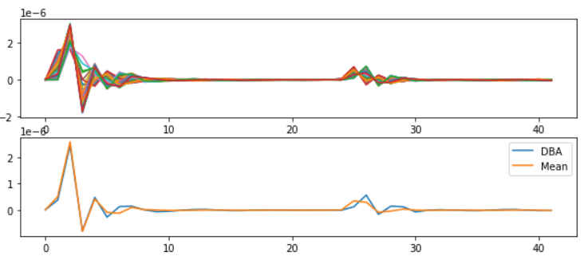
Analysis of Experimental Results
2. Source of Error of DBA
Why, despite the template looking very similar, is the error in D unsatisfactory (3.43)?
Model | S Prediction | D Prediction
No Template | 0.79 / 1.64 | 1.79 / 4.31
Mean | 1.35 / 1.38 | 4.53 / 4.44
DBA | 2.05 / 1.96 | 3.43 / 4.15
Feature = Amp(Large Peak) / Amp(Small Peak)
Source of Errors:
Amplitudes of large peak are underestimated.
Large peaks have more points than small peaks, leading to inevitable errors in matching due to DTW misalignment.
Error from small peaks’ misalignment has been solved successfully.

Slide 13
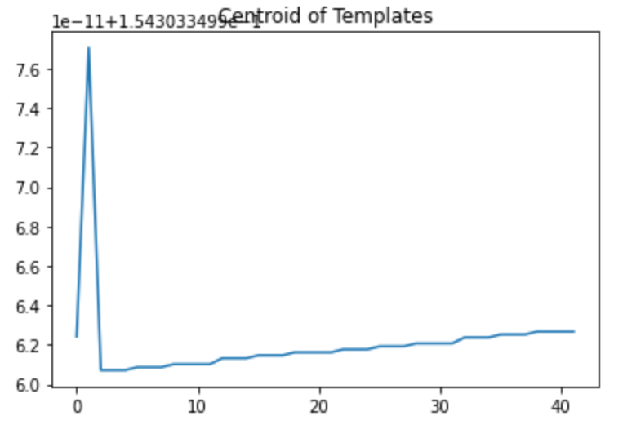
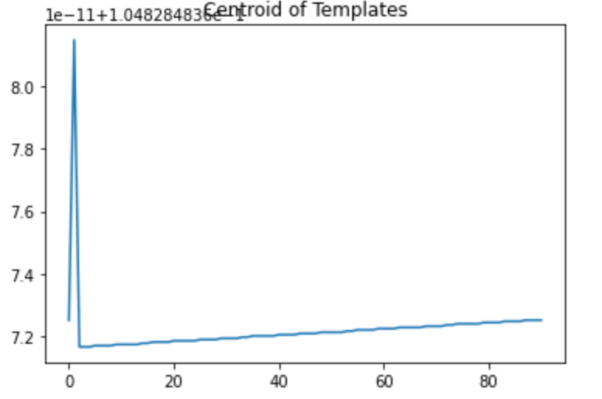
Analysis of Experimental Results
3. A Type of Ineffective Centroid Calculation Method
Model | S Prediction | D Prediction
PCA | - / - | - / -
K-SC | - / - | - / -
Essentially, all of them use the eigenvector of a matrix as centroids for quick clustering.
However, for Template4Prediction task, this approach is too coarse and cannot be used.

Slide 14
Analysis of Experimental Results
4. Trainable Method
Model | S Prediction | D Prediction
DBA | 2.05 / 1.96 | 3.43 / 4.15
GTW | - / - | - / -
TTW | 1.52 / - | 4.28 / -
Soft-DTW | 1.35 / 1.38 | 4.53 / 4.44
These models all have available libraries. Currently, the trainable methods don't seem effective.
However, these papers involve a lot of mathematical theory, and I'll need some time to understand it.
As of now (up to papers from 2018), there‘s a trend in Time Series Average method shifting from intuitive to counterintuitive(Gradient related), which we need to pay attention to.

Slide 15
Analysis of Experimental Results
General trend in the development of models in time series average:
Incremental -> Batch
Intuitive -> Counterintuitive
Based on current experimental results, this development trend seems to be inconsistent with the goal of Template4Prediction.
At the current pace, it will take me at least another 5-6 weeks to fully review important papers up to the year 2023.

Slide 16
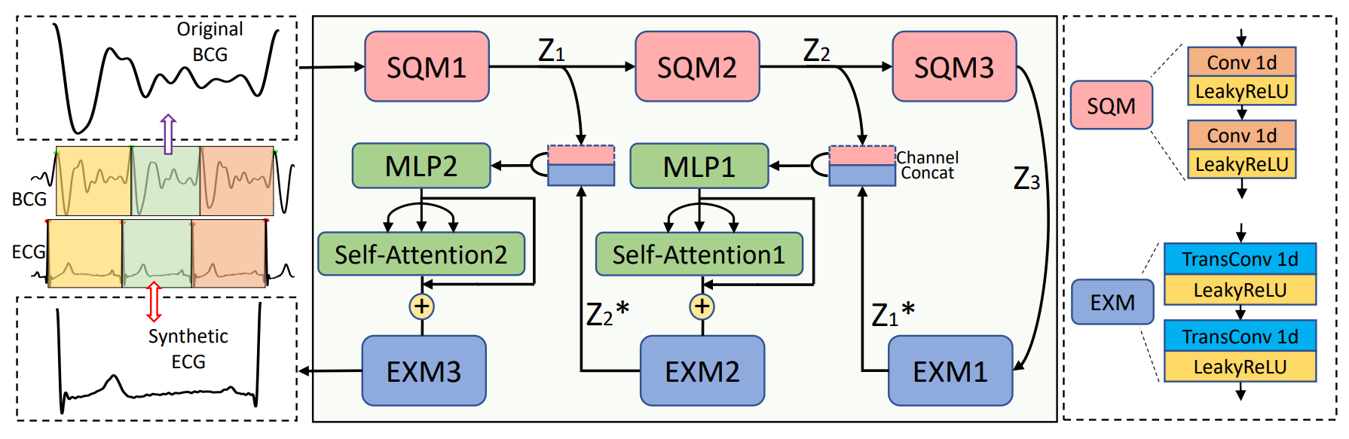
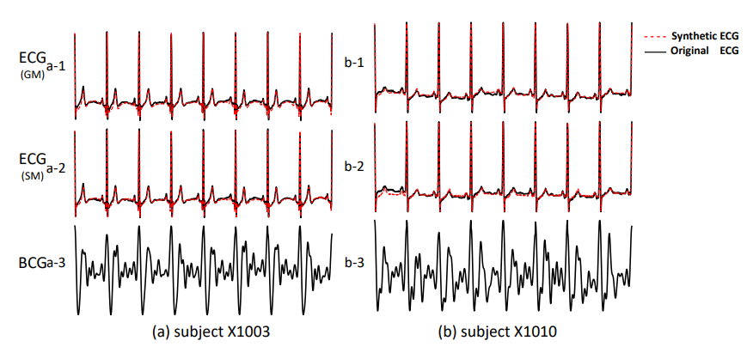
Generative Model
Rec-AUNet: Attentive UNet for Reconstruction of ECG from BCG^{[9]}
While generating a template from a lengthy signal may not be feasible.
This network architecture should, at the very least, be able to capture the characteristics of the BCG signal.
If someone in our lab is working on this direction, they might consider trying out this architecture.

Slide 17
Part_2

Slide 18
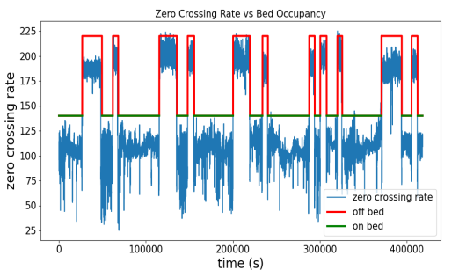
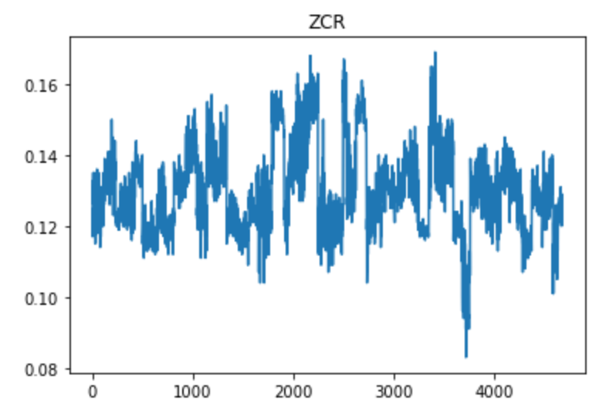
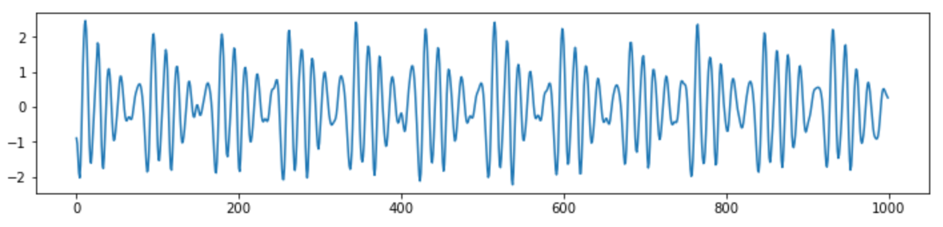
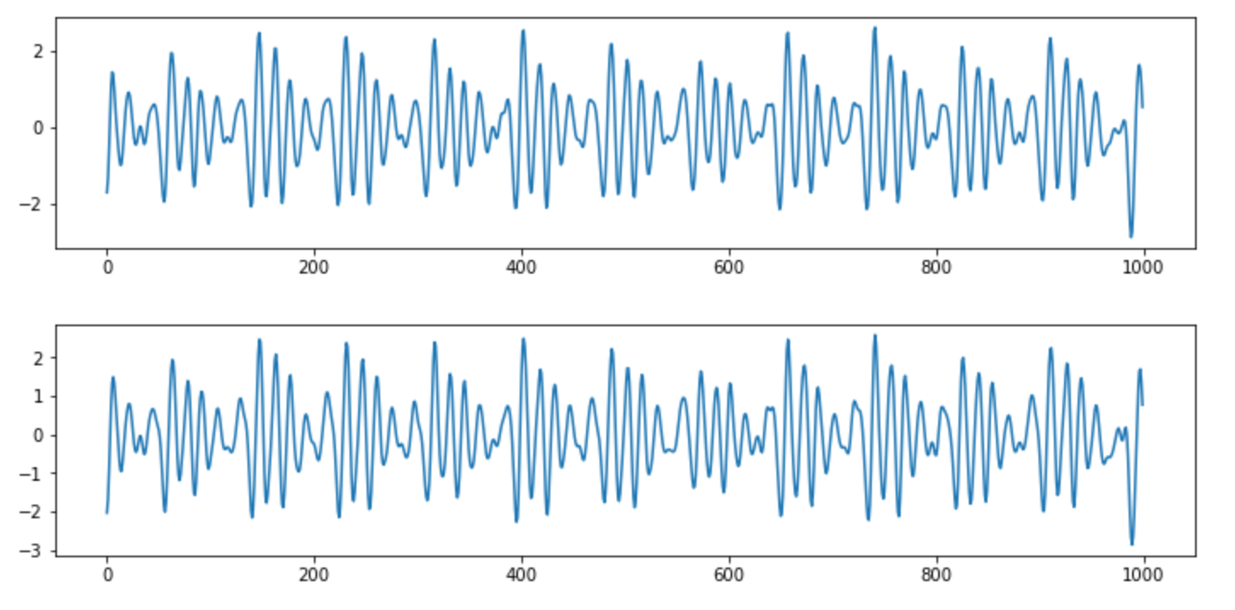
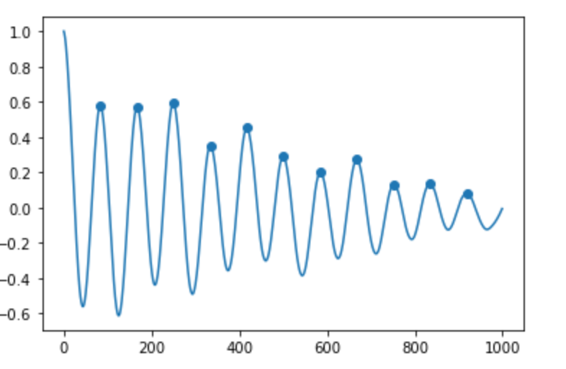
Denoise and Choose High Quality Signals
ZCR
High Quality Signal
Sliding Window?
ACF

Slide 19
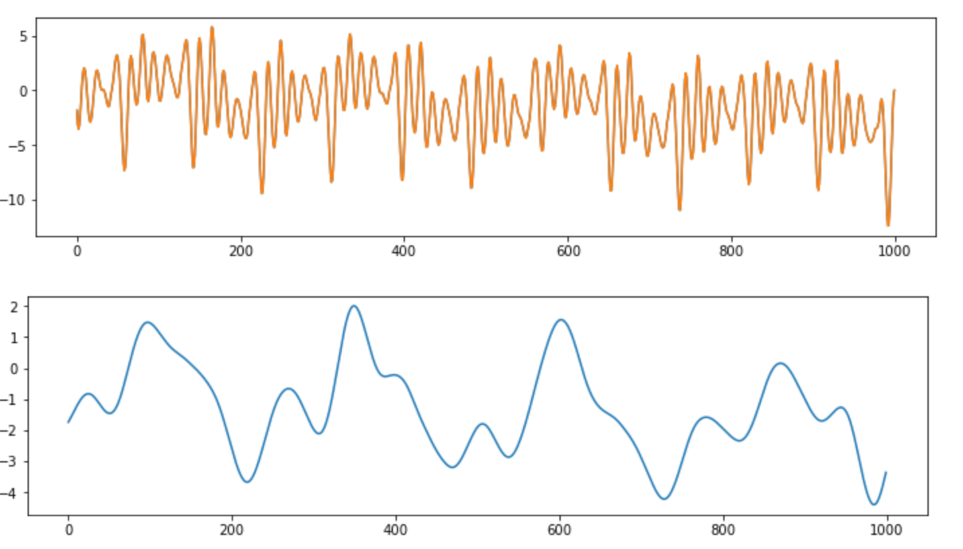


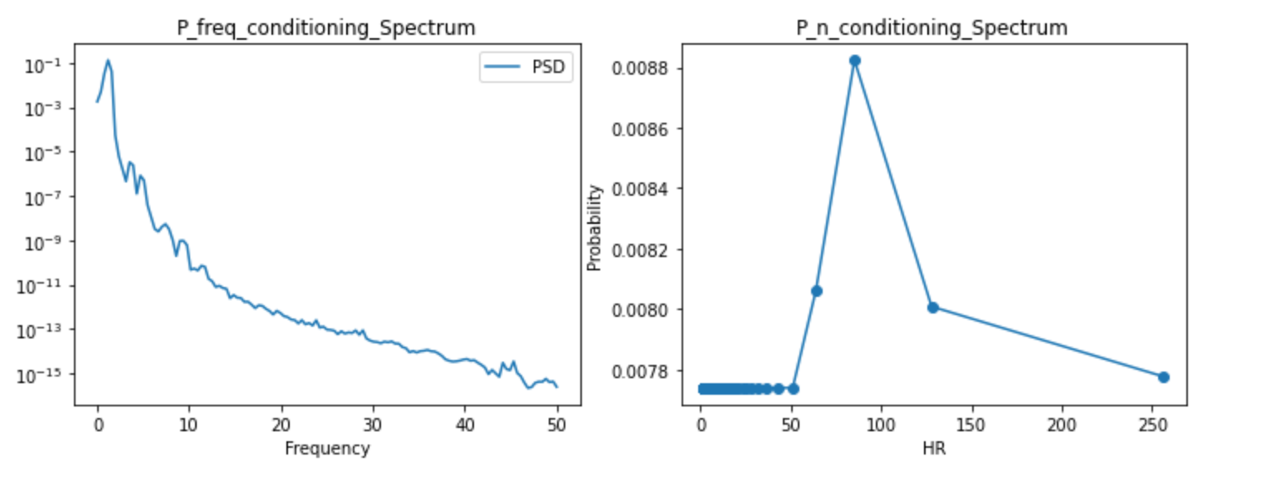
Respiration
Fusion
Why Respiration Pattern will appear?
How does it help and guide us in eliminating Respiration?

Slide 20
Part_3

Slide 21
Work_3: Learning Progress and Future Learning Plan
Theoretical Studies:
1. 现代数字信号处理I/II 张颢
Too difficult, omitted too many relevant foundations of traditional filter design.
2. EE123 Digital Signal Processing, UCB
More inclined towards traditional methods, more suitable for laying a solid foundation.
Next Research Directions:
Read more papers in the relevant field between 2018-2023.
Read and contemplate papers you sent me that are related to blood pressure.
3. When evaluating algorithm performance, make extensive use of real datasets, or explore the effects on different types of signals.
4. Prioritize knowledge in DSP and if there's additional capacity, delve into Li Mu's hands-on deep learning series.

Slide 22
Questions
To what extent should my research reach? What will the results be compared against? Will testing be done on publicly available datasets of real signals? Currently, even if we extract templates from our mixed signals, we can't find corresponding indicators for S and D.
Regarding the TS-LLM project, is it already decided to proceed, or are we still in the observation stage? What level of knowledge should be acquired for the foundation?
Do we have the latest real data? I noticed many signals in IOT2023 are 30 seconds long.

Slide 23
Reference
[1] Gupta, Lalit, et al. "Nonlinear alignment and averaging for estimating the evoked potential." IEEE transactions on biomedical engineering 43.4 (1996): 348-356.
[2] Niennattrakul, Vit, and Chotirat Ann Ratanamahatana. "Shape averaging under time war**." 2009 6th International Conference on Electrical Engineering/Electronics, Computer, Telecommunications and Information Technology. Vol. 2. IEEE, 2009.
[3] Niennattrakul, Vit, Dararat Srisai, and Chotirat Ann Ratanamahatana. "Shape-based template matching for time series data." Knowledge-Based Systems 26 (2012): 1-8.
[4] Petitjean, François, Alain Ketterlin, and Pierre Gançarski. "A global averaging method for dynamic time war**, with applications to clustering." Pattern recognition 44.3 (2011): 678-693.
[5] Schultz, David, and Brijnesh Jain. "Nonsmooth analysis and subgradient methods for averaging in dynamic time war** spaces." Pattern Recognition 74 (2018): 340-358.
[6] Cuturi, Marco, and Mathieu Blondel. "Soft-dtw: a differentiable loss function for time-series." International conference on machine learning. PMLR, 2017.
[7] Morel, Marion, et al. "Time-series averaging using constrained dynamic time war** with tolerance." Pattern Recognition 74 (2018): 77-89.
[8] Khorram, Soheil, Melvin G. McInnis, and Emily Mower Provost. "Trainable time war**: Aligning time-series in the continuous-time domain." ICASSP 2019-2019 IEEE International Conference on Acoustics, Speech and Signal Processing (ICASSP). IEEE, 2019.
[9] Wang, Peng, et al. "Rec-AUNet: Attentive UNet for Reconstruction of ECG from BCG." 2022 IEEE International Conference on Bioinformatics and Biomedicine (BIBM). IEEE, 2022.

Slide 24
Thanks!

