Slide 1
Presentation
Jiayu Chen
2024.01.30

Slide 2
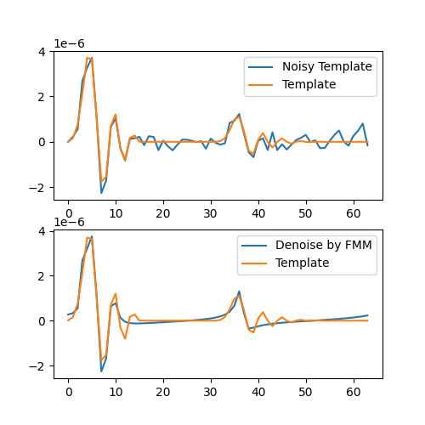
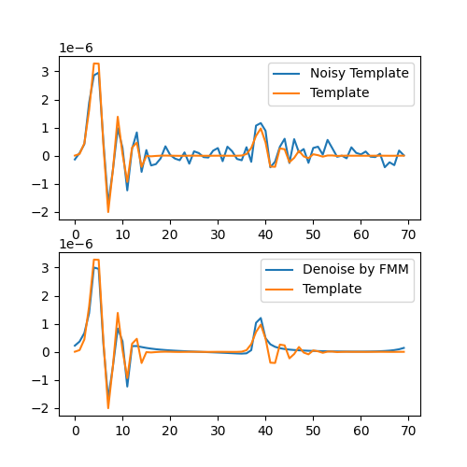
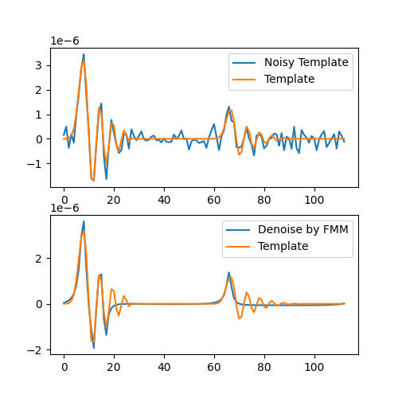
Denoise the One-Circle Signal
Decomposing the original signal and reconstructing it may help us to denoise the signal.
However, we cannot verify the effectiveness of this denoising method because we currently lack a valid measurement method on real signals referred to as BSG signals.
Testing the denoising capability of this method on simulated SCG signals against white noise shows significant potential.
Notes:
Diastolic, Systolic

Slide 3
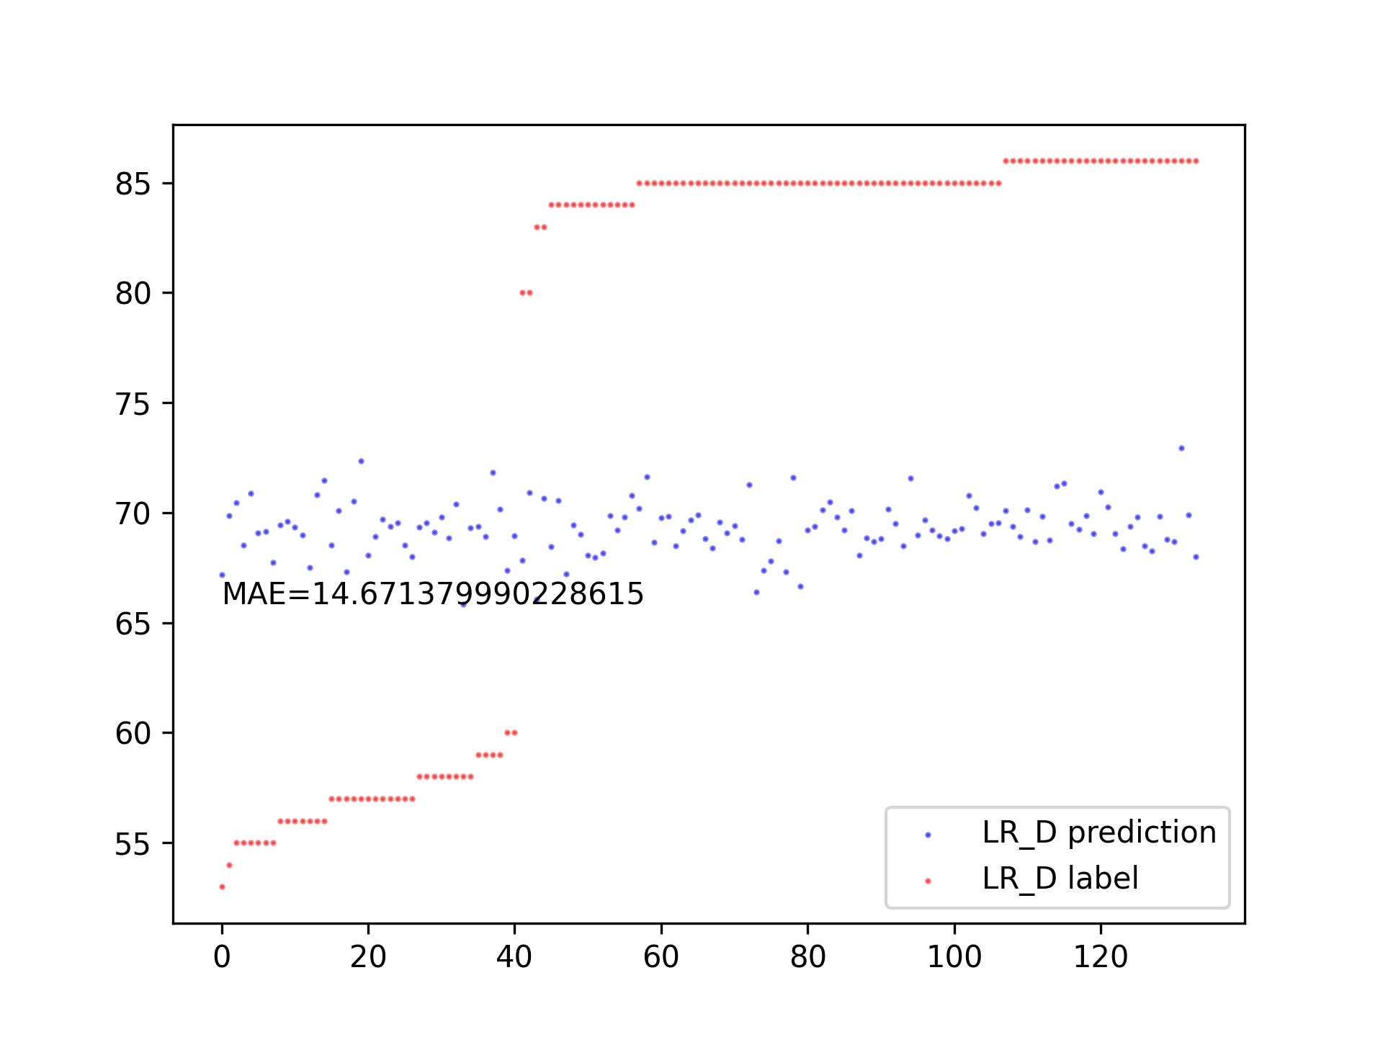
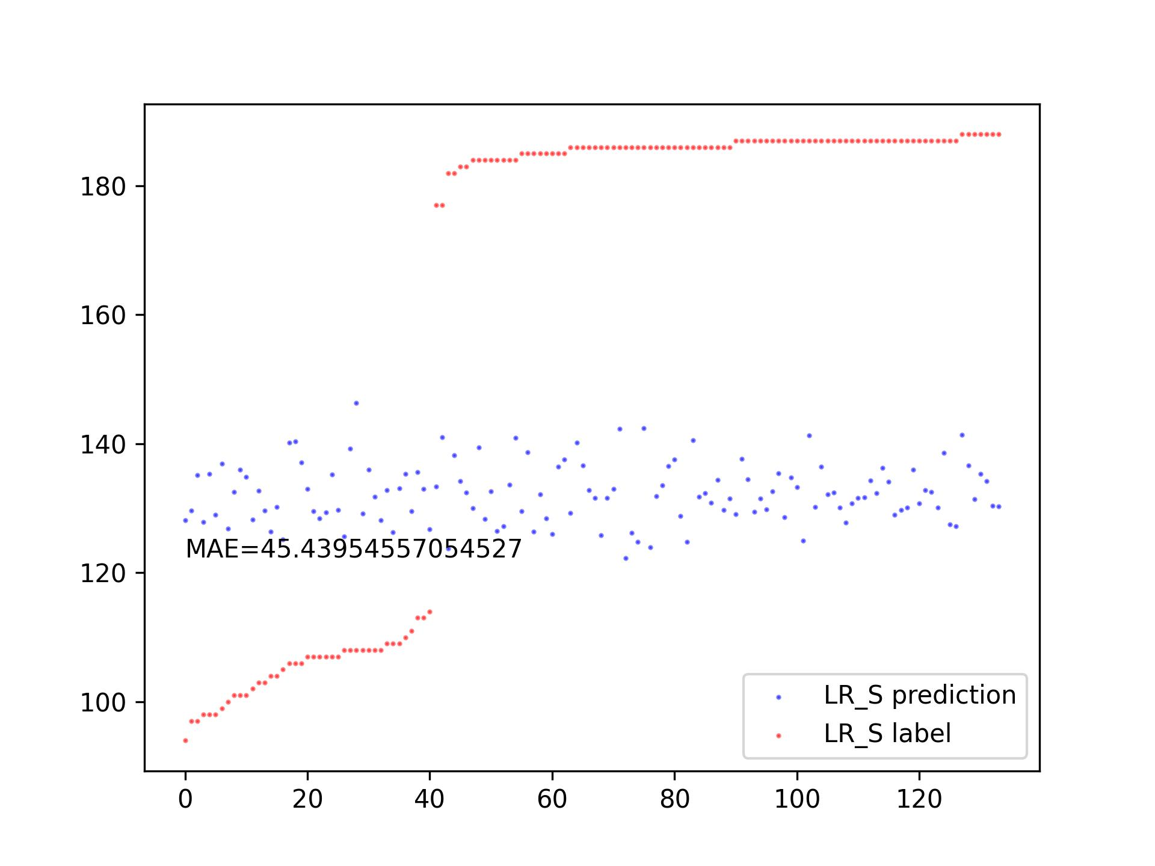
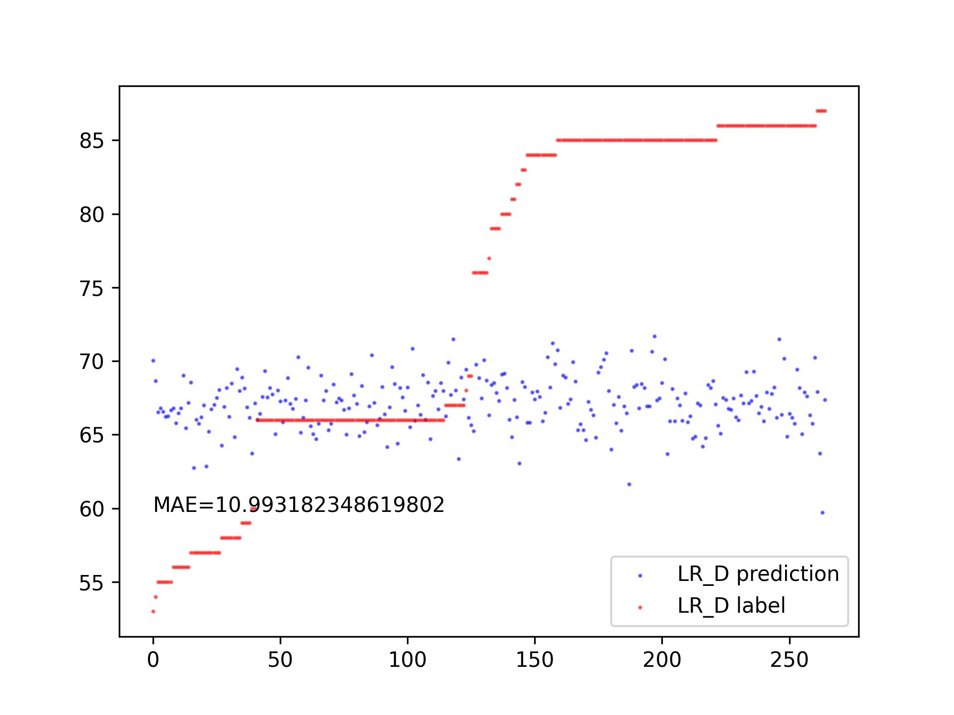
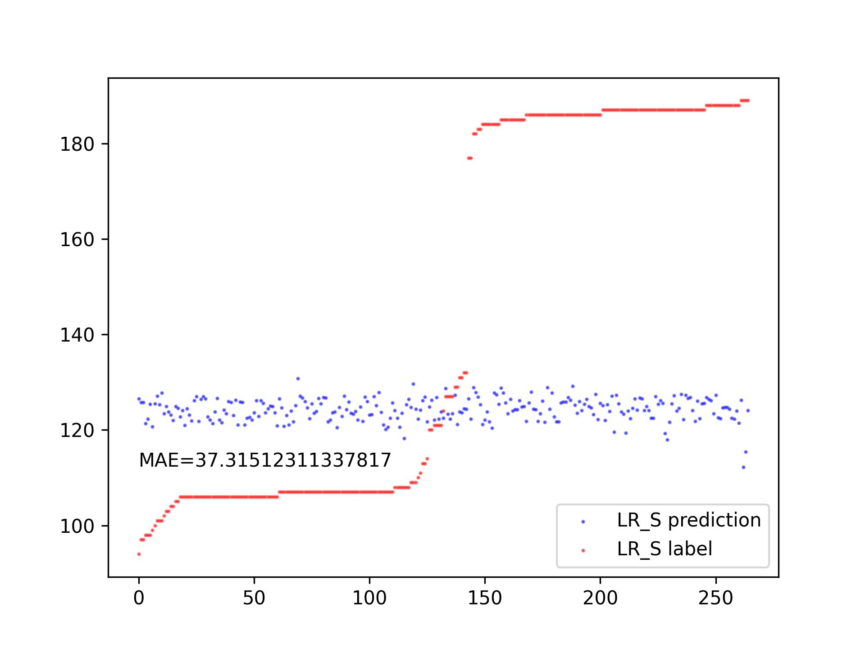
Use decomposition coefficients as features for prediction.
Our task is to predict blood pressure. It's a preliminary attempt. I just included all the coefficients, such as Alpha, Beta, Ogema, and A, in a Linear Regression.
However, the results indicate that these coefficients do not encompass the necessary features for accurate predictions.
Train Set: 300, Test Set: 150
Train Set: 500, Test Set: 300

Slide 4
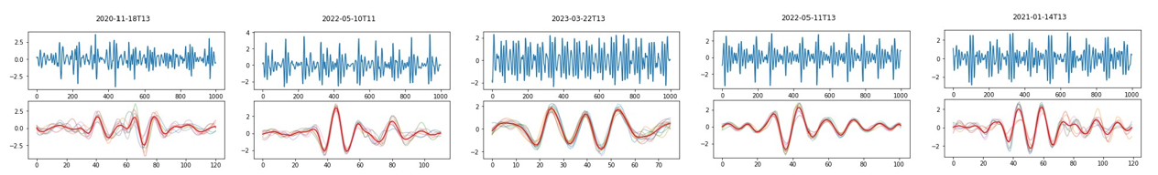
Encountered Issues:
We must decompose a single-cycle signal into a large number of components, if we want to focus on smaller peaks.
However, if we decompose a single-cycle signal into a large number of components, the relationship between these components becomes chaotic. There is a loss of interpretability in decomposed components.
Moreover, we don’t know how many components are appropriate for decomposition, as there is a significant difference between the waveforms of real signals.

Slide 5
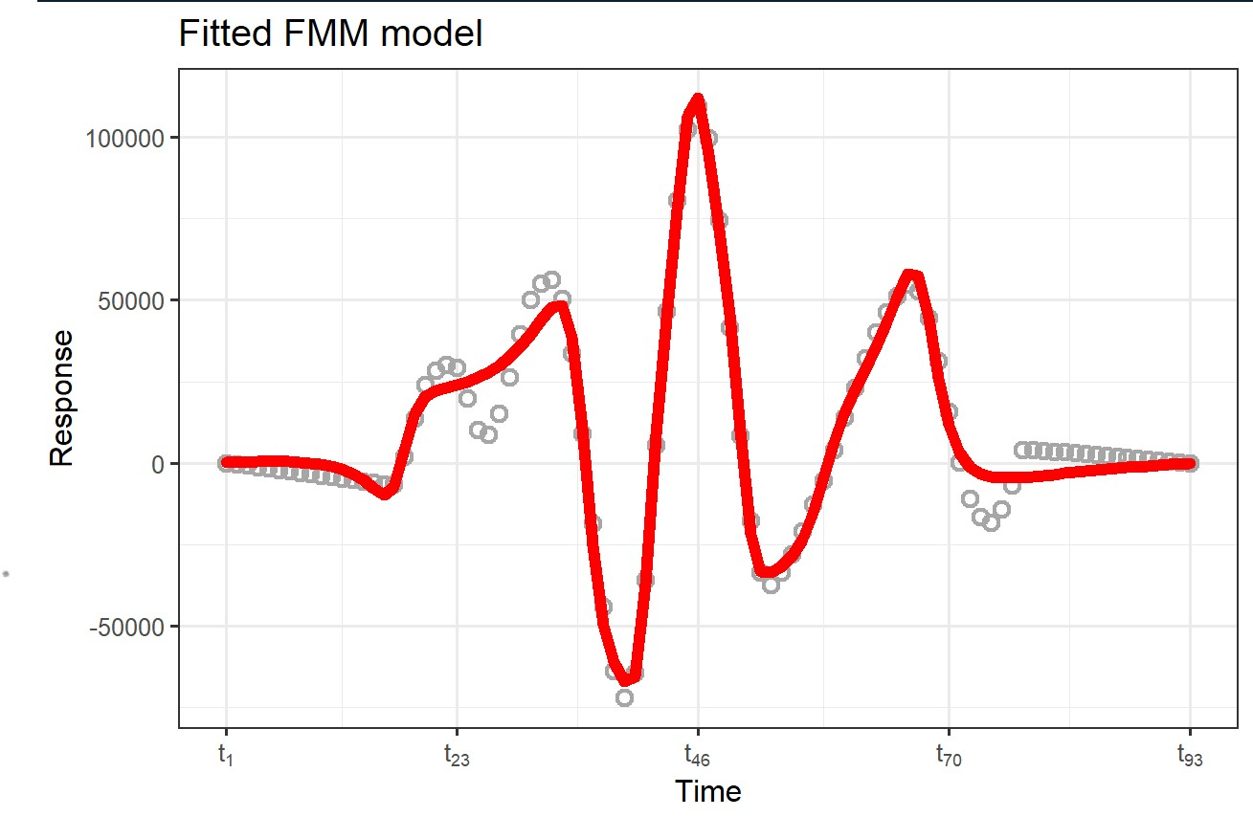
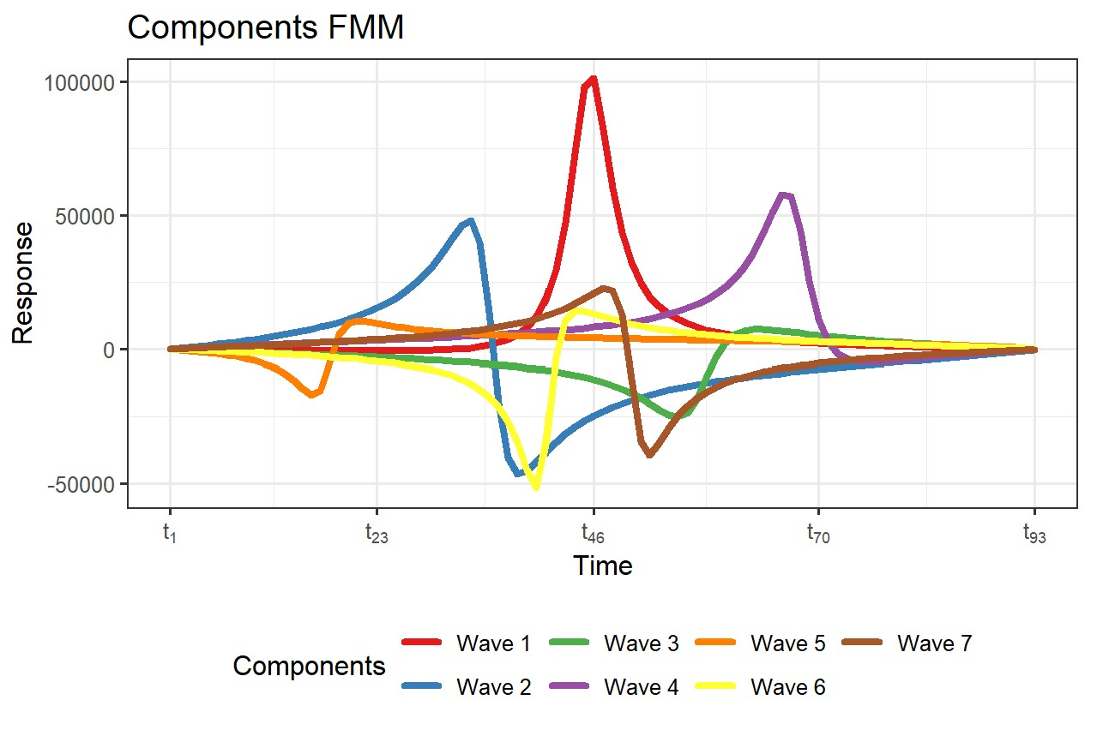
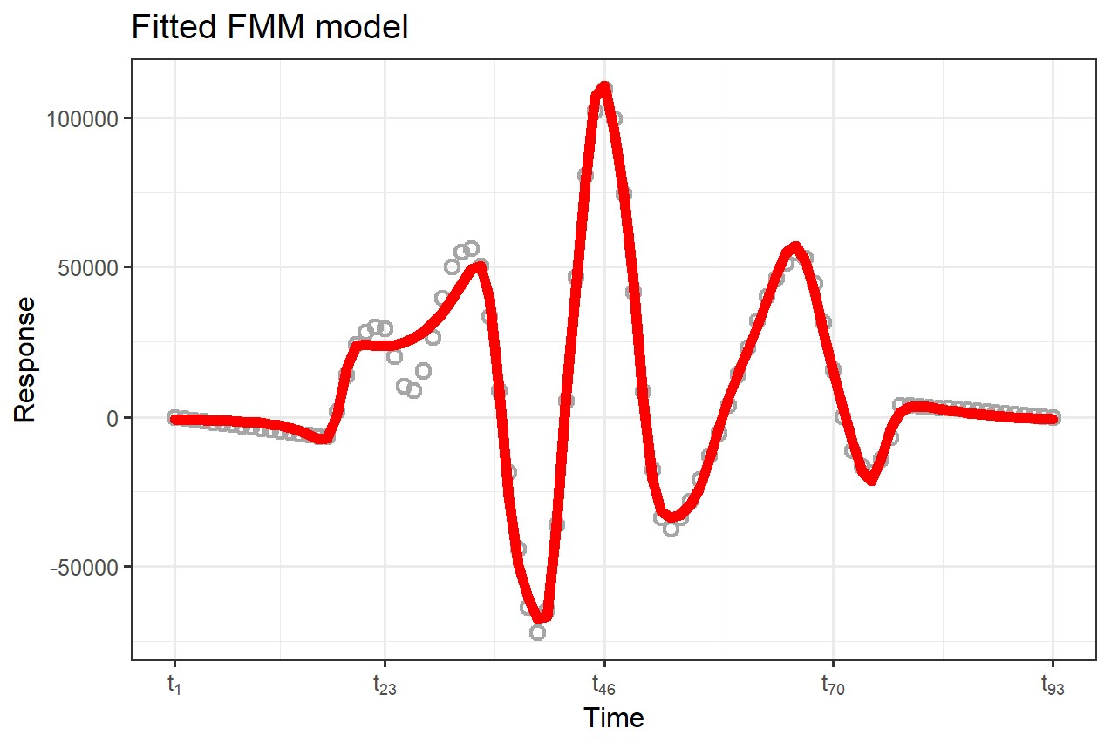
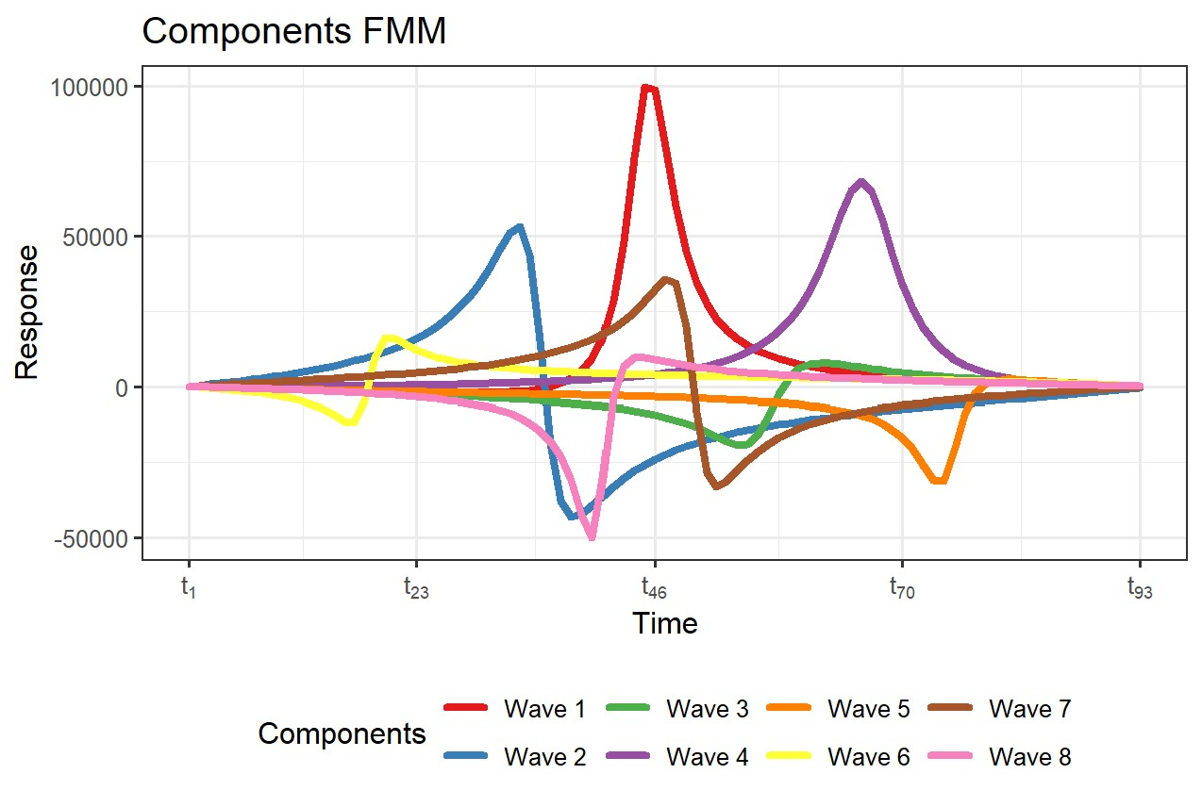
There is almost no interpretability in decomposed components.
We need to decompose the single-cycle signal into a large number of components, if we want to focus on smaller peaks.

Slide 6
Thanks!

