Slide 1
Presentation
Jiayu Chen
2024.02.26

Slide 2
Work Description
Part_1: Template-based IBI Prediction
Part_2: BP-related Features
Part_3: Questions

Slide 3
Part_1

Slide 4
Template-based IBI Prediction
The background information of irregular heart rate：
Sinus arrhythmia(窦性心率不齐)
Respiratory sinus arrhythmia: Heart rate increases during inhalation and decreases during exhalation.
Non-respiratory sinus arrhythmia
Judgment Criteria:
Fluctuations in IBI between 10% and 20% are considered relatively normal.
Diagnosis of Heart Rate Abnormality:
When IBI monitoring is entirely accurate and successfully identifies heart rate abnormality.
When IBI monitoring is not entirely accurate but still successfully identifies heart rate abnormality.
Healthy: [1000ms, 1000ms, 1000ms, 1000ms]
Unhealthy: [1000ms, 1250ms, 1000ms, 1000ms]
Detected IBI: [1000ms, 1250ms, 1000ms, 1000ms] -> Abnormal
Detected IBI: [1000ms, 950ms, 300ms, 1000ms, 1000ms] -> Abnormal

Slide 5
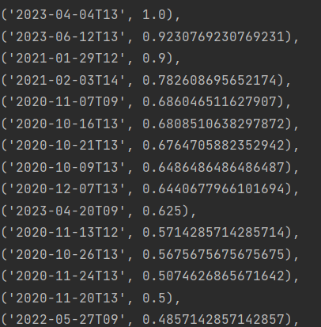
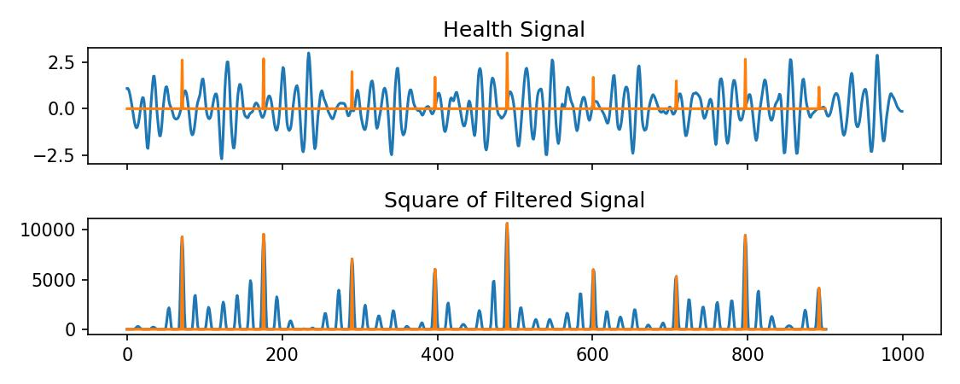
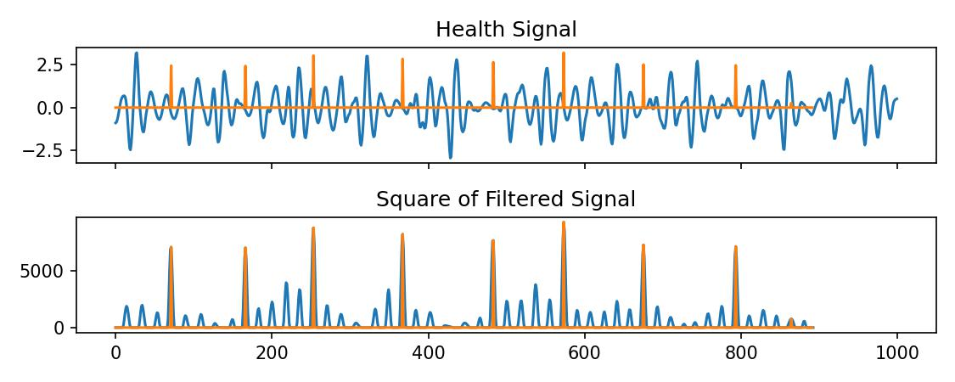
Template-based IBI Prediction
Subject Ratio of Abnormal Signals
Experiments Results on Real Data:
4,421 pieces of 10-second BSG signal
3471 pieces of signals with Normal IBI
950 pieces of signals with Abnormal IBI
A ratio of 78.5%

Slide 6
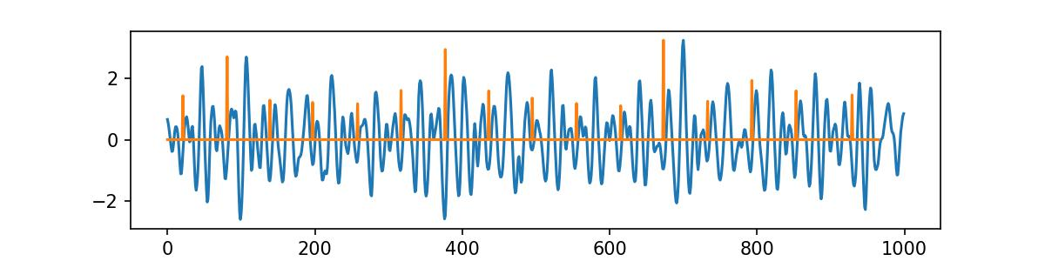
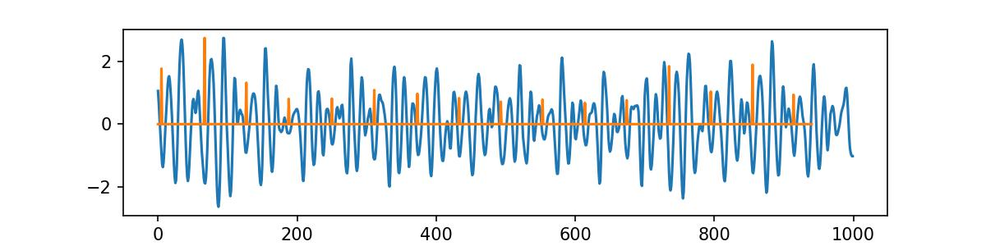
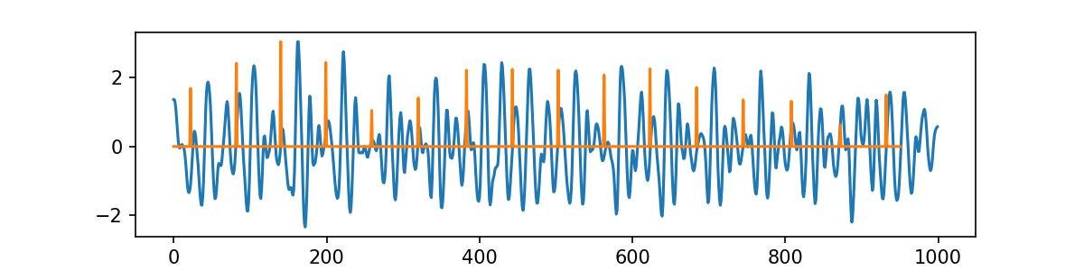
Template-based IBI Prediction
Experiments Results on Real Data
950 pieces of signals displaying abnormal IBI are filtered out.
The signals with confirmed normal IBI were used as the baseline to construct a simulated dataset.
Below 4 situations are carefully tested.
Extreme Heart Rate: Instances where heart rate is exceptionally high(HR > HR_max * 0.98).
Abnormalities occurring within a single heartbeat.
Respiratory Sinus Arrhythmia
Signals are of moderate quality. (Only 4 good circles within a 10-second piece)

Slide 7
Template-based IBI Prediction
Abnormal Data Construction: Add or subtract a random number within the range of 240ms to 480ms from the original IBI.
Abnormalities occurring within a single heartbeat.
One Abnormal Heartbeat | Mean | Experiment_1 | Experiment_2 | Experiment_3
Add 3.5Hz Sine Wave | 0.967 | 0.946 | 0.964 | 0.991
Add 6Hz Sine Wave | 0.927 | 0.926 | 0.915 | 0.941
Abnormal Type | Noise | Mean | Experiment_1 | Experiment_2 | Experiment_3
One Abnormal Heartbeat | Add 3.5Hz Sine Wave | 0.967 | 0.946 | 0.964 | 0.991
 | Add 6Hz Sine Wave | 0.927 | 0.926 | 0.915 | 0.941
Respiratory Sinus Arrhythmia | Add 3.5Hz Sine Wave | 0.983 | 0.987 | 0.979 | 0.983
 | Add 6Hz Sine Wave | 0.960 | 0.958 | 0.970 | 0.925

Slide 8
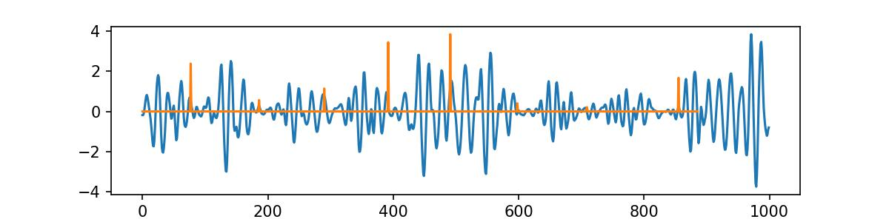
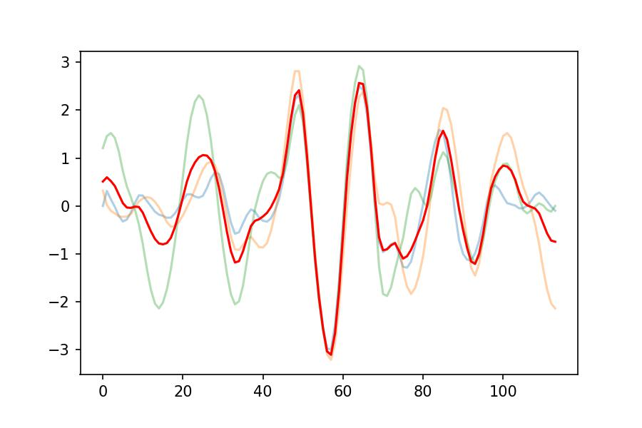
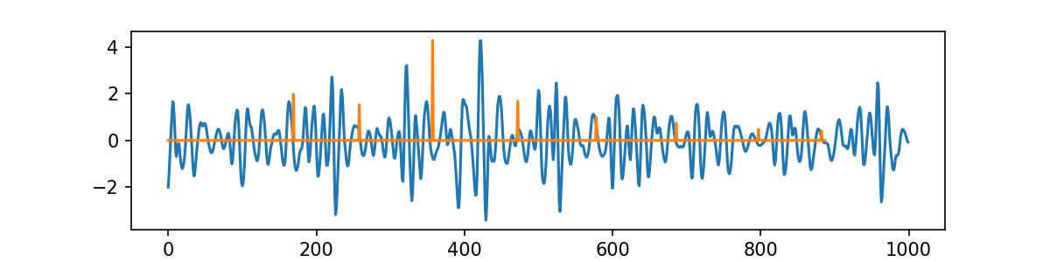
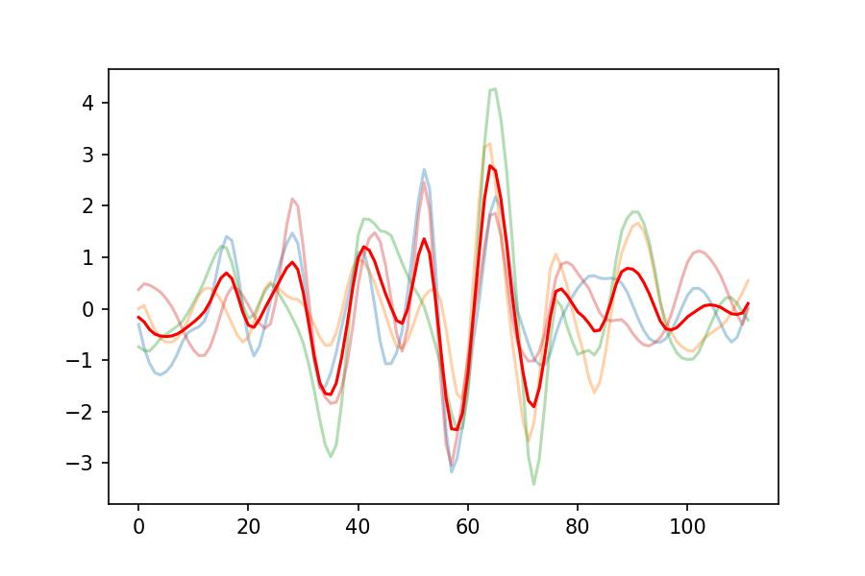
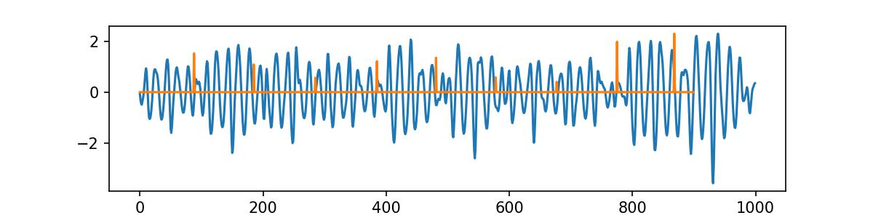
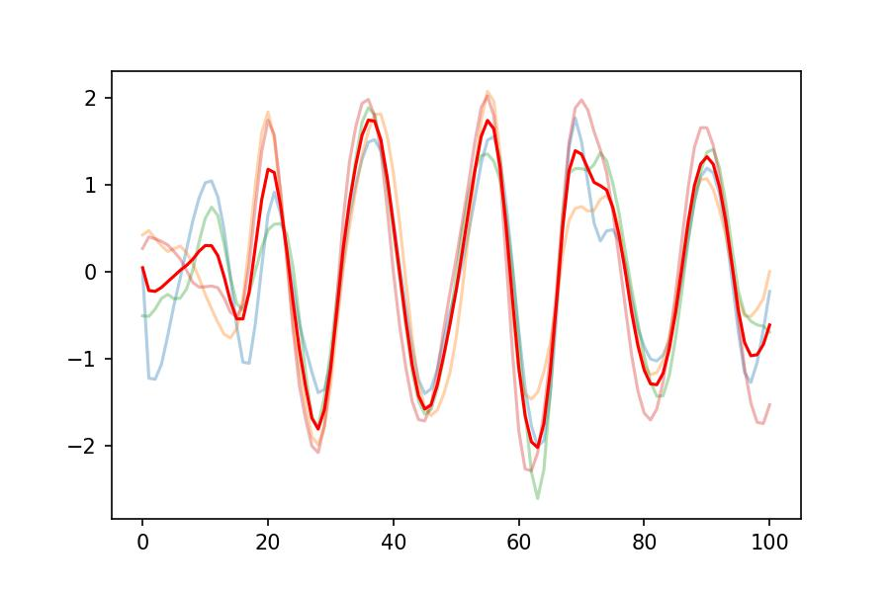
Template-based IBI Prediction
Signals are of moderate quality

Slide 9
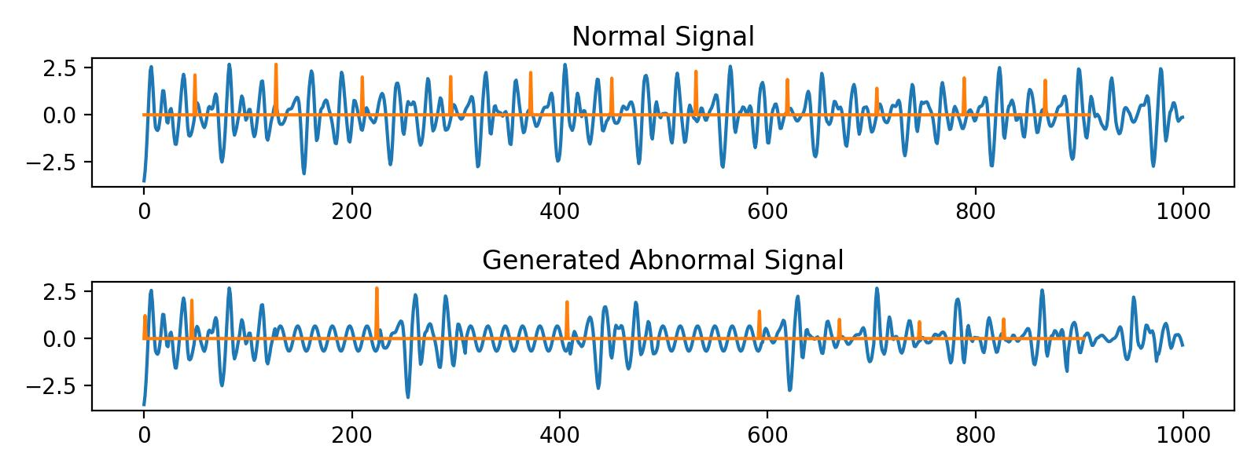
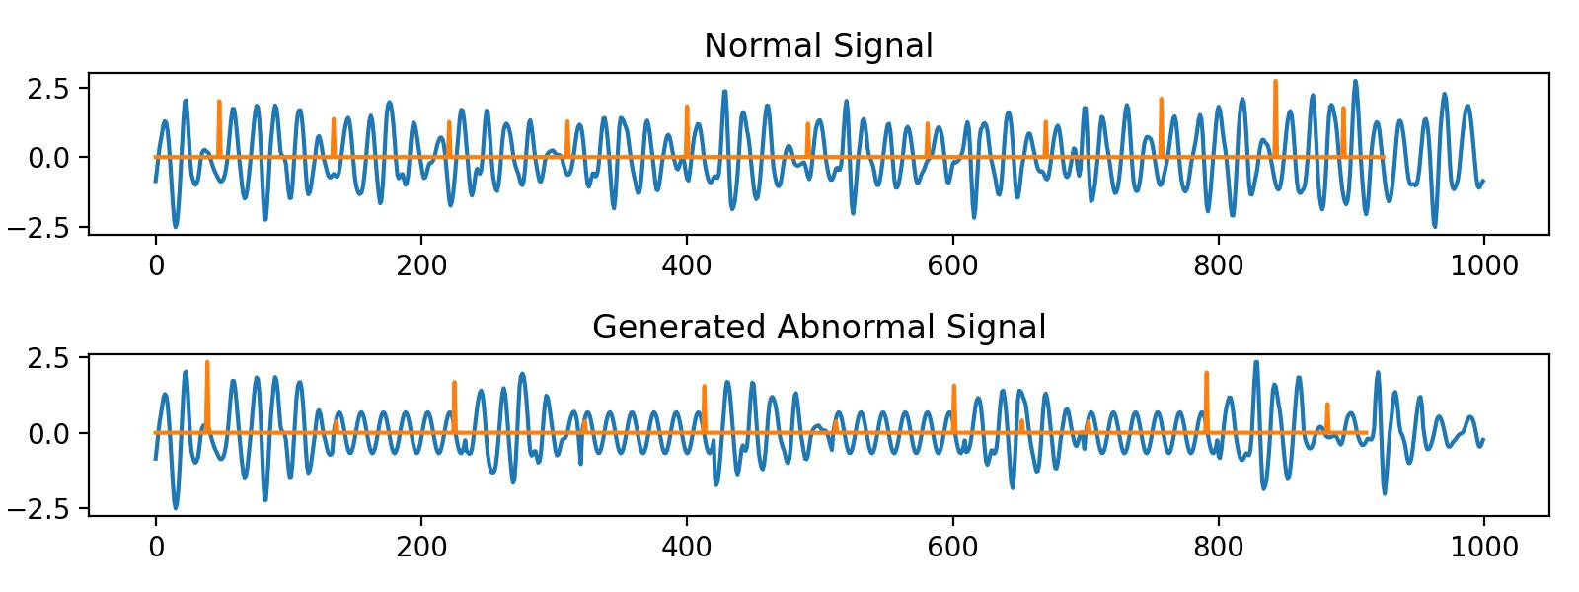
Template-based IBI Prediction
Uniform Distribution of Heartbeats:
Diagnosis of Heart Rate Abnormalities:
1. When IBI is entirely accurate and successfully identifies abnormalities.
2. When IBI is not entirely accurate but still successfully identifies abnormalities.
Currently, it's difficult to determine exactly how many IBIs can be accurately identified.
Additionally, it's easier to misinterpret heartbeats that are widely spaced.
For example, if the interval between heartbeats is supposed to be 100ms but due to an anomaly, it becomes 150ms, it might be misjudged as a combination of 80ms and 70ms intervals. However, anomalies where the interval between heartbeats shortens are relatively easier to identify.

Slide 10
Part_2

Slide 11
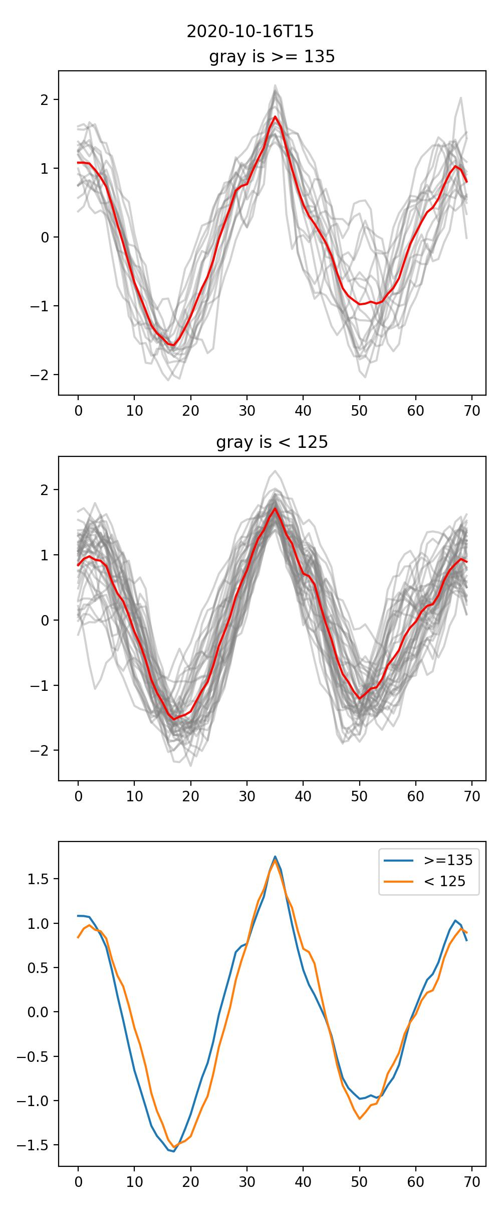
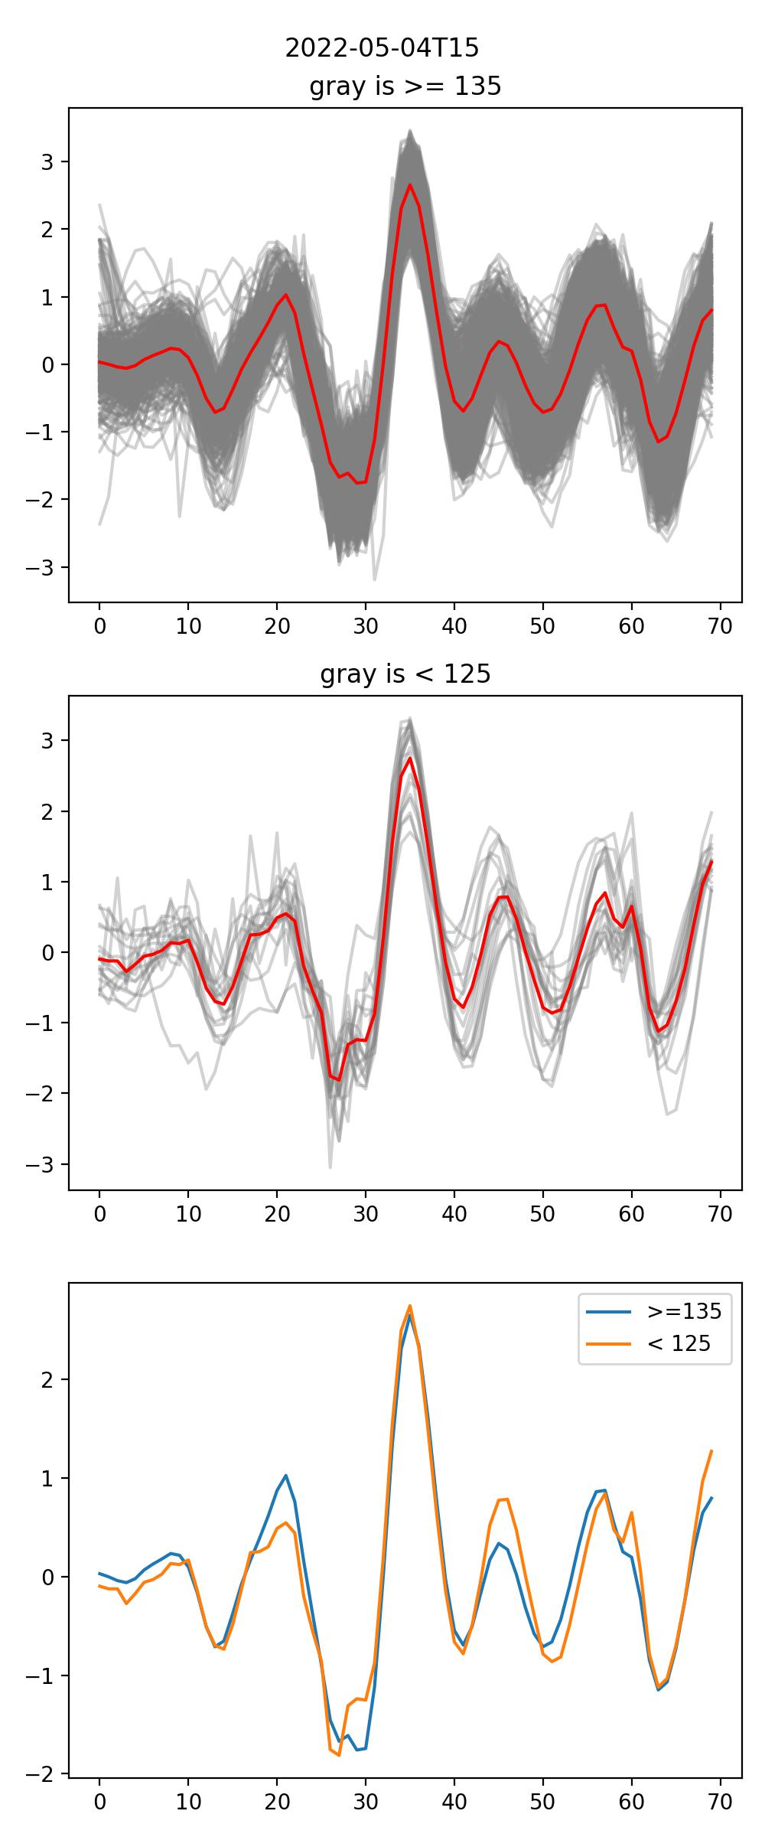
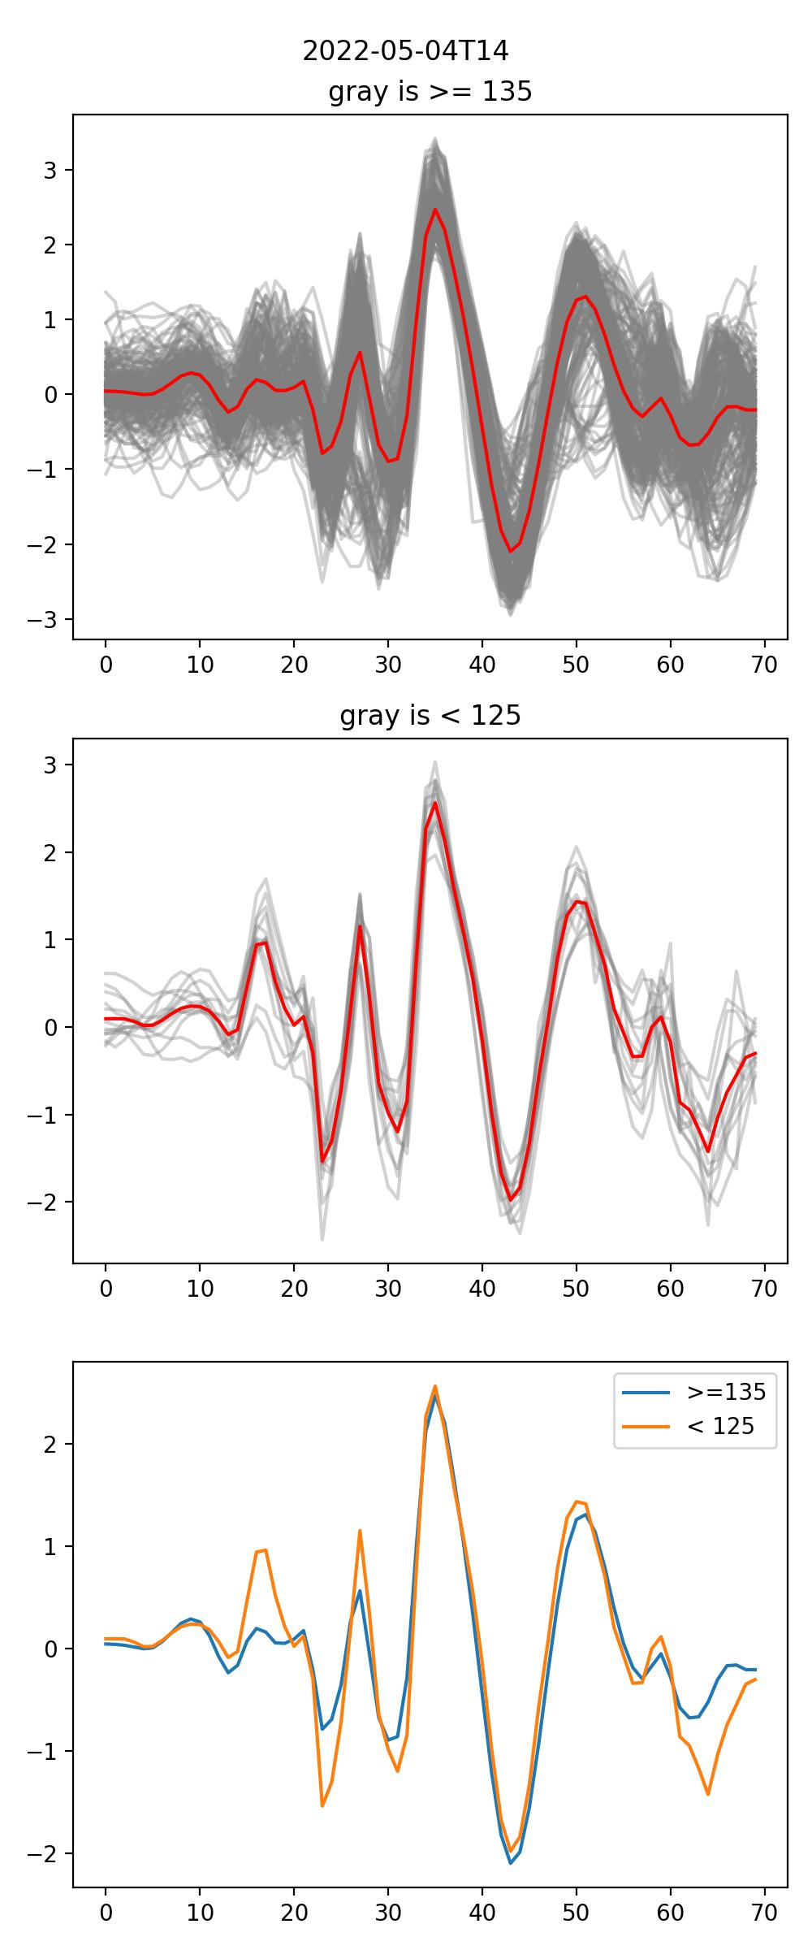
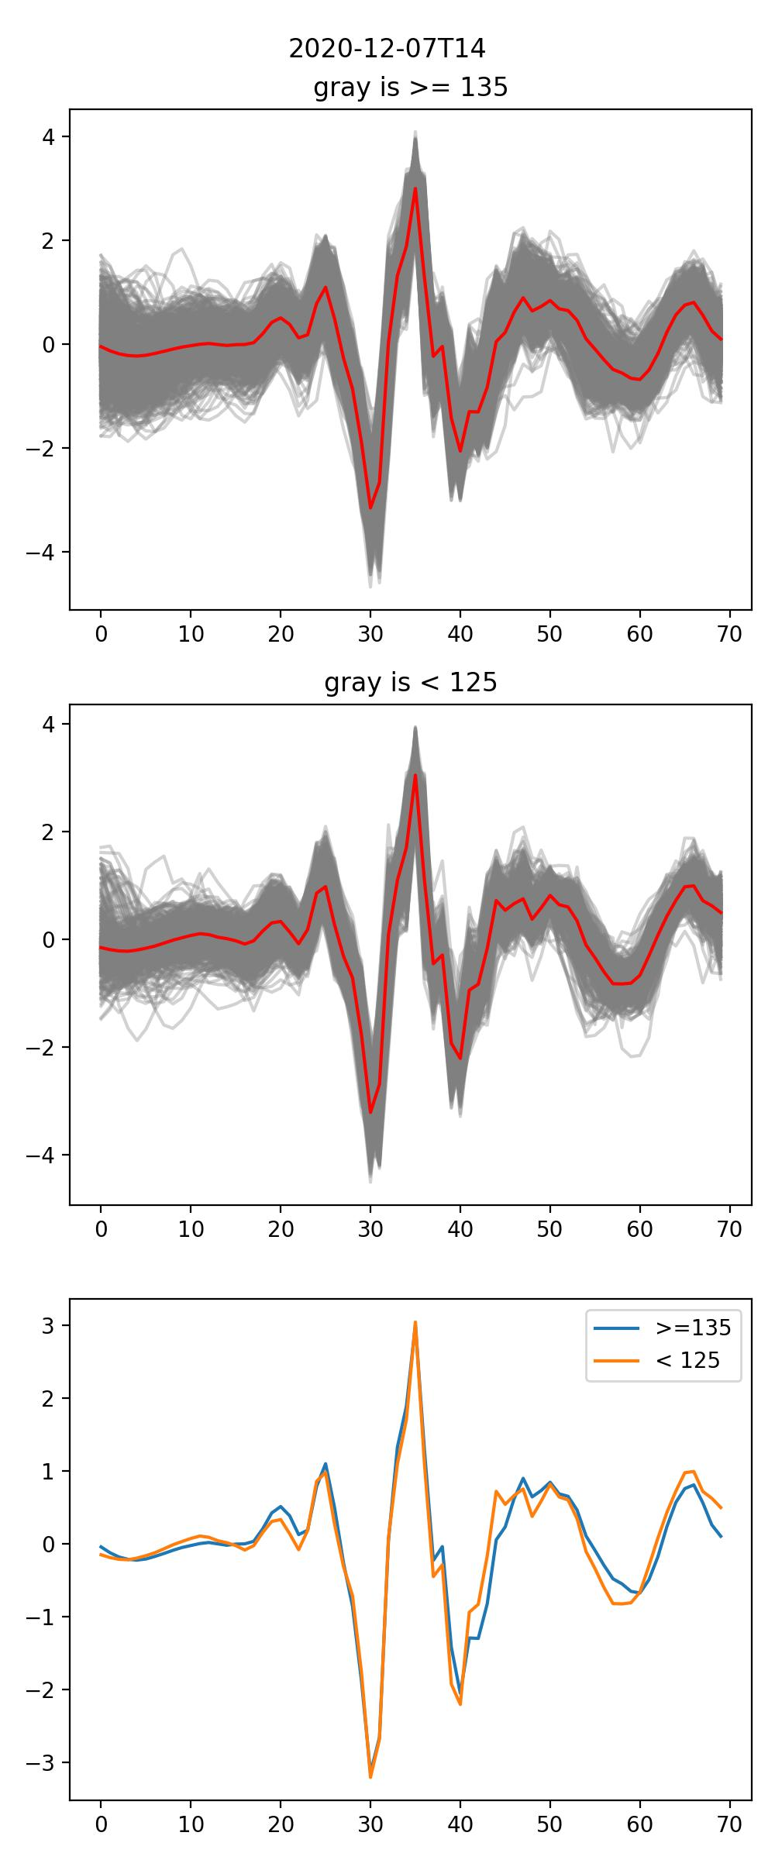
Classification Model
Visualize and analyze the test results of the classification model, attempting to summarize what the model has learned.
Some existing issues:
When slicing, usually only the first few peaks can be seen, typically around 3-4.
The red line in the graph represents the Mean Template. The reason for this difference is due to the asymmetry in sample quantities. Samples with more data points tend to be smoother, while those with fewer data points tend to be more rugged.
Based on above 2 reasons, analyzing the test results of the classification model suggests that our feature extraction may not be helped

Slide 12
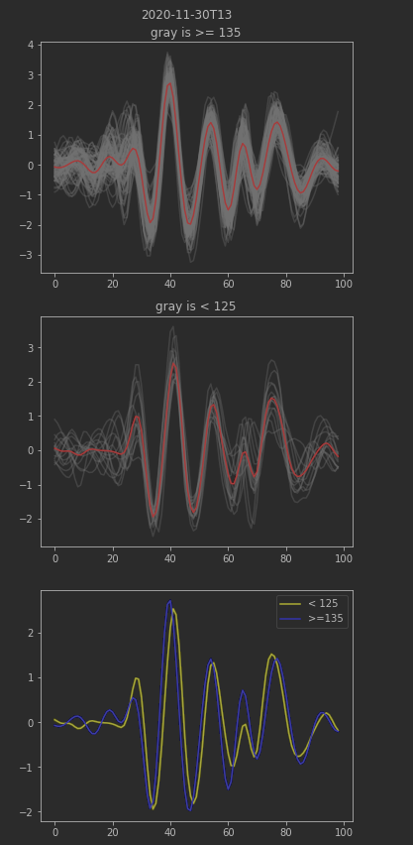
Complete Circle Segmentation
Then, I visualized the complete signal slices and attempted to directly extract features related to peaks (mainly amplitudes) in the BSG signal.
The motivation behind this approach stemmed from the core challenge of waveform uncertainty. Additionally, upon observing the image on the right, I speculated whether the waveform evolved based on BP as the independent variable.
However, after reviewing some papers, I realized that this approach might not be feasible.
Signal Type | Core Feature | Feature Type
SCG-PPG | PTT or PAT | Time
ECG-PPG | PTT or PAT | Time
PCG-PPG | PTT or PAT | Time
SCG | AO to AC | Time
BCG | IJK | Amplitude

Slide 13
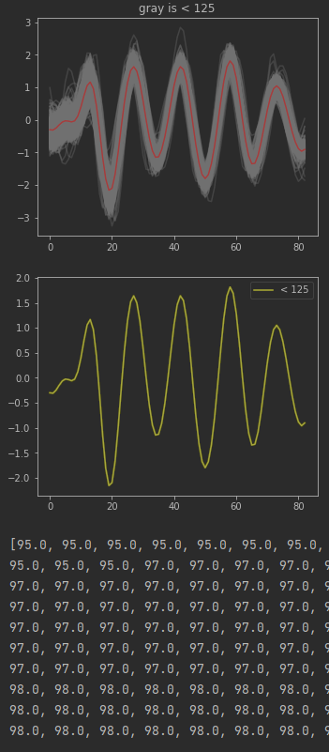
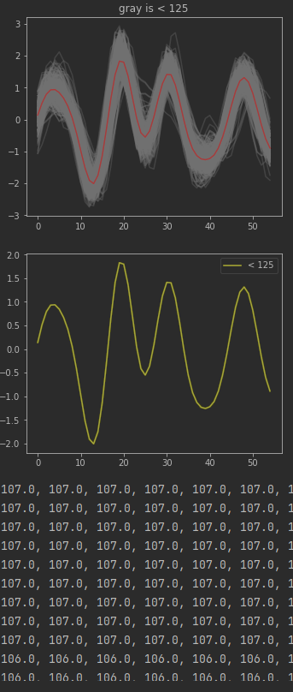
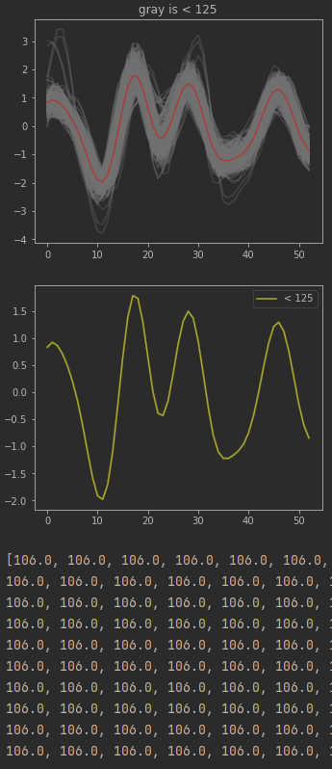
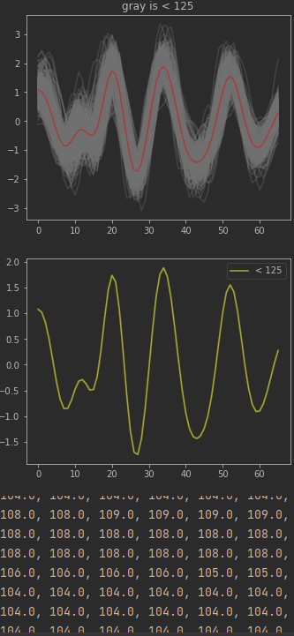

Slide 14
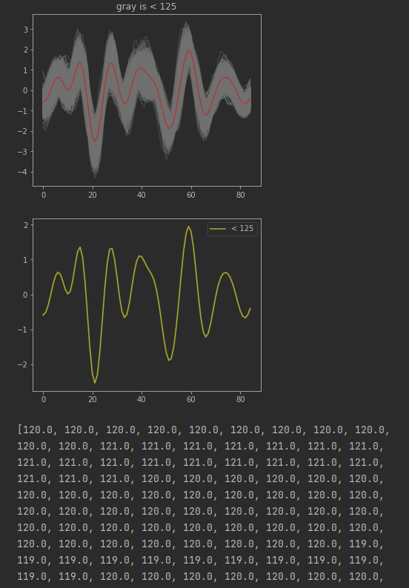
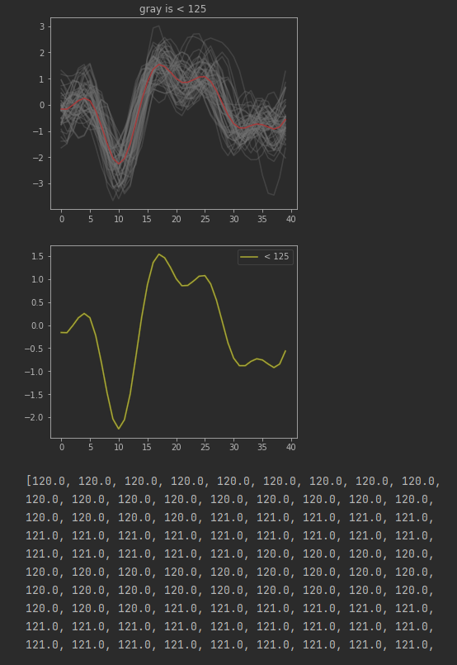
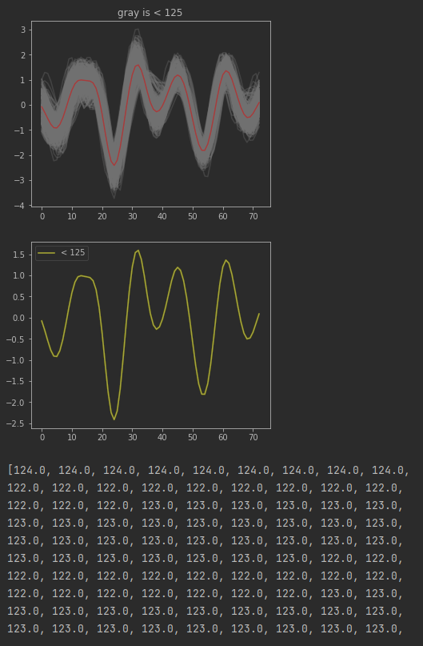

Slide 15
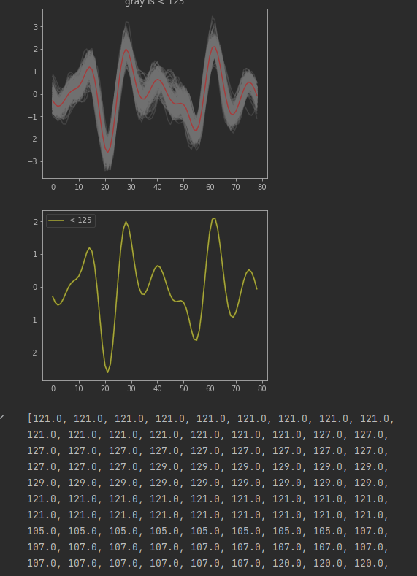
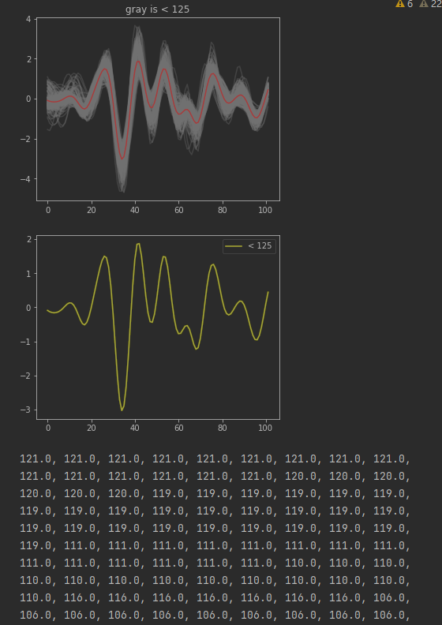
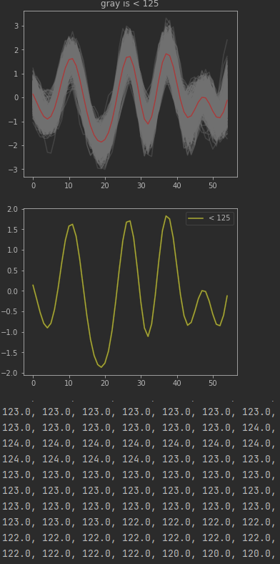

Slide 16
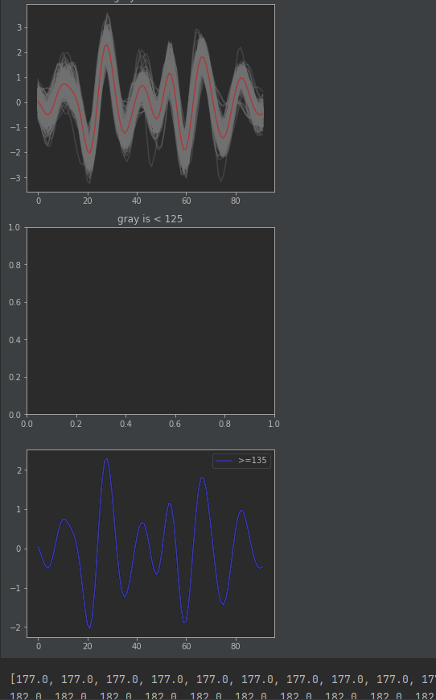
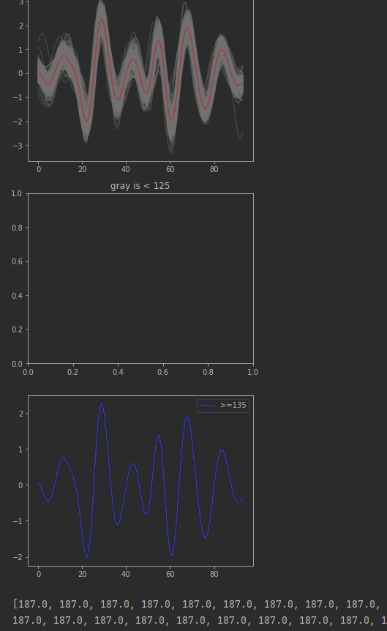

Slide 17
Next Step
All types of Pulse Transit Times (PTTs) and Pulse Arrival Times (PATs) can be calculated using BCG-PPG signals and SCG-PPG signals. And PAT and PTT are proven to be directly proportional to S and D.
Locating the positions of the J peak/OA peak in the BSG signal or in the derivative of the BSG signal may help us gain a better understanding of the BSG signal.
Problems
About the accuracy of VTCN-based classification model.
2. I totally.

Slide 18
Thanks!

