Slide 1
Weekly Presentation
Jiayu Chen
2023.8.21
Notes:
Ok, I will begin my weekly Presentation

Slide 2
Work Description
Work_1: Automated feature selection is performed from 480 features.
Work_2:Attempting to predict variables S and D using signals with a noise level of 0.8.
Work_3:Tutorial Writing
Work_4:Theoretical knowledge Learning
Notes:
Here is a brief work description
In Work_1, I automate feature selection from 480 features. This automated feature selection demonstrates good performance.
Work_2 involves predicting S and D using signals with a noise level of 0.8.
Work_3 is tutorial writing.
Work_4 is about theoretical knowledge learning.

Slide 3
Work_1: Features Selection
Outcomes:
For the prediction of S, the algorithm identifies the sole feature "Dis21/Dis12" as the most influential.
For the prediction of D, the final selection involves 4 features, including “P1/P2".
Several Advantages:
1. Simplified Feature Construction: Focusing on straightforward features like “Dis12” and “Dis21”, we don’t need to manually engineer complex features like "Dis21/Dis21".
2. Minimal Parameter Adjustment: The entire process hinges on one parameter that has a negligible impact on final results.
3. Reduced Randomness: The method shows low levels of randomness.
Notes:
The automated feature selection process among 480 features yields good outcomes:
For the prediction of S, the algorithm identifies the sole feature “Dis21 slash Dis12” as the most influential. Similarly, in predicting D, the final selection involves four features, including “P1 slash P2".
This approach has several advantages:
Simplified Feature Construction: Focusing on straightforward features , we don’t need to manually engineer complex features.
2. Minimal Parameter Adjustment: The entire process hinges on a single parameter that has a negligible impact on the final results.
3. Reduced Randomness: The method shows low levels of randomness. It is reproducible.

Slide 4
Work_1: Features Selection
Data
(Noise: 0.1, No RR)
S Prediction
D Prediction
Basic Features
Selecting 20 commonly used fundamental features.
Feature Cross
The 20 features are expanded into 480 features.
Relevance Calculation
480 -> 428
480 -> 370
Univariate Feature Selection and Choose Best K
428 -> 3
370 -> 5
Recursive Feature Elimination (RFE)
3 -> 1
Just “Dis21_divide_Dis12”
5 -> 4
“P2_divide_P1” included
Test
MAE: 4.09 (“P2_divide_P1 only)
MAE: 4.47 (Selected 4 features)
MAE: 1.76
Notes:
Here is the process.
1st. Extract Basic Features, I choose 20 commonly used fundamental features.
2nd. Perform Feature Cross and The 20 features are expanded into 480 features
third. Calculate relevance between Features and Predicted Values. This relevance is not Pearson corelated coefficient. It is hypothesis testing.
To S Prediction，480 are reduced to 428. To D Prediction, 480 are reduced to 370
forth. Apply Univariate Feature Selection and Choose Best K. The number of features is significantly reduced.
Before that. Perform Recursive Feature Elimination (RFE) for Final Feature Selection. For S Prediction，core feature is selected. For D prediction, core feature is included in the final feature selection.
Lastly. Conclude with Testing Using the Test Set.

Slide 5
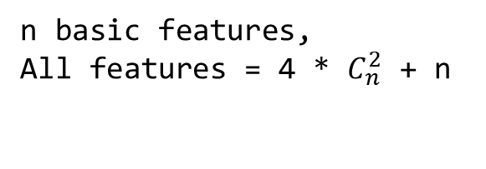
Basic Features
Dis12 | Spectrum Entropy | Sum of Absolute Difference | Centroid
Dis21 | Spectrum Centroid | Mean of Absolute Difference | Kurt
Dis22 | Max | Mean of Difference | Skew
P1 | Min | Median | RMS
P2 | Mean | Zero Crossing Rate | Entropy
Work_1: Features Selection
Step 1.
Get Basic Features and Do Feature Cross
Feature Cross
20 Commonly used Features
Core Feature of S:Dis21/Dis12
Core Feature of D:P1/P2
Not in this table
Feature_0 . . . Feature_19
Get Feature_i and Feature_j
n basic features,
All features = 4 * $C_{n}^{2}$ + n
_add_
_minus_
_multi_
_divide_
Feature_i
Feature_j
Add 4 new crossed Featurs
Notes:
Step 1 Get Basic Features and Do Feature Cross
I choose 20 common basic features, as shown in this table. the core feature for S and D are not basic features and are not included in this table.
From these 20 features, I select two features each time .
Then, I perform feature cross by applying addition, subtraction, multiplication, and division operations to these two selected features.
Using this approach for feature cross, I can obtain a total of 480 features.

Slide 6
Step 3.
Univariate Feature Selection
Work_1: Features Selection
Univariate feature selection based on F-Test
F-test captures
linear dependency
Choose Top K
Univariate feature selection based on mutual information
Mutual information captures any kind of dependency
Choose Top K
Step 2.
Relevance Calculation
Calculate relevance between Feature_i and S/D, and then get p-value.
If p-value < 0.05, filter this Feature_i out.
Logical AND Operation
When K = 3
S: {‘Dis22_divide_Dis21’, ‘Dis21_divide_Dis12’, ‘Dis22_divide_Dis12’}
D: {‘Dis22_minus_P2’, ‘P1_multi_P2’, ‘Dis22_add_P2’, ‘P2_divide_P1’, ‘P2’}
S Prediction
480 -> 428
D Prediction
480 -> 370
Notes:
Step2 is Relevance Calculation
Calculate relevance between Feature_i and S/D, and then get p-value. If p-value is less than 5 percent, filter this feature out.
And Step 3 is Univariate Feature Selection
I do Univariate feature selection based on F-Test and Mutual Information at the same time
F-test captures linear dependency and mutual information captures any kind of dependency
We choose top K features and Perform a logical AND operation on the selected K features.
When K equals 3, For S prediction, I get 3 features. For D prediction, I get 5 features.

Slide 7
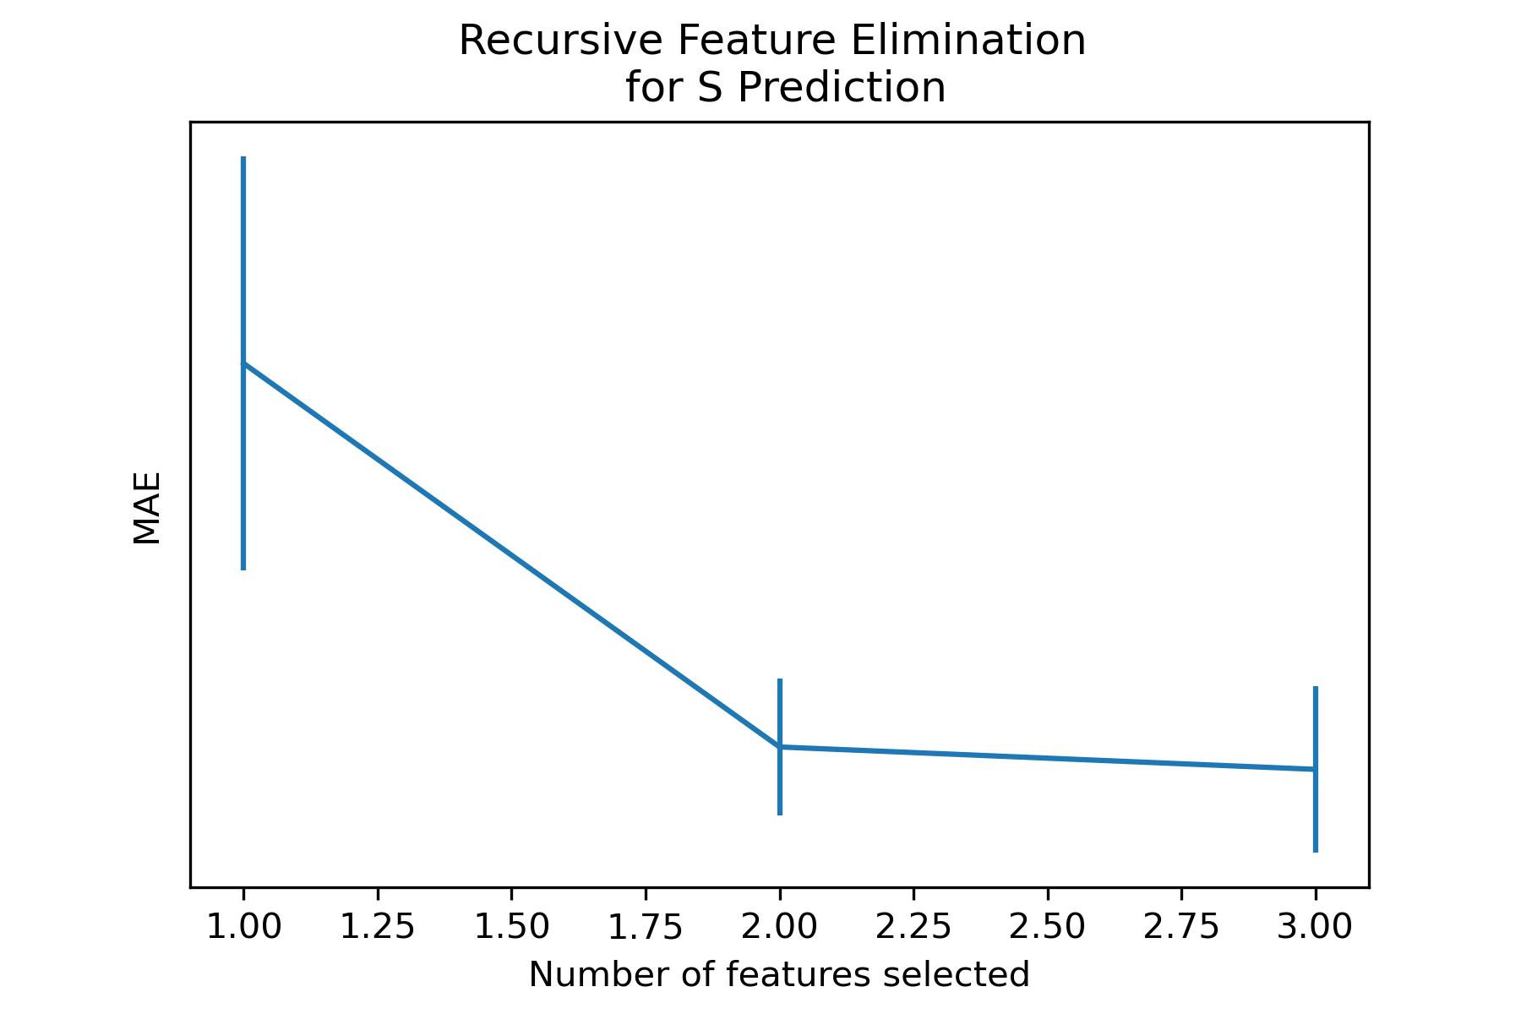
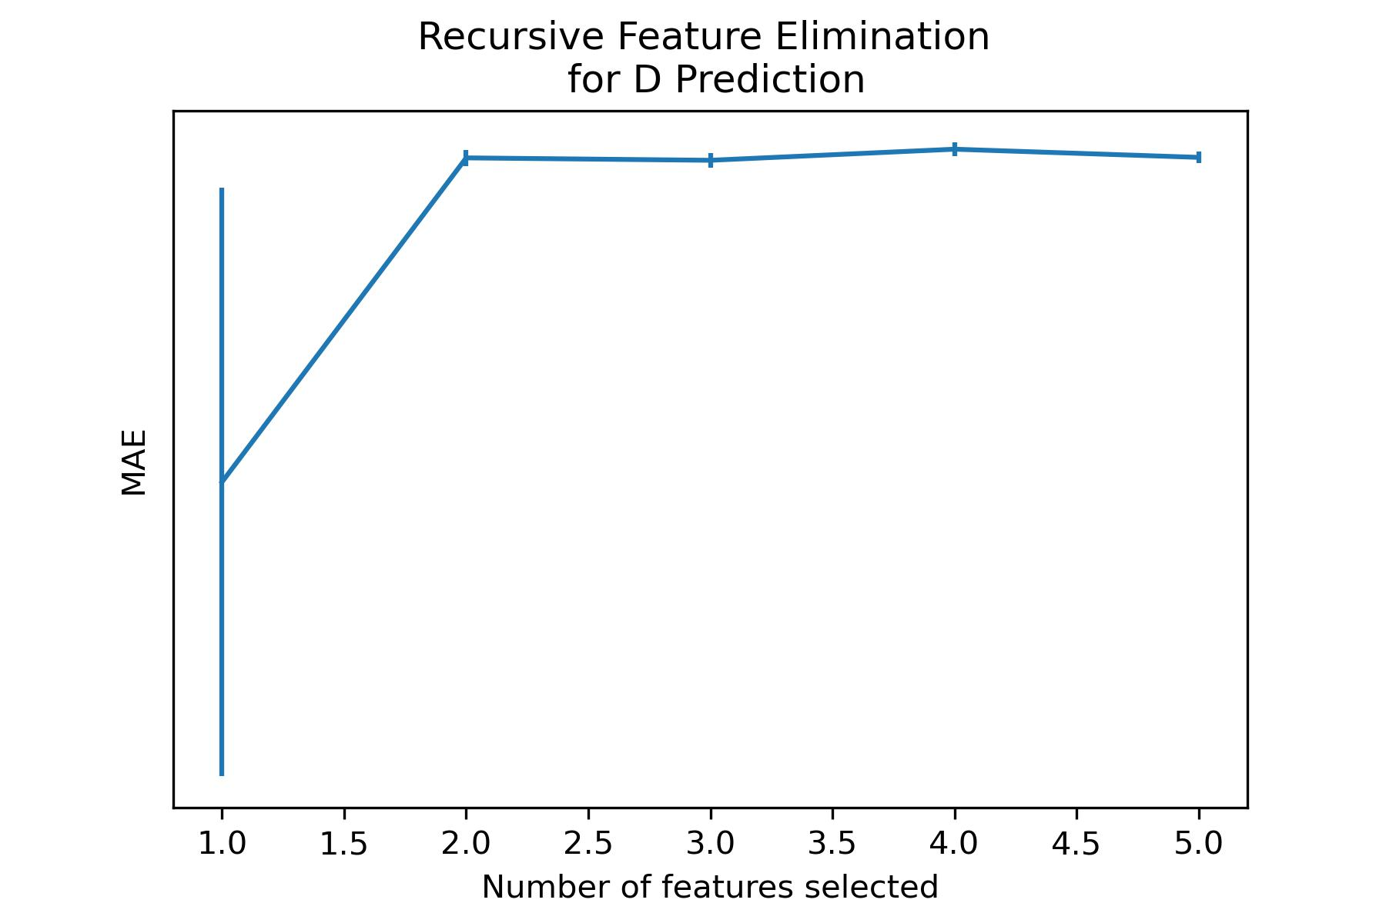
Work_1: Features Selection
Step 4.
Recursive Feature Elimination(RFE)
Optimal Choice for S Prediction:
‘Dis21_divide_Dis12’
Optimal Choice for D Prediction：
‘Dis22_minus_P2’, ‘Dis22_add_P2’, ‘P2_divide_P1’, ‘P2’
Notes:
Next step is to do Recursive Feature Elimination(RFE)
For S ，core feature is selected. For D, core feature is included in the final feature selection.
It is not bad.

Slide 8
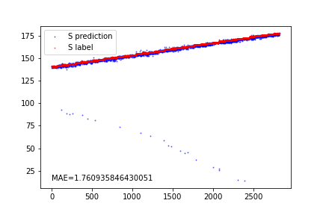
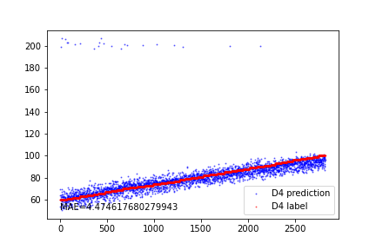
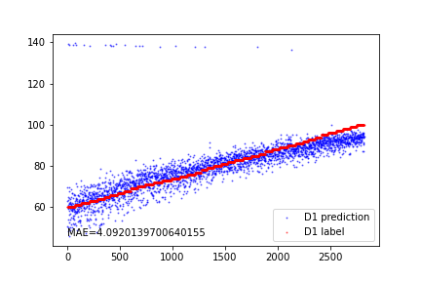
Work_1: Features Selection
Prediction performance for S
Prediction performance for D using the 4 features recommended by RFE
Prediction performance for D using only "P2_divide_P1"
I think
the core feature for D is not selected because no appropriate denoising procedures are applied to signals with a noise level of 0.1.
At the same time, the prediction performance using only the "P2_divide_P1" feature is not satisfactory (MAE=4.09).
Notes:
Here is the result of Prediction.
I think
the core feature for D is not selected because no denoising procedures are applied to signals with a noise level of 0.1.
The prediction performance using only the "P2_divide_P1" feature is not satisfactory.

Slide 9
Work_2: S & D prediction in the noise level of 0.8
Data, Noise: 0.8
Data, Noise: 0.8
Bandpass filter
EEMD
FFT / Wavelet
Denoising
IMF_1
Smooth
Feature Extraction
S/D Prediction
Test
Notes:
Let’s look at the next work
When dealing with data having a noise level of 0.8, I first apply a combination of Bandpass filtering and FFT/Wavelet Denoising. However, the results are not very promising.
Then, I try out EEMD and notice that IMF1 closely resembles the original clean signal. As a result,
I experiment with using IMF1 for prediction.

Slide 10
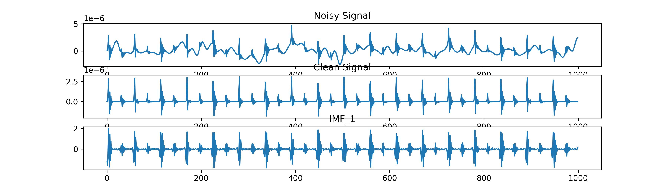
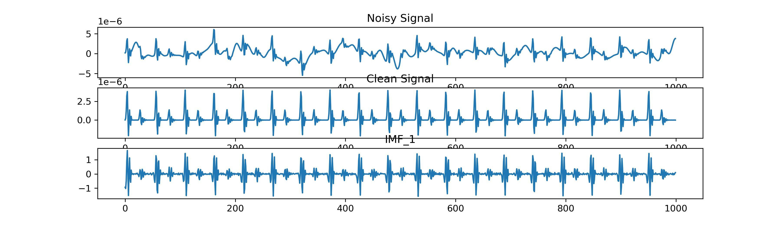
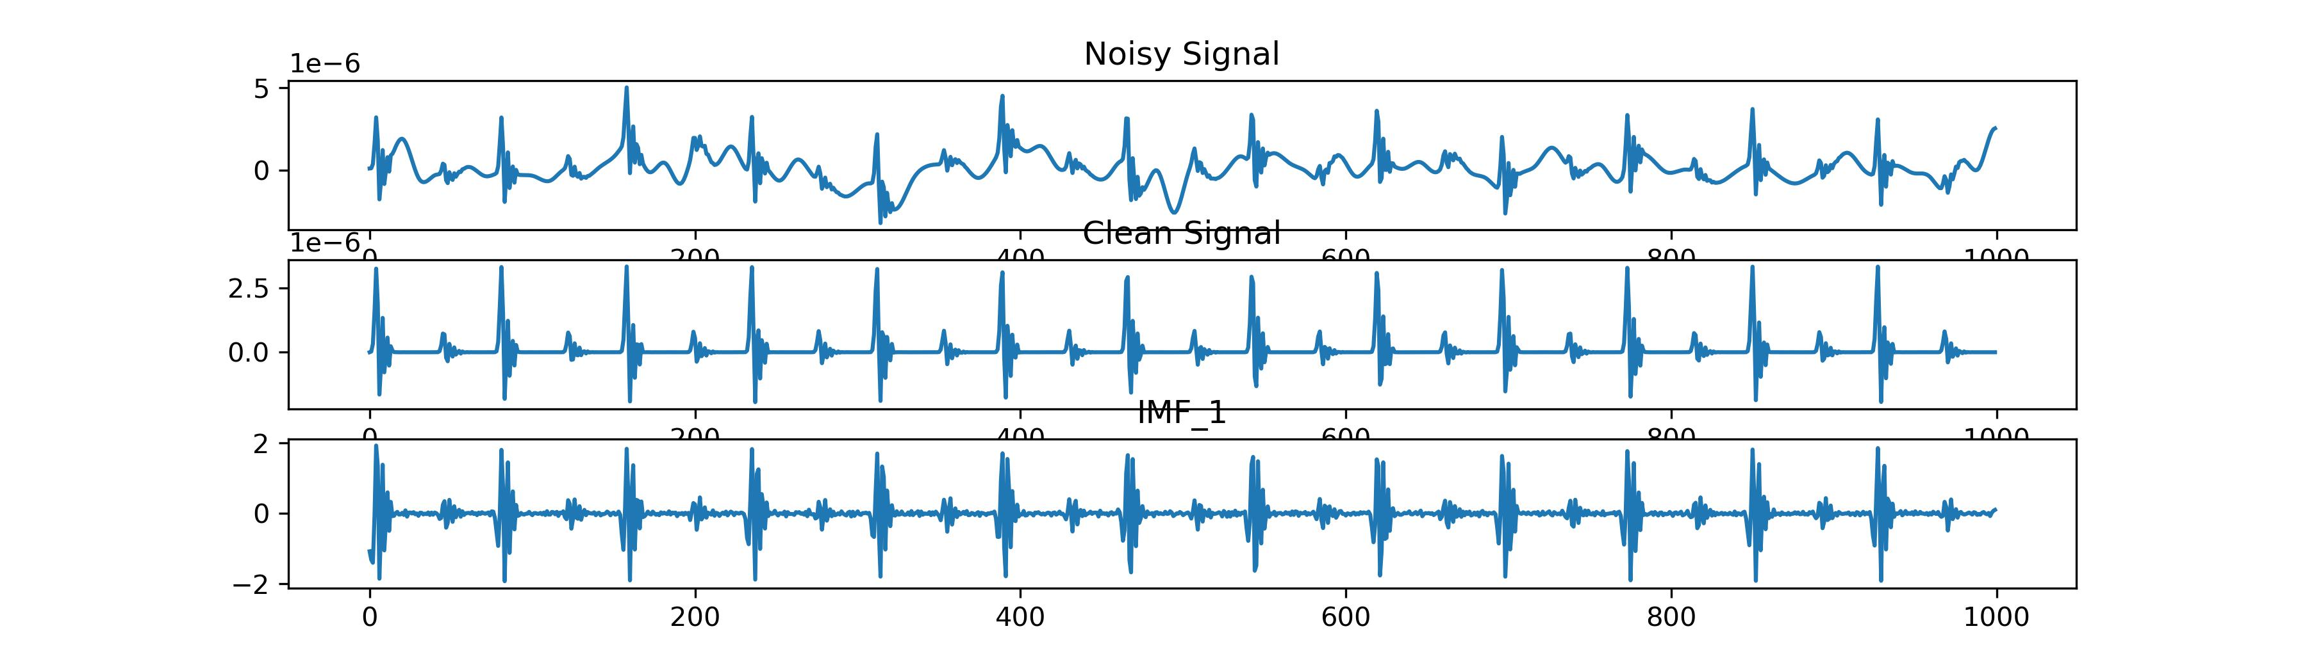
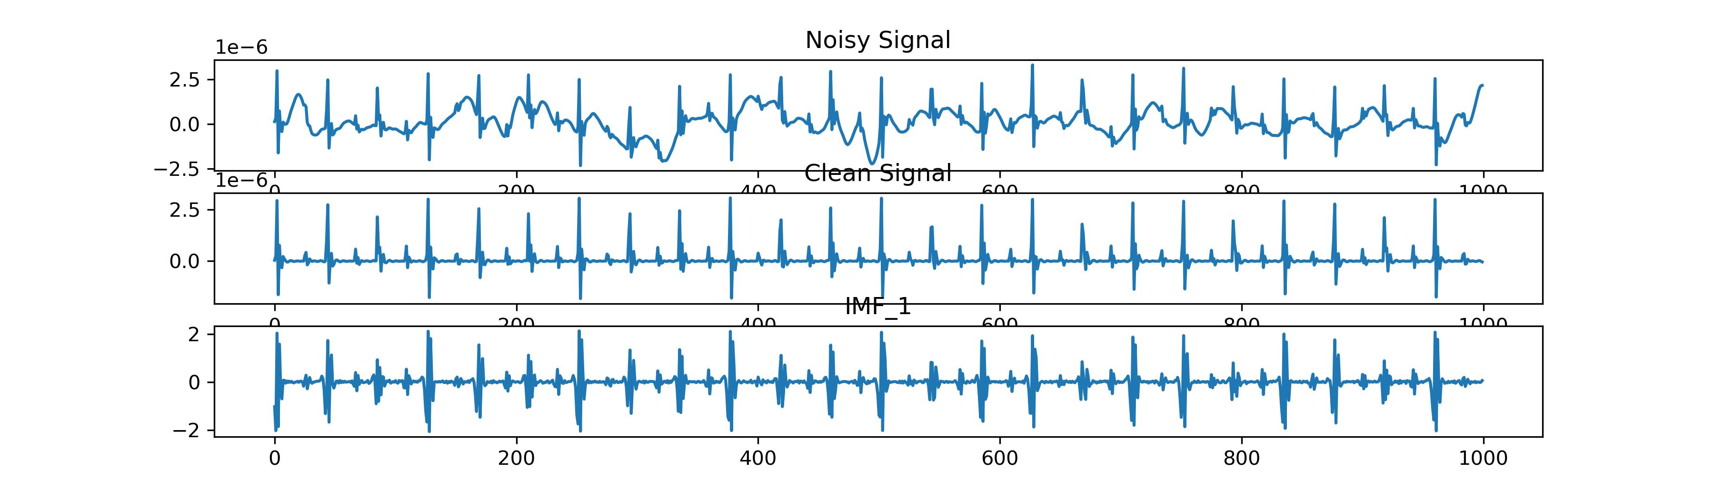
Work_2: S & D prediction in the noise level of 0.8
Noisy Signal of 0.8
Clean Signal
IMF_1 After EEMD
It's almost impossible to discern the original signal.
IMF1 closely resembles original clean signal
The variations in peak heights are great, while intervals remain consistent.
It might be possible to employ IMF_1 for predicting S, rather than D.
Notes:
When the noise level reaches 0.8, it becomes almost impossible to discern the original signal.
I've noticed that IMF1 closely resembles the original clean signal. The differences in peak heights are significant, while the intervals remain consistent.
It might be possible to employ IMF_1 for predicting S, rather than D.

Slide 11
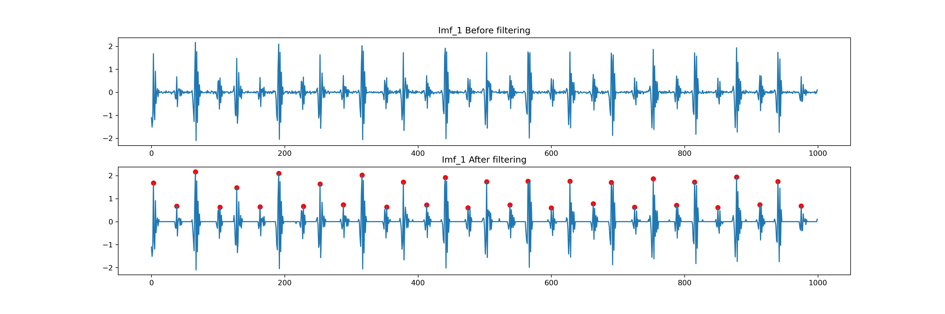
Work_2: S & D prediction in the noise level of 0.8
Signals between peaks are quite noisy and unclear, which is affecting the accuracy of peak detection.
Signal[Abs(Signal) < threshold * max(Signal)] = 0
Notes:
Signals between peaks are quite noisy and unclear, which is affecting the accuracy of peak detection.
I attempt to make it smoother using the equation below. In the end, the peaks detection have good results.

Slide 12
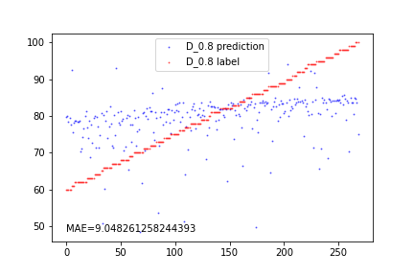
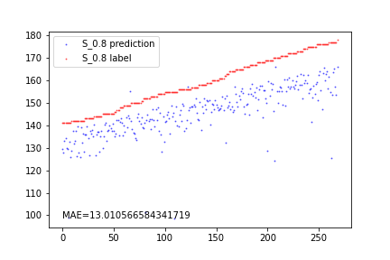
Work_2: S & D prediction in the noise level of 0.8
EEMD is extremely slow, which is why I use a training set of 500 signals and a test set of 300 signals.
The prediction for D is unsuccessful due to the great change in relative heights of peaks.
Regarding the prediction of S, the model can capture the trend, but MAE is notably high.
The performance is not meeting the desired standard.
I'm not sure whether this approach holds value for further exploration.
Notes:
EEMD is extremely slow, which is why I use a training set of 500 signals and a test set of 300 signals.
I'm not certain whether this approach holds value for further exploration.

Slide 13
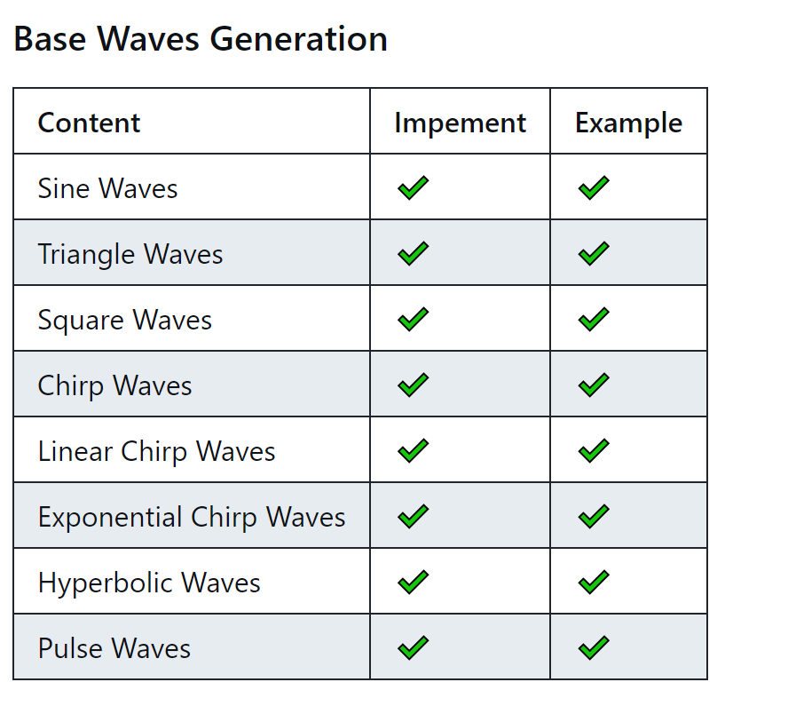
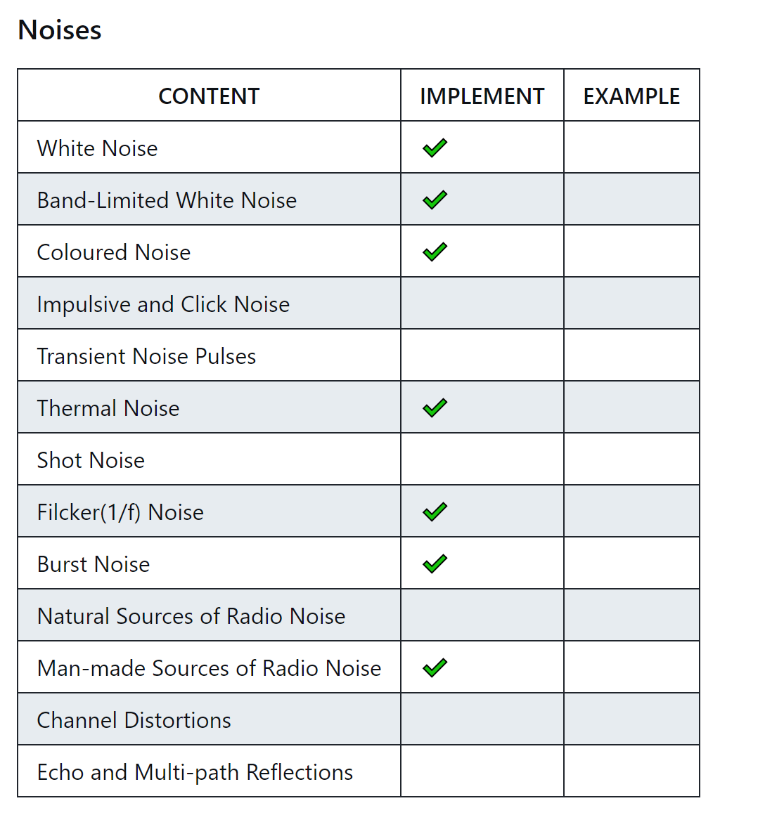
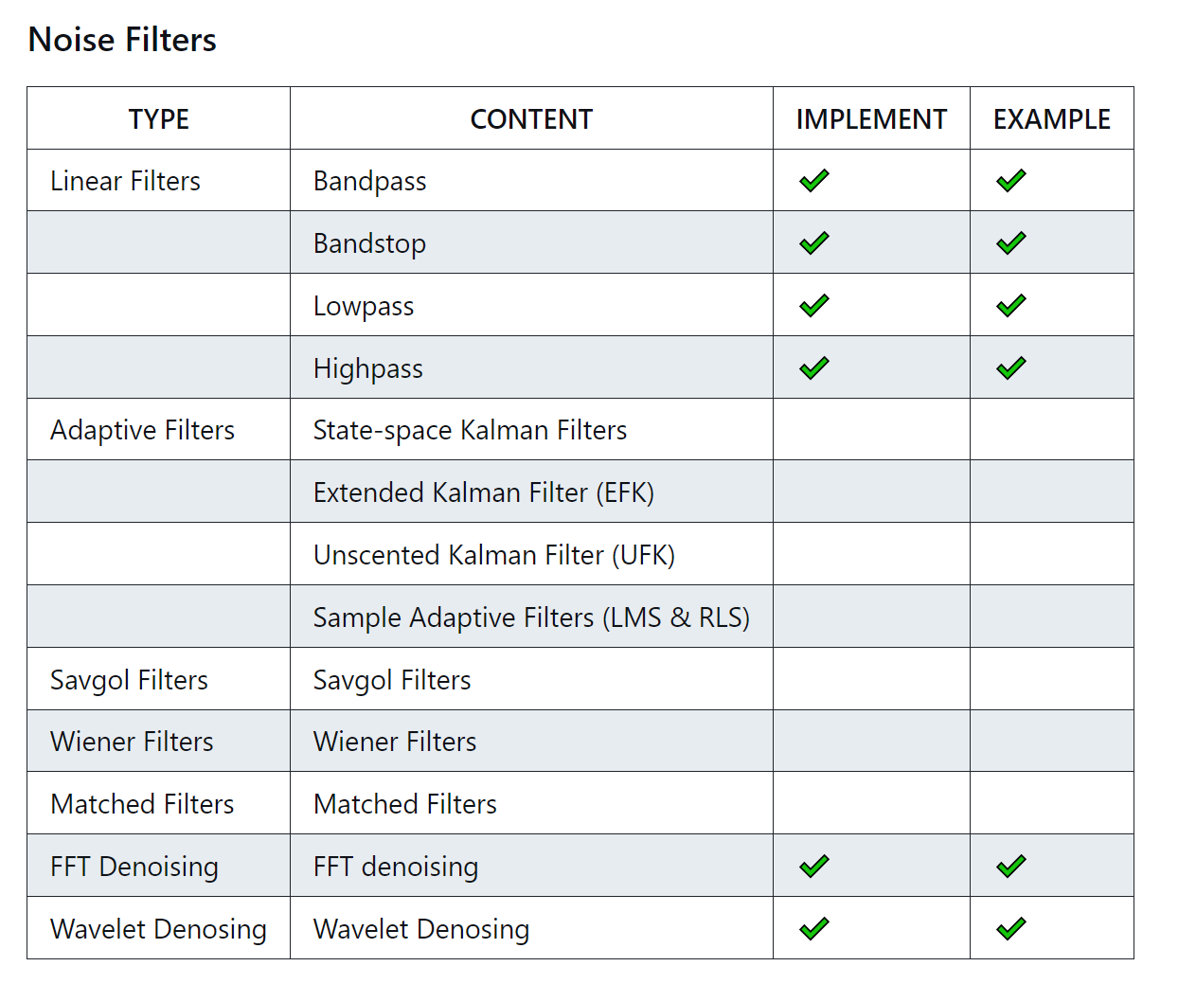
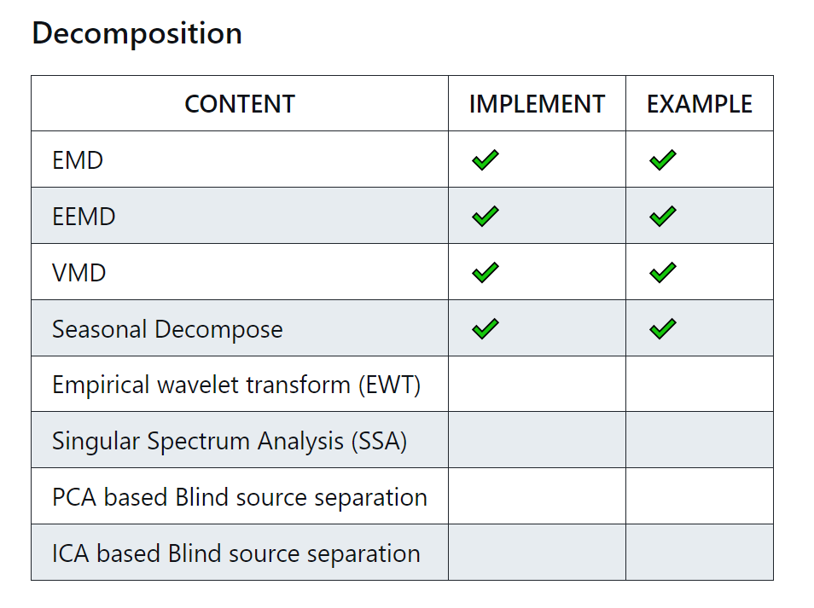
Work_3: Tutorial
In noise generation, I've encountered some challenges.
Some noise definitions are vague and difficult to implement accurately. (e.g. Transient Noise Pulses and Short Noise)

Slide 14
Work_4: Theoretical knowledge Learning
Signals and Systems
Probability for Computer Scientists
Course: EE120, Berkeley
This week’s Progress:
Lecture 10 (the DFT; FIR filters)
Lecture 11 (Fourier transforms in two dimensions)
Course: CS109, Standford
This week's progress:
Part 1 (Counting)
Part 2 (Combinatorics)
Part 3 (Definition of Probability)
Next week’s plan:
Part 4 (Counting)
Part 5 (Combinatorics)
Part 6 (Definition of Probability)
Part 7 (Probability of or)
Part 8 (Conditional Probability)
Part 9 (Independence)
Notes:
This week, I have a hard time learning Hidden Markov Models.
I need to allocate some time to learning probability in order to better understand advanced concepts.

Slide 15
Questions
During the denoising process, how do we determine that the outcome is satisfactory and that denoising results are acceptable? Can we determine this before features are fed into the model?
I just listened to a presentation by Yida. He has also put in a lot of effort into automated feature selection. Should we collaborate to solve this now, or should we each look for solutions independently?

Slide 16
Thanks!

