Slide 1
Presentation
Jiayu Chen
2023.12.12

Slide 2
Work Description
Part_1: Take a look at the tutorial first.
Part_2: Why doesn’t FMM work?
Part_3: An easy experiment about sampling rate.
Part_4: Cut, realign, and extract templates from real signals.
Part_5: The possible research directions for the next step.
Part_6: Questions

Slide 3
Part_1

Slide 4
Part_2

Slide 5
Why doesn’t FMM work
Advantages of FMM (from emails):
“particularly when dealing with pronounced spike waves”
“The FMM model is specifically effective at identifying high peaks against the background noise”
“to detect other less prominent peaks more components could be added.”
Disadvantages of FMM (from the demo code):
It is necessary to decompose a single-cycle signal into a sufficient number of components, if we want to focus on smaller peaks.
2. After decomposition, the relationship between various components becomes chaotic. There is a loss of interpretability in decomposed components.

Slide 6
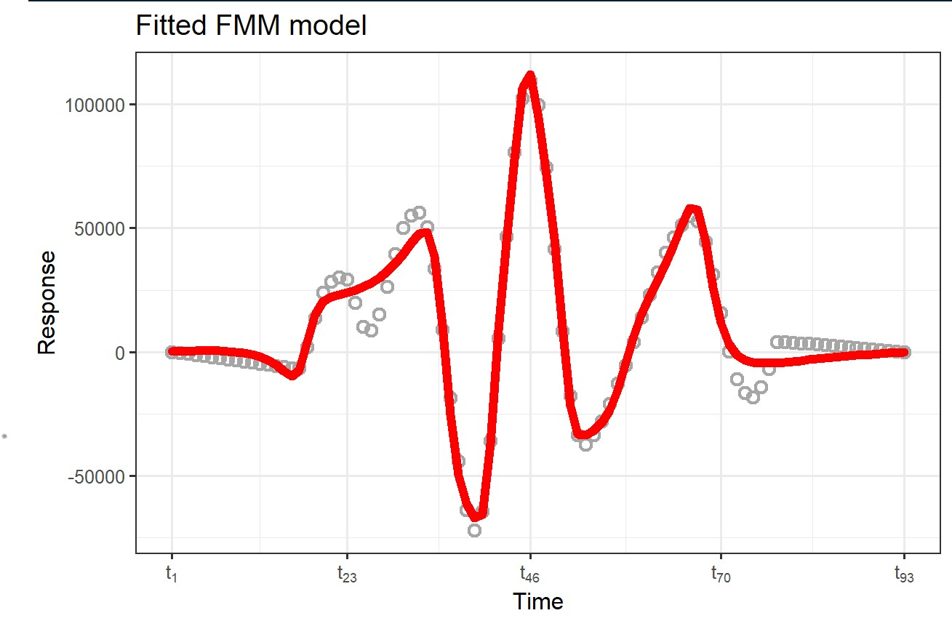
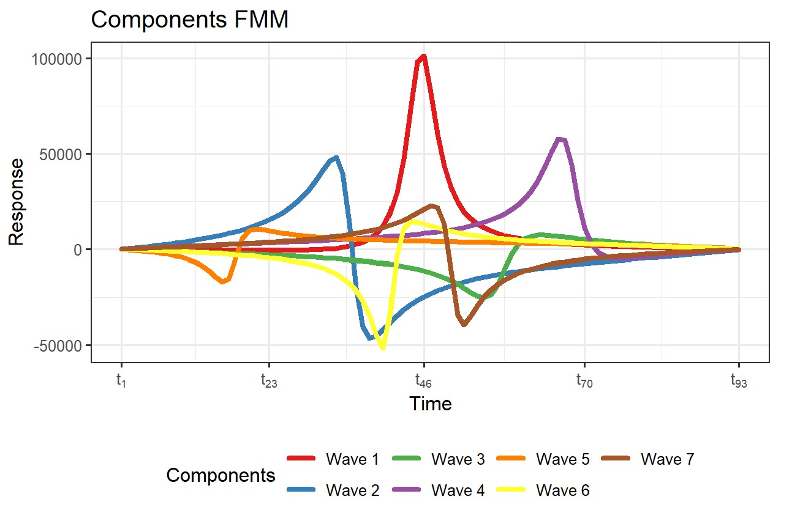
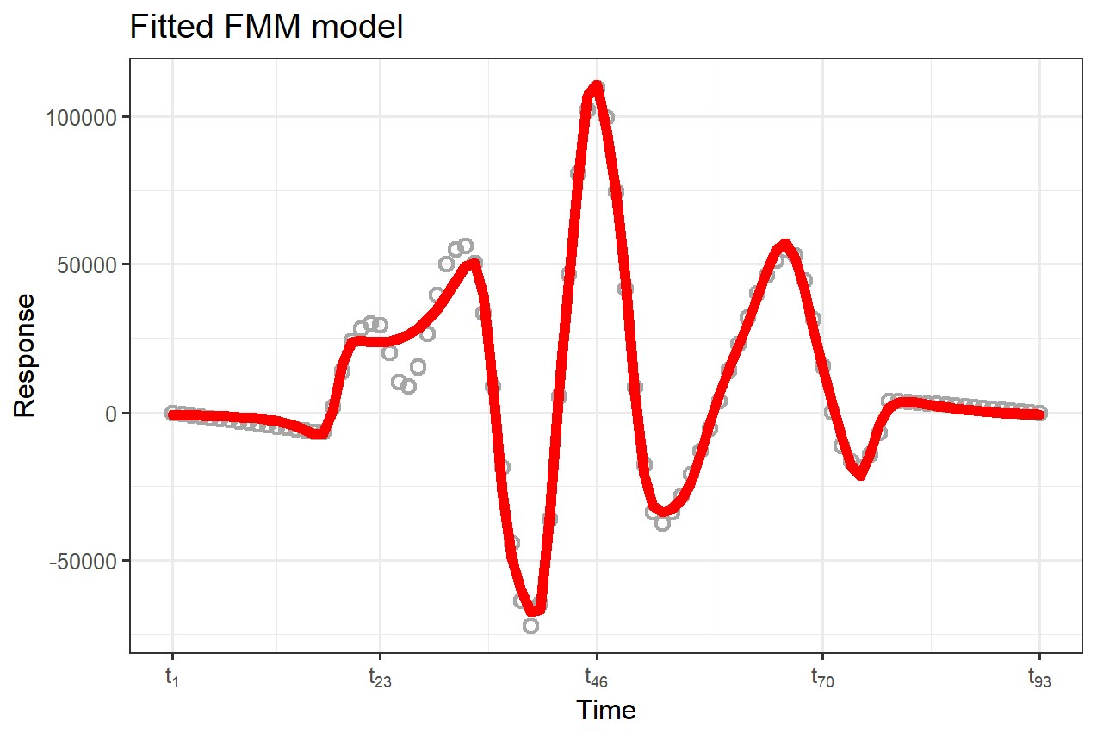
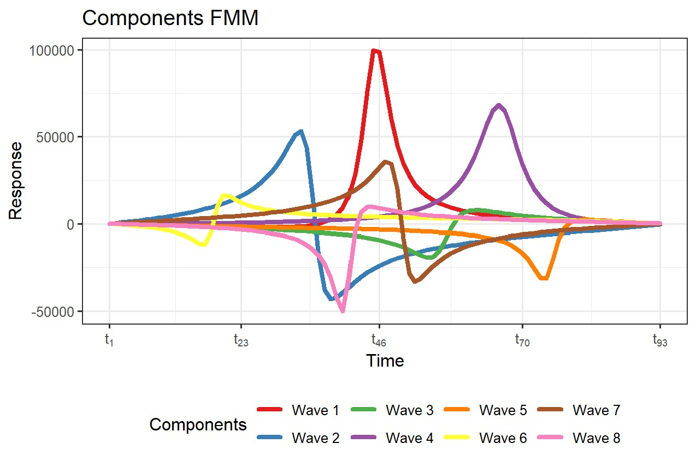
Why doesn’t FMM work
There is almost no interpretability in decomposed components.
We need to decompose a single-cycle signal into a sufficient number of components, if we want to focus on smaller peaks

Slide 7
Part_3

Slide 8
An easy experiment about sampling rate.
The impact of different sampling rates on time series alignment.
Model | Data | Sampling Rate | Resample Method | S | D
Template: Mean | Simulation | 100 | - | 1.35 | 4.53
Template: Mean | Simulation | 100->150 | FFT | 0.95 | 3.24
Template: Mean | Simulation | 100->150 | POLY | 0.95 | 2.98
Template: Mean | Simulation | 150 | - | 0.92 | 2.36
Model | Data | Sampling Rate | Resample Method | S | D
Template: Mean | Simulation | 100 | - | 1.35 | 4.53
Template: Mean | Simulation | 100->200 | FFT | 0.70 | 2.47
Template: Mean | Simulation | 100->200 | POLY | 0.64 | 2.07
Template: Mean | Simulation | 200 | - | 0.65 | 1.75
Conclusion:
Resampling signals with low sampling rates can significantly improve the model's performance. Within a certain range, a higher sampling rate is better.
The resampling mode has a significant impact on the results, with FFT and POLY yielding completely different effects.

Slide 9
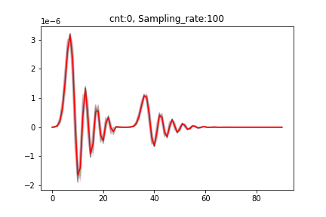
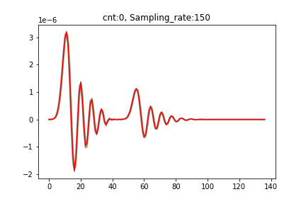

An easy experiment about sampling rate.
Principle of accuracy improvement
With the increase in sampling rate, originally relatively separated peaks gradually come closer together. So the error decreases.
Resample
Low Sampling Rate
High Sampling Rate

Slide 10
Part_4

Slide 11
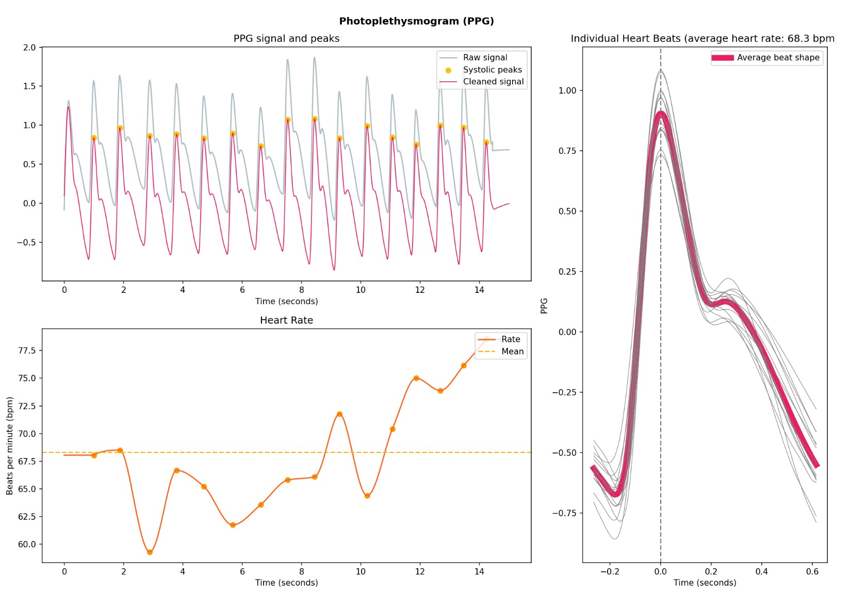
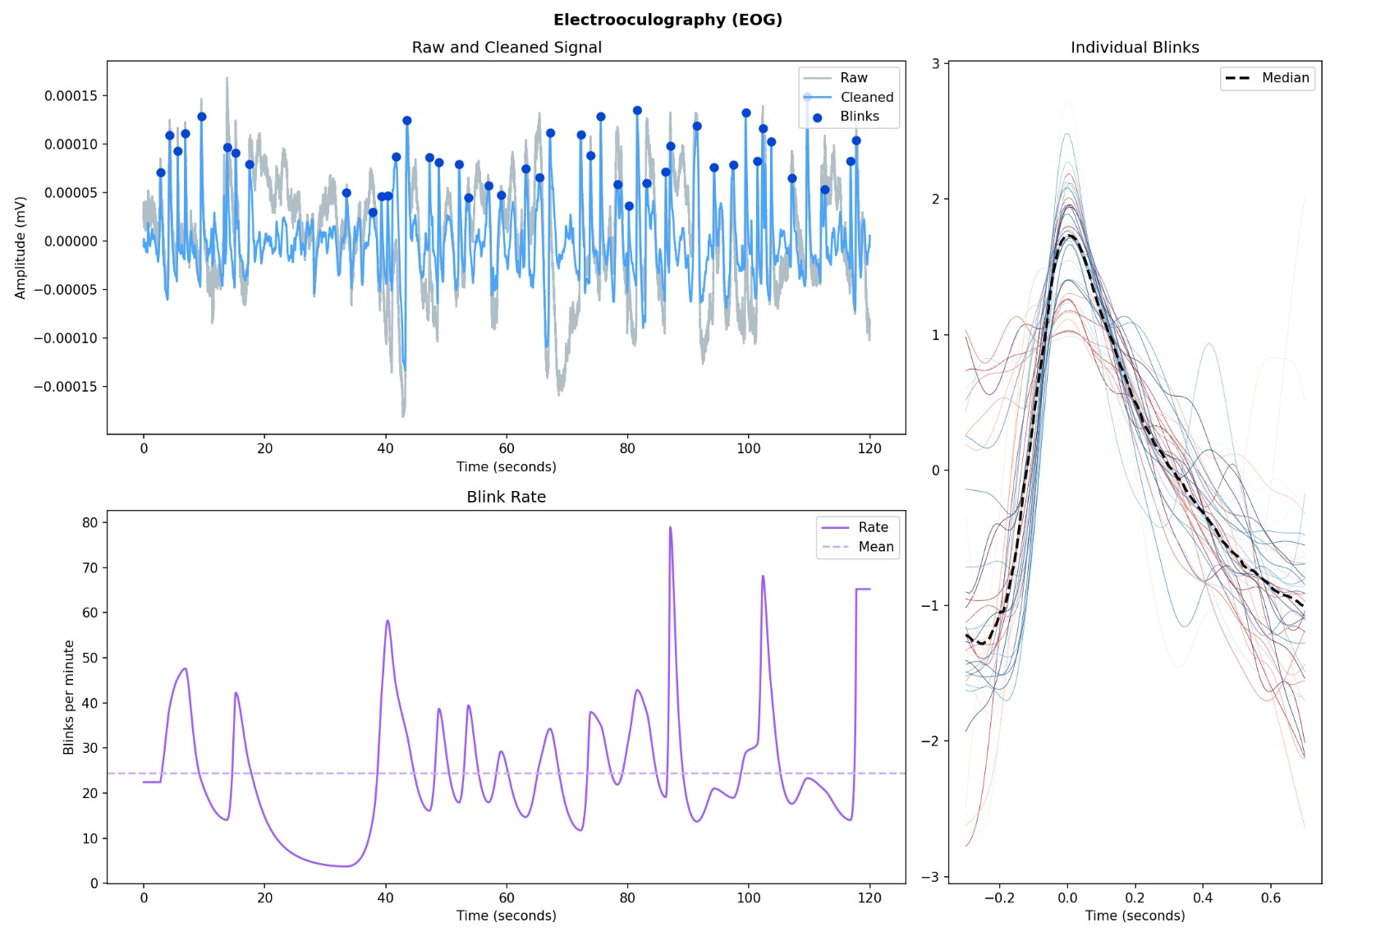
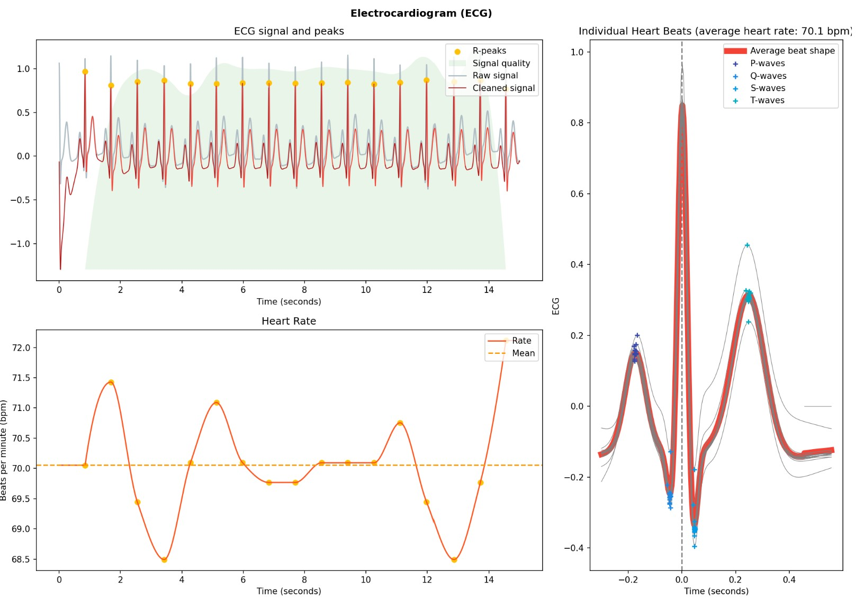
Cut, realign, and extract templates from real signals.
The idea of segmenting signals and extracting individual beat has already been employed in the processing of biosignals.
(The pictures are from the demo of Neurokit2)
They are all dealing with single-peak signals, which are often relatively easy to segment.
The methods used are quite naive, such as calculate mean or median.
After extraction, there isn't much utility; it's just observing what the resulting shape looks like.

Slide 12
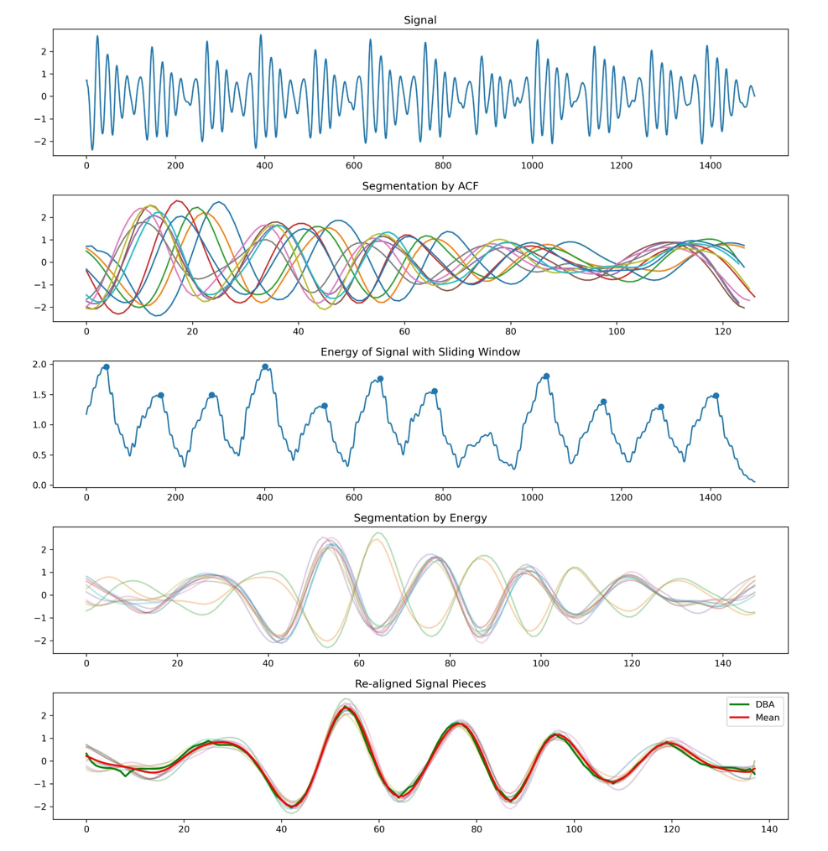
Cut, realign, and extract templates from real signals.
Compared to simulated SCG signals, challenges encountered in real signals are as follows:
Real signals are noisy, multi-peak signals, especially with varying amplitudes among multiple peaks.
The initial section of the signal is often problematic, with periodic incompleteness.
I attempted to utilize an approach presented by Yingjian Song in IoT2023.
While this method is sufficient for estimating heart rate, it is not adequate for accurate segmentation, leading to the following two issues:
Significant and unmanageable errors, making alignment difficult.
The resulting segments are not the desired cycles after the split.
Signal
Hilbert transform for envelope
Peak Detection
ACF
We get
Savitzky-Golay filter
Segmentation
We want

Slide 13
Cut, realign, and extract templates from real signals.
Solution approach:
Is it possible to transform the multi-peak issue in the time domain into a single-peak problem in another domain, and ensure that this single peak is relatively fixed within each cycle?
Upon observation, the distribution of energy density within a single cycle of the signal is often relatively stable.
Transforming the multi-peak issue in the time domain into a single-peak problem in the energy density domain.

Slide 14
Cut, realign, and extract templates from real signals.
The distribution of energy density is often relatively stable, but not completely identical.
To enhance precision, it is necessary to re-align the signals that have already been segmented.
Linear Alignment -> O(T)
Linear Realignment
Acceptable
One-circle pieces
Non-Linear Alignment -> O(T^2)
Non-Linear Realignment
Unacceptable
没有必要
统计学中目前有人在搞

Slide 15
Cut, realign, and extract templates from real signals.
Start
Choose one piece x from N pieces X
Calculate the ACF between x and X[1]
Calculate the ACF between x and X[N-1]
Add ACF results from N-1 times
Find the appropriate time unit for lag.
Time complexity O(N^3), where N represents the average length of a single cycle.
This algorithm is guaranteed to converge.
Realign piece x.
Get re-aligned pieces

Slide 16
Cut, realign, and extract templates from real signals.
Template acquisition methods:
Using DBA to calculate the template results in sharp peaks. Although features are preserved, the signal shape is disrupted and lacks smoothness.
Directly calculating the mean results in a smoother template, but the effective capture of peak values is not as good as algorithms like DBA.
Currently, we have no way to measure the quality of generated templates. We need to develop a metric for assessment.

Slide 17
Cut, realign, and extract templates from real signals.
Signal quality:
For heart rate calculation, the previous filtering algorithm has performed exceptionally well. However, for template extraction and feature analysis, it is not sufficient and requires an additional filtering layer.
Observation of real data:
- Amplitudes of peaks within each cycle are not consistent.
- Waveforms sometimes resemble SCG, sometimes resemble BCG, and at times fall between the two.

Slide 18
Part_5

Slide 19
The possible research directions for the next step.
Direction 1
How to prove and validate the effectiveness of the algorithm?
On what dataset?
- Simulated datasets: NK2, ECG, PPG, EDA, etc.
- Real datasets: NK2, PhysicalNet, etc.
The challenge lies in having mostly long signals without sufficient labels, making it challenging to explore the correlation between specific features and metrics.
What metrics to use?
- For the Template4Prediction task, effective metrics have not yet been determined.
- Common metrics include:
1. Within Group Squared Sum (WGSS).
2. Using the computed template for nearest centroid classification in UCR dataset.
- For 1. WGSS calculation is an NP-Complete problem. Some excellent DTW algorithms can achieve good gradients on local optima, but for SCG signal prediction, accuracy is poor.
2. This is generally used for Template4Classification problems, and it may not be suitable for our use case.

Slide 20
The possible research directions for the next step.
Direction 2
In the same signal segment, the relative heights of multiple peaks within each cycle are not consistent. It might not be reliable to use this information to extract a perfectly clean signal segment.
Error Interval
Template
A Normal Distribution with Known Mean and Std.
Probability
The computed features may not necessarily be specific values but rather a probability distribution.
A0 / A1

Slide 21
The possible research directions for the next step.
Direction 2
Error Interval
Template
A Normal Distribution with Known Mean and Std.
Compared to the template, it is even more critical to pay attention to the Error Interval.
How to generate the Error Interval
How to sample to obtain a probability distribution of features are important considerations.

Slide 22
The possible research directions for the next step.
Direction 3
Kalman filtering has many nice properties, but it can only filter correspondingly between time units.
If Kalman filtering can be extended to the domain of Dynamic Time Warping (DTW), it should greatly enhance the effectiveness of Kalman filtering for our specific problem. 。
Time Domain
DTW Domain

Slide 23
Questions
If we want to precisely understand the BedDot BSG signal, do we need to simultaneously measure a person's SCG, BCG, and BSG signals to explore the relationships between these three signals? Are there any papers that have simultaneously measured SCG and BCG signals? I haven't found relevant papers.

Slide 24
Thanks!

