Slide 1
Weekly Presentation
Jiayu Chen
2023.11.06

Slide 2
Work Description
Part_1:
About Getting Template (Weighted Average, Kalman Filter, DTW)
Some Thoughts about Removing Breathing Effect
Part_2:
Paper_1: A global averaging method for DTW
Paper_2: shapeDTW: shape Dynamic Time Warping
Paper_3: k-Shape
Part_3: Learning Progress and Future Learning Plan
Part_4: Some Thoughts about Undergraduate Thesis
Part_5: Questions

Slide 3
Part_1: Research - Getting Template
Model | State | S Prediction | D Prediction
No Template | No RR, Peak-Based Segmentation | 0.79 / 1.64 | 1.79 / 4.31
Mean | No RR, Peak-Based Segmentation | 1.35 / 1.38 | 4.53 / 4.44
Median | No RR, Peak-Based Segmentation | 1.42 / 1.45 | 4.07 / 4.49
PCA | No RR, Peak-Based Segmentation | - / - | - / -
K-shape 1 | No RR, Peak-Based Segmentation | 2.20 / 2.74 | 4.85 / 5.88
Weighted Avg | No RR, Peak-Based Segmentation | 1.95 / 1.98 | 4.63 / 4.74
K-shape 2 | No RR, Peak-Based Segmentation | 2.18 / 1.79 | 4.76 / 5.24
Kalman Filter | No RR, Peak-Based Segmentation | 1.45 / 1.37 | 4.82 / 4.60
DBA | No RR, Peak-Based Segmentation | 2.05 / 1.96 | 3.43 / 4.15
NLAAF1 | No RR, Peak-Based Segmentation | 8.43 / 23.19 | 3.14 / 5.21
NLAAF2 | No RR, Peak-Based Segmentation | 20.67 / 33.39 | 3.64 / 7.04
GTW | No RR, Peak-Based Segmentation | - / - | - / -
TTW | No RR, Peak-Based Segmentation | 1.52 / | 4.28 /
K-SC | No RR, Peak-Based Segmentation

Slide 4
Part_1: Research - Getting Template
Model | S Prediction | D Prediction | Model | S Prediction | D Prediction
No Template | 0.79 / 1.64 | 1.79 / 4.31 | New
Mean | 1.35 / 1.38 | 4.53 / 4.44 | NLAAF1 | 8.43 / 23.19 | 3.14 / 5.21
Median | 1.42 / 1.45 | 4.07 / 4.49 | NLAAF2 | 20.67 / 33.39 | 3.64 / 7.04
PCA | - / - | - / - | GTW | - / - | - / -
K-shape 1 | 2.20 / 2.74 | 4.85 / 5.88 | TTW | 1.52 / - | 4.28 / -
Weighted Avg | 1.95 / 1.98 | 4.63 / 4.74 | K-SC | - / - | - / -
K-shape 2 | 2.18 / 1.79 | 4.76 / 5.24 | PSA | 2.27 / 19.05 | 5.40 / 8.89
Kalman Filter | 1.45 / 1.37 | 4.82 / 4.60 | Soft-DTW | 1.35 / 1.38 | 4.53 / 4.44
DBA | 2.05 / 1.96 | 3.43 / 4.15 | ICDTW | 2.66 / - | 5.08 / -

Slide 5
Part_1: Research - Getting Template
Model | Sampling rate | S Prediction | D Prediction
Template: Mean | 100 | 1.35 | 4.53
Template: Mean | 150 | 0.92 | 2.36
Template: Mean | 200 | 0.65 | 1.75

Slide 6
当前探索的主要方向
Before 2018
With DTW
In 2018
Time Series Average
After 2018
Phototype4Regression
Template4Regression
Without DTW
需要细细思考
Multi-Sensors Fusion
另一个比较大的领域
Generative Model
有零星的论文支撑
2018年及以前肯定没有这个概念2019年以后目前没发现

Slide 7
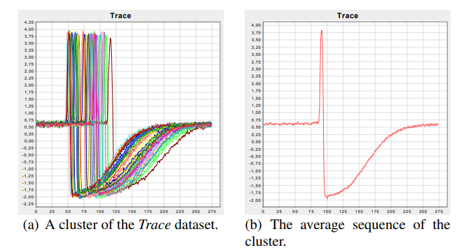
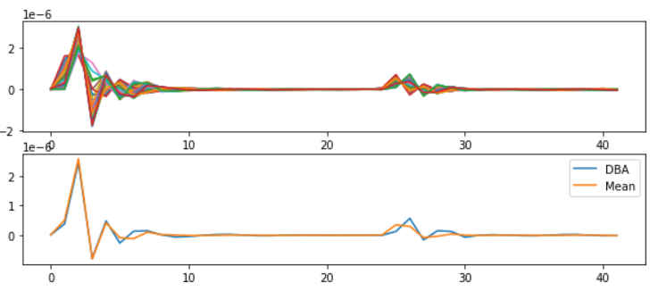
Part_2: Paper Reading
Petitjean F, Ketterlin A, Gançarski P. A global averaging method for dynamic time warping, with applications to clustering[J]. Pattern recognition, 2011, 44(3): 678-693.
Paper_1: A global averaging method for DTW - DBA
The Propose of the Paper: the computation of an average of a set of sequences
Solved Problems:
They develop a global technique for averaging a set of sequences, which avoids using iterative pairwise averaging.
2. They describe a new strategy to reduce the length of the resulting average sequence.

Slide 8
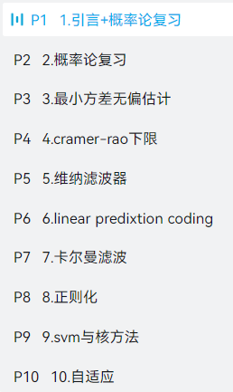
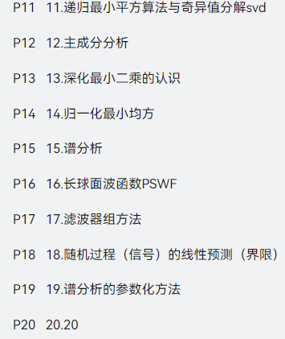
Work_3: Learning Progress and Future Learning Plan
Completed theoretical studies:
EE120 (all videos and lectures)
Complex Functions and Integral Transforms (completed half of the exercise book)
Theoretical studies I plan to undertake next.：
现代数字信号处理I 张颢
现在数字信号处理II 张颢
(Array signal processing, time-frequency analysis,
compressive sensing, Bayesian methods)
Next research directions:
1. Further exploration of methods mentioned in K-shape.
2. Seek out latest methods in data mining journals.
3. Search for algorithms that can effectively decompose the frequency domain.
4. Gradually explore real datasets based on the laboratory's research papers.

Slide 9
Some Thoughts about My Undergraduate Thesis
I hope it is a framework for any periodic physical signal.
Segmentation
Get Template
The actual achieved results should be as follows:
Even when segmentation is only possible based on the periodic length, it's possible to synthesize a reasonably good signal.
If more information can be generated during the segmentation process, the template synthesis will be even better.
Sliced signals without any knowledge of their nature
Sliced signals with some knowledge of their nature
Sliced signals with deep knowledge of their nature

Slide 10
Questions
Do you think what I just said has any research value, or if it's implemented, does it make sense?
2. In our laboratory paper, does the deep learning model also have data shift in its dataset? I have built an identical model, but it doesn't work.
3. Regarding the proposal presentation, Professor Xie's advice is to approach it from a more general perspective. For instance, what I should write about is how to perform the extraction of a standard template from a periodic physical signal, then elucidate my methodology, and in the experimental section, validate it using our SCG signal or BCG signal.
4. In the current thesis, when mentioning 'Time Alignment' or 'DTW,' they are often used for clustering, classification, and data argumentation. Can we refer to the current work as 'DTW for Regression'? Compared to 'DTW for Classification,' 'DTW for Regression' has a distinct focus.
5. Do you think the tutorial we wrote is too simple?

Slide 11
Thanks!

