Slide 1
Weekly Presentation
Jiayu Chen
2023.9.18
Notes:
Ok, I will begin my weekly Presentation

Slide 2
Work Description
Part_1:
About Getting Template (Weighted Average, Kalman Filter, DTW)
Some Thoughts about Removing Breathing Effect
Part_2:
Paper_1: A global averaging method for DTW
Paper_2: shapeDTW: shape Dynamic Time Warping
Paper_3: k-Shape
Part_3: Learning Progress and Future Learning Plan
Part_4: Questions

Slide 3
Part_1: Research - Getting Template
Previous的研究情况
最新的进展
KF已经try出来了，但是调参还是没有很熟练
使用DBA的算法，D的效果已经从原来的4.5->3.5了

Slide 4
Part_1: Research - Getting Template
Previous的研究情况
Model | State | S Prediction | D Prediction
No Template | No RR, Peak-Based Segmentation | 0.79 / 1.64 | 1.79 / 4.31
Mean | No RR, Peak-Based Segmentation | 1.35 / 1.38 | 4.53 / 4.44
Median | No RR, Peak-Based Segmentation | 1.42 / 1.45 | 4.07 / 4.49
PCA | No RR, Peak-Based Segmentation | - / - | - / -
K-shape | No RR, Peak-Based Segmentation | 2.20 / 2.74 | 4.85 / 5.88
Clustering | No RR, Peak-Based Segmentation
Weighted Avg | No RR, Peak-Based Segmentation
K-shape 2 | No RR, Peak-Based Segmentation
Kalman Filter | No RR, Peak-Based Segmentation
DBA | No RR, Peak-Based Segmentation

Slide 5
Part_1: Research - Getting Template
已有的一些DTW的变形的效果示意图

Slide 6
Part_1: Research - Breath Removal

Slide 7
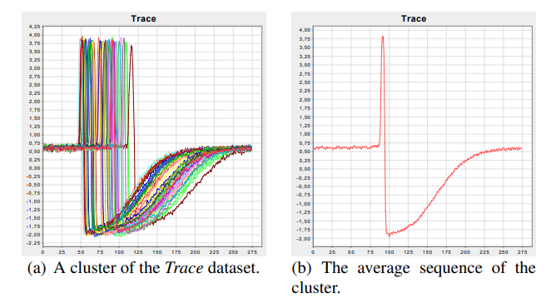
Part_2: Paper Reading
Paper_1: A global averaging method for DTW
论文的目的: the computation of an average of a set of sequences
解决的问题
They develop a global technique for averaging a set of sequences, which avoids using iterative pairwise averaging.
2. They describe a new strategy to reduce the length of the resulting average sequence.
使用的方法

Slide 8
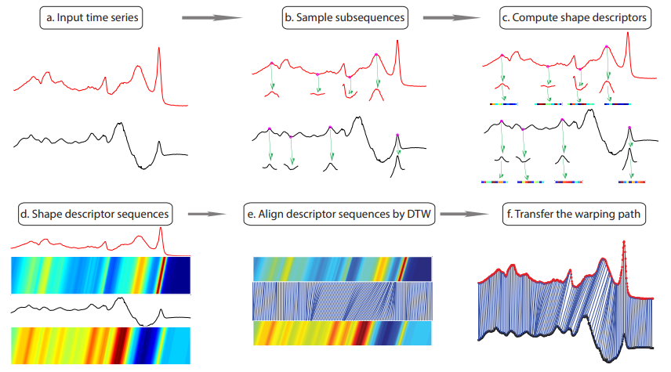
Part_2: Paper Reading
Paper_2: shapeDTW: shape Dynamic Time Warping
Shape Descriptors:
Raw-Subseq,
PAA, DWT,
Slope, HOG1d
Derivative

Slide 9
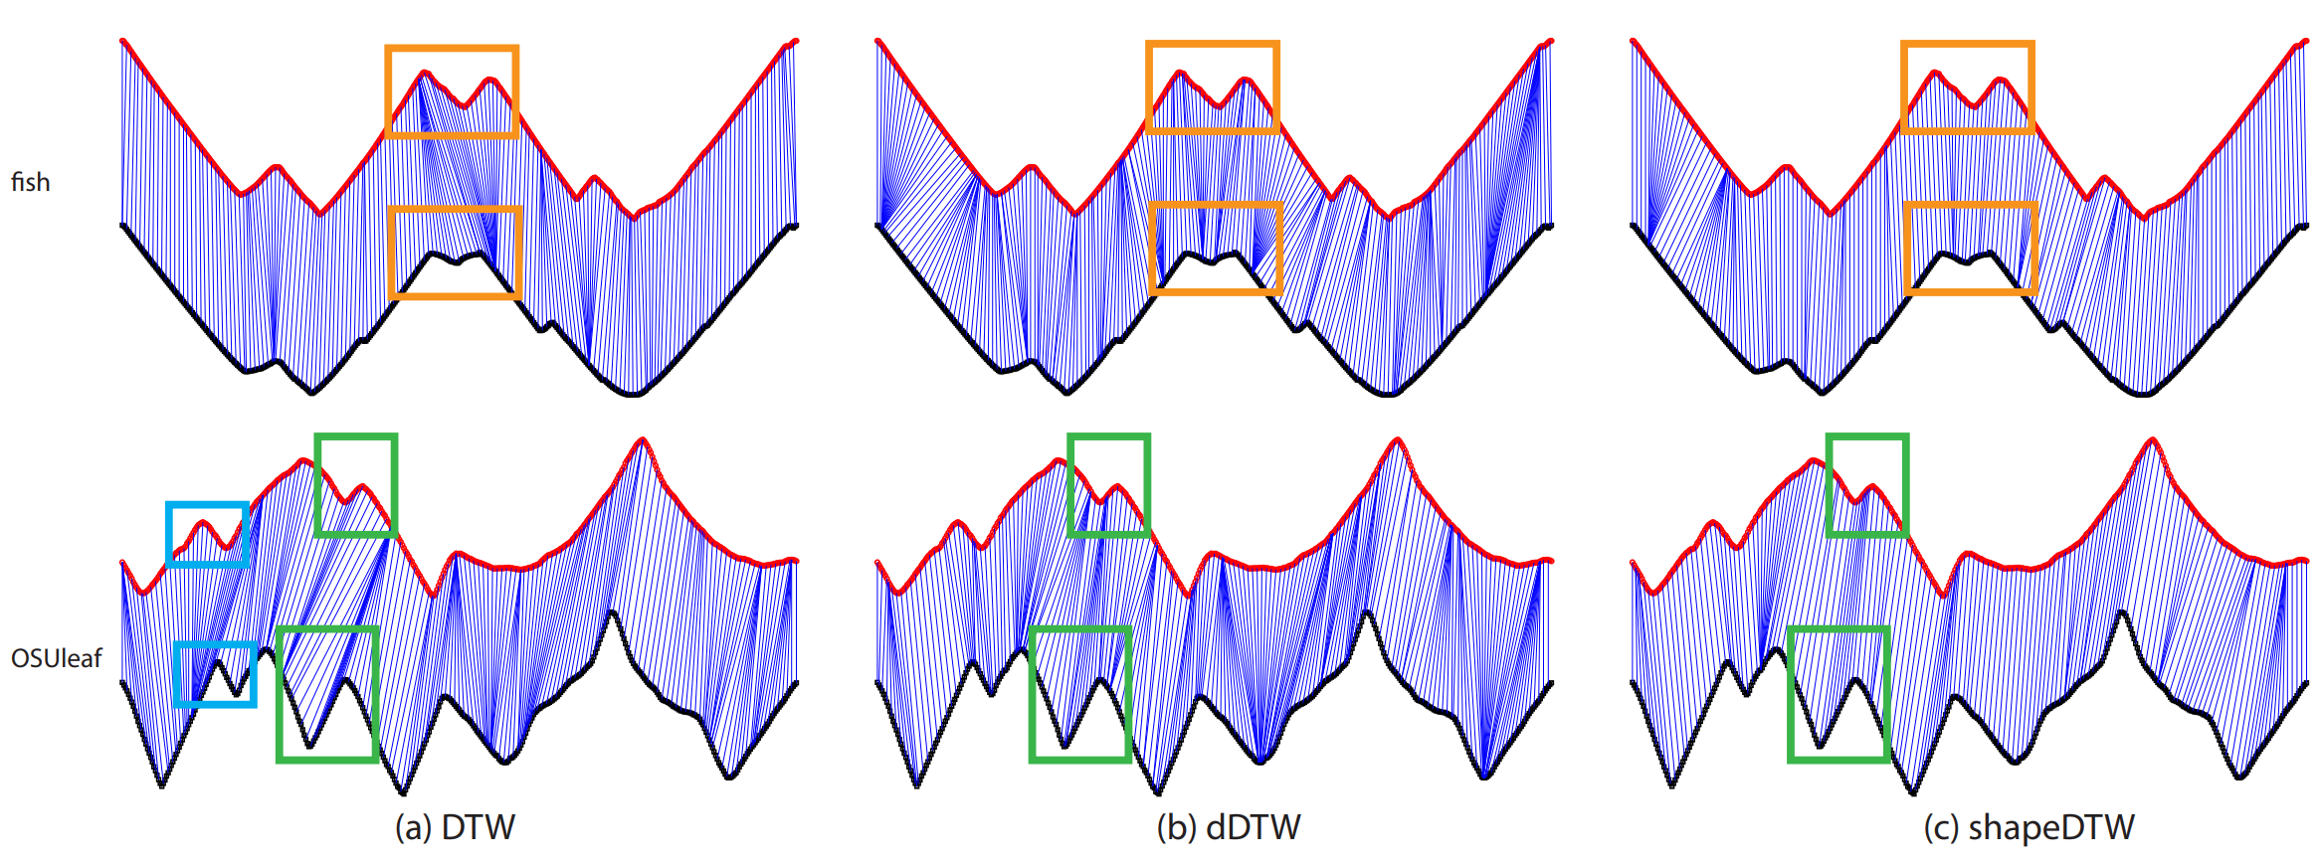
Part_2: Paper Reading
Paper_2: shapeDTW: shape Dynamic Time Warping

Slide 10
Part_2: Paper Reading
Paper_3: k-Shape
NLAAF: Nonlinear alignment and averaging filters
PSA: Prioritized shape averaging
RSTMF: Ranking Shape-based Template Matching Framework
DBA: Dynamic Time Warping Barycenter Averaging
KSC: K-Spectral Centroid Clustering
Matrix Decomposition

Slide 11
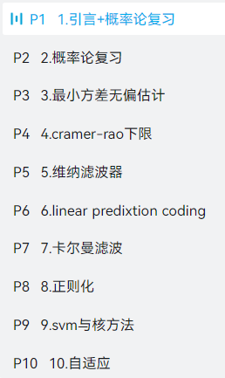
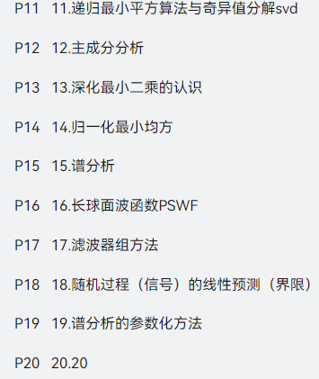
Work_3: Learning Progress and Future Learning Plan
已经完成的:
EE120 (all videos and lectures)
Complex Functions and Integral Transforms (completed half of the exercise book)
接下来打算做的：
现代数字信号处理I
现在数字信号处理II
(列信号处理、时频分析、压缩感知、贝叶斯方法)
接来下的科研方向：
对K-shape中提及的方法进行进一步的尝试
在数据挖掘期刊中，进一步寻找最新的方法
寻找能对频域进行有效分解的算法
慢慢探索真实数据集

Slide 12
Some Thoughts about My Undergraduate Thesis
I hope it is a framework for any periodic physical signal
Segmentation
Get Template
真正实现起来的效果：
即使分隔的一塌糊涂，也能合成一个还算可以的信号
同时，如果能在分隔过程中产生更多的信息，那么模板合成的会更加好。
Sliced signals without any knowledge of their nature
Sliced signals with some knowledge of their nature
Sliced signals with deep knowledge of their nature

Slide 13
Questions
In our laboratory paper, does the deep learning model also have data shift in its dataset? I have built an identical model, but it doesn't work.
2. Regarding the proposal presentation, Professor Xie's advice is to approach it from a more general perspective. For instance, what I should write about is how to perform the extraction of a standard template from a periodic physical signal, then elucidate my methodology, and in the experimental section, validate it using our SCG signal or BCG signal.
3. In the current thesis, when mentioning 'Time Alignment' or 'DTW,' they are often used for clustering, classification, and data argumentation. Can we refer to the current work as 'DTW for Regression'? Compared to 'DTW for Classification,' 'DTW for Regression' has a distinct focus.

Slide 14
Work_3: Obtaining Template
In Work 3, an attempt has been made to define what constitutes a good algorithm for obtaining an SCG signal template.
Let’s begin with a comparison of algorithms that can recover a single-cycle signal, evaluating their performances on both noise-free and slightly noisy data.
I will give analyses on this table in detail.
No Noise / Noise Level of 0.1
Method | S Prediction | D Prediction
No Template | 0.79 / 1.64 | 1.79 / 4.31
Median | 1.42 / 1.45 | 4.07 / 4.49
Mean | 1.35 / 1.38 | 4.53 / 4.44
K-shape | 2.20 / 2.74 | 4.85 / 5.88
PCA-based | - / - | - / -

Slide 15
Work_3: Obtaining Template
1 Comparison of ‘No Template’ method and ‘Get Template’ method
The ‘No Template’ method is not robust and is heavily affected by noise.
However, the ‘Get Template’ methods, while not very accurate on clean signals(this part will be explained later), are less affected by noise.
No Noise / Noise Level of 0.1
Method | S Prediction | D Prediction
No Template | 0.79 / 1.64 | 1.79 / 4.31
Median | 1.42 / 1.45 | 4.07 / 4.49
Mean | 1.35 / 1.38 | 4.53 / 4.44
Raise Rapidly
Raise Slightly
Raise Slightly
From results of Mean Method, we could say recovering a single cycle signal can help us to achieve noise reduction.

Slide 16
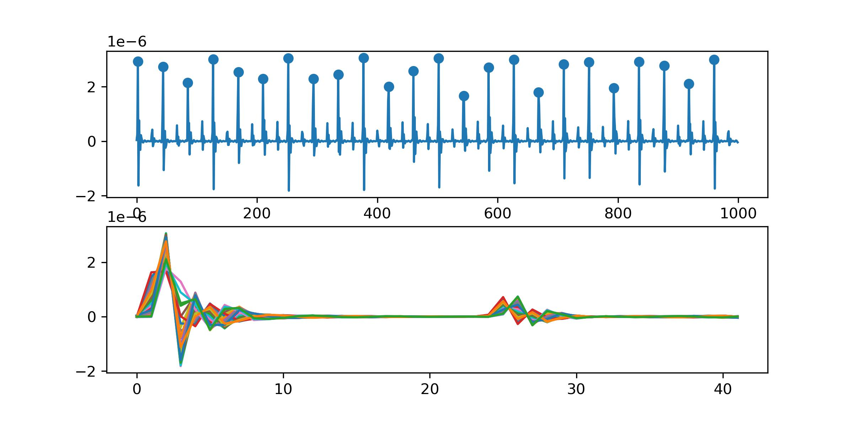
Work_3: Obtaining Template
No Noise
Method | S Prediction | D Prediction
No Template | 0.79 | 1.79
Median | 1.42 | 4.07
Mean | 1.35 | 4.53
2 Why does methods of getting the template result in poor performances for both S and D prediction, even in noise-free signals?
I think I find the reason.
For D Prediction:
Small peaks are not aligned properly. Both mean and median methods significantly affect height of small peaks, leading to a decrease in accuracy.
For S Prediction:
Due to the limitation of the sampling rate, even with a perfect "Get Template" algorithm, the S prediction result is still not as good as that of the "No Template" algorithm.
e.g.
No Template: d12 = 12.5 (can be a decimal)
Get Template: d12 = 12/13 (can only be int)
Example of Segmentation
Notes:
For D Prediction:
The reason is peaks are not aligned properly. Both mean and median methods significantly affect height of small peaks, leading to a decrease in their accuracy.
For S prediction:
Due to the limitation of the sampling rate, even with a perfect "Get Template" algorithm, the S prediction result is still not as good as that of the "No Template" algorithm.

Slide 17
Work_3: Obtaining Template
No Noise / Noise Level of 0.1
Method | S Prediction | D Prediction
No Template | 0.79 / 1.64 | 1.79 / 4.31
Median | 1.42 / 1.45 | 4.07 / 4.49
K-shape | 2.20 / 2.74 | 4.85 / 5.88
3 Why the performance of K-shape is not satisfactory?
The K-shape algorithm generates a new signal during clustering. The issue lies in the clustering rather than the underlying Time-Warping concept.
We should discard clustering and focus on researching how to apply Time-Warping effectively.

Slide 18
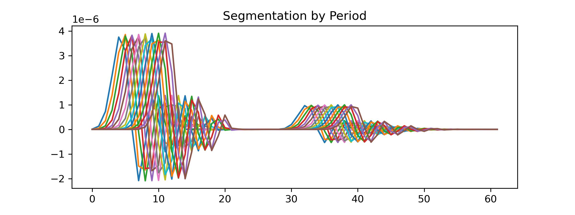
Work_3: Obtaining Template
What features should a good algorithm for obtaining a template have?
Feature 1: The highest points of both large and small peaks for each piece should be aligned after applying the algorithm.
Feature 2: The distance between two peaks of the template should be the rounded average of distances between two peaks for all pieces.
Feature 3: The ability to handle time shifts (possibly essential in real data but less critical in simulated signals).
The primary focus of research should indeed be on Time Warping to get perfect template of SCG signals.

Slide 19
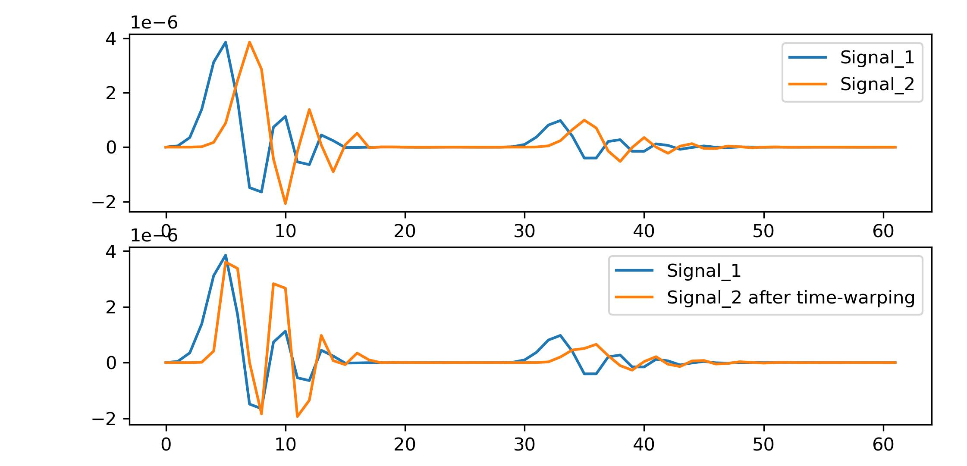
Work_3: Obtaining Template
The results I have obtained regarding SCG signal are as follows:
Big peaks are aligned.
The alignment effect for small peaks is not noticeable.
The signal distortion is significant.
Reason 1:
The method is based on derivations. However, ECG signals are relatively smooth, but simulated SCG signals are much sharper.
Reason 2:
In the paper, after stretching the time axis, missing parts need to be interpolated.
The ECG signals in the paper have a sampling rate of 1 KHz, while our signals have a sampling rate of only 100 Hz. The length of our templates is often in the range of 40-80. Interpolation will introduce significant errors which result in distortion.

Slide 20
Thanks!

