Slide 1
Presentation
Jiayu Chen
2024.07.29

Slide 2
Our New Model Works Well In Real Data (3AE4)
HR Estimation on Real AFib Data
Dataset | IoT2023 | Jiayu-easy | Jiayu-complex
3AE4_1 | Number: 13981 Ratio: 81% MAE: 6.57 | Number: 9765 Ratio: 58% MAE: 3.27 | Number: 9632 Ratio: 57% MAE: 4.27
3AE4_2 | Number: 10971 Ratio: 64% MAE: 13.82 | Number: 6899 Ratio: 41% MAE:3.58 | Number: 6895 Ratio: 41% MAE: 3.18
3AE4_3 | Number: 11285 Ratio: 66% MAE: 21.75 | Number: 5312 Ratio: 31% MAE: 4.54 | Number: 5222 Ratio: 31% MAE: 3.13
3AE4_4 | Number: 10287 Ratio: 60% MAE: 31.938 | Number: 3661 Ratio: 21% MAE: 5.3 | Number: 3396 Ratio:20% MAE: 3.29
3AE4_All | Number: 46524 Ratio: 68% MAE: 17.5 | Number: 25637 Ratio:38% MAE: 3.87 | Number: 25145 Ratio:37% MAE:3.62
*Number in the table means useful 10s signal piece after Quality Control. Ratio=Number/All.

Slide 3
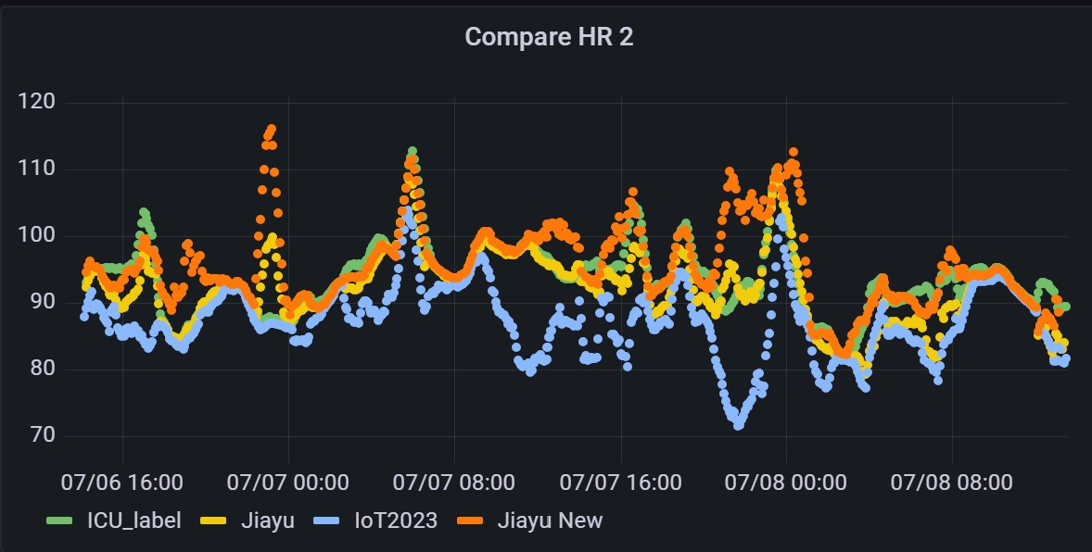
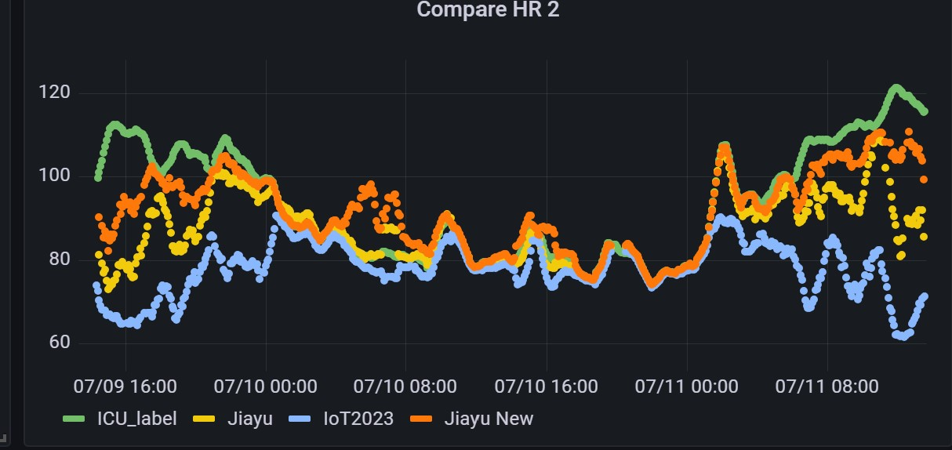
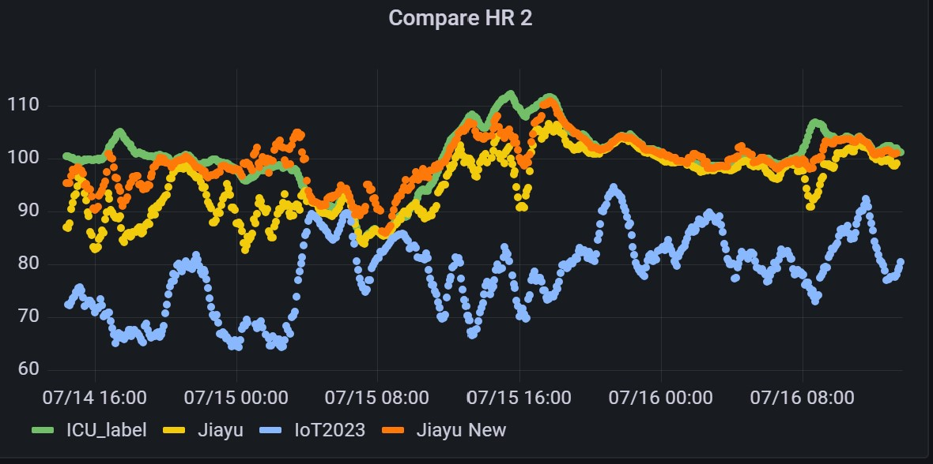
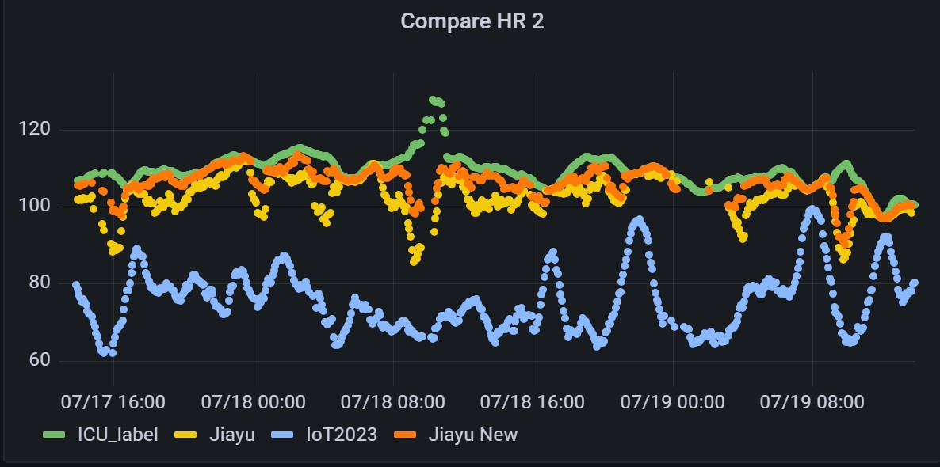
HR Estimation Shown in Panel
Yellow line is the results of easy version algorithm.
Orange line is the results of complex version algorithm(more computationally expensive).
Two versions use the same quality control, so the input data are the same. The complex version works better.
In general, template-based heart rate estimation is not bad.

Slide 4
A Question: Whether Afib pieces are dropped out by quality control?
Some pieces, when heart rates are changing dramatically, could be used to test whether Afib pieces are reserved after the quality control.
Low HR
High HR

Slide 5
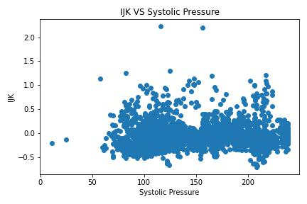
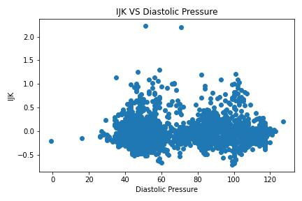
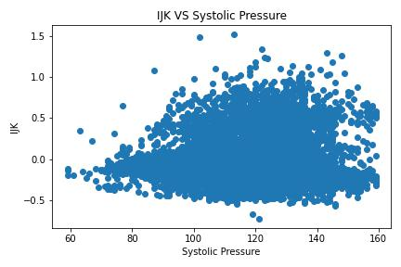
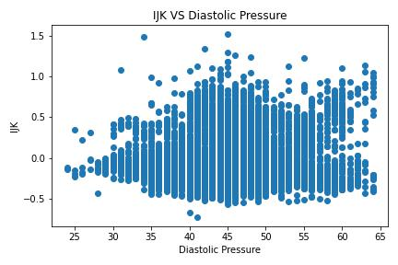
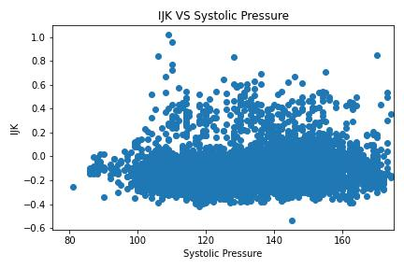
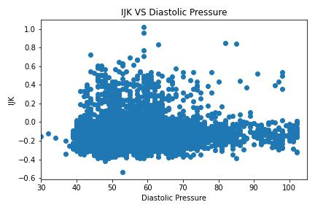
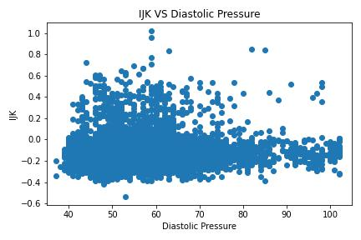
Only 4 peaks/valleys are stable and could be extracted precisely. Here are three typical waveforms.
3A80
J
J
J
3AE4
K
3AFC
K
K
I
I
I
4C34

Slide 6
Dataset | IoT2023 | Jiayu | Yingjian v4 | Intersection
3AE4_1 | Number: 13981 Ratio: 81% | Number: 9765 Ratio: 58% | Number: 7556 Ratio: 44% | 5771
3AE4_2 | Number: 10971 Ratio: 64% | Number: 6899 Ratio: 41% | Number: 4247 Ratio: 25% | 2823
3AE4_3 | Number: 11285 Ratio: 66% | Number: 5312 Ratio: 31% | Number: 5214 Ratio: 31% | 2894
3AE4_4 | Number: 10287 Ratio: 60% | Number: 3661 Ratio: 21% | Number: 5390 Ratio: 32% | 2532
My Quality Control
Yingjian’s Quality Control Version 4
The intersection part is small, but high quality.
Highly Low Quality Pieces

