Slide 1
Weekly Presentation
Jiayu Chen
2023.11.20

Slide 2
Work Description
Part_1:
The overall framework of the research
Easy introduction to important papers
Analysis of experimental results
Part_2: Analysis of experimental results of the paper from IoT2023
Part_3: Some arrangements for future research studies.
Part_4: Questions

Slide 3
Part_1

Slide 4
Overall Framework of the Research
The main direction of current exploration
Before 2018
With DTW
In 2018
Time Series Average
After 2018
Phototype4Regression
Template4Regression
Phototype4Prediction
Template4Prediction
Need careful consideration
Without DTW
Multi-Sensors Fusion
Another relatively large field
Sporadic support from
research papers
Generative Model
The concept definitely did not exist in 2018 and before. As of 2019 onwards, I have not found it so far.

Slide 5
Overall Framework of the Research
X_t
X
Asymmetric
Increment
Y
Incremental Averaging
Y_t-1, Y_t, Y_t+1
Warping Path: (X_t, Y_t-1), (X_t, Y_t), (X_t, Y_t+1)
Symmetric
Increment
Asymmetric Method: Take a reference: X, Y -> X.
Take X as a reference.
Result: X_t = (X_t + Y_t-1 + Y_t + Y_t+1) / 4
Disadvantage: There is no natural criterion for choosing a reference.
Asymmetric
Batch
Batch
Averaging
Symmetric Method: Create a new one: X, Y -> Z.
Result: Z_t-1 = (X_t + Y_t-1) / 2
Z_t = (X_t + Y_t) / 2
Z_t+1 = (X_t + Y_t+1) / 2
Disadvantage: Have more time points than X and Y.
Symmetric
Batch
Notes:
在2018年以前，的二三十年里面，这个领域TSA的进展，主要分为了这两大类，四小类。
10s的信号有15个周期，而我成功把这信号里的15个周期切分好了。
Incremental Averaging， local，不能一次同时处理这15个周期，他只能两两之间，进行对齐啊，取平均啊。
Batch Averaging， global，它是一个全局的算法。他可以同时对15个周期进行迭代。求取最优值。
这两大类之下，分别又由两种，一种是非对称的，一种是对称的。
非对称的简单来说就是，他需要选取一个参考。假设把上面的X选为参考，那么X，Y两条时间序列，会最后融为X这一条。其余所有的周期，都会和X进行取平均，并且融入X。这个的缺点就非常明显。
对称的呢，就是说，它会把X和Y两个周期，变成一个新的周期。同时，上面这个示例中，我画出来了三对点之间的一一对应关系。
这三个对应关系，会变成新的周期中的三个点。那这个的缺点更加明显了，就是他合成的新的序列，会变得越来越长越来越长。
但是，这种方法，对我们的任务，是有一个巨大的优点，我后面会去介绍。

Slide 6
Before 2017: Intuitive
After 2017
Asymmetric
Increment
SSG^{[5]}, 2017
Incremental Averaging
PSA^{[2]}, 2009
Soft-DTW^{[6]} 2017
Symmetric
Increment
NLAAF^{[1]}, 1996
ICDTW^{[3]}, 2012
TTW^{[8]}, 2018
Asymmetric
Batch
DBA^{[4]}, 2011
CDBA^{[7]}, 2017
Batch
Averaging
Symmetric
Batch
O(T^N)
computationally expensive
1. Improve the NLAAF algorithm.
2. Prepare for the emergence of the DBA algorithm.

Slide 7
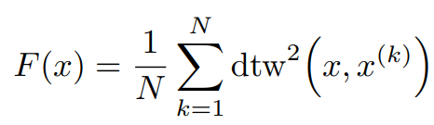
After 2017: Optimization
SSG, 2017
Fr´echet Function
A polynomial-time algorithm for finding a global minimum of the non-differentiable, non-convex Fr´echet function is unknown.
Soft-DTW 2017
TTW, 2018
SSG
F = min{F_C1, F_C2, F_C3, …}, F_C is differentiable and convex function.
Soft-DTW
DTW(min, +) -> DTW(*, +)
TTW
Translate Discrete Signal into Continuous Signal by Sinc function. And Take DTW as constraints of optimization problem.

Slide 8
Analysis of Experimental Results
The impact of different sampling rates on time series alignment.
Model | Data | Sampling Rate | S Prediction | D Prediction
Template: Mean | Simulation | 100 | 1.35 | 4.53
Template: Mean | Simulation | 150 | 0.92 | 2.36
Template: Mean | Simulation | 200 | 0.65 | 1.75
For simulated signals, the source of error lies in the sampling rate.
Simulated signals, low sampling rate, Non-Linear Alignment
Simulated signals, high sampling rate, Linear Alignment
Linear Alignment -> O(T)
Acceptable
Non-Linear Alignment -> O(T^2)
For real signals, the degree of distortion on time axis depends on the alignment we actually need.
Next week, I will use the periodicity determination method from IoT2023 to segment real signals.
Unacceptable

Slide 9
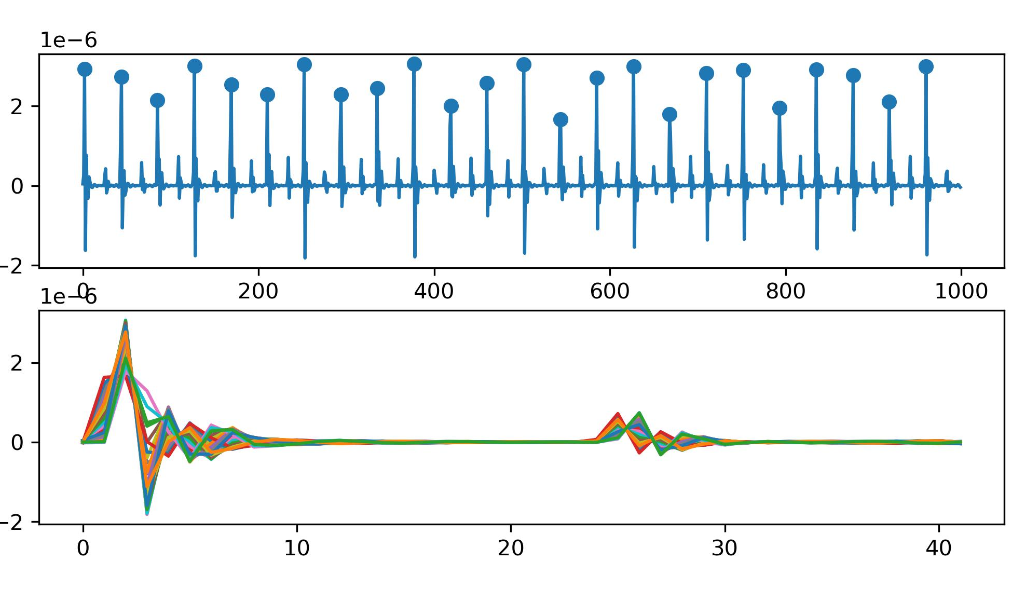
Previous Slides
No Noise
Method | S Prediction | D Prediction
No Template | 0.79 | 1.79
Median | 1.42 | 4.07
Mean | 1.35 | 4.53
2 Why does methods of getting the template result in poor performances for both S and D prediction, even in noise-free signals?
I think I find the reason.
For D Prediction:
Small peaks are not aligned properly. Both mean and median methods significantly affect height of small peaks, leading to a decrease in accuracy.
For S Prediction:
Due to the limitation of the sampling rate, even with a perfect "Get Template" algorithm, the S prediction result is still not as good as that of the "No Template" algorithm.
e.g.
No Template: d12 = 12.5 (can be a decimal)
Get Template: d12 = 12/13 (can only be int)
Example of Segmentation

Slide 10
Analysis of Experimental Results
1. All Experiment Results
Model | S Prediction | D Prediction | Model | S Prediction | D Prediction
No Template | 0.79 / 1.64 | 1.79 / 4.31 | New
Mean | 1.35 / 1.38 | 4.53 / 4.44 | NLAAF1 | 8.43 / 23.19 | 3.14 / 5.21
Median | 1.42 / 1.45 | 4.07 / 4.49 | NLAAF2 | 20.67 / 33.39 | 3.64 / 7.04
PCA | - / - | - / - | GTW | - / - | - / -
K-shape 1 | 2.20 / 2.74 | 4.85 / 5.88 | TTW | 1.52 / - | 4.28 / -
Weighted Avg | 1.95 / 1.98 | 4.63 / 4.74 | K-SC | - / - | - / -
K-shape 2 | 2.18 / 1.79 | 4.76 / 5.24 | PSA | 2.27 / 19.05 | 5.40 / 8.89
Kalman Filter | 1.45 / 1.37 | 4.82 / 4.60 | Soft-DTW | 1.35 / 1.38 | 4.53 / 4.44
DBA | 2.05 / 1.96 | 3.43 / 4.15 | ICDTW | 2.66 / - | 5.08 / -
Segmentation Methods: Base on Large Peaks
The implication of experimental results: Assess the performance limits of various algorithms under the most ideal conditions.

Slide 11
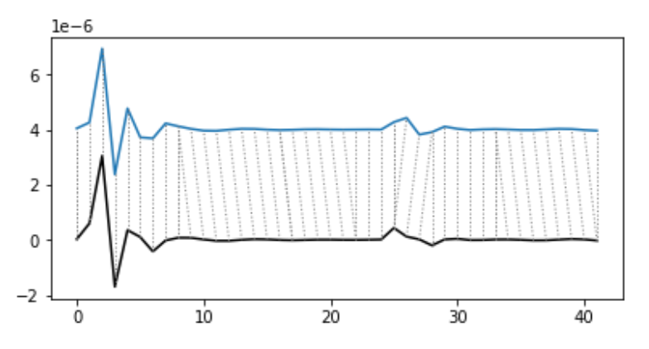
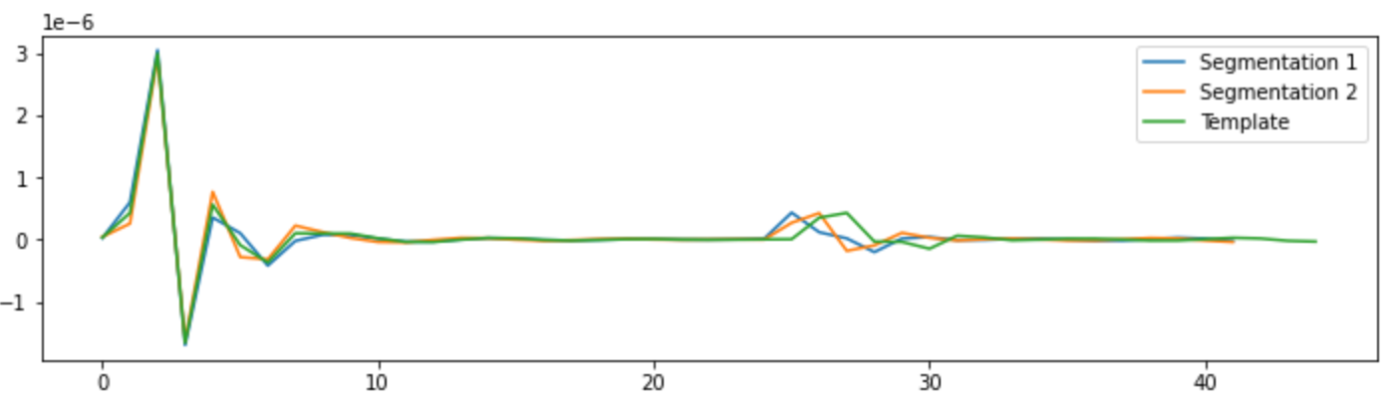
Analysis of Experimental Results
2. Effectiveness of NLAAF
Model | S Prediction | D Prediction
No Template | 0.79 / 1.64 | 1.79 / 4.31
Mean | 1.35 / 1.38 | 4.53 / 4.44
NLAAF1 | 8.43 / 23.19 | 3.14 / 5.21
NLAAF2 | 20.67 / 33.39 | 3.64 / 7.04
DBA | 2.05 / 1.96 | 3.43 / 4.15
Y_t-1, Y_t
Y
X
X_t
NLAAF:
Z_t-1 = (X_t + Y_t-1) / 2
Z_t = (X_t + Y_t) / 2
DBA:
Z_t = (X_t + Y_t-1 + Y_t) / 3
Values of large peak and small peak in template must be the average of all correctly extracted peak values.
Therefore, its theoretical upper limit should be 1.79.
Notes:
NLAAF 这个算法，对于D的预测，效果非常好。一个是3.14， 一个是3.64，一个和DBA这个算法的效果差不多，另一个比DBA效果好不少。
下面这两个图，是算法运行过程中的一部分。

Slide 12
Analysis of Experimental Results
2. Effectiveness of NLAAF
Model | S Prediction | D Prediction
No Template | 0.79 / 1.64 | 1.79 / 4.31
Mean | 1.35 / 1.38 | 4.53 / 4.44
NLAAF1 | 8.43 / 23.19 | 3.14 / 5.21
NLAAF2 | 20.67 / 33.39 | 3.64 / 7.04
DBA | 2.05 / 1.96 | 3.43 / 4.15
The poor performance in the presence of noise.
Is likely because the highest peak corresponds to another highest peak.
There is never a situation where positive and negative contributions cancel each other out.
This scenario tends to amplify the noise rather than mitigating it.

Slide 13
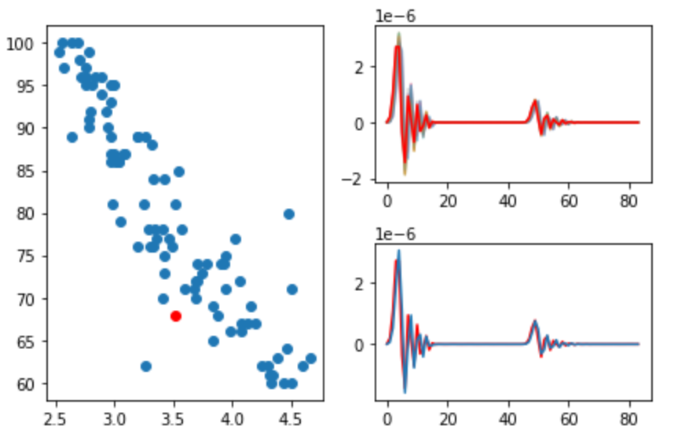
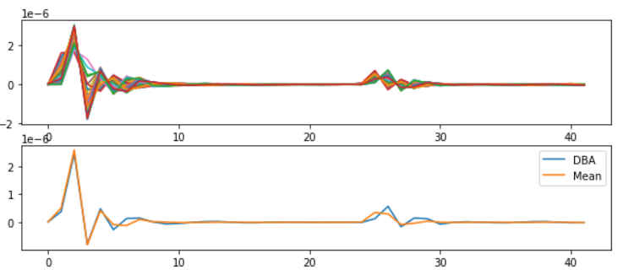
Analysis of Experimental Results
2. Source of Error of DBA
Why, despite the template looking very similar, is the error in D unsatisfactory (3.43)?
DBA Template
Model | S Prediction | D Prediction
No Template | 0.79 / 1.64 | 1.79 / 4.31
Mean | 1.35 / 1.38 | 4.53 / 4.44
DBA | 2.05 / 1.96 | 3.43 / 4.15
D
Mean
DBA
Feature
Feature = Amp(Large Peak) / Amp(Small Peak)
Source of Errors:
Amplitudes of large peak are underestimated.
Large peaks have more time points than small peaks, leading to inevitable errors in matching due to DTW misalignment.
Error from small peaks’ misalignment has been solved successfully.
Notes:
散点图，表示D这个特征和他对应特征之间的相关性。 特征就是 大峰的幅度 / 小峰的幅度。
如果这些散点都落在了两条黄色的虚线之间，那说明特征提取的非常好
但是呢，我们可以看到，就是说，蓝色的散点，普遍落在了左侧的区域中。
特征的分母是小峰的高度，这个我们已经测得非常非常准了，但是测出来的特征偏小，说明我门大峰的高度，有问题。
这个红色的点，它理想中应该出现在绿色的这个地方。我们结合右边的图来看，DBA获取得到的template它是偏小的。
误差的来源，在于Large peaks have more time points than small peaks, leading to inevitable errors in matching due to DTW misalignment.

Slide 14
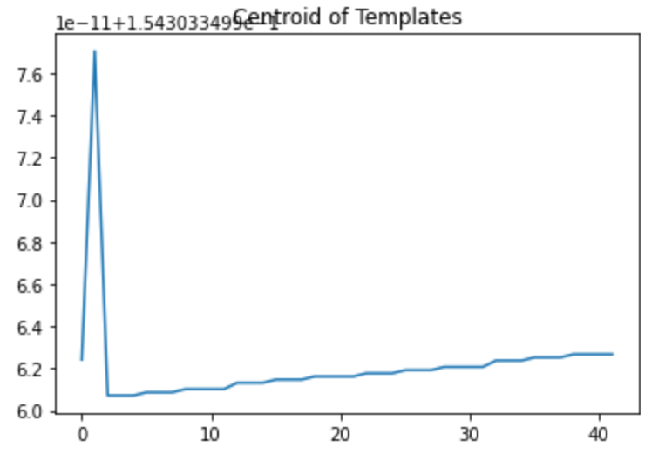
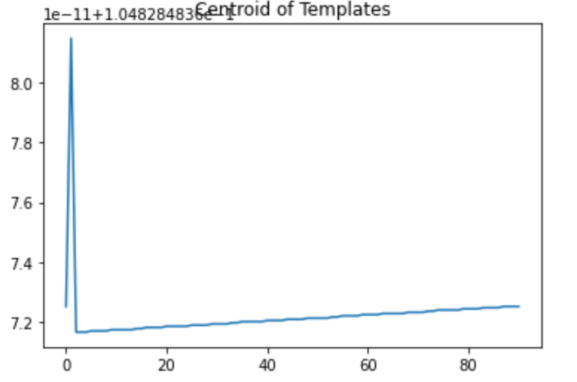
Analysis of Experimental Results
3. A Type of Ineffective Centroid Calculation Method
Model | S Prediction | D Prediction
PCA | - / - | - / -
K-SC | - / - | - / -
Essentially, all of them use the eigenvector of a matrix as centroids for quick clustering.
However, for Template4Prediction task, this approach is too coarse and cannot be used.

Slide 15
Analysis of Experimental Results
4. Trainable Method
Model | S Prediction | D Prediction
DBA | 2.05 / 1.96 | 3.43 / 4.15
GTW | - / - | - / -
TTW | 1.52 / - | 4.28 / -
Soft-DTW | 1.35 / 1.38 | 4.53 / 4.44
These models all have available libraries. Currently, the trainable methods don't seem effective.
However, these papers involve a lot of mathematical theory, and I'll need some time to understand it.
As of now (up to papers from 2018), there‘s a trend in Time Series Average method shifting from intuitive to counterintuitive(Gradient related), which we need to pay attention to.

Slide 16
Analysis of Experimental Results
General trend in the development of models in time series average:
Incremental -> Batch
Intuitive -> Counterintuitive
Based on current experimental results, this development trend seems to be inconsistent with the goal of Template4Prediction.
At the current pace, it will take me at least another 5-6 weeks to fully review important papers up to the year 2023.

Slide 17
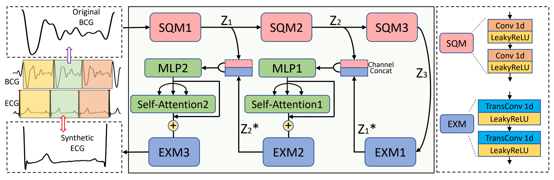
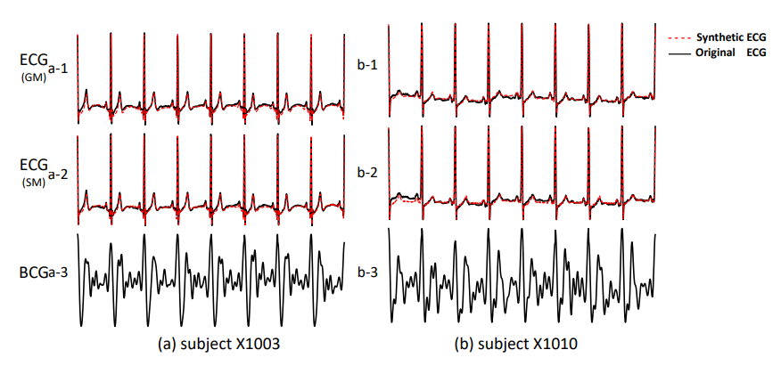
Generative Model
Rec-AUNet: Attentive UNet for Reconstruction of ECG from BCG^{[9]}
While generating a template from a lengthy signal may not be feasible.
This network architecture should, at the very least, be able to capture the characteristics of the BCG signal.
If someone in our lab is working on this direction, they might consider trying out this architecture.

Slide 18
Part_2

Slide 19
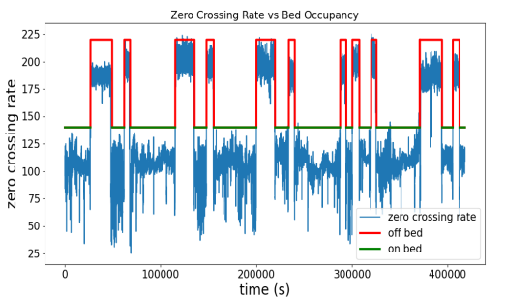
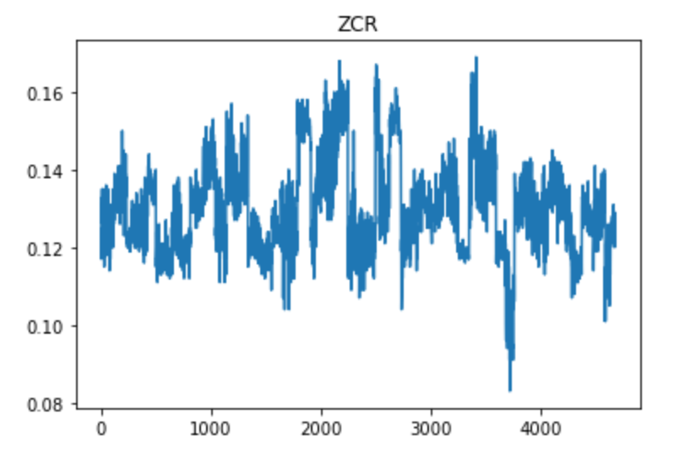
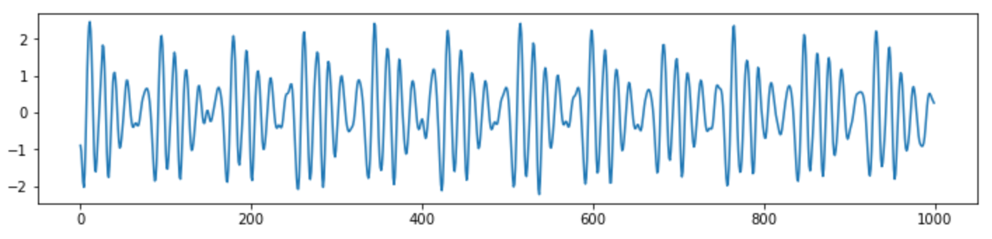
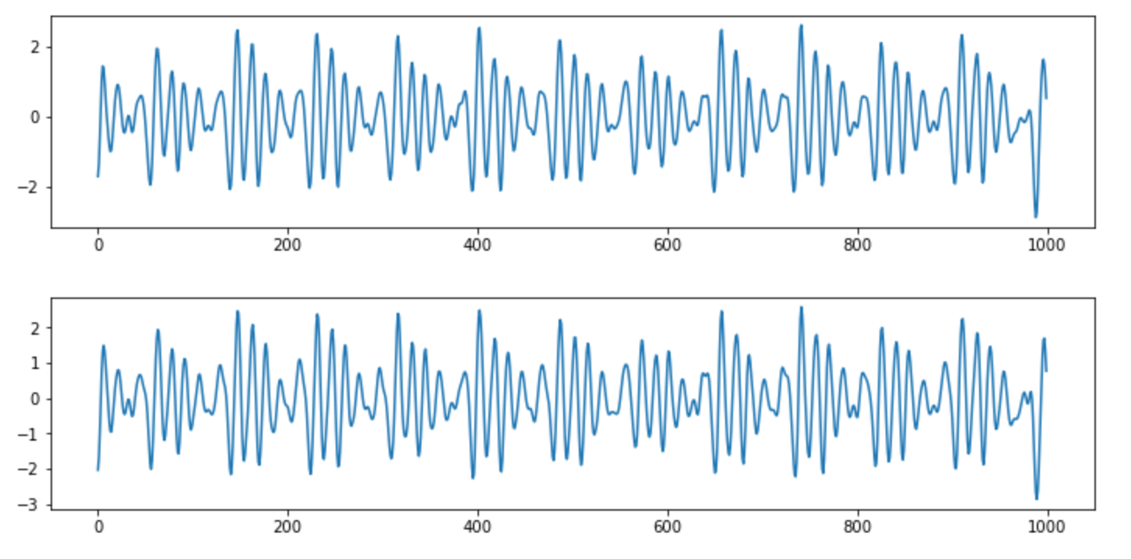
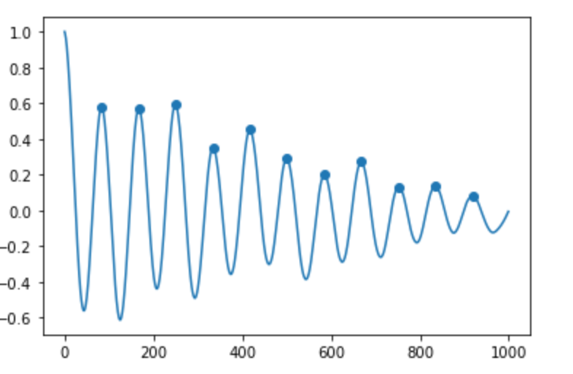
Denoise and Choose High Quality Signals
ZCR
High Quality Signal
Sliding Window?
ACF

Slide 20
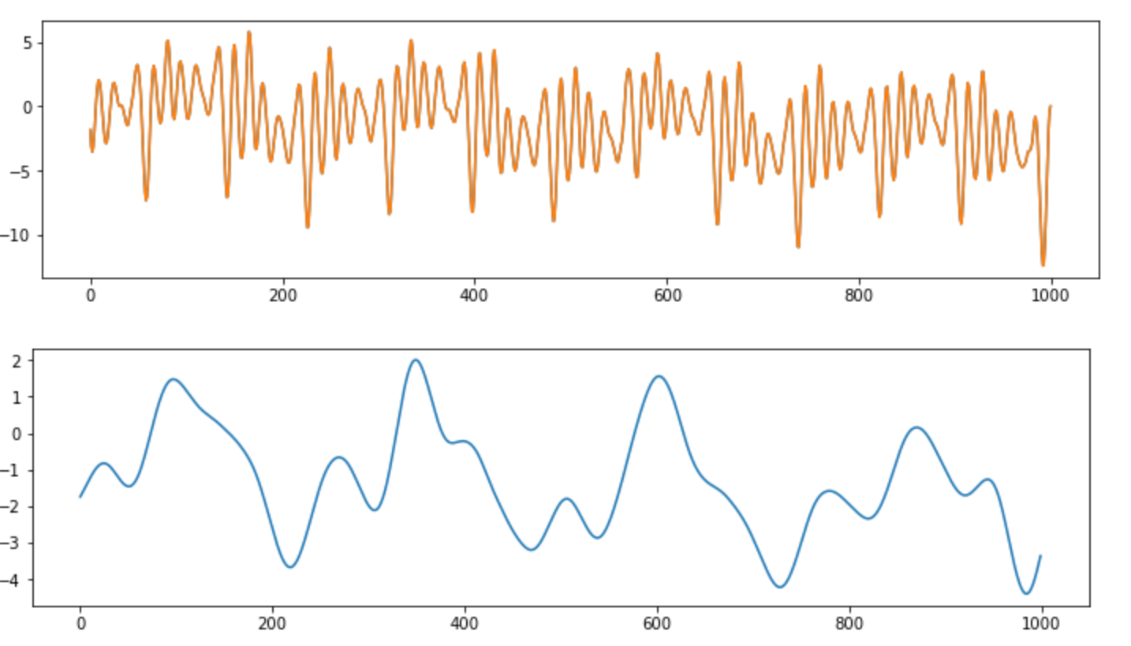


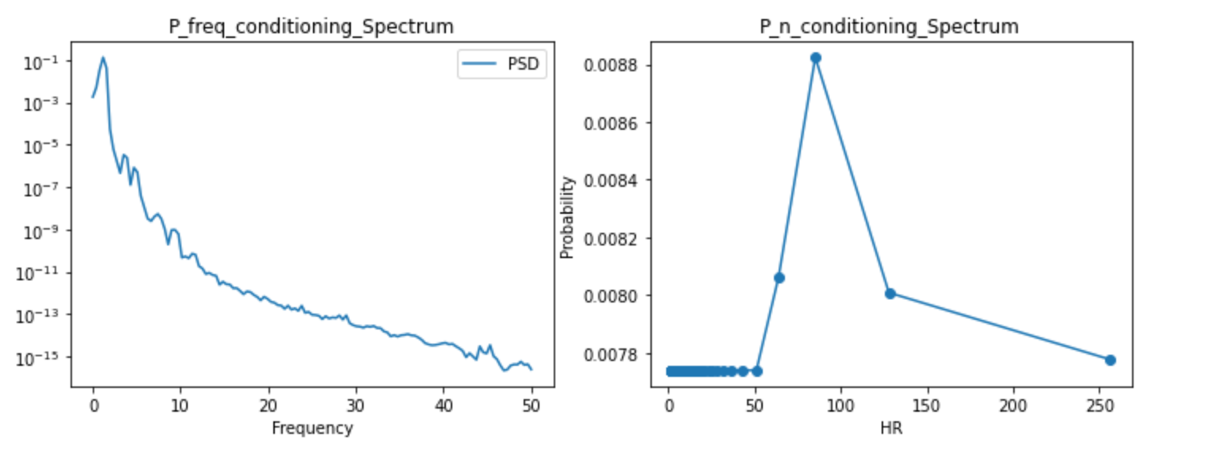
Respiration
Fusion
Why Respiration Pattern will appear?
How does it help and guide us in eliminating Respiration?

Slide 21
Part_3

Slide 22
Work_3: Learning Progress and Future Learning Plan
Theoretical Studies:
1. 现代数字信号处理I/II 张颢
Too difficult, omitted too many relevant foundations of traditional filter design.
2. EE123 Digital Signal Processing, UCB
More inclined towards traditional methods, more suitable for laying a solid foundation.
Next Research Directions:
Read more papers in the relevant field between 2018-2023.
Read and contemplate papers you sent me that are related to blood pressure.
3. When evaluating algorithm performance, make extensive use of real datasets, or explore the effects on different types of signals.
4. Prioritize knowledge in DSP and if there's additional capacity, delve into Li Mu's hands-on deep learning series.

Slide 23
Questions
To what extent should my research reach? What will the results be compared against? Will testing be done on publicly available datasets of real signals? Currently, even if we extract templates from our mixed signals, we can't find corresponding indicators for S and D.
Regarding the TS-LLM project, is it already decided to proceed, or are we still in the observation stage? What level of knowledge should be acquired for the foundation?
Do we have the latest real data? I noticed many signals in IOT2023 are 30 seconds long.

Slide 24
Reference
[1] Gupta, Lalit, et al. "Nonlinear alignment and averaging for estimating the evoked potential." IEEE transactions on biomedical engineering 43.4 (1996): 348-356.
[2] Niennattrakul, Vit, and Chotirat Ann Ratanamahatana. "Shape averaging under time war**." 2009 6th International Conference on Electrical Engineering/Electronics, Computer, Telecommunications and Information Technology. Vol. 2. IEEE, 2009.
[3] Niennattrakul, Vit, Dararat Srisai, and Chotirat Ann Ratanamahatana. "Shape-based template matching for time series data." Knowledge-Based Systems 26 (2012): 1-8.
[4] Petitjean, François, Alain Ketterlin, and Pierre Gançarski. "A global averaging method for dynamic time war**, with applications to clustering." Pattern recognition 44.3 (2011): 678-693.
[5] Schultz, David, and Brijnesh Jain. "Nonsmooth analysis and subgradient methods for averaging in dynamic time war** spaces." Pattern Recognition 74 (2018): 340-358.
[6] Cuturi, Marco, and Mathieu Blondel. "Soft-dtw: a differentiable loss function for time-series." International conference on machine learning. PMLR, 2017.
[7] Morel, Marion, et al. "Time-series averaging using constrained dynamic time war** with tolerance." Pattern Recognition 74 (2018): 77-89.
[8] Khorram, Soheil, Melvin G. McInnis, and Emily Mower Provost. "Trainable time war**: Aligning time-series in the continuous-time domain." ICASSP 2019-2019 IEEE International Conference on Acoustics, Speech and Signal Processing (ICASSP). IEEE, 2019.
[9] Wang, Peng, et al. "Rec-AUNet: Attentive UNet for Reconstruction of ECG from BCG." 2022 IEEE International Conference on Bioinformatics and Biomedicine (BIBM). IEEE, 2022.

Slide 25
Thanks!

