Slide 1
Presentation
Jiayu Chen
2023.12.12

Slide 2
Work Description
Part_1: Take a look at the tutorial first.
Part_2: Why doesn’t FMM work?
Part_3: An easy experiment about sampling rate.
Part_4: Cut, realign, and extract templates from real signals.
Part_5: The possible research directions for the next step.
Part_6: Questions

Slide 3
Part_1

Slide 4
Part_2

Slide 5
Why doesn’t FMM work
Advantages of FMM (from emails):
“particularly when dealing with pronounced spike waves”
“The FMM model is specifically effective at identifying high peaks against the background noise”
“to detect other less prominent peaks more components could be added.”
Disadvantages of FMM (from the demo code):
It is necessary to decompose a single-cycle signal into a sufficient number of components, if we want to focus on smaller peaks.
2. After decomposition, the relationship between various components becomes chaotic. There is a loss of interpretability in decomposed components.

Slide 6
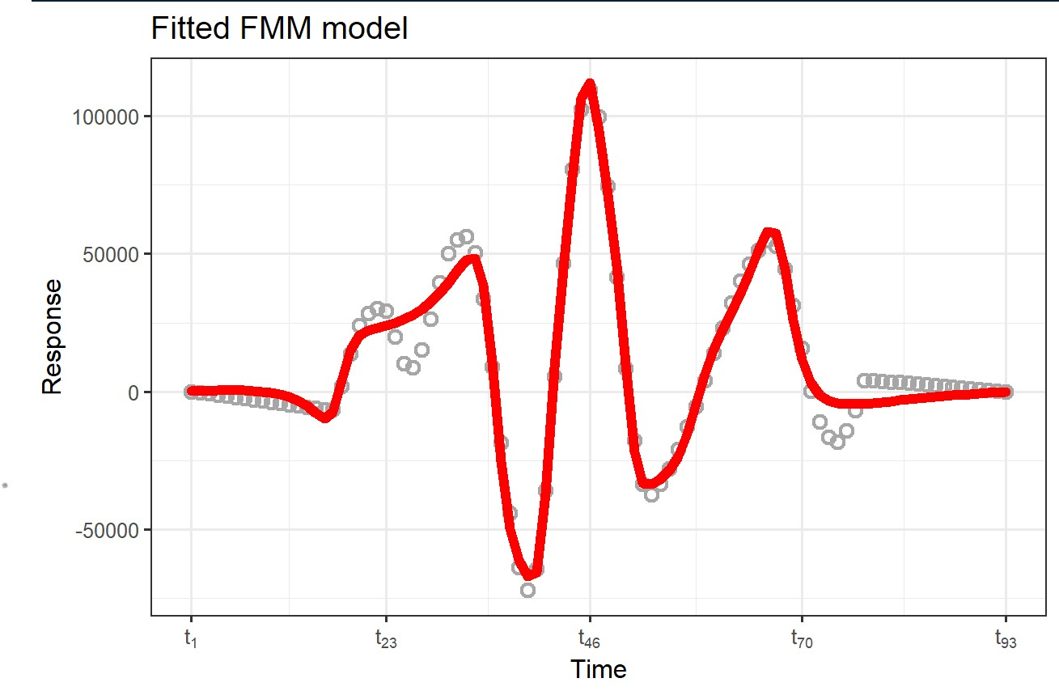
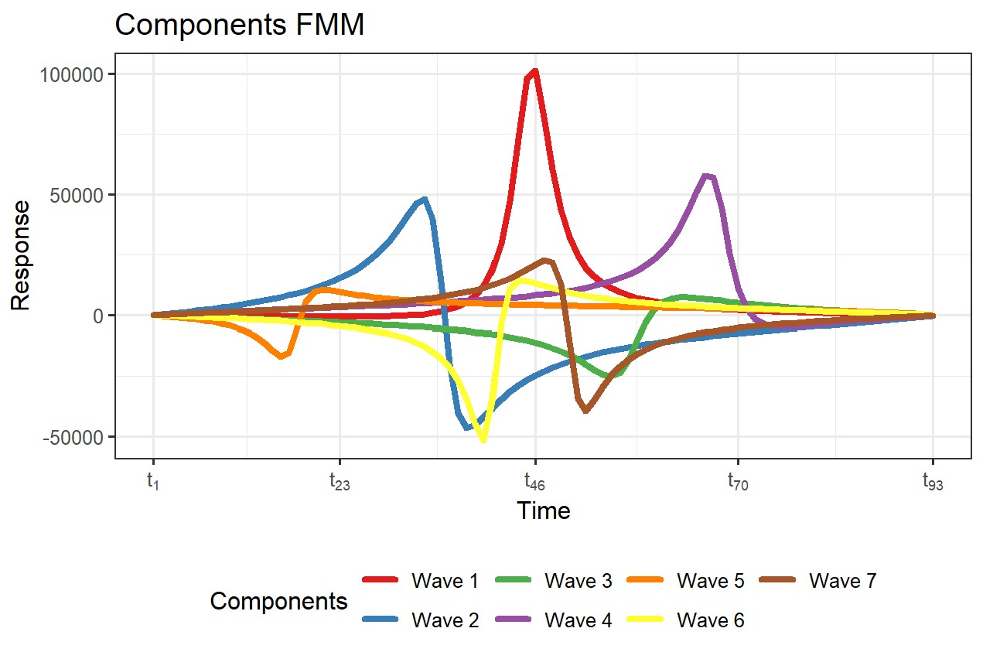
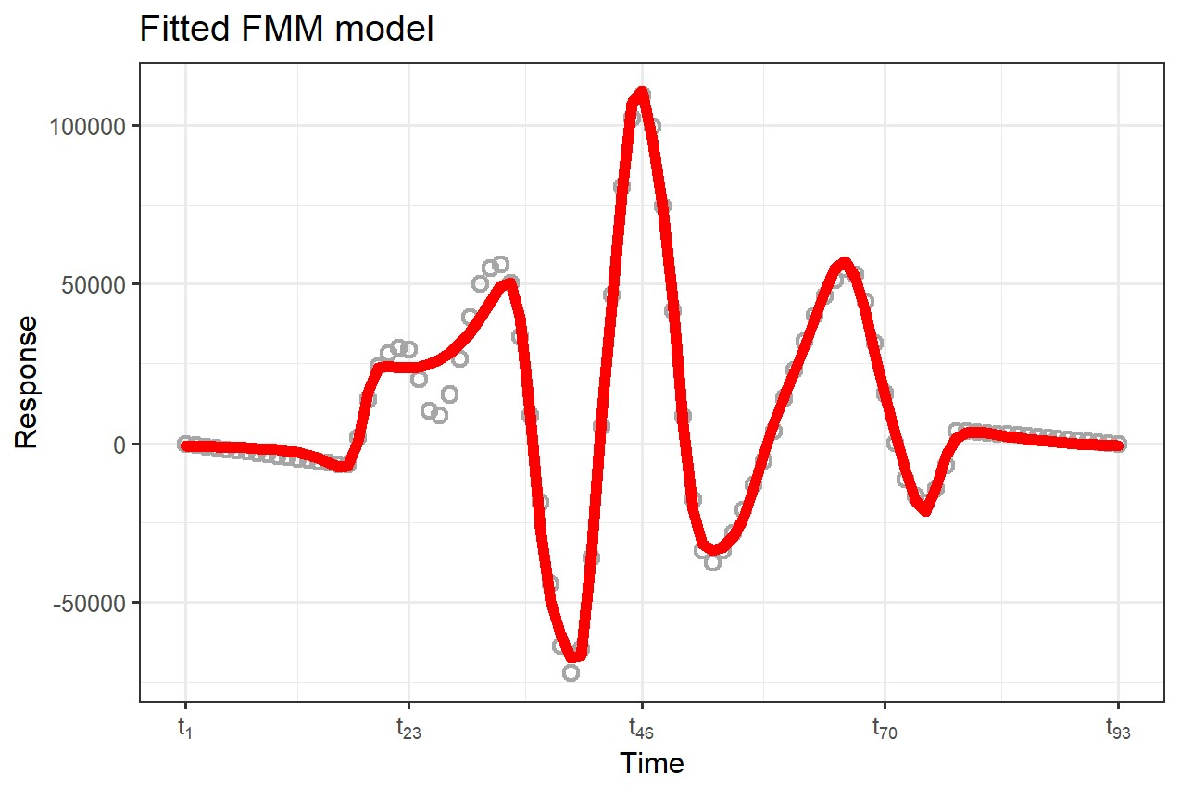
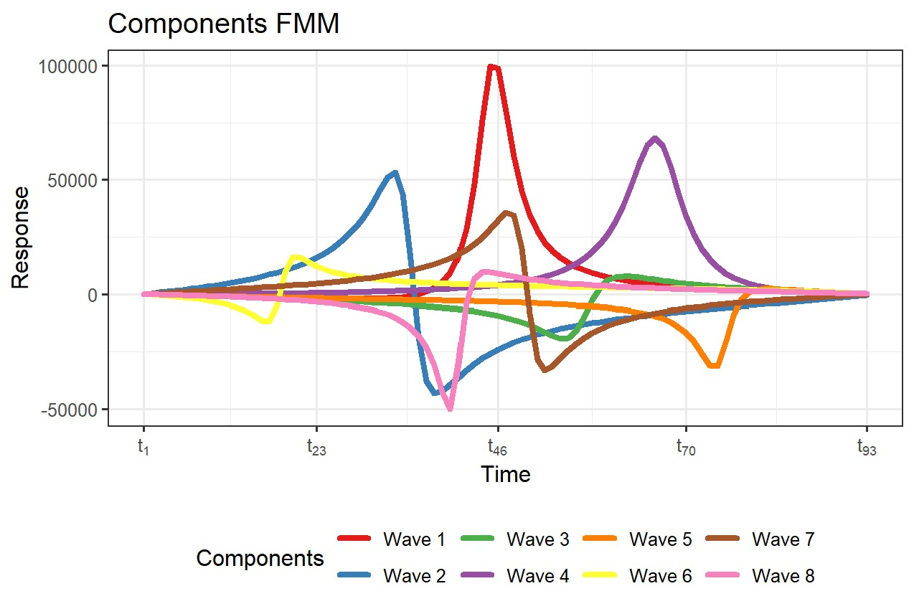
Why doesn’t FMM work
There is almost no interpretability in decomposed components.
We need to decompose a single-cycle signal into a sufficient number of components, if we want to focus on smaller peaks

Slide 7
Part_3

Slide 8
An easy experiment about sampling rate.
The impact of different sampling rates on time series alignment.
Model | Data | Sampling Rate | Resample Method | S | D
Template: Mean | Simulation | 100 | - | 1.35 | 4.53
Template: Mean | Simulation | 100->150 | FFT | 0.95 | 3.24
Template: Mean | Simulation | 100->150 | POLY | 0.95 | 2.98
Template: Mean | Simulation | 150 | - | 0.92 | 2.36
Model | Data | Sampling Rate | Resample Method | S | D
Template: Mean | Simulation | 100 | - | 1.35 | 4.53
Template: Mean | Simulation | 100->200 | FFT | 0.70 | 2.47
Template: Mean | Simulation | 100->200 | POLY | 0.64 | 2.07
Template: Mean | Simulation | 200 | - | 0.65 | 1.75
Conclusion:
Resampling signals with low sampling rates can significantly improve the model's performance. Within a certain range, a higher sampling rate is better.
The resampling mode has a significant impact on the results, with FFT and POLY yielding completely different effects.

Slide 9
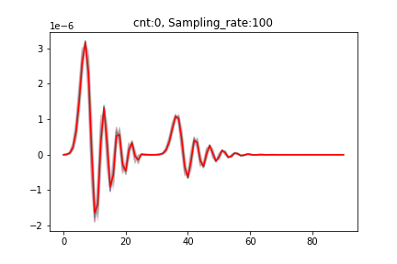
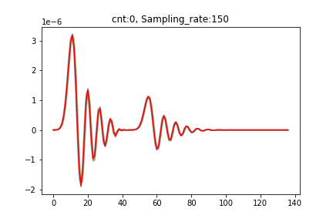

An easy experiment about sampling rate.

Slide 10
Part_4

Slide 11
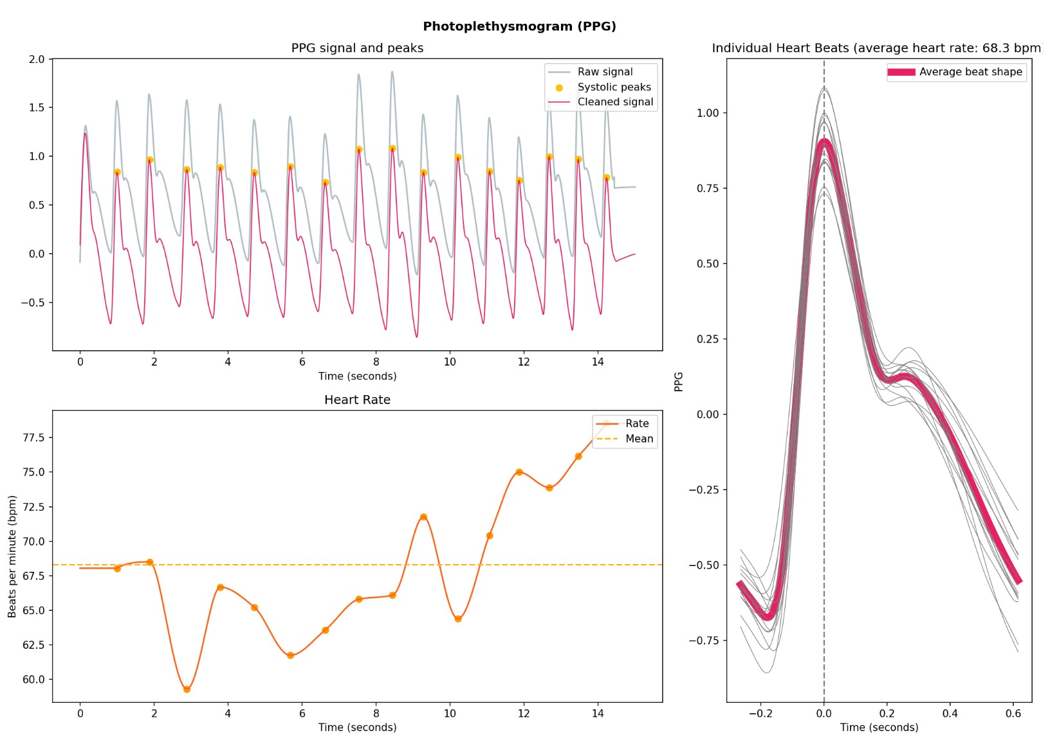
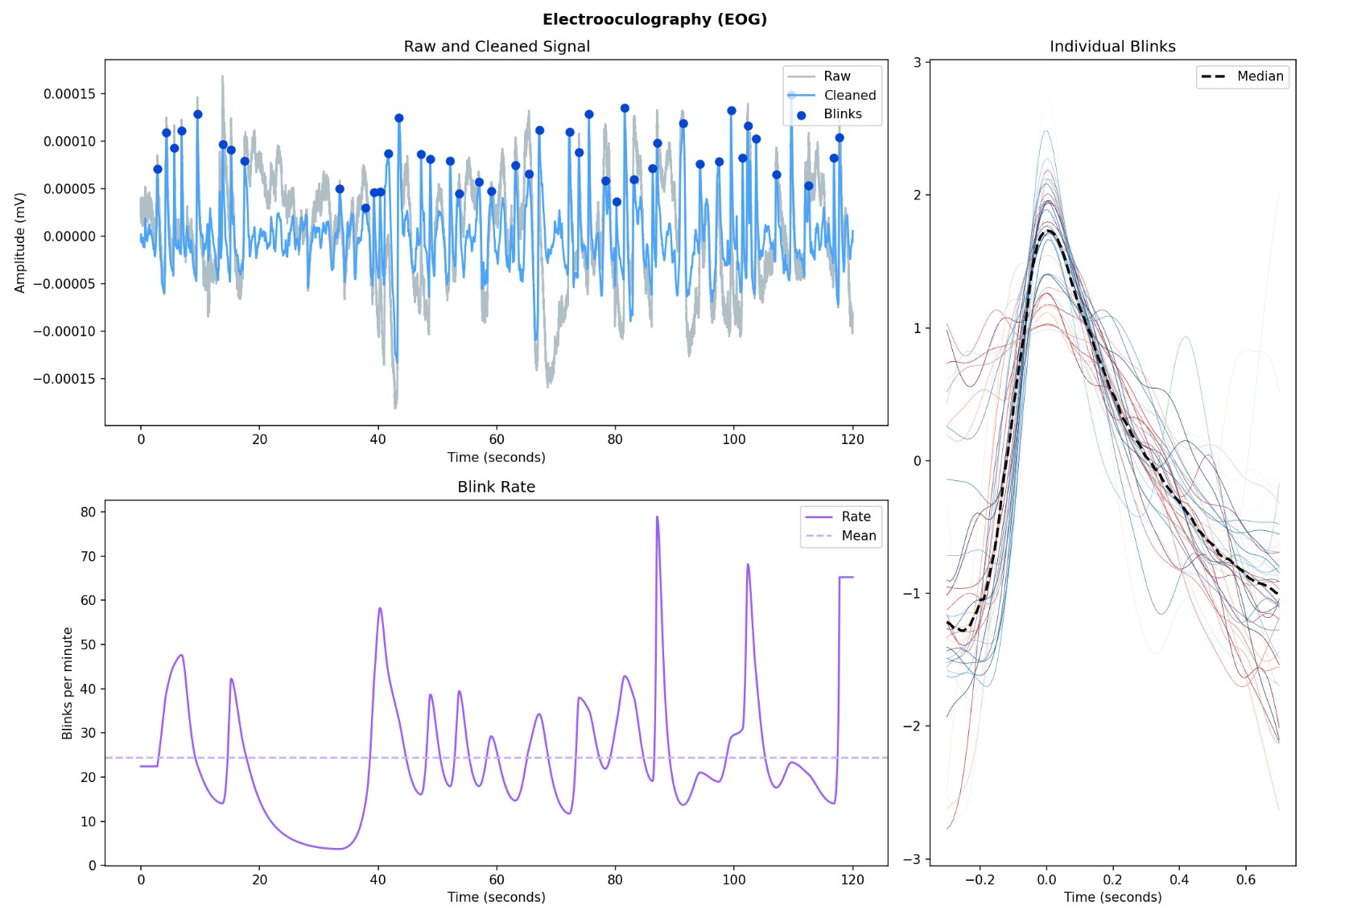
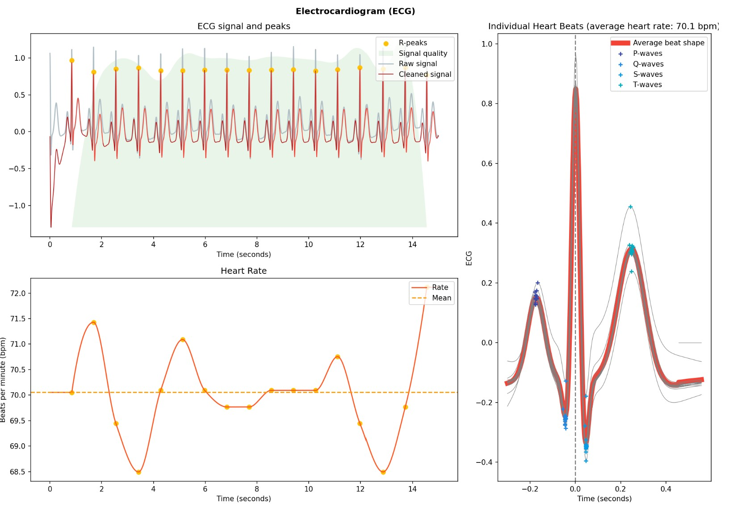
Cut, realign, and extract templates from real signals.
The idea of segmenting signals and extracting individual beat has already been employed in the processing of biosignals.
(The pictures are from the demo of Neurokit2)
They are all dealing with single-peak signals, which are often relatively easy to segment.
The methods used are quite naive, such as calculate mean or median.
After extraction, there isn't much utility; it's just observing what the resulting shape looks like.

Slide 12
Cut, realign, and extract templates from real signals.
真实信号中遇到的问题：
真实信号是一个有噪声的多峰信号呢，尤其是多个峰的amplitude的相对大小并不固定。
第一节信号往往是有问题的，周期残缺
尝试了使用Yingjian Song发表在IoT2023上的一个思路，即xxxx
这个方法用于心率的估计已经足够了，但是对于准确的分隔并不足够，这种方法会造成以下的几种问题
误差很大很大，无法对齐
切分完以后，并不是我们想要的周期。
解决思路：
能不能把一个时域上的多峰问题，变成其他域上的单峰问题，并且这个单峰在每个周期内的位置，要相对固定。
经过观察，信号的单个周期中，能量密度的分布往往比较稳定。
将时域上的多峰问题->能量密度上的单峰问题

Slide 13
Cut, realign, and extract templates from real signals.
能量密度的分布往往比较稳定，但是也不是完全一模一样。
为了提升精度，那就需要对已经切分完成的信号进行重对齐。
Linear Alignment -> O(T)
Linear Realignment
Acceptable
One-circle pieces
Non-Linear Alignment -> O(T^2)
Non-Linear Realignment
Unacceptable

Slide 14
Cut, realign, and extract templates from real signals.
Start
Choose one piece x from N pieces X
Calculate the ACF between x and X[1]
Calculate the ACF between x and X[N-1]
Add ACF results from N-1 times
Find the appropriate time unit for lag.
时间复杂度O(N^3), N表示单个周期的平均长度
这个算法是一定能够收敛的
Realign piece x.
Get re-aligned pieces

Slide 15
Cut, realign, and extract templates from real signals.
获得模板的方法：
1. 用DBA求取平均值的方法，会出现非常尖锐的尖峰。虽然特征能够保留，但是信号的形状被破坏了，不够平滑。
2. 直接求取平均值的方法获得的template会比较平滑，峰值的有效获取，不如DBA等算法。
3. 我们目前没有办法去衡量生成模板的质量。我们需要开发一种指标进行求取。

Slide 16
Cut, realign, and extract templates from real signals.
信号质量
对于心率的计算，之前的过滤算法已经表现的非常优秀了。但是用于提取模板，并分析特征，还不太够，需要再加一层过滤。
真实数据的观察
各个周期里峰的amplitude并不一致
波形时而接近scg，时而接近bcg，时而介于两者之间

Slide 17
Part_5

Slide 18
The possible research directions for the next step.
Direction 1
如何进行对照实验？
在什么数据集上？
模拟数据集：NK2， ECG，PPG，EDA等信号
真实数据集：NK2， PhysicalNet等
问题在于，一般都是直接一大段信号，缺少足够的标签，没有办法去探索特定特征和指标之间的相关性
采用什么指标？
对于 Template4Prediction的任务，目前仍然没有给出有效的指标
常见的1. within group squared sum WGSS
2. 把计算出来的template用于nearest centroid classification in UCR dataset.
对于1. WGSS的计算，是一个NP Complete问题，有一些比较优秀的DTW算法可以得到很不错的梯度上的局部最优，但是用于SCG信号的预测，精度很差
2. 这个一般是Template4Classification问题用的，我们使用不合适

Slide 19
The possible research directions for the next step.
Direction 2
同一段信号中，每个周期多个峰的相对高度都不一样。
用这个东西，去提取出一段完美的信号，可能不太靠谱。
Error Interval
Template
A Normal Distribution with Known Mean and Std.
Probability
The computed features may not necessarily be specific values but rather a probability distribution.
A0 / A1

Slide 20
The possible research directions for the next step.
Direction 2
同一段信号中，每个周期多个峰的相对高度都不一样。
用这个东西，去提取出一段完美的信号，可能不太靠谱。
Error Interval
Template
A Normal Distribution with Known Mean and Std.
比起template，也更加需要注意
Error Interval该如何生成
该如何去采样从而得到一个特征的概率分布

Slide 21
The possible research directions for the next step.
Direction 3
卡尔曼滤波有许多非常非常棒的性质，但是卡尔曼滤波只能时间单元之间一一对应的进行滤波
如果能将卡尔曼滤波扩展到DTW域中，那应该能够大大的提升卡尔曼滤波的对于我们这个问题的效果。
Time Domain
DTW Domain

Slide 22
Questions
To what extent should my research reach? What will the results be compared against? Will testing be done on publicly available datasets of real signals? Currently, even if we extract templates from our mixed signals, we can't find corresponding indicators for S and D.
Regarding the TS-LLM project, is it already decided to proceed, or are we still in the observation stage? What level of knowledge should be acquired for the foundation?
Do we have the latest real data? I noticed many signals in IOT2023 are 30 seconds long.

Slide 23
Thanks!

