Slide 1
Weekly Presentation
Jiayu Chen
2023.11.06

Slide 2
Work Description
Part_1:
整体的框架
我们的研究和已有研究的一些关联
极其重要的论文的导读
Part_2:
一些实验结果的分析
IoT2023 那篇论文的实验结果分析
Part_3:
1. 接下来的一些安排
2.
Part_5: Questions

Slide 3
当前探索的主要方向
Before 2018
With DTW
In 2018
Time Series Average
After 2018
Phototype4Regression
Template4Regression
Template4Prediction
Without DTW
需要细细思考
Multi-Sensors Fusion
另一个比较大的领域
Generative Model
有零星的论文支撑
2018年及以前肯定没有这个概念2019年以后目前没发现

Slide 4
Asymmetric
Increment
Incremental Averaging
Warping Path: (X_t, Y_t-1), (X_t, Y_t), (X_t, Y_t+1)
Symmetric
Increment
Asymmetric Method: Take a reference.
Take X as a reference.
Result: X_t = (X_t + Y_t-1 + Y_t, + Y_t+1) / 4
Disadvantage: Not well-defined. There is no natural criterion for choosing a reference.
Asymmetric
Batch
Batch
Averaging
Symmetric Method: Create a new one.
Result: Z_t+1 = (X_t + Y_t-1) / 2
Z_t = (X_t + Y_t) / 2
Z_t+1 = (X_t + Y_t+1) / 2
Disadvantage: Have more time points than X and Y.
Symmetric
Batch

Slide 5
Before 2017: Intuitive
After 2017
Asymmetric
Increment
SSG, 2017
Incremental Averaging
PSA, 2009
Soft-DTW 2017
Symmetric
Increment
NLAAF, 1996
ICDTW, 2012
TTW, 2018
Asymmetric
Batch
DBA, 2011
CDBA, 2017
Batch
Averaging
Symmetric
Batch
O(T^N)
computationally expensive
1 改进NLAAF算法
2 为DBA算法的出现做准备

Slide 6
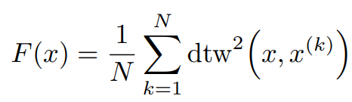
After 2017: Optimization
SSG, 2017
Fr´echet Function
A polynomial-time algorithm for finding a global minimum of the non-differentiable, non-convex Fr´echet function is unknown.
Soft-DTW 2017
TTW, 2018
SSG
F = min{F_C1, F_C2, F_C3, …}, F_C is differentiable and convex function.
Soft-DTW
DTW(min, +) -> DTW(*, +)
TTW
Translate Discrete Signal into Continuous Signal by Sinc function. And Take DTW as constraints of optimization problem.

Slide 7
Denoising Effect
ZCR Effect
Requirements
ACF Effect

Slide 8
Respiration
Signal fusion
Why Respiration Pattern will appear?

Slide 9
Time Series Average For Classification
Time Series Average For Regression

Slide 10
Part_1: Research - Getting Template
Model | S Prediction | D Prediction | Model | S Prediction | D Prediction
No Template | 0.79 / 1.64 | 1.79 / 4.31 | New
Mean | 1.35 / 1.38 | 4.53 / 4.44 | NLAAF1 | 8.43 / 23.19 | 3.14 / 5.21
Median | 1.42 / 1.45 | 4.07 / 4.49 | NLAAF2 | 20.67 / 33.39 | 3.64 / 7.04
PCA | - / - | - / - | GTW | - / - | - / -
K-shape 1 | 2.20 / 2.74 | 4.85 / 5.88 | TTW | 1.52 / - | 4.28 / -
Weighted Avg | 1.95 / 1.98 | 4.63 / 4.74 | K-SC | - / - | - / -
K-shape 2 | 2.18 / 1.79 | 4.76 / 5.24 | PSA | 2.27 / 19.05 | 5.40 / 8.89
Kalman Filter | 1.45 / 1.37 | 4.82 / 4.60 | Soft-DTW | 1.35 / 1.38 | 4.53 / 4.44
DBA | 2.05 / 1.96 | 3.43 / 4.15 | ICDTW | 2.66 / - | 5.08 / -

Slide 11
Part_1: Research - Getting Template
Model | Sampling rate | S Prediction | D Prediction
Template: Mean | 100 | 1.35 | 4.53
Template: Mean | 150 | 0.92 | 2.36
Template: Mean | 200 | 0.65 | 1.75

Slide 12
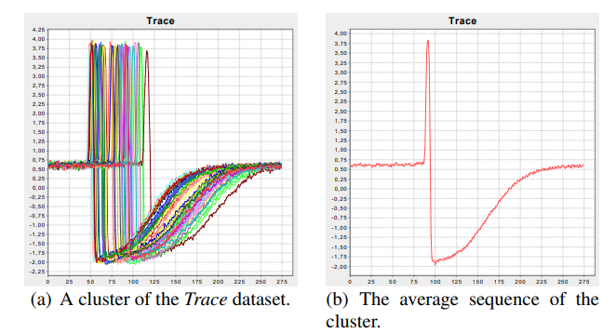
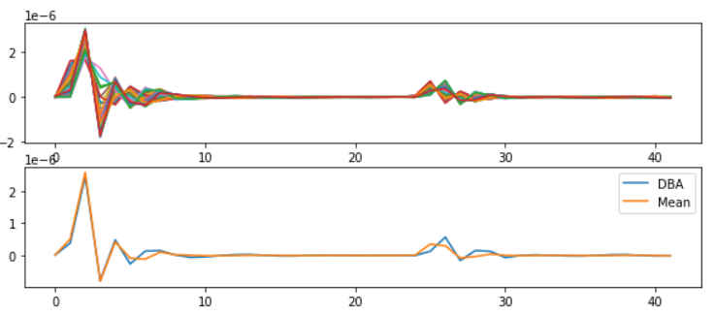
Part_2: Paper Reading
Petitjean F, Ketterlin A, Gançarski P. A global averaging method for dynamic time warping, with applications to clustering[J]. Pattern recognition, 2011, 44(3): 678-693.
Paper_1: A global averaging method for DTW - DBA
The Propose of the Paper: the computation of an average of a set of sequences
Solved Problems:
They develop a global technique for averaging a set of sequences, which avoids using iterative pairwise averaging.
2. They describe a new strategy to reduce the length of the resulting average sequence.

Slide 13
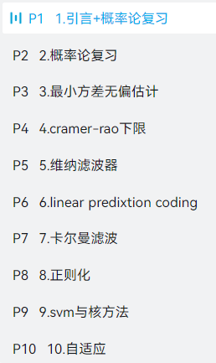
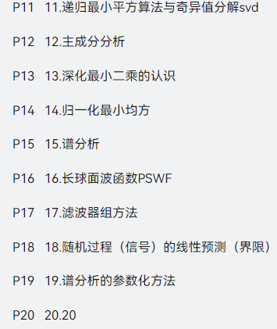
Work_3: Learning Progress and Future Learning Plan
Completed theoretical studies:
EE120 (all videos and lectures)
Complex Functions and Integral Transforms (completed half of the exercise book)
Theoretical studies I plan to undertake next.：
现代数字信号处理I 张颢
现在数字信号处理II 张颢
(Array signal processing, time-frequency analysis,
compressive sensing, Bayesian methods)
Next research directions:
1. Further exploration of methods mentioned in K-shape.
2. Seek out latest methods in data mining journals.
3. Search for algorithms that can effectively decompose the frequency domain.
4. Gradually explore real datasets based on the laboratory's research papers.

Slide 14
Some Thoughts about My Undergraduate Thesis
I hope it is a framework for any periodic physical signal.
Segmentation
Get Template
The actual achieved results should be as follows:
Even when segmentation is only possible based on the periodic length, it's possible to synthesize a reasonably good signal.
If more information can be generated during the segmentation process, the template synthesis will be even better.
Sliced signals without any knowledge of their nature
Sliced signals with some knowledge of their nature
Sliced signals with deep knowledge of their nature

Slide 15
Questions
Do you think what I just said has any research value, or if it's implemented, does it make sense?

Slide 16
Thanks!

