Slide 1
Weekly Presentation
Jiayu Chen
2023.8.21
Notes:
Ok, I will begin my weekly Presentations

Slide 2
Work Description
Work_1: Automated feature selection is performed from 480 features.
Work_2:Attempting to predict variables S and D using signals with a noise level of 0.8.
Work_3:Tutorial Writing
Work_4:Theoretical knowledge Learning
Notes:
Here is brief work description
In Work_1, I automate feature selection from 480 features. This automated selection demonstrates good performance.
Work_2 involves predicting S and D using signals with a 0.8 noise level.
Work_3 is tutorial writing.
Work_4 focuses on theoretical knowledge learning.

Slide 3
Work_1: Features Selection
Outcomes:
For the prediction of S, the algorithm identifies the sole feature "Dis21/Dis12" as the most influential.
For the prediction of D, the final selection involves 4 features, including “Amplitude1/Amplitude2".
Several Advantages:
1. Simplified Feature Construction: Focusing on straightforward features like “Dis12” and “Dis21”, there's no need to manually engineer complex features like "Dis21/Dis21".
2. Minimal Parameter Adjustment: The entire process hinges on one parameter that has a negligible impact on final results.
3. Reduced Randomness: The method shows low levels of randomness.
Notes:
The automated feature selection process among the 480 features yields remarkable outcomes:
For the prediction of variable S, the algorithm identifies the sole feature "Dis21/Dis12" as the most influential. Similarly, in predicting variable D, the final selection involves four features, including "Amplitude1" and "Amplitude2".
This approach presents several distinct advantages:
Simplified Feature Construction: By exclusively focusing on straightforward features, there's no need to manually engineer complex features
2. Minimal Parameter Adjustment: The entire process hinges on a single parameter that has a negligible impact on the final results. This simplifies the tuning process and reduces the likelihood of overfitting.
3. Reduced Randomness: The method exhibits low levels of randomness, leading to more consistent and reproducible results across different runs.
Overall, this feature selection technique effectively narrows down the feature set, leverages fundamental features for accurate predictions, and streamlines the process by minimizing the reliance on intricate features and parameter adjustments.

Slide 4
Work_1: Features Selection
Data
(Noise: 0.1, No RR)
S Prediction
D Prediction
Basic Features
Selecting 20 commonly used fundamental features.
Feature Cross
The 20 features are expanded into 480 features.
Relevance Calculation
480 -> 428
480 -> 370
Univariate Feature Selection and Choose Best K
428 -> 3
370 -> 5
Recursive Feature Elimination (RFE)
3 -> 1
Just “Dis21_divide_Dis12”
5 -> 4
“P2_divide_P1” included
Test
MAE: 4.09 (“P2_divide_P1 only)
MAE: 4.47 (Selected 4 features)
MAE: 1.76
Notes:
This is a flowchart showing the process:
1. Extract Basic Features， I choose 20 commonly used fundamental features.
2. Perform Feature Cross and The 20 features are expanded into 480 features
3. Calculate Correlation between Features and Predicted Values. To S Prediction，480 are turned into 428. To the D Prediction, 480 are turned into 370
4. Apply Univariate Feature Selection and Choose Best K. The number of features is significantly reduced.
5. Proceed with Recursive Feature Elimination (RFE) for Final Feature Selection. For S Prediction，core feature is selected. For D prediction, core feature is included in the final features selection.
6. Conclude with Testing Using the Test Set.

Slide 5
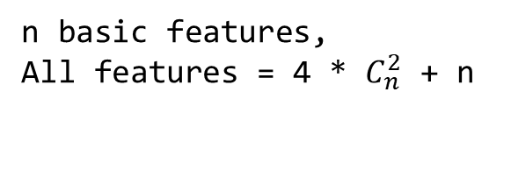
Basic Features
Dis12 | Spectrum Entropy | Sum of Absolute Difference | Centroid
Dis21 | Spectrum Centroid | Mean of Absolute Difference | Kurt
Dis22 | Max | Mean of Difference | Skew
P1 | Min | Median | RMS
P2 | Mean | Zero Crossing Rate | Entropy
Work_1: Features Selection
Step 1.
Get Basic Features and Do Feature Cross
Feature Cross
20 Commonly used Features
Core Feature of S:Dis21/Dis12
Core Feature of D:P1/P2
Not in this table
Feature_0 . . . Feature_19
n basic features,
All features = 4 * $C_{n}^{2}$ + n
Get Feature_i and Feature_j
_add_
_minus_
_multi_
_divide_
Feature_i
Feature_j
n = 20 ,
All Features = 480
Add 4 new crossed Featurs
Notes:
Step 1 is Get Basic Features and Do Feature Cross
I choose 20 common basic features. Among them, the core feature for S and D are not basic features and are not included in this table.
From 20 features, I select two features.
Then, I perform feature cross by applying addition, subtraction, multiplication, and division operations to these two selected features.
Using this approach for feature cross on 20 features, I can obtain a total of 480 features.

Slide 6
Step 3.
Univariate Feature Selection
Work_1: Features Selection
Univariate feature selection based on F-Test
F-test captures
linear dependency
Choose Top K
Univariate feature selection based on mutual information
Mutual information captures any kind of dependency
Choose Top K
Step 2.
Relevance Calculation
Calculate relevance between Feature_i and S/D, and then get p-value.
If p-value < 0.05, filter it out.
Logical AND Operation
When K = 3
S: {‘Dis22_divide_Dis21’, ‘Dis21_divide_Dis12’, ‘Dis22_divide_Dis12’}
D: {‘Dis22_minus_P2’, ‘P1_multi_P2’, ‘Dis22_add_P2’, ‘P2_divide_P1’, ‘P2’}
S Prediction
480 -> 428
D Prediction
480 -> 370
Notes:
Step2 is Relevance Calculation
Calculate relevance between Feature_i and S/D, and then get p-value. If p-value < 0.05, filter it out.
And Step 3 is Univariate Feature Selection
I do Univariate feature selection based on F-Test and Mutual Information at the same time
F-test captures linear dependency and mutual information captures any kind of dependency
We choose top K features and Perform a logical AND operation on the selected K features.
For S prediction, I get 3 features.
For D prediction, I get 5 features.

Slide 7
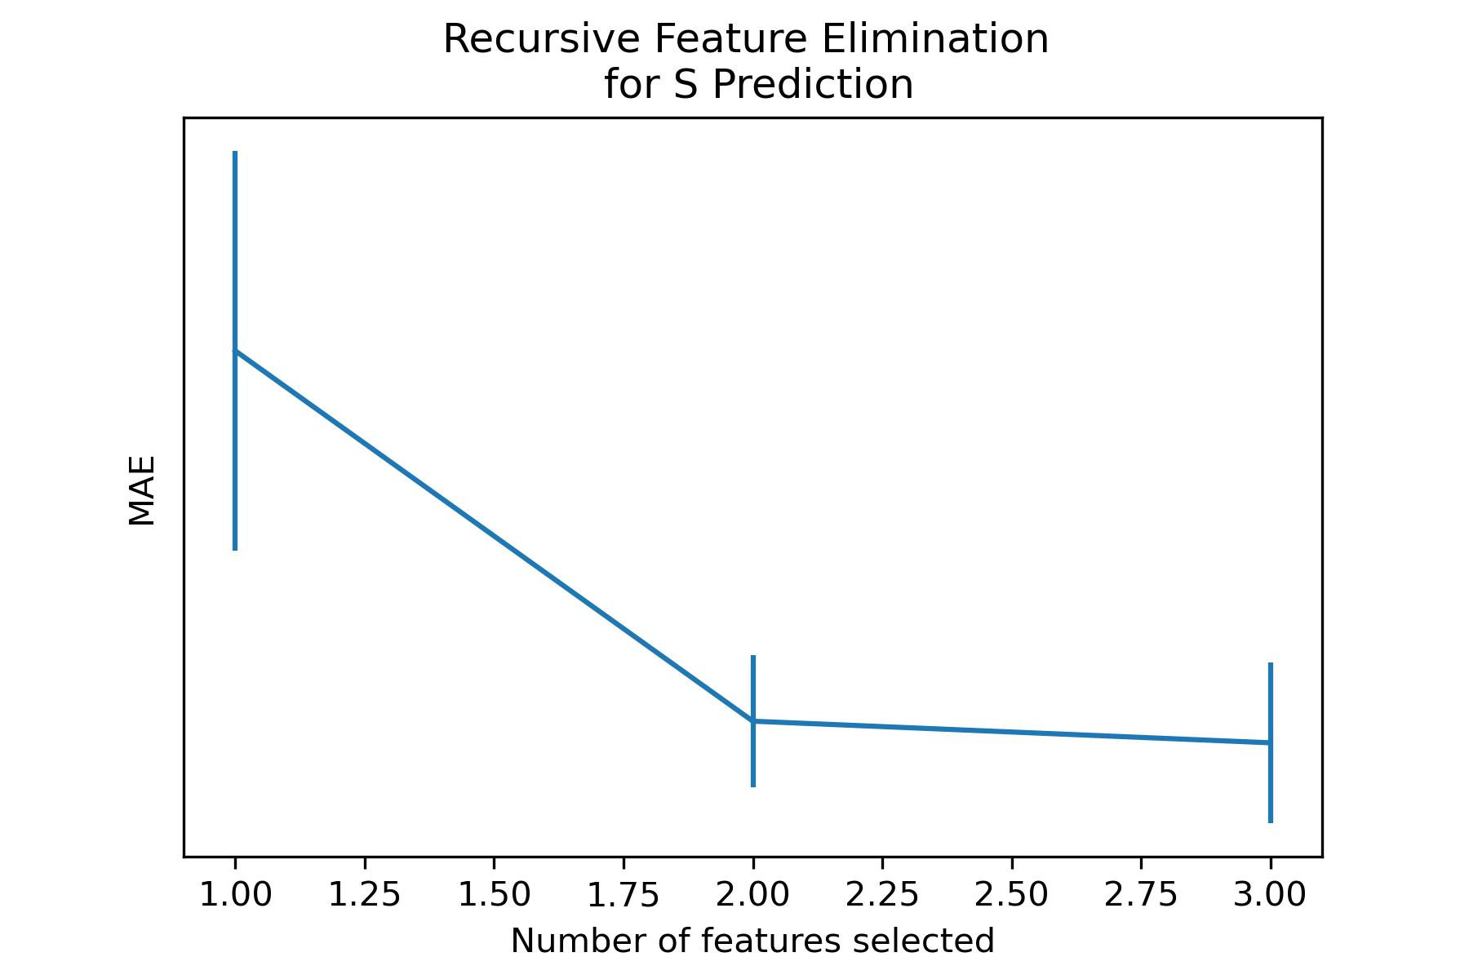
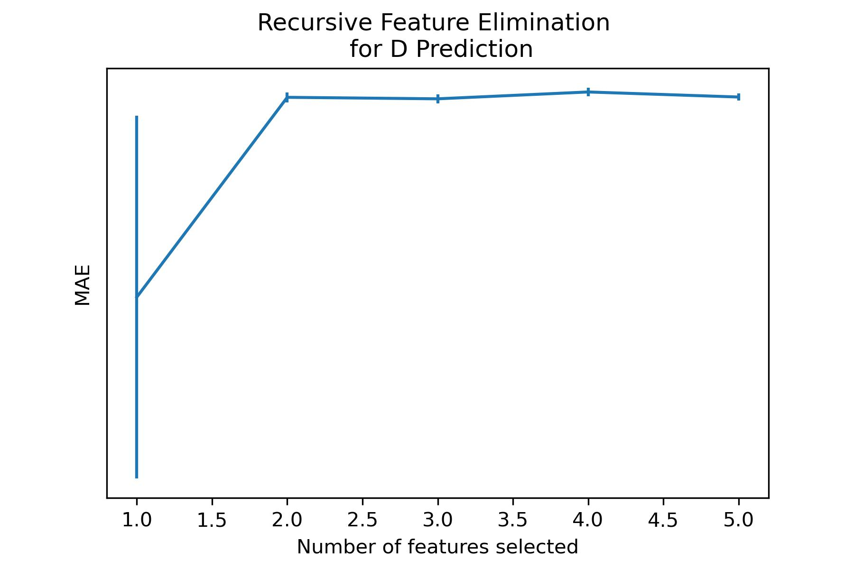
Work_1: Features Selection
Step 4.
Recursive Feature Elimination(RFE)
Optimal Choice for S Prediction:
‘Dis21_divide_Dis12’
Optimal Choice for D Prediction：
‘Dis22_minus_P2’, ‘Dis22_add_P2’, ‘P2_divide_P1’, ‘P2’
Notes:
Next step is to do Recursive Feature Elimination(RFE)
For S ，core feature is selected. For D, core feature is included in the final features selection.
It is not bad.

Slide 8
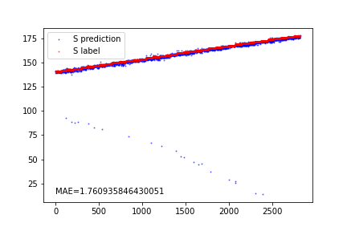
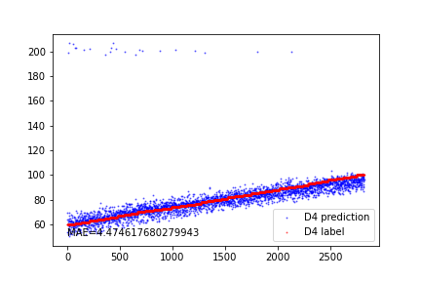
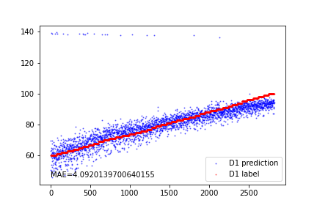
Work_1: Features Selection
Prediction performance for S
Prediction performance for D using the 4 features recommended by RFE
Prediction performance for D using only "P2_divide_P1"
I think
the core feature for D is not selected because no denoising procedures are applied to signals with a noise level of 0.1.
The prediction performance using only the "P2_divide_P1" feature is not satisfactory.
Notes:
Here is the result of Prediction.
I think
the core feature for D is not selected because no denoising procedures are applied to signals with a noise level of 0.1.
The prediction performance using only the "P2_divide_P1" feature is not satisfactory.

Slide 9
Work_2: S & D prediction in the noise level of 0.8
Data, Noise: 0.8
Data, Noise: 0.8
Bandpass filter
EEMD
FFT / Wavelet
Denoising
IMF_1
Smooth
Feature Extraction
S/D Prediction
Test
Notes:
When dealing with data having a noise level of 0.8, I first apply a combination of Bandpass filtering and FFT/Wavelet Denoising. However, the results are not very promising.
Then, I try out EEMD and notice that IMF1 closely resembles the original clean signal. As a result, I experiment with using IMF1 for prediction.

Slide 10
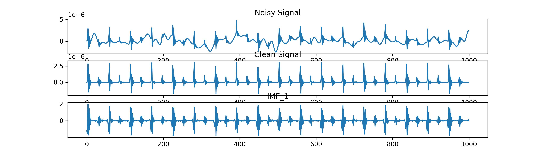
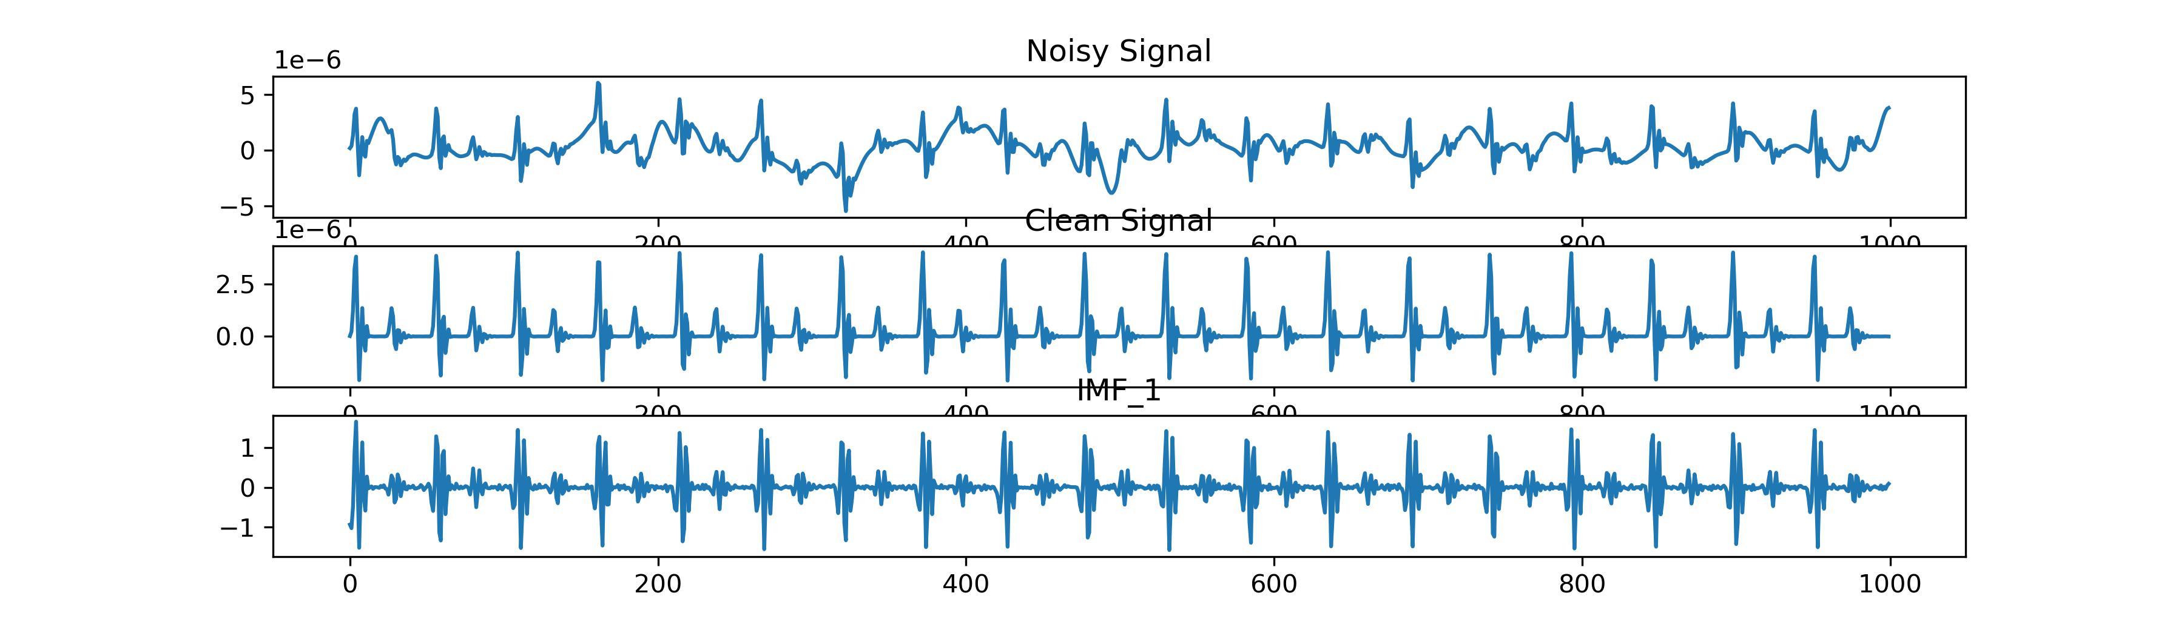
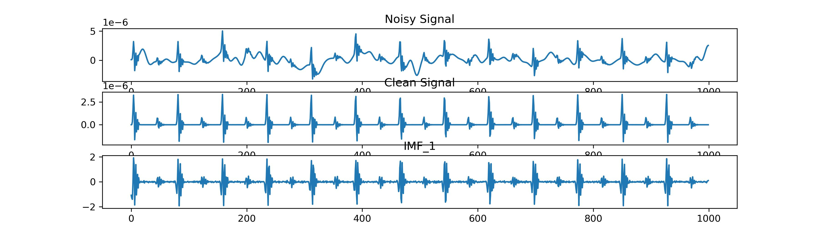
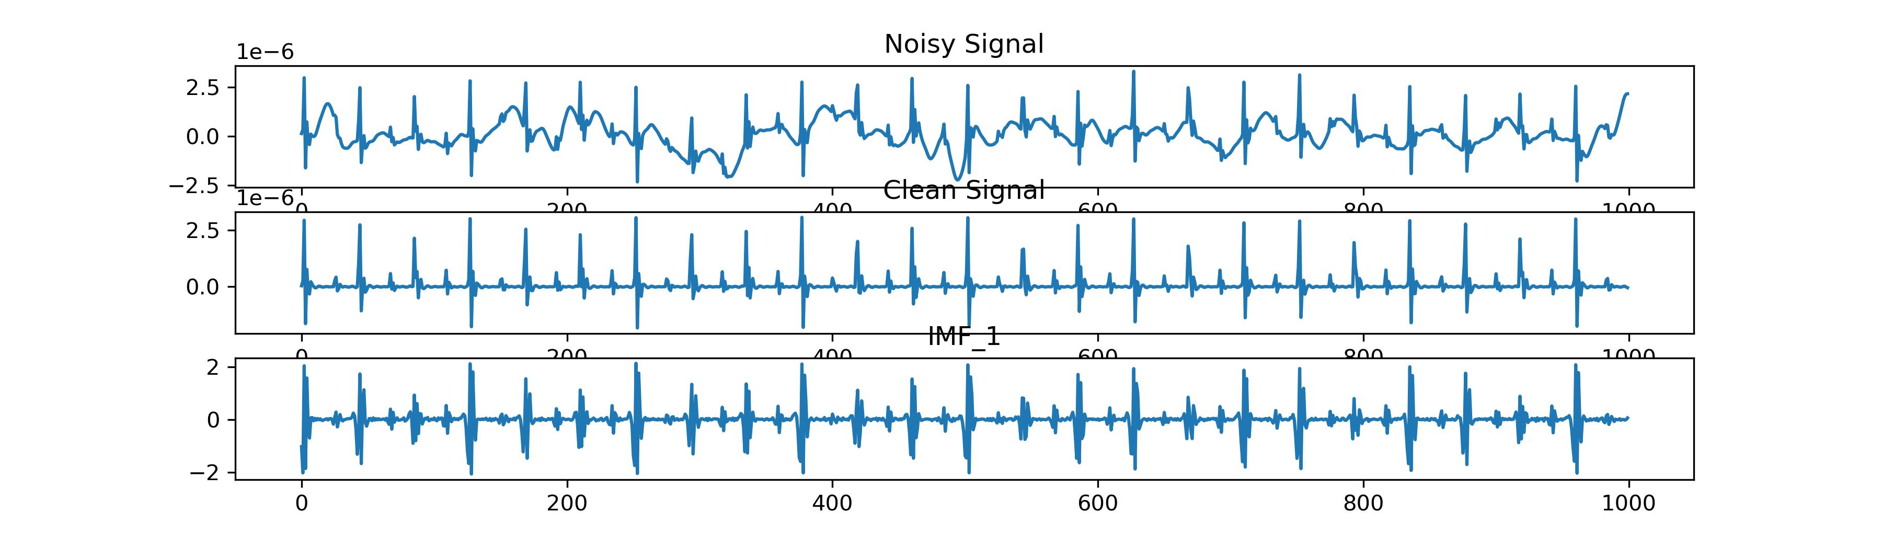
Work_2: S & D prediction in the noise level of 0.8
Noisy Signal of 0.8
Clean Signal
IMF_1 After EEMD
It's almost impossible to discern the original signal.
The variations in peak heights are great, while intervals remain relatively consistent.
It might be possible to employ IMF_1 for predicting S, rather than D.
Notes:
When the noise level reaches 0.8, it becomes almost impossible to discern the original signal.
I've noticed that IMF1 closely resembles the original clean signal. The differences in peak heights are significant, while the intervals remain relatively consistent.
It could be feasible to utilize IMF1 for predicting S.

Slide 11
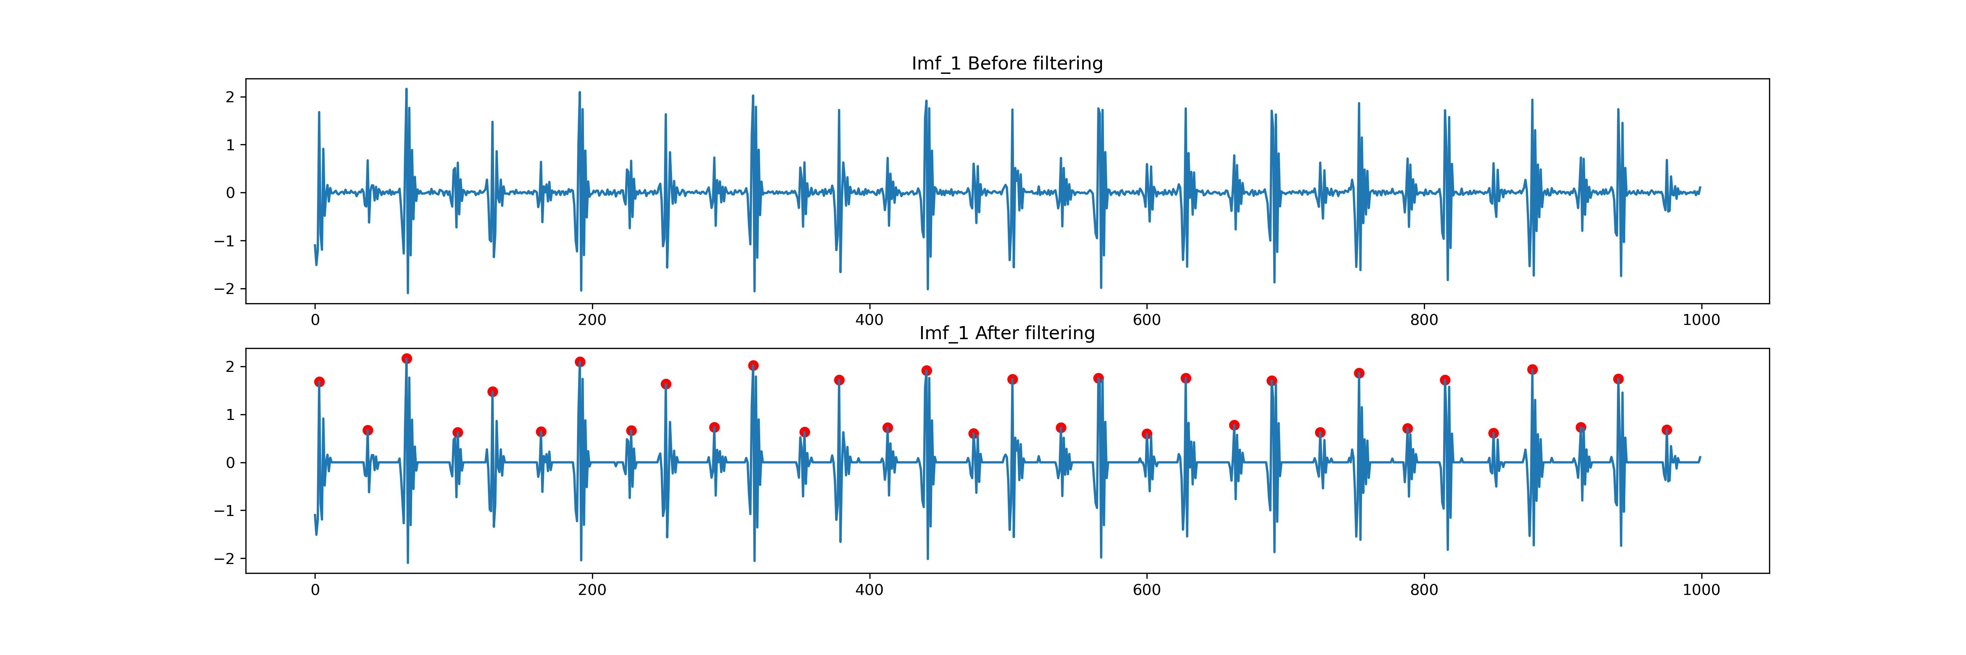
Work_2: S & D prediction in the noise level of 0.8
Signals between peaks are quite noisy and unclear, which is affecting the accuracy of peak detection.
Notes:
Signals between peaks are quite noisy and unclear, which is affecting the accuracy of peak detection.
I attempt to make it smoother. In the end, the peaks detection have good results.

Slide 12
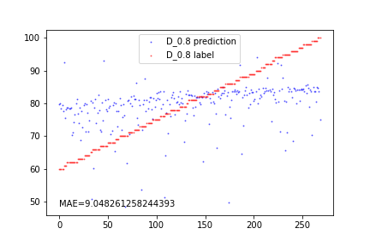
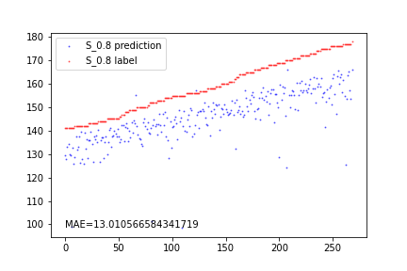
Work_2: S & D prediction in the noise level of 0.8
EEMD is extremely slow, which is why I use a training set of 500 signals and a test set of 300 signals.
The prediction for D is unsuccessful due to the great alteration in relative heights of peaks.
Regarding the prediction of S, the model can capture the trend, but MAE is notably high.
The performance is not meeting the desired standard.
I'm not sure whether this approach holds value for further exploration.
Notes:
EEMD is extremely slow, which is why I use a training set of 500 signals and a test set of 300 signals.
I'm not certain whether this approach holds value for further exploration.

Slide 13
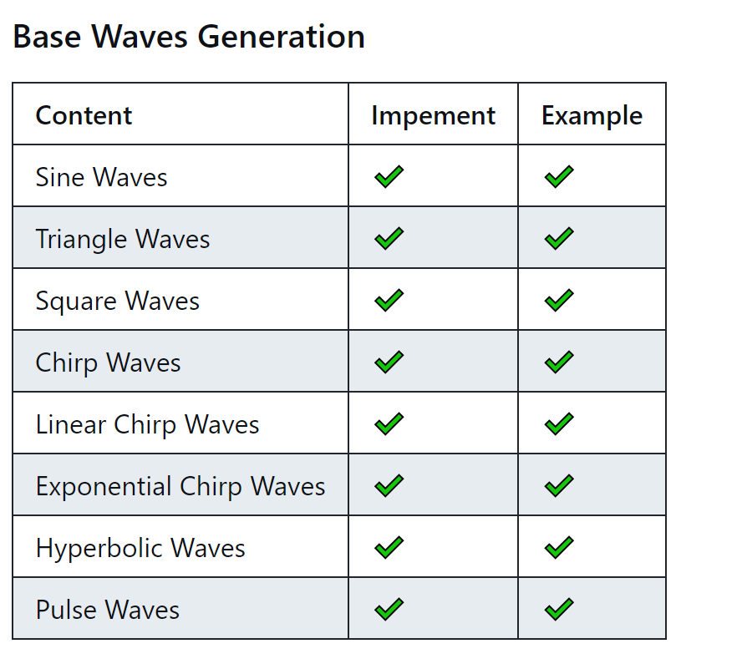
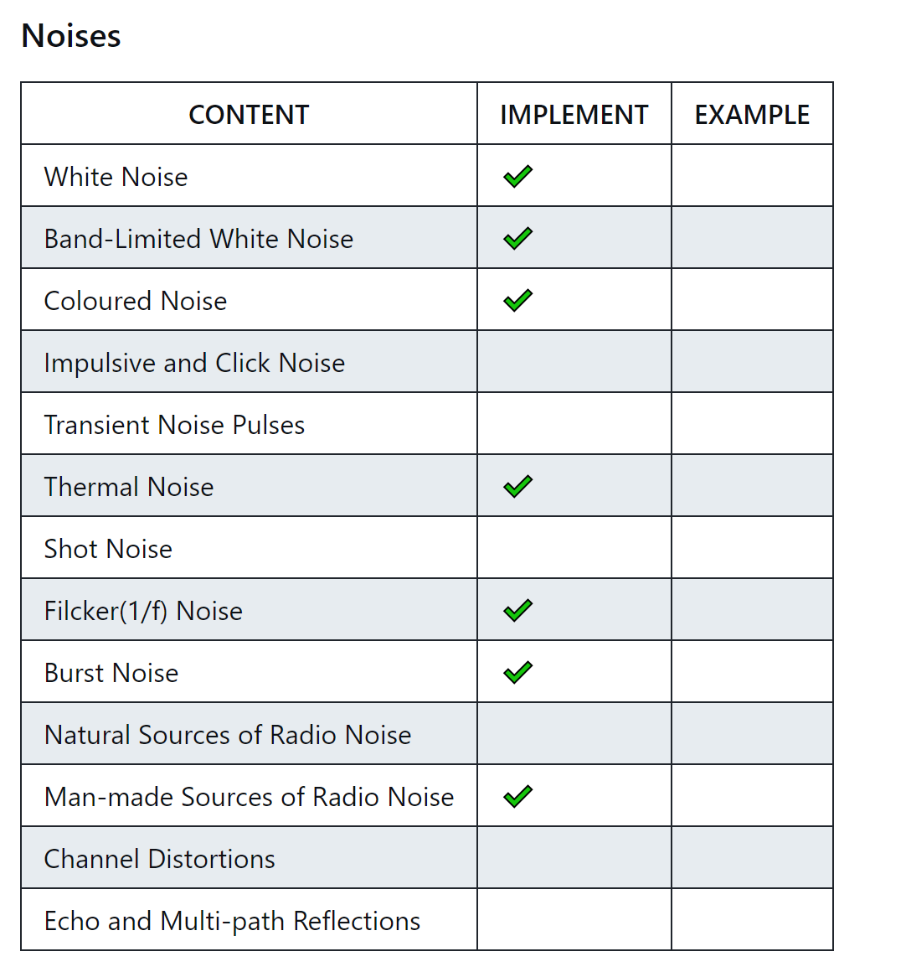
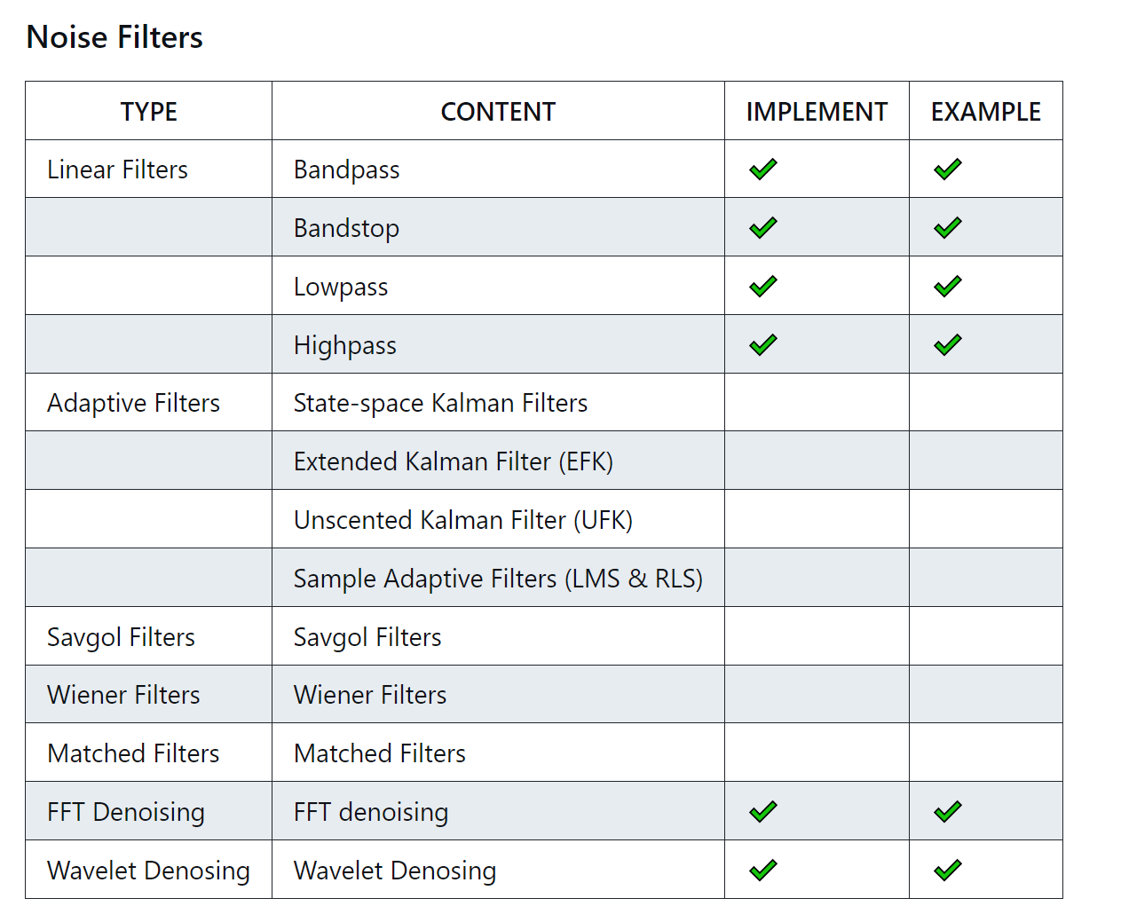
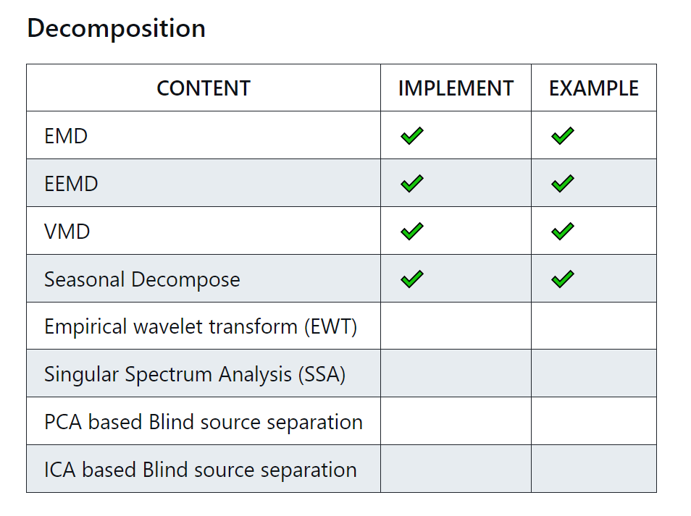
Work_3: Tutorial
In noise generation, I've encountered some challenges.
Some noise definitions are vague and difficult to implement accurately.
Notes:
展示一下进度。

Slide 14
Work_4: Theoretical knowledge Learning
Signals and Systems
Probability for Computer Scientists
Course: EE120, Berkeley
This week’s Progress:
Lecture 10 (the DFT; FIR filters)
Lecture 11 (Fourier transforms in two dimensions)
Course: CS109, Standford
This week's progress:
Part 1 (Counting)
Part 2 (Combinatorics)
Part 3 (Definition of Probability)
Next week’s plan:
Part 4 (Counting)
Part 5 (Combinatorics)
Part 6 (Definition of Probability)
Part 7 (Probability of or)
Part 8 (Conditional Probability)
Part 9 (Independence)
Notes:
This week, I have a hard time learning Hidden Markov Models.
I need to allocate some time to study probability theory in order to better understand the concepts.

Slide 15
Questions
During the denoising process, how do we determine that the outcome is satisfactory and that denoising results are acceptable? Can we determine this before features are fed into the model?

Slide 16
Thanks!

