Slide 1
Weekly Presentation
Jiayu Chen
2023.9.11
Notes:
Ok, I will begin my weekly Presentation

Slide 2
Work Description
Work_1: Tutorial Writing: finish the framework of the main function and try 2 filters(Wiener filter and Savgol filter)
Work_2: Preliminarily remove the impact of respiration by fft-denoising.
Work_3: Using the combination of Wiener filter and fft denoising to remove the normal noise (add np.random.normal() directly) and respiration.
Work_4: Confronted with Laplace Noise and Normal Noise added by Neurokit2, the combination of Savgol filter and fft denoising-achieved better results, more accurate in prediction and much more faster, compared with the combination of SSA and Template.

Slide 3
Work_1: Tutorial
For Algorithm
Wiener filter and Savgol filter have been tried in SCG Signals. Both of these filters have shown good performance. I’ll explain it in Work_3 and Work_4.
For Main Function
I completed the reconstruction for Add Noise(10), Decompose(4), including interfaces, visualization, code comments and more.
Currently, the fundamental features of main function have been implemented.
Use 4 core commands to show you the demo.
Notes:
本周：
完成了对于Generate waves(7), Add Noise(10), Filter(4), decompose(8)完成了全部的重构，包括接口，作图等
目前基本的功能已经实现
直接进行展示3个指令
下周需要改进的：
有一些细节仍然不太到位：对于输入的字符串，如果有空格会出问题
还没有进行充分的测试
Save功能仍然没有想好如何实现

Slide 4
Work_1: Tutorial
There are still many details need to be resolved to improve the robustness of the code.
I will continue to spend time improving this main function next week.

Slide 5
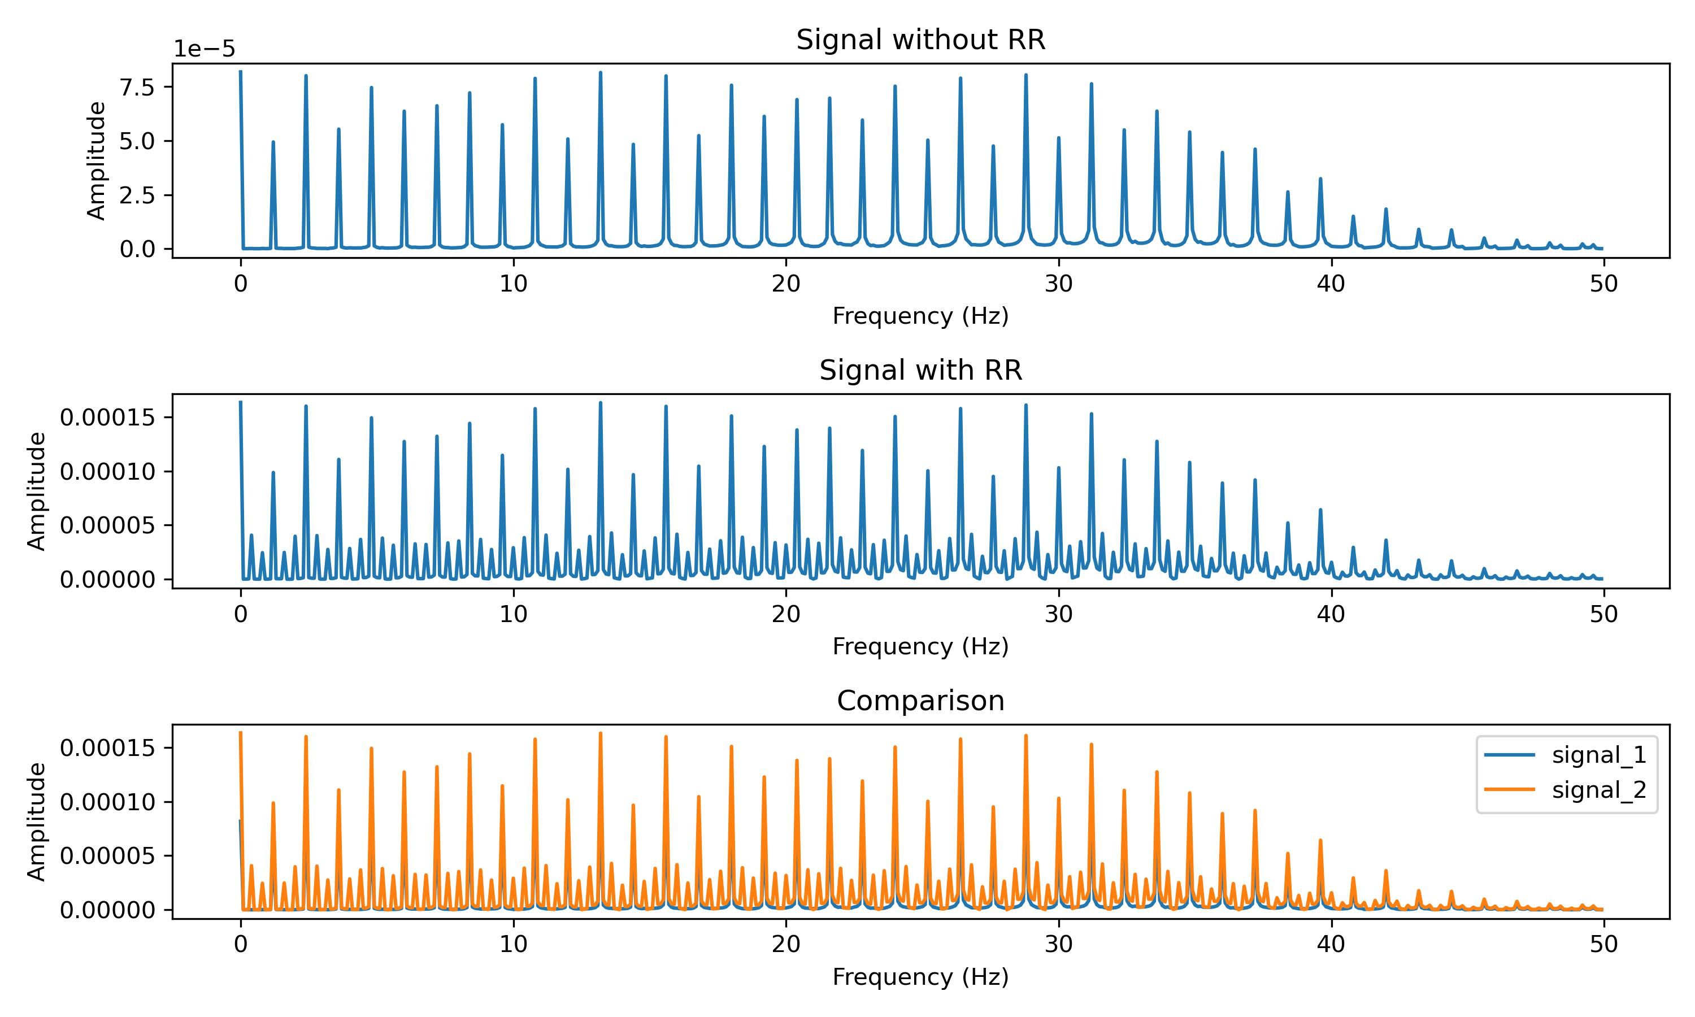
Work_2: Remove the impact of Respiration by fft
For Signal with respiration, peaks in frequency domain are between 2 small peaks.
But I haven't fully understood the mathematical principles yet.
Notes:
My second work is removing the impact of Respiration by fft-denosing.
I transform the signal into freq domain and make observation.
The first figure is the signal with Respiration and second figure is the signal without Respiration
we can clearly see the difference between them.
For Signal with respiratory, peaks in frequency domain are between 2 small peaks.
But I haven't fully understood the mathematical principles yet.

Slide 6
Work_2: Remove the impact of respiratory by fft
Threshold of FFT Denoising = (Max Amplitude * 0.35)²
Energy
Notes:
FFT Denoising is very suitable for this task.
If we can set the suitable threshold for the fft denoising, the small peaks can be removed clearly.
I just set the threshold as the equation below. It works well.

Slide 7
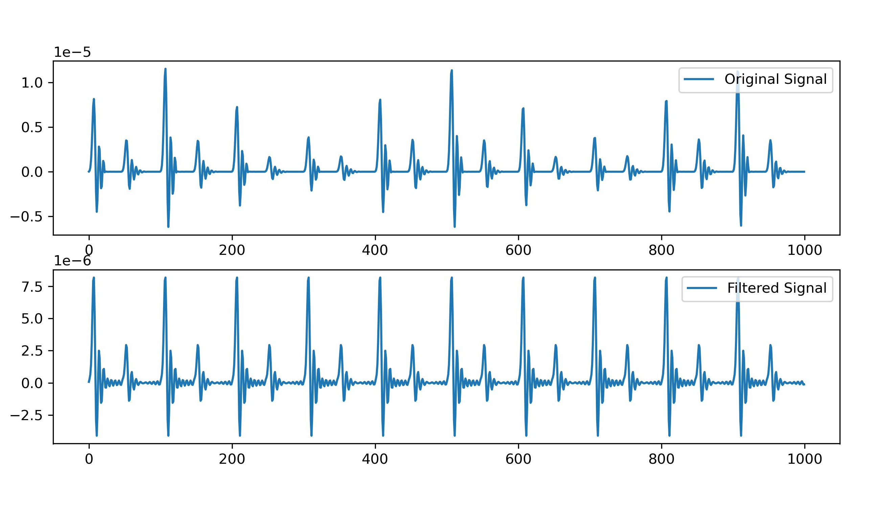
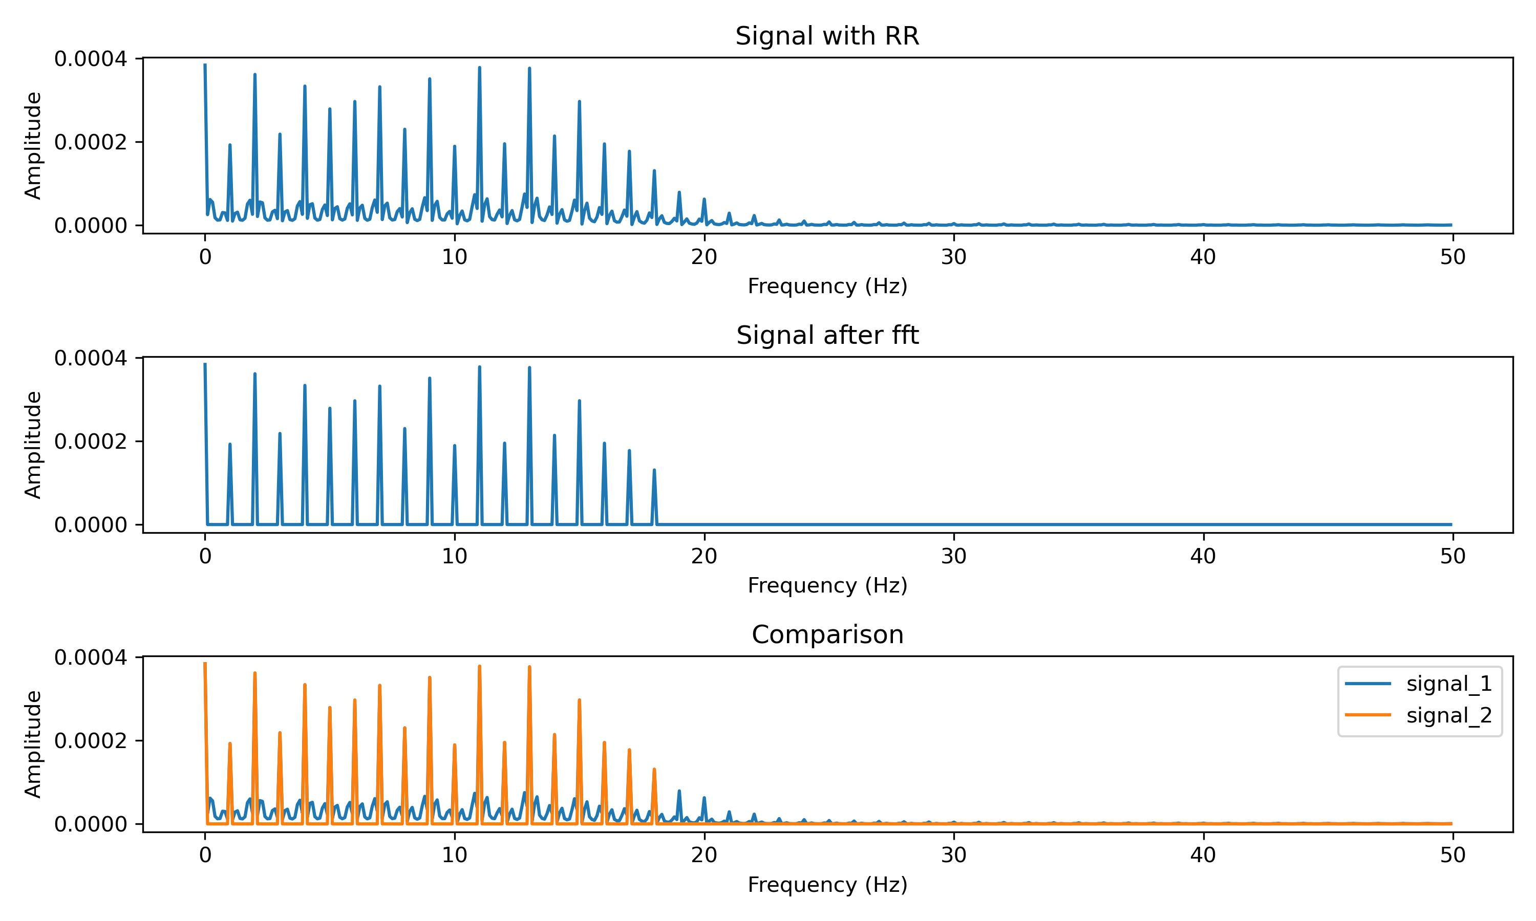
Work_2: Remove the impact of respiratory by fft
Result of FFT-Denosing
Removing high-frequency, low-amplitude components from the signal can result in the appearance of subtle fluctuations.
But the result is acceptable.
Notes:
Let’s look at the result.
The left two picture ares the comparison of original signal and filtered signal. The impact of resp has been removed from the signal.
The right 3 pictures are the comparison of signal in frequency domain. You can see. Although small peaks next to large peaks are removed, some high-frequency, low-amplitude components are removed either. This will result in slight flunctuations in signal.
But I think the result is acceptable.

Slide 8
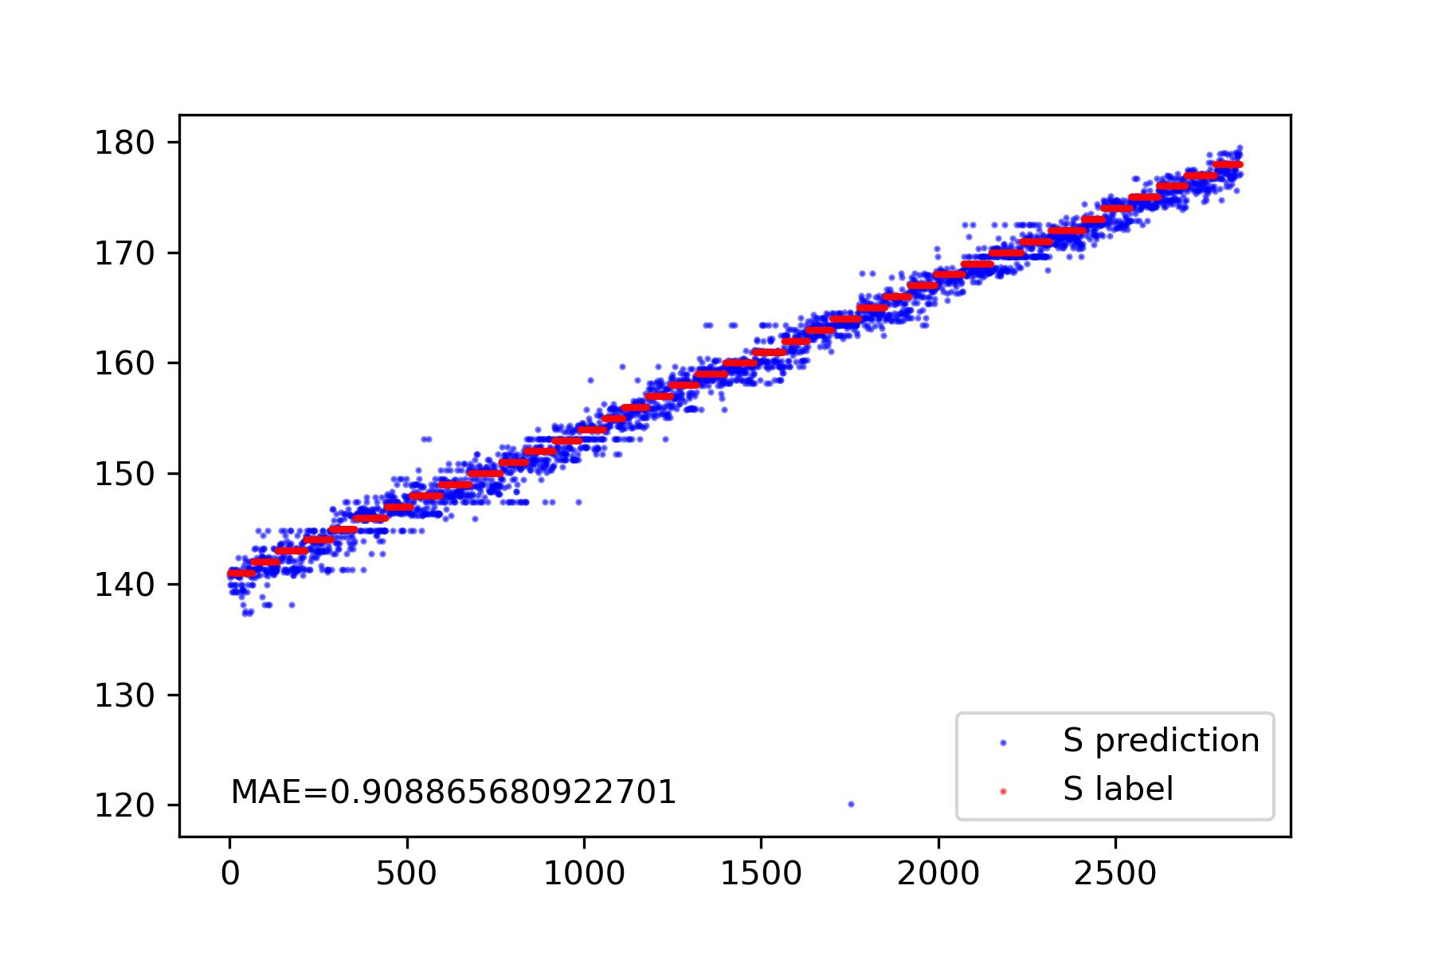
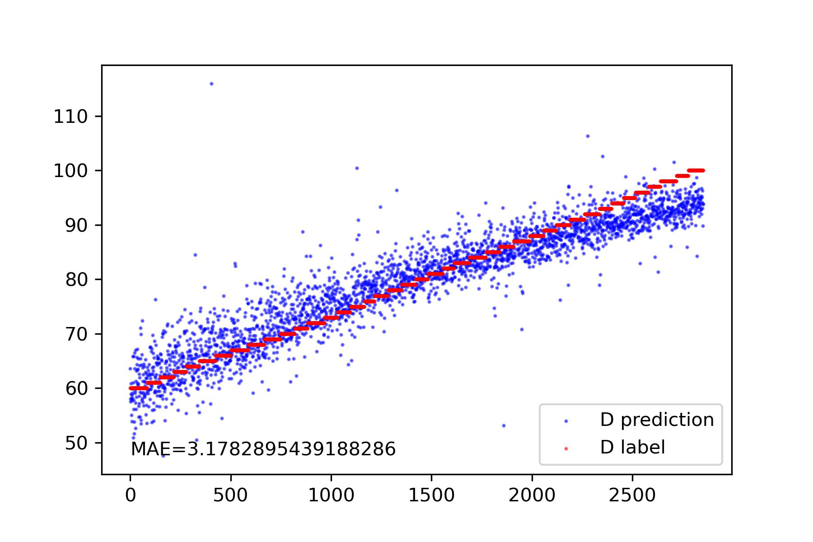
Work_2: Remove the impact of respiratory by fft
Result of S and D Prediction, when the signal's noise level is 0 and influenced by breathing.
The prediction result for D indicate that at least this denoising effect can barely be acceptable.
Notes:
Ok, my second work is over.

Slide 9
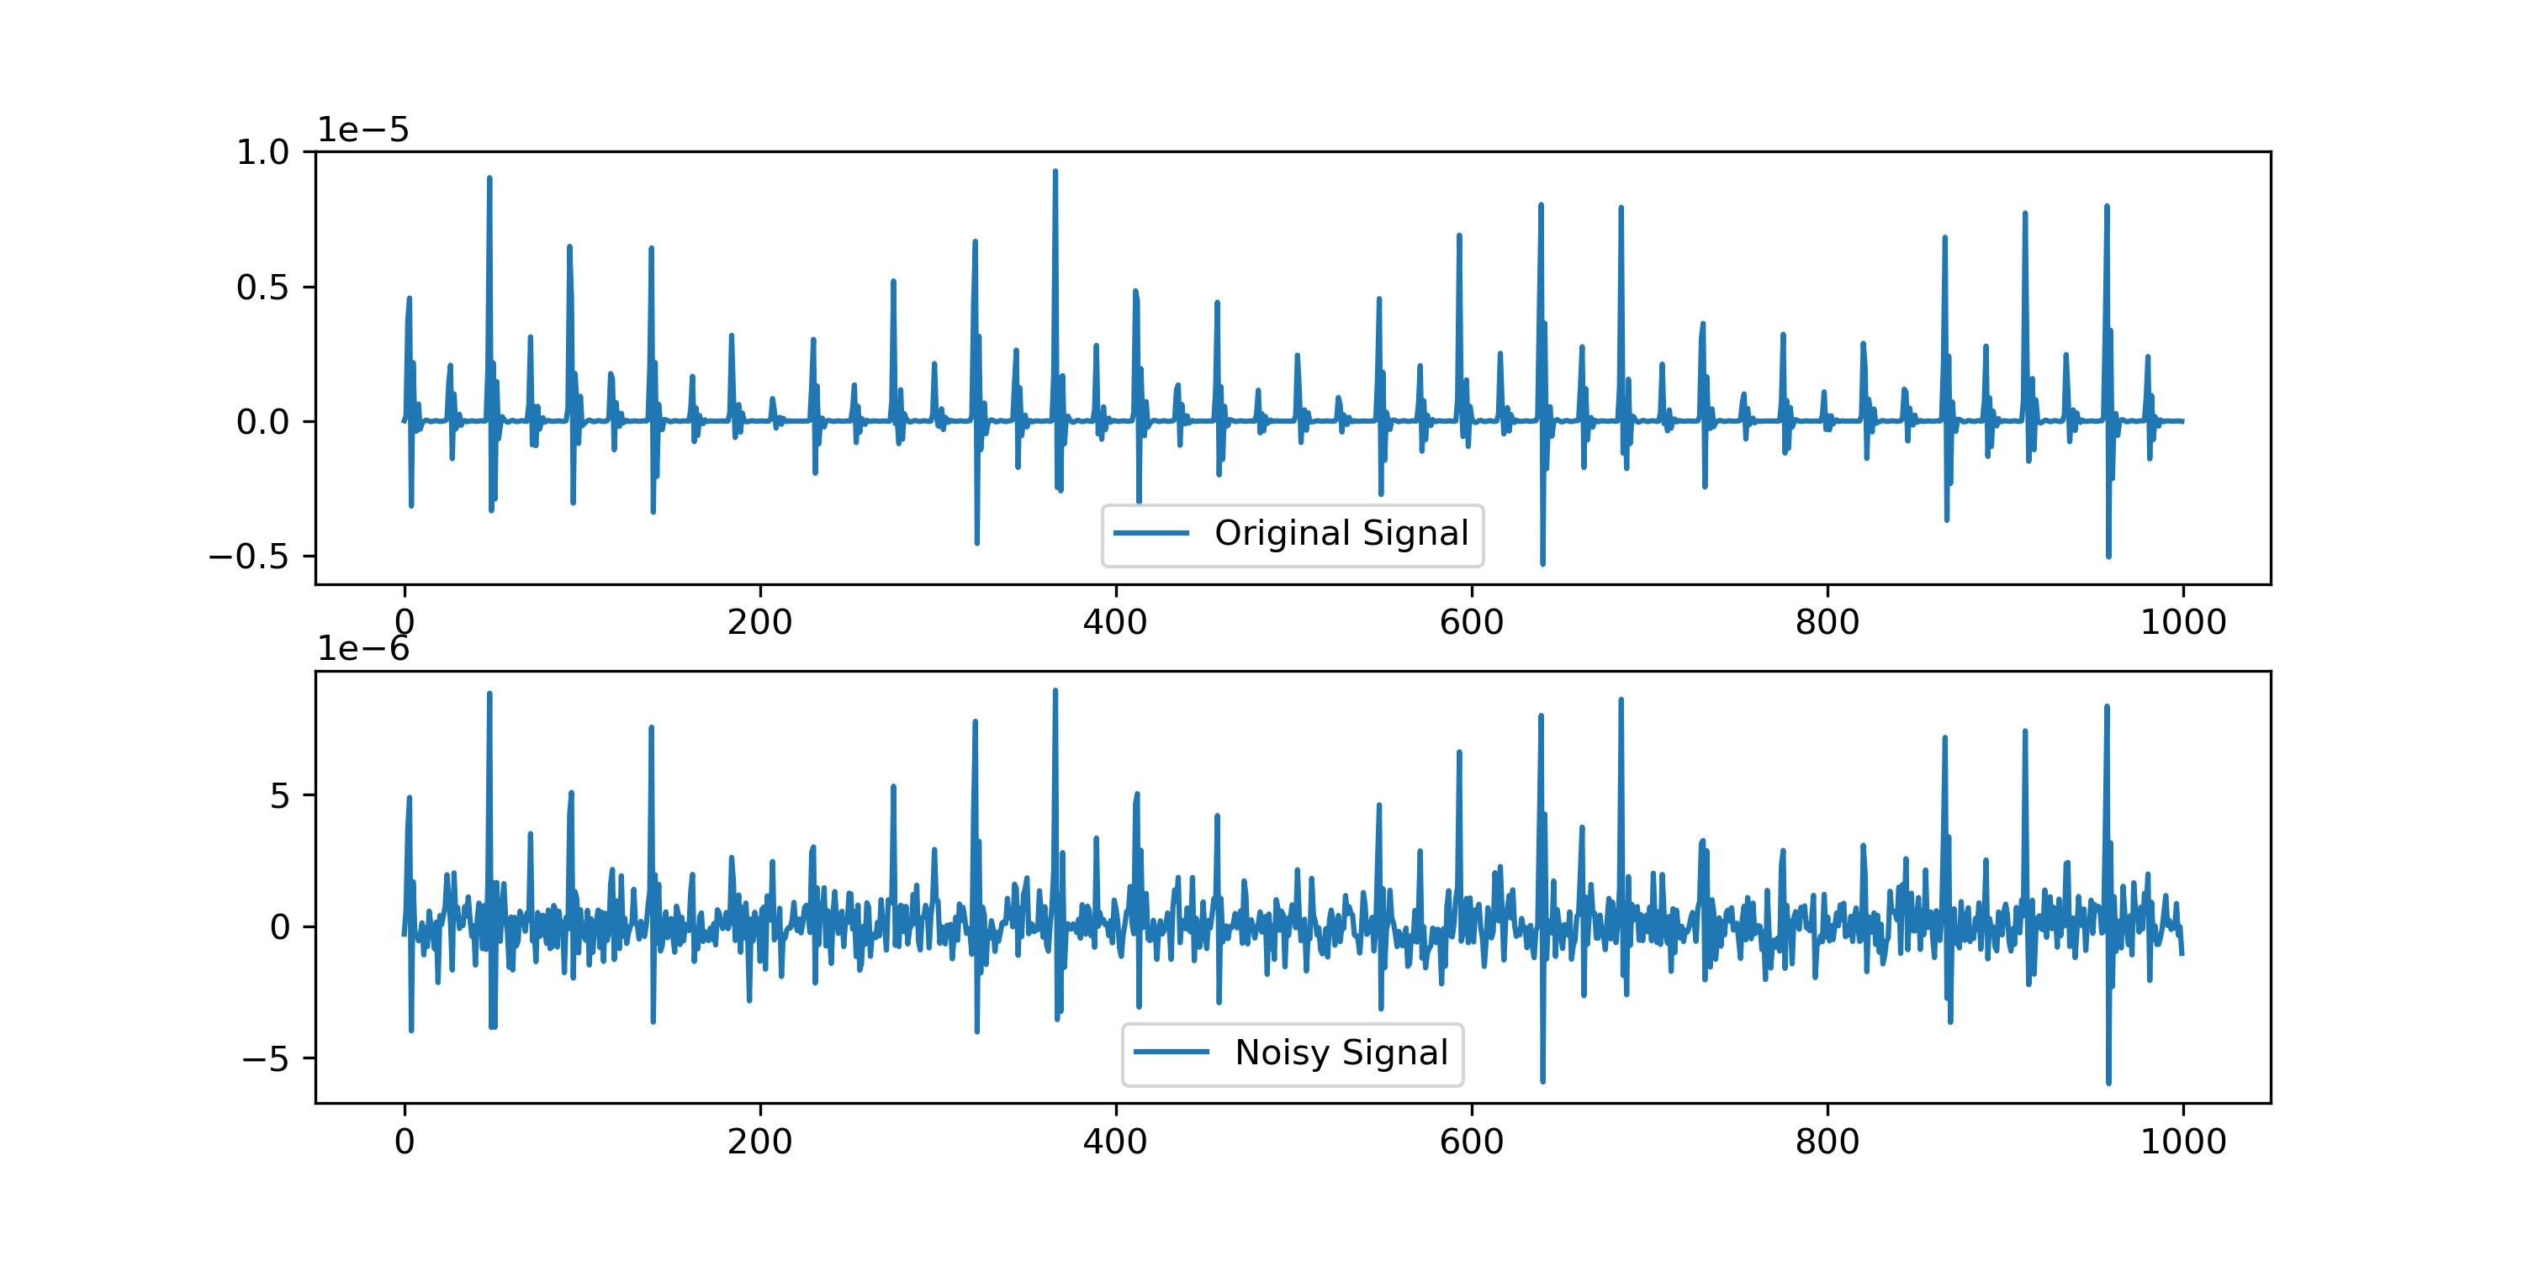
Work_3: Remove Normal Nosie and respiratory
Noisy Signal = Clean Signal + np.random.normal()
Mean value of Noisy Signal is 0.
Notes:
Last week, Prof song, you told me that I should Add the noise that mean is equal to 0
So I try to add the Normal noise directly.
AND the effect of add noise directly is like the picture below. The mean value is 0.

Slide 10
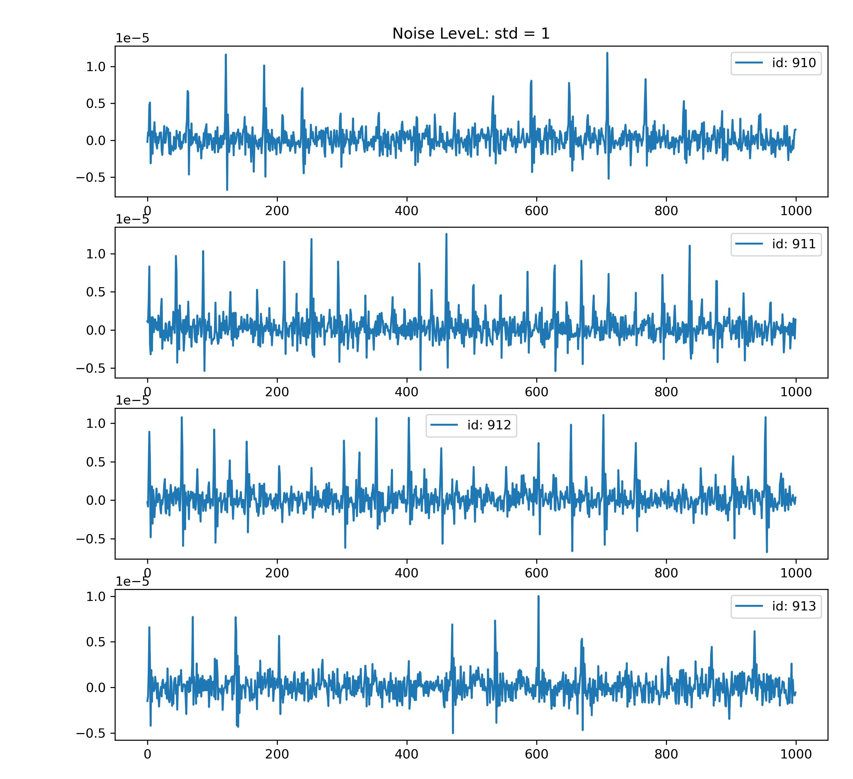
Work_3: Remove Normal Nosie and respiratory
Noisy Signal = Clean Signal + np.random.normal()
When normal(mean=0, std=1), we can hardly detect the small peaks. Just as the right 4 figures.

Slide 11
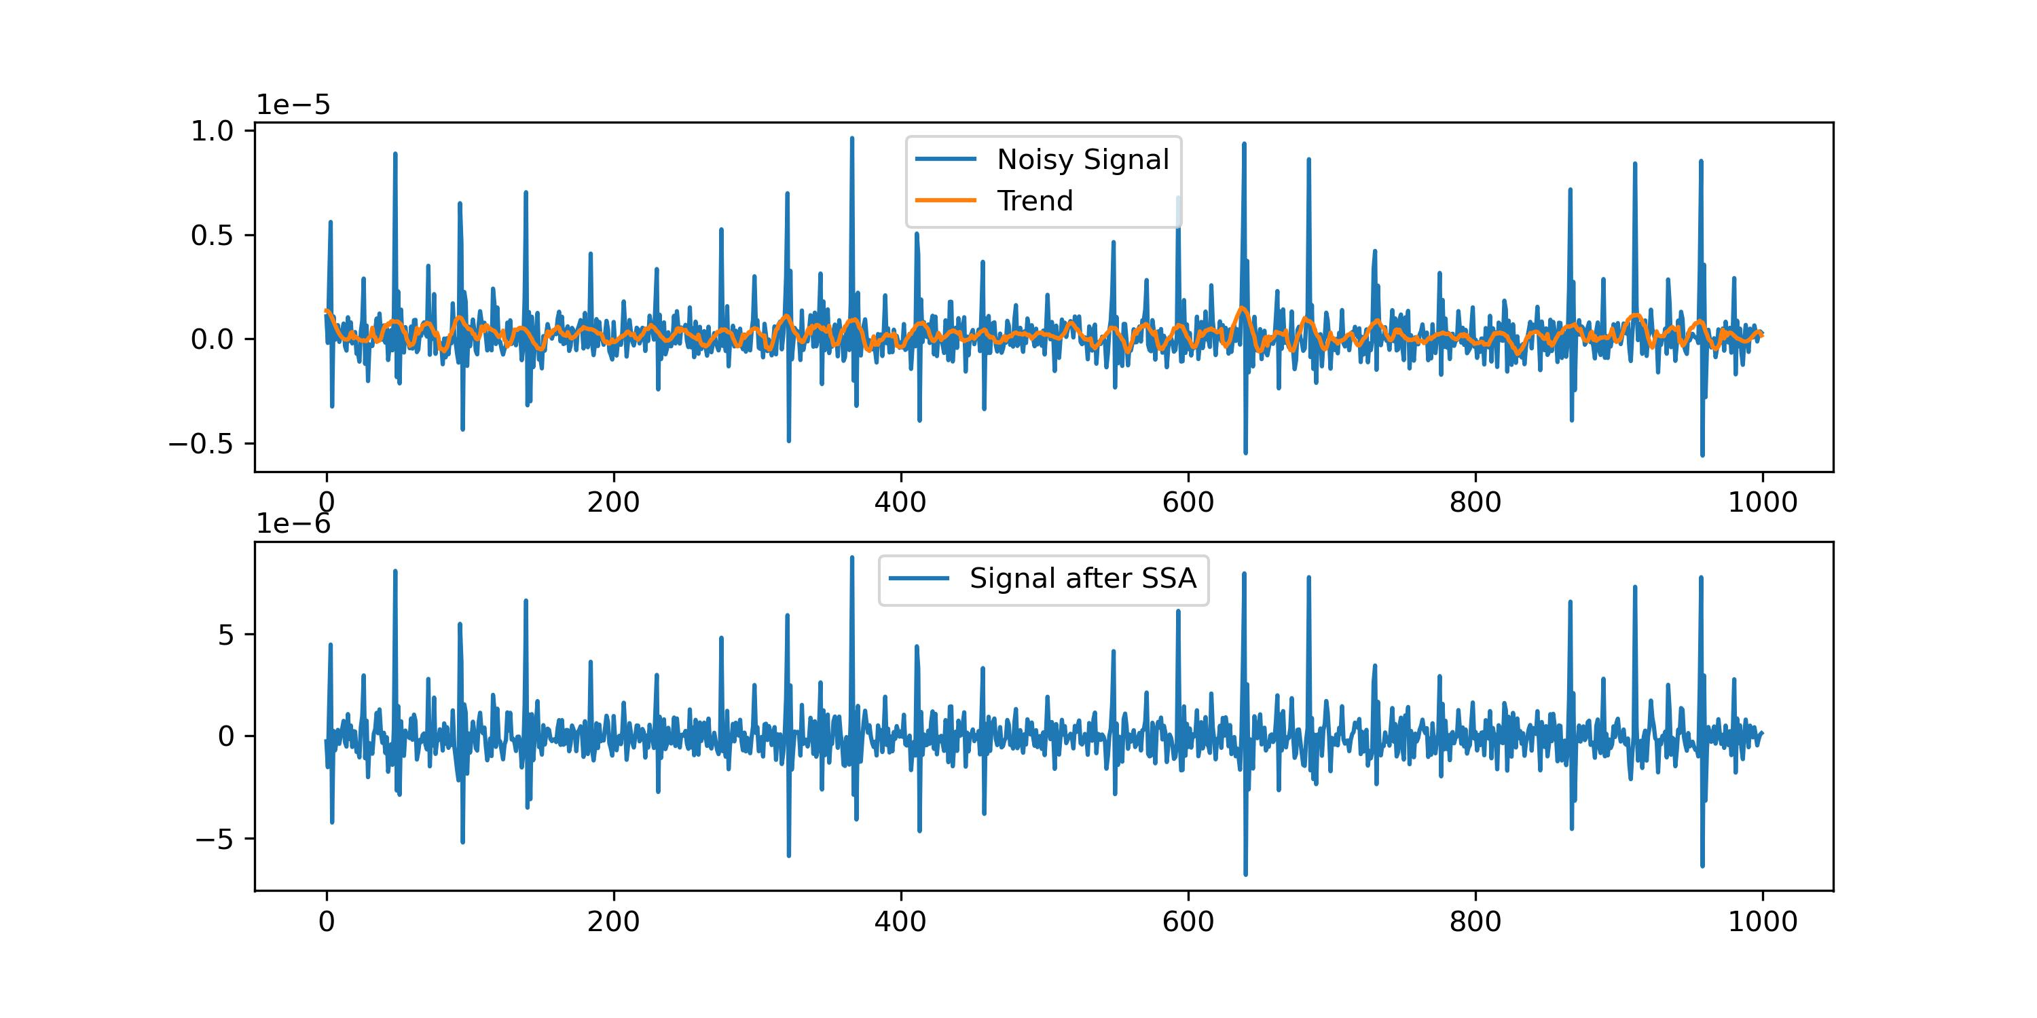
Work_3: Remove Normal Nosie and respiratory
We cannot get the trend of Noisy Signal.
SSA don’t work well at this situation.
Notes:
In this situation, We cannot get the trend exactly, so the SSA don’t work well.
You can see the below picture. The signal after SSA is still very noisy.

Slide 12
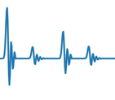
Work_3: Remove Normal Nosie and respiratory
Noisy Signals
Wiener Filter
Local features are used to obtain statistical information about noise
Roughly calculate the SNR
Apply Wiener Filter
Apply FFT Denoising
Extract Features
S, D Prediction
Notes:
So I design a combination of filters to remove this kind of noise.
First one is the wiener filter. But wiener filter need to know the statistical information about the noise.
So I try to use the local features to get statistical feature of the noise. Just as the picture shows, I get the noise between these peaks.
Then I can roughly calculate the SNR and apply Wiener Filter.
The Apply FFT-denoising to remove the Res
Then extract the features and predict S and D

Slide 13
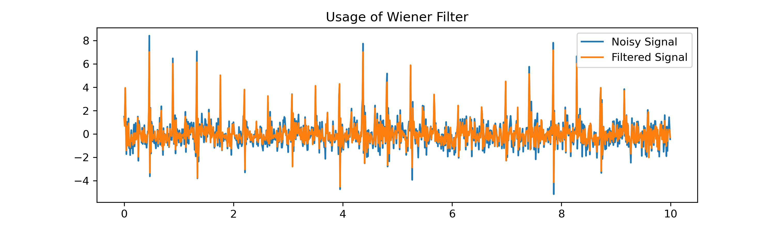
Work_3: Remove Normal Nosie and respiratory
The Wiener Filter can preliminarily suppress noise.
It works better than SSA, but this signal is still noisy.
So fft-denoising should be used too.

Slide 14
Work_3: Remove Normal Nosie and respiratory
Noise Level | S | D
Normal(mean=0, std=0.1) | 0.95 | 3.50
Normal(mean=0, std=0.2) | 0.95 | 3.73
Normal(mean=0, std=0.3) | 0.91 | 4.02
Normal(mean=0, std=0.4) | 1.02 | 4.31
Normal(mean=0, std=0.5) | 1.06 | 4.70
Normal(mean=0, std=0.6) | 1.06 | 5.13
Normal(mean=0, std=0.7) | 1.02 | 5.56
Normal(mean=0, std=0.8) | 1.12 | 6.03
Normal(mean=0, std=0.9) | 1.34 | 6.46
Normal(mean=0, std=1.0) | 1.34 | 6.55
When the standard deviation of noise increases,
the value of S grows slowly, indicating peaks detection is accurate.
However, the value of D increases rapidly, indicating the noise added to peaks cannot be effectively eliminated.

Slide 15
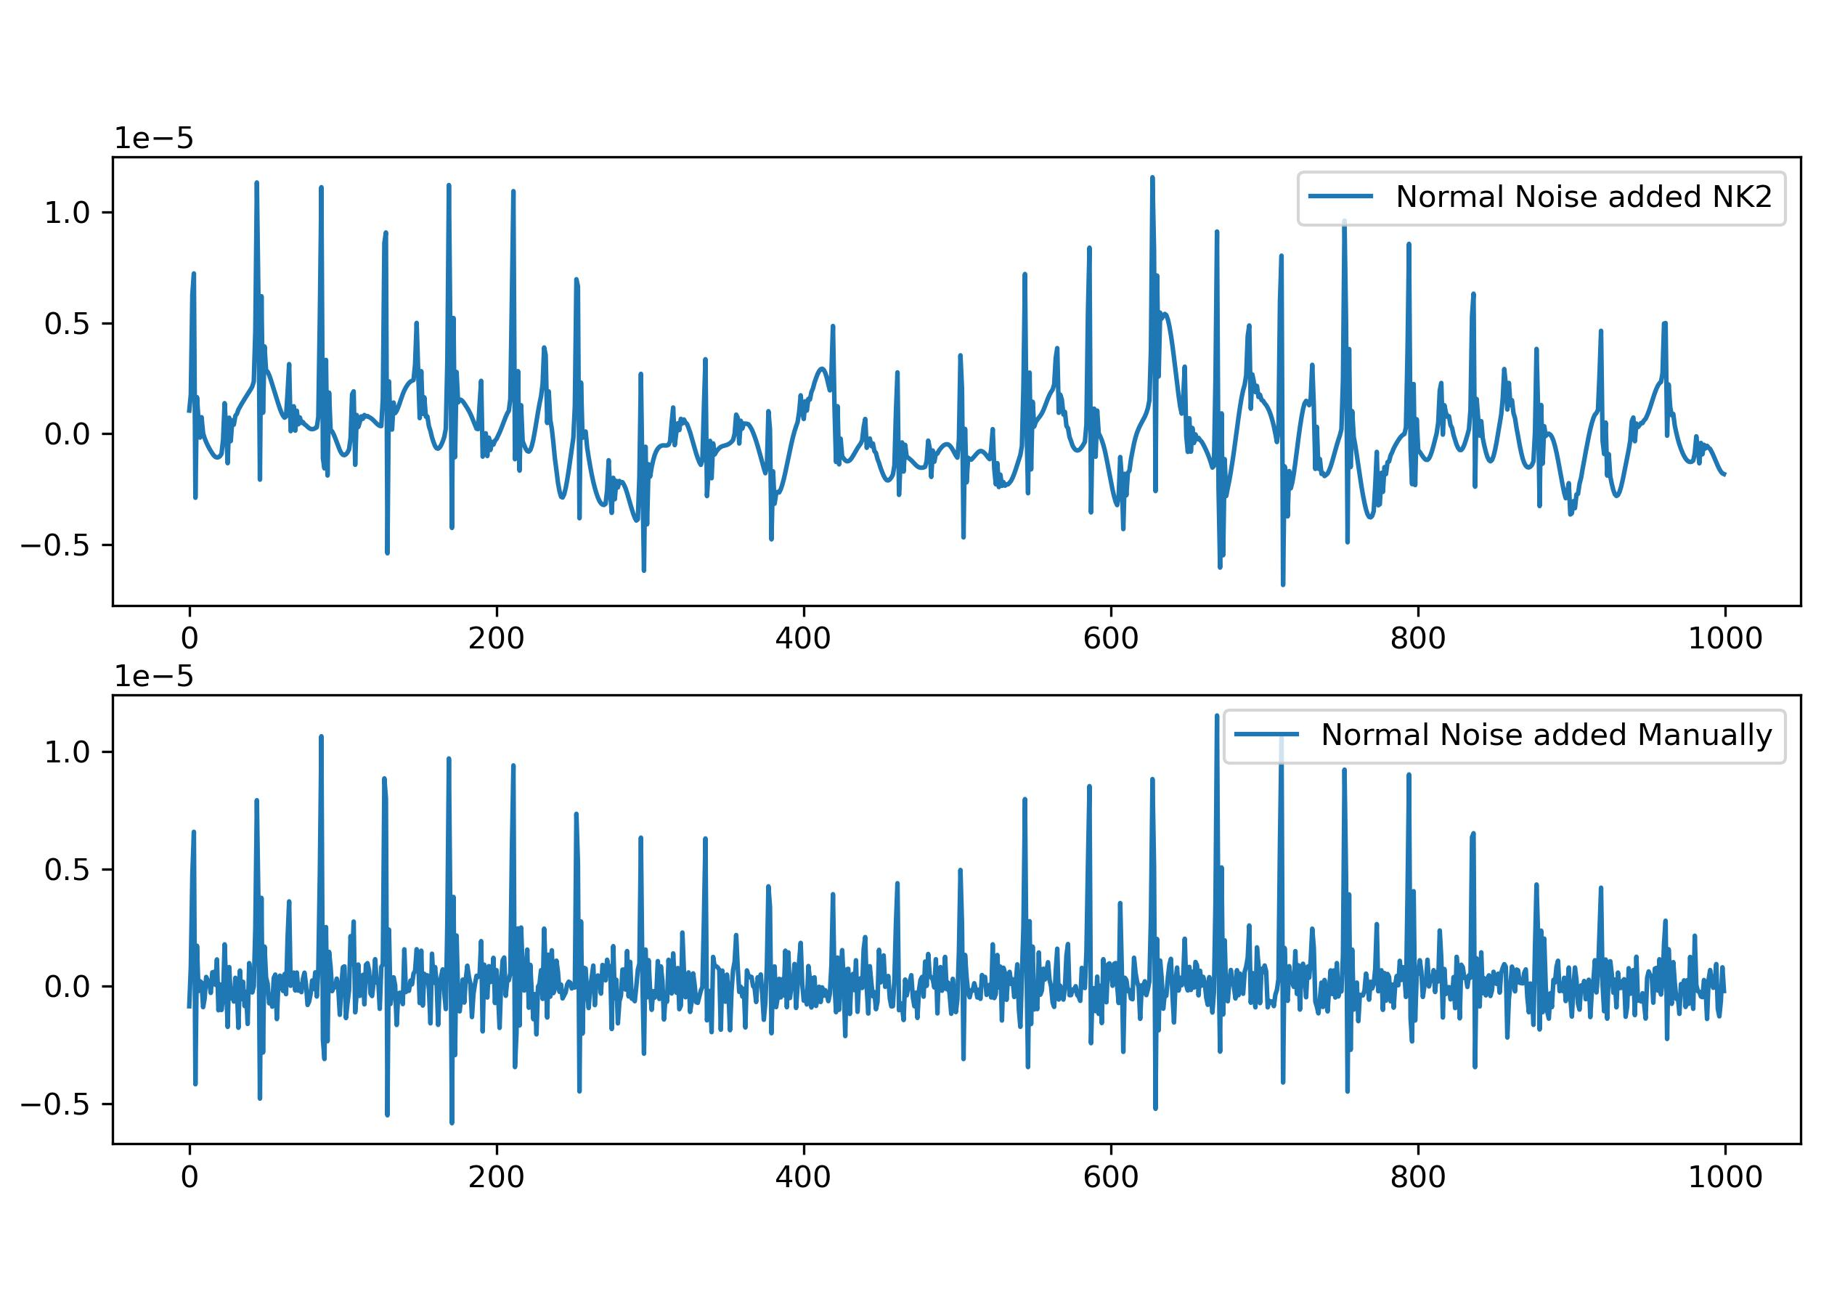
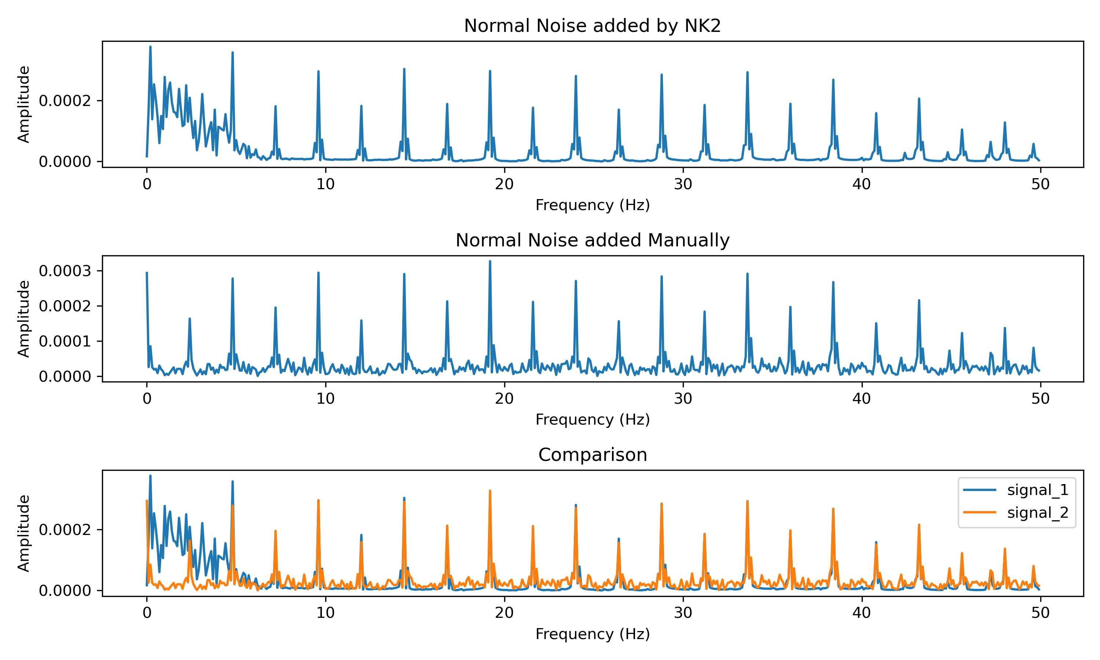
Work_4: Remove Laplace Noise and Normal Noise added by Neurokit2
Noises added by Neurokit2 are different from these added manually(np.random.normal())
Noises from Nk2 will make signal have trend, which means noises are low-frequent.

Slide 16
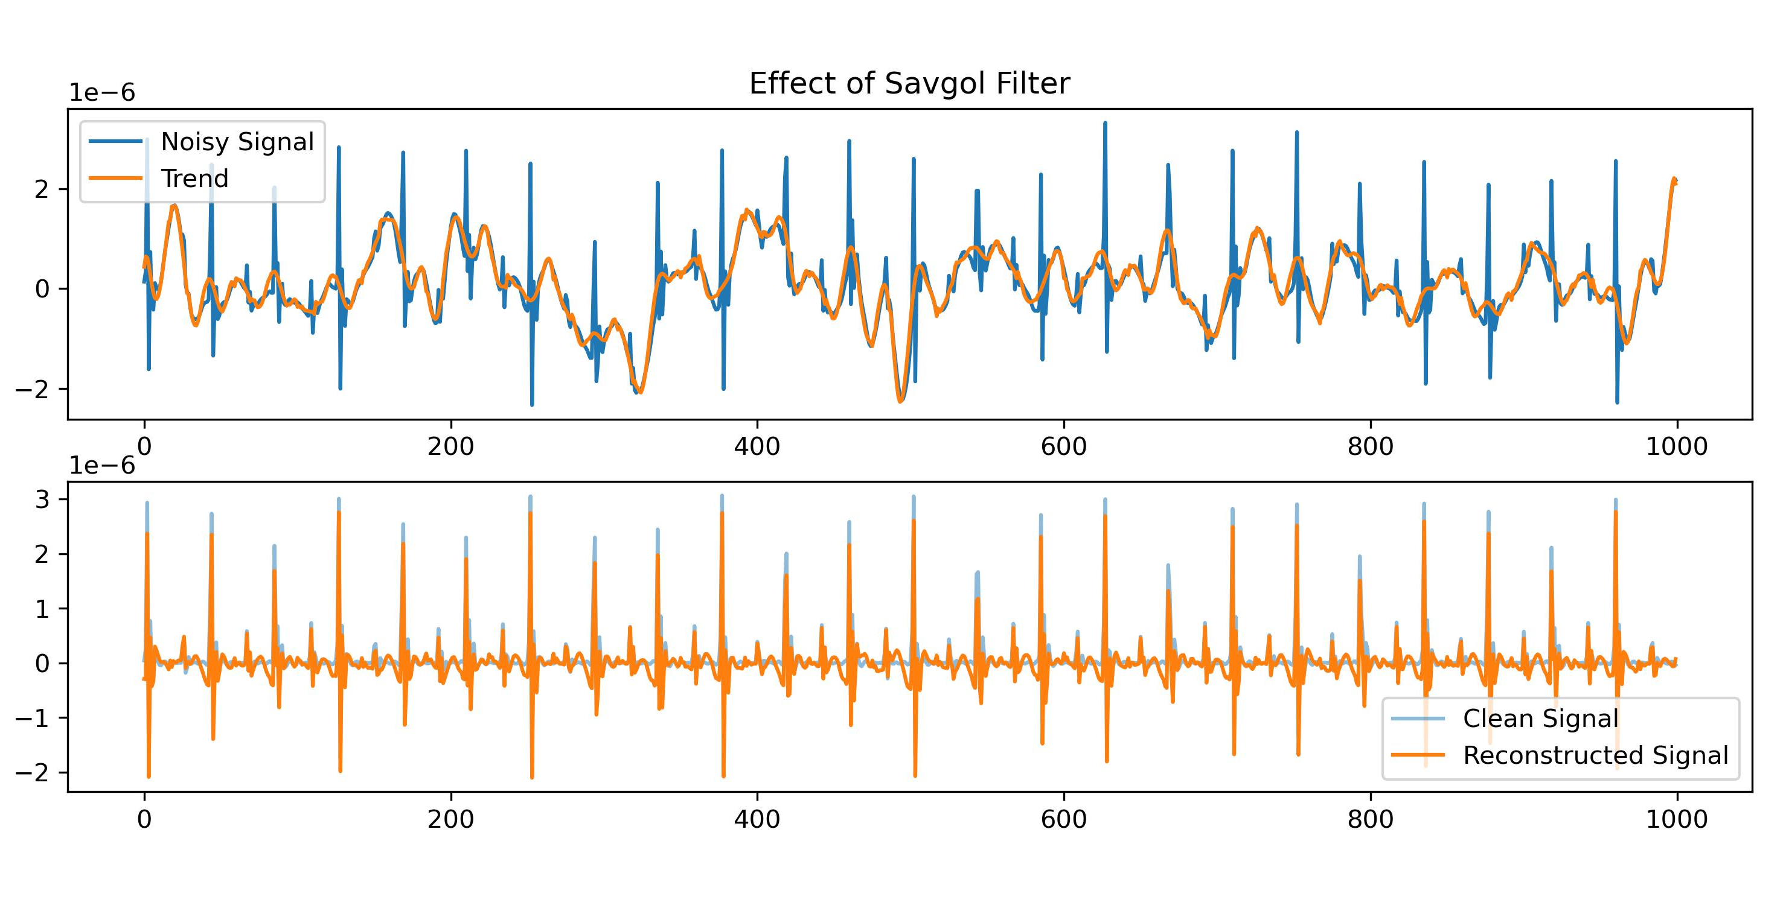
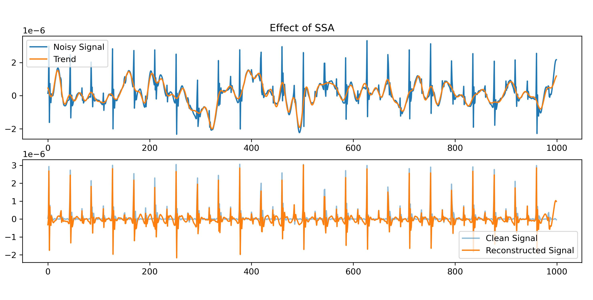
Work_4: Remove Laplace Noise and Normal Noise added by Neurokit2
SSA is primarily used to get low-frequency signals (trends). However, there are many similar methods can achieve results.
Decomposition and reconstruction to get low-frequency signals is equivalent to directly smoothing the signal.
For the same signal, here is a comparison of the effectiveness of SSA and Savgol filter.

Slide 17
Work_4: Remove Laplace Noise and Normal Noise added by Neurokit2
Savgol filter + fft-denoising for Noisy Signal with Respiration
Time: About 5 sec
Noise | S | D
Normal Noise_level 0.1 | 0.97 | 4.99
Normal Noise_level 0.4 | 0.92 | 5.11
Normal Noise_level 0.8 | 0.97 | 5.47
Laplace Noise_level 0.1 | 0.95 | 4.91
Laplace Noise_level 0.4 | 0.90 | 5.18
Laplace Noise_level 0.8 | 1.15 | 6.11
SSA + Template for Noisy Signal without Respiration
Time: About 170 min
Noise | S | D
Laplace Noise_level 0.8 | 1.64 | 6.28
The combination of a Savitzky-Golay filter and FFT denoising on data with respiration achieved better results in less time compared to SSA on data without respiration.

Slide 18
Conclusion:
Regardless of whether FFT denoising, Wiener filter, or Savitzky-Golay filter is used, the noise added to the peaks cannot be effectively eliminated. I should spend more time on it.
Notes:
展示Nk2的添加和直接添加之间的区别，时域和频域
展示S filter的效果，以及为什么可以代替SSA
直接展示结果的表格

Slide 19
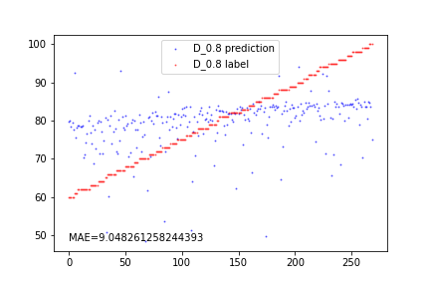
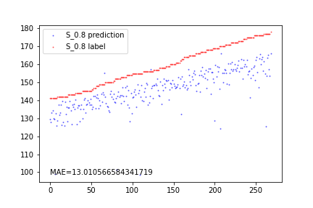
Questions
1. You said in google doc: Zaid tried EEMD and found it can also decompose the simulated SCG signals well. Compare to EEMD. I have tried it before. Maybe you can tell me to what extent has this method achieved.
2. My current attempts with these methods may yield decent results, but they are all very conventional approaches and not innovative. Could you provide me with a few research papers that can give me an idea of the level of noise reduction achievable for SCG signals to be considered publishable?

Slide 20
Thanks!

