Slide 1
Weekly Presentation
Jiayu Chen
2023.9.11
Notes:
Ok, I will begin my weekly Presentation

Slide 2
Work Description
Work_1: Tutorial Writing: finish the framework of the main function and try 2 advanced filter(Wiener filter and Savgol filter)
Work_2: Preliminarily remove the impact of respiratory by fft.
Work_3: Using the combination of Wiener filter and fft denoising to remove the normal noise (add np.random.normal() directly) and respiratory.
Work_4: Confronted with Laplace Noise and Normal Noise added by Neurokit2, the combination of Savgol filter and fft denoising achieved better results, more accurate in prediction and much more faster, compared with the combination of SSA and Template.

Slide 3
Work_1: Tutorial
For Algorithm
Wiener filter and Savgol filter have been tried in SCG Signals. Both of these filters have shown good performance.
For Main Function
Completed the full reconstruction for Generate Waves(7), Add Noise(10), Filters(8), Decompose(4), including interfaces, visualization, code comments and more.
Currently, the fundamental features of main function have been implemented.
Show the Demo: 4 core commands
Notes:
本周：
完成了对于Generate waves(7), Add Noise(10), Filter(4), decompose(8)完成了全部的重构，包括接口，作图等
目前基本的功能已经实现
直接进行展示3个指令
下周需要改进的：
有一些细节仍然不太到位：对于输入的字符串，如果有空格会出问题
还没有进行充分的测试
Save功能仍然没有想好如何实现

Slide 4
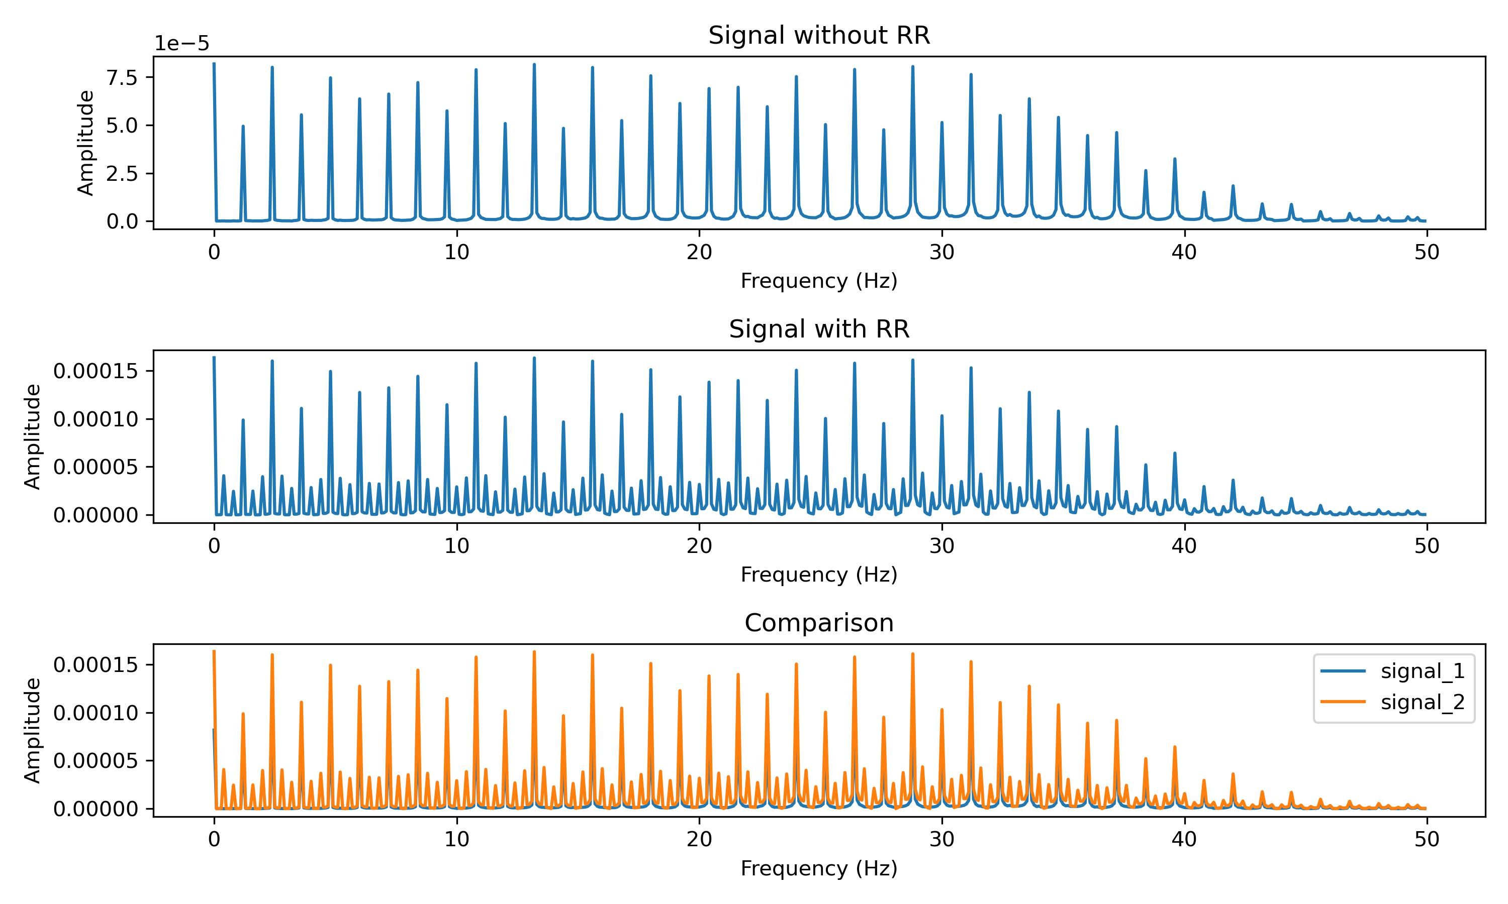
Work_2: Remove the impact of respiratory by fft
For Signal with respiratory, peaks in frequency domain are between 2 small peaks.
But I haven't fully understood the mathematical principles yet.
Notes:
My second work is removing the impact of respiratory by fft denosing.
We transform the signal into freq domain and The first figure is the signal with respiratory and second figure is the signal without respiratory
we can clearly see the difference between them.
For Signal with respiratory, peaks in frequency domain are between 2 small peaks.
But I haven't fully understood the mathematical principles yet.

Slide 5
Work_2: Remove the impact of respiratory by fft
Threshold of FFT Denoising = (Max Amplitude * 0.35)²
Energy
Notes:
FFT Denoising is very suitable for this task.
If we can set the suitable threshold for the fft denoising, the small peaks can be removed clearly.
I just set the threshold as the equation below. I works well.

Slide 6
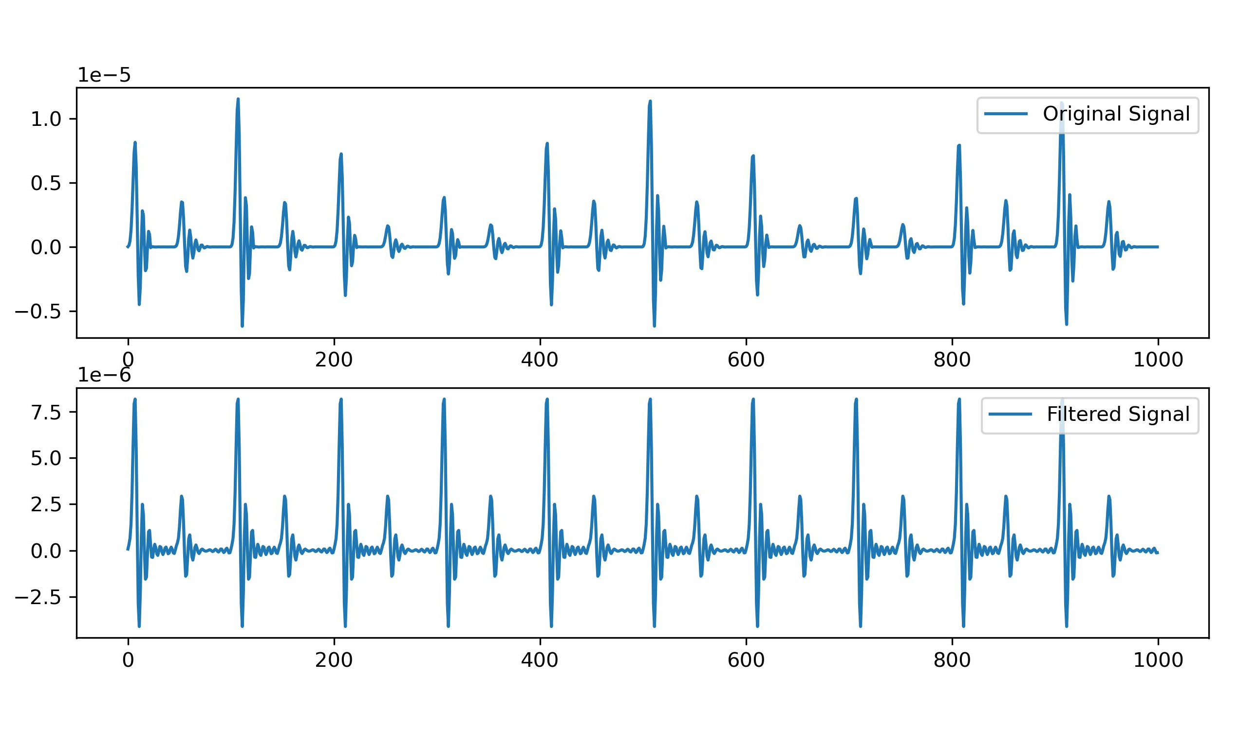
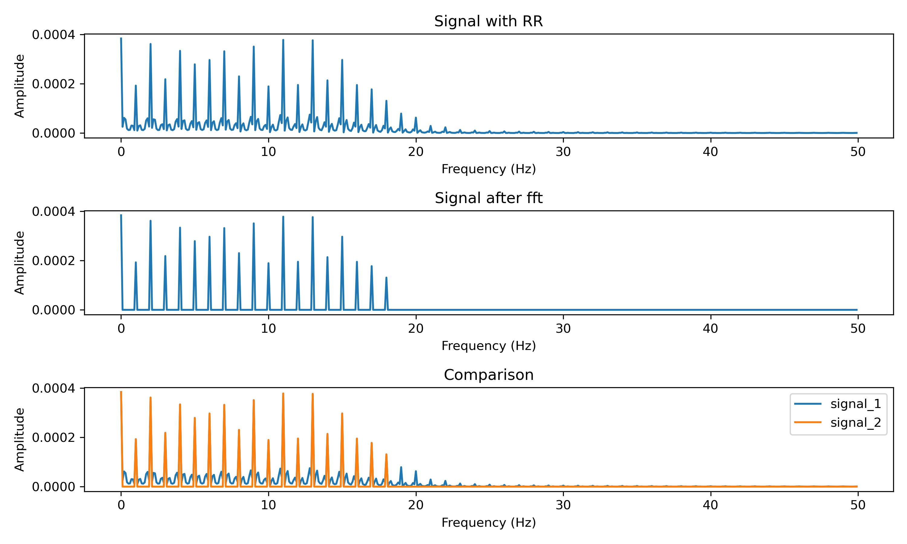
Work_2: Remove the impact of respiratory by fft
Result of FFT-Denosing
Removing high-frequency, low-amplitude components from the signal can result in the appearance of subtle fluctuations.
But the result is acceptable.
Notes:
Let’s look at the result.
The left two picture are the comparison of original signal and filtered signal. The impact of resp has been removed from the signal.
The right 3 pictures are the comparison of signal in frequency dormain. You can see. Although small peaks next to large peaks are removed, some high-frequency, low-amplitude components are removed either. This will result in subtle flunctions in signal.
But I think the result is acceptable.

Slide 7
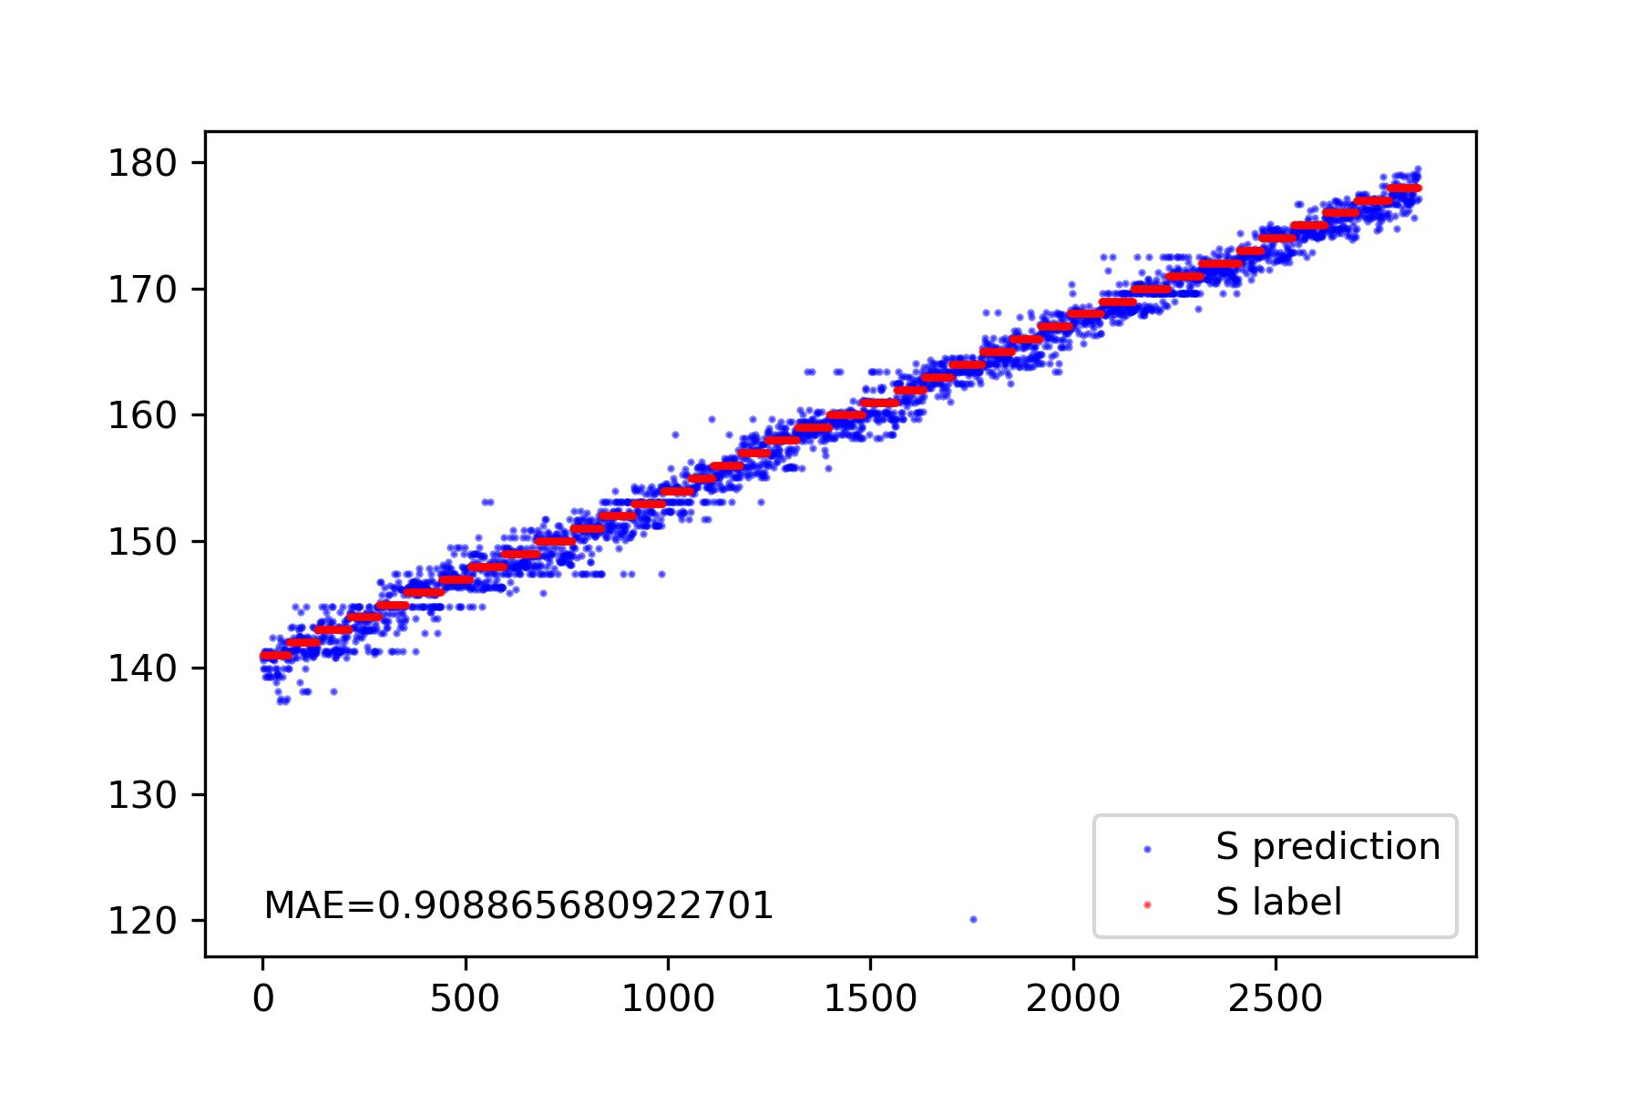
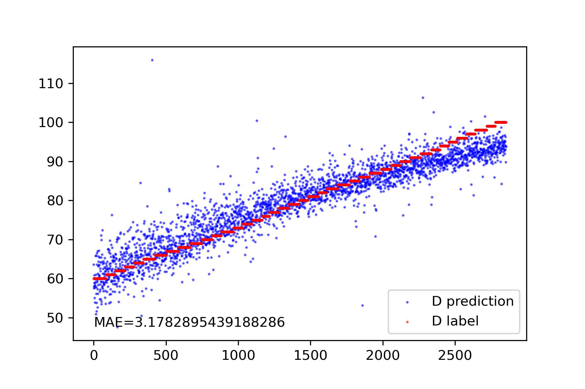
Work_2: Remove the impact of respiratory by fft
Result of S and D Prediction, 当信号的噪声程度为0并且受到呼吸的影响时
Notes:
展示频域的
展示单个信号使用fft以后的效果
展示数据集上测试的结果

Slide 8
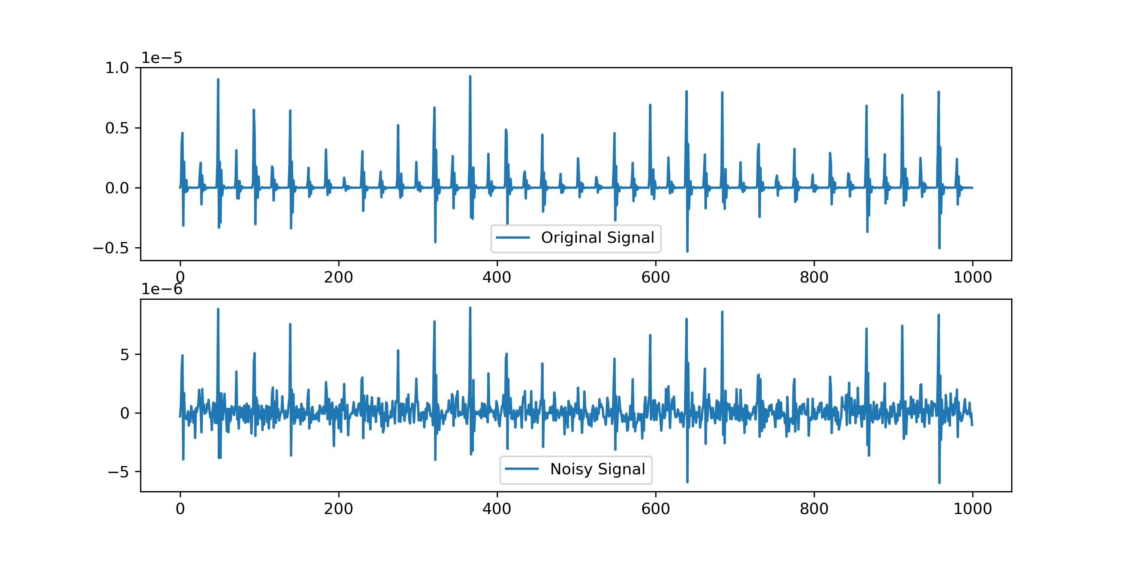
Work_3: Remove Normal Nosie and respiratory
Noisy Signal = Clean Signal + np.random.normal()
Mean value of Noisy Signal is 0.
Notes:
展示Normal Noise的效果, 这种情况下SSA并不起作用，因为get不到趋势
展示W filter的效果，wfilter如何应用到了我们算法中去
直接展示结果的表格

Slide 9
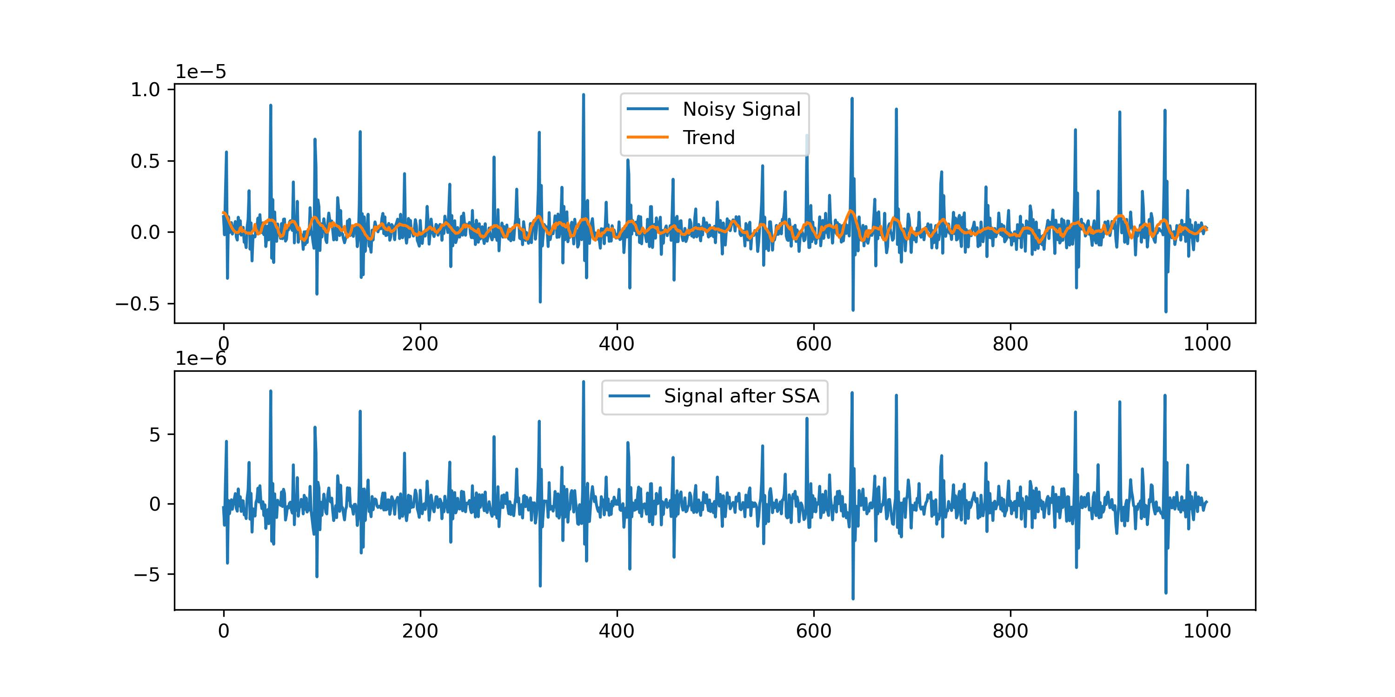
Work_3: Remove Normal Nosie and respiratory
We cannot get the trend of Noisy Signal.
SSA don’t work well at this situation.
Notes:
展示Normal Noise的效果, 这种情况下SSA并不起作用，因为get不到趋势
展示Wiener filter的效果，wiener filter 如何应用到了我们算法中去
直接展示结果的表格

Slide 10
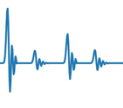
Work_3: Remove Normal Nosie and respiratory
Noisy Signals
Wiener Filter
Local features are used to obtain statistical information about noise
Roughly calculate the SNR
Apply Wiener Filter
Apply FFT Denoising
Extract Features
S, D Prediction
Notes:
展示Normal Noise的效果, 这种情况下SSA并不起作用，因为get不到趋势
展示Wiener filter的效果，wiener filter 如何应用到了我们算法中去
直接展示结果的表格

Slide 11
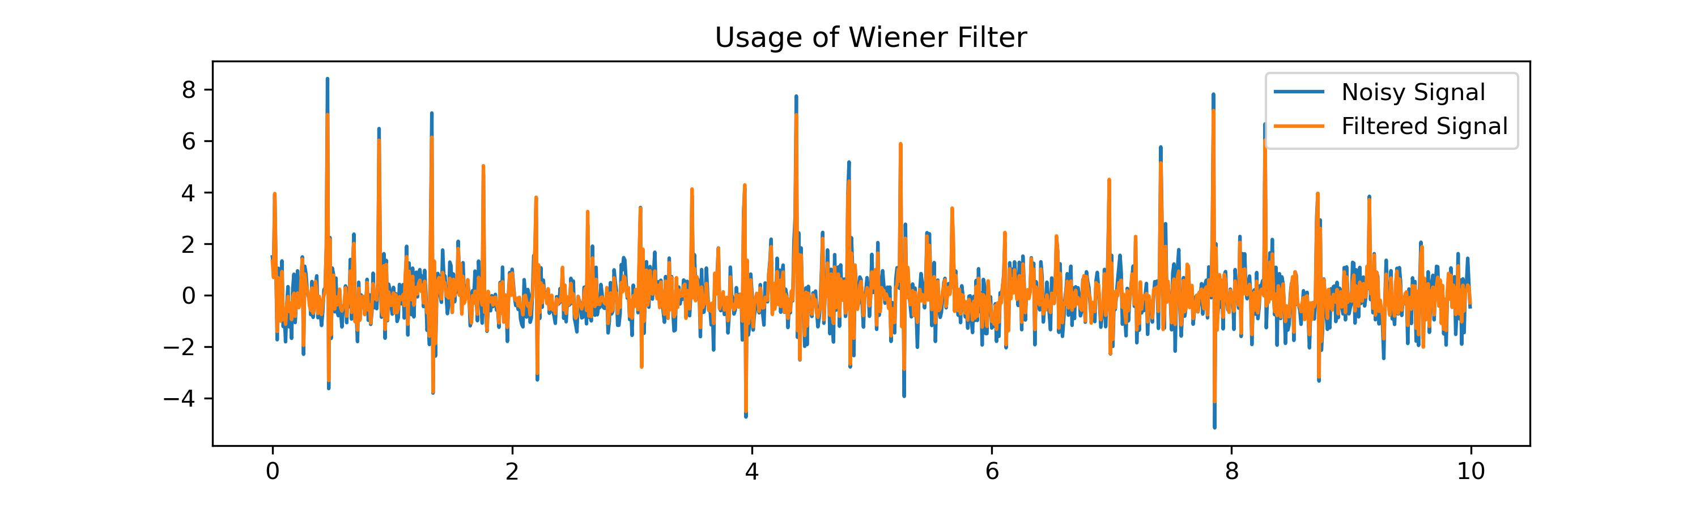
Work_3: Remove Normal Nosie and respiratory
Wiener Filter可以初步的抑制噪声
Notes:
展示Normal Noise的效果, 这种情况下SSA并不起作用，因为get不到趋势
展示W filter的效果，wiener filter如何应用到了我们算法中去
直接展示结果的表格

Slide 12
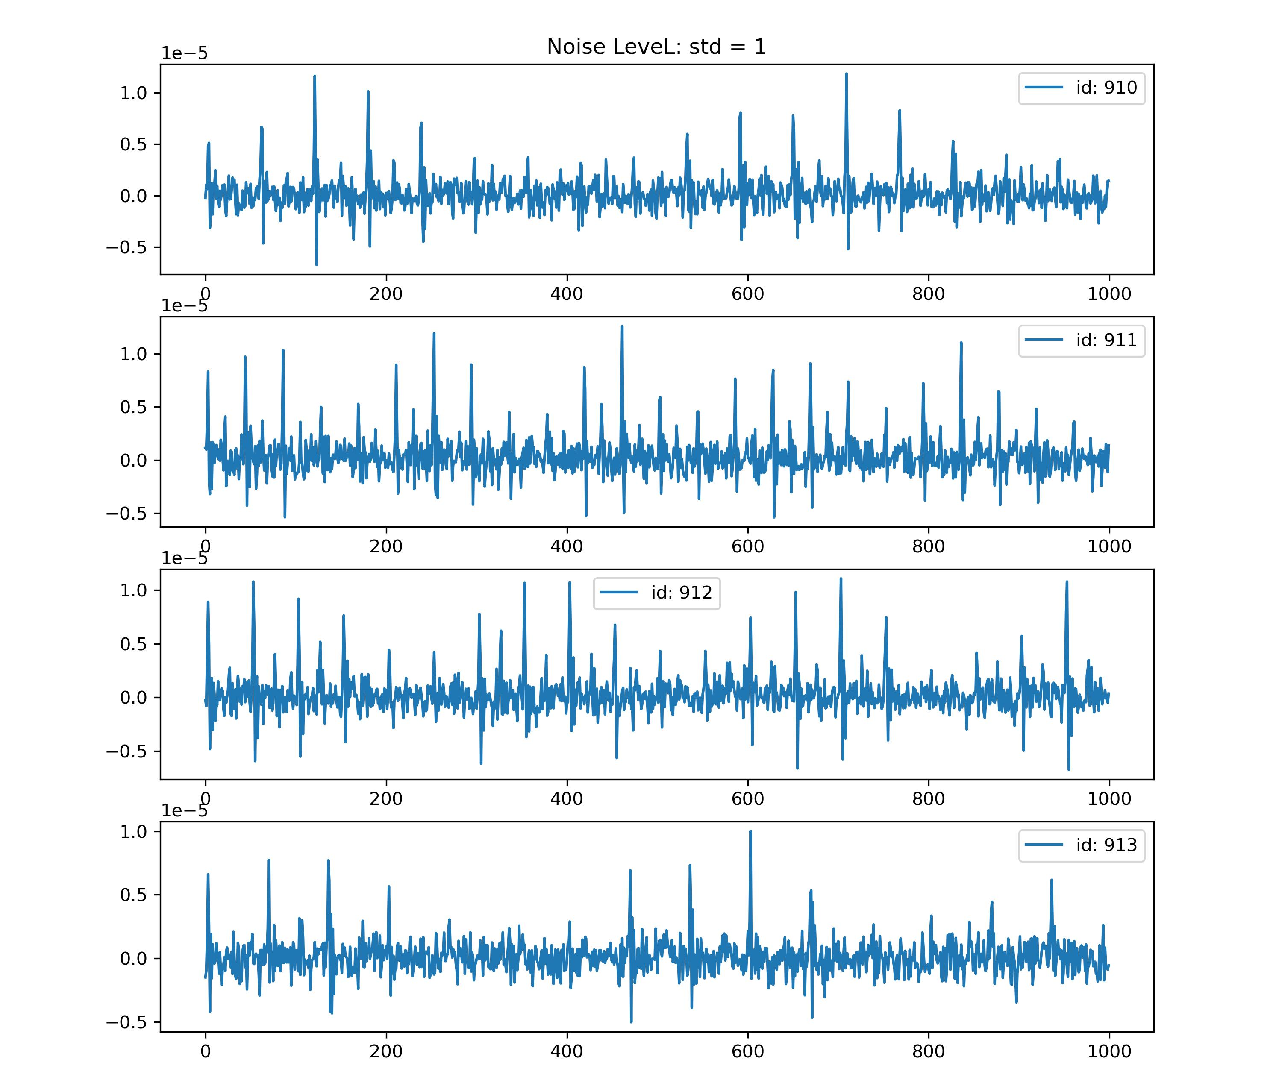
Work_3: Remove Normal Nosie and respiratory
Notes:
展示Normal Noise的效果, 这种情况下SSA并不起作用，因为get不到趋势
展示W filter的效果，wfilter如何应用到了我们算法中去
直接展示结果的表格

Slide 13
Work_3: Remove Normal Nosie and respiratory
Noise Level | S | D
Normal(mean=0, std=0.1) | 0.95 | 3.50
Normal(mean=0, std=0.2) | 0.95 | 3.73
Normal(mean=0, std=0.3) | 0.91 | 4.02
Normal(mean=0, std=0.4) | 1.02 | 4.31
Normal(mean=0, std=0.5) | 1.06 | 4.70
Normal(mean=0, std=0.6) | 1.06 | 5.13
Normal(mean=0, std=0.7) | 1.02 | 5.56
Normal(mean=0, std=0.8) | 1.12 | 6.03
Normal(mean=0, std=0.9) | 1.34 | 6.46
Normal(mean=0, std=1.0) | 1.34 | 6.55
Notes:
展示Normal Noise的效果, 这种情况下SSA并不起作用，因为get不到趋势
展示W filter的效果，wfilter如何应用到了我们算法中去
直接展示结果的表格

Slide 14
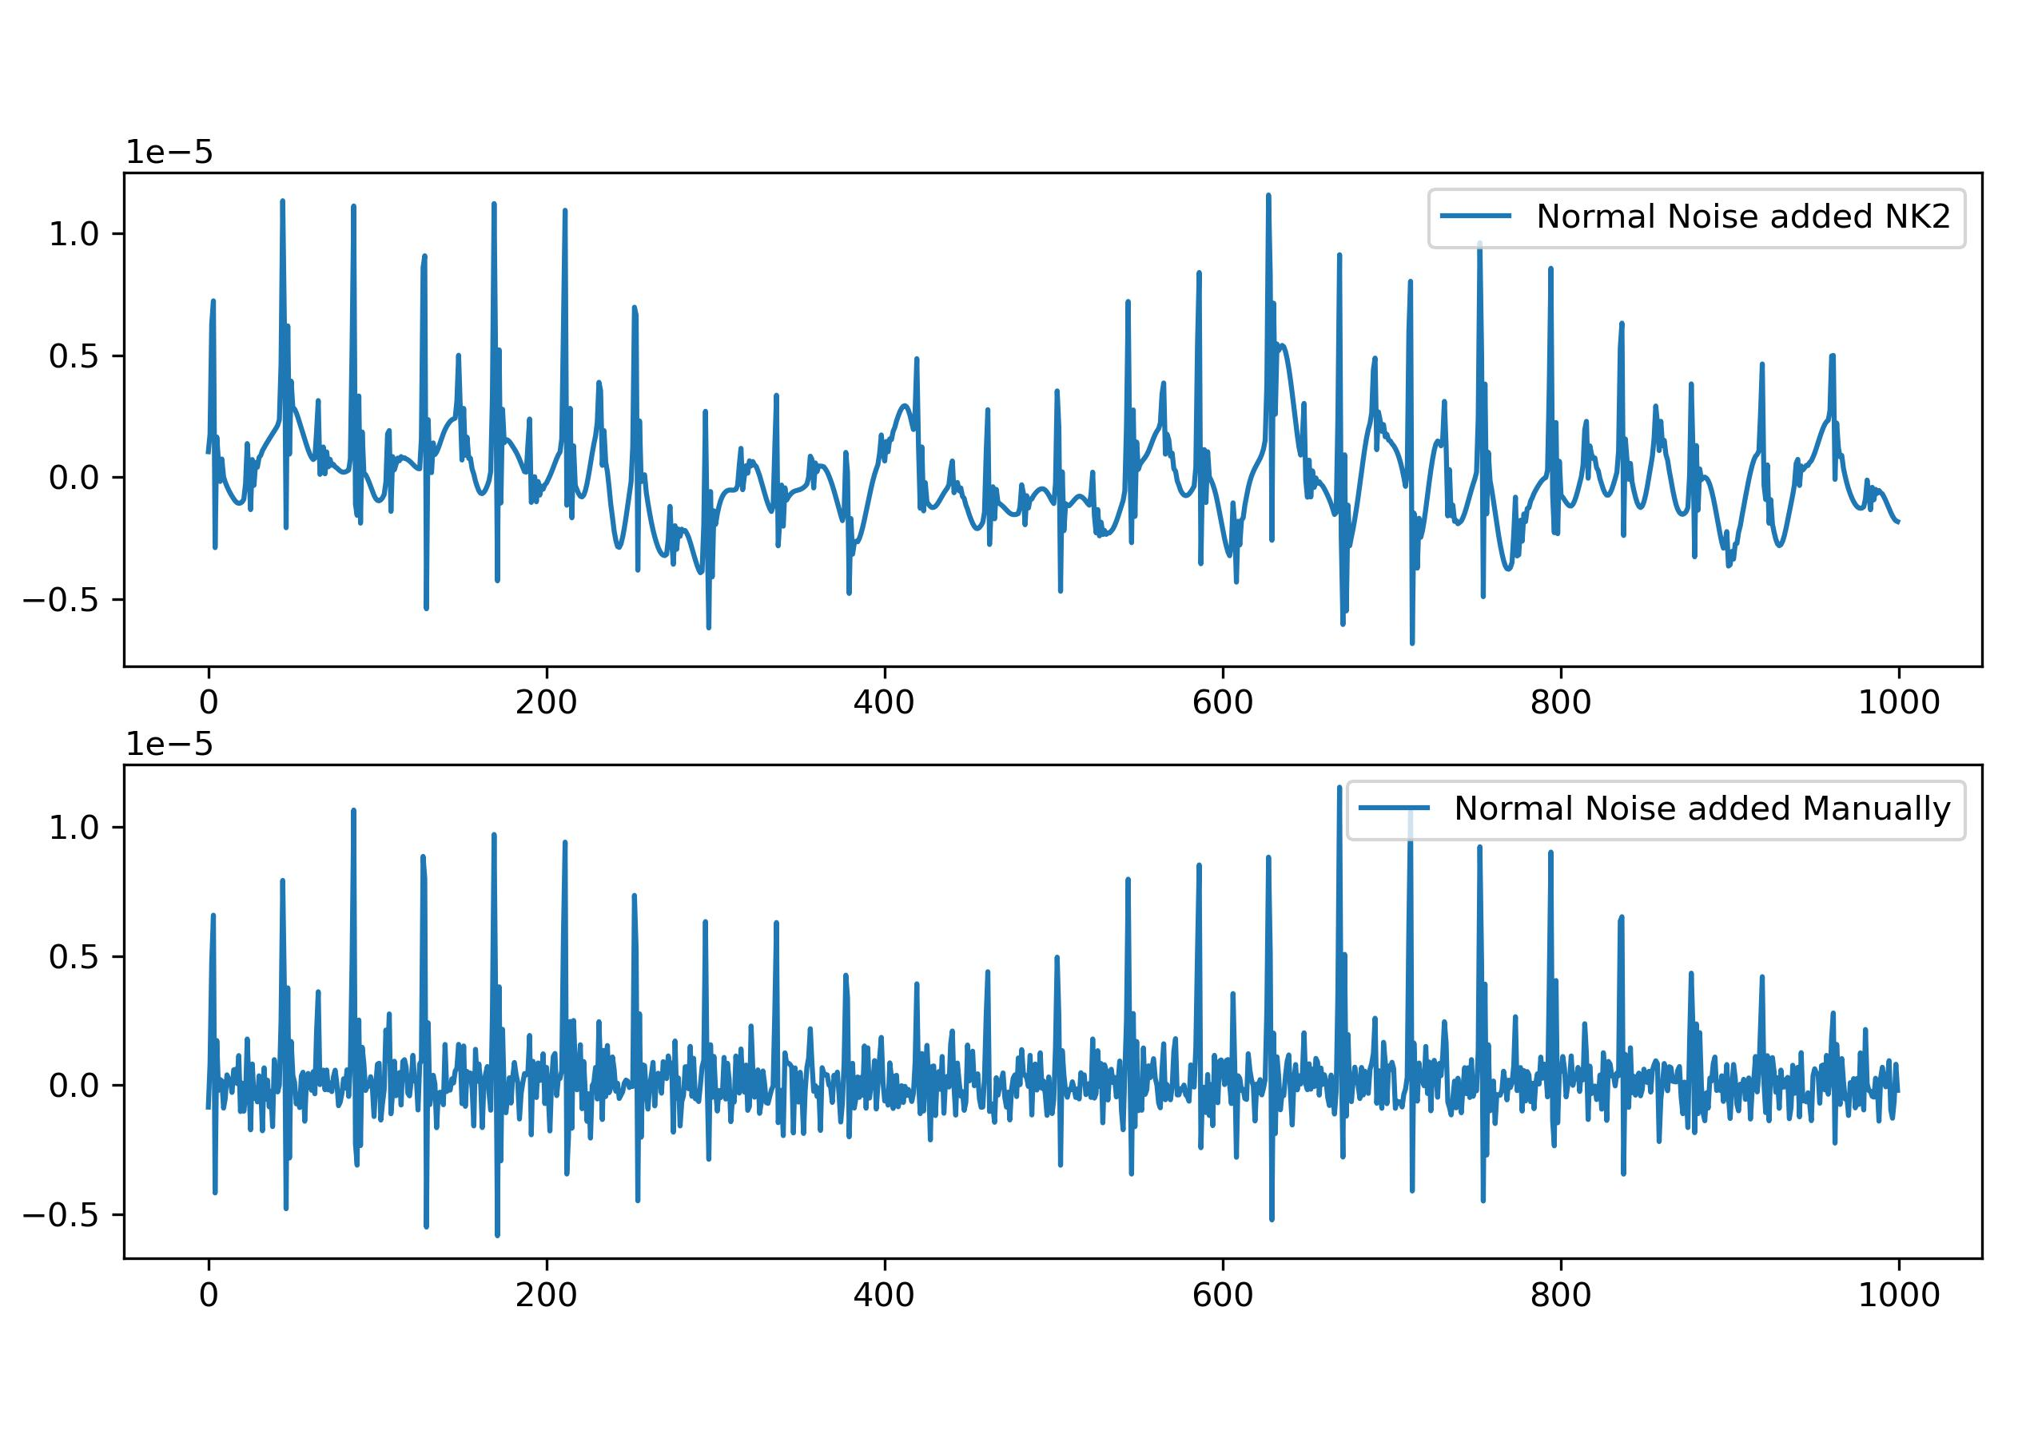
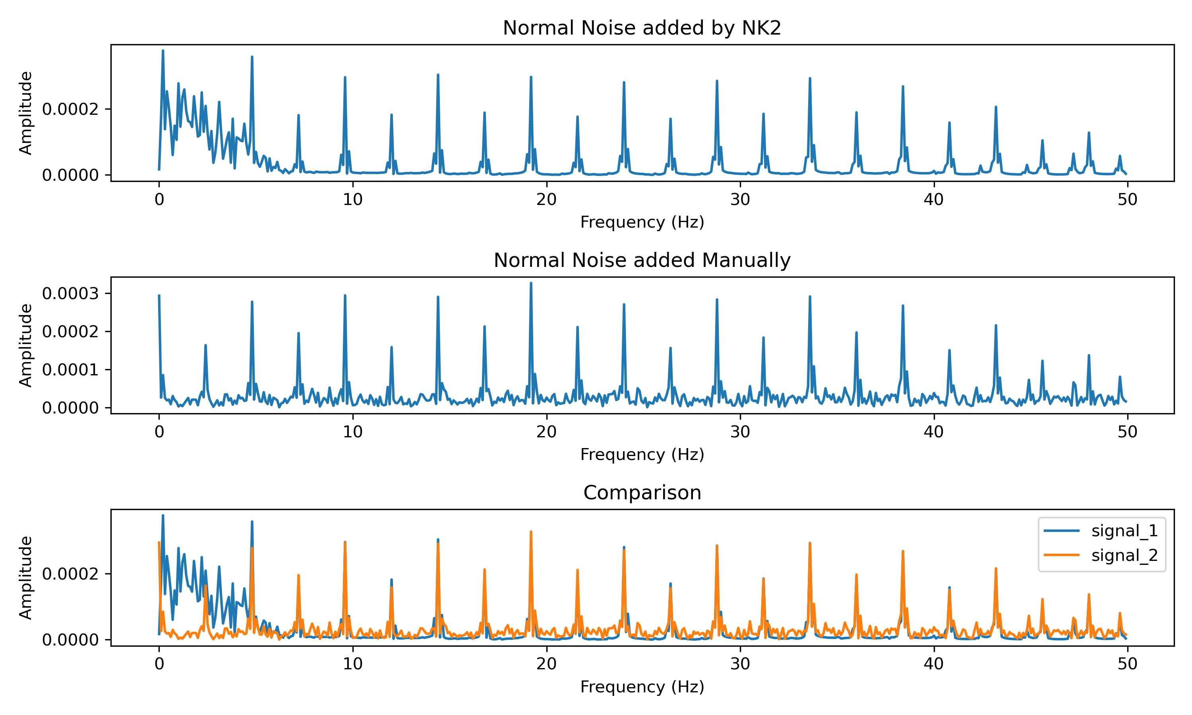
Work_4: Remove Laplace Noise and Normal Noise added by Neurokit2
Normal Noise added by NeuroKit2 is in low frequency
Noisy_Signal = Clean_Signal + np.random.normal()
Noise is added to all frequency.
Notes:
展示Nk2的添加和直接添加之间的区别，时域和频域
展示S filter的效果，以及为什么可以代替SSA
直接展示结果的表格

Slide 15
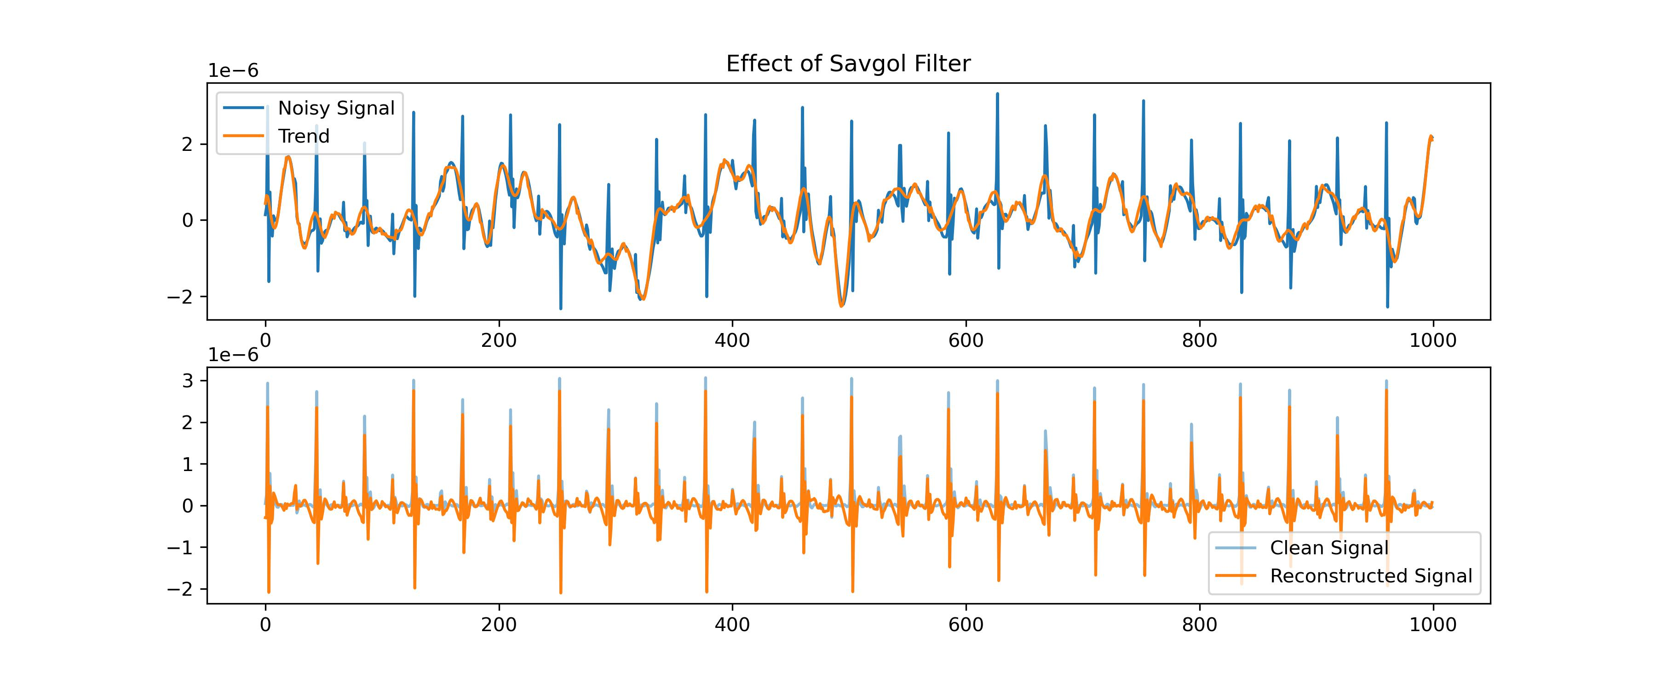
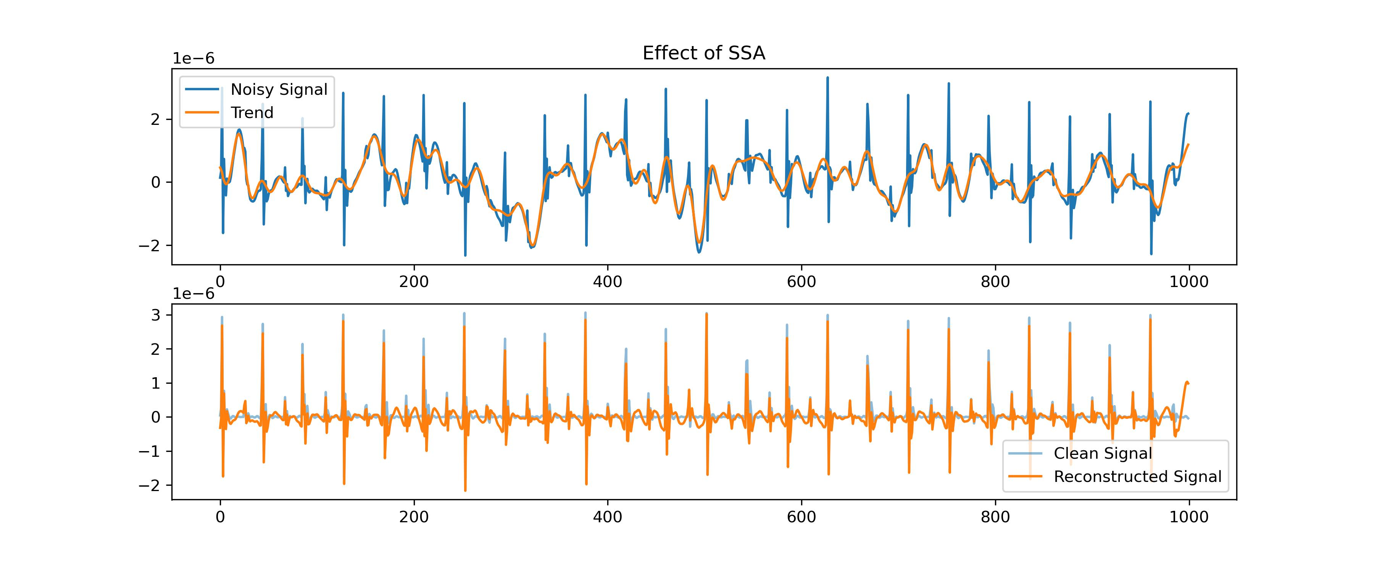
Work_4: Remove Laplace Noise and Normal Noise added by Neurokit2
使用SSA，仅仅是为了滤除低频信号，也就是Trend。
而我们有很多类似的方法，能够达到和SSA类似的效果。
分解后再重组，从而得到低频信号 = 直接对信号进行平滑
对于同一个信号，使用SSA和S filter的效果对比图
Notes:
展示Nk2的添加和直接添加之间的区别，时域和频域
展示S filter的效果，以及为什么可以代替SSA
直接展示结果的表格

Slide 16
Work_4: Remove Laplace Noise and Normal Noise added by Neurokit2
Savgol filter + fft-denoising for Noisy Signal with Respiratory
Time: About 5 sec
Noise | S | D
Normal Noise_level 0.1 | 0.97 | 4.99
Normal Noise_level 0.4 | 0.92 | 5.11
Normal Noise_level 0.8 | 0.97 | 5.47
Laplace Noise_level 0.1 | 0.95 | 4.91
Laplace Noise_level 0.4 | 0.90 | 5.18
Laplace Noise_level 0.8 | 1.15 | 6.11
SSA + Template for Noisy Signal without Respiratory
Time: About 170 min
Noise | S | D
Laplace Noise_level 0.8 | 1.64 | 6.28
Savgol filter+fft-denoising 在一个有R的数据上，用更短的时间，去实现了比SSA更好的效果
Notes:
展示Nk2的添加和直接添加之间的区别，时域和频域
展示S filter的效果，以及为什么可以代替SSA
直接展示结果的表格

Slide 17
Conclusion:
Notes:
展示Nk2的添加和直接添加之间的区别，时域和频域
展示S filter的效果，以及为什么可以代替SSA
直接展示结果的表格

Slide 18
Questions
真实数据集的标签有点问题
Compare to EEMD,可以给我进一步的解释

Slide 19
Thanks!

