Slide 1
Weekly Presentation
Jiayu Chen
2023.11.20

Slide 2
Work Description
Part_1:
The overall framework of the research
Introduction to the critically important paper
Analysis of some experimental results
Some correlations between our research and existing studies
Part_2: Analysis of the experimental results of the IoT2023 paper
Part_3: Some arrangements for future research studies.
Part_4: Questions

Slide 3
Part_1

Slide 4
Overall Framework of the Research
The main direction of current exploration
Before 2018
With DTW
In 2018
Time Series Average
After 2018
Phototype4Regression
Template4Regression
Template4Prediction
Need careful consideration
Without DTW
Multi-Sensors Fusion
Another relatively large field
Sporadic support from
research papers.
Generative Model
The concept definitely did not exist in 2018 and before. As of 2019 onwards, I have not found it so far.

Slide 5
Overall Framework of the Research
Asymmetric
Increment
Incremental Averaging
Warping Path: (X_t, Y_t-1), (X_t, Y_t), (X_t, Y_t+1)
Symmetric
Increment
Asymmetric Method: Take a reference.
Take X as a reference.
Result: X_t = (X_t + Y_t-1 + Y_t, + Y_t+1) / 4
Disadvantage: Not well-defined. There is no natural criterion for choosing a reference.
Asymmetric
Batch
Batch
Averaging
Symmetric Method: Create a new one.
Result: Z_t+1 = (X_t + Y_t-1) / 2
Z_t = (X_t + Y_t) / 2
Z_t+1 = (X_t + Y_t+1) / 2
Disadvantage: Have more time points than X and Y.
Symmetric
Batch

Slide 6
Before 2017: Intuitive
After 2017
Asymmetric
Increment
SSG, 2017
Incremental Averaging
PSA, 2009
Soft-DTW 2017
Symmetric
Increment
NLAAF, 1996
ICDTW, 2012
TTW, 2018
Asymmetric
Batch
DBA, 2011
CDBA, 2017
Batch
Averaging
Symmetric
Batch
O(T^N)
computationally expensive
1. Improve the NLAAF algorithm.
2. Prepare for the emergence of the DBA algorithm.

Slide 7
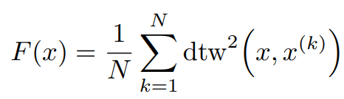
After 2017: Optimization
SSG, 2017
Fr´echet Function
A polynomial-time algorithm for finding a global minimum of the non-differentiable, non-convex Fr´echet function is unknown.
Soft-DTW 2017
TTW, 2018
SSG
F = min{F_C1, F_C2, F_C3, …}, F_C is differentiable and convex function.
Soft-DTW
DTW(min, +) -> DTW(*, +)
TTW
Translate Discrete Signal into Continuous Signal by Sinc function. And Take DTW as constraints of optimization problem.

Slide 8
Analysis of Experimental Results
The impact of different sampling rates on alignment.
Model | Sampling Rate | S Prediction | D Prediction
Template: Mean | 100 | 1.35 | 4.53
Template: Mean | 150 | 0.92 | 2.36
Template: Mean | 200 | 0.65 | 1.75
Linear Alignment -> O(T)
For simulated signals, the source of error lies in the sampling rate.
Simulated signals, low sampling rate, Non-Linear Alignment
Simulated signals, high sampling rate, Linear Alignment
Acceptable
Non-Linear Alignment -> O(T^2)
For real signals, the degree of distortion on time axis depends on the alignment we actually need.
Next week, I will use the periodicity determination method from IoT2023 to segment real signals.
Unacceptable

Slide 9
Part_1: Research - Getting Template
Model | S Prediction | D Prediction | Model | S Prediction | D Prediction
No Template | 0.79 / 1.64 | 1.79 / 4.31 | New
Mean | 1.35 / 1.38 | 4.53 / 4.44 | NLAAF1 | 8.43 / 23.19 | 3.14 / 5.21
Median | 1.42 / 1.45 | 4.07 / 4.49 | NLAAF2 | 20.67 / 33.39 | 3.64 / 7.04
PCA | - / - | - / - | GTW | - / - | - / -
K-shape 1 | 2.20 / 2.74 | 4.85 / 5.88 | TTW | 1.52 / - | 4.28 / -
Weighted Avg | 1.95 / 1.98 | 4.63 / 4.74 | K-SC | - / - | - / -
K-shape 2 | 2.18 / 1.79 | 4.76 / 5.24 | PSA | 2.27 / 19.05 | 5.40 / 8.89
Kalman Filter | 1.45 / 1.37 | 4.82 / 4.60 | Soft-DTW | 1.35 / 1.38 | 4.53 / 4.44
DBA | 2.05 / 1.96 | 3.43 / 4.15 | ICDTW | 2.66 / - | 5.08 / -

Slide 10
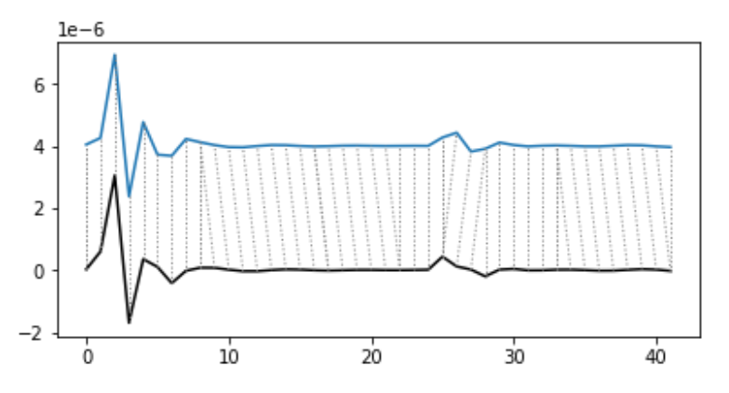
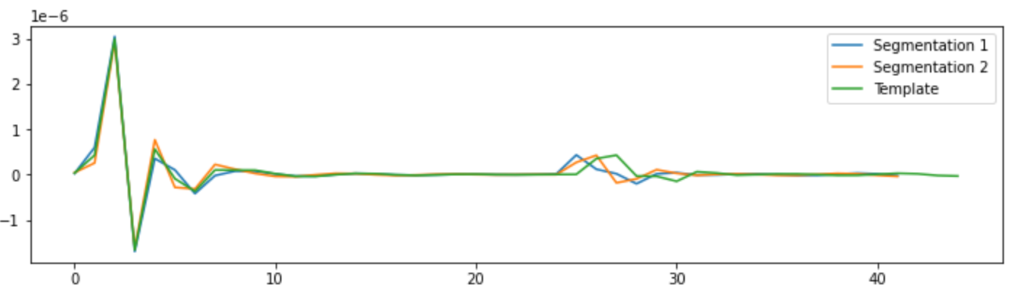
Part_1: Research - Getting Template
Model | S Prediction | D Prediction
Mean | 1.35 / 1.38 | 4.53 / 4.44
NLAAF1 | 8.43 / 23.19 | 3.14 / 5.21
NLAAF2 | 20.67 / 33.39 | 3.64 / 7.04
DBA | 2.05 / 1.96 | 3.43 / 4.15

Slide 11
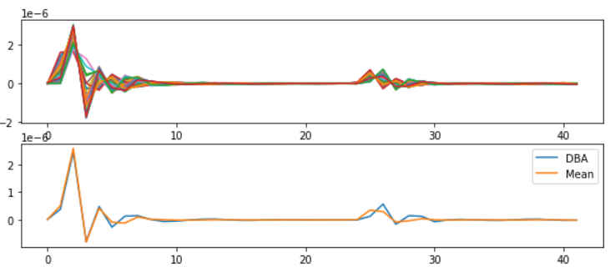

Slide 12
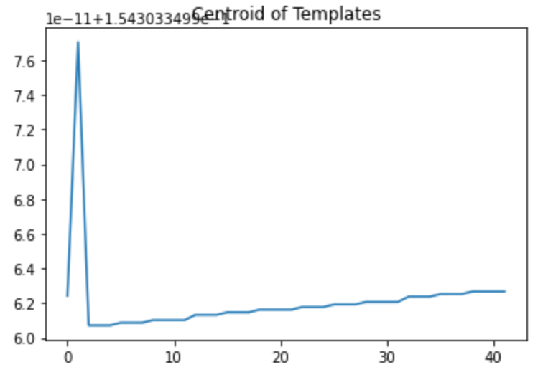
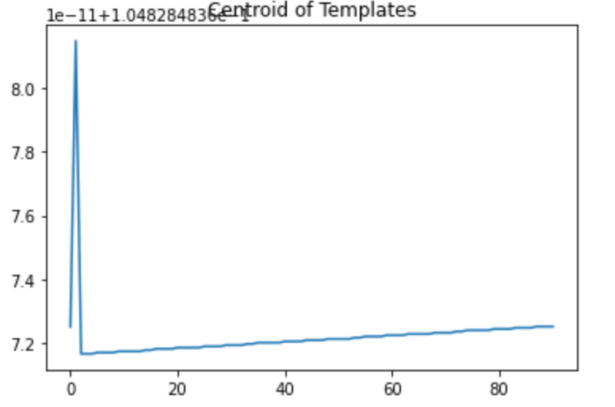
Part_1: Research - Getting Template
Model | S Prediction | D Prediction
PCA | - / - | - / -
K-SC | - / - | - / -

Slide 13
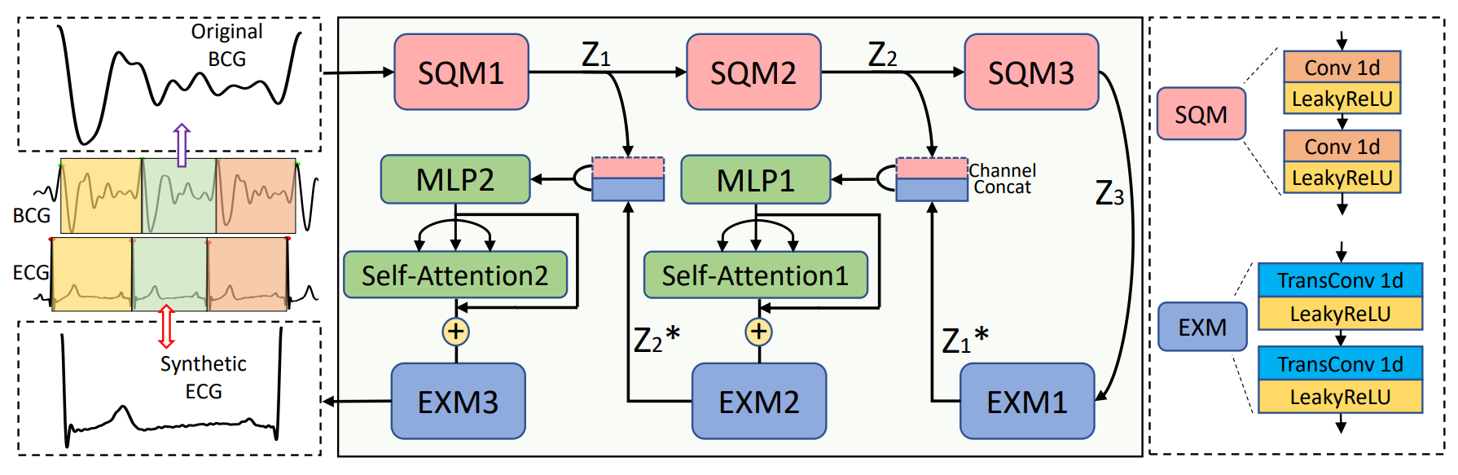
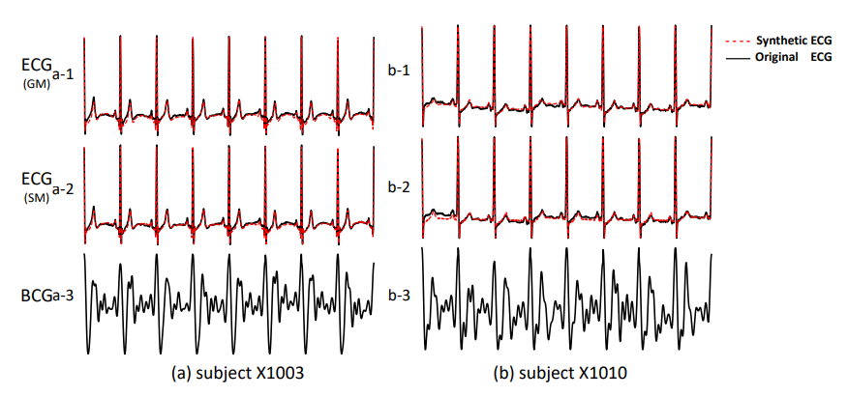
Part_1: Research - Getting Template

Slide 14
Part_2

Slide 15
Denoising Effect
ZCR Effect
Requirements
ACF Effect

Slide 16
Respiration
Signal fusion
Why Respiration Pattern will appear?

Slide 17
Time Series Average For Classification
Time Series Average For Regression

Slide 18
Part_2

Slide 19
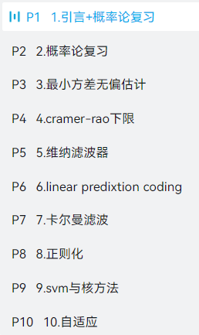
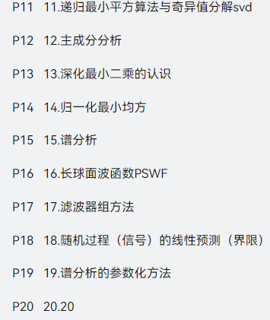
Work_3: Learning Progress and Future Learning Plan
Completed theoretical studies:
EE120 (all videos and lectures)
Complex Functions and Integral Transforms (completed half of the exercise book)
Theoretical studies I plan to undertake next.：
现代数字信号处理I 张颢
现在数字信号处理II 张颢
(Array signal processing, time-frequency analysis,
compressive sensing, Bayesian methods)
Next research directions:
1. Further exploration of methods mentioned in K-shape.
2. Seek out latest methods in data mining journals.
3. Search for algorithms that can effectively decompose the frequency domain.
4. Gradually explore real datasets based on the laboratory's research papers.

Slide 20
Questions
Do you think what I just said has any research value, or if it's implemented, does it make sense?

Slide 21
Thanks!

