Slide 1
Weekly Presentation
Jiayu Chen
2023.8.21
Notes:
Ok, I will begin my weekly Presentations

Slide 2
Work Description
Work_1: Automated feature selection is performed from 480 features.
Work_2:Attempting to predict variables S and D using signals with a noise level of 0.8.
Work_3:Tutorial Writing
Work_4:Theoretical knowledge Learning
Notes:
Here is brief work description
In Work_1, I automate feature selection from a pool of 480 features. This automated selection demonstrates excellent performance.
Work_2 involves predicting variables S and D using signals with a 0.8 noise level.
Additionally, Work_3 is tutorial writing.
while Work_4 focuses on enhancing theoretical knowledge learning.

Slide 3
Work_1: Features Selection
Outcomes:
For the prediction of S, the algorithm identifies the sole feature "Dis21/Dis12" as the most influential.
For the prediction of D, the final selection involves 4 features, including “Amplitude1/Amplitude2".
Several Advantages:
1. Simplified Feature Construction: Focusing on straightforward features like “Dis12” and “Dis21”, there's no need to manually engineer complex features like "Dis21/Dis21".
2. Minimal Parameter Adjustment: The entire process hinges on one parameter that has a negligible impact on final results.
3. Reduced Randomness: The method shows low levels of randomness.
Notes:
The automated feature selection process among the 480 features yields remarkable outcomes:
For the prediction of variable S, the algorithm identifies the sole feature "Dis21/Dis12" as the most influential. Similarly, in predicting variable D, the final selection involves four features, including "Amplitude1" and "Amplitude2".
This approach presents several distinct advantages:
1. **Simplified Feature Construction**: By exclusively focusing on straightforward features like Dis12 and Dis21, there's no need to manually engineer complex features like "Dis21/Dis21", saving time and effort.
2. **Minimal Parameter Adjustment**: The entire process hinges on a single parameter that has a negligible impact on the final results. This simplifies the tuning process and reduces the likelihood of overfitting.
3. **Reduced Randomness**: The method exhibits low levels of randomness, leading to more consistent and reproducible results across different runs.
Overall, this feature selection technique effectively narrows down the feature set, leverages fundamental features for accurate predictions, and streamlines the process by minimizing the reliance on intricate features and parameter adjustments.
大概介绍一下，它的效果：480个特征中进行筛选，
对于S的预测，选出“Dis21/Dis12”这个唯一特征。对于D的预测，最后筛选出包含“Amplitude1/Amplitude2”在内的4个特征
优点：
我们只需要构造Dis12， Dis21这种简单特征，不需要手动构造”Dis21/Dis21”这种非基础的特征
全程只有一个参数可以调节，并且这个参数对最终结果影响不大
几乎没有随机性

Slide 4
Work_1: Features Selection
Data
(Noise: 0.1, No RR)
S Prediction
D Prediction
Basic Features
Selecting 20 commonly used fundamental features.
Feature Intersection
The 20 features are expanded into 480 features.
Relevance Calculation
480 -> 428
480 -> 370
Univariate Feature Selection and Choose Best K
428 -> 3
370 -> 5
Recursive Feature Elimination (RFE)
3 -> 1
Just “Dis21_divide_Dis12”
5 -> 4
“P2_divide_P1” included
Test
MAE: 4.09 (“P2_divide_P1 only)
MAE: 4.47 (Selected 4 features)
MAE: 1.76
Notes:
总体概览图，每一步，S和Dprediction对应的特征数量的变化
一个流程图
Step1.
Relevance table：
S: 480 -> 428
D: 480 ->370
Step2.
Selected Best K based on f & mutual_info -> 3 / 4 / 5 ….
Best 3
S: 'Dis22_divide_Dis21', 'Dis21_divide_Dis12', 'Dis22_divide_Dis12’
D: 'Dis22_minus_P2', 'P1_multi_P2', 'Dis22_add_P2', 'P2_divide_P1', 'P2’
Step3.
对训练集做Rfecv, 并进行4折交叉检验。
S的最好选择，是选择出：Dis21_divide_Dis12
D的最好选择：'Dis22_minus_P2', 'Dis22_add_P2', 'P2_divide_P1', 'P2’
lgS, lgD1, lgD4
(1.7609358464300493, 4.092013970064015, 4.474617680279943)

Slide 5
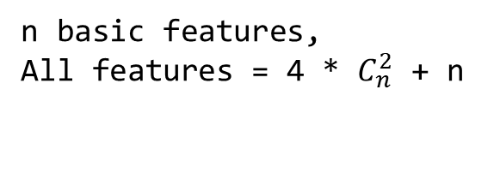
Basic Features
Dis12 | Spectrum Entropy | Sum of Absolute Difference | Centroid
Dis21 | Spectrum Centroid | Mean of Absolute Difference | Kurt
Dis22 | Max | Mean of Difference | Skew
P1 | Min | Median | RMS
P2 | Mean | Zero Crossing Rate | Entropy
Work_1: Features Selection
Step 1.
Get Basic Features and Do Feature Intersection
Feature Intersection
20 Commonly used Features
Core Feature of S:Dis21/Dis12
Core Feature of D:P1/P2
Not in this table
Feature_0 . . . Feature_19
n basic features,
All features = 4 * $C_{n}^{2}$ + n
Get Feature_i and Feature_j
_add_
_minus_
_multi_
_divide_
Feature_i
Feature_j
n = 20 ,
All Features = 480
Add 4 new intersected Featurs
Notes:
选择了20个常见的basic Feature。其中，S的关键指标xxx和D的关键指标，
不是直接能求得的，而是需要经过我们观察的复杂指标。
我们从20个feature中。
Feature随机选取两个。
然后对这两个特征，以加减乘除的方式进行，特征交叉。
以这种方法进行特征交叉，n个特征。可以获得4 * Cn2个特征。
所以20个特征一共可以获得480个特征。

Slide 6
Step 3.
Univariate Feature Selection
Work_1: Features Selection
Univariate feature selection based on F-Test
F-test captures
linear dependency
Choose Top K
Univariate feature selection based on mutual information
mutual information captures any kind of dependency
Choose Top K
Step 2.
Relevance Calculation
Calculate relevance between Feature_i and S/D, and then get p-value.
If p-value < 0.05, filter it out.
Union
K = 3
S: {‘Dis22_divide_Dis21’, ‘Dis21_divide_Dis12’, ‘Dis22_divide_Dis12’}
D: {‘Dis22_minus_P2’, ‘P1_multi_P2’, ‘Dis22_add_P2’, ‘P2_divide_P1’, ‘P2’}
S Prediction
480 -> 428
D Prediction
480 -> 370
Notes:
相关性表格
p-value calculation

Slide 7
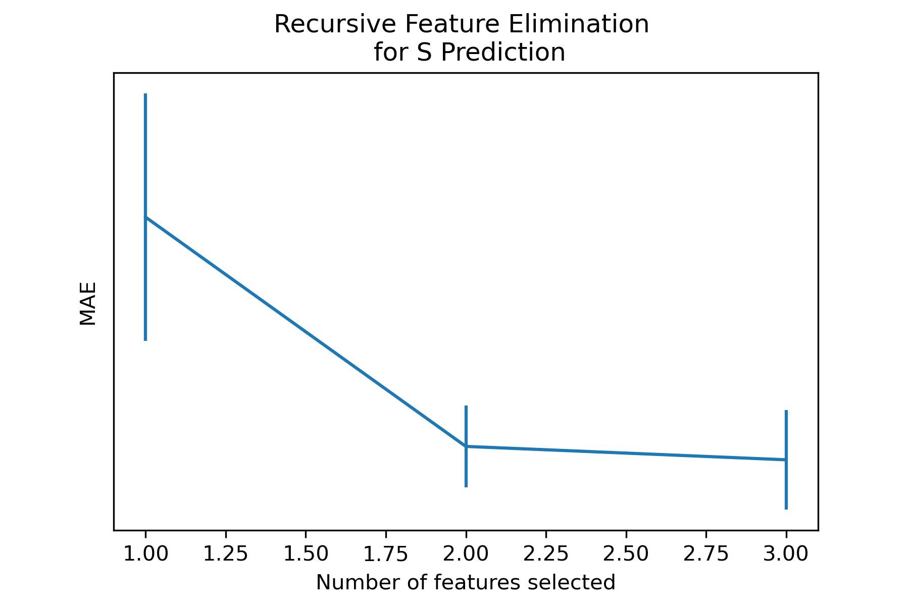
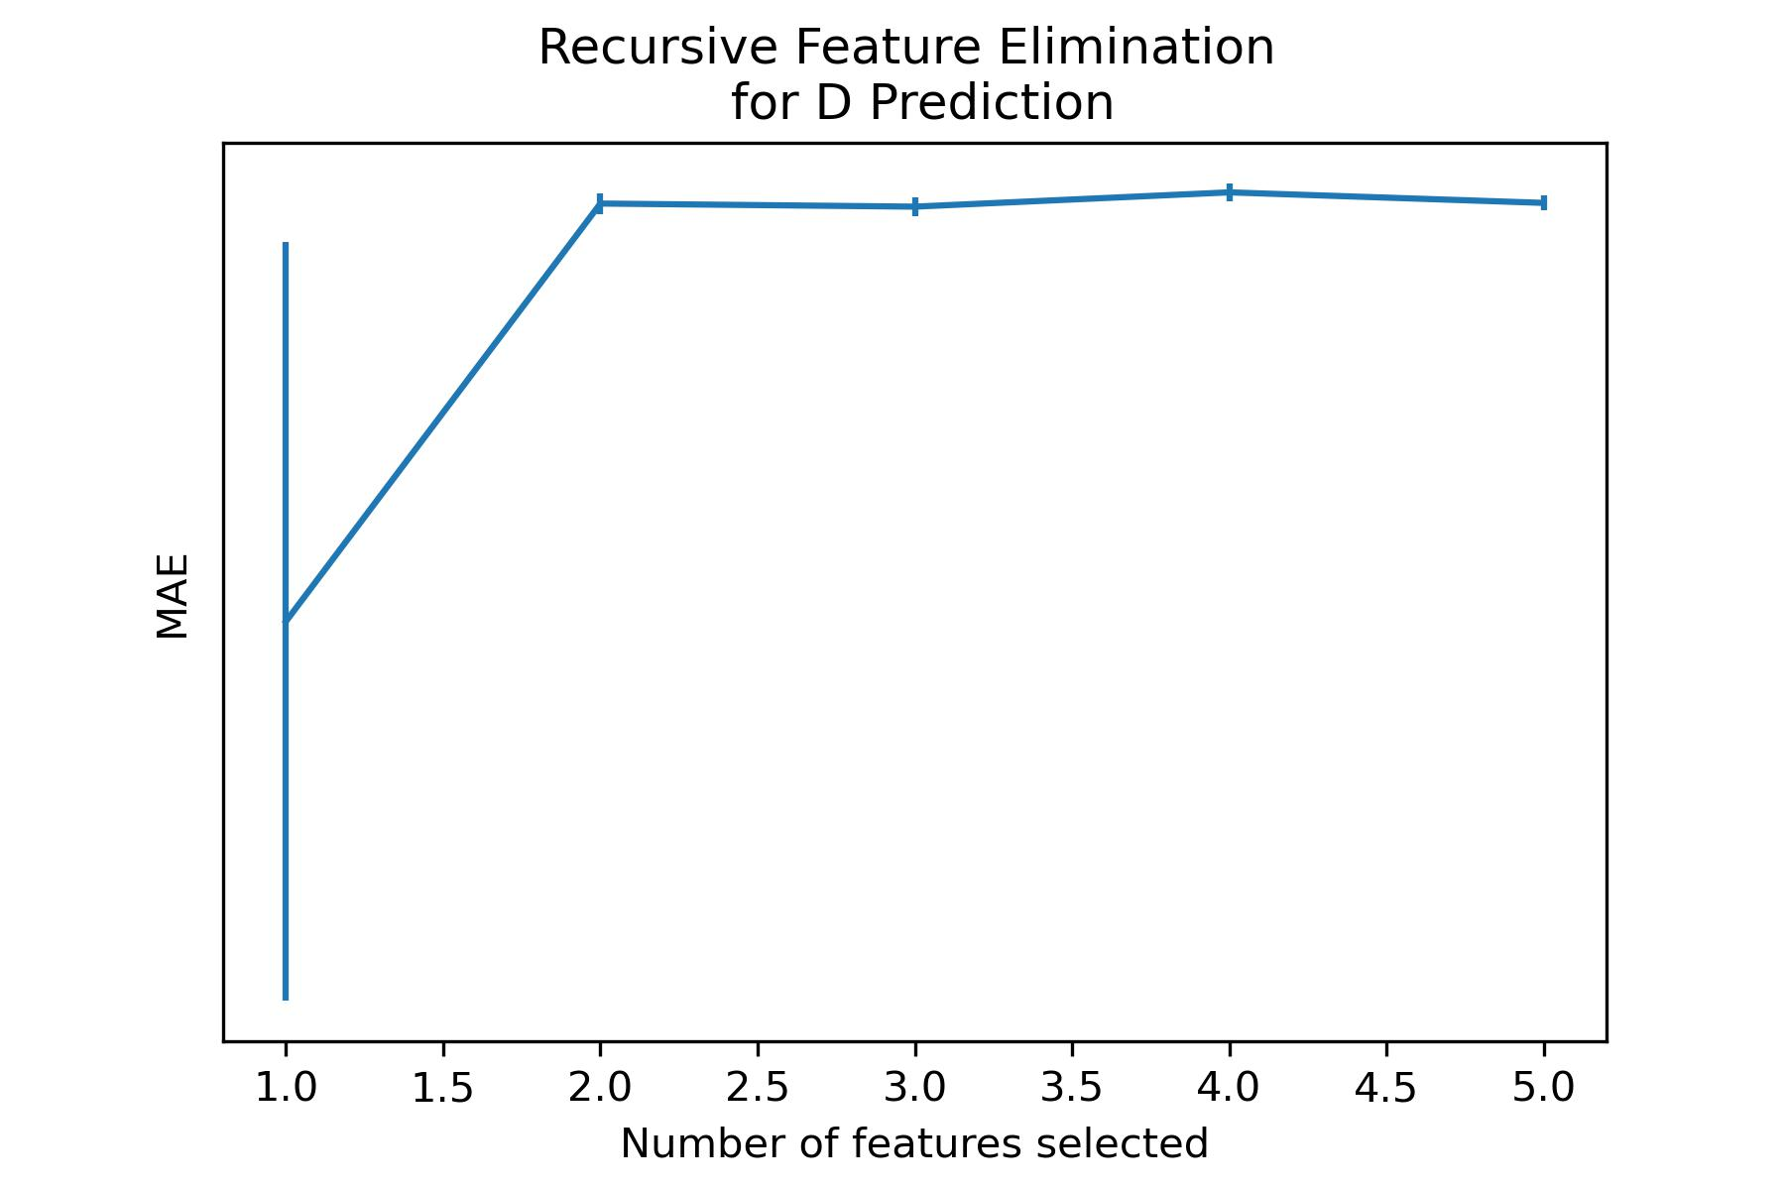
Work_1: Features Selection
Step 4.
Recursive Feature Elimination(RFE)
Optimal Choice for S Prediction:
‘Dis21_divide_Dis12’
Optimal Choice for D Prediction：
‘Dis22_minus_P2’, ‘Dis22_add_P2’, ‘P2_divide_P1’, ‘P2’
Notes:
自动回归的折线图

Slide 8
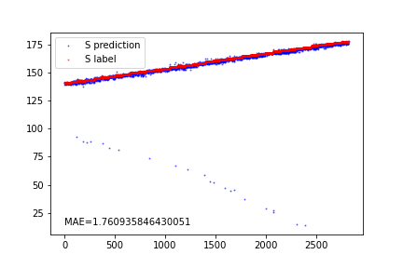
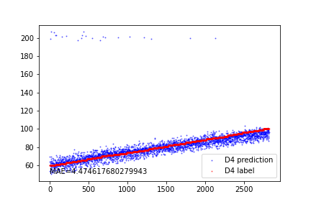
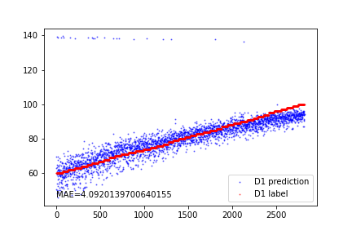
Work_1: Features Selection
Prediction performance for S
Prediction performance for D using the 4 features recommended by RFE
Prediction performance for D using only "P2_divide_P1"
I think
the core features for D were not selected because no denoising procedures are applied to signals with a noise level of 0.1.
The prediction performance using only the "P2_divide_P1" feature is not satisfactory.
Notes:
结果展示S和D的拟合效果
和原因分析

Slide 9
Work_2: S & D prediction in the noise level of 0.8
Data, Noise: 0.8
Data, Noise: 0.8
Bandpass filter
EEMD
FFT / Wavelet
Denoising
IMF_1
Smooth
Feature Extraction
S/D Prediction
Test
Notes:
大概阐释方法。

Slide 10
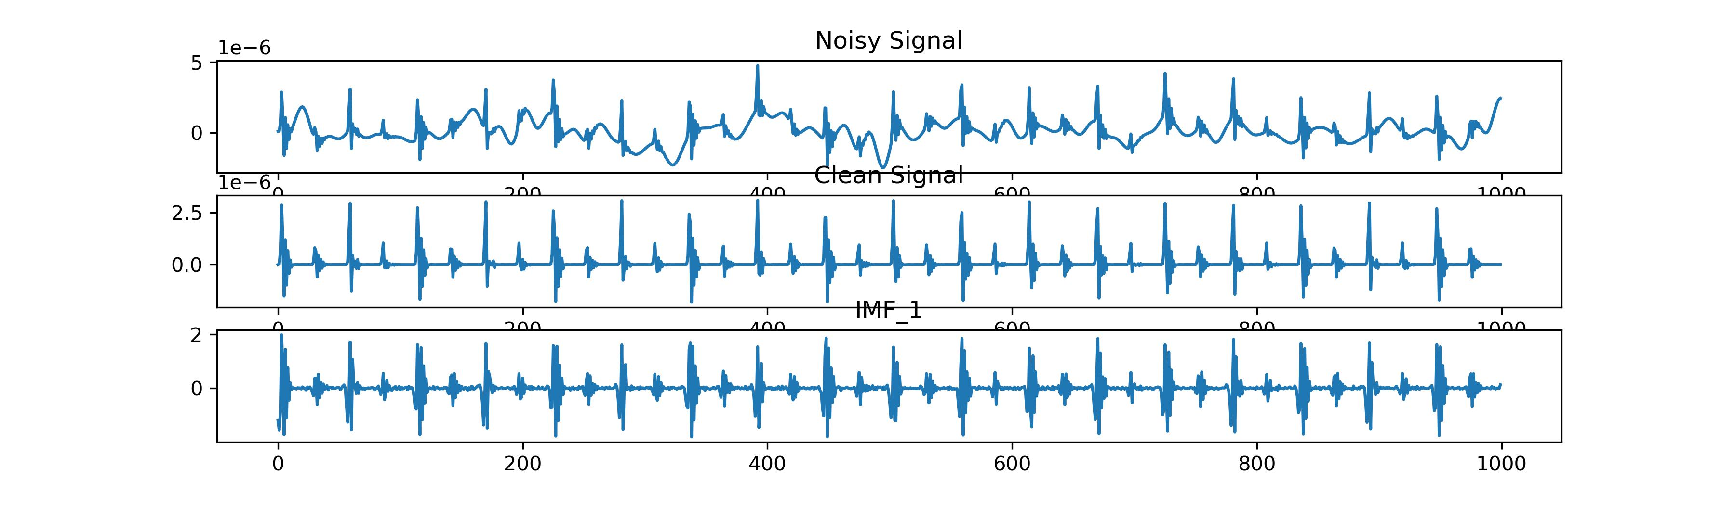
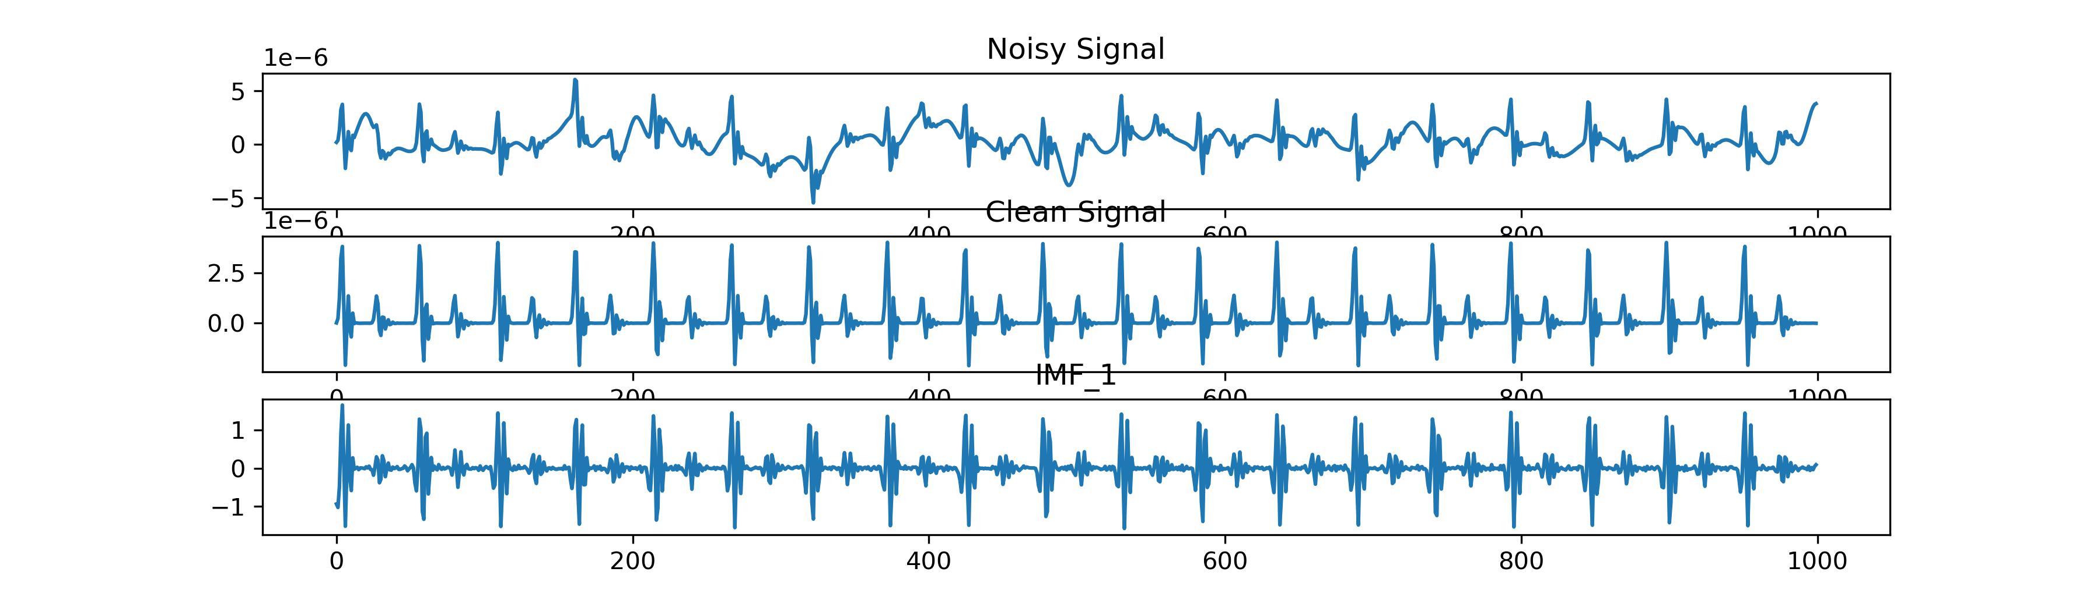
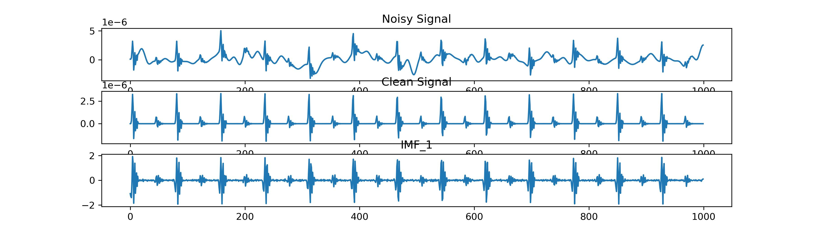
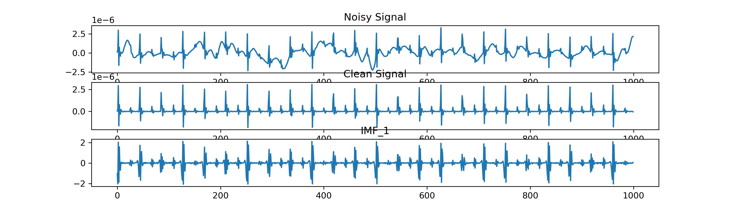
Work_2: S & D prediction in the noise level of 0.8
Noisy Signal of 0.8
Clean Signal
IMF_1 After EEMD
It's almost impossible to discern the original signal.
The variations in peak heights are great, while intervals remain relatively consistent.
It might be possible to employ IMF_1 for predicting S.
Notes:
IMF1和xx的原始信号的相似性

Slide 11
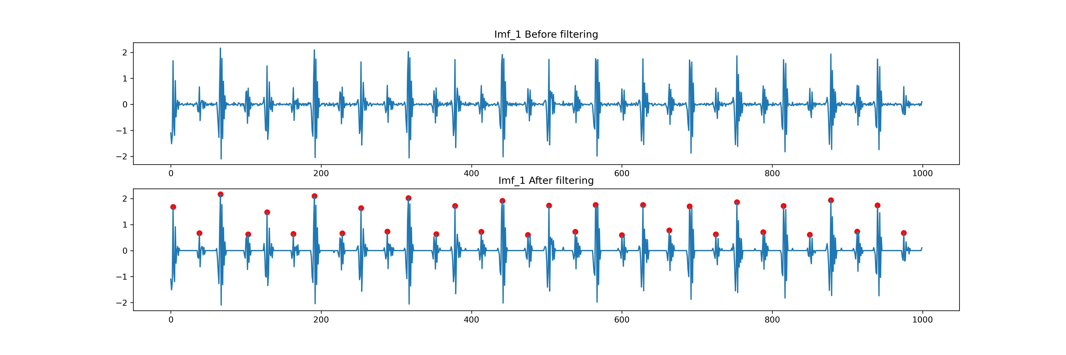
Work_2: S & D prediction in the noise level of 0.8
Signals between peaks are quite noisy and unclear, which is affecting the accuracy of peak detection.
Notes:
问题阐释，边变粗了。同时毛毛的。不知道如何去进行降噪。使用了一个trick。效果一般。

Slide 12
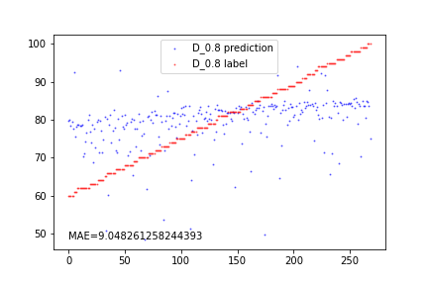
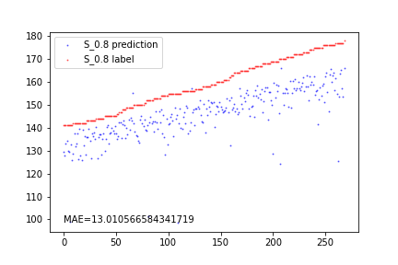
Work_2: S & D prediction in the noise level of 0.8
EEMD is extremely slow, which is why I use a training set of 500 signals and a test set of 300 signals.
The prediction for D is unsuccessful due to the great alteration in relative heights of peaks.
Regarding the prediction of S, the model can capture the trend, but MAE is notably high.
The performance is not meeting the desired standard.

Slide 13
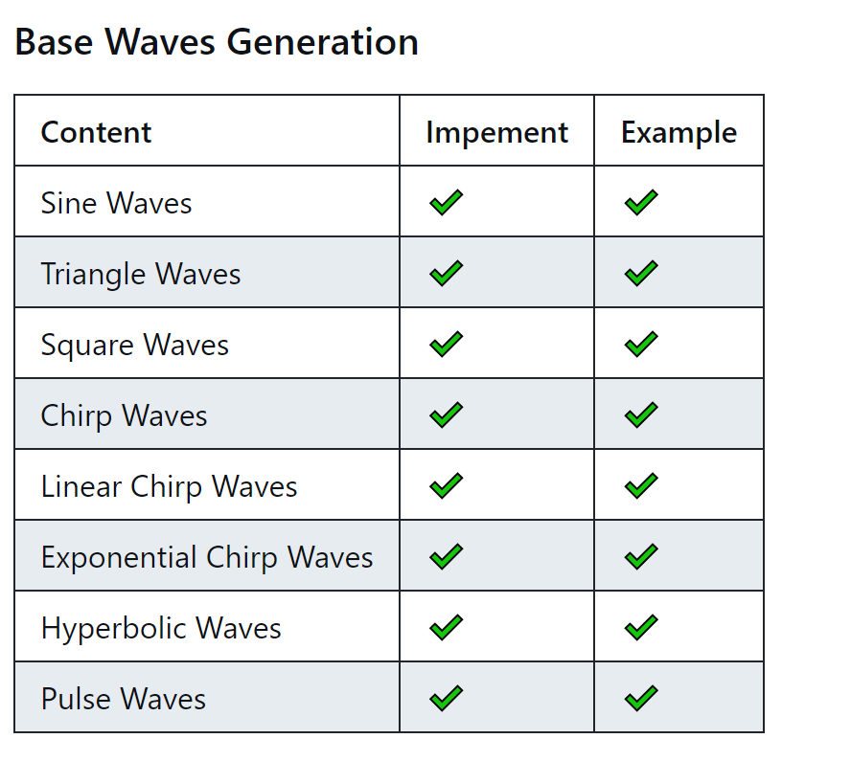
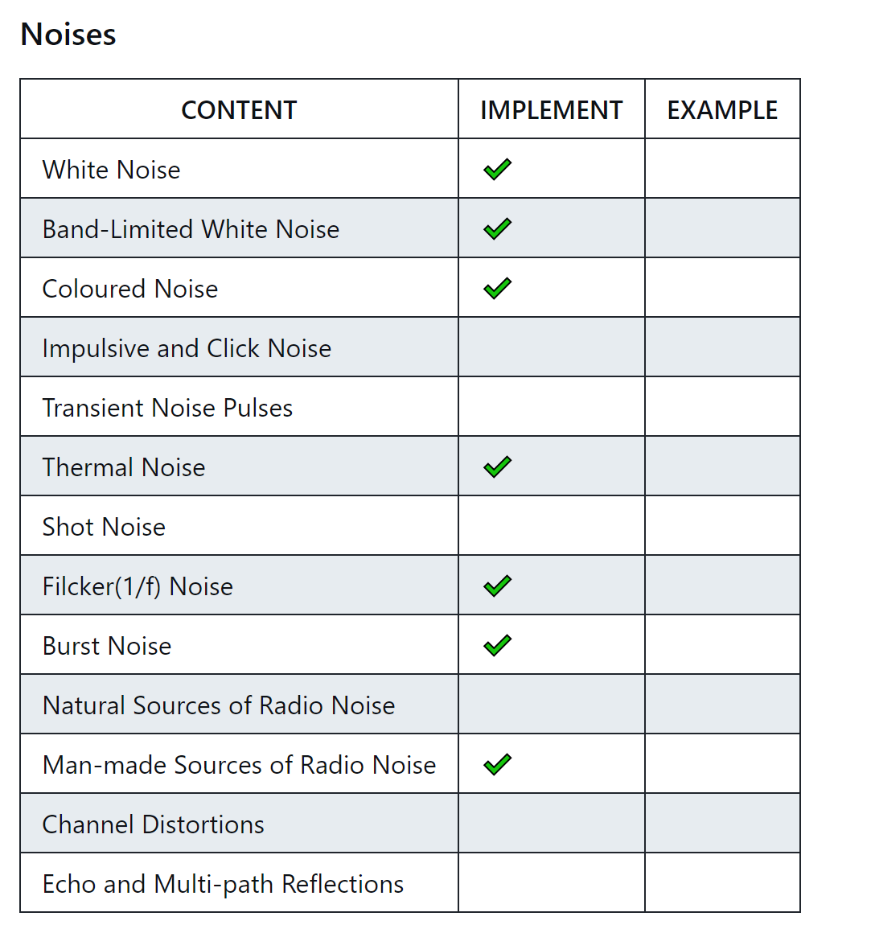
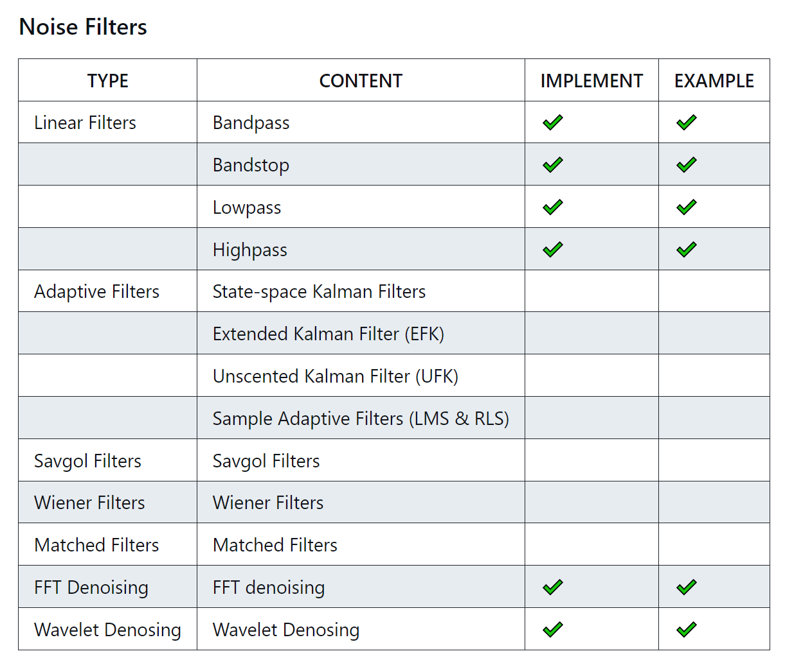
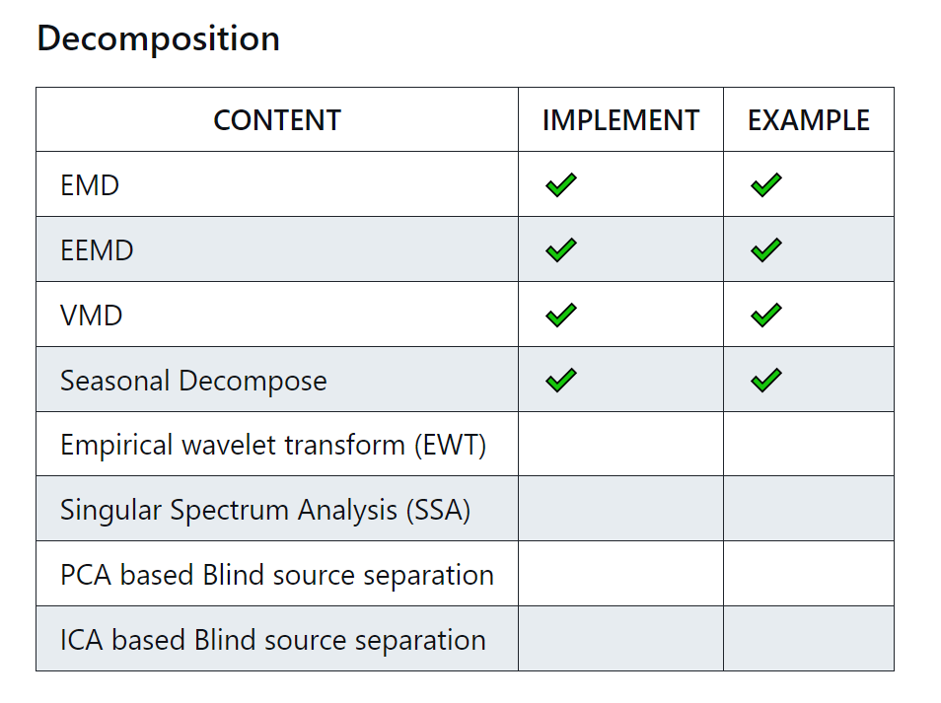
Work_3: Tutorial
In noise generation, I've encountered some challenges.
Some noise definitions are vague and difficult to implement accurately.
Notes:
展示一下进度。

Slide 14
Work_4: Theoretical knowledge Learning
Signals and Systems
Probability for Computer Scientists
Course: EE120, Berkeley
This week’s Progress:
Lecture 10 (the DFT; FIR filters)
Lecture 11 (Fourier transforms in two dimensions)
Course: CS109, Standford
This week's progress:
Part 1 (Counting)
Part 2 (Combinatorics)
Part 3 (Definition of Probability)
Next week’s plan:
Part 4 (Counting)
Part 5 (Combinatorics)
Part 6 (Definition of Probability)
Part 7 (Probability of or)
Part 8 (Conditional Probability)
Part 9 (Independence)
Notes:
This week, I have a hard time learning Hidden Markov Models.
I need to allocate some time to study probability theory in order to better understand the concepts.

Slide 15
Questions
During the denoising process, how do we determine that the outcome is satisfactory and that denoising results are acceptable? Can we determine this before features are fed into the model?

Slide 16
Thanks!

