Slide 1
Weekly Presentation
Jiayu Chen
2023.11.06

Slide 2
Work Description
Part_1:
About Getting Template (Weighted Average, Kalman Filter, DTW)
Some Thoughts about Removing Breathing Effect
Part_2:
Paper_1: A global averaging method for DTW
Paper_2: shapeDTW: shape Dynamic Time Warping
Paper_3: k-Shape
Part_3: Learning Progress and Future Learning Plan
Part_4: Some Thoughts about Undergraduate Thesis
Part_5: Questions

Slide 3
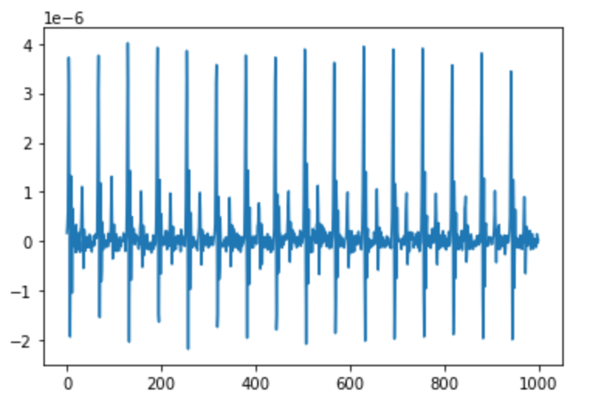
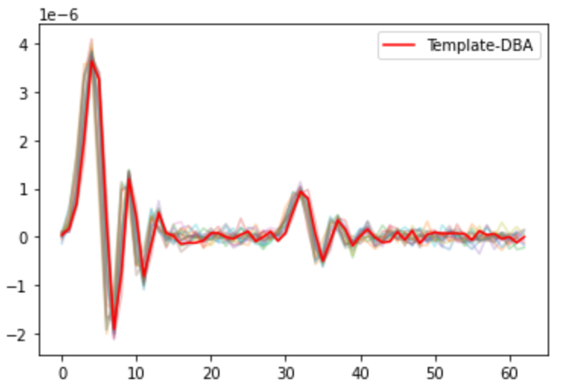
Part_1: Research - Getting Template
Model | State | S Prediction | D Prediction
No Template | No RR, Peak-Based Segmentation | 0.79 / 1.64 | 1.79 / 4.31
Mean | No RR, Peak-Based Segmentation | 1.35 / 1.38 | 4.53 / 4.44
Median | No RR, Peak-Based Segmentation | 1.42 / 1.45 | 4.07 / 4.49
PCA | No RR, Peak-Based Segmentation | - / - | - / -
K-shape 1 | No RR, Peak-Based Segmentation | 2.20 / 2.74 | 4.85 / 5.88
Weighted Avg | No RR, Peak-Based Segmentation | 1.95 / 1.98 | 4.63 / 4.74
K-shape 2 | No RR, Peak-Based Segmentation | 2.18 / 1.79 | 4.76 / 5.24
Kalman Filter | No RR, Peak-Based Segmentation | 1.45 / 1.37 | 4.82 / 4.60
DBA | No RR, Peak-Based Segmentation | 2.05 / 1.96 | 3.43 / 4.15

Slide 4
Part_1: Research - Getting Template
Preliminary conclusions reflected by experimental results:
Conclusion1:
In the case of using linear regression, the theoretical upper limit for predicting D of pure SCG signals should be 1.8.
However, current results obtained with the DBA algorithm suggest that the process of obtaining a standard template is a denoising process.
(The DBA algorithm will be briefly introduced later.)
Model | State | S Prediction | D Prediction
No Template | No RR, Peak-Based Segmentation | 0.79 / 1.64 | 1.79 / 4.31
DBA | No RR, Peak-Based Segmentation | 2.05 / 1.96 | 3.43 / 4.15

Slide 5
Part_1: Research - Getting Template
Preliminary conclusions reflected by experimental results:
Conclusion2:
Our previous use of K-shape and the conclusions (next page) drawn were incorrect.
Model | State | S Prediction | D Prediction
K-shape 1 | No RR, Peak-Based Segmentation | 2.20 / 2.74 | 4.85 / 5.88
K-shape 2 | No RR, Peak-Based Segmentation | 2.18 / 1.79 | 4.76 / 5.24

Slide 6
Previous Slide
No Noise / Noise Level of 0.1
Method | S Prediction | D Prediction
No Template | 0.79 / 1.64 | 1.79 / 4.31
Median | 1.42 / 1.45 | 4.07 / 4.49
K-shape | 2.20 / 2.74 | 4.85 / 5.88
3 Why the performance of K-shape is not satisfactory?
The K-shape algorithm generates a new signal during clustering. The issue lies in the clustering rather than the underlying Time-Warping concept.
We should discard clustering and focus on researching how to apply Time-Warping effectively.

Slide 7
Part_1: Research - Getting Template
Preliminary conclusions reflected by experimental results:
Conclusion3:
In principle, the Kalman Filter's approach to dealing with multi-sensor confusion can effectively suppress noise. Although the current results are not promising, I still believe that the path of the Kalman Filter has potential. However, it might not be worth publishing.
Model | State | S Prediction | D Prediction
No Template | No RR, Peak-Based Segmentation | 0.79 / 1.64 | 1.79 / 4.31
Mean | No RR, Peak-Based Segmentation | 1.35 / 1.38 | 4.53 / 4.44
Median | No RR, Peak-Based Segmentation | 1.42 / 1.45 | 4.07 / 4.49
Kalman Filter | No RR, Peak-Based Segmentation | 1.45 / 1.37 | 4.82 / 4.60
DBA | No RR, Peak-Based Segmentation | 2.05 / 1.96 | 3.43 / 4.15

Slide 8
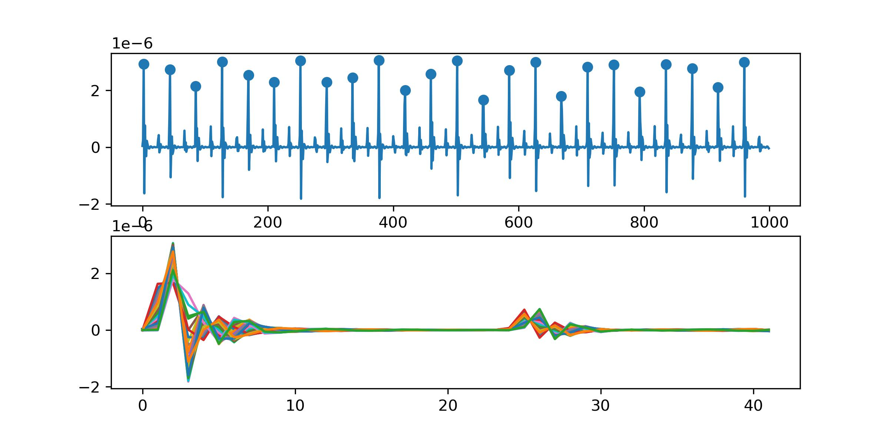
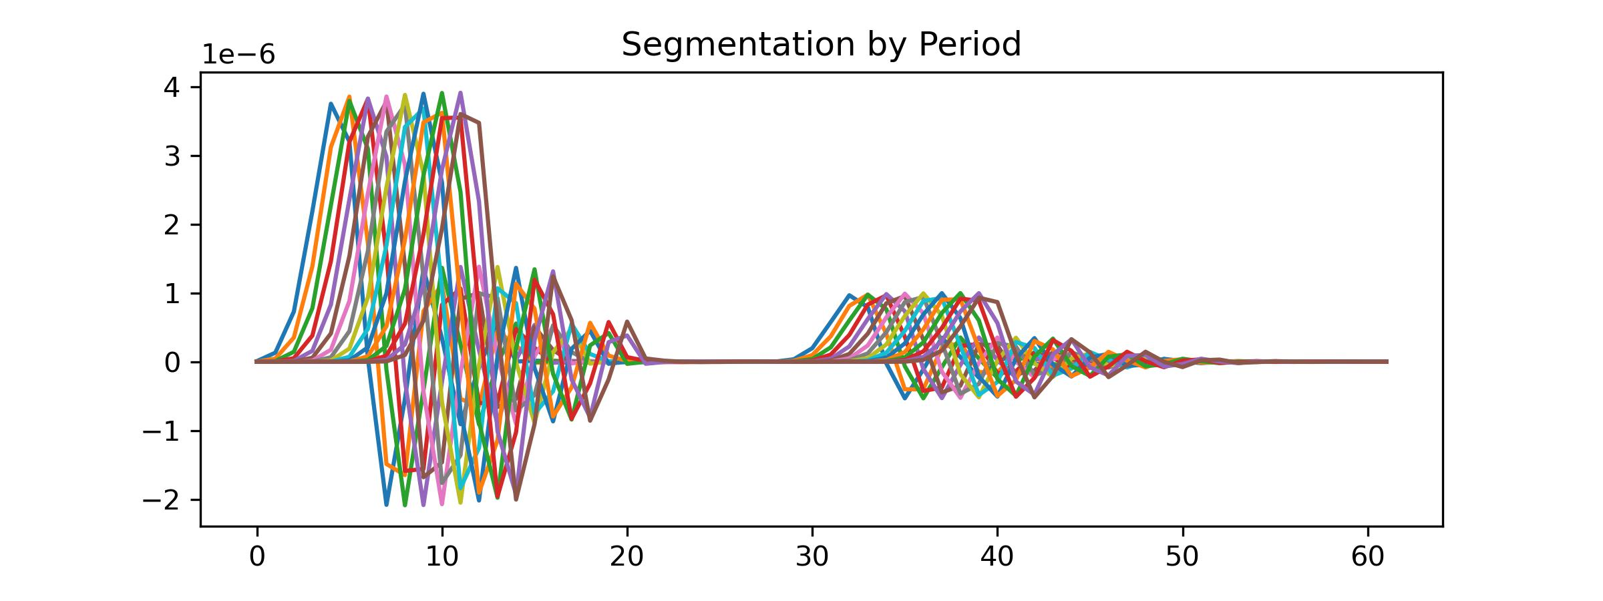
Previous Slide
What features should a good algorithm for obtaining a template have?
Feature 1: The highest points of both large and small peaks for each piece should be aligned after applying the algorithm.
Feature 2: The distance between two peaks of the template should be the rounded average of distances between two peaks for all pieces.
Feature 3: The ability to handle time shifts (possibly essential in real data but less critical in simulated signals).
The primary focus of research should indeed be on Time Warping to get perfect template of SCG signals.

Slide 9
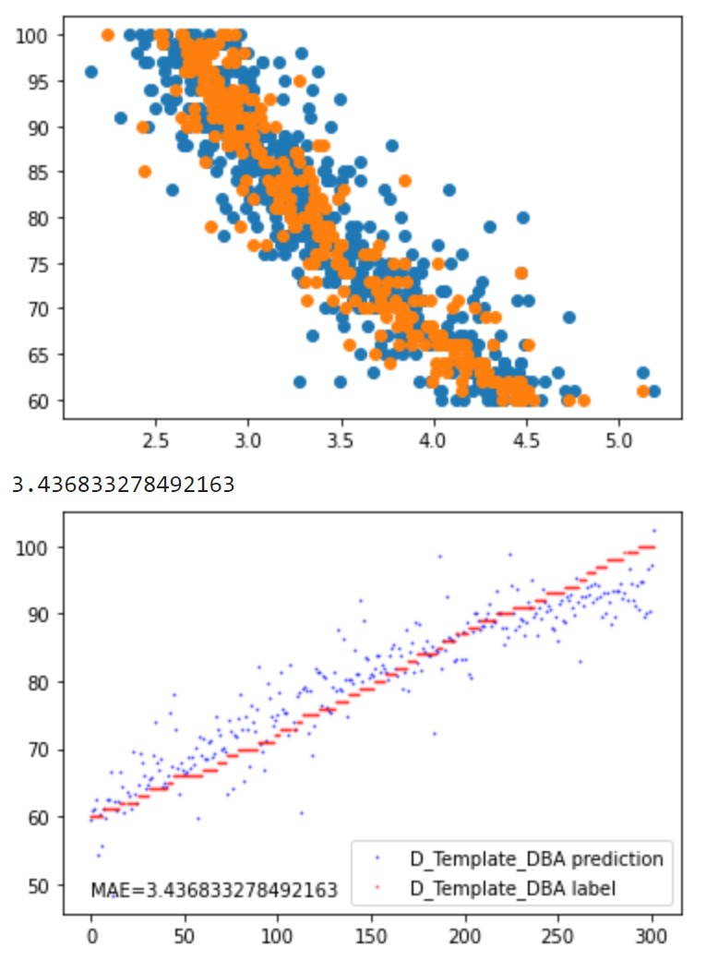
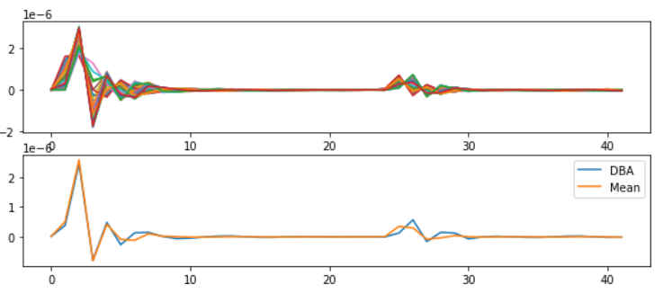
Part_1: Research - Getting Template
At the same time, I have separately run models like DTW, dDTW, wDTW, and shapeDTW on pure SCG signals. Since SCG signals themselves are not very complex, the matching results are all quite similar.
Conclusion:
1. Thanks to methods like DBA for calculating the mean of sequences, the issue of small peaks has been largely resolved.
2. As can be seen in the graph on the right, the points are scattered. In the future, further analysis is needed to
identify the bottlenecks of this algorithm.

Slide 10
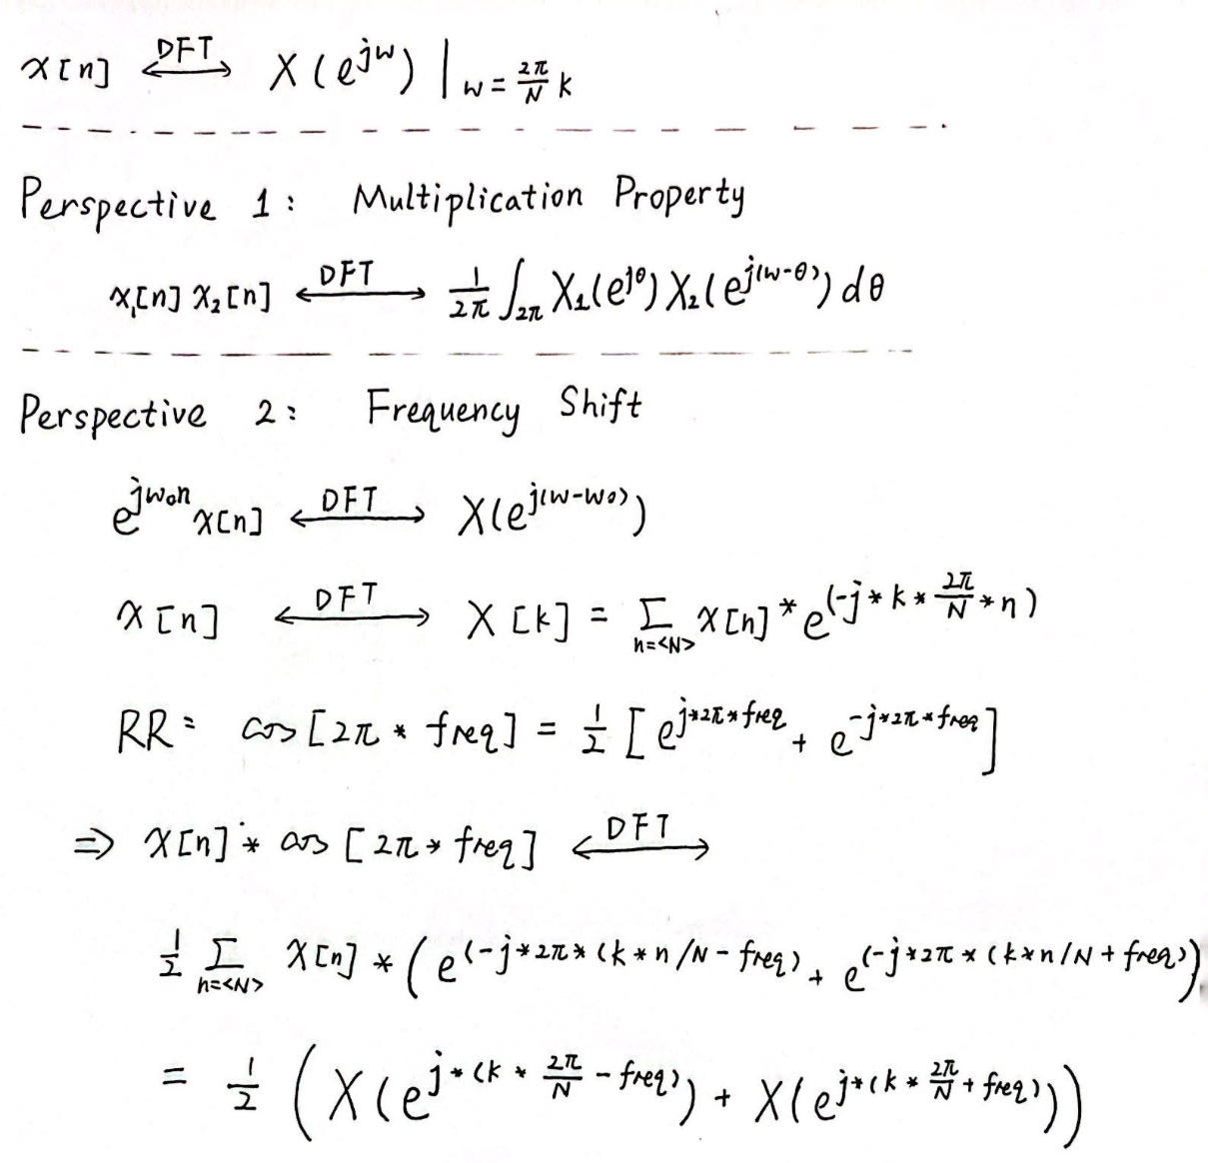
Part_1: Research - Breath Removal
Perspective 1:
The multiplication in the time domain is equivalent to convolution in the frequency domain. It's not easy to approach the problem from this perspective.
Perspective 2:
The original equation is equivalent to the linear addition of the original signal after it undergoes a frequency shift.
Provided us with some insights:
1. Breathing is very likely the lowest-frequency component in meaningful signals.
2. For time-domain decomposition, there is no way to separate the breathing signal.
3. Multiplying the original signal by a periodic signal in the frequency domain works well. Algorithms that can decompose the frequency domain may be able to solve the problem.

Slide 11
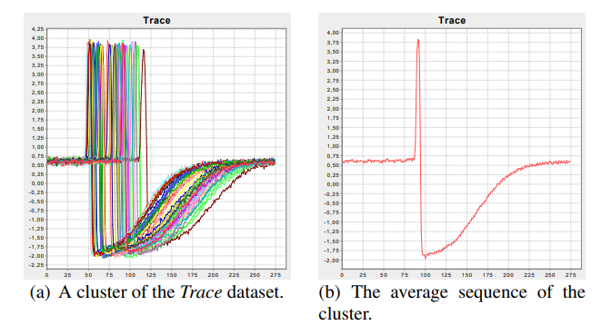
Part_2: Paper Reading
Petitjean F, Ketterlin A, Gançarski P. A global averaging method for dynamic time warping, with applications to clustering[J]. Pattern recognition, 2011, 44(3): 678-693.
Paper_1: A global averaging method for DTW - DBA
The Propose of the Paper: the computation of an average of a set of sequences
Solved Problems:
They develop a global technique for averaging a set of sequences, which avoids using iterative pairwise averaging.
2. They describe a new strategy to reduce the length of the resulting average sequence.

Slide 12
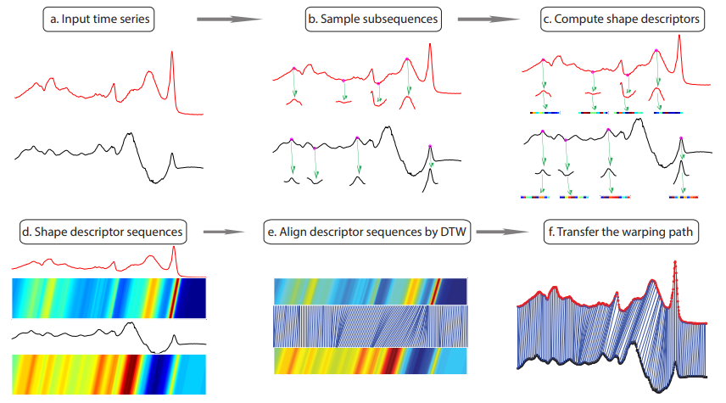
Part_2: Paper Reading
Zhao J, Itti L. shapedtw: Shape dynamic time warping[J]. Pattern Recognition, 2018, 74: 171-184.
Paper_2: shapeDTW: shape Dynamic Time Warping
Shape Descriptors:
Raw-Subseq,
PAA, DWT,
Slope, HOG1d
Derivative

Slide 13
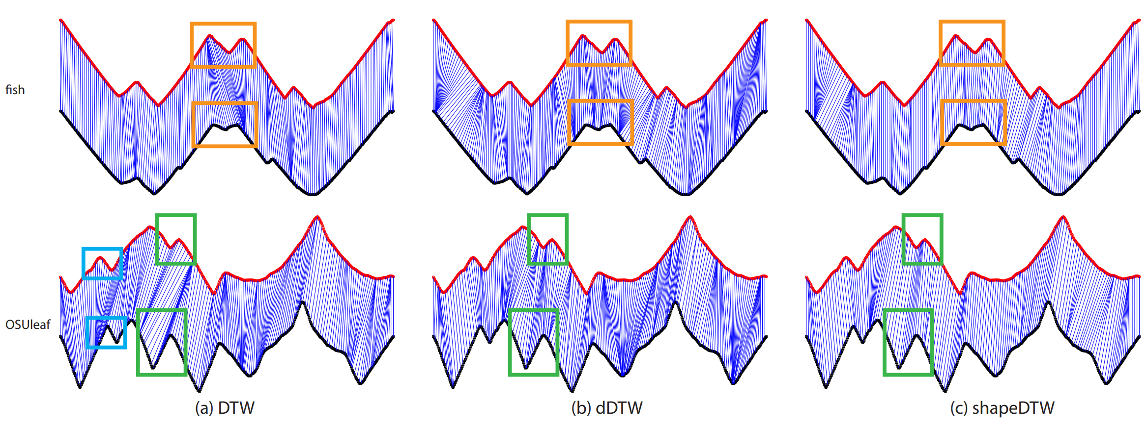
Part_2: Paper Reading
Paper_2: shapeDTW: shape Dynamic Time Warping

Slide 14
Part_2: Paper Reading
Paparrizos J, Gravano L. k-shape: Efficient and accurate clustering of time series[C]//Proceedings of the 2015 ACM SIGMOD international conference on management of data. 2015: 1855-1870.
Paper_3: k-Shape
NLAAF: Nonlinear alignment and averaging filters
PSA: Prioritized shape averaging
RSTMF: Ranking Shape-based Template Matching Framework
DBA: Dynamic Time Warping Barycenter Averaging
KSC: K-Spectral Centroid Clustering

Slide 15
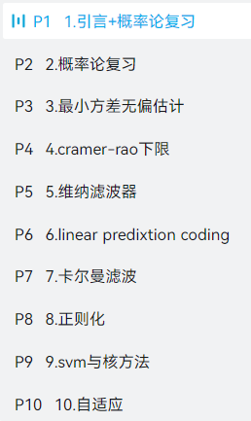
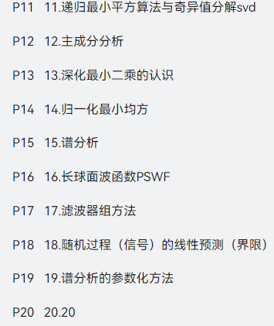
Work_3: Learning Progress and Future Learning Plan
Completed theoretical studies:
EE120 (all videos and lectures)
Complex Functions and Integral Transforms (completed half of the exercise book)
Theoretical studies I plan to undertake next.：
现代数字信号处理I 张颢
现在数字信号处理II 张颢
(Array signal processing, time-frequency analysis,
compressive sensing, Bayesian methods)
Next research directions:
1. Further exploration of methods mentioned in K-shape.
2. Seek out latest methods in data mining journals.
3. Search for algorithms that can effectively decompose the frequency domain.
4. Gradually explore real datasets based on the laboratory's research papers.

Slide 16
Some Thoughts about My Undergraduate Thesis
I hope it is a framework for any periodic physical signal.
Segmentation
Get Template
The actual achieved results should be as follows:
Even when segmentation is only possible based on the periodic length, it's possible to synthesize a reasonably good signal.
If more information can be generated during the segmentation process, the template synthesis will be even better.
Sliced signals without any knowledge of their nature
Sliced signals with some knowledge of their nature
Sliced signals with deep knowledge of their nature

Slide 17
Questions
Do you think what I just said has any research value, or if it's implemented, does it make sense?
2. In our laboratory paper, does the deep learning model also have data shift in its dataset? I have built an identical model, but it doesn't work.
3. Regarding the proposal presentation, Professor Xie's advice is to approach it from a more general perspective. For instance, what I should write about is how to perform the extraction of a standard template from a periodic physical signal, then elucidate my methodology, and in the experimental section, validate it using our SCG signal or BCG signal.
4. In the current thesis, when mentioning 'Time Alignment' or 'DTW,' they are often used for clustering, classification, and data argumentation. Can we refer to the current work as 'DTW for Regression'? Compared to 'DTW for Classification,' 'DTW for Regression' has a distinct focus.
5. Do you think the tutorial we wrote is too simple?

Slide 18
Questions
Regarding excellent graduation theses in Jiangsu Province, the bottom line is that there must be a thesis publication.

Slide 19
Thanks!

