Slide 1
An Easy Presentation About FMM
Jiayu Chen
2023.11.06

Slide 2
Firstly, limited by my mathematical knowledge, I currently don't have a deep understanding of the mathematical principles behind the algorithm.
I can only share my perspective as a user regarding the algorithm's practical use in our experiments.
1. I will provide my R commands.
2. I will demonstrate the algorithm's effects.
3. I will offer a simple analysis.
If I have not been using FMM correctly, I would greatly appreciate it if you could point it out in person. Any suggestions you can provide would be highly appreciated."

Slide 3
Our current objectives are:
Eliminate the influence of the breathing artifact on the signal.
2. Eliminate the impact of echo on the signal.
3. Use a segment of the signal (approximately 10 seconds, typically containing 10-25 cycles) to generate a standard template, thereby improving the signal-to-noise ratio.

Slide 4
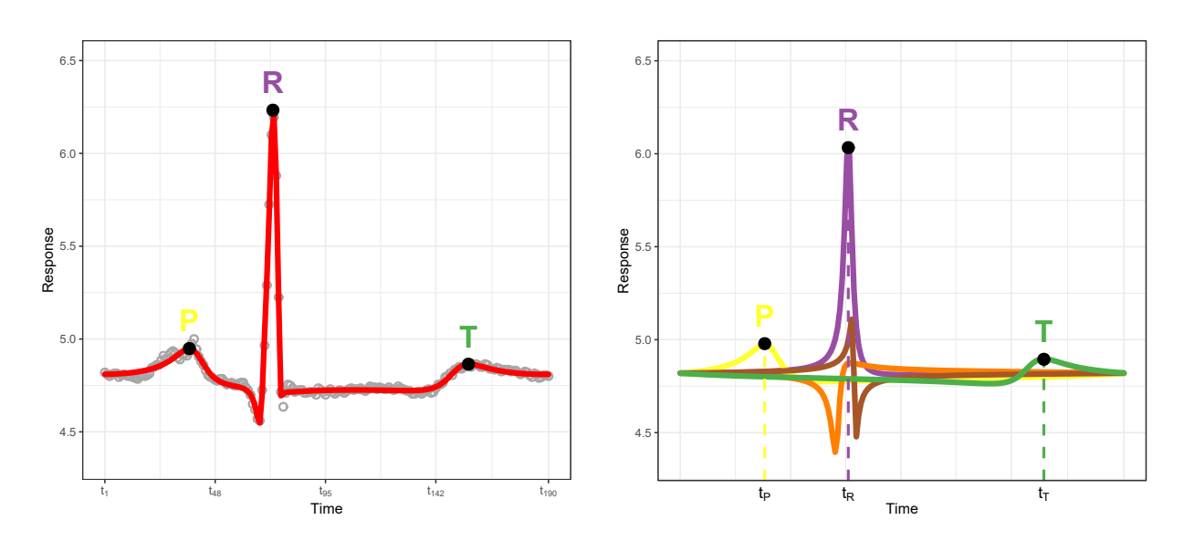
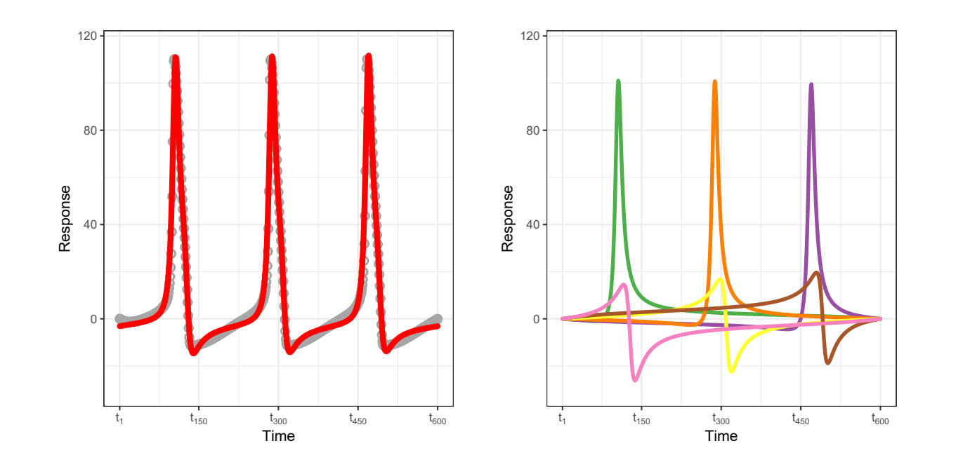
在我的印象里面，FMM算法有两种使用方式：
Usage1
One-Circle or Multi-Circles input
One-circle output
Usage2
Multi-Circles input
Multi-circles output

Slide 5
Smoothed Template (One Circle)
&
FMM Components
FMM Algo
Whole Signal
FMM Components
Usage1
fitFMM(vData=scg_signal, nPeriods=16, nback=3)
# break one 16-period scg signal into 16 periods, calculate the average of these periods and decompose it into 3 components.
Usage2
If I want to handle the whole signal, I have to use the FMM like this:
fitFMM(vData=scg_signal, nPeriods=1, nback=16 * 3)
# I need to decompose the whole signal into 48 components! I can’t get results in my laptop.

Slide 6
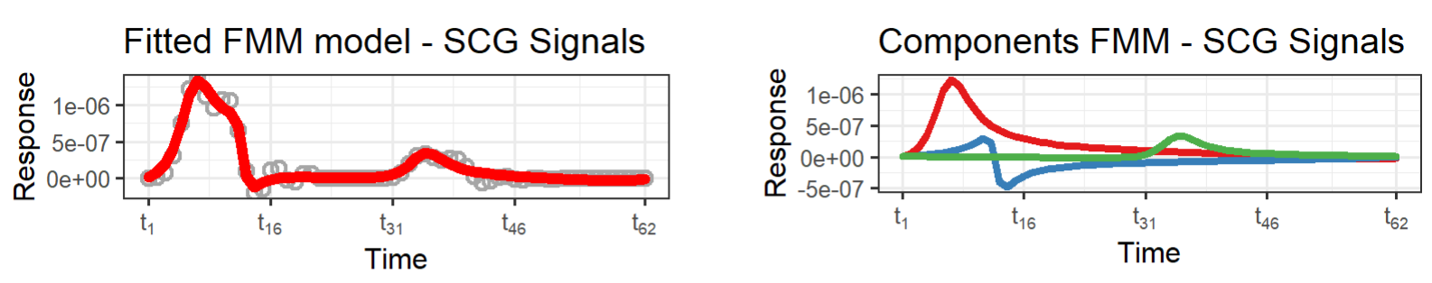
In Usage1, I guess you split the signal like this:
Calculate the length:
length(Single-Circle Signal) = length(Whole Signal) / #Circles
2. Take Average and get one circle.

Slide 7
使用一段信号（10s左右，常常包含10-25个周期）去合成一个标准的模板，从而提高信号的信噪比。
Usage 2
FMM Algo
Smoothed Template (One Circle)
&
FMM Components
Whole Signal
length(Single-Circle Signal) = length(Whole Signal) / #Circles
Caused Issues：

Slide 8
Thanks!

