Slide 1
Presentation
Jiayu Chen
2024.02.26

Slide 2
Work Description
Part_1: Template-based IBI Prediction
Part_2: BP-related Features
Part_3: Questions

Slide 3
Template-based IBI Prediction
Heart Beat Estimation
HR Estimation, MAE | Yingjian | New Method
All Back | 1.115 | 1.021
All, Posture=0 | 1.984 | 2.000
Dataset 1的质量比dataset2的质量要好不少。
本数据使用的Yingjian学长的quality control方法，所以New Method的数值可以进一步的提升
Dataset 1的质量比dataset2的质量要好不少。
本数据使用的Yingjian学长的quality control方法，所以New Method的数值可以进一步的提升

Slide 4
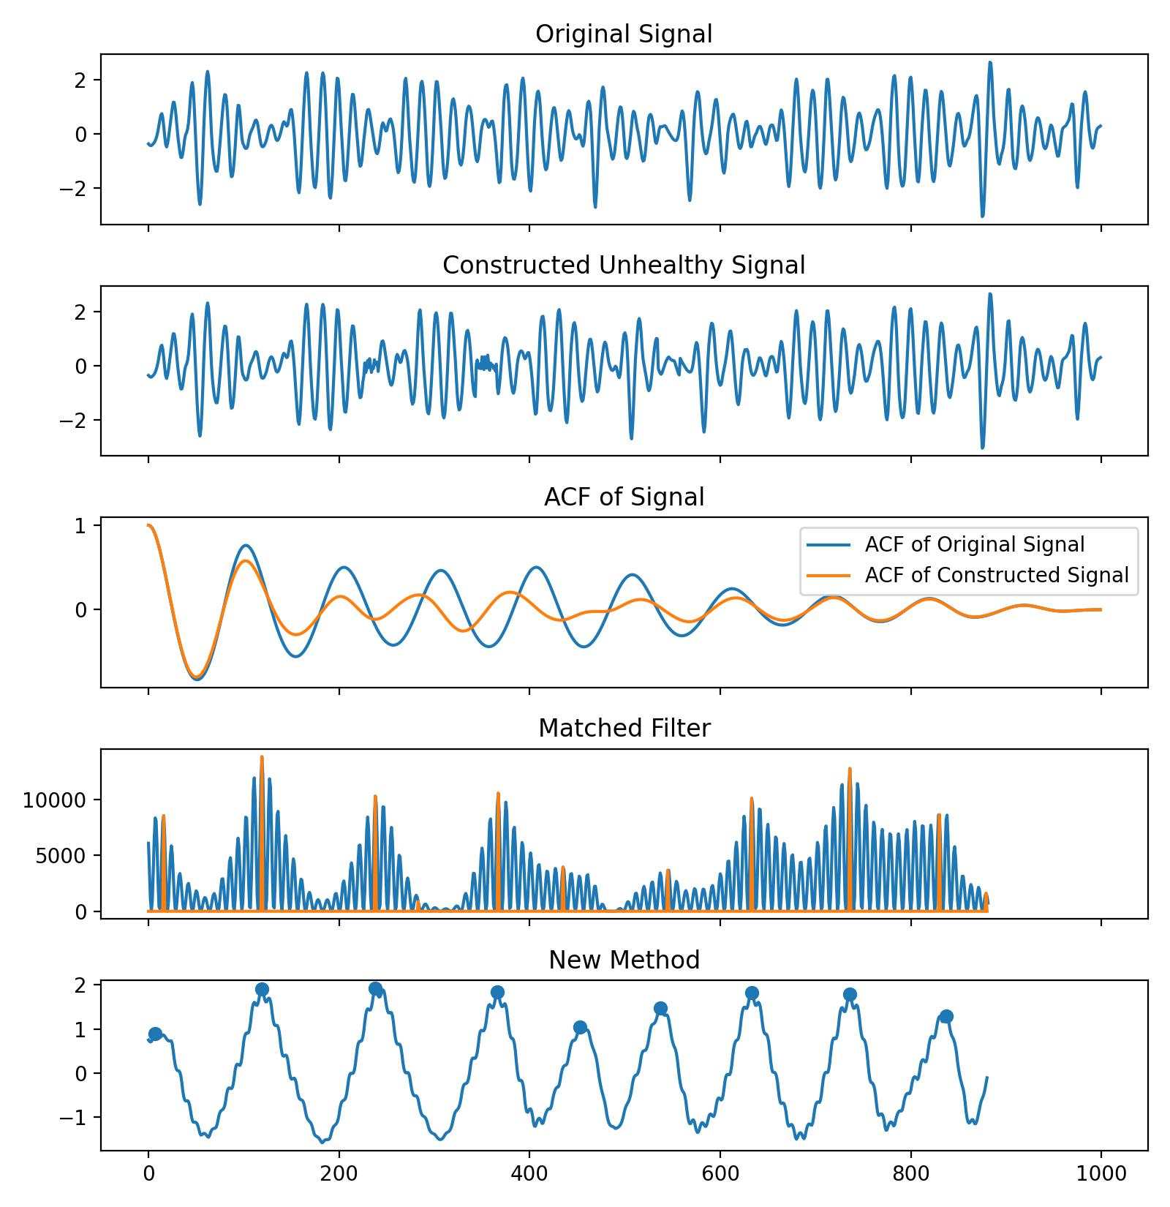
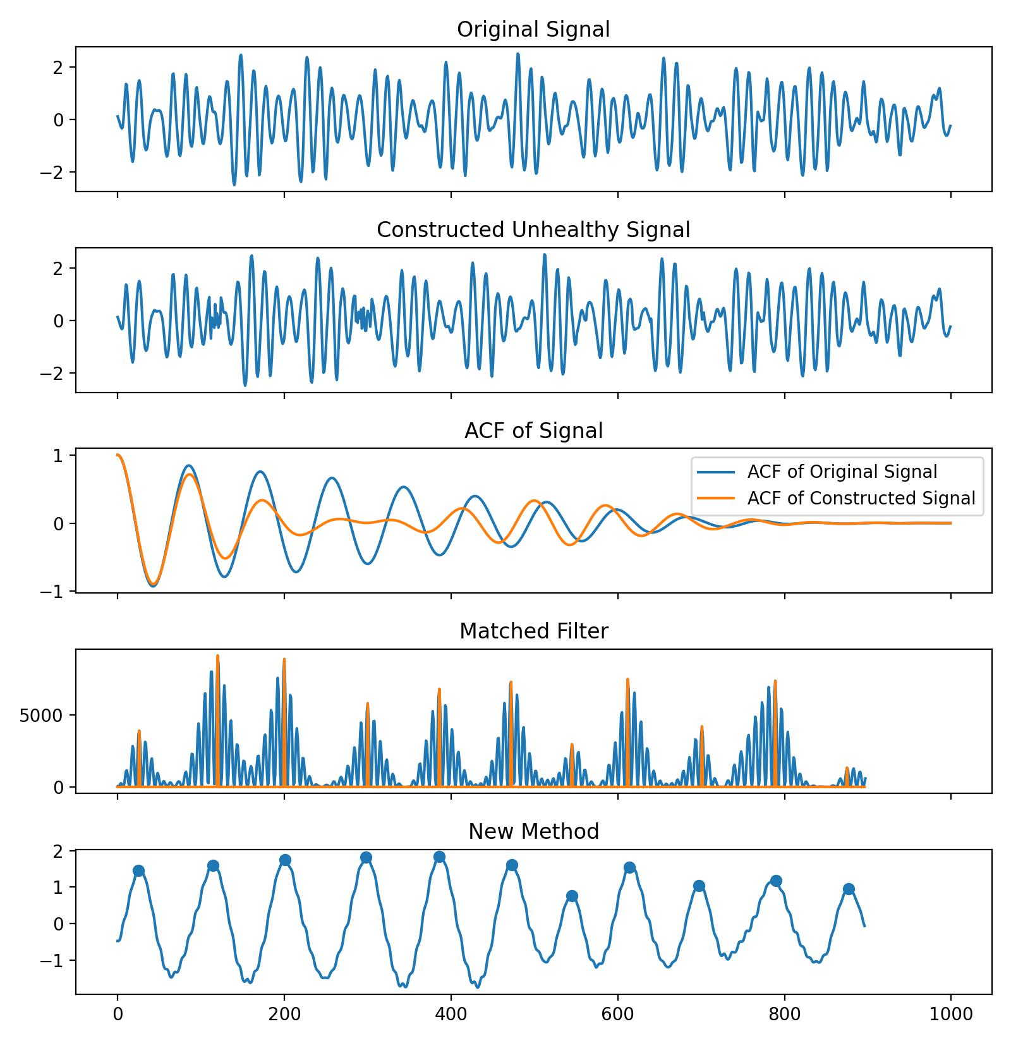
Template-based IBI Prediction
Confusion Matrix | Normal | Abnormal
Normal | 548 | 95
Abnormal | 3 | 2519
保证心率不变的情况下，构造心率异常的数据集，心率正常与心率异常的比例大致在1:4。
通过先提出的算法进行异常与不异常的分类。

Slide 5
Template-based IBI Prediction
HR Estimation, MAE | Yingjian | New Method
All Back | 1.115 | 1.021
HR Estimation, MAE | Yingjian
All Back(all) | 1.115
All Back(healthy) | 1.851
All Back(arrhythmia) | 1.034
Conclusion:
1.

Slide 6
Template-based IBI Prediction

Slide 7
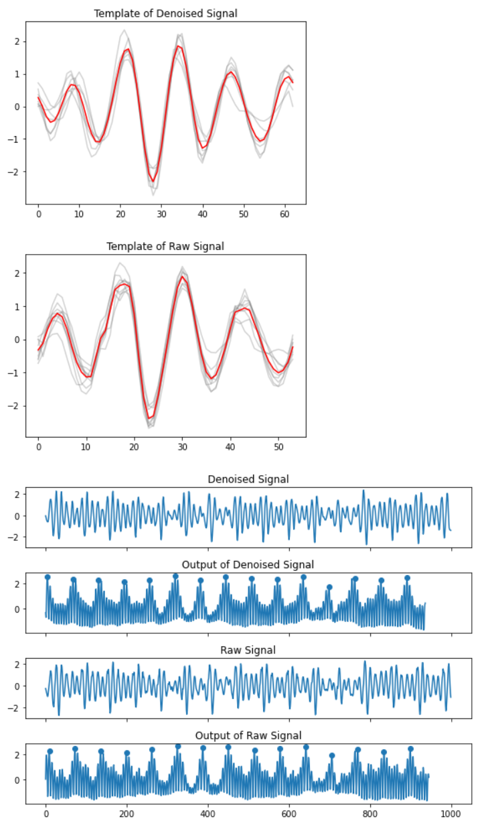
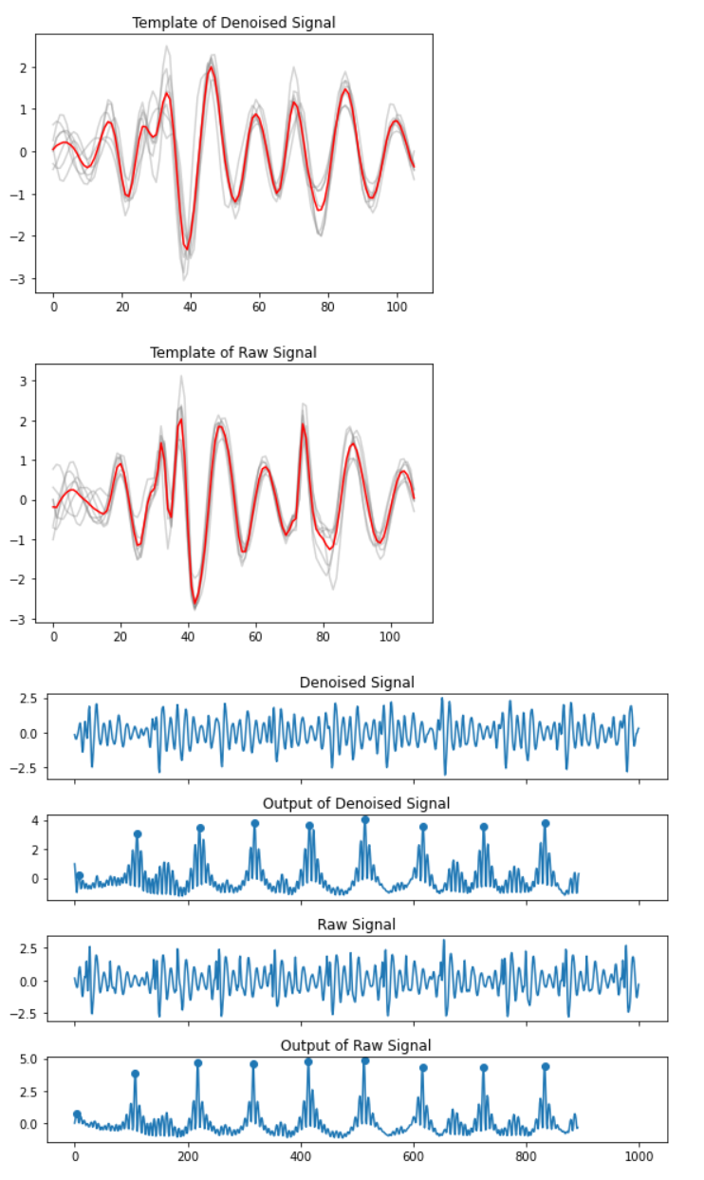
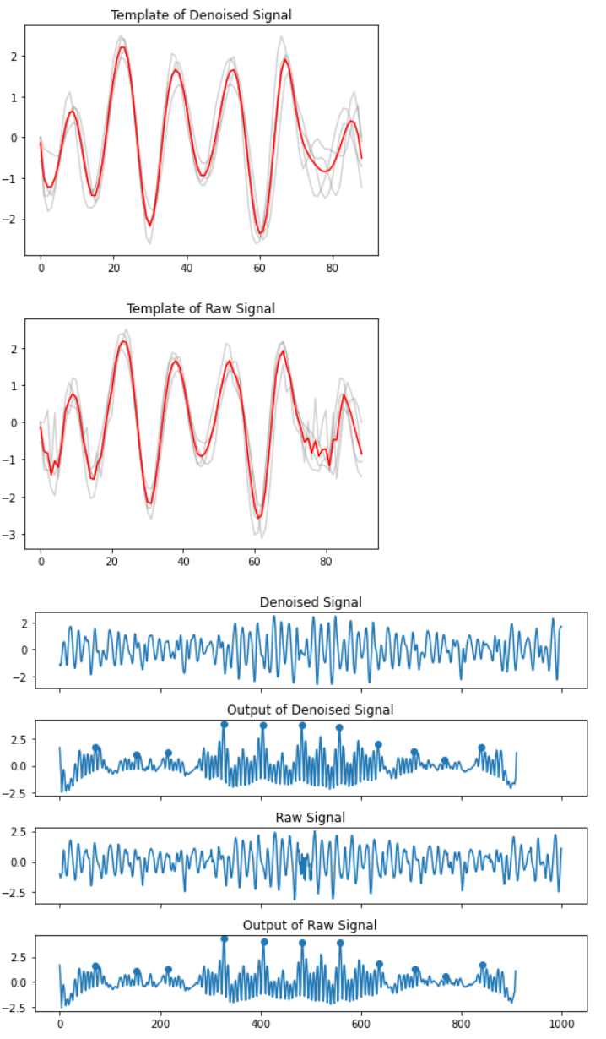
Template-based IBI Prediction
HR Estimation, MAE | Yingjian | New Method
All Back | 1.977 | 1.615

Slide 8
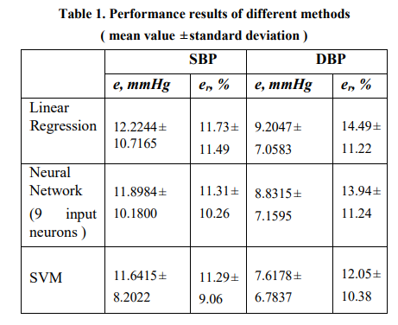
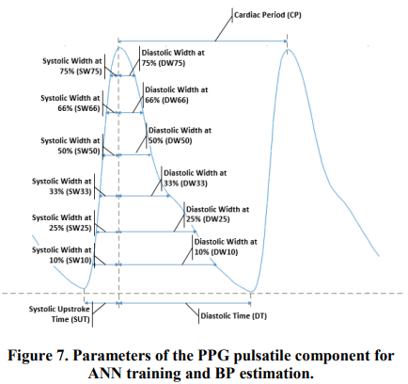
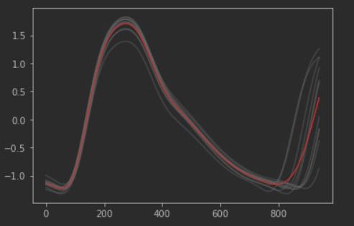
Template-based IBI Prediction
Model | S | D
LR | 15.737 | 8.495
SVR | 14.905 | 7.869

Slide 9
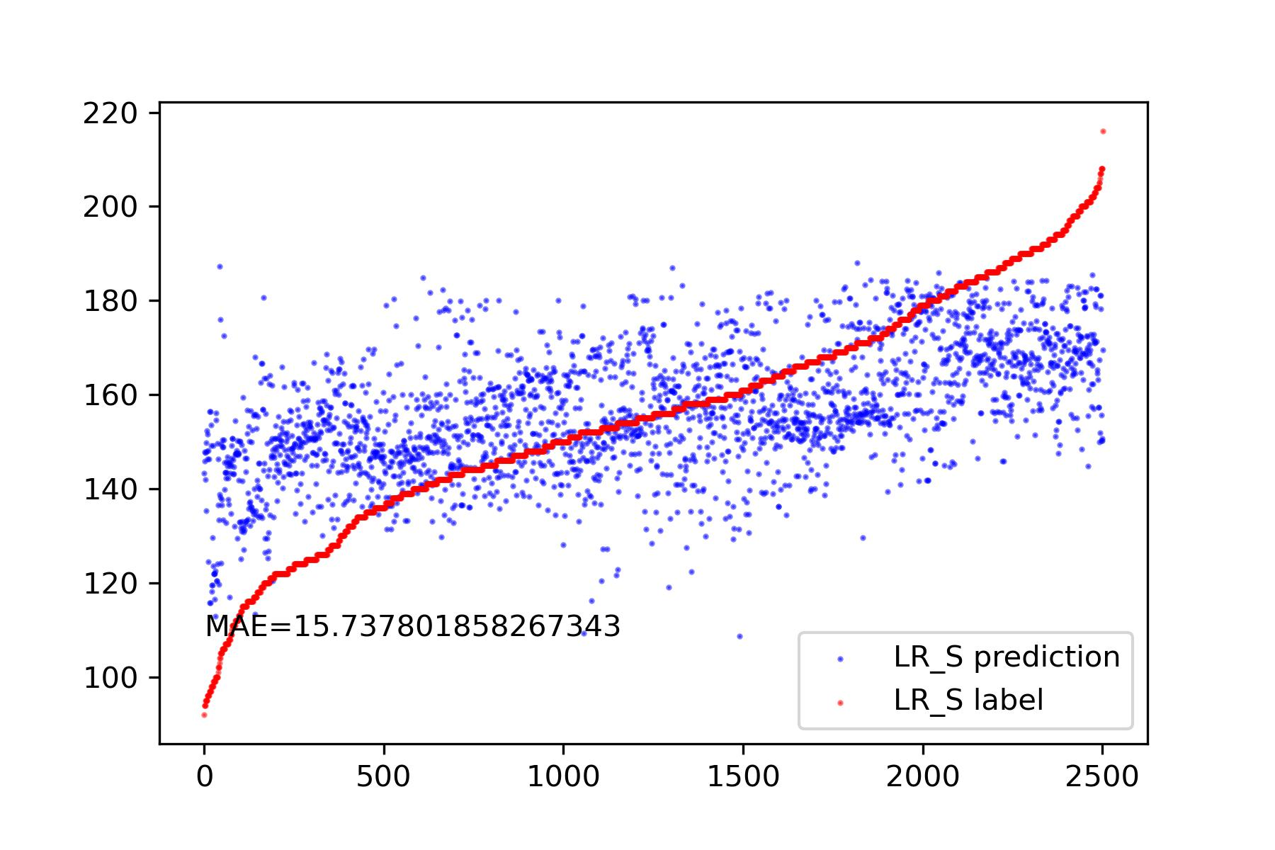
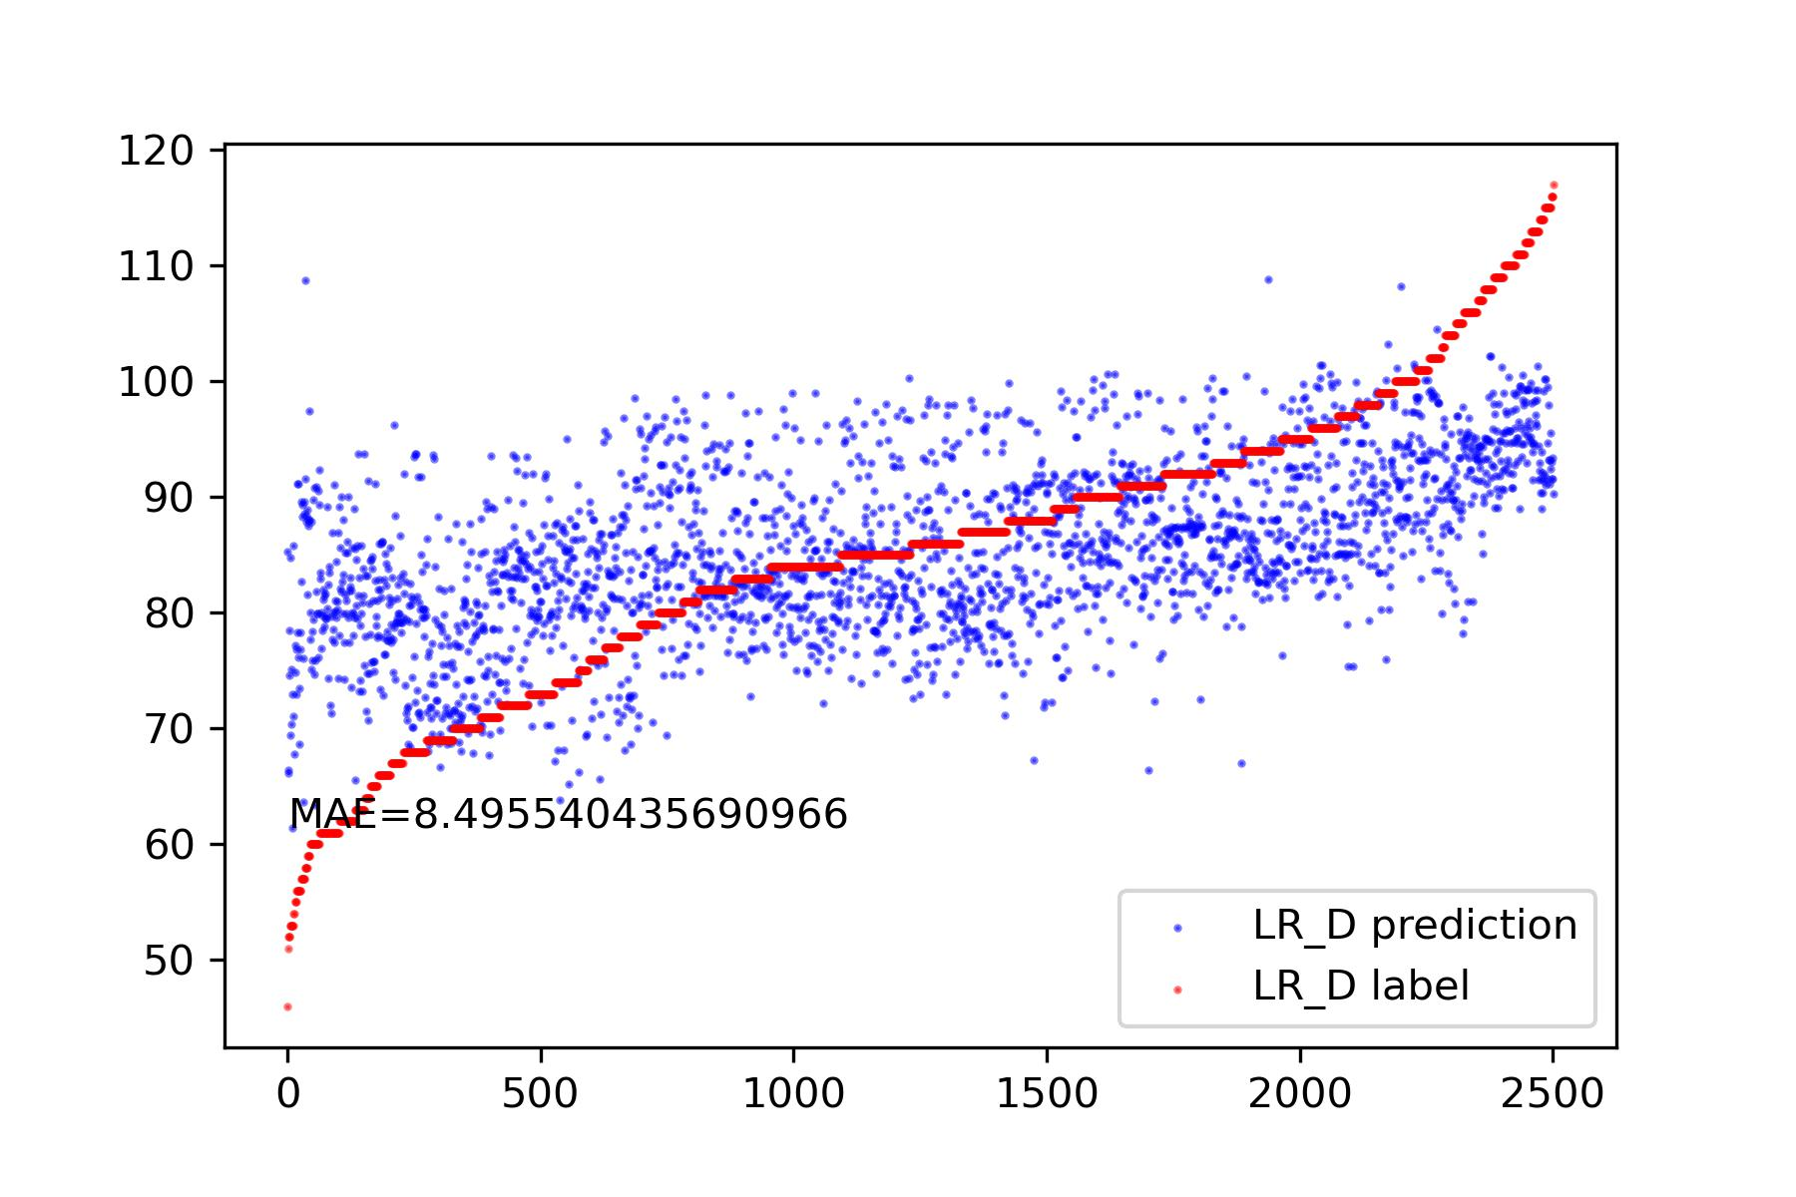
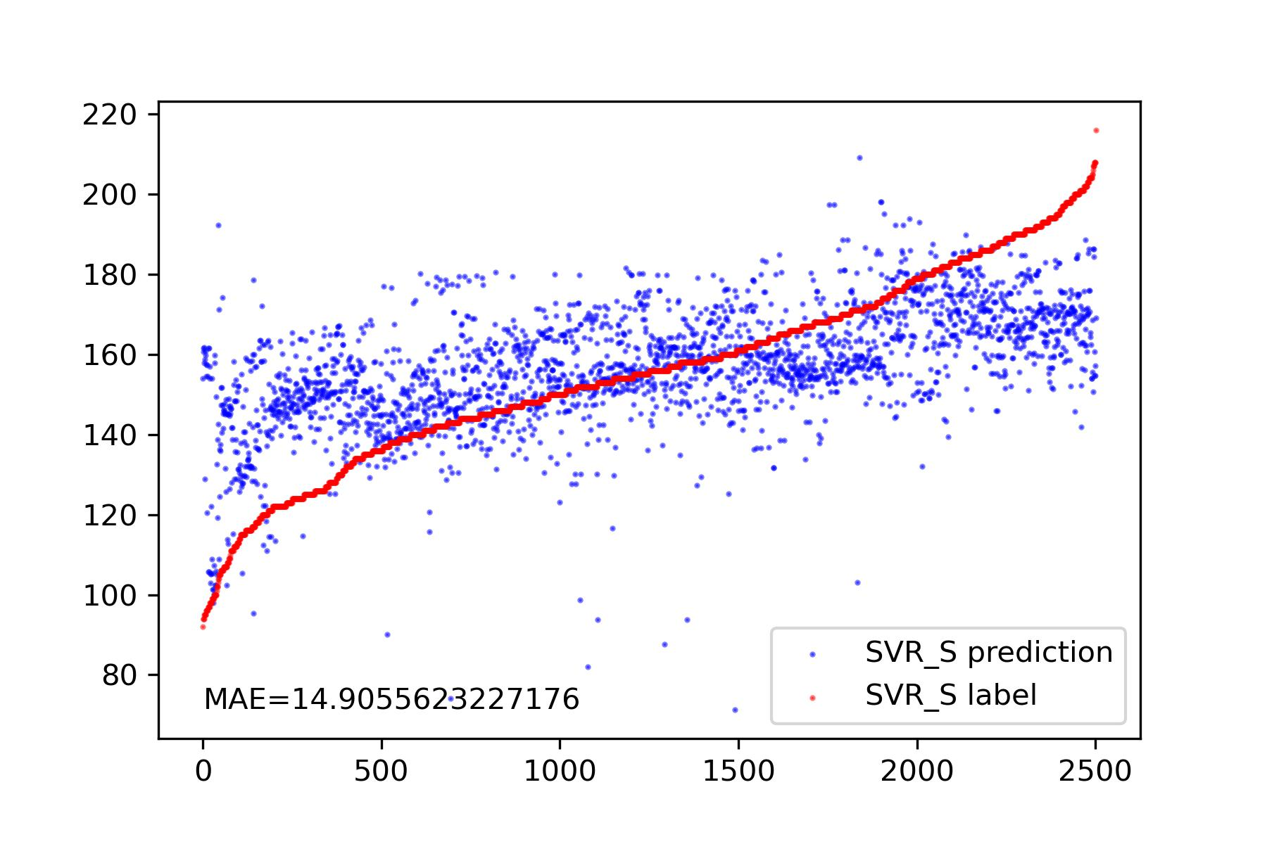
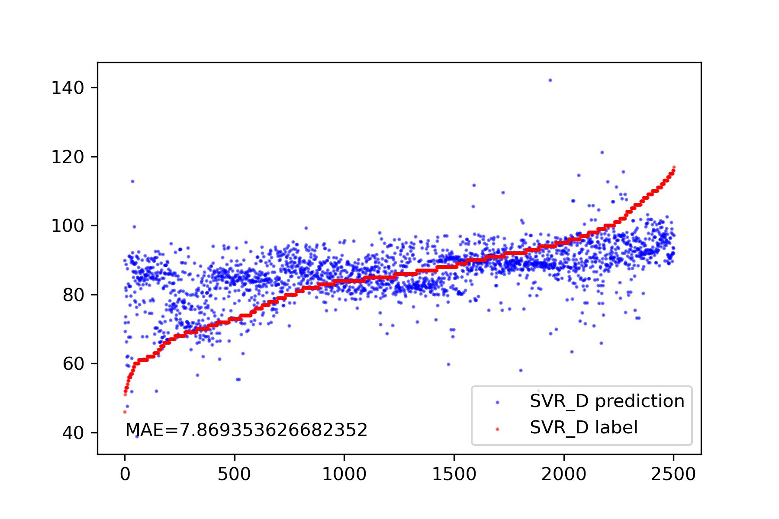

Slide 10
Thanks!

