Slide 1
Chapter 2:
Boolean Algebra and Logic Gates
  Binary Logic and Gates
  Boolean Algebra
  Canonical and Standard Forms

Slide 2
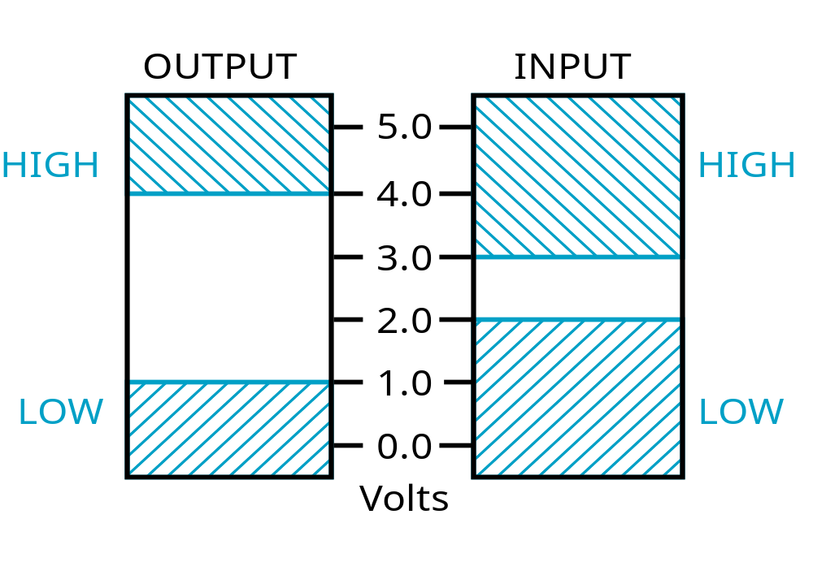
Voltage and Logical Signal
Threshold Region
Notes:
The HIGH range typically corresponds to binary 1 and LOW range to binary 0. The threshold region is a range of voltages
for which the input voltage value cannot be interpreted reliably as either a 0 or a 1.

Slide 3
Analog and Digital Signal
Time
Continuous in value & time
Analog
Discrete in value & continuous in time
Digital

Slide 4
Digital Logic
Digital logic consists of binary variables and a set of logical operations.
The logical variables are designated by letters of the alphabet, such as A, B, C, x, y, z, etc, with each variable having two and only two distinct possible values: 1 and 0,
There are three basic logical operations: AND, OR, and NOT.
Logic gates implement logic operations.
Boolean Algebra: a useful mathematical system for specifying and transforming logic functions.

Slide 5
Logical Operations
AND is denoted by a dot (·).
OR is denoted by a plus (+).
NOT is denoted by an overbar ( ¯ ), a single quote mark (') after, or (~) before the variable.
Examples:
  Y=A.B is read “Y is equal to A AND B.”
  z=x+y is read “z is equal to x OR y.”
  X =A is read “X is equal to NOT A.”
Chapter 2 - Part 1 <number>

Slide 6
Truth Tables
Truth table − a tabular listing of the values of a function for all possible combinations of values on its arguments
Example: Truth tables for the basic logic operations:
AND
OR
X | Y | Z = X+Y
0 | 0 | 0
0 | 1 | 1
1 | 0 | 1
1 | 1 | 1
NOT
X
Y
Z = X·Y
X
Z
=
X
0
0
0
0
1
0
1
0
1
0
1
0
0
1
1
1
Chapter 2 - Part 1 <number>

Slide 7
Logic Function Implementation
Using Switches
  For inputs:
    logic 1 is switch closed
    logic 0 is switch open
  For outputs:
    logic 1 is light on
    logic 0 is light off.
  NOT uses a switch such
  that:
    logic 1 is switch open
    logic 0 is switch closed
Switches in parallel => OR
Switches in series => AND
Normally-closed switch => NOT
C
Chapter 2 - Part 1 <number>

Slide 8
Logic Function Implementation (Continued)
Example: Logic Using Switches
Light is on (L = 1) for
  L(A, B, C, D) =
  and off (L = 0), otherwise.
Useful model for relay circuits and for CMOS gate circuits, the foundation of current digital logic technology
B
C
A
D
Chapter 2 - Part 1 <number>
Notes:
L (A, B, C, D) = A ((B C') + D) = A B C' + A D

Slide 9
Logic Gates
In the earliest computers, switches were opened and closed by magnetic fields produced by energizing coils in relays. The switches in turn opened and closed the current paths.
Later, vacuum tubes that open and close current paths electronically replaced relays.
Today, transistors are used as electronic switches that open and close current paths.
Chapter 2 - Part 1 <number>

Slide 10
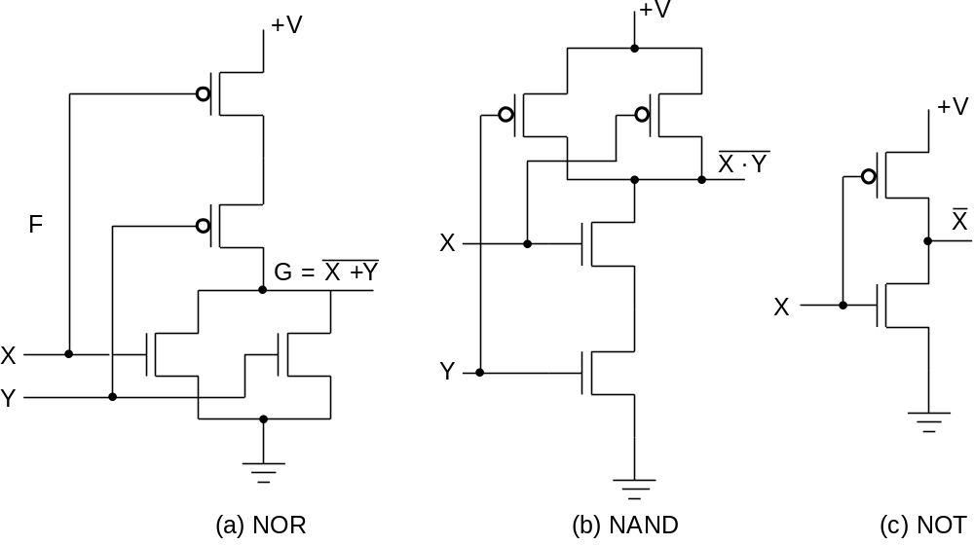
Logic Gates (continued)
Implementation of logic gates with transistors (See Reading Supplement − CMOS Circuits)
Transistor or tube implementations of logic functions are called logic gates or just gates
Transistor gate circuits can be modeled by switch circuits
Chapter 2 - Part 1 <number>
Notes:
The transistor without the “bubble” on its input is an N-type field effect
transistor. It acts like a closed switch between its top and bottom terminals
with an H (1) applied to its input on its left. It acts like an open switch with
an L (0) applied to its input. The transistor with the “bubble” on its input is a
P-type field effect transistor. The +V at the top provides an H (1) and the
Ground symbol at the bottom provides an L (0). By modeling the two types
of field effect transistors as switches, one can see how the series and
parallel interconnections can produce 1’s and 0’s on the outputs on the
right in response to applied 1’s and 0’s on the inputs on the left. NOR and
NAND are OR and AND, each followed by a NOT respectively.

Slide 11
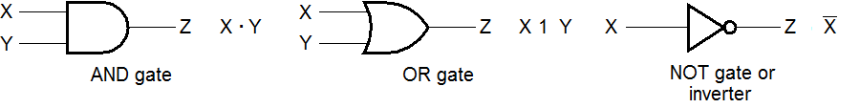
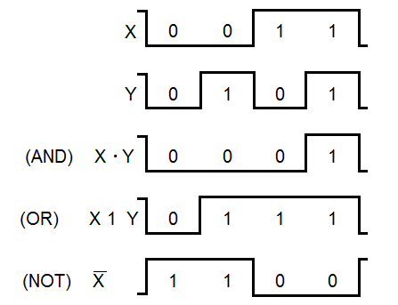
Logic Gate Symbols and Behavior
Logic gates symbols:
Timing diagram(waveform)

Slide 12
Expressions of Logic Function
Truth Table
Equation
X Y Z
F
=
X
+
Y
⋅
Z
0 0 0
0
F
=
X
+
Y
Z
0 0 1
1
0 1 0
0
Logic Diagram
0 1 1
0
X
1 0 0
1
1 0 1
1
Y
F
1 1 0
1
Z
1 1 1
1
Boolean equations, truth tables and logic diagrams describe the same function!
Truth tables are unique; expressions and logic diagrams are not.
Chapter 2 - Part 1 <number>

Slide 13
Boolean Algebra
An algebraic structure defined on a set of at least two elements, B, together with three binary operators (denoted +, · and ) that satisfies the following basic identities:
1.
X
+ 0
=
X
2.
X
. 1
=
X
3.
X
1
1
4.
X
. 0
0
+
=
=
5.
X + X
=
X
6.
X . X
=
X
7.
X + X
=
1
8.
X . X
=
0
9.
X = X
10.
X + Y
=
Y + X
11.
XY
=
YX
Commutative
12.
(X + Y)
+
Z
=
X + (Y
+
Z)
13.
(XY)
Z
=
X(Y
Z)
Associative
14.
X(Y +
Z)
=
XY
+
XZ
15.
X
+ YZ
=
(X + Y)
(X + Z)
Distributive
DeMorgan
16.
X + Y
=
X . Y
17.
X . Y
=
X + Y
’
s
Chapter 2 - Part 1 <number>

Slide 14
Boolean Operator Precedence
The order of evaluation in a Boolean
expression is:
1.
Parentheses
2.
NOT
3.
AND
4.
OR
Consequence: Parentheses appear
around OR expressions
Example: F = A(B + C)(C + D)
Chapter 2 - Part 1 <number>

Slide 15
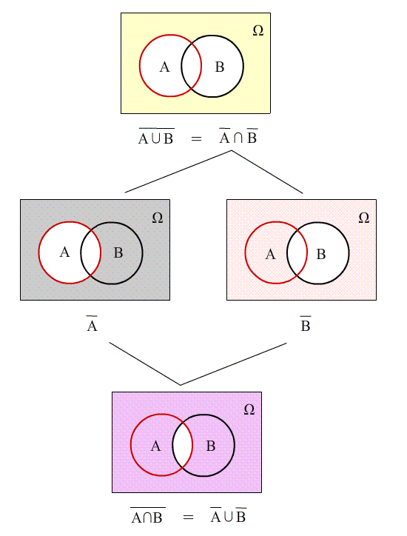
DeMorgan law

Slide 16
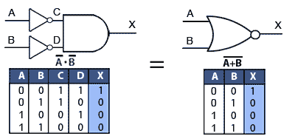
DeMorgan law

Slide 17
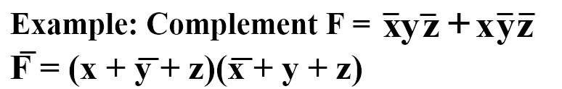
Generalizations of DeMorgan law
  (A+B+C+ ... +F)' = A'B'C' ... F'
  (ABC ... F)' = A'+ B'+C'+ ... +F'

Slide 18
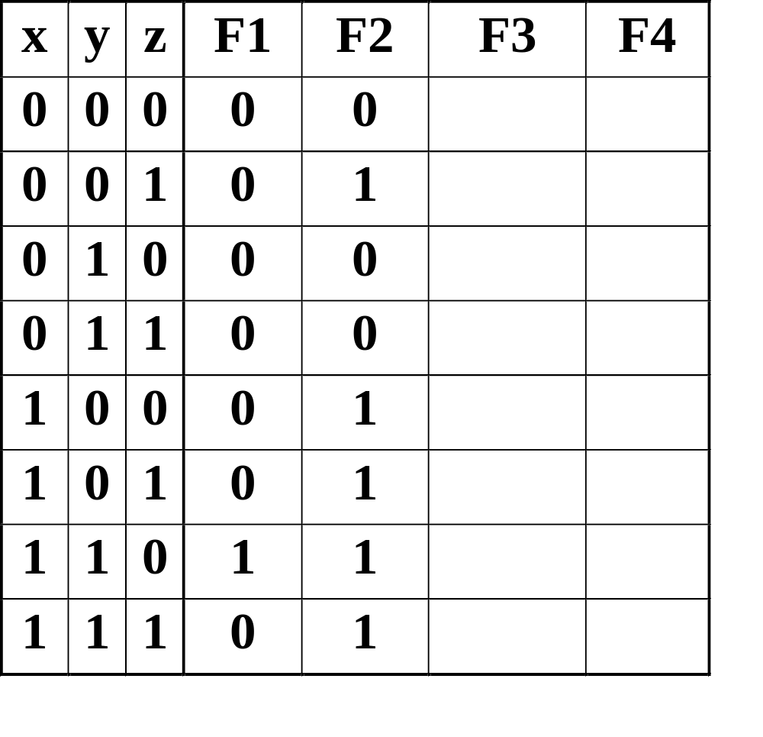
Boolean Function Evaluation
F1
=
xy
z
F2
=
x
+
y
z
F3
=
x
y
z
+
x
y
z
+
x
y
F4
=
x
y
+
x
z
Chapter 2 - Part 1 <number>
Notes:
F3 is 1 for x’y’z’, x’yz, xy’z’ and xy’z => F3 = 1,0,0,1,1,1,0,0
F4 is 1 for xy’z’, xy’z, x’y’z and x’y z => F4 = 0,1,0,1,1,1,0,0

Slide 19
Canonical and Standard Forms
Minterms and Maxterms
  A minterm: an AND term consists of all literals in their normal form or in their complement form
  For example, two binary variables x and y,
    xy, xy', x'y, x'y'
  It is also called a standard product
  n variables can be combined to form 2^{n} minterms
  A maxterm: an OR term
  It is also call a standard sum
  2^{n} maxterms
2-<number>

Slide 20
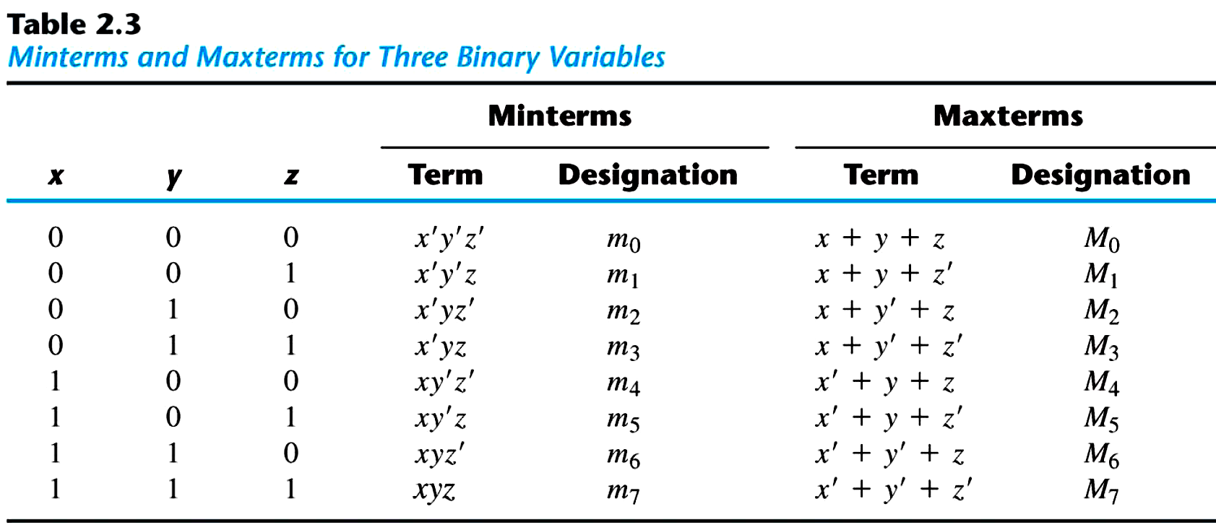
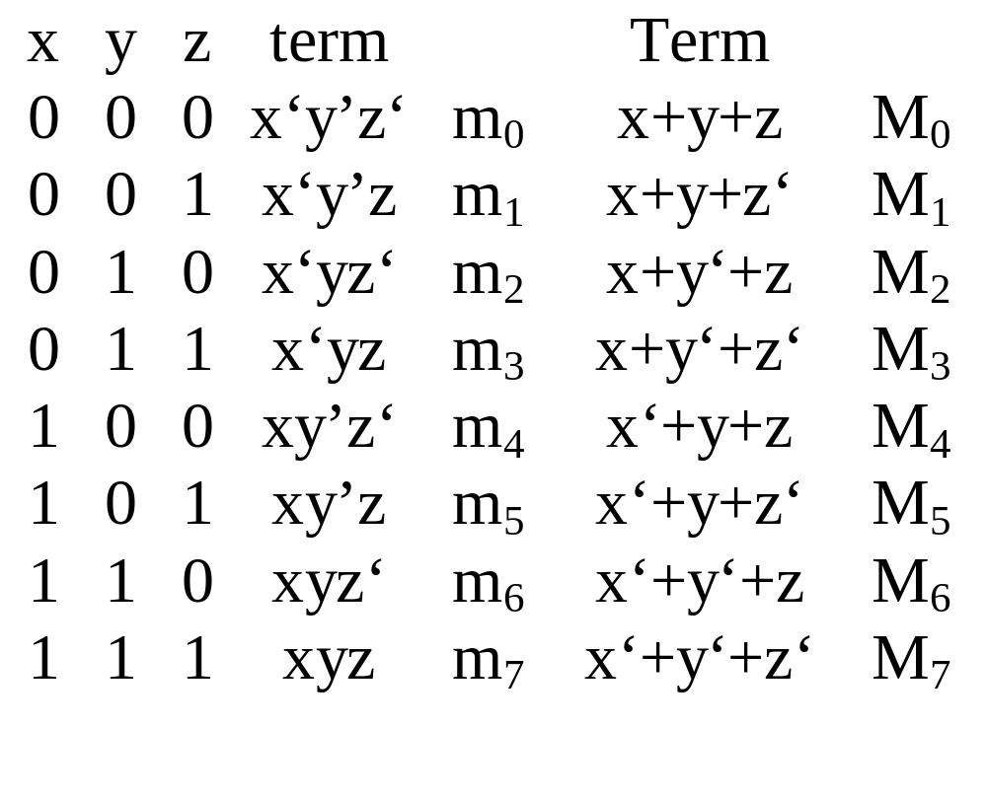
  each maxterm is the complement of its corresponding minterm, and vice versa
2-<number>

Slide 21
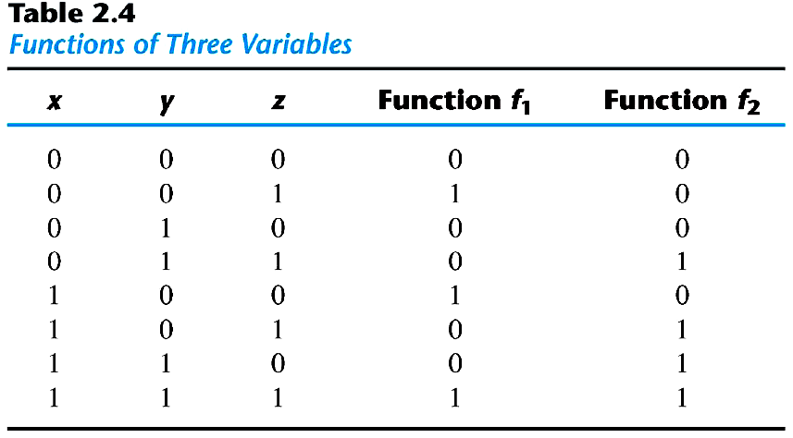
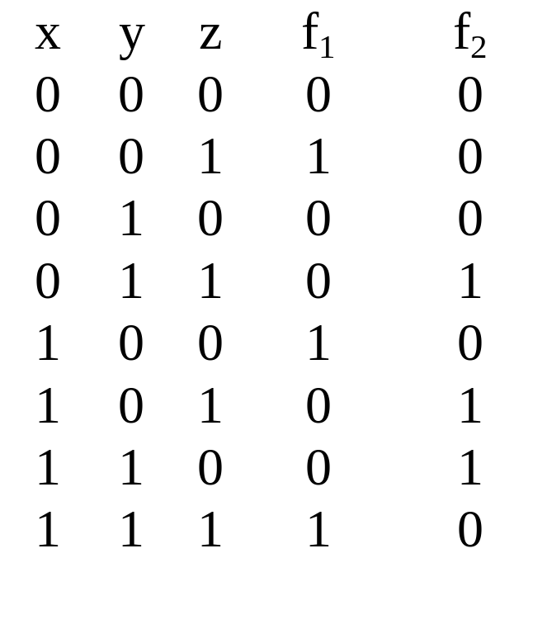
An Boolean function can be expressed by
  a truth table
  sum of minterms
  f₁ = x'y'z + xy'z' + xyz = m₁ + m₄ +m₇
  f₂ = x'yz+ xy'z + xyz'+xyz = m₃ + m₅ +m₆ + m₇
2-<number>

Slide 22
The complement of a Boolean function
  the minterms that produce a 0
  f₁' = m₀ + m₂ +m₃ + m₅ + m₆ = x'y'z'+x'yz'+x'yz+xy'z+xyz'
  f₁ = (f₁')' = (x+y+z)(x+y'+z) (x+y'+z') (x'+y+z')(x'+y'+z) = M₀ M₂ M₃ M₅ M₆
  Any Boolean function can be expressed as
    a sum of minterms
    a product of maxterms
    canonical form
2-<number>

Slide 23
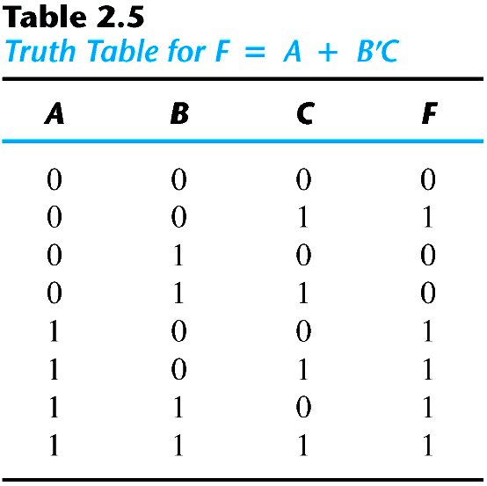
Sum of minterms
  F = A+B'C = A (B+B') + B'C = AB +AB' + B'C = AB(C+C') + AB'(C+C') + (A+A')B'C =ABC+ABC'+AB'C+AB'C'+A'B'C
  F = A'B'C +AB'C' +AB'C+ABC'+ ABC = m₁ + m₄ +m₅ + m₆ + m₇
  F(A,B,C) = Σ(1, 4, 5, 6, 7)
  or, built the truth table first
2-<number>

Slide 24
Product of maxterms
  x + yz = (x + y)(x + z) = (x+y+zz')(x+z+yy') =(x+y+z)(x+y+z’)(x+y'+z)
  F = xy + x'z = (xy + x') (xy +z) = (x+x')(y+x')(x+z)(y+z) = (x'+y)(x+z)(y+z)
  x'+y = x' + y + zz' = (x'+y+z)(x'+y+z')
  F = (x+y+z)(x+y'+z)(x'+y+z)(x'+y+z') = M₀M₂M₄M₅
  F(x,y,z) = Π(0,2,4,5)
2-<number>

Slide 25
Conversion between Canonical Forms
  F(A,B,C) = Σ(1,4,5,6,7)
  F'(A,B,C) = Σ(0,2,3)
  By DeMorgan's theorem F(A,B,C) = Π(0,2,3)
  m_{j}' = M_{j}
  sum of minterms = product of maxterms
  interchange the symbols Σ and Π and list those numbers missing from the original form
  Σ of 1's
  Π of 0's
2-<number>

Slide 26
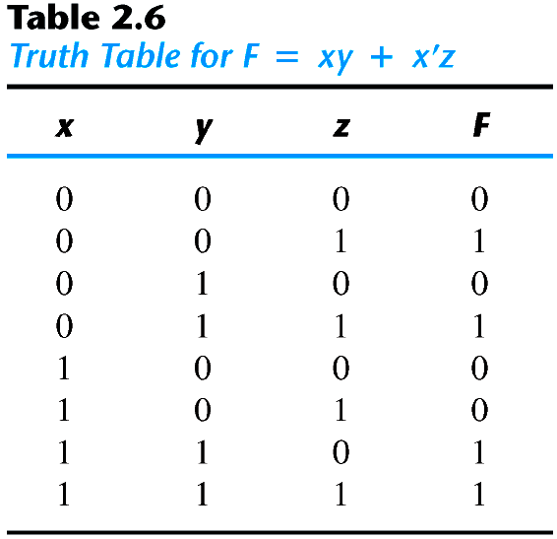
Example
  F = xy + x′z
  F(x, y, z) = Σ(1, 3, 6, 7)
  F(x, y, z) = Π (0, 2, 4, 6)
2-<number>

Slide 27
Standard Forms
  Canonical forms are seldom used
  sum of products F₁ = y' + zy+ x'yz'
  product of sums F₂ = x(y'+z)(x'+y+z'+w)
  F₃ = A'B'CD+ABC'D'
2-<number>

Slide 28
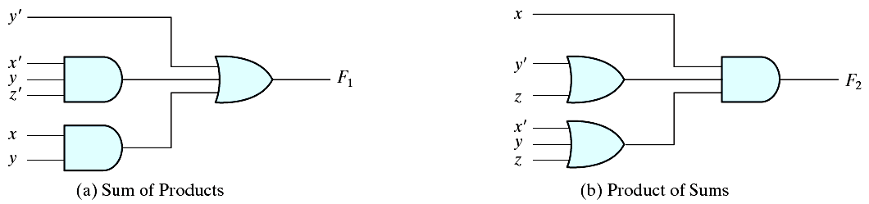
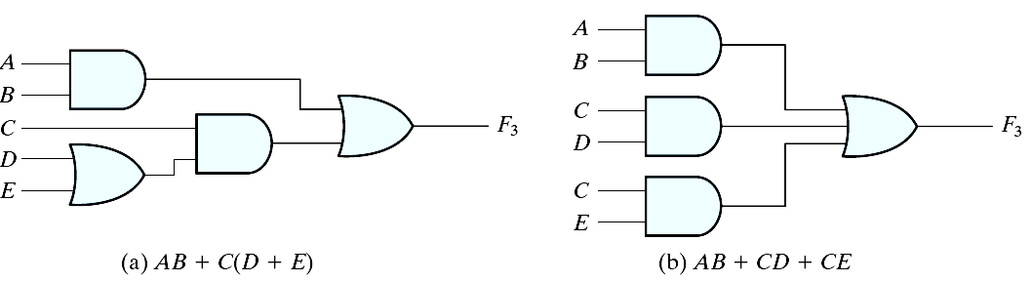
Two-level implementation
Multi-level implementation
2-<number>

Slide 29
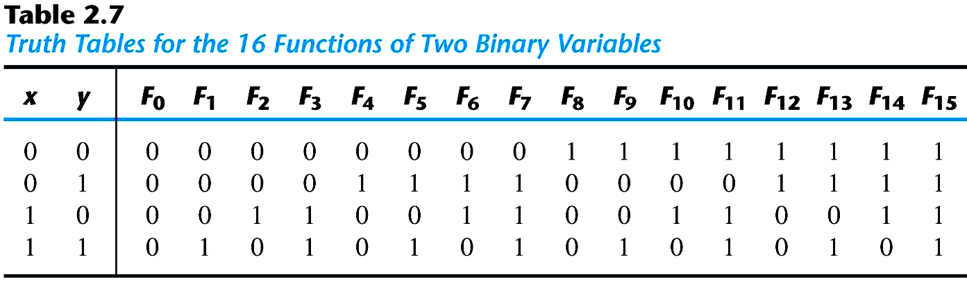
Other Logic Operations
2^{n} rows in the truth table of n binary variables
2^{2n} functions for n binary variables
16 functions of two binary variables
2-<number>

Slide 30
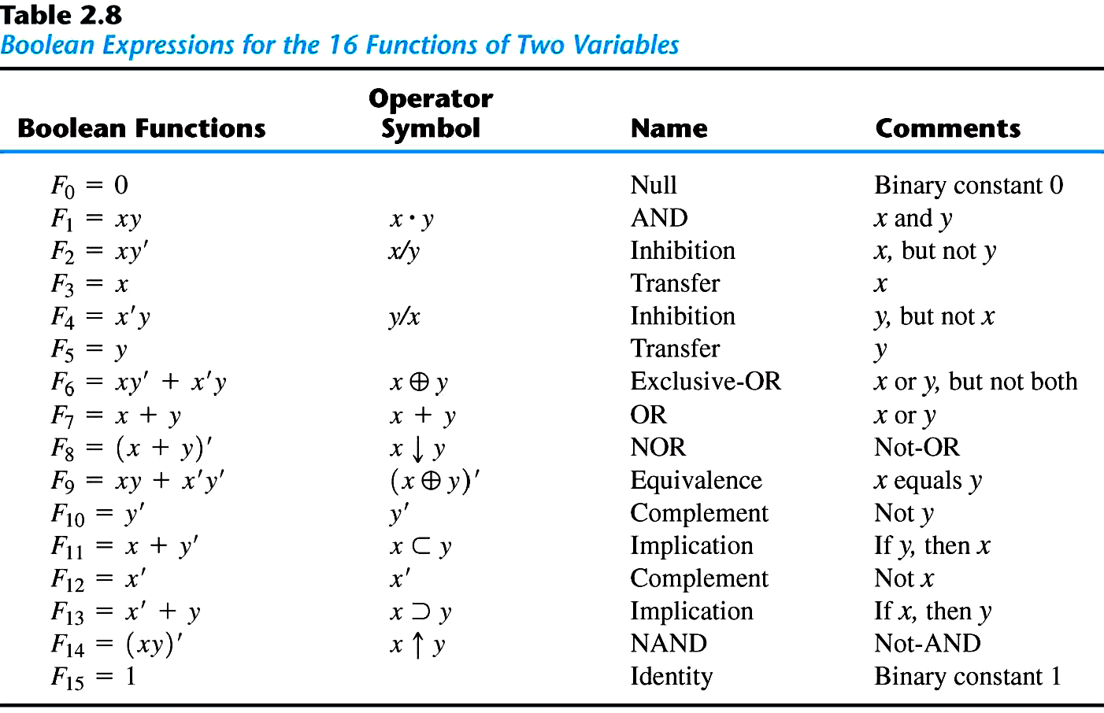
2-<number>

