Slide 2
Overview
Part 2 – Combinational Logic
  Functions and functional blocks
  Rudimentary logic functions
  Decoding using Decoders
    Implementing Combinational Functions with Decoders
  Encoding using Encoders
  Selecting using Multiplexers
    Implementing Combinational Functions with Multiplexers
Chapter 3 <number>

Slide 3
Functions and Functional Blocks
The functions considered are those found to be very useful in design
Corresponding to each of the functions is a combinational circuit implementation called a functional block.
In the past, functional blocks were packaged as small-scale-integrated (SSI), medium-scale integrated (MSI), and large-scale-integrated (LSI) circuits.
Today, they are often simply implemented within a very-large-scale-integrated (VLSI) circuit.
Chapter 3 <number>

Slide 4
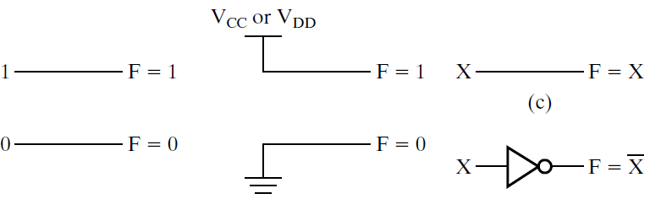
Rudimentary Logic Functions
Functions of a single variable X
Can be used on the
inputs to functional
blocks to implement
other than the block’s
intended function
T
A
BLE 4-1
Functions of
One
V
a
ria
b
le
X
F
= 0
F
= X
F
=
X
F = 1
0
0
0
1
1
1
0
1
0
1
Chapter 3 <number>

Slide 5
Multiple-bit Rudimentary Functions
Multi-bit Examples:
A wide line is used to represent
a bus which is a vector signal
In (b) of the example, F = (F₃, F₂, F₁, F₀) is a bus.
The bus can be split into individual bits as shown in (b)
Sets of bits can be split from the bus as shown in (c)
for bits 2 and 1 of F.
The sets of bits need not be continuous as shown in (d) for bits 3, 1, and 0 of F.
A
F
A
3
3
2
1
F
1
2
4
4
2:1
F(2:1)
2
F
0
F
0
F
1
1
A
0
(c)
F
0
A
(a)
(b)
3
4
3,1:0
F(3), F(1:0)
F
(d)
Chapter 3 <number>

Slide 6
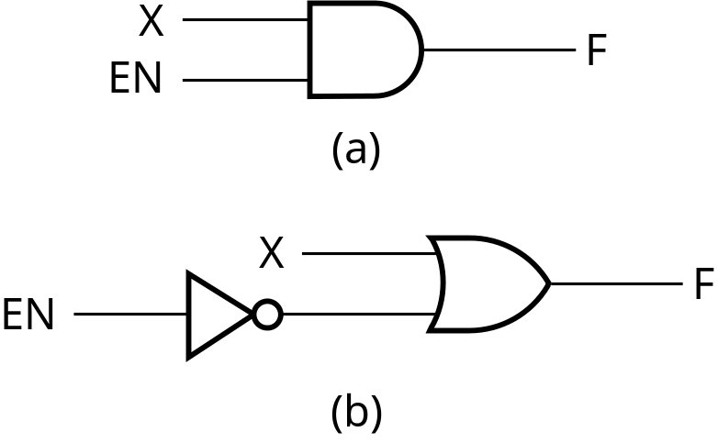
Enabling Function
Enabling permits an input signal to pass through to an output
Disabling blocks an input signal from passing through to an output, replacing it with a fixed value
The value on the output when it is disable can be Hi-Z (as for three-state buffers and transmission gates), 0 , or 1
When disabled, 0 output
When disabled, 1 output
See Enabling App in text
Chapter 3 <number>

Slide 7
Decoding
Decoding - the conversion of an n-bit input code to an m-bit output code with
n ≤ m ≤ 2^{n} such that each valid code word produces a unique output code
Circuits that perform decoding are called decoders
Here, functional blocks for decoding are
  called n-to-m line decoders, where m ≤ 2^{n}, and
  generate 2^{n} (or fewer) minterms for the n input variables
Chapter 3 <number>

Slide 8
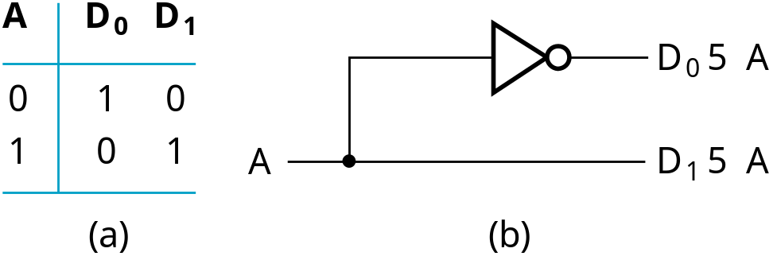
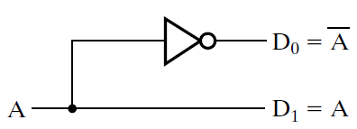
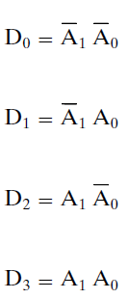
Decoder Examples
1-to-2-Line Decoder
2-to-4-Line Decoder
A
0
A
1
A
0
D
0
D
1
D
2
D
3
A
1
0
0
1
0
0
0
D
5
A
A
0
1
0
1
0
0
0
1
0
1
0
0
0
1
0
1
1
0
0
0
1
D
1
5
A
1
A
0
(a)
D
2
5
A
1
A
0
Note that the 2-4-line
made up of 2 1-to-2-
line decoders and 4 AND gates.
D
3
5
A
1
A
0
(b)
Chapter 3 <number>

Slide 9
Decoder Expansion
General procedure given in book for any decoder with n inputs and 2^{n} outputs.
This procedure builds a decoder backward from the outputs.
The output AND gates are driven by two decoders with their numbers of inputs either equal or differing by 1.
These decoders are then designed using the same procedure until 2-to-1-line decoders are reached.
The procedure can be modified to apply to decoders with the number of outputs ≠ 2^{n}
Chapter 3 <number>

Slide 10
Decoder Expansion - Example 1
3-to-8-line decoder
  Number of output ANDs = 8
  Number of inputs to decoders driving output ANDs = 3
  Closest possible split to equal
    2-to-4-line decoder
    1-to-2-line decoder
  2-to-4-line decoder
    Number of output ANDs = 4
    Number of inputs to decoders driving output ANDs = 2
    Closest possible split to equal
      Two 1-to-2-line decoders
See next slide for result
Chapter 3 <number>

Slide 11
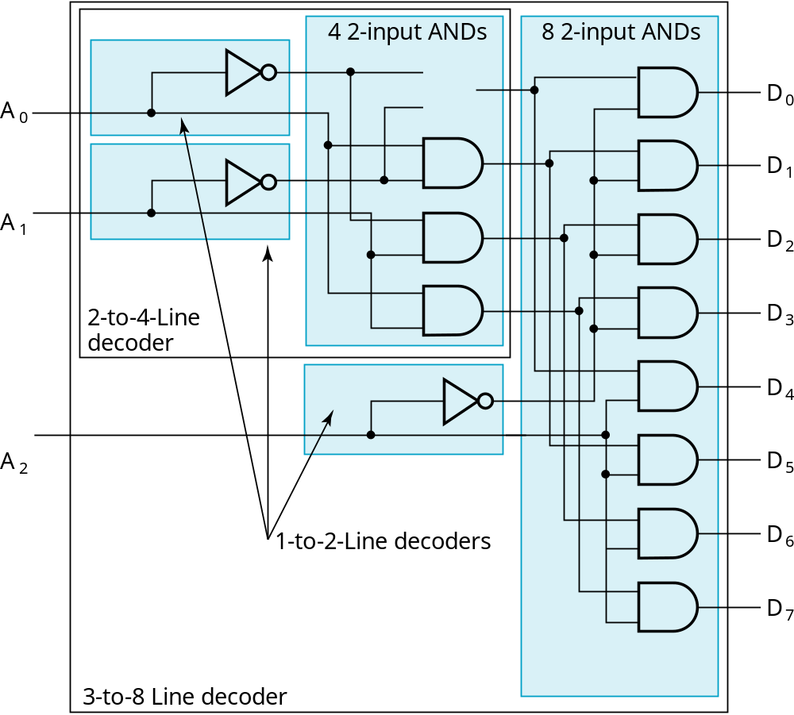
Decoder Expansion - Example 1
Result
Chapter 3 <number>

Slide 12
Decoder Expansion - Example 2
7-to-128-line decoder
  Number of output ANDs = 128
  Number of inputs to decoders driving output ANDs = 7
  Closest possible split to equal
    4-to-16-line decoder
    3-to-8-line decoder
  4-to-16-line decoder
    Number of output ANDs = 16
    Number of inputs to decoders driving output ANDs = 2
    Closest possible split to equal
      2 2-to-4-line decoders
  Complete using known 3-8 and 2-to-4 line decoders
Chapter 3 <number>

Slide 13
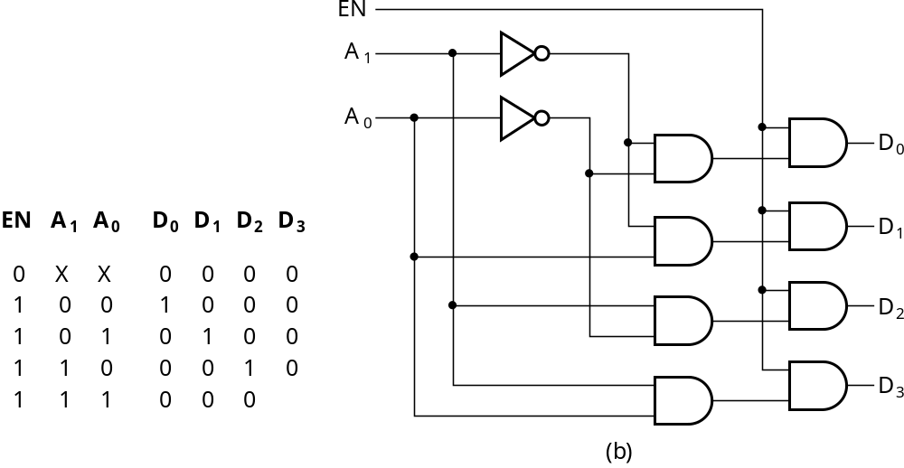
Decoder with Enable
In general, attach m-enabling circuits to the outputs
See truth table below for function
  Note use of X’s to denote both 0 and 1
  Combination containing two X’s represent four binary combinations
Alternatively, can be viewed as distributing value of signal EN to 1 of 4 outputs
In this case, called a
demultiplexer
Chapter 3 <number>

Slide 14
Encoding
Encoding - the opposite of decoding - the conversion of an m-bit input code to a n-bit output code with n ≤ m ≤ 2^{n} such that each valid code word produces a unique output code
Circuits that perform encoding are called encoders
An encoder has 2^{n} (or fewer) input lines and n output lines which generate the binary code corresponding to the input values
Typically, an encoder converts a code containing exactly one bit that is 1 to a binary code corres-ponding to the position in which the 1 appears.
Chapter 3 <number>

Slide 15
Encoder Example
A decimal-to-BCD encoder
  Inputs: 10 bits corresponding to decimal digits 0 through 9, (D₀, …, D₉)
  Outputs: 4 bits with BCD codes
  Function: If input bit D_{i} is a 1, then the output (A₃, A₂, A₁, A₀) is the BCD code for i,
The truth table could be formed, but alternatively, the equations for each of the four outputs can be obtained directly.
Chapter 3 <number>

Slide 16
Encoder Example (continued)
Input D_{i} is a term in equation A_{j} if bit A_{j} is 1 in the binary value for i.
Equations:
  A₃ = D₈ + D₉
  A₂ = D₄ + D₅ + D₆ + D₇
  A₁ = D₂ + D₃ + D₆ + D₇
  A₀ = D₁ + D₃ + D₅ + D₇ + D₉
F₁ = D₆ + D₇ can be extracted from A₂ and A₁ Is there any cost saving?
Chapter 3 <number>
Notes:
No. The total gate input cost remains the same.

Slide 17
Priority Encoder
If more than one input value is 1, then the encoder just designed does not work.
One encoder that can accept all possible combinations of input values and produce a meaningful result is a priority encoder.
Among the 1s that appear, it selects the most significant input position (or the least significant input position) containing a 1 and responds with the corresponding binary code for that position.
Chapter 3 <number>

Slide 18
Priority Encoder Example
Priority encoder with 5 inputs (D₄, D₃, D₂, D₁, D₀) - highest priority to most significant 1 present - Code outputs A2, A1, A0 and V where V indicates at least one 1 present.
Xs in input part of table represent 0 or 1; thus table entries correspond to product terms instead of minterms. The column on the left shows that all 32 minterms are present in the product terms in the table
No. of Min-terms/Row | Inputs |  |  |  |  | Outputs
 | D4 | D3 | D2 | D1 | D0 | A2 | A1 | A0 | V
1 | 0 | 0 | 0 | 0 | 0 | X | X | X | 0
1 | 0 | 0 | 0 | 0 | 1 | 0 | 0 | 0 | 1
2 | 0 | 0 | 0 | 1 | X | 0 | 0 | 1 | 1
4 | 0 | 0 | 1 | X | X | 0 | 1 | 0 | 1
8 | 0 | 1 | X | X | X | 0 | 1 | 1 | 1
16 | 1 | X | X | X | X | 1 | 0 | 0 | 1
Chapter 3 <number>
Notes:
Go over table explaining how entries were obtained, particularly those containing Xs

Slide 19
Priority Encoder Example (continued)
Could use a K-map to get equations, but can be read directly from table and manually optimized if careful:
  A₂ = D₄
  A₁ = D₃ + D₂ = F₁, F₁ = (D₃ + D₂)
  A₀ = D₃ + D₁ = (D₃ + D1)
  V = D₄ + F₁ + D₁ + D₀
D4
D4
D3
D4
D4
D4
D3
D2
D4
D2
Chapter 3 <number>

Slide 20
Selecting
Selecting of data or information is a critical function in digital systems and computers
Circuits that perform selecting have:
  A set of information inputs from which the selection is made
  A single output
  A set of control lines for making the selection
Logic circuits that perform selecting are called multiplexers
Selecting can also be done by three-state logic or transmission gates
Chapter 3 <number>

Slide 21
Multiplexers
A multiplexer selects information from an input line and directs the information to an output line
A typical multiplexer has n control inputs (S_{n − 1}, … S₀) called selection inputs, 2^{n} information inputs (I₂^{n} ₋ ₁, … I₀), and one output Y
A multiplexer can be designed to have m information inputs with m < 2^{n} as well as n selection inputs
Chapter 3 <number>

Slide 22
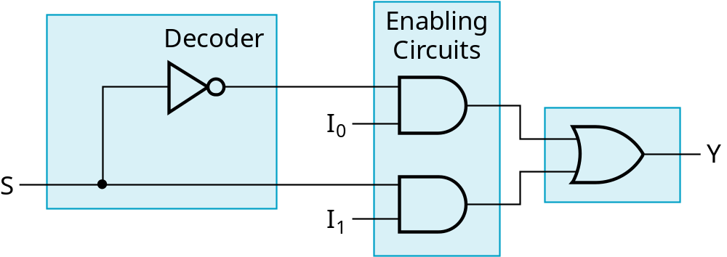
2-to-1-Line Multiplexer
Since 2 = 2¹, n = 1
The single selection variable S has two values:
  S = 0 selects input I₀
  S = 1 selects input I₁
The equation:
Y = I₀ + SI₁
The circuit:
S
Chapter 3 <number>

Slide 23
2-to-1-Line Multiplexer (continued)
Note the regions of the multiplexer circuit shown:
  1-to-2-line Decoder
  2 Enabling circuits
  2-input OR gate
To obtain a basis for multiplexer expansion, we combine the Enabling circuits and OR gate into a 2x2 AND-OR circuit:
  1-to-2-line decoder
  2x2 AND-OR
In general, for an 2^{n}-to-1-line multiplexer:
  n-to-2^{n}-line decoder
  2^{n} x2 AND-OR
Chapter 3 <number>

Slide 24
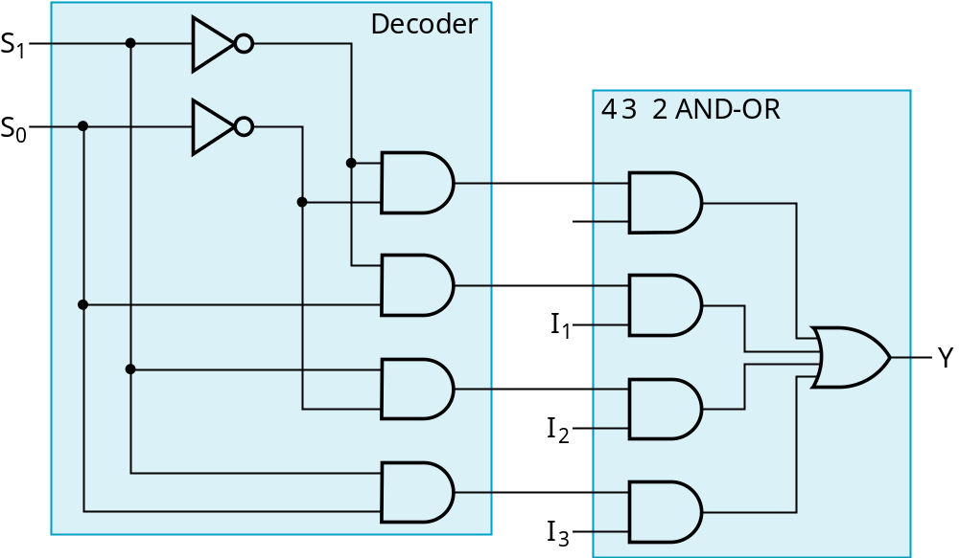
Example: 4-to-1-line Multiplexer
2-to-2²-line decoder
2² x2 AND-OR
Chapter 3 <number>

Slide 25
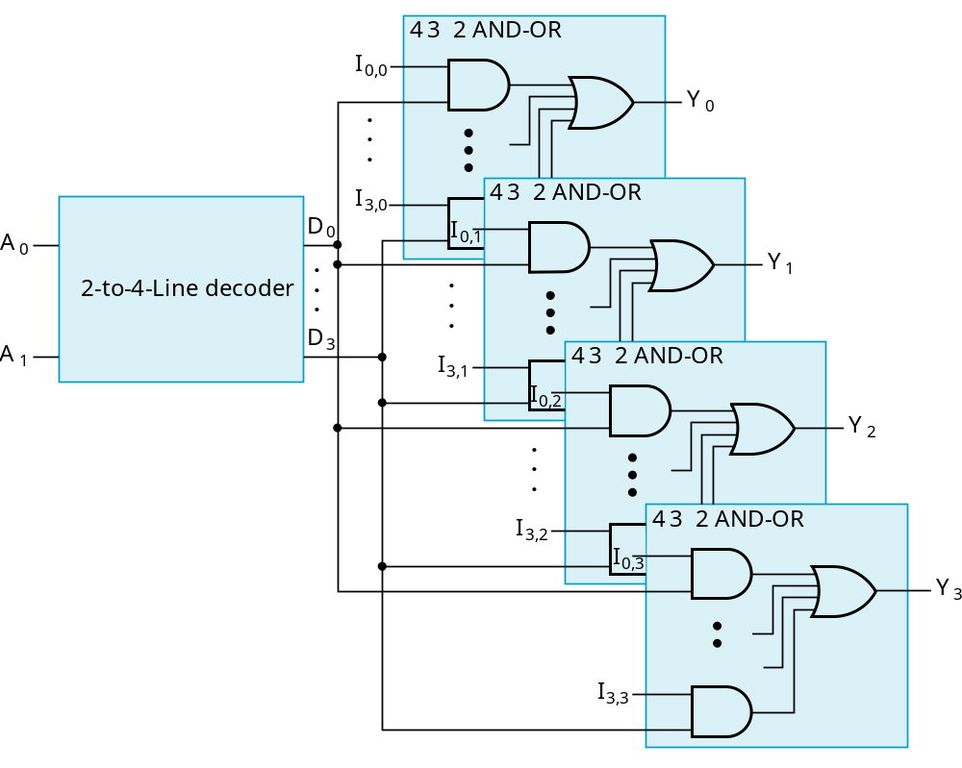
Multiplexer Width Expansion
Select “vectors of bits” instead of “bits”
Use multiple copies of 2^{n} x2 AND-OR in parallel
Example:
4-to-1-line
quad multi-
plexer
Chapter 3 <number>

Slide 26
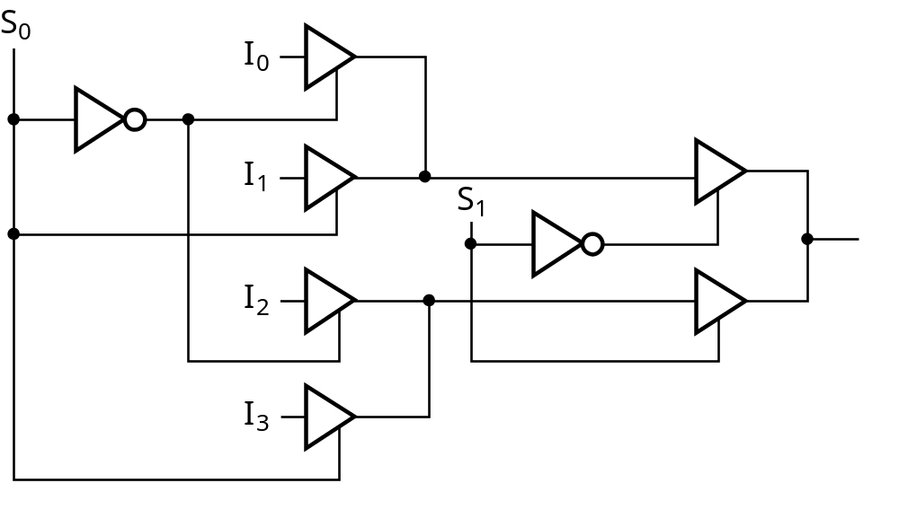
Other Selection Implementations
Three-state logic in place of AND-OR
Gate input cost = 14 compared to 22 (or 18) for gate implementation
Chapter 3 <number>

Slide 27
Combinational Logic Implementation
- Multiplexer Approach 1
Implement m functions of n variables with:
  Sum-of-minterms expressions
  An m-wide 2^{n}-to-1-line multiplexer
Design:
  Find the truth table for the functions.
  In the order they appear in the truth table:
    Apply the function input variables to the multiplexer inputs S_{n − 1}, … , S₀
    Label the outputs of the multiplexer with the output variables
  Value-fix the information inputs to the multiplexer using the values from the truth table (for don’t cares, apply either 0 or 1)
Chapter 3 <number>

Slide 28
Example: Gray to Binary Code
Design a circuit to
convert a 3-bit Gray
code to a binary code
The formulation gives
the truth table on the
right
It is obvious from this
table that X = C and the
Y and Z are more complex
Gray
Binary
A B C
x y z
0
0
0
0
0
0
1 0
0
0
0 1
1
1 0
0 1 0
0 1 0
0 1
1
0 1
1
1 0
0
1
1
1
1 0 1
1 0 1
1
1 0
0
0 1
1
1
1
Chapter 3 <number>

Slide 29
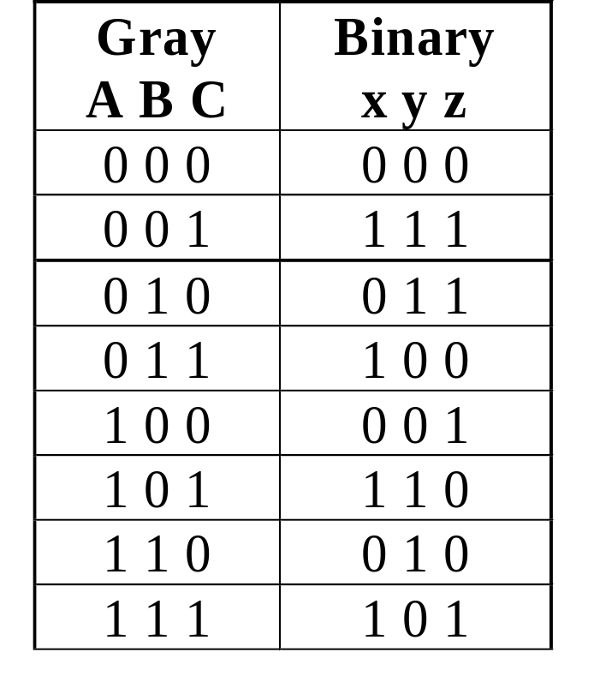
Gray to Binary (continued)
Rearrange the table so
that the input combinations
are in counting order
Functions y and z can
be implemented using
a dual 8-to-1-line
multiplexer by:
  connecting A, B, and C to the multiplexer select inputs
  placing y and z on the two multiplexer outputs
  connecting their respective truth table values to the inputs
Chapter 3 <number>

Slide 30
Gray to Binary (continued)
Note that the multiplexer with fixed inputs is identical to a ROM with 3-bit addresses and 2-bit data!
0
D00
0
D10
1
D01
1
D11
1
D02
1
D12
0
D03
0
D13
0
D04
1
D14
1
Out
Y
0
Out
Z
D05
D15
1
D06
0
D16
0
D07
1
D17
A
S2
A
S2
8-to-1
8-to-1
B
S1
B
S1
MUX
S0
MUX
C
S0
C
Chapter 3 <number>

Slide 31
Combinational Logic Implementation
- Multiplexer Approach 2
Implement any m functions of n + 1 variables by using:
  An m-wide 2^{n}-to-1-line multiplexer
  A single inverter
Design:
  Find the truth table for the functions.
  Based on the values of the first n variables, separate the truth table rows into pairs
  For each pair and output, define a rudimentary function of the final variable (0, 1, X, )
  Using the first n variables as the index, value-fix the information inputs to the multiplexer with the corresponding rudimentary functions
  Use the inverter to generate the rudimentary function
X
X
Chapter 3 <number>

Slide 32
Example: Gray to Binary Code
Design a circuit to
convert a 3-bit Gray
code to a binary code
The formulation gives
the truth table on the
right
It is obvious from this
table that X = C and the
Y and Z are more complex
Gray
Binary
A B C
x y z
0
0
0
0
0
0
1 0
0
0
0 1
1
1 0
0 1 0
0 1 0
0 1
1
0 1
1
1 0
0
1
1
1
1 0 1
1 0 1
1
1 0
0
0 1
1
1
1
Chapter 3 <number>

Slide 33
Gray to Binary (continued)
Rearrange the table so that the input combinations are in counting order, pair rows, and find rudimentary functions
Gray A B C | Binary x y z | Rudimentary Functions of C for y | Rudimentary Functions of C for z
0 0 0 | 0 0 0
0 0 1 | 1 1 1
0 1 0 | 0 1 1
0 1 1 | 1 0 0
1 0 0 | 0 0 1
1 0 1 | 1 1 0
1 1 0 | 0 1 0
1 1 1 | 1 0 1
F = C
F = C
F = C
F = C
F = C
F = C
F = C
F = C
Chapter 3 <number>

Slide 34
Gray to Binary (continued)
Assign the variables and functions to the multiplexer inputs:
Note that this approach (Approach 2) reduces the cost by almost half compared to Approach 1.
This result is no longer ROM-like
Extending, a function of more than n variables is decomposed into several sub-functions defined on a subset of the variables. The multiplexer then selects among these sub-functions.
C
D00
C
D10
C
D01
C
D11
C
C
C
D02
Out
Y
C
D12
Out
Z
C
D03
C
D13
A
S1
8-to-1
A
S1
8-to-1
B
S0
MUX
B
S0
MUX
Chapter 3 <number>

Slide 35
Terms of Use
All (or portions) of this material © 2008 by Pearson Education, Inc.
Permission is given to incorporate this material or adaptations thereof into classroom presentations and handouts to instructors in courses adopting the latest edition of Logic and Computer Design Fundamentals as the course textbook.
These materials or adaptations thereof are not to be sold or otherwise offered for consideration.
This Terms of Use slide or page is to be included within the original materials or any adaptations thereof.
Chapter 3 <number>

