Slide 1
數位系統導論
A1
VHDL硬體描述語言
陳慶瀚
國立中央大學資工系
2014年4月15日

Slide 2
History of VHDL
－ 1980年代初：VHSIC（Very High Speed Integrated Circuit）的計劃以gate level的方式描述電路。
－ 1982年：VHSIC硬體描述語言(VHSIC Hardware Description Language），簡稱VHDL。
－ 1987年： VHDL成為IEEE標準(IEEE 1076) 。
－ 1988年：美國國防部規定所有官方的ASIC設計均要以VHDL為其硬體描述語言，自此之後VHDL也漸漸成為業界間流通的一種標準。
－ 1994 ： IEEE發表新版 VHDL Standard 1164
－ 1996 ：結合電路合成的程式標準規格，發表IEEE 1164.3
－現在：VHDL已經成為「電子設計自動化」（EDA）工程的共通語言；
－未來：朝向系統階層(system-level)的設計

Slide 3

Introduction to VHDL
Structure Model VHDL code
  Entity
  Architecture
  Component
  Configuration

Slide 4
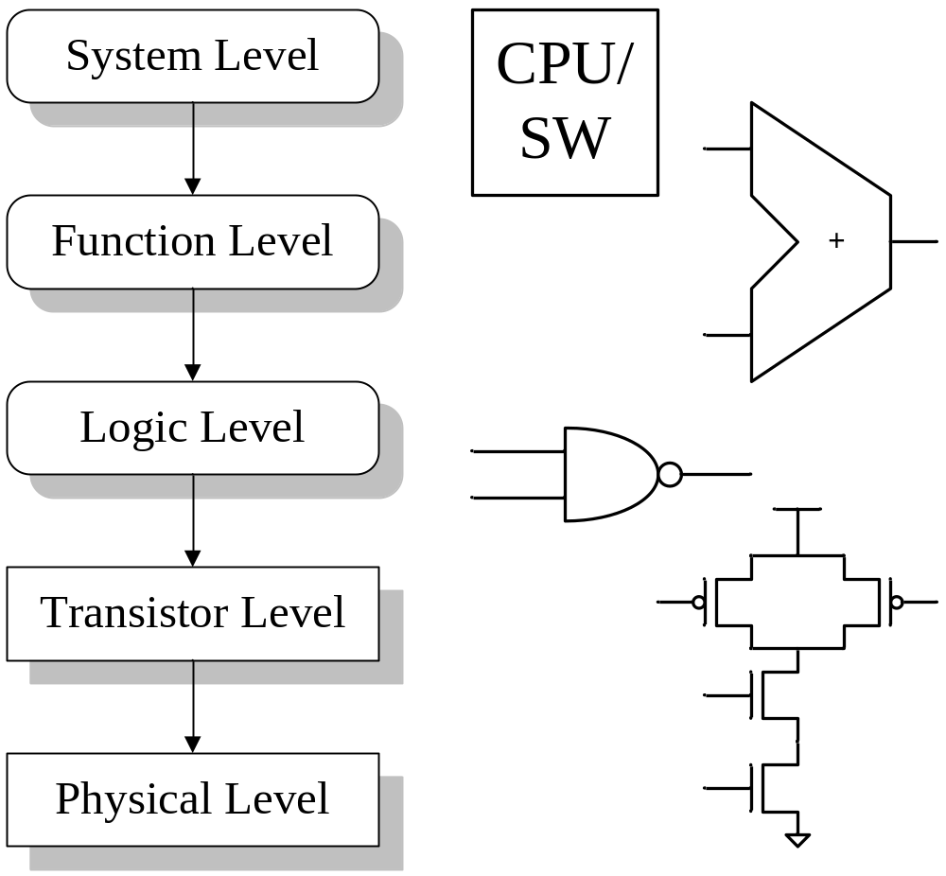
Top-down IC Design Flow

Slide 5
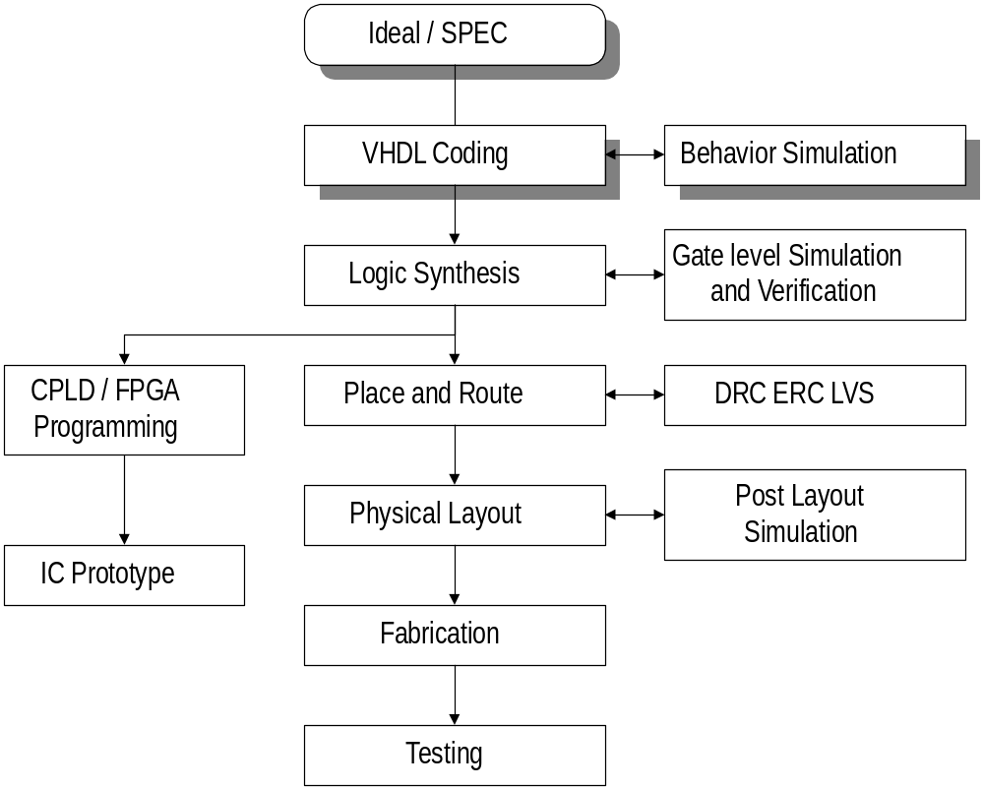
VHDL Design Flow

Slide 6
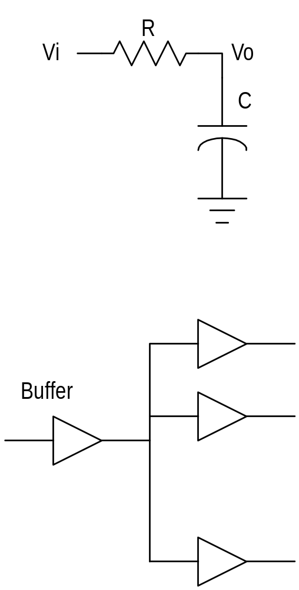
Timing Delay
Ideal delay time = 0
  for functional level
Real delay time
delay factors :
  technology
  ( TTL, CMOS, GaAs )
  RC delay
  fan-out

Slide 7
Simulating Strategy
Time driven
  Monitor value at every time period
  High precision
  SPICE, etc
Event driven
  Record when value change (event )
  Less simulation time and memory
  Behavior simulator :
  VHDL, Verilog

Slide 8

Concurrent and Sequential
Concurrent
  Each statement execute at the same time
  ( logic circuits )
Sequential
  Statements execute in series
  ( programming languages as C, FORTAN )
Statement
A = B;
B = C;
assume : A=1,B=2,C=3
⇨ concurrent result
A = B = C= 3
⇨sequential result
A = B = 2
B = C = 3

Slide 9
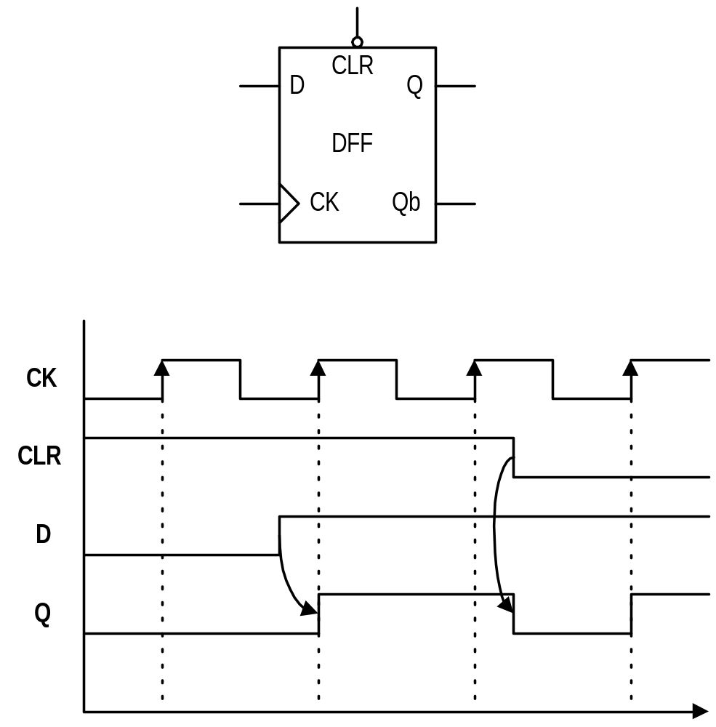
Synchronous and Asynchronous
同步的基準通常指CLOCK
Synchronous signal change value when clock assert.

Slide 10
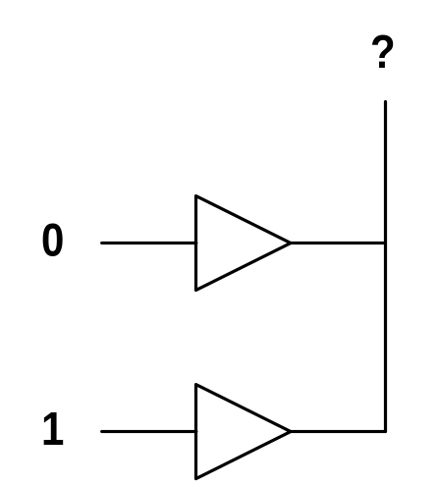
Logic Values and Multi-driven
9 value of IEEE std 1164 -1993 :
type STD_LOGIC is (
`U’ -- Uninitialized
`X’ -- Forcing Unknown
`0’ -- Forcing Low
`1’ -- Forcing High
`Z’ -- High Impedance
`W’ -- Weak Unknown
`L’ -- Weak Low
`H’ -- Weak High
`-’ -- Don’t Care
);
Multi-driven problem
  wire and
  wire or

Slide 11
HDL Design Modeling
Structure
  description of COMPONENT and WIRE
Data-Flow
  concurrent signal assignment (select, conditional )
Behavior
  Sequential signal assignment (high level language)
Mix of above three

Slide 12
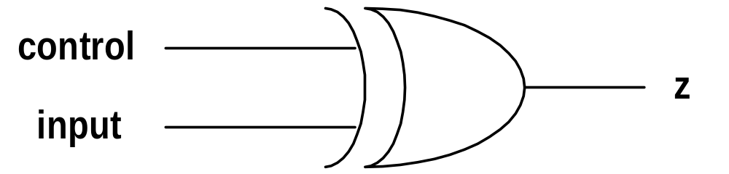
Traditional Design
規格(SPEC) :
當control=1時, z = input
否則 z = inv(input)
IF (control = ‘1’ ) THEN
z <= input;
ELSE
z <= NOT ( input );
ENDIF;

Slide 13
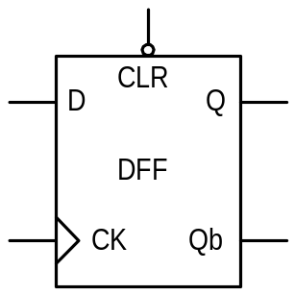
Entity
描述 I/O port 的規格
語法:
Example: D Flip-Flop
ENTITY entity_name IS
PORT ( … );
END entity_name ;
ENTITY dff IS
PORT(D :IN STD_LOGIC;
CK :IN STD_LOGIC;
CLR:IN STD_LOGIC;
Q :OUT STD_LOGIC;
Qb :OUT STD_LOGIC);
END dff;
-- This is a comment

Slide 14
Architecture
描述內部電路
一個 Entity 可存在多個Architecture
語法:
ARCHITECTURE a_name OF e_name IS
-- signals,variables declaration
BEGIN
-- statements
END a_name ;

Slide 15
Architecture - Example : dff
ARCHITECTURE behavior OF dff IS
BEGIN
PROCESS
BEGING
IF(CLR = ‘1’) THEN
Q <= ‘0’;
ELSE CK’EVENT AND CK=‘1’ THEN
Q <= D;
ENDIF;
WAIT ON CLR, CK;
END PROCESS;
END behavior;

Slide 16
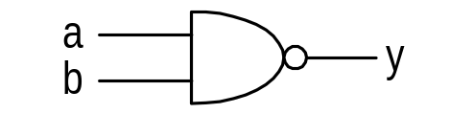
Component
宣告元件(logic gate)的名稱與 I/O port
語法:
Example: nand2
COMPONENT comp_name
PORT ( … );
END COMPONENT ;
COMPONENT nand2
PORT(a,b :IN STD_LOGIC;
y :OUT STD_LOGIC);
END COMPONENT;

Slide 17
Configuration
決定使用那一個Architecture
語法:
CONFIGURATION c_name OF e_name IS
-- configurations
END c_name ;

Slide 18
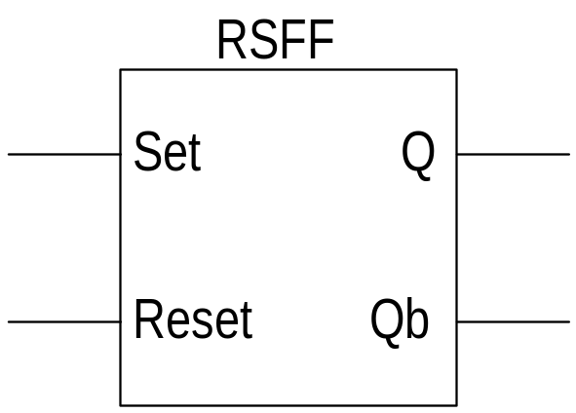
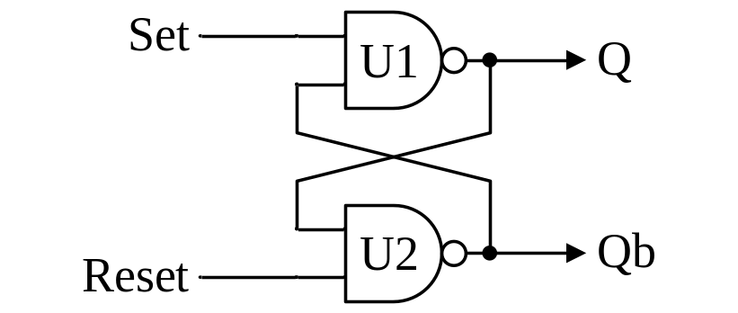
Example : R-S Latch
ENTITY rsff IS
PORT(set,reset:IN BIT;
q,qb:BUFFER BIT);
END rsff;
ARCHITECTURE netlist OF rsff IS
COMPONENT nand2
PORT(a,b:IN BIT;
c:OUT BIT);
END COMPONENT;
BEGIN
U1:nand2 PORT MAP(set,qb,q);
U2:nand2 PORT MAP(reset,q,qb);
END netlist;
Symbol
Schematic

Slide 19
Port Mapping
Mapping with order (pre-example)
Mapping with name association
  Example:
U1:
nand2 PORT MAP(a=>set ,b=>qb, c=>q);
U2:
nand2 PORT MAP(c=>qb, a=>reset, b=>q);

Slide 20
VHDL Operator
Comparison Operator
Logic Declaration
Arithmetic Operator
Bitwise Operator

Slide 21
Logic Declaration
AND
OR
NOT
NOR
NAND
XOR
XNOR
邏輯運算子可以應用在三種資料型態：BIT, BOOLEAN 和STD_LOGIC

Slide 22
Logic Operators
Logic operators(應用在三種資料型態：BIT, BOOLEAN 和STD_LOGIC):
  not and or xor nand xnor
library ieee;
use ieee.std_logic_1164.all;
ENTITY log_ex IS
PORT( A,B :in std_logic_vector(0 to 3);
Y :out std_logic_vector(0 to 3);
Z :out std_logic);
end log_ex;
architecture a of log_ex is
begin
Y(0) <= A(0) AND B(0) ;
Y(1) <= A(1) OR B(1) ;
Y(2) <= A(2) NOR B(2) ;
Y(3) <= A(3) XOR B(3) ;
Z <= (not A(0)) nand B(0);
end A;

Slide 23
Relational operators
Relational operators:
  = , /= , < , <= , > , >=
  Operands must be of the same type
library ieee;
use ieee.std_logic_1164.all;
ENTITY rel_ex IS
PORT( A,B,C,D,E,F:in std_logic_vector(2 downto 0);
Y: out std_logic);
end rel_ex;
architecture behavior of rel_ex is
begin
process(A,B,C,D,E,F)
begin
if((A=B) or ((C>D) and not(E<=F))) then
y<='1';
else
y<='0';
end if;
end process;
end behavior;

Slide 24
Arithmetic Operator
所有Synthetizer都支援
“+” : 加法
“-” : 減法
有些Synthetizer支援
“ * ” : 乘法
“ABS” : 求絕對值
編譯時設定數值運算時使用
“/” : 除法
“**” : 次方
“MOD” : 求模數
“REM” : 求餘數

Slide 25
Bitwise Operator
SRL
Fill value
SLA
SRA
ROL
SLL
Fill value
ROR
A sll 2 為 “01010100”
A srl 3 為 “00010010”
A sla 3 為 “10101111”
A sra 2 為 “11100101”
A rol 3 為 “10101100”
A ror 5 為 “10101100”

Slide 26
Arithmetic Operators
Arith. operators:
  + (加) - (減) * (乘) / (除) **(次方)
library IEEE;
use IEEE.Std_logic_1164.all;
use IEEE.Std_logic_unsigned.all;
entity arith_ex is
port(A,B : in integer range 7 downto 0;
C,D : out integer range 64 downto 0;
E,F,G : out integer range 7 downto 0);
end arith_ex;
architecture a of arith_ex is
begin
C <= A * B;
D <= 4**2;
E <= 4 mod 2;
F <= 6/2;
G <= 11 REM 3;
end a;

Slide 27
Data Flow Modeling
Concurrent statements
Signal Assignment
  Simple
  Conditional
  Select
Simulation Deltas
Generic
Block

Slide 28
Concurrent Statement
在ARCHITECTURE中所有陳述都是平行的
Example :
ARCHITECTUE statements OF example IS
BEGIN
y <= a AND b; --signal assignment
PROCESS(a, b, c); --process
BEGIN
--inside process is sequential
END
U1 : rsff PORT MAP(…); --component
END statements;
Notes:
在 architecture 的 BEGIN - END 中所有的陳述(statement)都是平行的, 也就是說當輸入訊號改變時, 所有相關的事件(event)都會被排入, 然後隨著時間做相對輸出的改變.
範例中訊號 a, b 會同時觸發 signal assignment 及 process.
在 process 中的 statement 卻是依序(sequential)進行的, process 在下一章會提到.

Slide 29
Signal Assignment
Let a = b
Logic Relation
a <= b;
c <= a AND b;
Delay
Primitive Logic Operators
  AND OR NAND NOR
  NOT XOR
a <= b AFTER 10ns;
Notes:
基本的Signal assignment 是一個箭頭符號 : <= , 將右值或運算結果傳給左邊的訊號線.
Signal assignment 也可以加上時間的延遲, 如 a <= b AFTER 10ns 表示由訊號 b 變化到造成 a 改變的延遲是10ns. 內定是採 inertial delay, 若要用 transport delay 則可寫成 :
a <= TRANSPORT b AFTER 10ns
箭頭的右手邊可包含運算式(加減乘除等)或邏輯關係, 邏輯關係包括AND, OR, NAND, NOR, NOT, XOR 六種主要運算元.
數值的表示 :
邏輯值用單引號括起來, 如邏輯 1 : ‘1’
陣列, 字串等用雙引號, 如 “0101”

Slide 30
Conditional Signal Assignment
語法 :
Signal assignment WHEN condition ELSE
the other value/signal [WHEN…ELSE…]
Example :
sel <= 0 WHEN a = ‘0’ AND b = ‘0’ ELSE
1 WHEN a = ‘1’ AND b = ‘0’ ELSE
2 WHEN a = ‘0’ AND b = ‘1’ ELSE
3 WHEN a = ‘1’ AND b = ‘1’ ELSE
4;
Notes:
條件式給值(conditional signal assignment)的陳述中, 當條件成立時就將右值或訊號傳給左值, 否則就看 ELSE 以後的條件. 這種描述相當於高階語言中的連續 if-else .
範例中若 a, b 都等於 ‘0’ 時第一行條件成立, 所以 sel 的值最後會等於 1 . 當 a, b 為其他值可類推. 最後一行是所以條件都不成立時, sel 會等於 4.

Slide 31
Select Signal Assignment
語法 :
WITH expression SELECT
signal assignment WHEN expression value,
the other assignment WHEN other expression value ;
Example:
WITH sel SELECT
q <= i0 WHEN 0,
i1 WHEN 1,
i2 WHEN 2,
i4 WHEN 3,
‘X’ WHEN OTHERS;
Notes:
選擇式給值(select signal assignment)的陳述中, 左值是由運算式(expression)結果或單一變數來做決定, 當運算結果不在列舉範圍內, 則最後一行 WHEN OTHERS 會被執行. 相當於高階語言中的 case.
範例中的 q 是由單一變數 sel 來選擇, 當 sel = 0 時 q <= i0, 依此類推, 最後一行不在範圍內時 q 會變為 ‘X’ - unknown

Slide 32
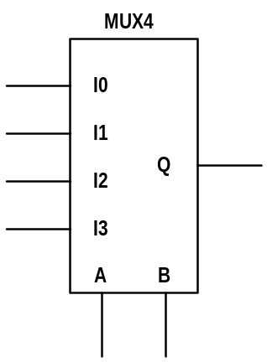
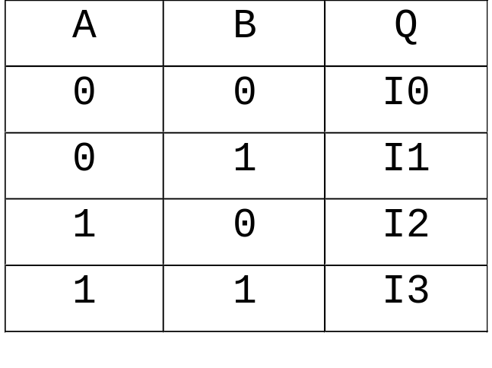
Example - 4-1 MUX
USE ieee.std_logic_1164.all
ENTITY mux4 IS
PORT (i0,i1,i2,i3,a,b :IN STD_LOGIC);
q :OUT STD_LOGIC);
END mux4
ARCHOITECTUR OF mux4 IS
SIGNAL sel :INTEGER;
BEGIN
WITH sel SELECT
q <= i0 WHEN 0,
i1 WHEN 1,
i2 WHEN 2,
i4 WHEN 3,
‘X’ WHEN OTHERS;
sel <= 0 WHEN a = ‘0’ AND b = ‘0’ ELSE
1 WHEN a = ‘1’ AND b = ‘0’ ELSE
2 WHEN a = ‘0’ AND b = ‘1’ ELSE
3 WHEN a = ‘1’ AND b = ‘1’ ELSE
4;
END;
Mux function table
Notes:
綜合前面的兩種陳述語法, 以四對一的多工選擇器為範例 :
(1) 內部信號 sel 由輸入的 a, b 做條件式給值(condition), 當 a, b 為 00, 01, 10, 11 時, sel 分別編成 0, 1, 2, 3; 最後不在範圍內則編為 4.
(2) 再由 sel做選擇式給值(select), 決定輸出訊號 q 該傳哪一個輸入(i0~i3). 不在範圍內的, 如 sel = 4 時, 輸出為 unknown
<註>內部訊號 sel 的資料形態為整數(INTEGER), 所以不用加引號.

Slide 33
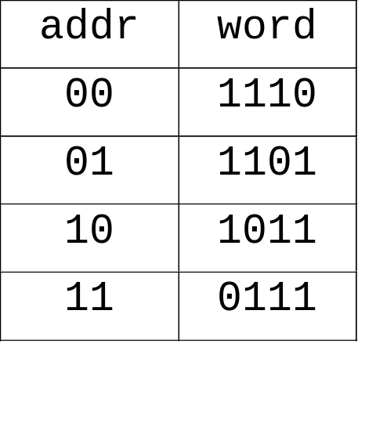
Example - Decoder
LIBRARY IEEE;
USE IEEE.std_logic_1164.all;
ENTITY decoder IS
PORT( addr :IN STD_LOGIC_VECTOR(1 DOWNTO 0);
word :OUT STD_LOGIC_VECTOR(3 DOWNTO 0));
END decoder;
ARCHITECTURE df OF decoder IS
BEGIN
word <= "1110" WHEN addr = "00" ELSE
"1101" WHEN addr = "01" ELSE
"1011" WHEN addr = "10" ELSE
"0111" WHEN addr = "11" ELSE
"1111" ;
END df;
2 to 4 decoder
table
Notes:
以二對四的解碼器(decoder)為例, 左邊表格是解碼器的 function table, 輸出的訊號 word 依輸入 addr 來選擇.
範例中的 architecture 只用到一個條件的式陳述. 條件與結果的關係可比對 function table. 最後不在範圍內時 word <= “1111”.
前一個範例中的多工選擇器也可以用單一的陳述來完成.
本例中所用到的資料型態為 STD_LOGIC_VECTOR, 定義在 IEEE 的標準資料庫中. 這種型態也就是所謂的 bus, 或是說由邏輯組成的陣列. (3 DOWNTO 0) 表示最高位元數(MSB)為3, 最低(LSB) 為0. 相反的話則宣告為(0 TO 3).

Slide 34
Driver Problem
Bad Example :
ARCHITECTURE bad OF mux IS
BEGIN
q <= i0 WHEN a =‘0’ AND b = ‘0’ ELSE ‘0’;
q <= i1 WHEN a =‘0’ AND b = ‘1’ ELSE ‘0’;
q <= i2 WHEN a =‘1’ AND b = ‘0’ ELSE ‘0’;
q <= i3 WHEN a =‘1’ AND b = ‘1’ ELSE ‘0’;
END bad;
Better Example :
ARCHITECTURE better OF mux IS
BEGIN
q <= i0 WHEN a =‘0’ AND b = ‘0’ ELSE
i1 WHEN a =‘0’ AND b = ‘1’ ELSE
i2 WHEN a =‘1’ AND b = ‘0’ ELSE
i3 WHEN a =‘1’ AND b = ‘1’ ELSE
‘x’; -- unknown
END bad;
Notes:
相同的功能設計下, Bad example 中有四個條件陳述, 而四個的目標都用來改變訊號 q . 若 a, b 都為 ‘0’ 的條件成立, 第一行使 q <= i0, 而另外三行則會使 q <= ‘0’, 造成 multi-driven 的問題. 採多數決定制的話, 最後的 q 會是 ‘0’, 其他的模擬軟體也可能使結果變成 ‘x’ - unknown.
Better example 是較好的解決方法, 針對訊號 q 只用了一個條件陳述, 串連了ELSE 來滿足其他條件的需求. 這樣就不會產生 multi-driven 的問題.
設計上建議最好不要用兩個或更多的陳述去改變相同訊號, 否則會潛在 multi-driven 的問題導致結果不正確.

Slide 35
Generic
Generic is design parameter such as
  time delay
  bus width
Pass information to an instance of entity
Example
ENTITY and2 IS
GENERIC(rise,fall :TINE;
load :INTEGER);
PORT(a,b :IN BIT;
c :OUT BIT);
END and2;
ARCHITECTURE load_dependent OF and2 IS
SIGNAL internal :BIT;
BEGIN
internal <= a AND b;
c <= internal AFTER (rise+(load*2ns))
WHEN internal = ‘1’
ELSE internal AFTER (fall+(load*3ns));
END load_dependent;
Notes:
Generic 用於在 architecture 中使用 instance 時, 傳遞一些的訊息, 用來調整時間延遲的估算, 或 bus 寬度的改變等參數.
使用generic可使電路可參數化, 例如影響時間的因素隨著製程而改變, 當製程進步時只要套上新的參數, 而不需改變原功能上的設計, Intel Pentium 晶片即是一個實例.
範例中, GENERIC傳遞了rise, fall, load 三個參數. 內部訊號 internal為一般的AND功能, 而 internal 傳到輸入訊號 c 時則依參數作計算 :
internal 改變至 ‘1’ , 訊號的正緣延遲為 rise + road * 2ns
internal 改變至 ‘0’ , 訊號的負緣延遲為 fall + road * 3ns

Slide 36
Generic
USE WORK.std_logic_1164.all
ENTITY test IS
GENERIC(rise, fall :TIME; load :INTEGER);
PORT(ina, inb, inc, ind : IN STD_LOGIC;
out1, out2 : OUT STD_LOGIC);
END test;
ARCHITECTURE test_arch OF test IS
COMPONENT and2
GENERIC(rise,fall :TINE; load :INTEGER);
PORT(a,b :IN BIT;
c :OUT BIT);
BEGIN
U1 :and2 GENERIC MAP(10ns, 20ns, 3)
PORT MAP (ina, inb, out1);
U2 :and2 GENERIC MAP(9ns, 11ns, 5)
PORT MAP (inc, ind, out2);
END test_arch;
Notes:
以上一個範例中的 and2 作為component, 在上一層使用它時 :
(1) 在 ENTITY 中宣告GENERIC
(2) 在 ARCHITECTURE 中使用 and2 時除了PORT MAP 外, 還用 GENERIC MAP 來傳遞不同的參數.
範例中 U1, U2 使用相同的 and2 gate, 但可以視實際的狀況給不同的參數.

Slide 37
Sequential Processing
Process Statements
Sequential Statements
  IF-THEN-ELSE
  CASE
  LOOP
  ASSERT
  WAIT

Slide 38
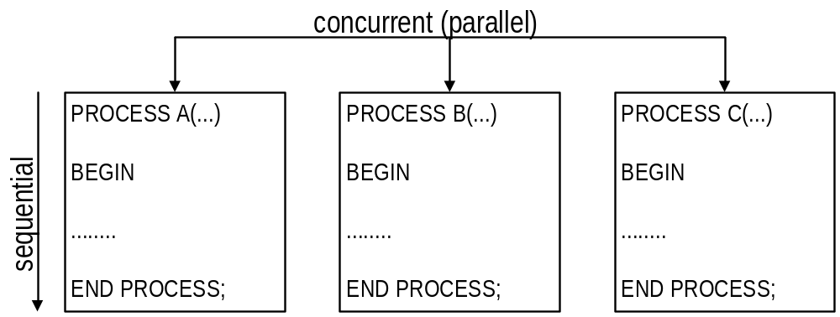
Process Statements

Slide 39
Process Statements 語法
[ process_label：] PROCESS( sensitivity_list )
{ process_declaration }
BEGIN
{ sequential_statements }
END PROCESS [ process_label ];
Example :
comb：PROCESS（a, b, c）
VARIABLE temp：STD_LOGIC;
BEGIN
temp：=NOT（a AND b）;
IF（c = ‘1’） THEN
y <= ‘0’;
ENDIF;
END PROCESS comb;

Slide 40
Process Statements 語法
語法說明
  process_label：流程的名稱標記，可有可無。
  sensitivity_list：使程式進入流程的觸發信號。一旦觸發信號改變時，即執行一次這個流程，否則流程不會被執行。
  process_declaration：宣告流程內部使用的信號或變數。
  sequential_statement；順序式的陳述。

Slide 41
Sequential Statement
IF-THEN-ELSE
CASE
LOOP
ASSERT
WAIT

Slide 42
IF-THEN-ELSE
語法:
Example (1) 2-1 Mux
IF condition THEN
sequential_statements
{ ELSIF condition THEN
sequential_conditions }
[ ELSE
sequential_statements ]
END IF;
PROCESS（sel, i0,i1)
BEGIN
IF（sel=’0’） THEN
y <= i0;
ELSE
y <= i1;
END IF;
END PROCESS;

Slide 43
IF-THEN-ELSE
Example (2)
Example (3) non-full branch
PROCESS（a, b）
BEGIN
IF（a = ‘0’）THEN
y <= ‘0’;
ELSE
y <= ‘b’;
END IF;
END PROCESS;
PROCESS（i0, i1, a, b)
BEGIN
IF（a = ‘0’ AND b = ‘1’）THEN
y <= i0;
ELSE IF （a=’1’ AND b=’0’）THEN
y <=i1;
END IF;
END PROCESSS;

Slide 44
CASE Statement
語法
Example 4-1 Mux
CASE expression IS
WHEN choice
{ sequential_statements }
WHEN choice
{sequential_statements}
WHEN OTHERS
{sequential_statements}
END CASE；
CASE sel IS
WHEN “00”
Z <= I0；
WHEN “01”
Z <= I1；
WHEN “10”
Z <= I2；
WHEN “11”
Z <= I3；
WHEN OTHERS
Z <= ‘X’；
END CASE；

Slide 45
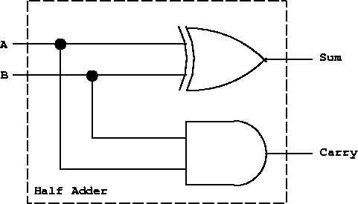
VHDL設計範例：1-bit adder
entity ha is
port ( A : in std_logic;
B : in std_logic;
Sum : out std_logic; -- sum out of A xor B
Carry : out std_logic -- carry out from A and B );
end ha;

Slide 46
VHDL設計範例：1-bit adder
architecture rtl of ha is
begin
Sum <= A XOR B;
Carry <= A AND B;
end rtl;

Slide 47
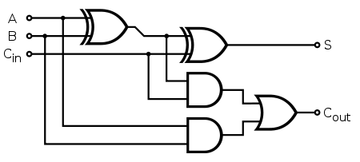
練習：使用VHDL設計1-bit full adder

