Slide 1
How to use lex/yacc on Windows

Slide 2
Download and Install MinGW
https://sourceforge.net/projects/mingw/

Slide 3
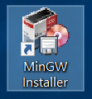
Use the Installer
After the installation, open the installer on the Desktop.

Slide 4
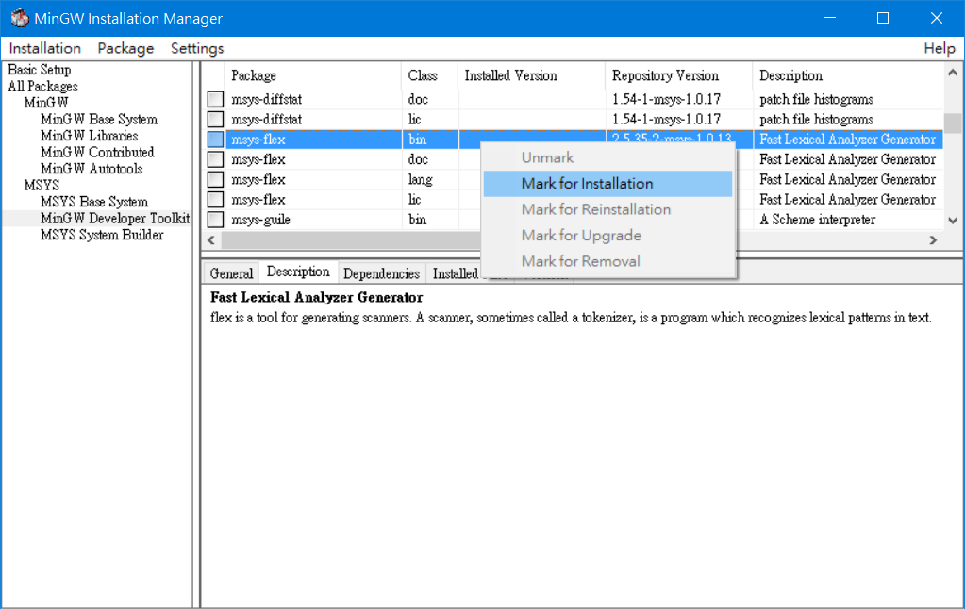
Mark “msys-flex” binary for installation
(alternative of lex)

Slide 5
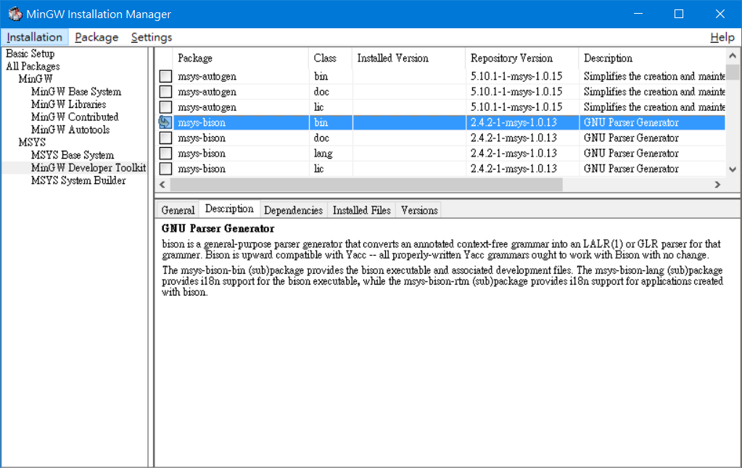
“msys-bison” is available too, mark it.
(alternative of yacc)

Slide 6
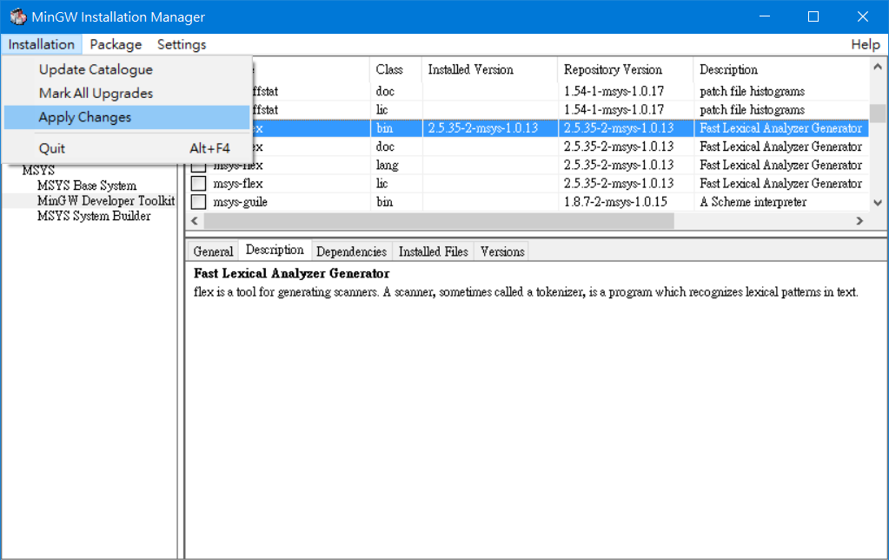
Apply changes

Slide 7
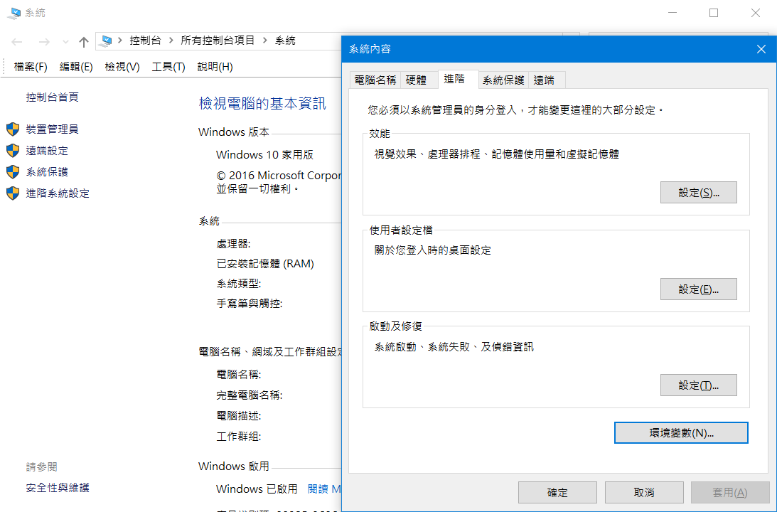
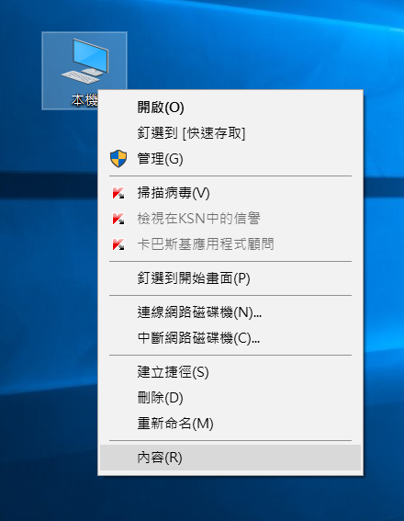
Setting the Environment variable

Slide 8
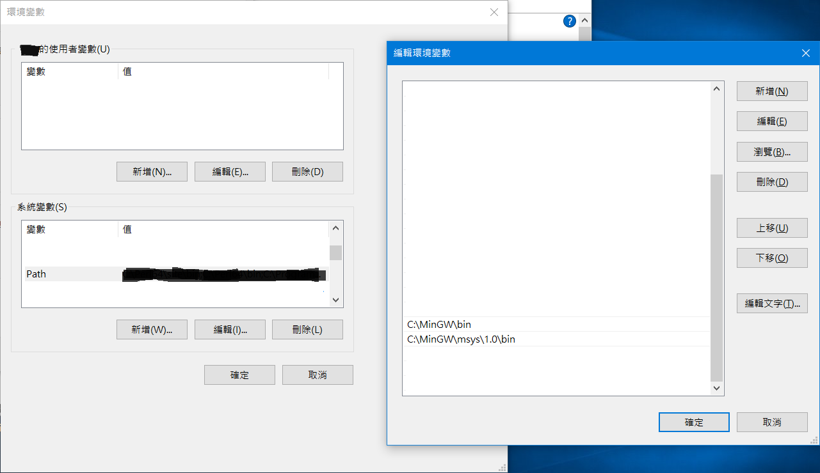
Add MinGW bin folder to ‘Path’ (important!)
Add these paths
The paths should exactly match the bin folders on your computer. It may differ on your computer,
You should check whether it matches beforehand.

Slide 9
Test & use
C:\path\to\your\folder> flex myLexProgram.l // this output lex.yy.c
C:\path\to\your\folder> bison myYaccProgram.y // this output myYaccProgram.c
C:\path\to\your\folder> gcc lex.yy.c myYaccProgram.c // this output a.exe
C:\path\to\your\folder> a // execute the program’s main()
(lex)
(yacc)
(or g++)

