Slide 2
Overview
Iterative combinational circuits
Binary adders
  Half and full adders
  Ripple carry and carry lookahead adders
Binary subtraction
Binary adder-subtractors
  Signed binary numbers
  Signed binary addition and subtraction
  Overflow
Binary multiplication
Other arithmetic functions
  Design by contraction
Chapter 4 <number>

Slide 3
Iterative Combinational Circuits
Arithmetic functions
  Operate on binary vectors
  Use the same subfunction in each bit position
Can design functional block for subfunction and repeat to obtain functional block for overall function
Cell - subfunction block
Iterative array - a array of interconnected cells
An iterative array can be in a single dimension (1D) or multiple dimensions
Chapter 4 <number>

Slide 4
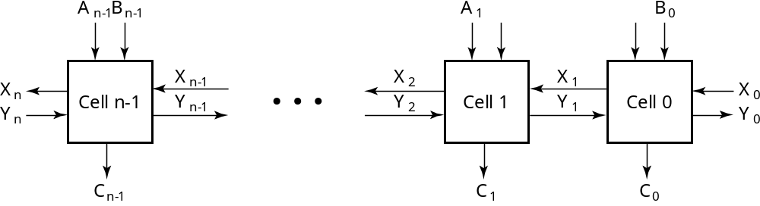
Block Diagram of a 1D Iterative Array
Example: n = 32
  Number of inputs = ?
  Truth table rows = ?
  Equations with up to ? input variables
  Equations with huge number of terms
  Design impractical!
Iterative array takes advantage of the regularity to make design feasible
Chapter 4 <number>
Notes:
Number of Inputs = 66
Truth Table Rows = 2⁶⁶
Equations with up to 66 variables

Slide 5
Functional Blocks: Addition
Binary addition used frequently
Addition Development:
  Half-Adder (HA), a 2-input bit-wise addition functional block,
  Full-Adder (FA), a 3-input bit-wise addition functional block,
  Ripple Carry Adder, an iterative array to perform binary addition, and
  Carry-Look-Ahead Adder (CLA), a hierarchical structure to improve performance.
Chapter 4 <number>

Slide 6
Functional Block: Half-Adder
A 2-input, 1-bit width binary adder that performs the following computations:
A half adder adds two bits to produce a two-bit sum
The sum is expressed as a sum bit , S and a carry bit, C
The half adder can be specified as a truth table for S and C ⇒
X
0
0
1
1
+ Y
+ 0
+ 1
+ 0
+ 1
C S
0 0
0 1
0 1
1 0
X
Y
C
S
0
0
0
0
0
1
0
1
1
0
0
1
1
1
1
0
Chapter 4 <number>

Slide 7
Logic Simplification: Half-Adder
The K-Map for S, C is:
This is a pretty trivial map!
By inspection:
and
These equations lead to several implementations.
S
Y
C
Y
1
0
1
0
1
X
1
X
1
S
=
X
⋅
Y
+
X
⋅
Y
=
X
⊕
Y
2
3
2
3
S
=
(
X
+
Y
)
⋅
(
X
+
Y
)
C
=
X
⋅
Y
C
=
(
(
X
⋅
Y
)
)
Chapter 4 <number>

Slide 8
Five Implementations: Half-Adder
We can derive following sets of equations for a half-adder:
(a), (b), and (e) are SOP, POS, and XOR implementations for S.
In (c), the C function is used as a term in the AND-NOR implementation of S, and in (d), the function is used in a POS term for S.
(
a
)
S
=
X
⋅
Y
+
X
⋅
Y
(
d
)
S
=
(
X
+
Y
)
⋅
C
C
=
X
⋅
Y
C
=
(
X
+
Y
)
(
b
)
S
=
(
X
+
Y
)
⋅
(
X
+
Y
)
(
e
)
S
=
X
⊕
Y
C
=
X
⋅
Y
C
=
X
⋅
Y
(
c
)
S
=
(
C
+
X
⋅
Y
)
C
=
X
⋅
Y
C
Chapter 4 <number>

Slide 9
Implementations: Half-Adder
The most common half adder implementation is: (e)
A NAND only implementation is:
X
S
Y
S
=
X
⊕
Y
C
C
=
X
⋅
Y
C
X
S
=
(
X
+
Y
)
⋅
C
C
=
(
(
X
⋅
Y
)
)
S
Y
Chapter 4 <number>

Slide 10
Functional Block: Full-Adder
A full adder is similar to a half adder, but includes a carry-in bit from lower stages. Like the half-adder, it computes a sum bit, S and a carry bit, C.
  For a carry-in (Z) of 0, it is the same as the half-adder:
  For a carry- in
  (Z) of 1:
Z
0
0
0
0
X
0
0
1
1
+ Y
+ 0
+ 1
+ 0
+ 1
C S
0
0
0 1
0 1
1 0
Z
1
1
1
1
X
0
0
1
1
+ Y
+ 0
+ 1
+ 0
+ 1
C S
0 1
1 0
1 0
1
1
Chapter 4 <number>

Slide 11
Logic Optimization: Full-Adder
Full-Adder Truth Table:
Full-Adder K-Map:
X
Y
Z
C
S
0
0
0
0
0
0
0
1
0
1
0
1
0
0
1
0
1
1
1
0
1
0
0
0
1
1
0
1
1
0
1
1
0
1
0
1
1
1
1
1
S
Y
C
Y
1
1
1
0
1
3
2
0
1
3
2
X
1
1
X
1
1
1
4
5
7
6
4
5
7
6
Z
Z
Chapter 4 <number>

Slide 12
Equations: Full-Adder
From the K-Map, we get:
The S function is the three-bit XOR function (Odd Function):
The Carry bit C is 1 if both X and Y are 1 (the sum is 2), or if the sum is 1 and a carry-in (Z) occurs. Thus C can be re-written as:
The term X·Y is carry generate.
The term X⊕Y is carry propagate.
S
=
X
Y
Z
+
X
Y
Z
+
X
Y
Z
+
X
Y
Z
C
=
X
Y
+
X
Z
+
Y
Z
S
=
X
⊕
Y
⊕
Z
X·Y
C
=
+
(
X
⊕
Y
)
Z
Chapter 4 <number>

Slide 13
Implementation: Full Adder
Ai
Bi
Full Adder Schematic
Here X, Y, and Z, and C
(from the previous pages)
are A, B, C_{i} and C_{o},
respectively. Also,
G = generate and
P = propagate.
Note: This is really a combination
of a 3-bit odd function (for S)) and
Carry logic (for C_{o}):
(G = Generate) OR (P =Propagate AND C_{i} = Carry In)
Co = G + P · Ci
Gi
Pi
Ci
Ci+1
Si
Chapter 4 <number>

Slide 14
Binary Adders
To add multiple operands, we “bundle” logical signals together into vectors and use functional blocks that operate on the vectors
Example: 4-bit ripple carry
adder: Adds input vectors A(3:0) and B(3:0) to get
a sum vector S(3:0)
Note: carry out of cell i
becomes carry in of cell
i + 1
Description
Subscript
Name
3 2 1 0
Carry In
0 1 1 0
Ci
Augend
1 0 1 1
Ai
Addend
0 0 1 1
Bi
Sum
1 1 1 0
Si
Carry out
0 0 1 1
Ci+1
Chapter 4 <number>

Slide 15
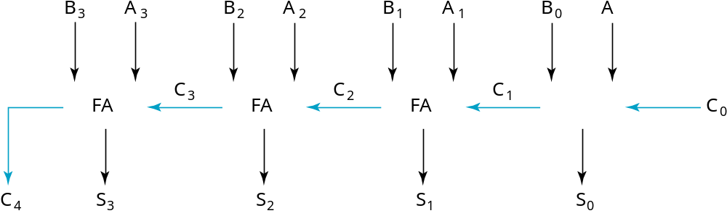
4-bit Ripple-Carry Binary Adder
A four-bit Ripple Carry Adder made from four 1-bit Full Adders:
Chapter 4 <number>

Slide 16
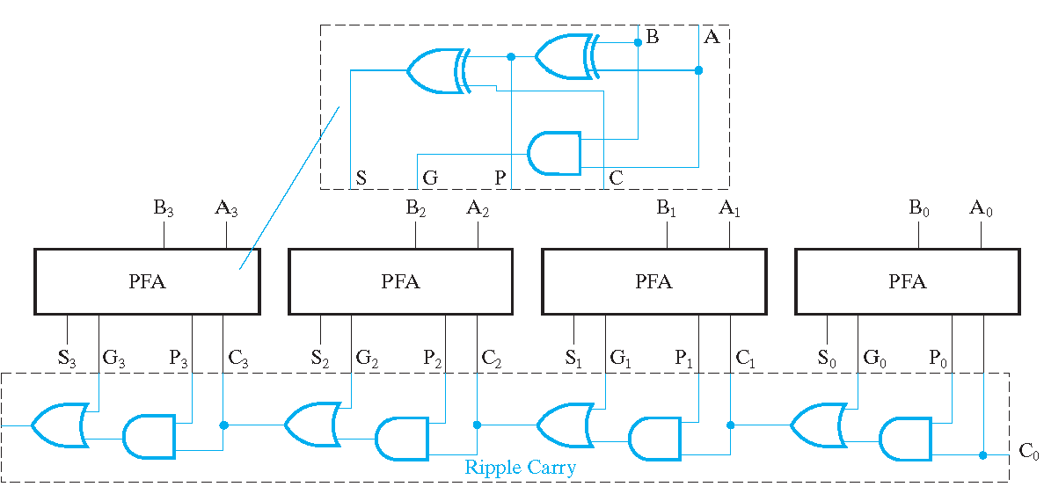
Carry Look Ahead Adder
Chapter 4 <number>

Slide 17
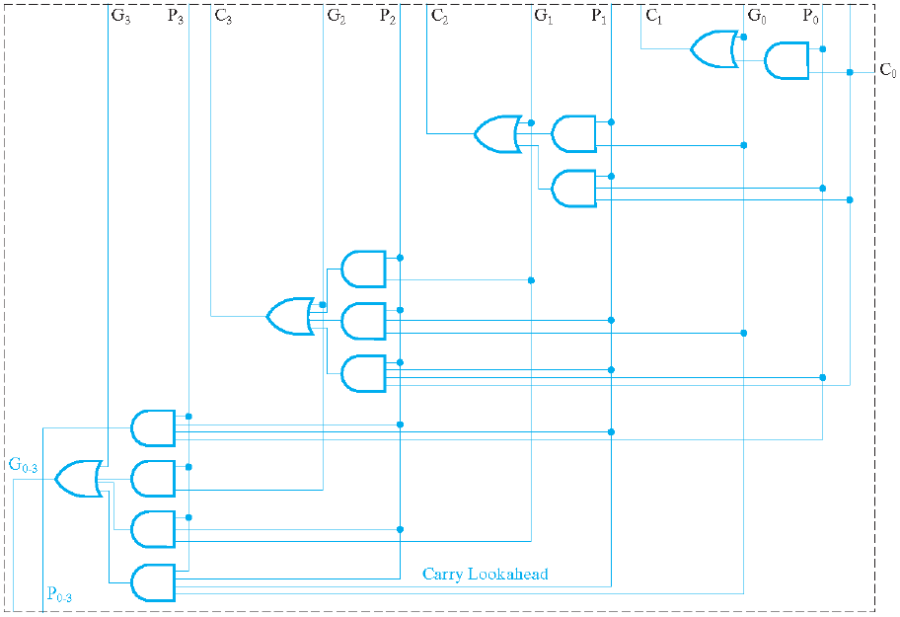
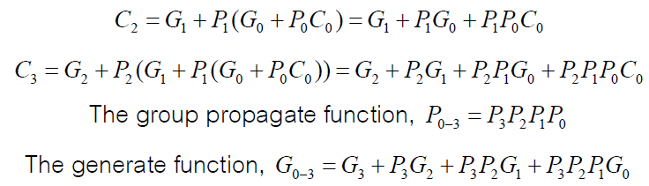

Carry Look Ahead Adder
Chapter 4 <number>

Slide 18
Unsigned Subtraction
Algorithm:
  Subtract the subtrahend N from the minuend M
  If no end borrow occurs, then M ≥ N, and the result is a non-negative number and correct.
  If an end borrow occurs, the N > M and the difference M − N + 2^{n} is subtracted from 2^{n}, and a minus sign is appended to the result.
Examples:
0 1
1001 0100
− 0111 − 0111
0010 1101
10000
− 1101
(−) 0011
Chapter 4 <number>

Slide 19
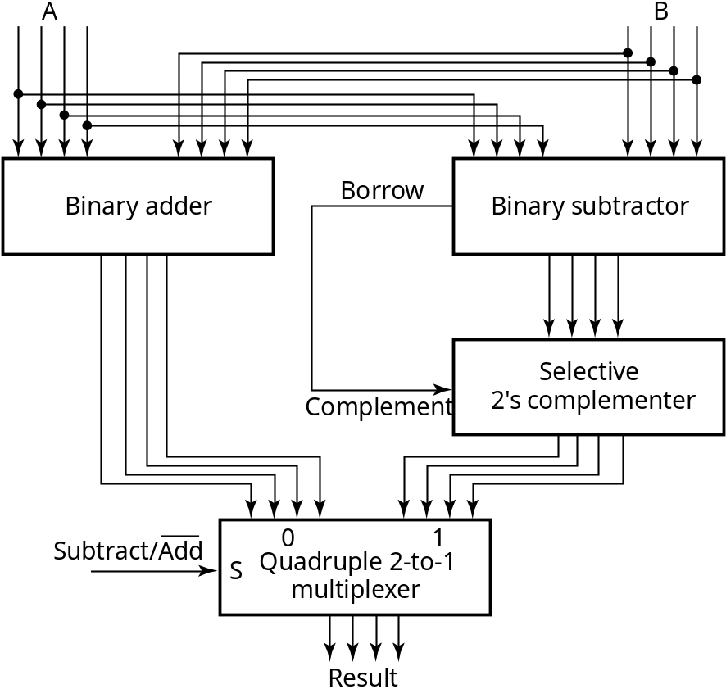
Unsigned Subtraction (continued)
The subtraction, 2^{n} − N, is taking the 2’s complement of N
To do both unsigned addition and unsigned subtraction requires:
Quite complex!
Goal: Shared simpler
logic for both addition
and subtraction
Introduce complements
as an approach
Chapter 4 <number>

Slide 20
Complements
Two complements:
  Diminished Radix Complement of N
    (r − 1)’s complement for radix r
    1’s complement for radix 2
    Defined as (r^{n} − 1) − Ν
  Radix Complement
    r’s complement for radix r
    2’s complement in binary
    Defined as r^{n} − N
Subtraction is done by adding the complement of the subtrahend
If the result is negative, takes its 2’s complement
Chapter 4 <number>

Slide 21
Binary 1's Complement
For r = 2, N = 01110011₂, n = 8 (8 digits):
(r^{n} – 1) = 256 -1 = 255₁₀ or 11111111₂
The 1's complement of 01110011₂ is then:
11111111
– 01110011
10001100
Since the 2^{n} – 1 factor consists of all 1's and since 1 – 0 = 1 and 1 – 1 = 0, the one's complement is obtained by complementing each individual bit (bitwise NOT).
Chapter 4 <number>

Slide 22
Binary 2's Complement
For r = 2, N = 01110011₂, n = 8 (8 digits), we have:
(r^{n} ) = 256₁₀ or 100000000₂
The 2's complement of 01110011 is then:
100000000
– 01110011
10001101
Note the result is the 1's complement plus 1, a fact that can be used in designing hardware
Chapter 4 <number>

Slide 23
Alternate 2’s Complement Method
Given: an n-bit binary number, beginning at the least significant bit and proceeding upward:
  Copy all least significant 0’s
  Copy the first 1
  Complement all bits thereafter.
2’s Complement Example:
  10010100
  Copy underlined bits:
  100
  and complement bits to the left:
  01101100
Chapter 4 <number>

Slide 24
Subtraction with 2’s Complement
For n-digit, unsigned numbers M and N, find M − N in base 2:
  Add the 2's complement of the subtrahend N to the minuend M:
  M + (2^{n} − N) = M − N + 2^{n}
  If M > N, the sum produces end carry r^{n} which is discarded; from above, M − N remains.
  If M < N, the sum does not produce an end carry and, from above, is equal to 2^{n} − ( N − M ), the 2's complement of ( N − M ).
  To obtain the result − (N – M) , take the 2's complement of the sum and place a − to its left.
Chapter 4 <number>

Slide 25
Unsigned 2’s Complement Subtraction Example 1
Find 01010100₂ – 01000011₂
01010100 01010100
– 01000011 + 10111101
00010001
The carry of 1 indicates that no correction of the result is required.
1
2’s comp
Chapter 4 <number>

Slide 26
Unsigned 2’s Complement Subtraction Example 2
Find 01000011₂ – 01010100₂
01000011 01000011
– 01010100 + 10101100
11101111
00010001
The carry of 0 indicates that a correction of the result is required.
Result = – (00010001)
0
2’s comp
2’s comp
Chapter 4 <number>

Slide 27
課堂練習
Find
(a)11010 – 10001
(b)111110 – 1111110
(c)00110 – 01110
(d)101001 – 101
Chapter 4 <number>

Slide 28
Signed Integers
Positive numbers and zero can be represented by unsigned n-digit, radix r numbers. We need a representation for negative numbers.
To represent a sign (+ or –) we need exactly one more bit of information (1 binary digit gives 2¹ = 2 elements which is exactly what is needed).
Since computers use binary numbers, by convention, the most significant bit is interpreted as a sign bit:
s a_{n–2} … a₂a₁a₀
where:
s = 0 for Positive numbers
s = 1 for Negative numbers
and a_{i} = 0 or 1 represent the magnitude in some form.
Chapter 4 <number>

Slide 29
Signed Integer Representations
Signed-Magnitude – here the n – 1 digits are interpreted as a positive magnitude.
Signed-Complement – here the digits are interpreted as the rest of the complement of the number. There are two possibilities here:
  Signed 1's Complement
    Uses 1's Complement Arithmetic
  Signed 2's Complement
    Uses 2's Complement Arithmetic
Chapter 4 <number>

Slide 30
Signed Integer Representation Example
r =2, n=3
Number
Sign
-
Mag.
1's Comp.
2's Comp.
+3
011
011
011
+2
010
010
010
+1
001
001
001
+0
000
000
000
–
0
100
111
—
–
1
101
110
111
–
2
110
101
110
–
3
111
100
101
–
4
—
—
100
Chapter 4 <number>

Slide 31
Signed-Magnitude Arithmetic
If the parity of the three signs is 0:
    1. Add the magnitudes.
    2. Check for overflow (a carry out of the MSB)
    3. The sign of the result is the same as the sign of the
    first operand.
If the parity of the three signs is 1:
    1. Subtract the second magnitude from the first.
    2. If a borrow occurs:
      take the two’s complement of result
      and make the result sign the complement of the sign of the first operand.
    3. Overflow will never occur.
Chapter 4 <number>

Slide 32
Sign-Magnitude Arithmetic Examples
Example 1: 0010
+ 0101
Example 2: 0010
+ 1101
Example 3: 1010
− 0101
Chapter 4 <number>
Notes:
Example 1: Since the parity of the signs is 0: ADD magnitudes giving 111
Append the sign of the first operand to obtain 0111
Example 2: Since the parity of the signs is 1: SUBTRACT 010
- 101
101 Borrow of 1
Taking the 2’s complement and appending the complement of the sign: 1011
Example 3: Since the parity of the signs is 0, ADD the magnitudes 010
101
111
Appending the sign if the top operand: 1111

Slide 33
Signed-Complement Arithmetic
Addition:
  1. Add the numbers including the sign bits, discarding a carry out of the sign bits (2's Complement), or using an end-around carry (1's Complement).
  2. If the sign bits were the same for both numbers and the sign of the result is different, an overflow has occurred.
  3. The sign of the result is computed in step 1.
Subtraction:
  Form the complement of the number you are subtracting and follow the rules for addition.
Chapter 4 <number>

Slide 34
Signed 2’s Complement Examples
Example 1: 1101
+ 0011
Example 2: 1101
− 0011
Chapter 4 <number>
Notes:
Example 1: Result is 0000. The carry out of the MSB is discarded.
Example 2: Complement 0011 to 1101 and add. Result is 1010. The carry out of the MSB is discarded.

Slide 35
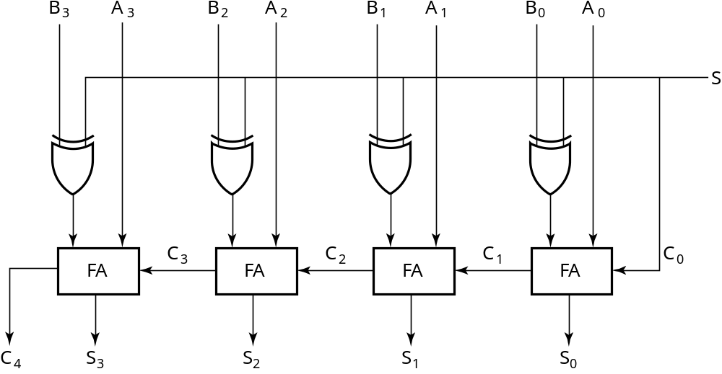
2’s Complement Adder/Subtractor
Subtraction can be done by addition of the 2's Complement.
1. Complement each bit (1's Complement.)
2. Add 1 to the result.
The circuit shown computes A + B and A – B:
For S = 1, subtract,
the 2’s complement
of B is formed by using
XORs to form the 1’s
comp and adding the 1
applied to C₀.
For S = 0, add, B is
passed through
unchanged
Chapter 4 <number>

Slide 36
Overflow Detection
Overflow occurs if n + 1 bits are required to contain the result from an n-bit addition or subtraction
Overflow can occur for:
  Addition of two operands with the same sign
  Subtraction of operands with different signs
Signed number overflow cases with correct result sign
0 0 1 1
+ 0 − 1 − 0 + 1
0 0 1 1
Detection can be performed by examining the result signs which should match the signs of the top operand
Chapter 4 <number>

Slide 37
Overflow Detection
Signed number cases with carries C_{n} and C_{n−1} shown for correct result signs:
0 0 0 0 1 1 1 1
0 0 1 1
+ 0 − 1 − 0 + 1
0 0 1 1
Signed number cases with carries shown for erroneous result signs (indicating overflow):
0 1 0 1 1 0 1 0
0 0 1 1
+ 0 − 1 −0 + 1
1 1 0 0
Simplest way to implement overflow V = C_{n} + C_{n − 1}
This works correctly only if 1’s complement and the addition of the carry in of 1 is used to implement the complementation! Otherwise fails for − 10 ... 0
Chapter 4 <number>

Slide 38
Other Arithmetic Functions
Convenient to design the functional blocks by contraction - removal of redundancy from circuit to which input fixing has been applied
Functions
  Incrementing
  Decrementing
  Multiplication by Constant
  Division by Constant
  Zero Fill and Extension
Chapter 4 <number>

Slide 39
Design by Contraction
Contraction is a technique for simplifying the logic in a functional block to implement a different function
  The new function must be realizable from the original function by applying rudimentary functions to its inputs
  Contraction is treated here only for application of 0s and 1s (not for X and X)
  After application of 0s and 1s, equations or the logic diagram are simplified by using rules given on pages 224 - 225 of the text.
Chapter 4 <number>

Slide 40
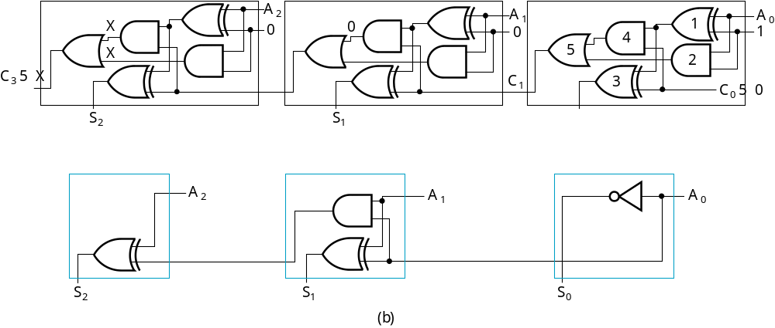
Design by Contraction Example
Contraction of a ripple carry adder to incrementer for n = 3
  Set B = 001
  The middle cell can be repeated to make an incrementer with n > 3.
Chapter 4 <number>

Slide 41
Incrementing & Decrementing
Incrementing
  Adding a fixed value to an arithmetic variable
  Fixed value is often 1, called counting (up)
  Examples: A + 1, B + 4
  Functional block is called incrementer
Decrementing
  Subtracting a fixed value from an arithmetic variable
  Fixed value is often 1, called counting (down)
  Examples: A − 1, B − 4
  Functional block is called decrementer
Chapter 4 <number>

Slide 42
Multiplication/Division by 2^{n}
(a) Multiplication
by 100
  Shift left by 2
(b) Division
by 100
  Shift right by 2
  Remainder
  preserved
B
3
B
2
B
1
B
0
0
0
C
5
C
4
C
3
C
2
C
1
C
0
(a)
B
3
B
2
B
1
B
0
0
0
C
3
C
2
C
1
C
0
C
2
1
C
2
2
(b)
Chapter 4 <number>

Slide 43
Binary Multiplication
The binary digit multiplication table is trivial:
This is simply the Boolean AND function.
Form larger products the same way we form larger products in base 10.
(a × b)
b = 0
b = 1
a = 0
0
0
a = 1
0
1
Chapter 5 <number>

Slide 44
Binary Multiplication Algorithm
We execute radix 2 multiplication by:
  Computing partial products, and
  Justifying and summing the partial products. (same as decimal)
To compute partial products:
  Multiply the row of multiplicand digits by each multiplier digit, one at a time.
  With binary numbers, partial products are very simple! They are either:
    all zero (if the multiplier digit is zero), or
    the same as the multiplicand (if the multiplier digit is one).
Note: No carries are added in partial product formation!
Chapter 5 <number>

Slide 45
Example: (101 x 011) Base 2
Partial products are: 101 × 1, 101 × 1, and 101 × 0
Note that the partial product
summation for n digit, base 2
numbers requires adding up
to n digits (with carries) in
a column.
Note also n × m digit multiply generates up to an m + n digit result (same as decimal).
1
0
1
×
0
1
1
1
0
1
1
0
1
0
0
0
0
0
1
1
1
1
Chapter 5 <number>

Slide 46
Multiplier Boolean Equations
We can also make an n × m “block” multiplier and use that to form partial products.
Example: 2 × 2 – The logic equations for each partial-product binary digit are shown below:
We need to "add" the columns to get
the product bits P0, P1, P2, and P3.
Note that some
columns may
generate carries.
b1
b0
×
a1
a0
(a0
.
b1)
(a0
.
b0)
+
(a1
.
b1)
(a1
.
b0)
P3
P2
P1
P0
Chapter 5 <number>

Slide 47
Multiplier Arrays Using Adders
An implementation of the 2 × 2 multiplier array is shown:
A
0
B
1
B
0
A
1
B
1
B
0
HA
HA
C
3
C
2
C
1
C
0
Chapter 5 <number>

Slide 48
Multiplication by a Constant
Multiplication of B(3:0) by 101
See text Figure 513 (a) for contraction
B
B
B
B
0
0
B
B
B
B
3
2
1
0
3
2
1
0
4-bit Adder
Carry
output
Sum
C
6
C
5
C
4
C
3
C
2
C
1
C
0
Chapter 4 <number>

Slide 49
Zero Fill
Zero fill - filling an m-bit operand with 0s to become an n-bit operand with n > m
Filling usually is applied to the MSB end of the operand, but can also be done on the LSB end
Example: 11110101 filled to 16 bits
  MSB end: 0000000011110101
  LSB end: 1111010100000000
Chapter 4 <number>

Slide 50
Extension
Extension - increase in the number of bits at the MSB end of an operand by using a complement representation
  Copies the MSB of the operand into the new positions
  Positive operand example - 01110101 extended to 16 bits:
  0000000001110101
  Negative operand example - 11110101 extended to 16 bits:
  1111111111110101
Chapter 4 <number>

Slide 51
Terms of Use
All (or portions) of this material © 2008 by Pearson Education, Inc.
Permission is given to incorporate this material or adaptations thereof into classroom presentations and handouts to instructors in courses adopting the latest edition of Logic and Computer Design Fundamentals as the course textbook.
These materials or adaptations thereof are not to be sold or otherwise offered for consideration.
This Terms of Use slide or page is to be included within the original materials or any adaptations thereof.
Chapter 4 <number>

