Slide 1
EH-05
Grafcet-to-VHDL硬體合成
Grafcet-to-VHDL Hardware Synthesis
陳慶瀚
機器智慧與自動化技術(MIAT)實驗室
國立中央大學資工系
2011年3月24日

Slide 2
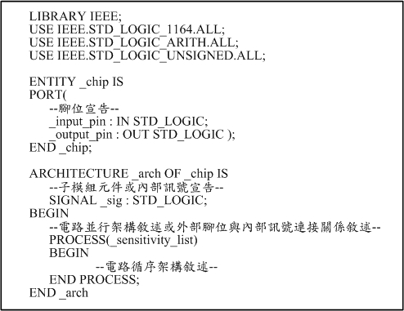
VHDL template

Slide 3
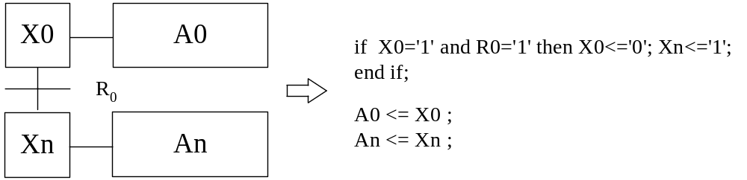
VHDL synthesis of Grafcet
Fundamental Block

Slide 4
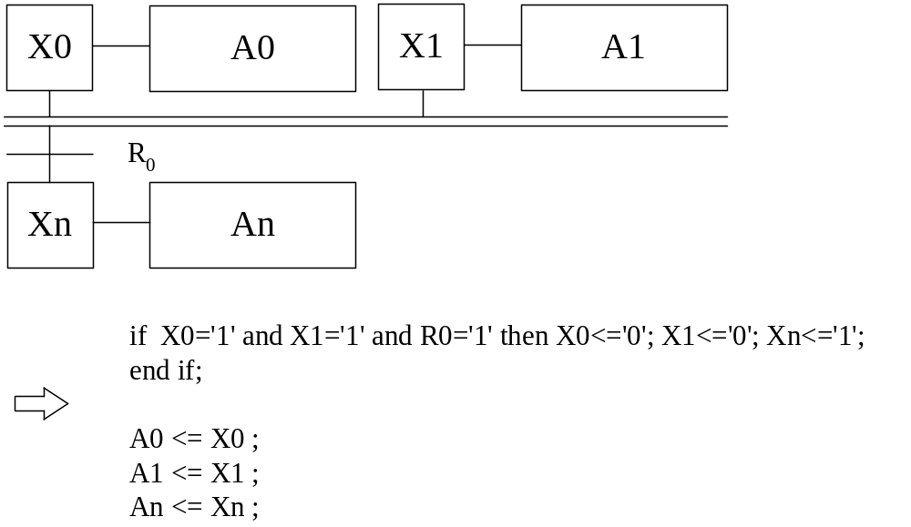
Convergence AND
VHDL synthesis of Grafcet

Slide 5
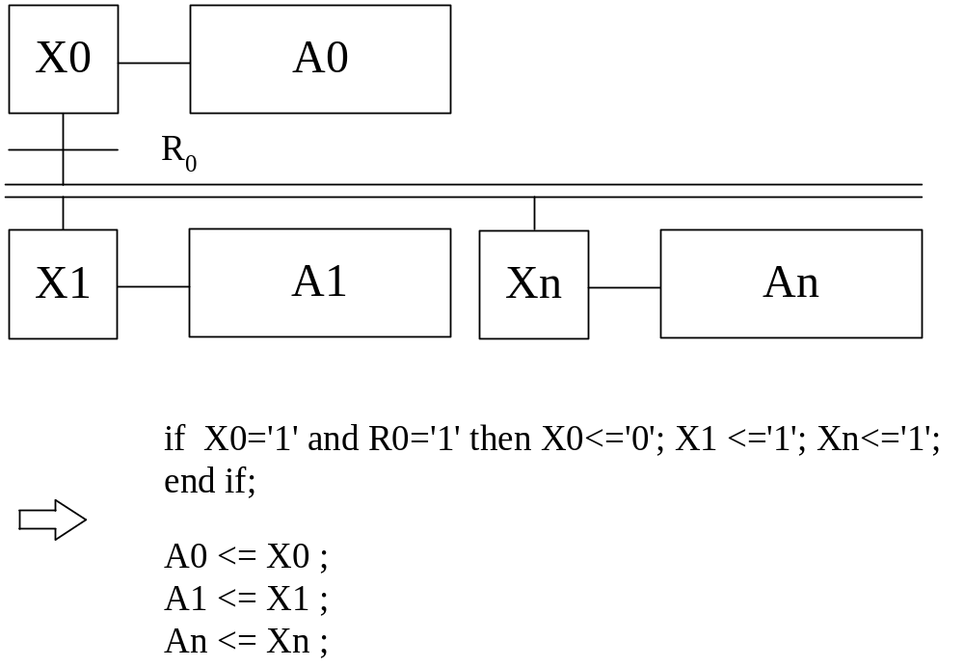
Divergence AND
VHDL synthesis of Grafcet

Slide 6
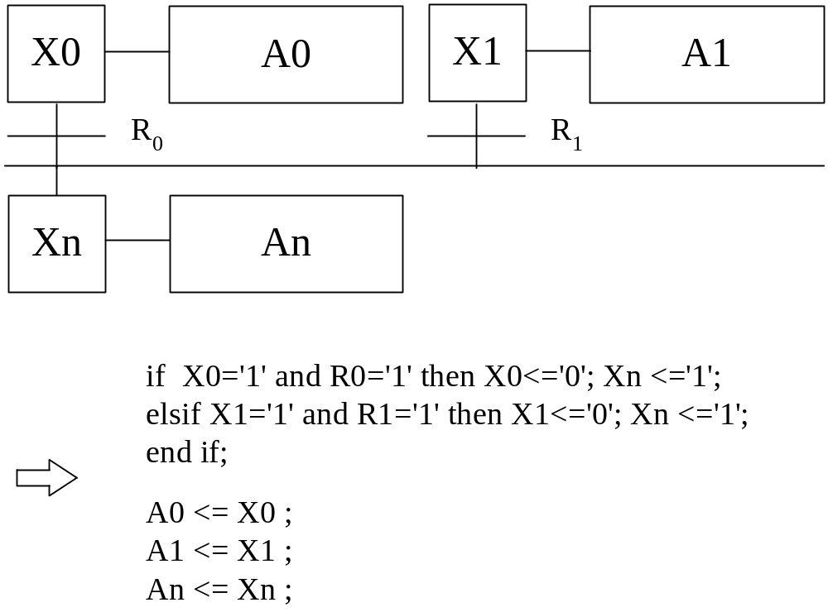
Convergence OR
VHDL synthesis of Grafcet

Slide 7
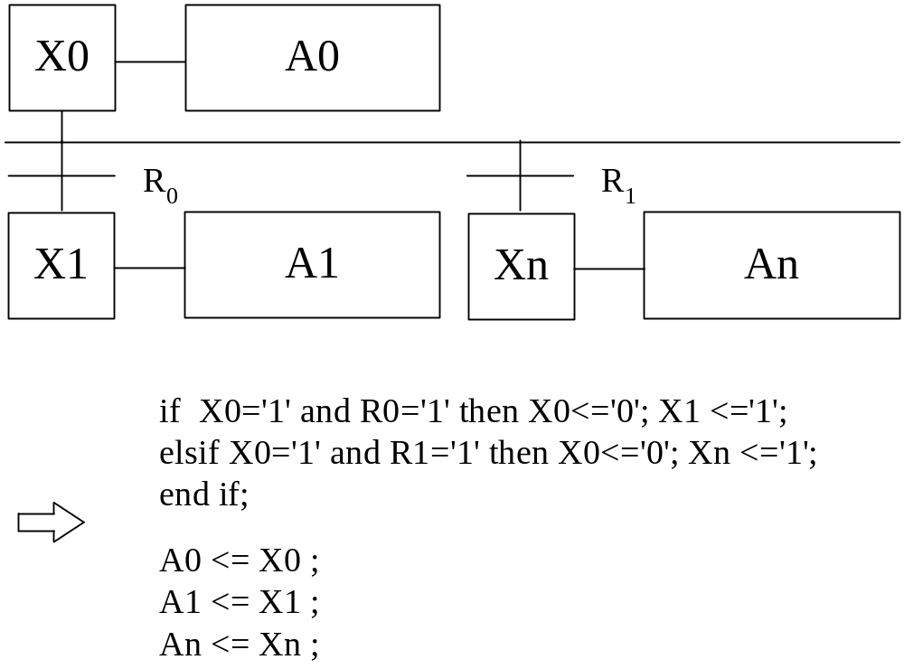
Divergence OR
VHDL synthesis of Grafcet

Slide 8
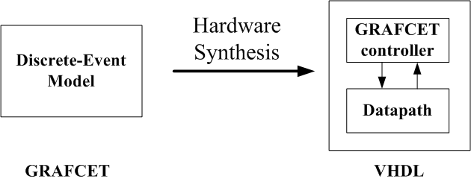
Complete Synthesis of Grafcet Model

Slide 9
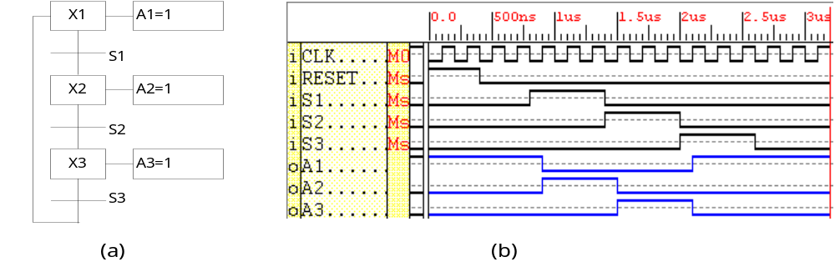
Synthesis of Grafcet Controller

Slide 10
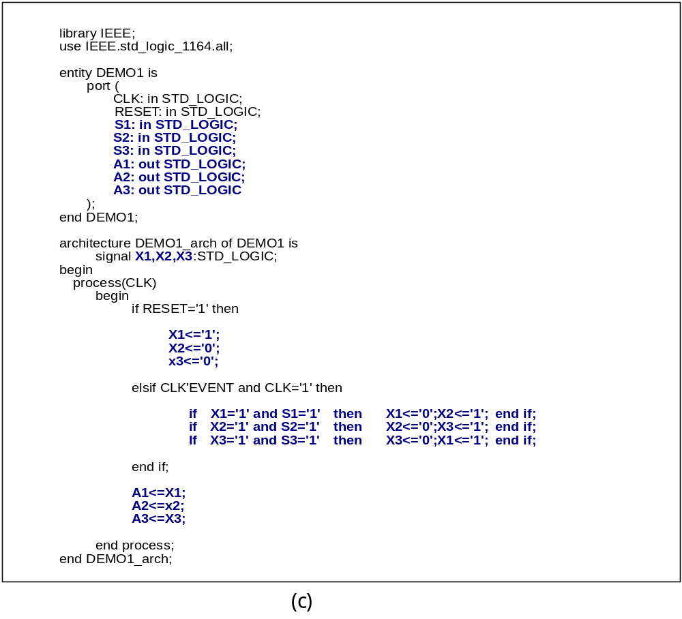
VHDL code of Grafcet Controller

Slide 11
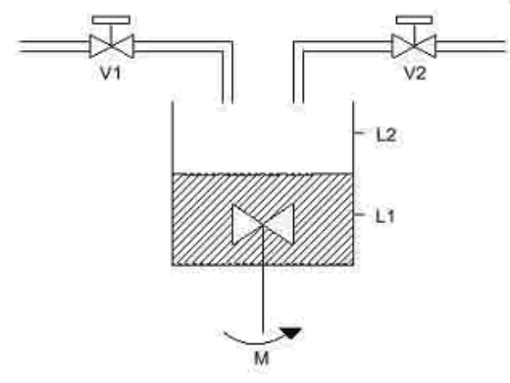
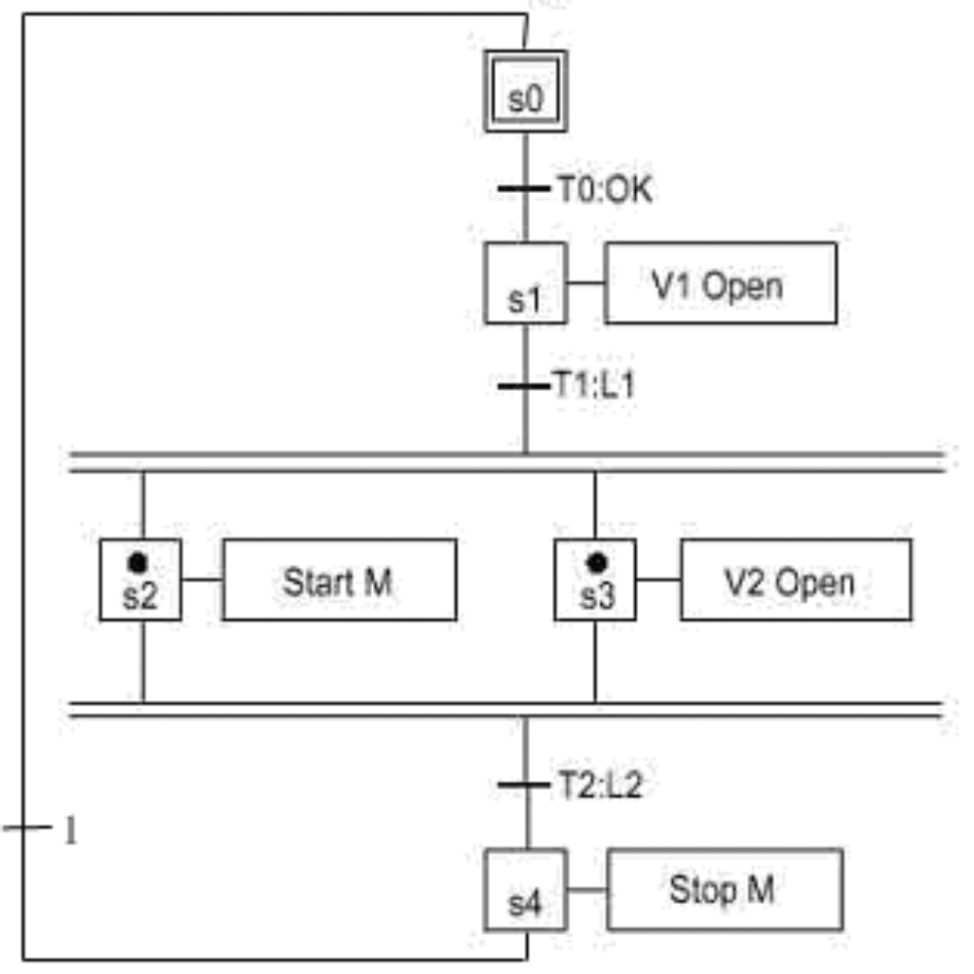
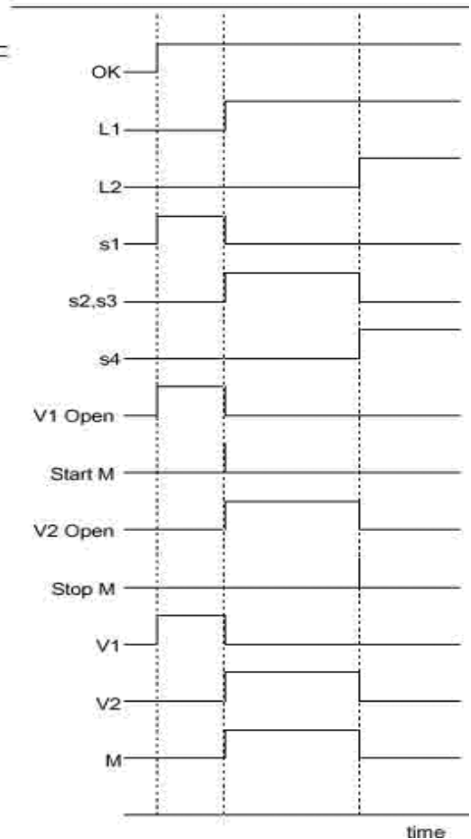
VHDL synthesis of Grafcet Controller

Slide 12
VHDL synthesis of Grafcet Controller
architecture miat of g0 is
signal s0,s1,s2,s3,s4 : std_logic;
begin
process(clk,rst)
begin
if rst='0' then
s0<='1'; s1<='0'; s2<='0'; s3<='0'; s4<='0';
elsif clk'event and clk='1' then
if s0='1' and OK='1' then
s0<='0'; s1<='1';
elsif s1='1' and L1='1' then
s1<=‘0’; s2<=‘1’; s3<=‘1’;
elsif s2='1' and s3='1' and L2='1' then
s2<=‘0’; s3<=‘0’; s4<=‘1’;
elsif s4='1' then
s4<=‘0’; s0<=‘1’;
end if;
end if;
end process;
V1<=s1; Start_M<=s2; V2<=s3; Stop_M<=s4;
END miat;
library ieee;
use IEEE.STD_LOGIC_1164.all;
entity g0 is
port(
clk : in std_logic;
rst : in std_logic;
OK : in std_logic;
L1,L2 : in std_logic;
V1,V2 : out std_logic;
Start_M : out std_logic;
Stop_M : out std_logic
);
end g0;

Slide 13
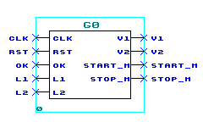
Synthesized Circuit Block Diagram

Slide 14
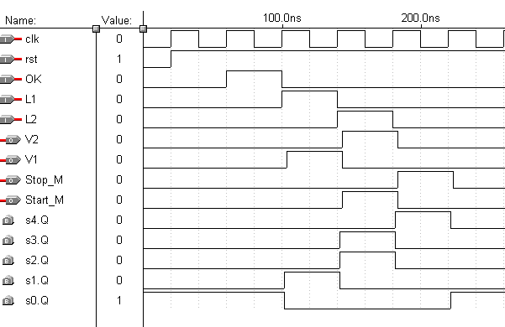
Simulated Timing Diagram

Slide 15
Synthesis of Microprogram Controller
Microprogram controller is control unit is responsible for coordinating actions within the CPU. The control unit decodes the instruction and issue a set of control signals that result in the instruction’s execution. These control signals cause data to be routed correctly within the CPU, generate correct external control signals, such as RD and WR in the 8085, and cause the ALU to perform the correct operation on the data.

Slide 16
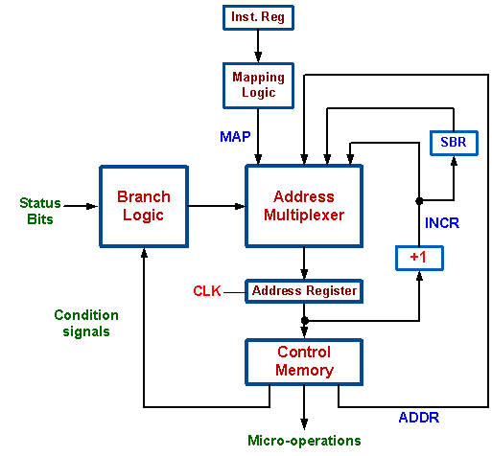
Conventional Architecture Design

Slide 17

New Approach for Microprogram Controller Design
Instruction Design
Behavioral Description
GRAFCET Modeling
High-Level Synthesis
  GRAFCET Controller Synthesis
  Datapath Synthesis
  System Synthesis

Slide 18
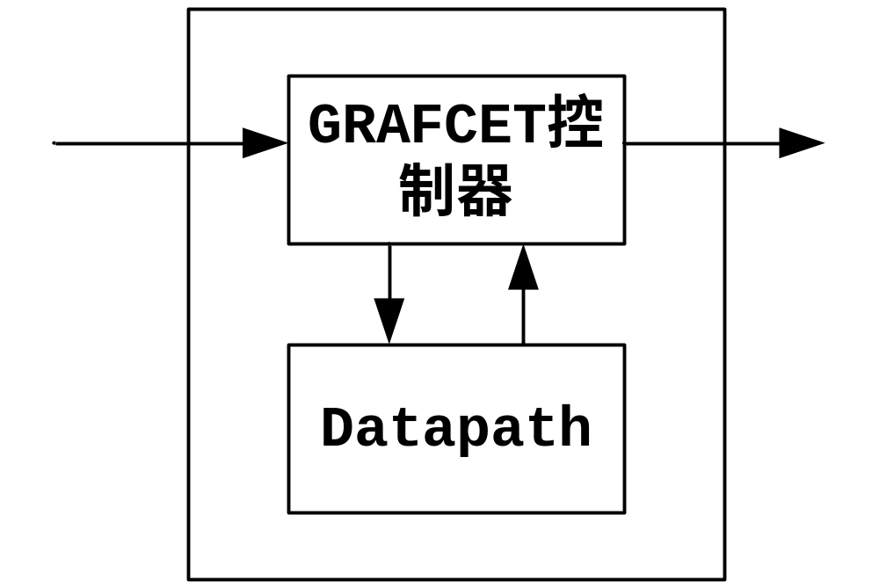
Hardware Architecture Template

Slide 19
Instruction Design
F3 | f2 | f1 | f0 | 指令 | Operand | 功能說明
0 | 0 | 0 | 0 | LD | (addr) | 從RAM的addr位址載入資料到ACC
0 | 0 | 0 | 1 | AND | (addr) | 從RAM的addr位址載入資料與ACC做AND運算，結果放在ACC
0 | 0 | 1 | 0 | OR | (addr) | 從RAM的addr位址載入資料與ACC做OR運算，結果放在ACC
0 | 0 | 1 | 1 | ANDC | (addr) | 從RAM的addr位址載入資料，將之反相並與ACC做AND運算，結果放在ACC
0 | 1 | 0 | 0 | STORE | (addr) | 將ACC資料存放
0 | 1 | 0 | 1 | JMP | [addr] | 程式無條件跳躍(改變程式計數器(PC)值為addr)
0 | 1 | 1 | 0 | JMPA | [addr] | 如果ACC為1，程式跳躍(改變程式計數器(PC)值為addr)
0 | 1 | 1 | 1 | STOP | [0] | 結束

Slide 20
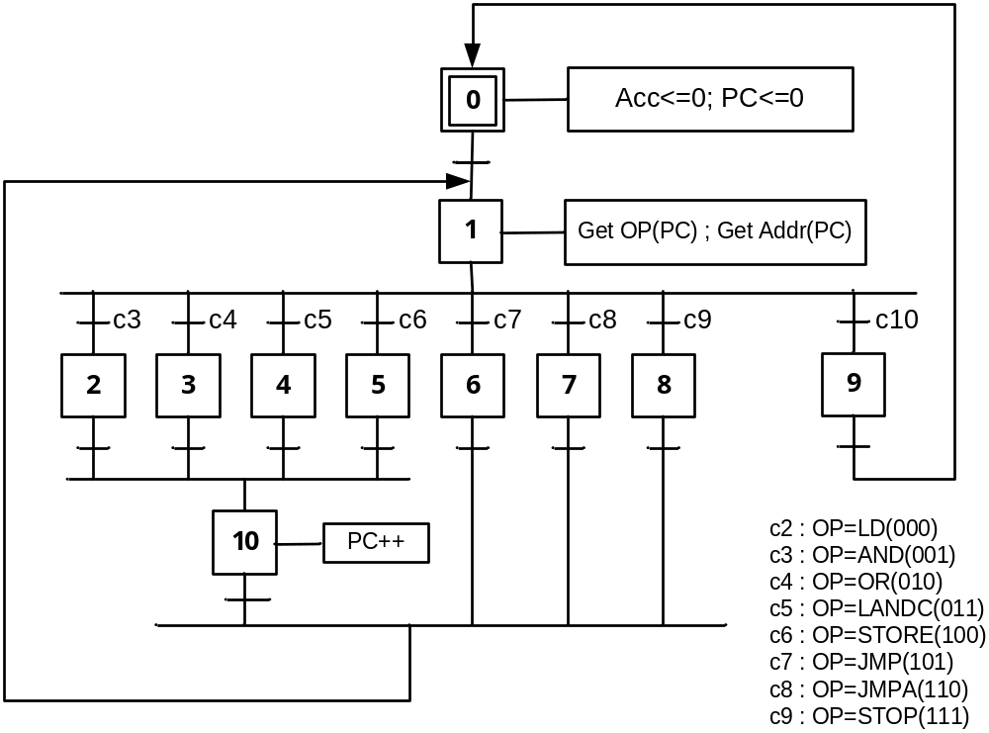
GRAFCET Modeling

Slide 21
VHDL Synthesis of Grafcet Controller
grafcet:PROCESS(CLK,RST)
BEGIN
IF RST='1' THEN
X0<='1';X1<='0';X2<='0';X3<='0'; X4<='0';X5<='0';X6<='0';X7<='0';X8<='0';X9<='0';X10<='0';
ELSIF CLK'EVENT AND CLK='1' THEN
IF X0='1' THEN X0<='0'; X1<='1';
ELSIF X1='1' THEN
IF OP="000" THEN X1<='0'; X2<='1';
ELSIF OP="001" THEN X1<='0'; X3<='1';
ELSIF OP="010" THEN X1<='0'; X4<='1';
ELSIF OP="011" THEN X1<='0'; X5<='1';
ELSIF OP="100" THEN X1<='0'; X6<='1';
ELSIF OP="101" THEN X1<='0'; X7<='1';
ELSIF OP="110" THEN X1<='0'; X8<='1';
ELSIF OP="111" THEN X1<='0'; X9<='1';
END IF;
ELSIF X2='1' THEN X2<='0';X10<='1';
ELSIF X3='1' THEN X3<='0';X10<='1';
ELSIF X4='1' THEN X4<='0';X10<='1';
ELSIF X5='1' THEN X5<='0';X10<='1';
ELSIF X6='1' THEN X6<='0';X1<='1';
ELSIF X7='1' THEN X7<='0';X1<='1';
ELSIF X8='1' THEN X8<='0';X1<='1';
ELSIF X9='1' THEN X9<='0';X0<='1';
ELSIF X10='1' THEN X10<='0';X1<='1';
END IF;
END IF;
END PROCESS grafcet;

Slide 22
Synthesis of Datapath Module
datapath:PROCESS(CLK,RST)
BEGIN
IF X0='1' THEN ACC<='0';PC<=0;RAM<="10000001";
ELSIF X1='1' THEN OP<="000";ADDR<=0;
ELSIF X2='1' THEN ACC<=RAM(ADDR);
ELSIF X3='1' THEN ACC<=ACC AND RAM(ADDR);
ELSIF X4='1' THEN ACC<=ACC OR RAM(ADDR);
ELSIF X5='1' THEN ACC<=NOT(RAM(ADDR));
ELSIF X6='1' THEN RAM(ADDR)<=ACC;
ELSIF X7='1' THEN PC<=ADDR;
ELSIF X8='1' THEN
IF ACC='1' THEN PC<=ADDR; END IF;
ELSIF X9='1' THEN PC<=0;
ELSIF X10='1' THEN PC<=PC+1;
END IF;
END PROCESS datapath;
OUTPUT<=ACC;
END arch;

Slide 23
Complete Architecture Synthesis
architecture arch of microp2 is
SIGNAL X0,X1,X2,X3,X4,X5,X6,X7,X8,X9,X10:STD_LOGIC;
SIGNAL ACC : STD_LOGIC;
SIGNAL RAM : STD_LOGIC_VECTOR(7 downto 0);
SIGNAL PC : INTEGER RANGE 0 TO 15;
SIGNAL ADDR : INTEGER RANGE 0 TO 7;
SIGNAL OP : STD_LOGIC_VECTOR(2 downto 0);
BEGIN
grafcet:PROCESS(CLK,RST)...
datapath:PROCESS(CLK,RST)...
OUTPUT<=ACC;
END arch;

