Slide 1

Oral defence
January 30, 2026

Slide 2


Team
We are:
Lili Maryns
Wout Cardoen
Maxime Jolie
Pierre-Yves Morreau
Amber Verschelden
External partner: Ledoux Media
Marketing for Real estate developer
“Project development accelerator | Launch your real estate projects successfully using the Ledoux marketing & sales methodology. Tested in more than 40+ new construction projects.”

Slide 3
Problem
Real estate developer: prices too high as soon as land comes online, too much competition.
property owners: want discretion, no brokers, do not know value.

Slide 4
Opportunity
A digital, discreet match between sellers and developers.
Offline behavior already exists, but without an efficient existing online platform.

Slide 5
The solution: GroundLink
A discreet online platform where property owners can anonymously offer their property and only verified real estate developer have access to these off-market opportunities.
Closed platform, anonymous listings, verified developers, private communication.

Slide 6
MVP userstories
As a property owner,
…I want to anonymously list my land on the platform
so that I can explore selling options without my neighbours or family knowing.
…I want to set my own asking price and property details
so that developers have the information they need to evaluate my listing.
…I want to receive private messages from verified developers
so that I can negotiate safely without sharing personal contact details.
…I want to edit or remove my listing at any moment
so that I stay fully in control of my property information.

Slide 7
MVP userstories
As a real estate developer,
…I want to log in with a verified professional account
so that I can access exclusive off-market land opportunities.
…I want to browse a list of available off-market land plots
so that I can quickly identify new development opportunities.
…I want to filter listings by location, size, and asking price
so that I can efficiently find plots that match my development criteria.
…I want to contact landowners privately through the platform
so that I can negotiate discreetly without intermediaries.

Slide 8
MVP userstories
As a system admin,
…I want to verify developer accounts before granting access
so that only legitimate professionals can view sensitive listings.
…I want to monitor listing activity and messages
so that I can ensure the platform remains secure and respectful for all users.

Slide 9
The website & its functions
Property owners: Post properties, manage them, send private messages.
Developers: Verified login, list & filters, discreet contact.

Slide 10
The algorithm
Price estimation of plots based on previous data (type, surface area, location.)
Model learns from sold plots, continuously improves
Operation:
  Identify similar plots:
  Finds previously sold plots with a similar type and size, and in the same or nearby location.
  Select nearest neighbors:
  k-NN chooses the k most similar sold plots based on these features.
  Predict price:
  The estimated price is calculated from the sale prices of these neighbors.
  As new sales enter the dataset, predictions stay up-to-date.

Slide 11
DEMO
https://www.youtube.com/watch?v=5l8xzvWOSDg

Slide 12
Best practices
No duplication!
Images via buckets
Render: https://group-24-4myd.onrender.com/

Slide 13
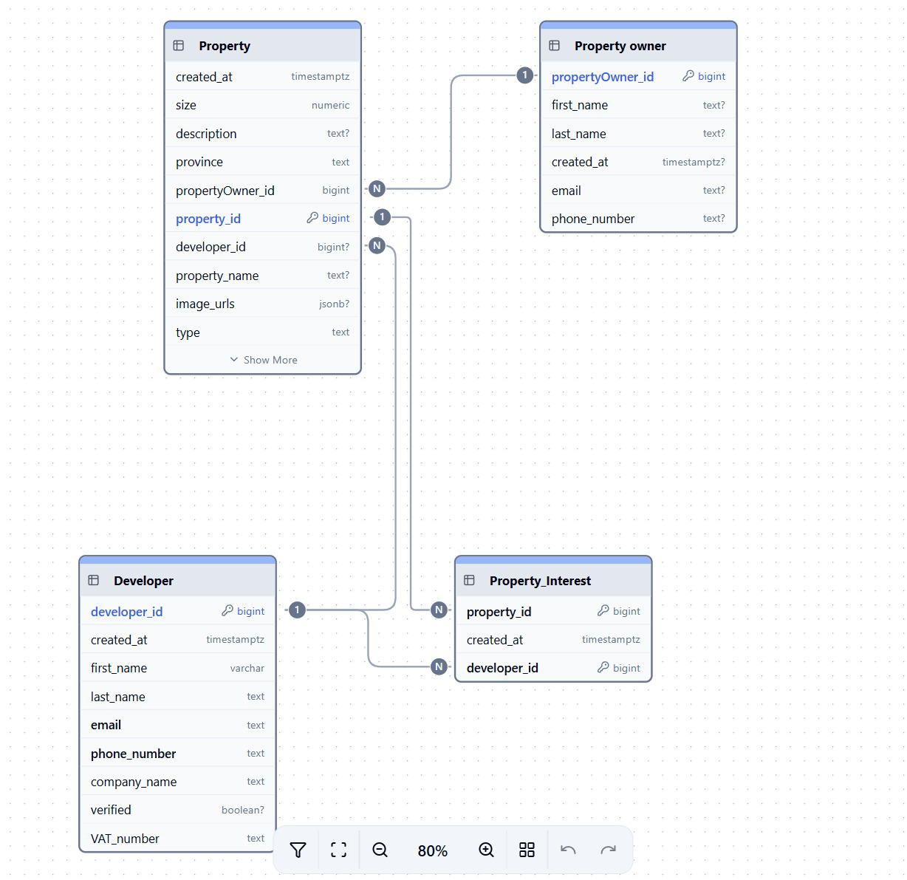
ERD Model

Slide 14
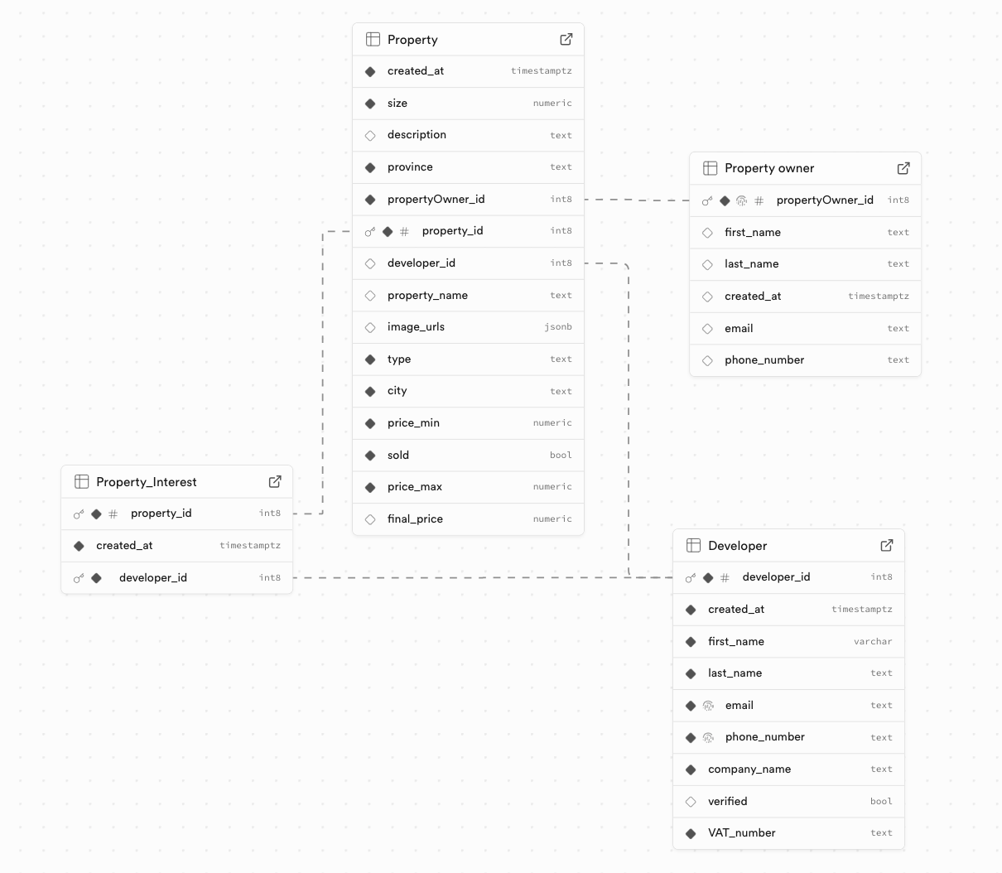
Supabase

Slide 15
Scalability
Centralised off-market platform for developers
  All property information accessible on one website
Richer property data model
  Add structured attributes such as building permit, zoning type, allowed density, regulatory constraints
Smarter price estimation
  Improve the algorithm with more data and parameters as the platform grows
Data driven network effects
  More listings and transactions continuously improve matching and pricing
Geographic expansion
  Scalable to new regions and international markets

Slide 16
Q&A

