Slide 1

Culex
Group2:
Anton Muyshondt
Leon Huysman
Lien De Maré
Sang Yoon
Stef Van De Velde

Slide 2
Summary
Introduction external partner
How we worked
Technical Realization & Architecture
Complex algorithm
Demo

Slide 3

Our external partner
Local photographer with great ambitions
Multi-disciplinary: Skilled in photography, videography, and editing.
Visual Storytelling
Goal: To develop a functional website that offers automated scheduling and real-time availability for all visual content services.

Slide 4
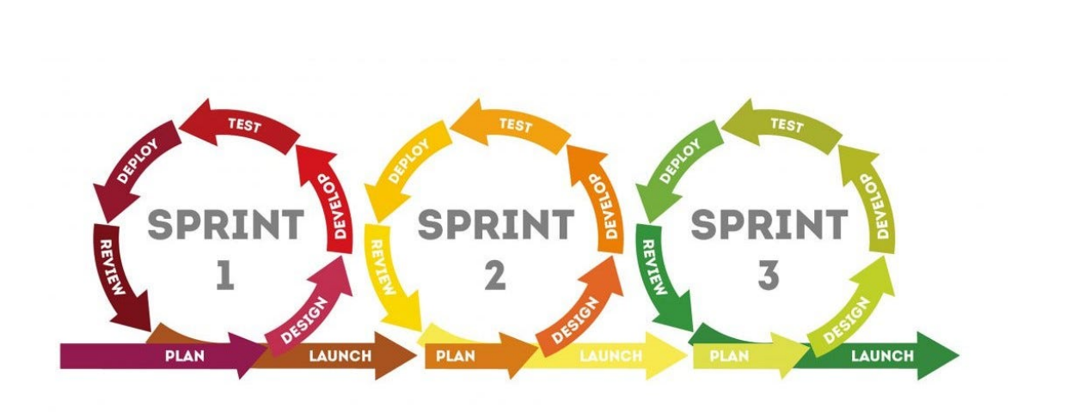
How we worked
Introduction meeting and project discussion with external partner (Culex)
Database architecture: ERD modeling and Supabase integration
Sprint 1: UI design in Figma and initial environment setup in VS Code
Sprint 2: Developing core website functionalities based on partner feedback and improvement of UI design.
Sprint 3: Final refinements, layout adjustments, and deployment

Slide 5
Summary
Introduction external partner
How we worked
Technical Realization & Architecture
Complex algorithm
Demo

Slide 6
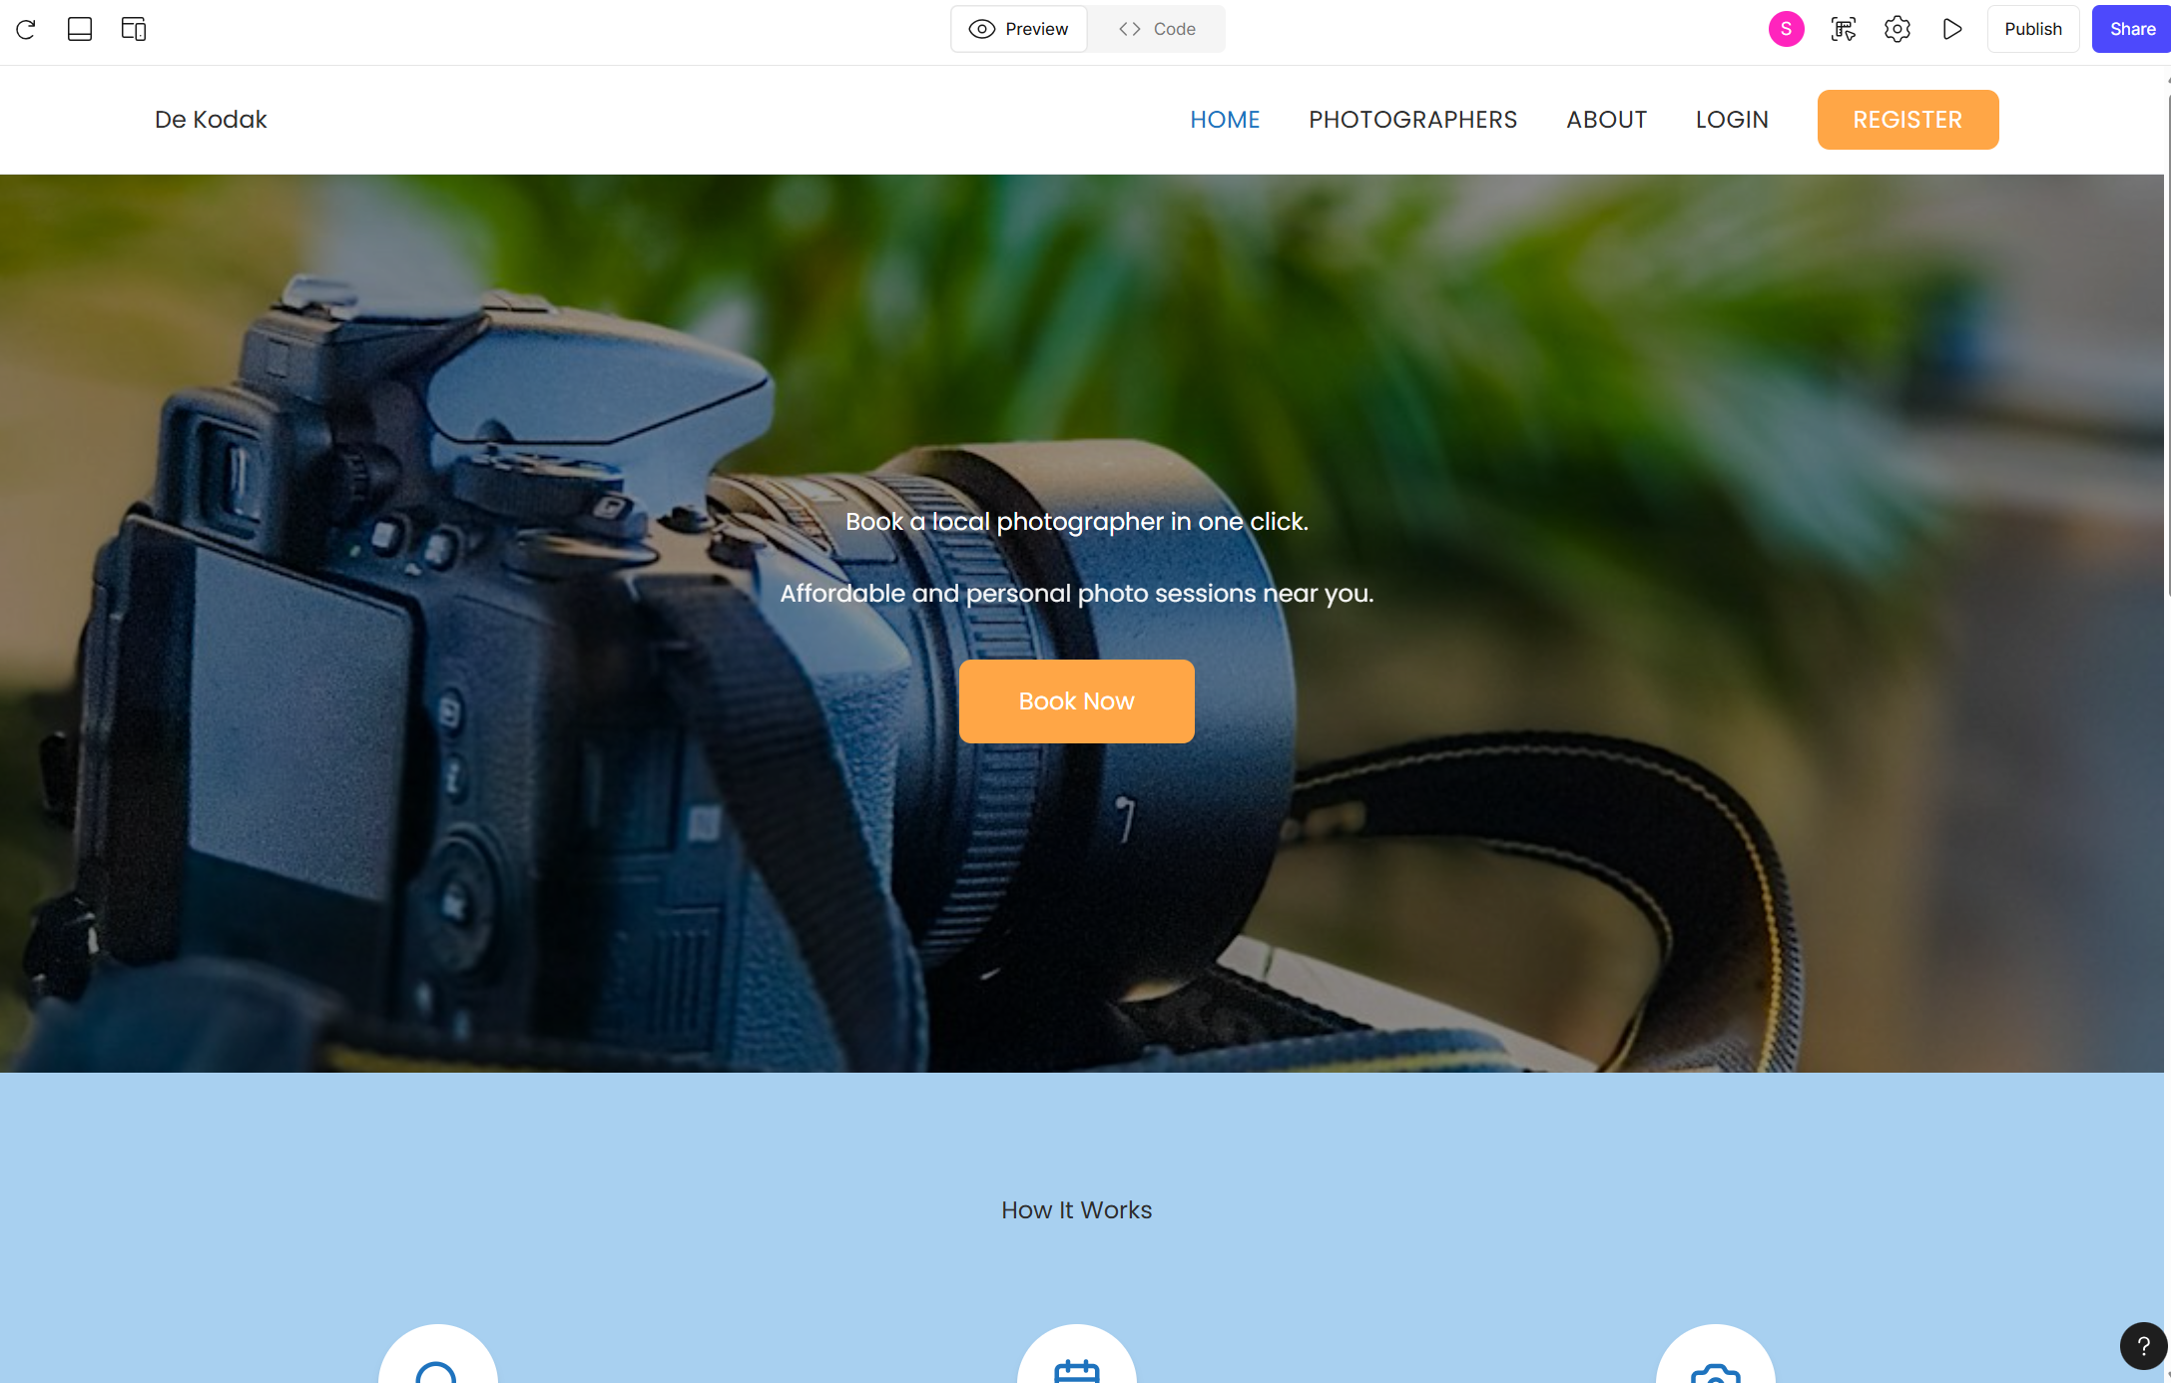
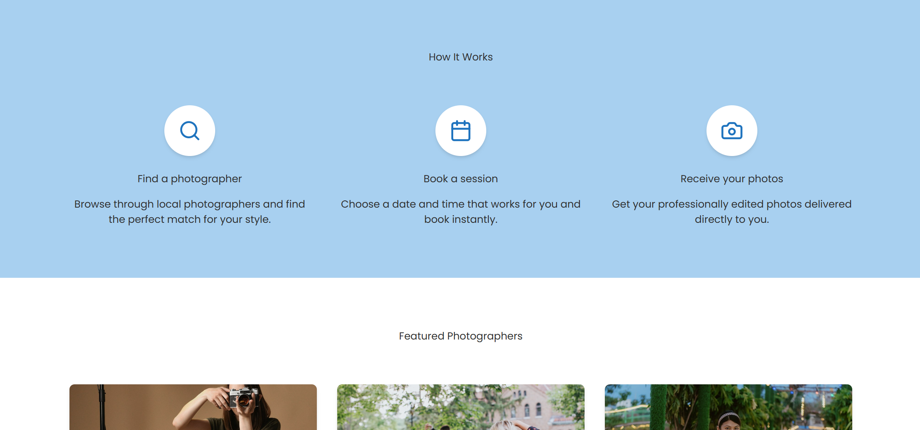
UI prototype with Figma

Slide 7
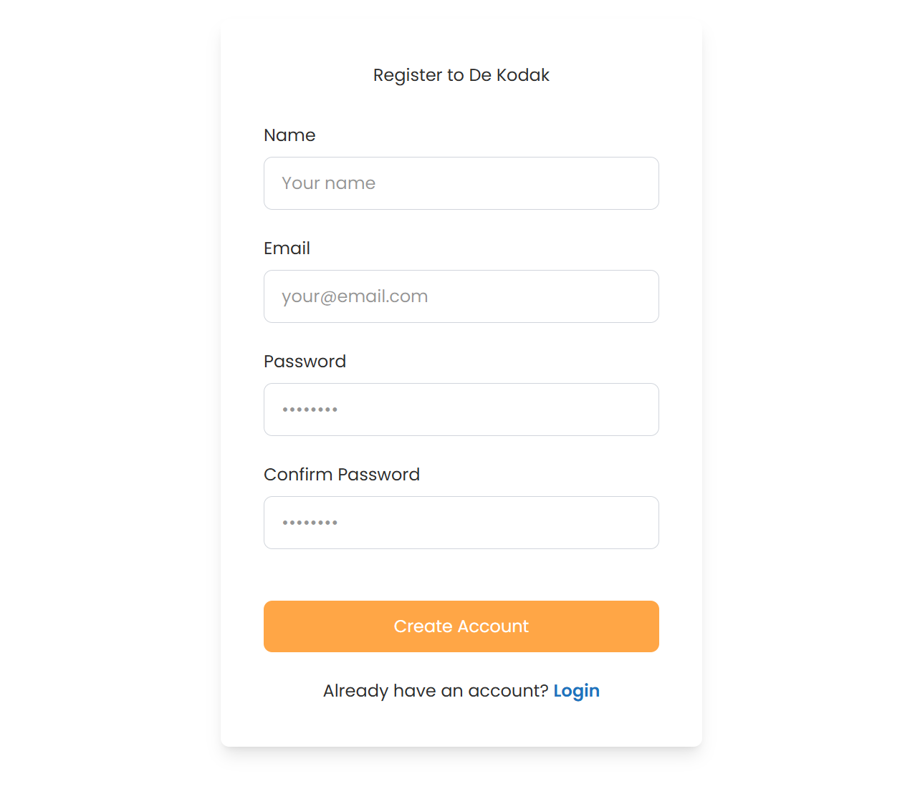
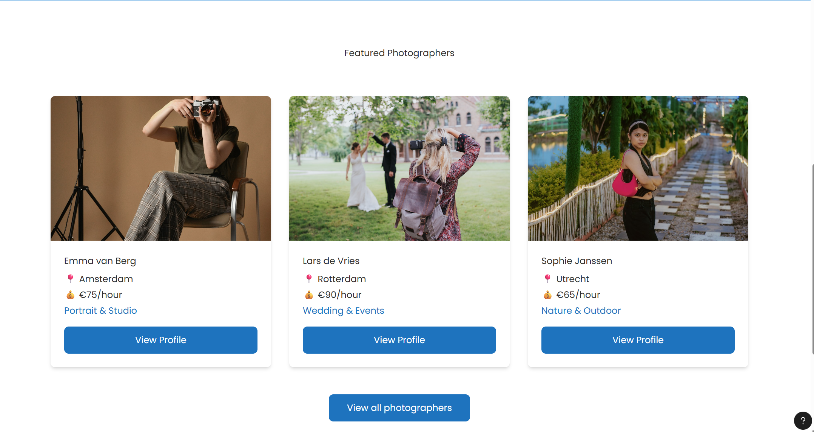
UI prototype with Figma

Slide 8
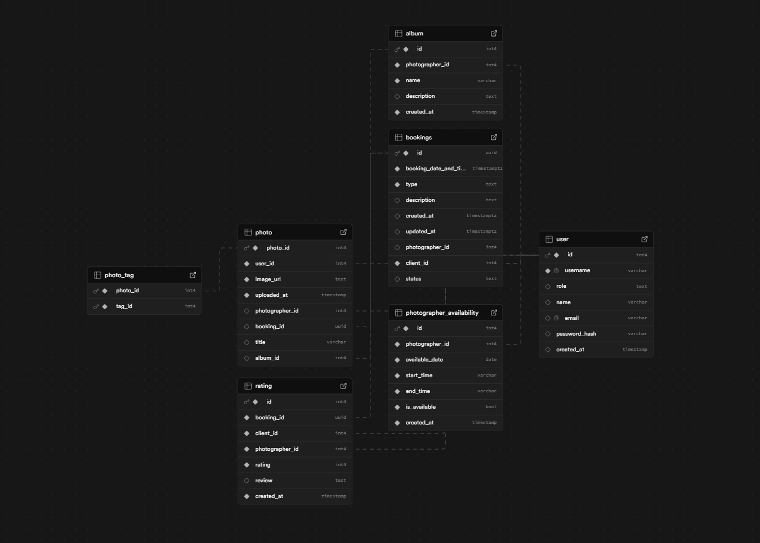
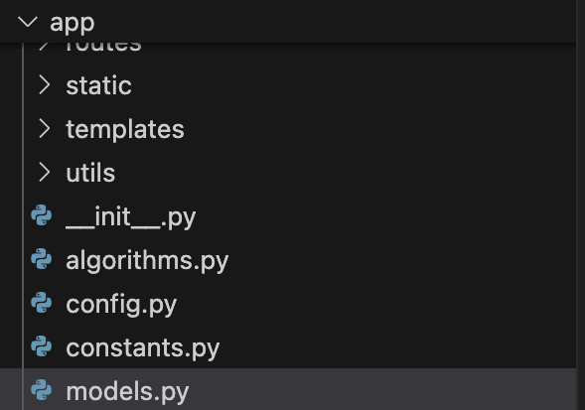
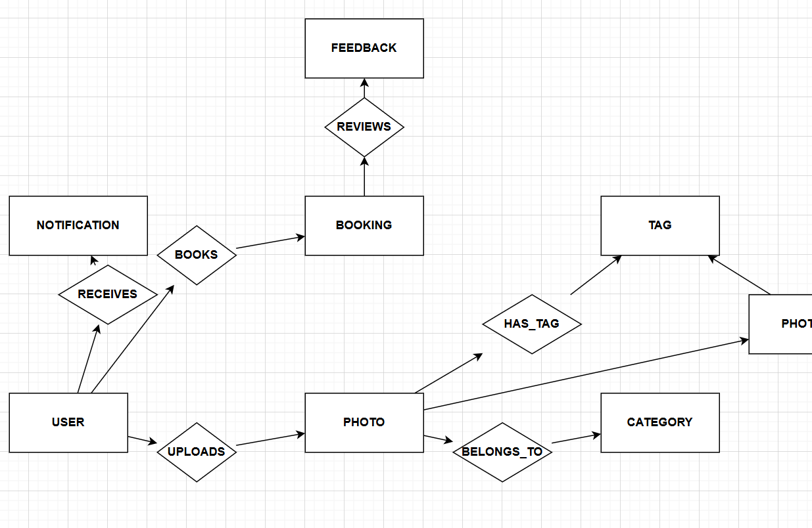
Database
Database-ontwerp and implementation via SQLAlchemy (Flask)

Slide 9
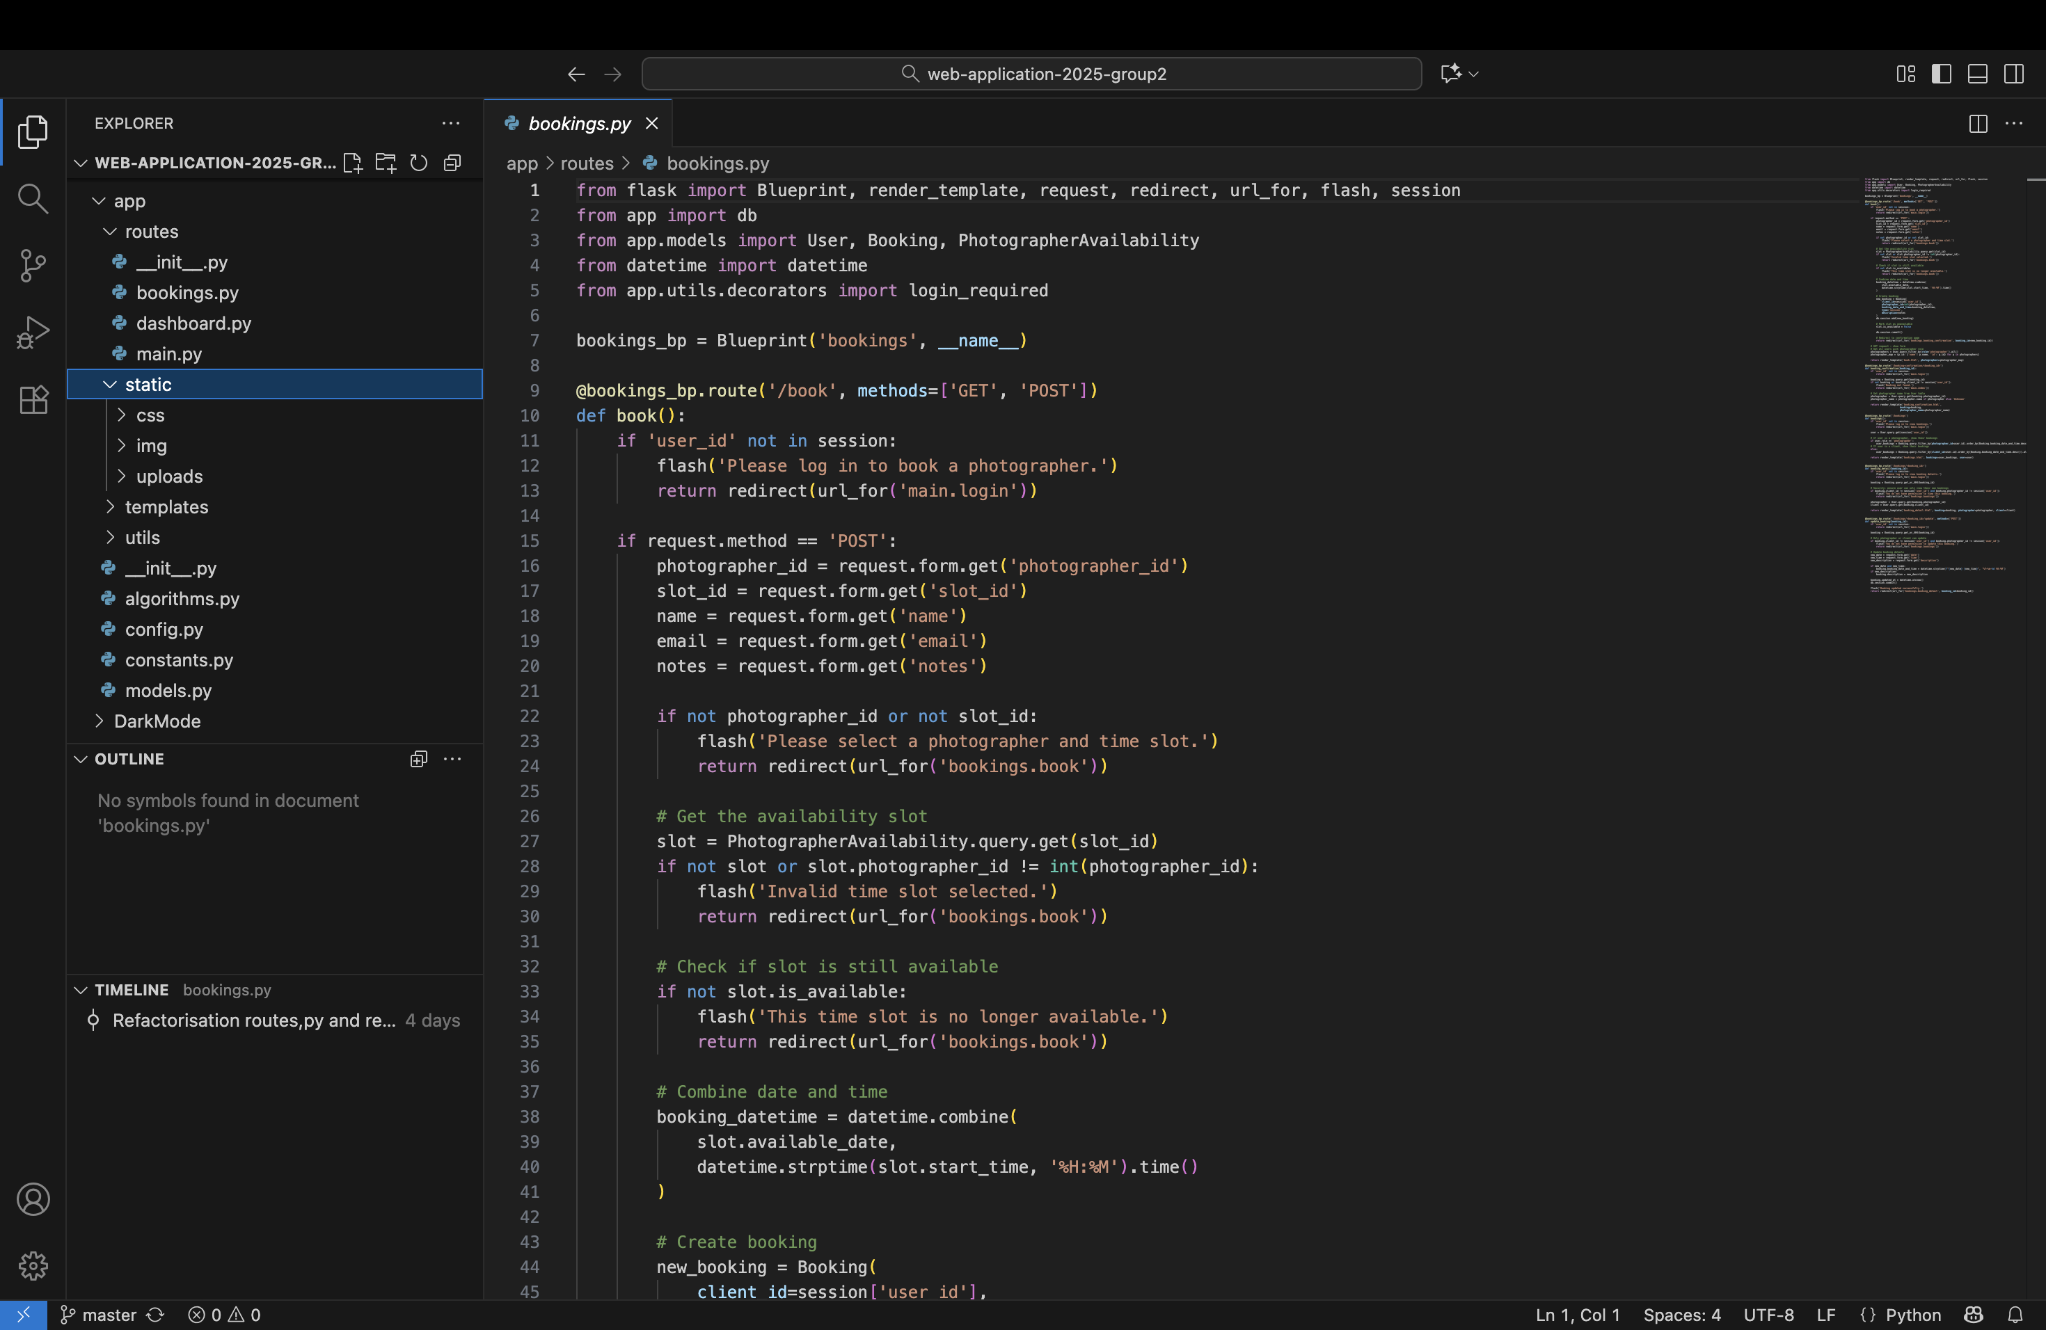
VSCode and Saas
Clean Code Structure
No Hardcoded Content
Scalable Architecture: Designed for growth.

Slide 10
Summary
Introduction external partner
How we worked
Technical Realization & Architecture
Complex algorithm
Demo

Slide 11
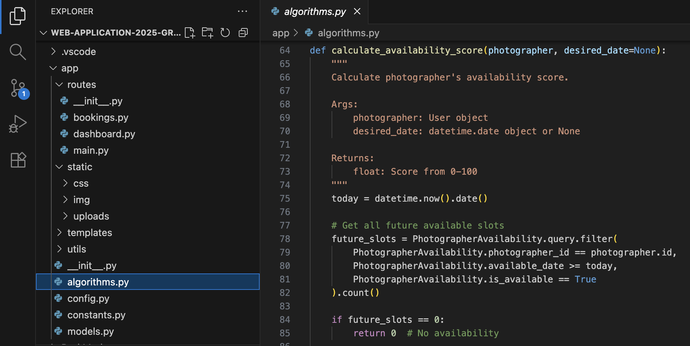
Algorithms
Photographer ranking algorithm (multi-factor scoring)
Style matching (portfolio/event-type relevance)
Availability scoring
Performance scoring (incl. ratings/completion)
Recency scoring

Slide 12
Summary
Introduction external partner
How we worked
Technical Realization & Architecture
Complex algorithm
Demo

Slide 13
User stories
User and authentication
Photo upload and management
Booking system
photographer’s portfolio

Slide 14
Demo
https://youtu.be/1N7cYVI5iBM

