Slide 1
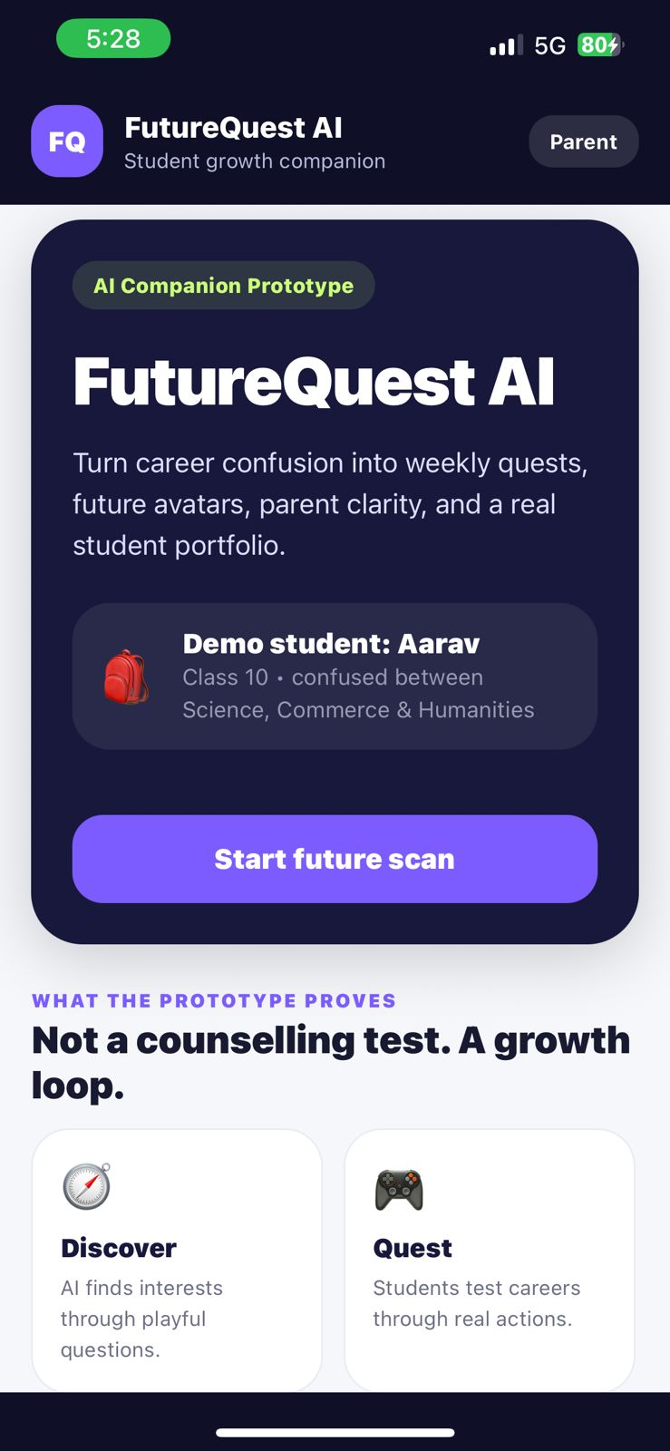
FutureQuest AI
From career confusion to a college-ready profile safely.
🎒
Demo student: Aarav
Class 10 • choosing between Science, Commerce & Humanities
APK built and working
Prepared by Aditya Dar, 2022A4PS0026P

Slide 2
The problem
The child is asked to make an adult decision before they have enough proof about themselves.
What currently happens
“Science, Commerce, or Humanities?”
Marks
Student is judged by current scores
For a Class 10 student, It becomes a family decision, a status decision and most importantly a confidence decision.
Pressure
Family and peer expectations take over
①
Too little exposure
Most students know only about JEE or NEET.
Stream choice
A direction gets locked too early
②
Advice is one-time
A report or counselling call cannot build readiness.
Late panic
College + applications become rushed
③
Parents need trust
They need proof, visibility and safety not just AI answers.

Slide 3
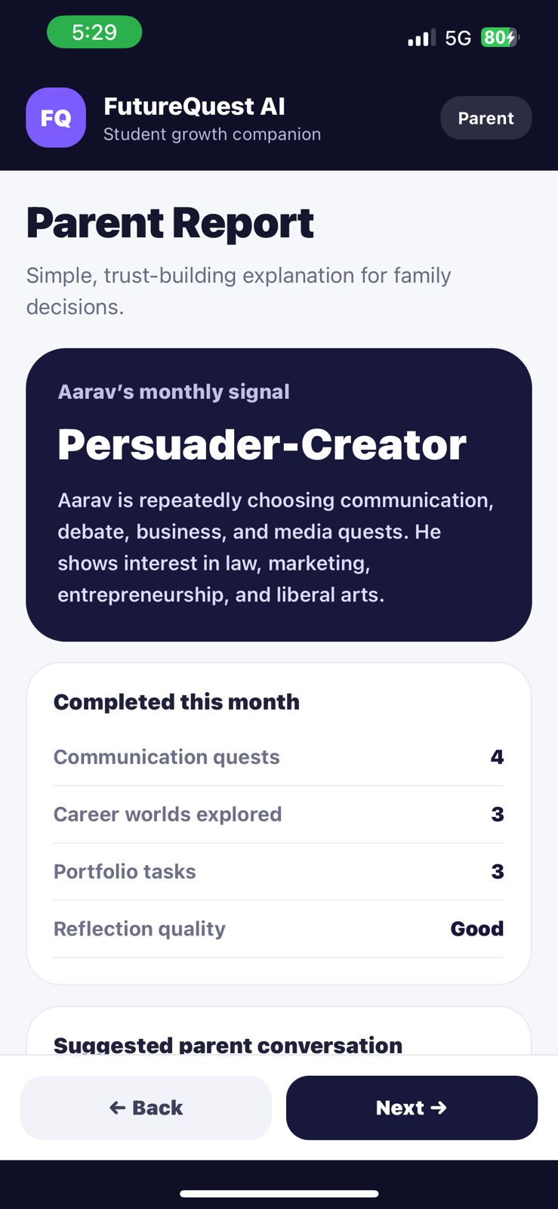
The goal has to be sharper
FutureQuest is not trying to make students “feel guided”. It has to get them somewhere real.
By Class 12, the child should have:
01
A confident direction
stream + career themes tested with evidence
02
A proof-of-work portfolio
projects, reflections, quests and internships
03
Applications ready
essays, activity list, documents and deadlines in one profile
04
Parent alignment
a plan that parents have seen, rated and approved
The student must confidently be able to say, that they have discovered their passion and will work towards achieving their dream.

Slide 4
What I built
A mobile AI companion that turns confusion and helplessness into a structured growth journey.
Future scan
Future avatar (AI image/video generator)
playful questions to understand the student
a simple identity to start exploration
Career worlds
Quests
students try paths like game worlds
weekly real-world actions, not passive advice
AI mentor
Parent report
answers confusion with next steps
safety, proof and family alignment
Positioning: We are not a Councilling Test but rather a safe growth loop from Class 8 to 12.

Slide 5
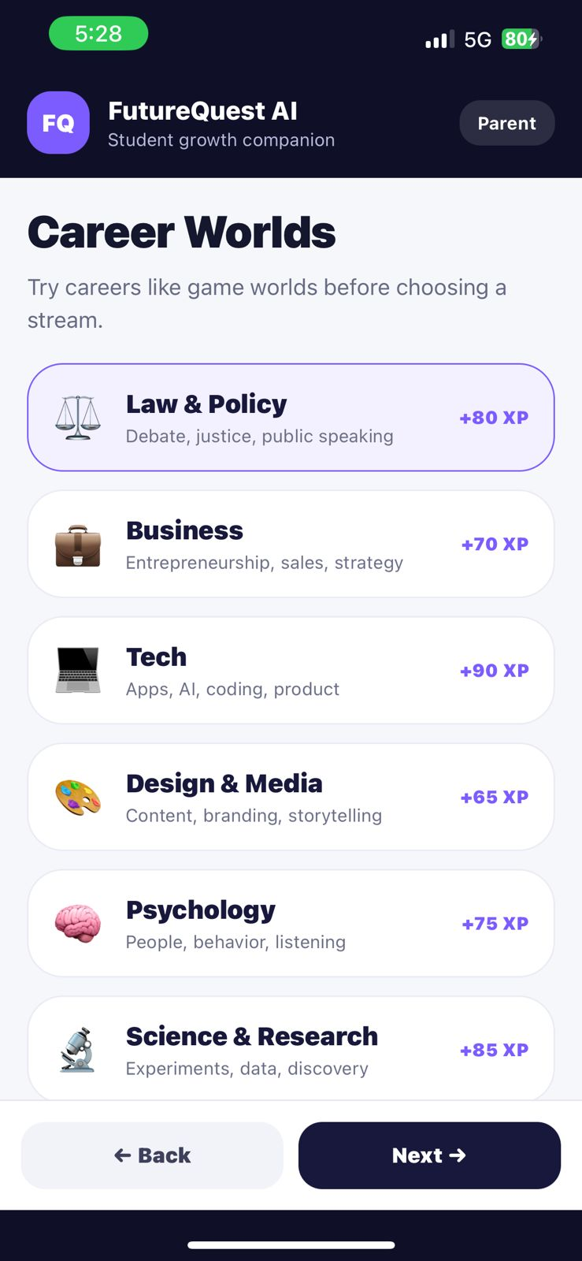
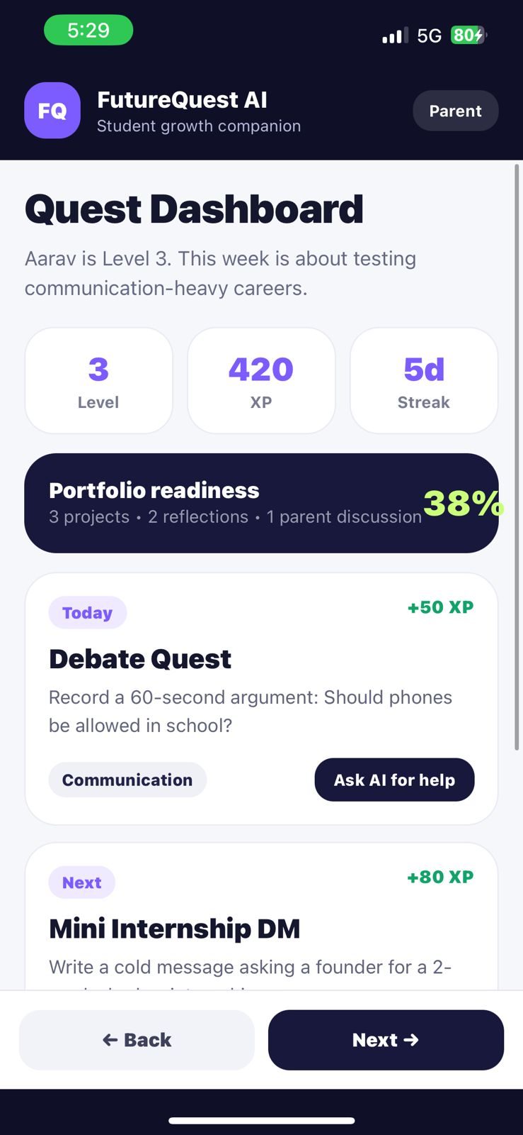
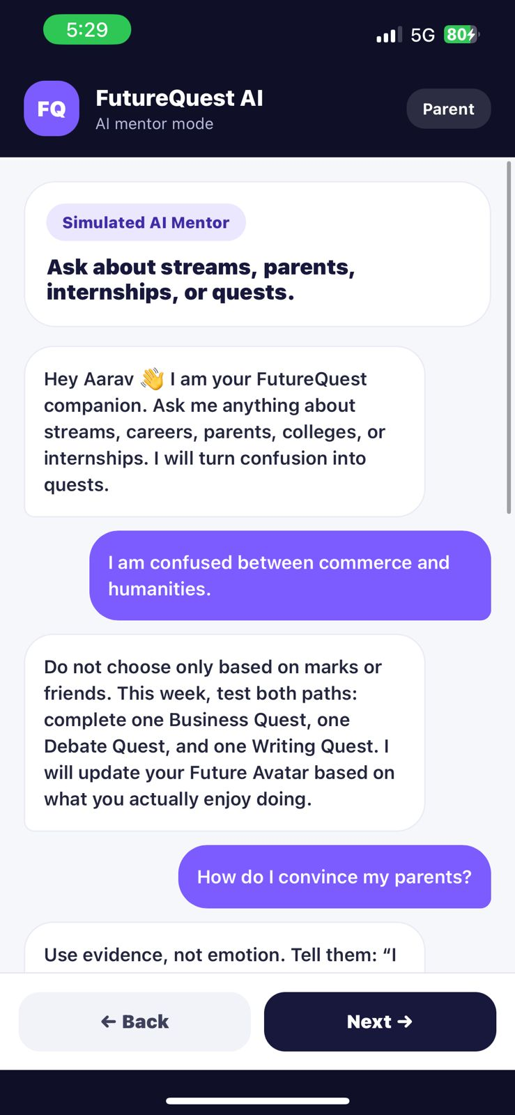
Prototype flow
One clean story: Aarav is confused today, and the app pushes him toward proof.
Start
Avatar
Worlds
Quest
AI plan
The experience here is end-to-end and not just a chatbot screen. The student will be entertained while also working towards a better future.

Slide 6
The product loop
The loop matters more than any one feature.
Discover
Try
Prove
Reflect
Apply
AI finds interests through playful questions
student completes a real career quest
work gets stored in portfolio
AI + parent review what changed
profile turns into internships and college applications
Every loop makes the next recommendation more trustworthy.

Slide 7
Student experience
Make careers feel tryable, not scary.
Future Avatar
A simple identity to begin exploration.
Career Worlds
Law, business, tech, design, psychology, science, each world has quests and XP.
The tone is important: it should feel like a teen product instead of a school form

Slide 8
Quests are how the app creates proof
Advice becomes useful only when it turns into action.
Debate Quest
Record a 60-sec argument. Builds communication.
Mini Internship DM
Write a message asking to shadow a founder.
College Compare
Compare 3 options with fees, entrance and fit.
Parent Conversation
Explain one path with evidence, not emotion.
How we solve the trust gap?
Parents do not have to trust a black-box answer. They can see the student’s actions, ratings and progress.

Slide 9
The AI mentor moment
The AI should not sound wise. It should make the next step obvious.
Student asks
“I’m confused between commerce and humanities.”
AI response
Do not choose only by marks. This week test both paths: one business quest, one debate quest and one writing quest.
So, the AI is not the answer. The next action is.
The prototype contains predefined responses to save on API costs. This will in the future possibly contain a real trained AI model.

Slide 10
Trust factor: every experience is rated
New users should be able to see what other parents and students experienced before joining.
Student rating
Parent rating
Mentor / college rating
Was the quest useful, fun and clear?
Was the activity safe and worth approving?
Did the opportunity actually deliver value?
Visible trust layer
Every quest, internship, mentor session and college interaction has a trust score. New users see ratings before participating.
Build trust before scale

Slide 11
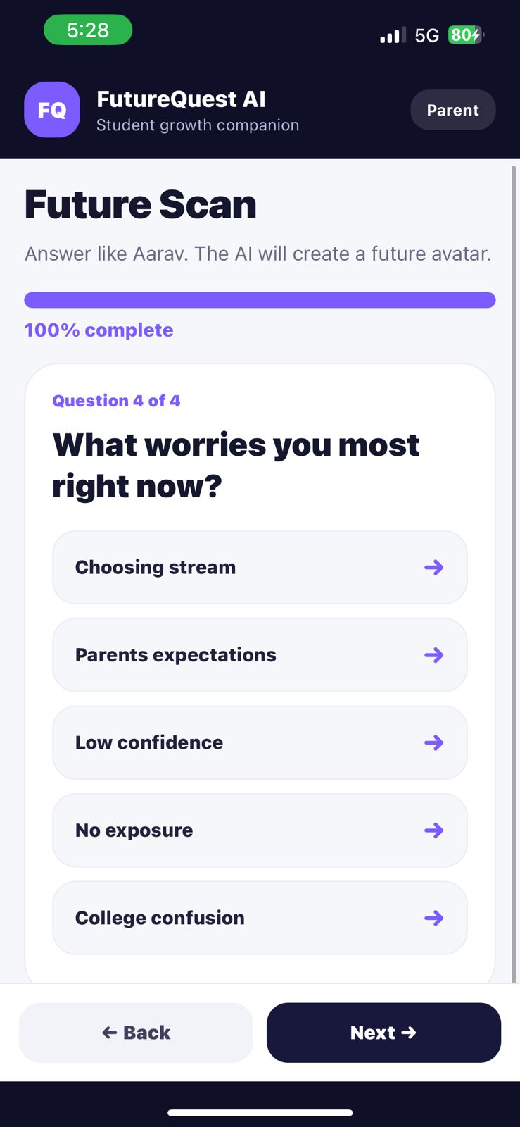
Parent mode is not optional
For Indian students, trust has to include the family.
Daily report
what the child explored, asked, completed and skipped
Approval rights
parents approve external activities, cohorts, mentors and opportunities
Engagement visibility
parents see worlds, quests, answers and portfolio progress
Conversation prompts
the app gives parents better questions to ask at home
Principle: the child gets freedom to explore; parents get enough visibility to feel safe.

Slide 12
Security is a product feature
For minors, safety has to be designed into the product from day one.
✓
No unapproved activity
external mentors, internships, cohorts and college connects need parent approval
Daily parent digest
✓
Minimum data storage
store only what is needed for the student profile and portfolio
Explored: Law & Policy
Completed: Debate Quest
Asked AI: stream decision
Needs approval: Mentor AMA
✓
Consent before sharing
child/parent consent before any data moves to schools, colleges or partners
✓
No direct kid-to-kid DMs
community is structured, moderated and visible
Approve / deny
✓
Delete / export controls
families can remove or export profile data

Slide 13
Community without unsafe chatting
Kids can learn from each other without turning the app into open social media.
Question board
No direct chat
no DMs or private groups
“How did you write your first internship DM?”
Moderated replies
AI + human review for sensitive topics
Students answer in structured templates. No names, no phone numbers, no direct messages.
Parent visibility
parents see what their child asks/answers
AI summarizes the best answers and removes unsafe content before it is visible.
Reputation score
helpful answers earn trust, not followers

Slide 14
The bigger outcome: one student profile
Long-term ambition: a CommonApp-style connection layer for college and opportunity applications.
Colleges
Internships
FutureQuest Profile
applications + essays
verified student portfolio
Schools
Parents
counsellor dashboard
approvals + reports
What the child finally gets
One profile that can carry their interests, projects, reflections, parent approvals, activity history and application material.
Reference model: Common App streamlines college applications for 1,000+ member colleges. FutureQuest can build an India/student-growth-first version over time.

Slide 15
Who adopts it first (TAM)
The market is huge, but the first wedge should be specific.
BEACHHEAD
24.8 crore
Class 9–10 students in Tier 1–3 private and affordable private schools
school students in India
WHY NOW
Source: PIB / Economic Survey 2024–25, UDISE+ 2023–24
stream choice pressure + parents willing to pay for clarity + AI makes personalization cheap
EXPANSION
Hinglish/Hindi, school pilots, CSR/govt access, college/internship partners
I faced this issue myself in class 12, so I decided to put my thoughts on the solution into this pitch deck

Slide 16
Business model + growth
Start free for students. Monetize trust, outcomes and distribution.
Free loop
Power user
Schools / partners
Future avatar
Limited quests
Basic portfolio
Safe Q&A
₹99–₹299/month
Parent daily reports
Application tools
Advanced AI mentor
Career readiness program
Counsellor dashboard
Parent sessions
College/internship rails
Near-zero-cost growth loops
shareable avatar
school challenge weeks
safe Q&A reputation
portfolio links
parent referrals

Slide 17
Why this can become hard to copy
The moat is not “AI chat”. It is the trusted student growth network around it.
01
Student growth graph
years of quests, reflections, skills, interests and avoided tasks
02
Trust data
ratings from students + parents visible before experiences
Chatbot
easy to copy
03
Portfolio proof
verified projects and experiences become portable identity
Trusted network
04
Parent approval layer
family trust becomes part of product adoption
05
Application rails
colleges, internships and schools connect to one student profile

Slide 18
What could fail in 12 months
And how I would reduce that risk.
Low retention
quests, streaks, squads and weekly challenges
Parent trust gap
daily reports, ratings, approvals and transparent reasoning
Safety incident
no DMs, moderation, consent, parent controls, data minimization
Generic AI risk
portfolio, ratings, application rails and student graph
Slow school sales
start D2C + challenge weeks, then sell pilots to schools
Next build priority: add parent approval flow + rated experiences + safe Q&A before adding more career content.

Slide 19
FutureQuest AI
The product is not “career advice”.
It is a safe system that helps a student discover, prove, explain and apply for their future.
Prorotype
Trust layer
Outcome
Built!
Defined!
college-ready profile!
THANK YOU!
Aditya Dar

Slide 20
References used
•
PIB / Economic Survey 2024–25: 24.8 crore students across 14.72 lakh schools with 98 lakh teachers, based on UDISE+ 2023–24.
•
Common App: online application platform for 1,100+ member colleges; used as reference model for the future application layer.
•
Mindler: existing career counselling offerings for Class 8–9 stream selection and Class 10–12 career planning.
•
Prototype screenshots: FutureQuest AI APK built with Expo / EAS.

