Slide 1
🏢 OfficeAxis
Employee Management FullStack Website

Slide 2
🛠️ Tech Stack
- Frontend: React.js (Vite)
- Backend: Spring Boot
- Database: PostgreSQL (Neon)
- Deployment: Netlify, Render, Docker, Neon

Slide 3
📸 Features
✅ Add / Update / Delete Employee
✅ Manage Departments
✅ Assign Department to Employee
✅ On Deletion of Department, Employee role will go to default ‘General Department’
✅ Responsive UI
✅ Full CRUD APIs
✅ On Deletion of Employee, the address will also erased from the DB.

Slide 4
📁 Project Structure
📦 officeaxis
├── backend (Spring Boot)
└── frontend (React + Vite)

Slide 5
Backend File Structure
├── backend (Spring Boot App) │ ├── src/main/java/com/officeaxis
│ │ ├── config/ │ │ ├── controller/ │ │ ├── dto/ │ │ ├── entity/
│ │ ├── exception/ │ │ ├── mapper/ │ │ ├── repository/ │ │ ├── service/ │ │ ├── service/impl/ │ └── .env (Db URL, username, password, frontend URL)

Slide 6
FrontEnd File Structure
├── frontend (React + Vite App)
│ ├── src/
│ │ ├── assets/
│ │ ├── components/
│ │ ├── containers/
│ │ ├── services/EmployeeService.js,DepartmentService.js,AddressService.js
│ └── .env (VITE_API_BASE_URL)

Slide 7
⚙️ Backend Execution
1. Install Java 17/21 & Maven
2. Setup PostgreSQL DB
3. Run:
./mvnw install
./mvnw spring-boot:run

Slide 8
⚙️ Frontend Execution
1. Install Node.js
2. Run:
npm install
npm run dev

Slide 9
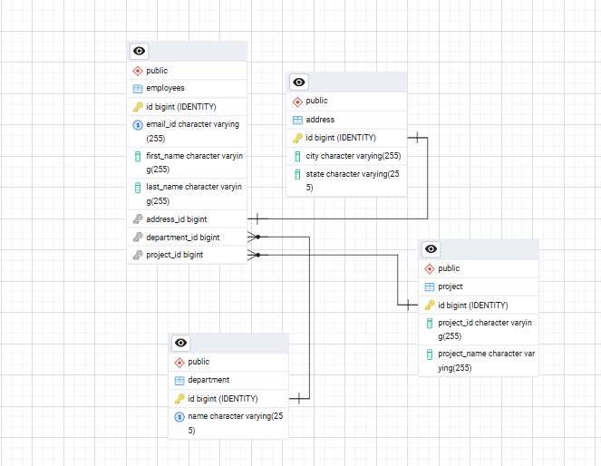
ER Diagram

Slide 10
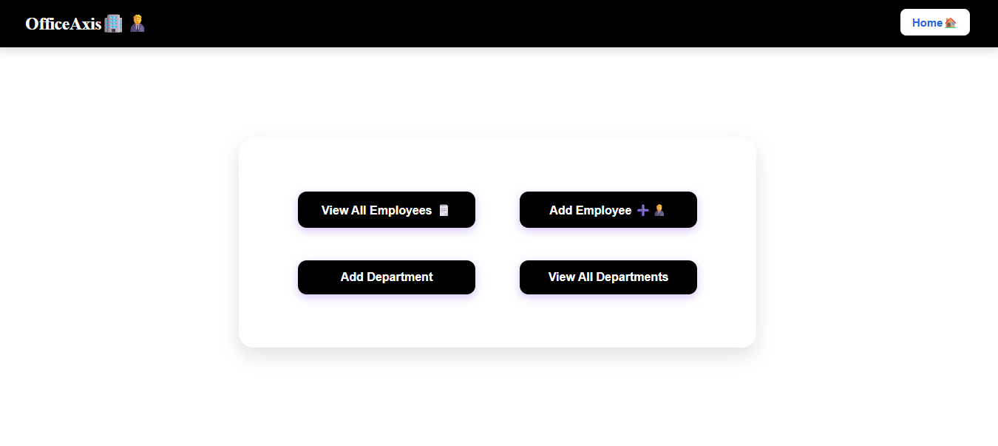
Application Overview
http://localhost:3000/

Slide 11
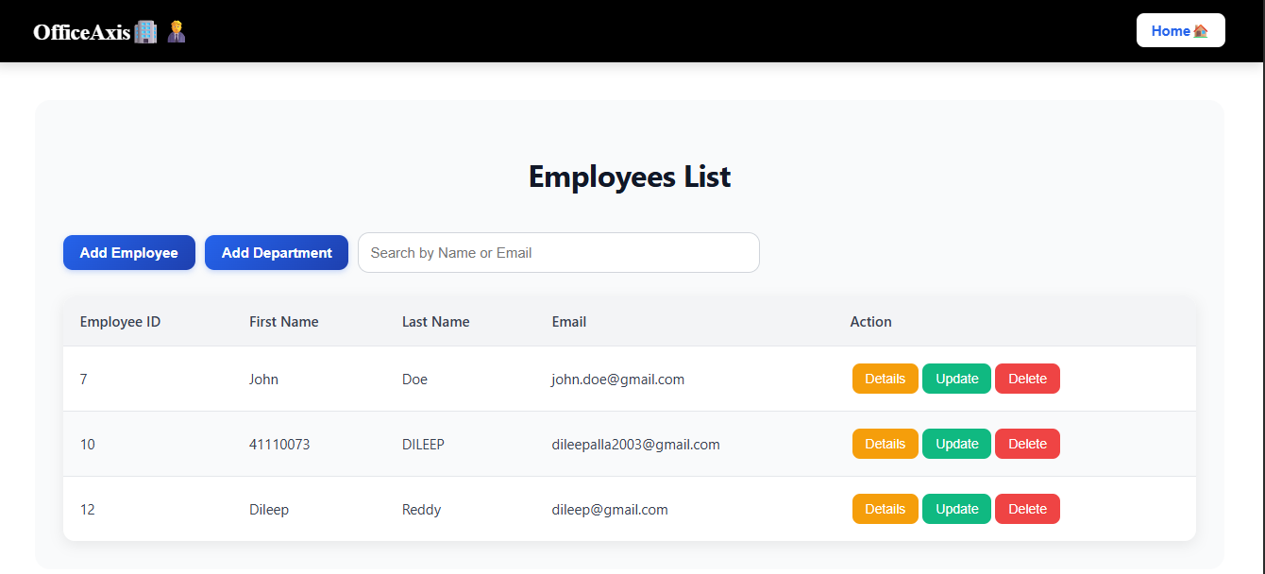
http://localhost:3000/employee

Slide 12
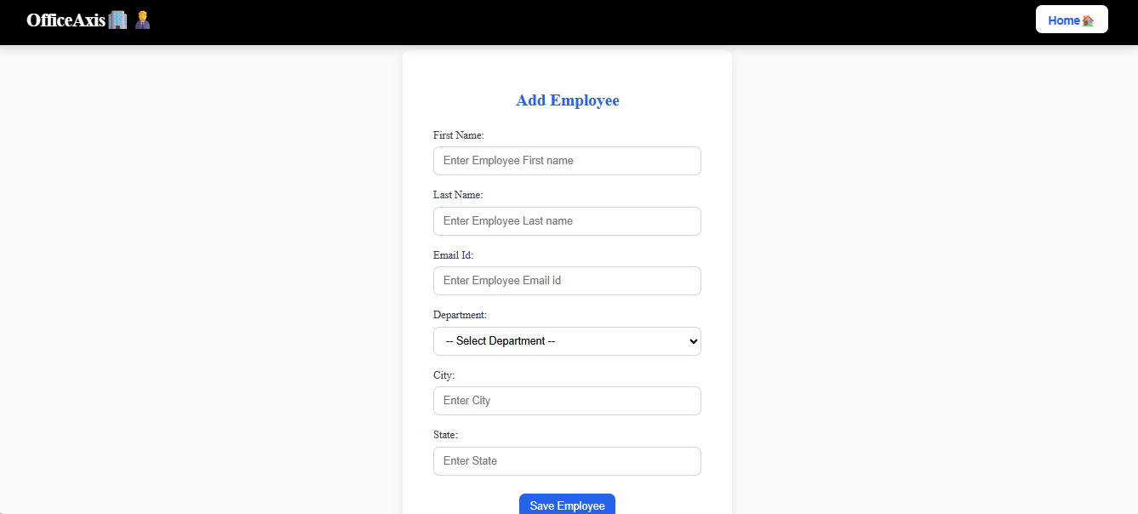
http://localhost:3000/add-employee

Slide 13
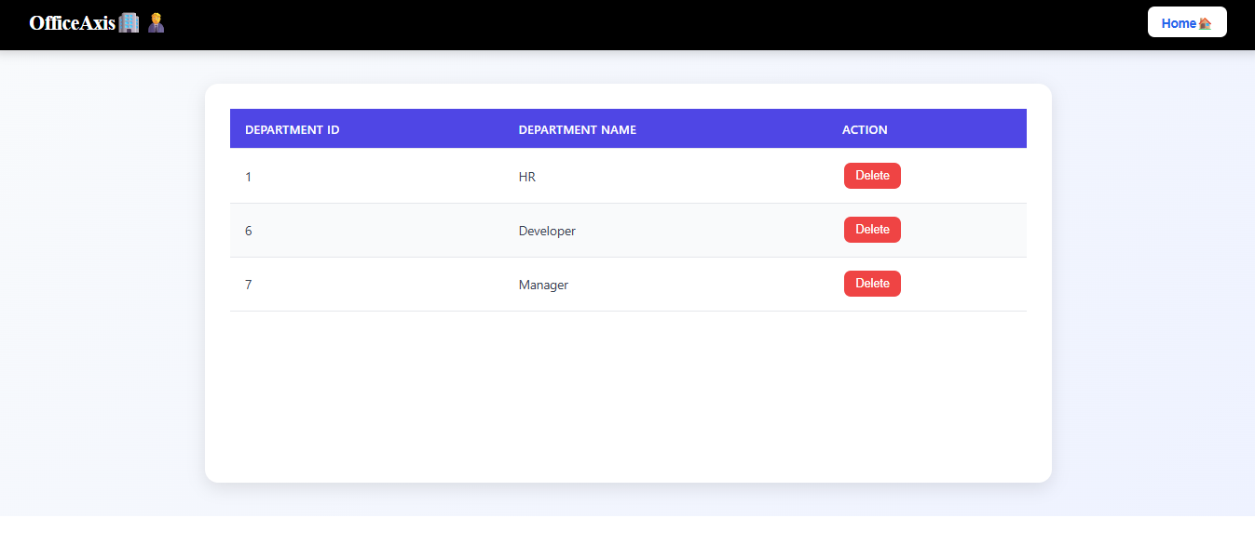
http://localhost:3000/department

Slide 14
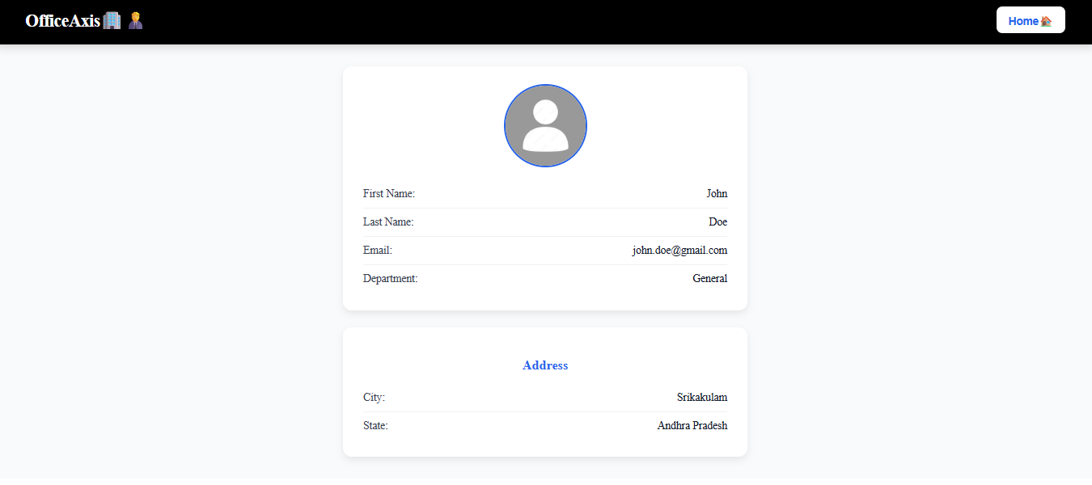
http://localhost:3000/employee/{id}

