Slide 1
From Conceptions to Measurement: Dutch Perspectives and the WOOP Tool

Slide 2
Disclosure slide
No (potential) conflict of interests

Slide 3
Development of the WOOP

Slide 4
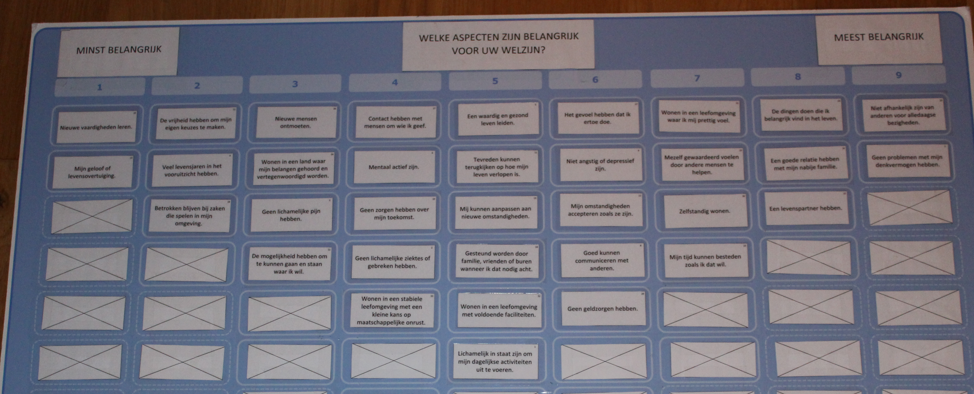
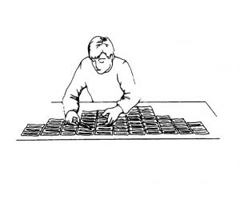
Views of older people in the Netherlands on wellbeing
Notes:
First, we conducted a Q-methodology study to investigate and describe the views among people aged 65 and older in the Netherlands regarding what constitutes well-being for them. Underlying aim was to identify aspects of life that should be covered by a comprehensive measure of the wellbeing of older people, taking into consideration the variety in views in this group about what is important for wellbeing.
Respondents ranked 34 aspects of well-being from the literature (see Table 1 in paper) according to how important they considered them to be for their own well-being and explained this during an interview.
An example of a ranking can be seen on the attached image.
Source: https://doi.org/10.1016/j.socscimed.2019.112535

Slide 5

Views of older people in the Netherlands on wellbeing
Health
Financial security
A life partner
1
A life partner
Living environment
Adaptation
5
2
Physical functioning
Family
Support
Mental health
Social network
Religion
4
3
Autonomy
Mental health
Helping others
Notes:
We found five distinct views on what constitutes well-being, in which different aspects were considered important:
health, financial security and a life partner
family, support and physical functioning
autonomy, mental health and helping others
social contacts, support, mental health and religion
a life partner, social contacts, living environment and adaptation.

Slide 6
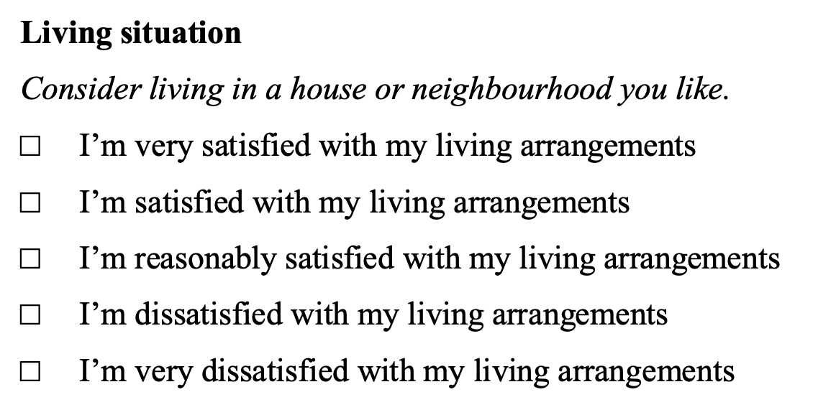
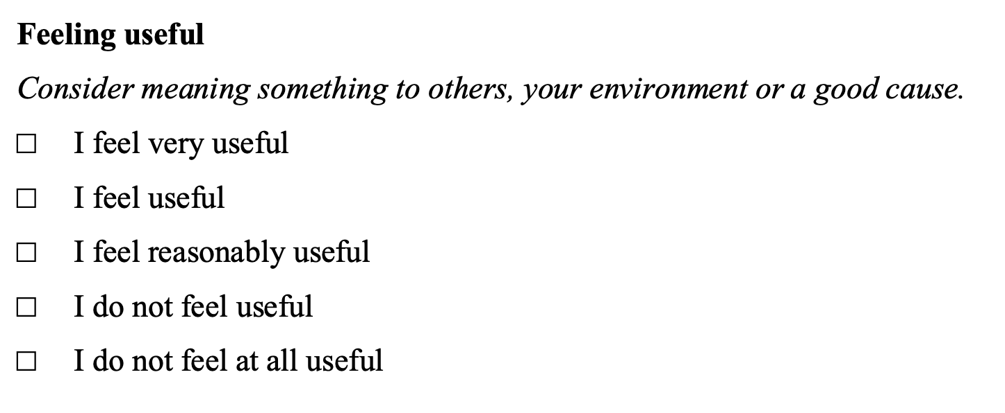
Translating the views of older people into dimensions for a new measure of well-being
Physical health
Living situation
Mental health
Being able to make ends meet
Social contacts
Well-being of
Older People (WOOP)
Independence
Receiving support
Feeling useful
Acceptance and resilience
Notes:
Next, we developed an instrument for measuring the well-being of older people, in which the heterogeneity in visions of well-being discussed earlier is represented.
The most important aspects of well-being from each of the five visions were translated into nine items for a new measuring instrument, the Well-being of Older People measure, or WOOP for short.
The nine items were: 'physical health', 'mental health', 'social contacts', 'receiving support', 'acceptance and resilience', 'feeling useful', 'independence', 'being able to make ends meet' and 'living situation’.
For each item, five answer options were defined to distinguish levels of well-being on each of the items and at the same time to keep it practically feasible for older people to complete the questionnaire themselves.
Content validation was conducted using an online survey with open-ended questions to collect information about participants' own definition of well-being, their interpretation of the items of the WOOP, and their assessment of the descriptions and response options provided with each item.
This resulted in small changes to the de wording of descriptions of items en de response options for some of the items. Examples of final version of two of the items are shown.
Source: https://doi.org/10.1186/s12955-021-01834-5

Slide 7
Performance of the WOOP

Slide 8
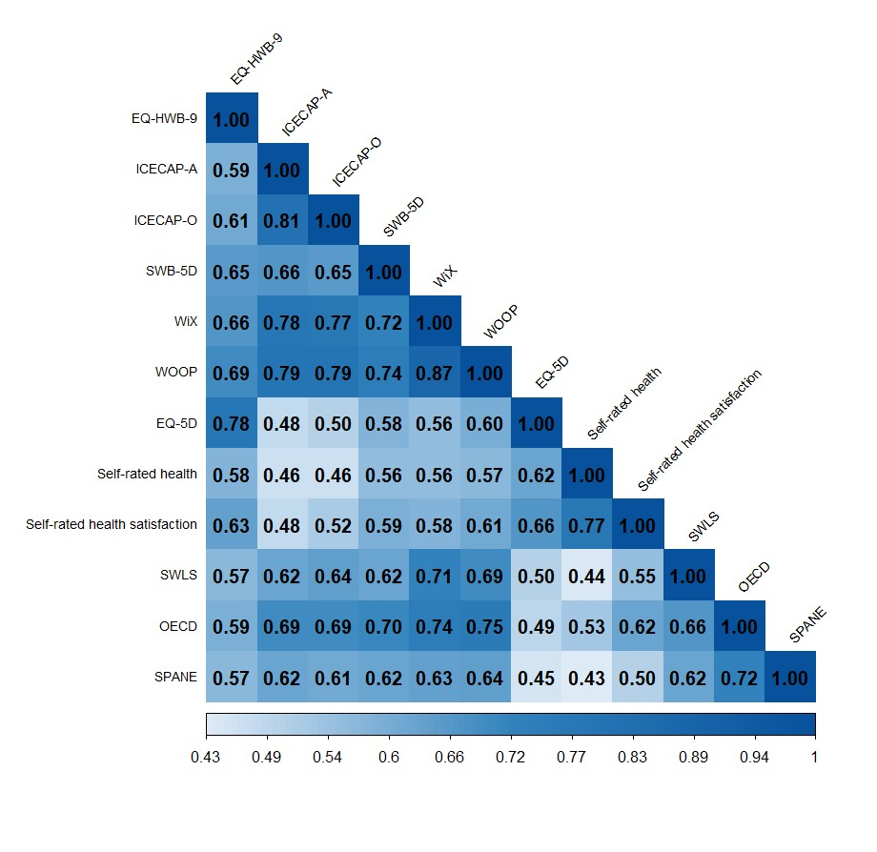
Convergent validity
All well-being instruments showed strong correlations among them
EQ-HWB-9 was more strongly correlated with EQ-5D-5L
WOOP presented the strongest correlations with the other wellbeing instruments and general well-being questionnaires

Slide 9
Known-group validity
All well-being instruments were able to distinguish between clinical and demographic groups
EQ-5D-5L, EQ-HWB-9 and SWB-5D showed higher detection in clinical groups
WOOP and WiX showed better detection in demographic groups
Group | EQ-5D-5L | EQ-HWB-9 | ICECAP-A | ICECAP-O | SWB-5D | WiX | WOOP
Arthritis
Clinical (n=104) | 66.59 (14.83) | 66.59 (17.10) | 60.32 (17.04) | 56.79 (16.80) | 58.94 (11.36) | 65.67 (14.57) | 64.08 (13.09)
Non-clinical (n=116) | 87.07 (8.47) | 87.00 (8.76) | 78.10 (13.41) | 73.51 (13.66) | 73.71 (13.42) | 81.53 (9.83) | 80.75 (10.88)
Mann-Whitney U results – U (p) [r] | 1209 (<0.001) [0.69] | 1414 (<0.001) [0.66] | 2463.5 (<0.001) [0.51] | 2753 (<0.001) [0.47] | 2344.5 (<0.001) [0.53] | 2142.5 (<0.001) [0.56] | 1991 (<0.001) [0.58]
Heart
Clinical (n=177) | 71.61 (15.48) | 69.10 (16.68) | 62.41 (17.90) | 57.21 (17.36) | 59.24 (14.36) | 65.30 (14.85) | 65.24 (14.87)
Non-clinical (n=280) | 91.04 (9.05) | 89.77 (9.36) | 79.43 (13.49) | 75.71 (14.48) | 76.45 (12.49) | 82.77 (10.12) | 82.53 (10.87)
Mann-Whitney U results – U (p) [r] | 6000 (<0.001) [0.64] | 5696.5 (<0.001) [0.65] | 11369.5 (<0.001) [0.46] | 9972.5 (<0.001) [0.51] | 8942.5 (<0.001) [0.54] | 7771.5 (<0.001) [0.58] | 8414 (<0.001) [0.56]
General Health
Poor health (n=1,011) | 77.91 (15.25) | 76.35 (17.08) | 66.97 (17.75) | 62.39 (17.77) | 64.74 (15.32) | 71.18 (14.93) | 70.55 (14.91)
Good health (n=1,133) | 93.00 (7.55) | 91.65 (8.64) | 81.17 (13.70) | 77.51 (14.27) | 79.56 (12.84) | 84.52 (10.14) | 84.95 (10.23)
Mann-Whitney U results – U (p) [r] | 952308 (<0.001) [0.58] | 926789 (<0.001) [0.54] | 835787 (<0.001) [0.40] | 850306 (<0.001) [0.42] | 884557.5 (<0.001) [0.47] | 884057 (<0.001) [0.47] | 902868 (<0.001) [0.50]
Income
Low (n=522) | 82.39 (15.77) | 80.28 (17.60) | 69.91 (19.52) | 66.37 (19.85) | 70.13 (16.47) | 73.54 (16.22) | 72.82 (16.19)
Medium (n=774) | 85.87 (13.76) | 84.47 (14.85) | 74.50 (16.23) | 70.34 (16.64) | 72.25 (15.74) | 78.18 (13.29) | 78.33 (13.60)
High (n=681) | 89.05 (11.65) | 88.30 (12.38) | 78.98 (15.62) | 74.29 (16.26) | 75.70 (15.16) | 82.65 (12.62) | 82.85 (12.75)
Kruskal-Wallis results – H (p) [η²] | 62.9 (<0.001) [0.03] | 78.6 (<0.001) [0.04] | 74.3 (<0.001) [0.04] | 55.5 (<0.001) [0.03] | 40.0 (<0.001) [0.02] | 117 (<0.001) [0.06] | 137 (<0.001) [0.07]
Relationship
Not in a relationship (n=703) | 84.10 (14.39) | 81.38 (16.84) | 70.67 (18.40) | 66.47 (18.95) | 69.63 (16.82) | 74.50 (15.38) | 74.08 (15.82)
In a relationship (n=1,441) | 86.76 (13.75) | 85.93 (14.32) | 76.33 (16.36) | 72.29 (16.74) | 74.00 (15.22) | 80.05 (13.34) | 80.15 (13.45)
Mann-Whitney U results – U (p) [r] | 445769.5 (<0.001) [0.10] | 420269.5 (<0.001) [0.14] | 418009 (<0.001) [0.14] | 417754.5 (<0.001) [0.14] | 429657 (<0.001) [0.12) | 394679.5 (<0.001) [0.18] | 390115.5 (<0.001) [0.19]
Effect size interpretation: small (0.01 ≤ η² < 0.06, 0.1 ≤ r < 0.24); moderate (.06 ≤ η² < 0.14, 0.24 ≤ r < 0.37); strong (η²≥ 0.14, r ≥ 0.37)

Slide 10
Test-retest reliability
All well-being instruments showed reliable assessment over time (ICC>0.70)
Instrument | Correlations main and retest sample | Complete agreement | ICC (95% CI)
No change in health (n=392)
EQ-5D-5L | 0.78 | 37.76% | 0.85 (0.82 – 0.88)
EQ-HWB-9 | 0.80 | 23.21% | 0.79 (0.75 -0.83)
ICECAP-A | 0.70 | 26.53% | 0.71 (0.66 - 0.76)
ICECAP-O | 0.69 | 28.57% | 0.73 (0.67 – 0.77)
SWB-5D | 0.73 | 26.02% | 0.76 (0.71 - 0.80)
WiX | 0.79 | 16.07% | 0.81 (0.78 - 0.84)
WOOP | 0.81 | 18.37% | 0.82 (0.78 – 0.85)
No change in well-being (n=383)
EQ-5D-5L | 0.79 | 37.86% | 0.84 (0.81 – 0.87)
EQ-HWB-9 | 0.81 | 23.50% | 0.80 (0.77 - 0.84)
ICECAP-A | 0.69 | 25.33% | 0.70 (0.65 - 0.75)
ICECAP-O | 0.69 | 29.50% | 0.72 (0.67 – 0.76)
SWB-5D | 0.73 | 26.11% | 0.75 (0.71 – 0.79)
WiX | 0.78 | 15.41% | 0.81 (0.77 - 0.84)
WOOP | 0.81 | 17.75% | 0.81 (0.77 – 0.84)

Slide 11
Conclusion
Developed for and with older individuals to ensure face validity
Equivalent or slightly superior psychometric performance in older populations
Future research will focus on studying implementation in evaluations

Slide 12
Thank you!

Slide 13
Appendix

Slide 14
The W-MIC study
Cross-sectional survey with follow-up measurement
7000 US and NL participants, with quotas for specific subgroups (general, older, targeted health conditions)
Dynata hosted and recruited participants
Demographics (Module A), Well-being instruments (Module B), Clinical severity (Module C), General health (Module D), General well-being (Module E)
Study design
Population
Measures
Data collection

Slide 15
In-survey quality checks
Attention check questions
Dynata’s quality check, including:
reCAPTCHAs,
Geo-IP tracking,
Address verification,
Digital fingerprinting,
IP deduplication
Dynata’s QualityScore:
<20 automatically excluded
21-50 manually checked by Dynata

Slide 16
Post-hoc data quality checks
Post-hoc data quality checks:
Criteria 1: Inconsistent pain reporting: EQ-HWB-9 (Q4) vs. EQ-5D-5L (Q83)
Criteria 2: Inconsistent daily activity reporting: EQ-HWB-9 (Q3) vs. EQ-5D-5L (Q82)
Criteria 3: Inconsistent financial situation: WiX (Q10) vs. ability to make ends meet (Q103)
Criteria 4: Child count inconsistency: More children <18 (Q99) than total children (Q98)
Criteria 5: Completion time <5 minutes
Criteria 6: Survey quality score <90
Criteria 7: >5 self-reported health conditions
Participants meeting ≥3 criteria were removed
Participants excluded if provided extreme inconsistencies in Criteria 1 and 2 (>2 Likert points) or in Criteria 3 (e.g., very satisfied but much difficulty)

Slide 17
Quality checks
7838 participants completed the survey (US: n=4045, 52%; NL: n=3793, 48%)
5336 (68%) failed at least one quality check criteria (out of 7)
683 (9%) were excluded
560 failed ≥3 criteria
202 provided extremely different answers

Slide 18
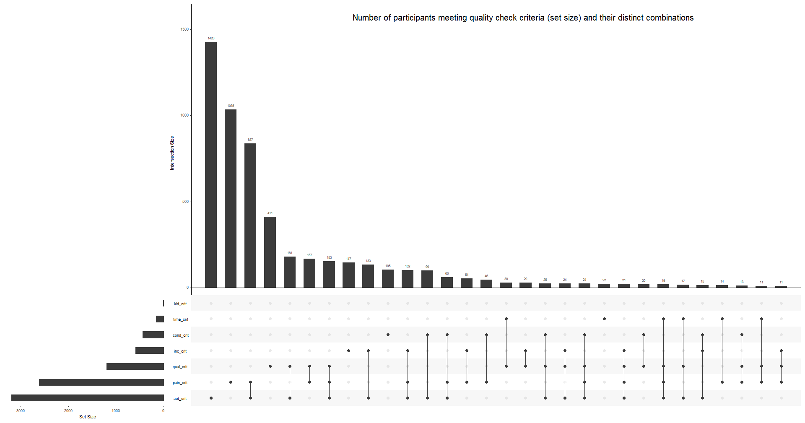
Quality checks

Slide 19
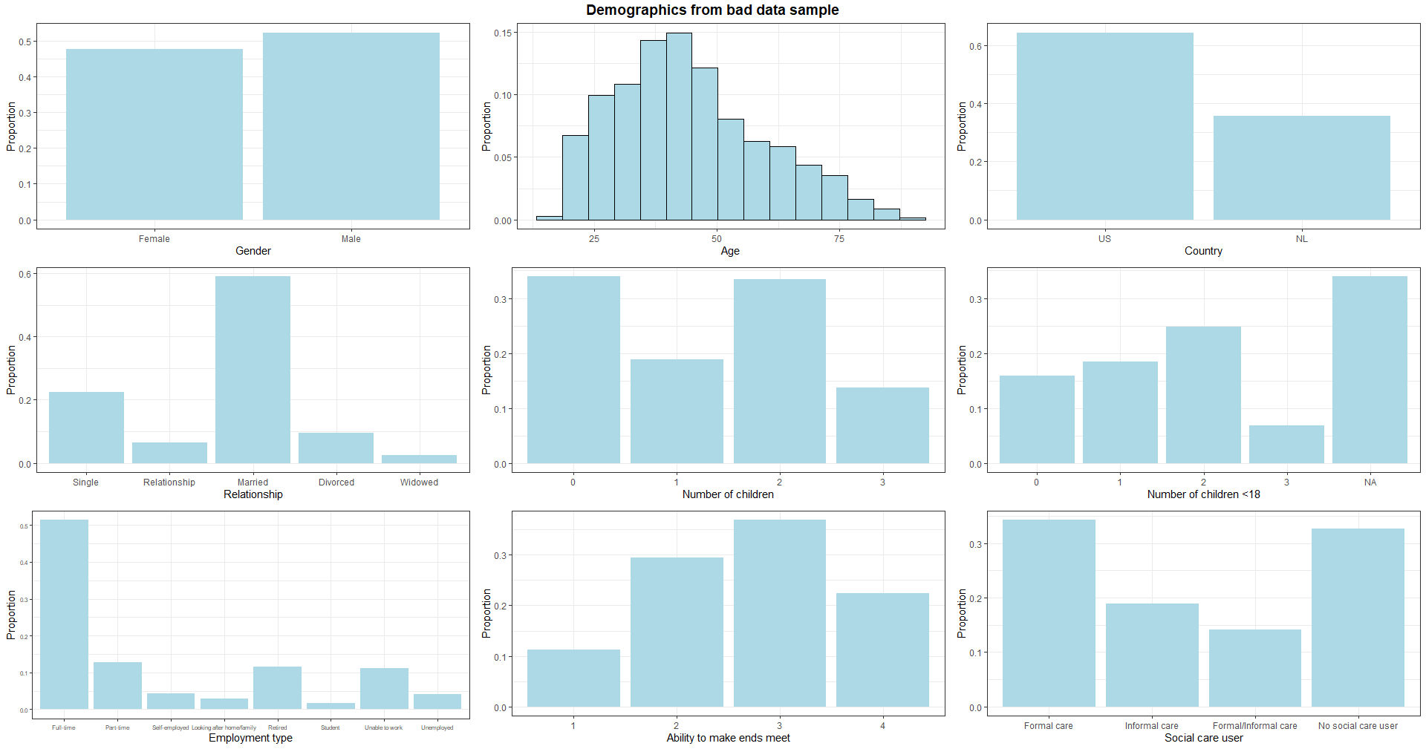
Demographics – Bad data sample

Slide 20
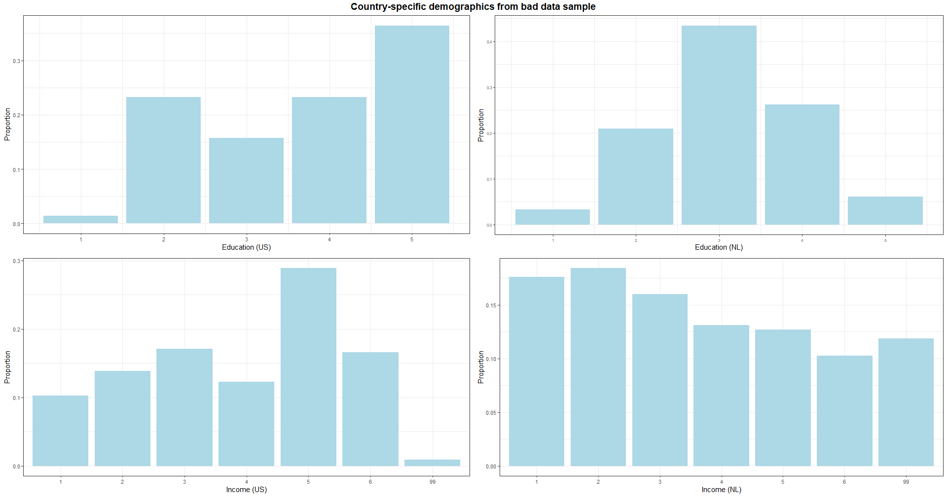
Demographics – Country-specific (bad data)

Slide 21
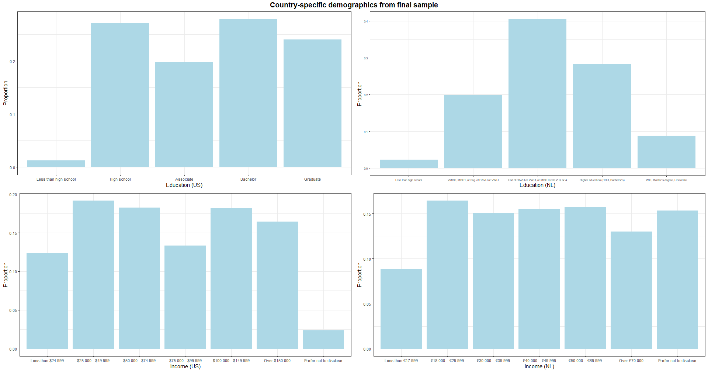
Demographics – Country-specific
7155 final sample (US: n= 3606, 50%; NL: n=3549, 50%)

Slide 22
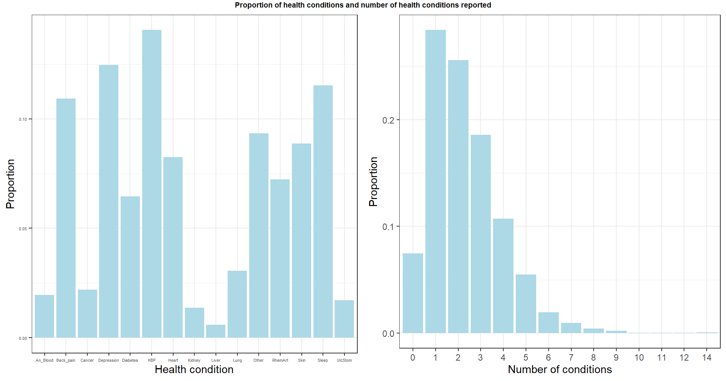
Health conditions

Slide 23
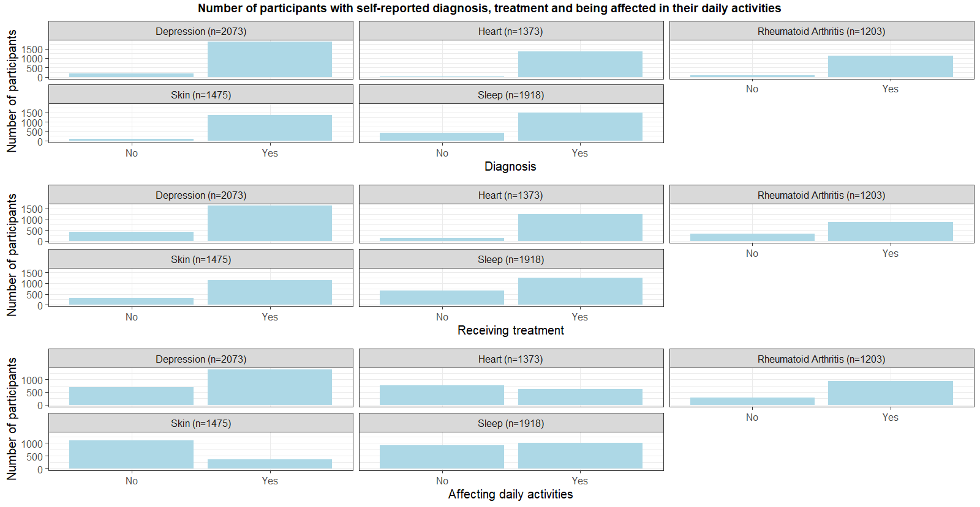
Targeted health conditions

Slide 24
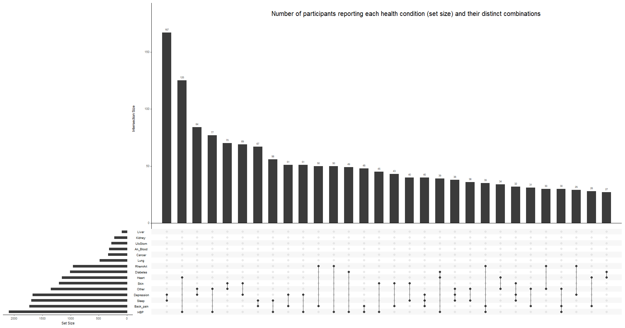
Comorbidity

Slide 25
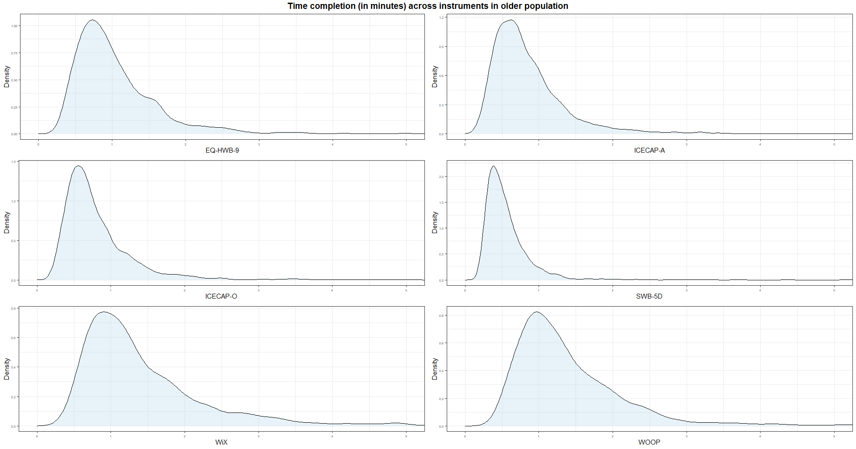
Completion time

Slide 26
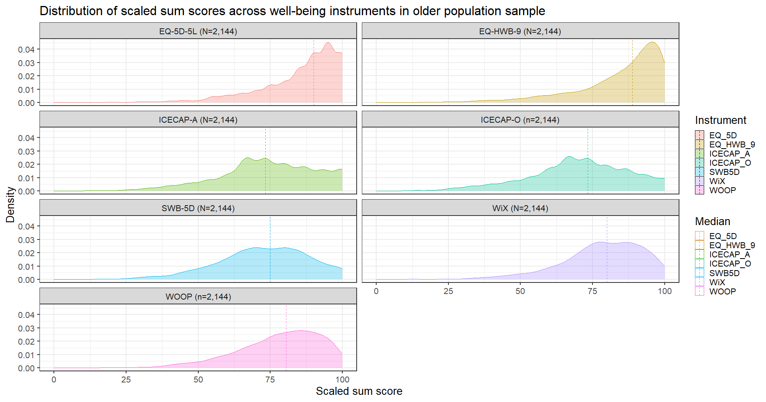
Descriptive statistics
Older adults had moderate to high levels of well-being across instruments
More negatively skewed in the EQ-5D-5L and EQ-HWB-9

Slide 27
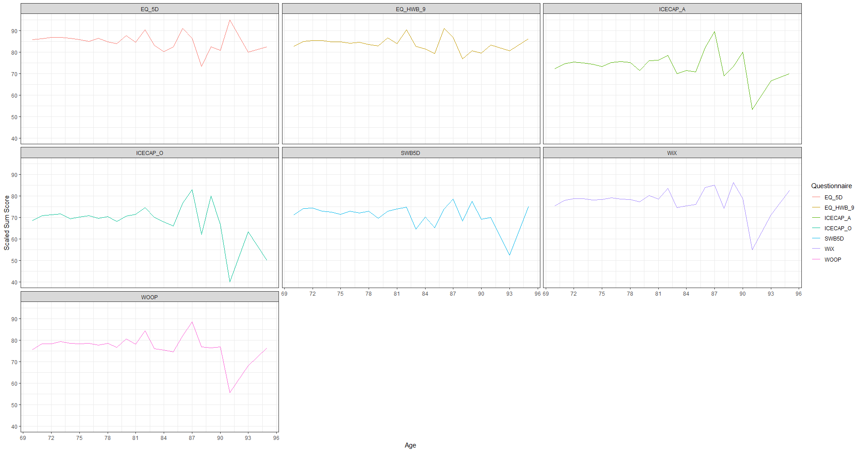
Descriptive statistics – Scores by age

Slide 28
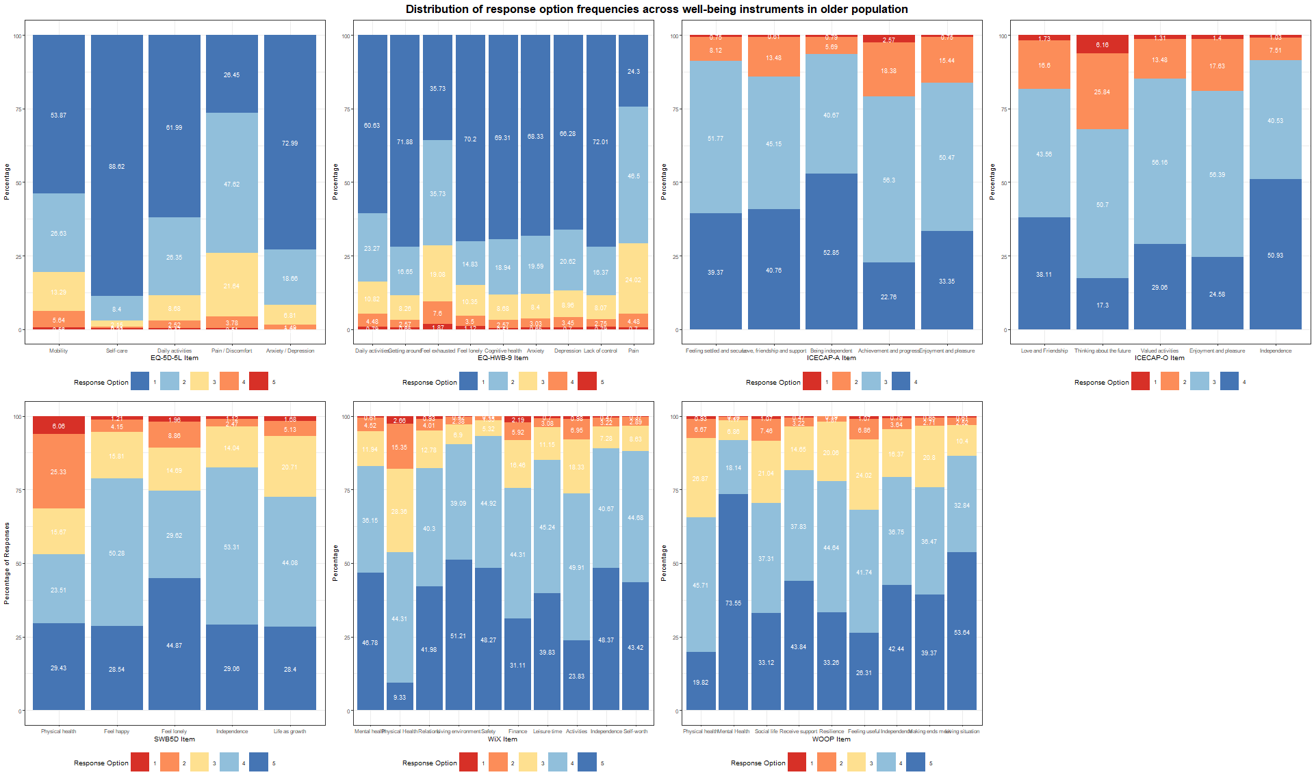
Response options frequencies

